Slide 1
Graphical Transformations
Graphical Transformations
June 2017
2H Q27
May 2018
1H Q29
SAM
3H Q27
1 Marker
Nov 2018
2H Q24
Nov 2018
3H Q20
Trig

Slide 2
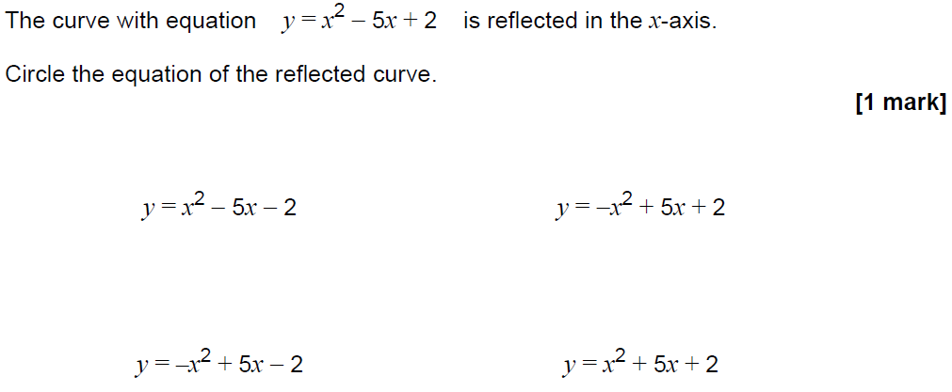
Graphical Transformations
SAM 3H Q27

Slide 3
Graphical Transformations
SAM 3H Q27
A

Slide 4
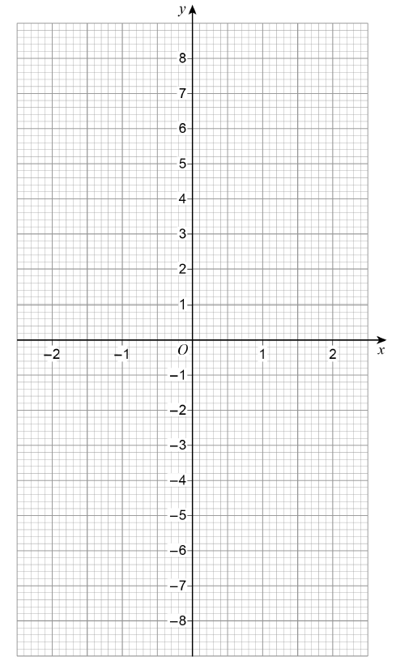
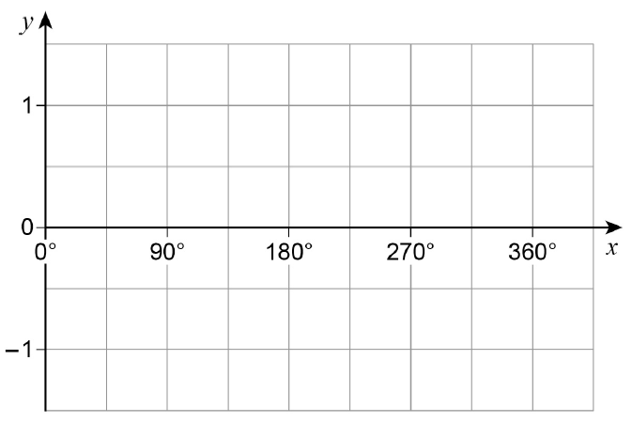
Graphical Transformations
June 2017 2H Q27

Slide 5
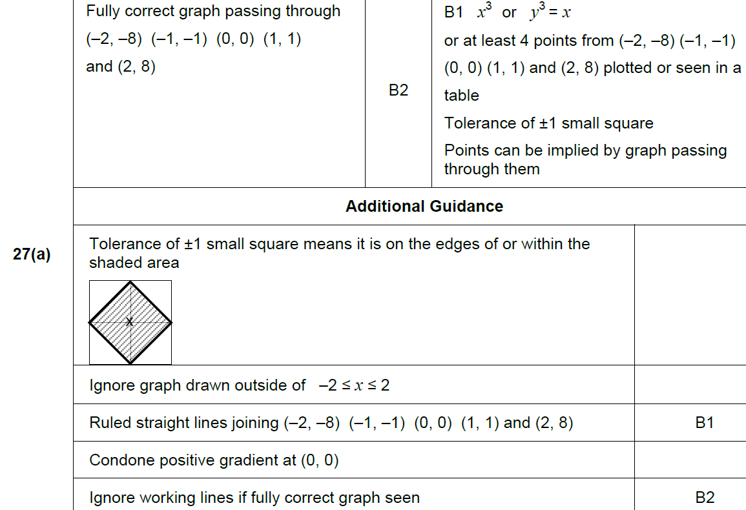
Graphical Transformations
June 2017 2H Q27
A

Slide 6
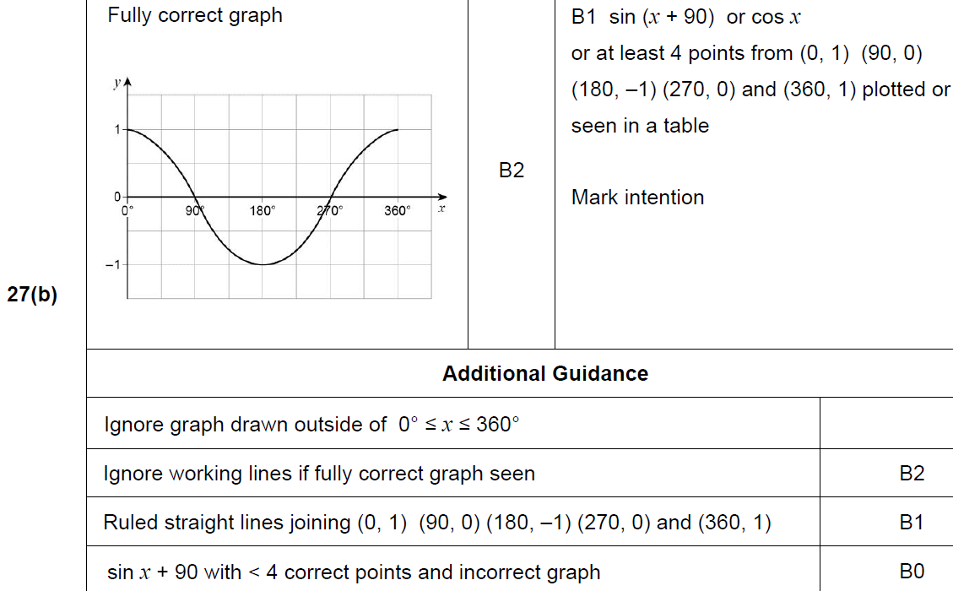
Graphical Transformations
June 2017 2H Q27
B

Slide 7
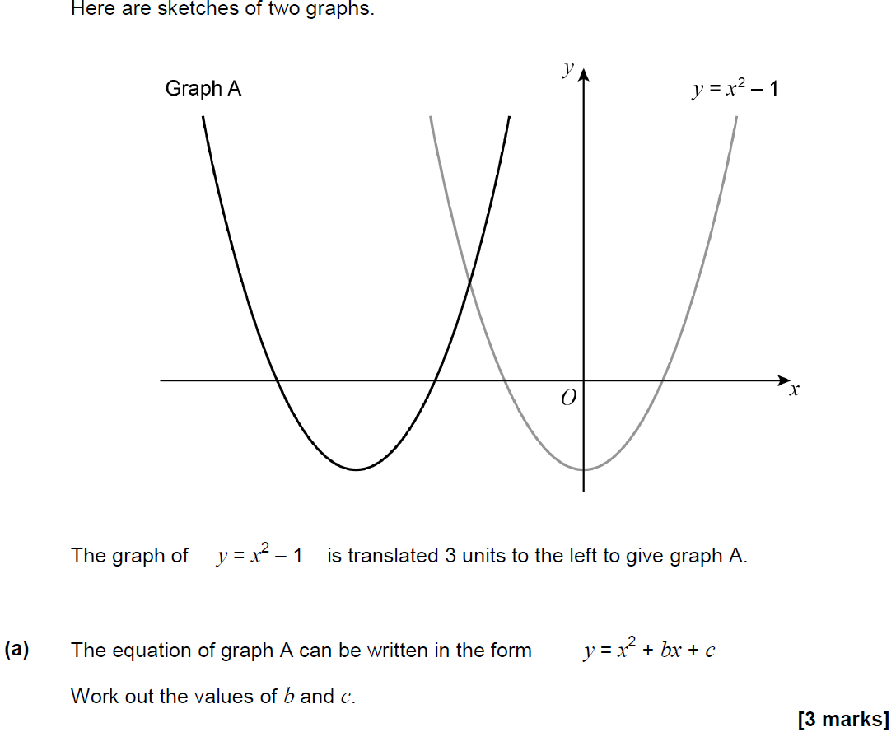
Graphical Transformations
May 2018 1H Q29

Slide 8
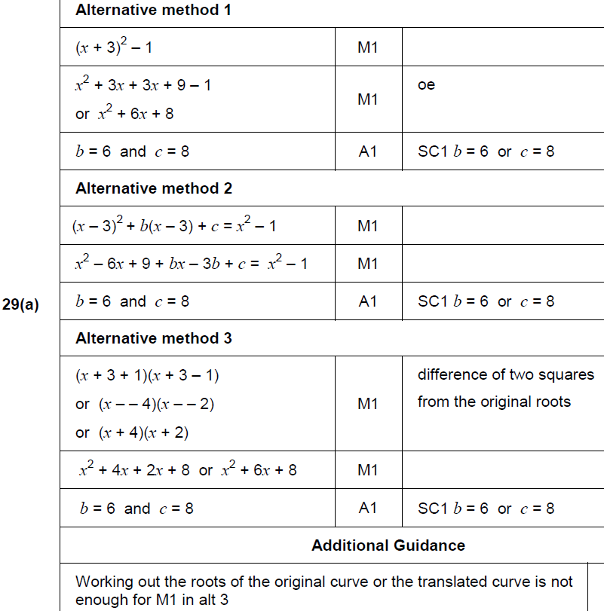
Graphical Transformations
May 2018 1H Q29
A

Slide 9
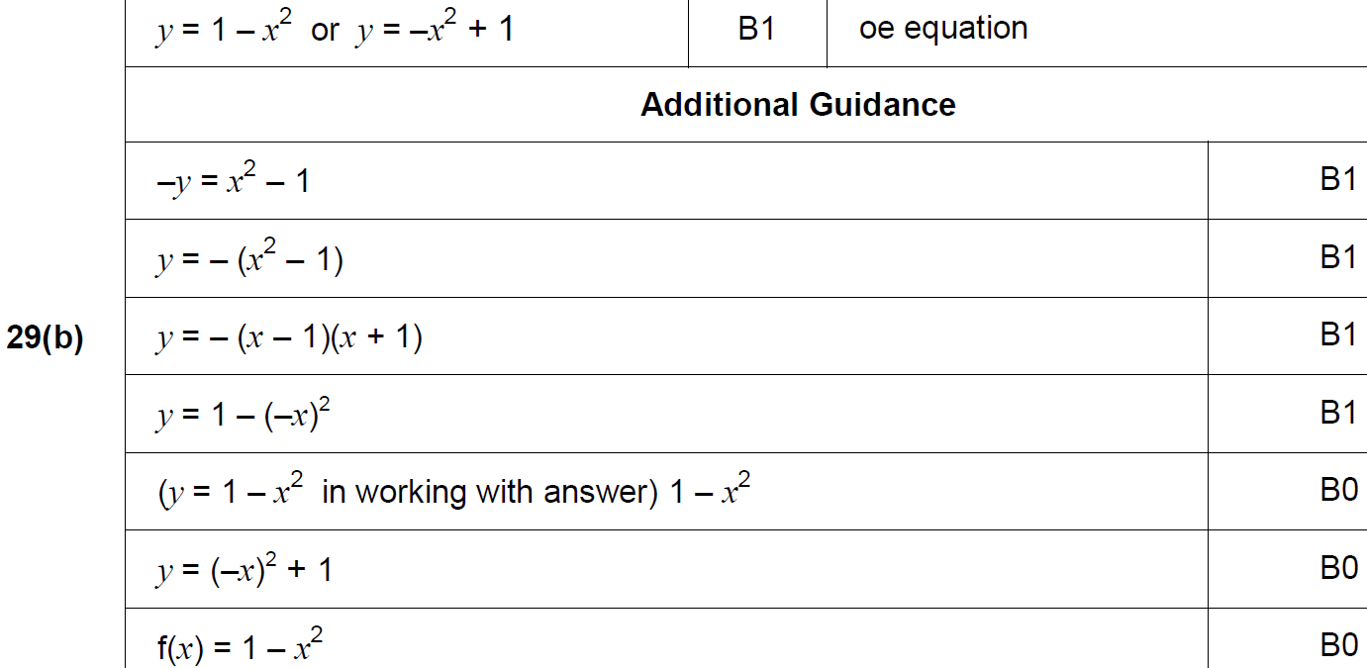
Graphical Transformations
May 2018 1H Q29
B

Slide 10
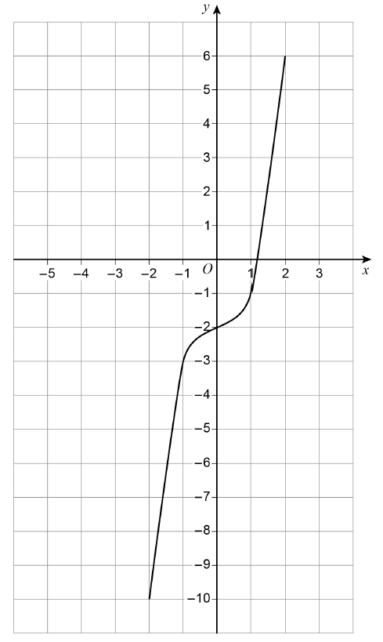
Graphical Transformations
Nov 2018 2H Q24
Here is a sketch of y = f(x)
The curve passes through the points
(–2, –10) (–1, –3) (0, –2) (1, –1) (2, 6)
On the grid, sketch the curve y = f(x + 2)
[2 marks]

Slide 11
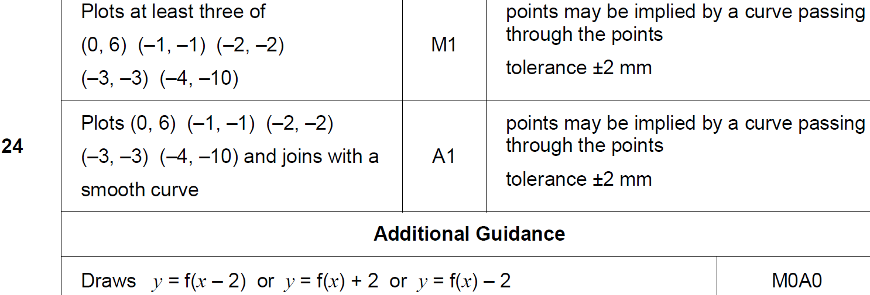
Graphical Transformations
Nov 2018 2H Q24
A

Slide 12
Graphical Transformations
Nov 2018 3H Q20

Slide 13
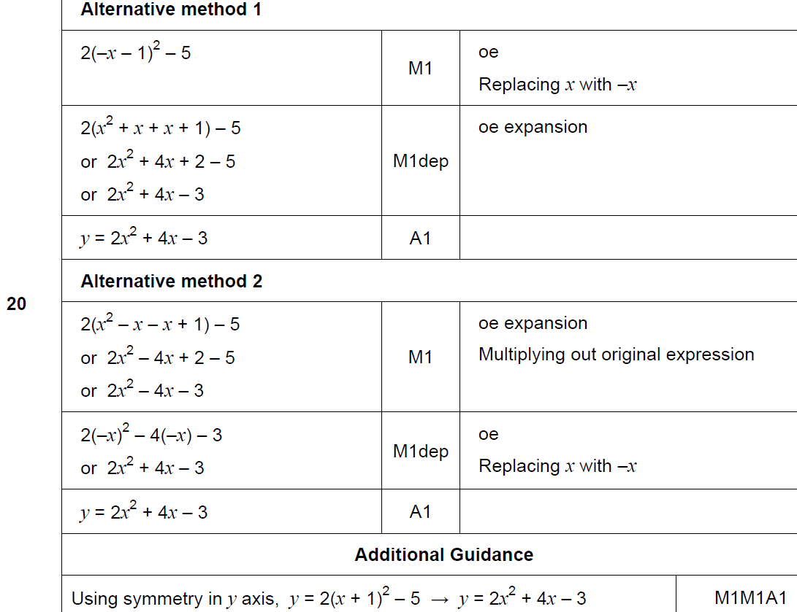
Graphical Transformations
Nov 2018 3H Q20
A

