Slide 1
Graphical Transformations
Graphical Transformations
June 2017 3H Q20
SAM
2H Q19
May 2018 1H Q18
Spec 1
3H Q16
Nov 2018 1H Q18
Spec 2
2H Q19
June 2019 3H Q15

Slide 2
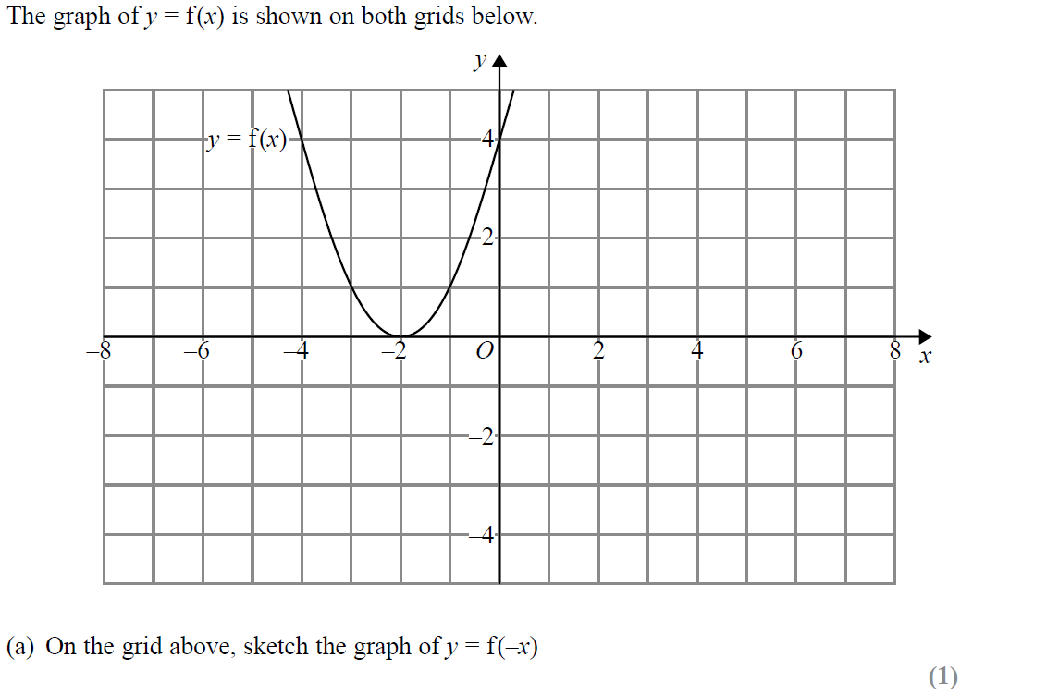
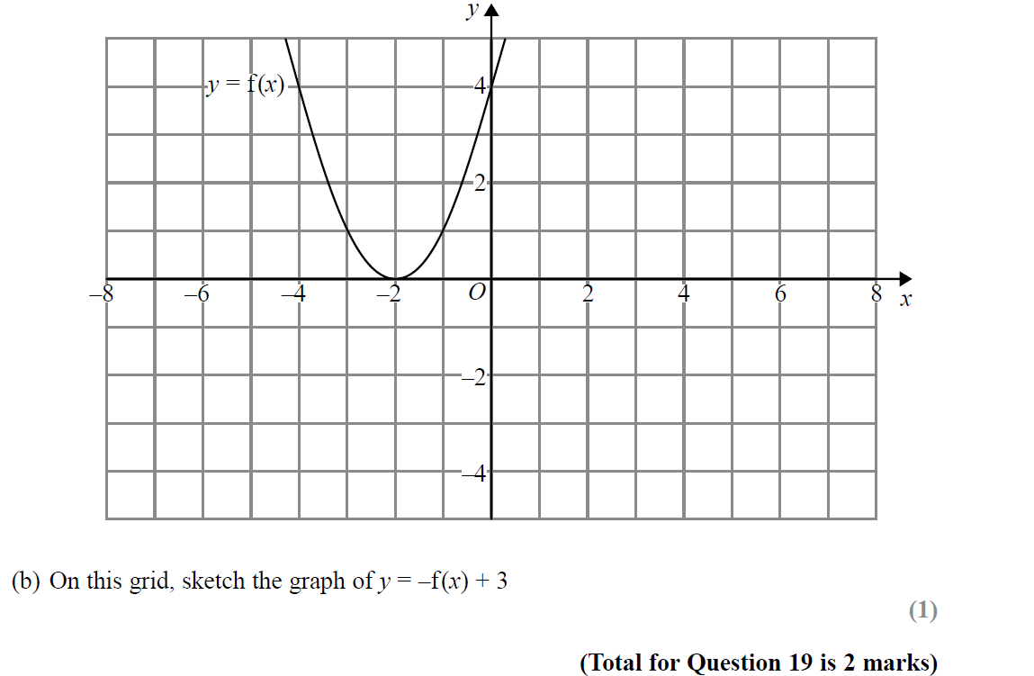
Graphical Transformations
SAM 2H Q19
Reveal Graph (a)
Reveal Graph (b)

Slide 3
Graphical Transformations
SAM 2H Q19
A
B
I think this should be (-2,3)

Slide 4
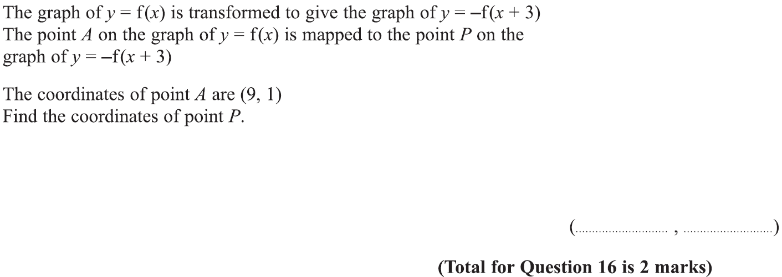
Graphical Transformations
Specimen Set 1 3H Q16

Slide 5
Graphical Transformations
Specimen Set 1 3H Q16
A

Slide 6
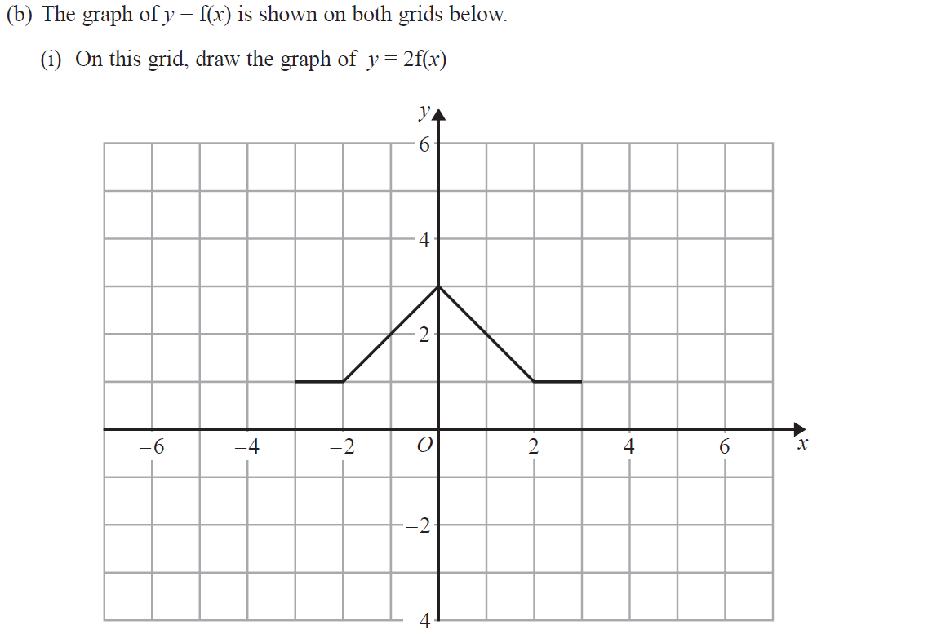
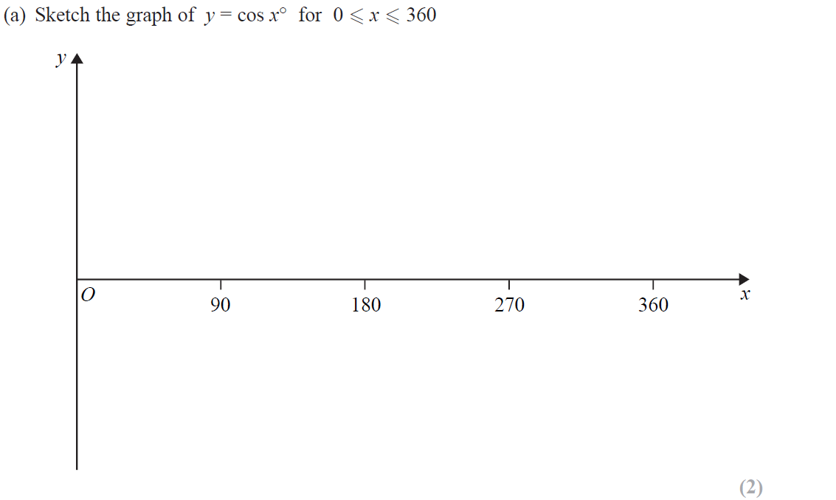
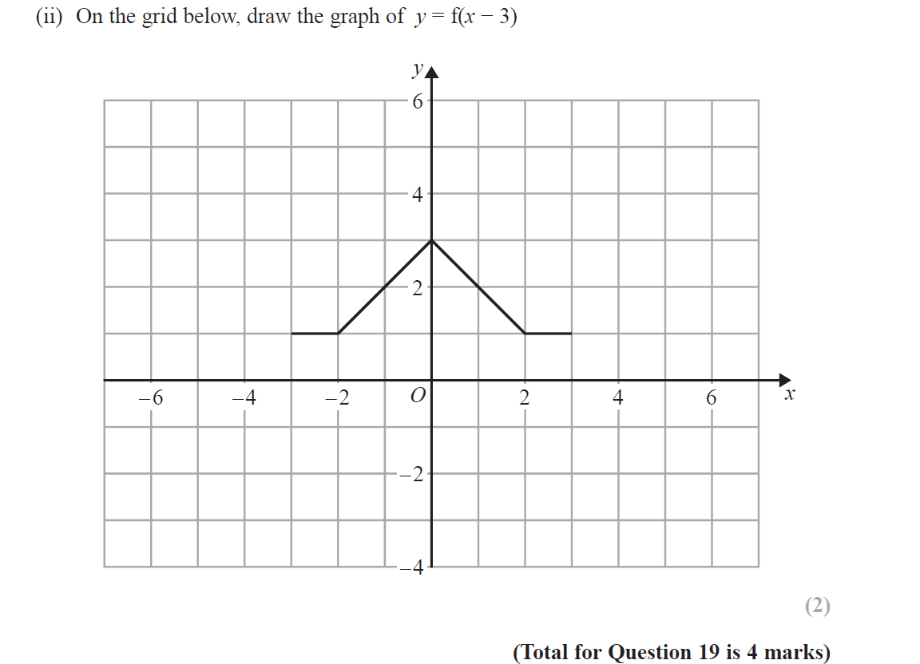
Graphical Transformations
Specimen Set 2 2H Q19
Reveal Graph (i)
Reveal Graph (ii)

Slide 7
Graphical Transformations
Specimen Set 2 2H Q19
A
B

Slide 8
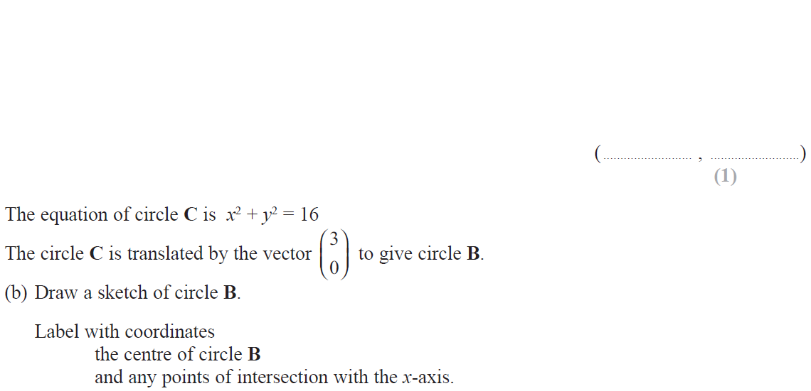
Graphical Transformations
June 2017 3H Q20

Slide 9
Graphical Transformations
June 2017 3H Q20
A
B

Slide 10
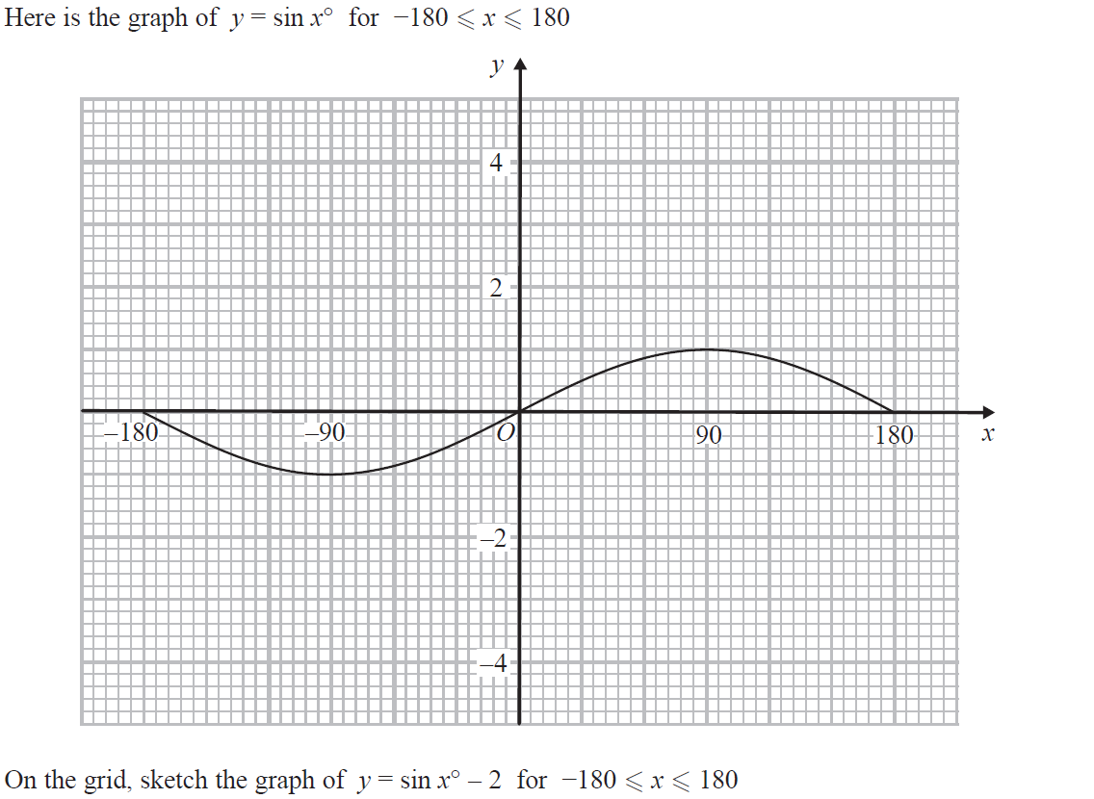
Graphical Transformations
May 2018 1H Q18
Reveal Graph

Slide 11
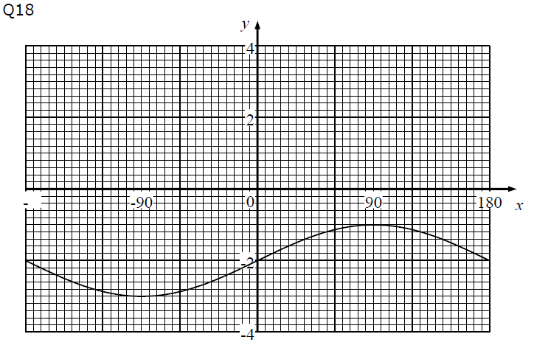
Graphical Transformations
May 2018 1H Q18
A

Slide 12
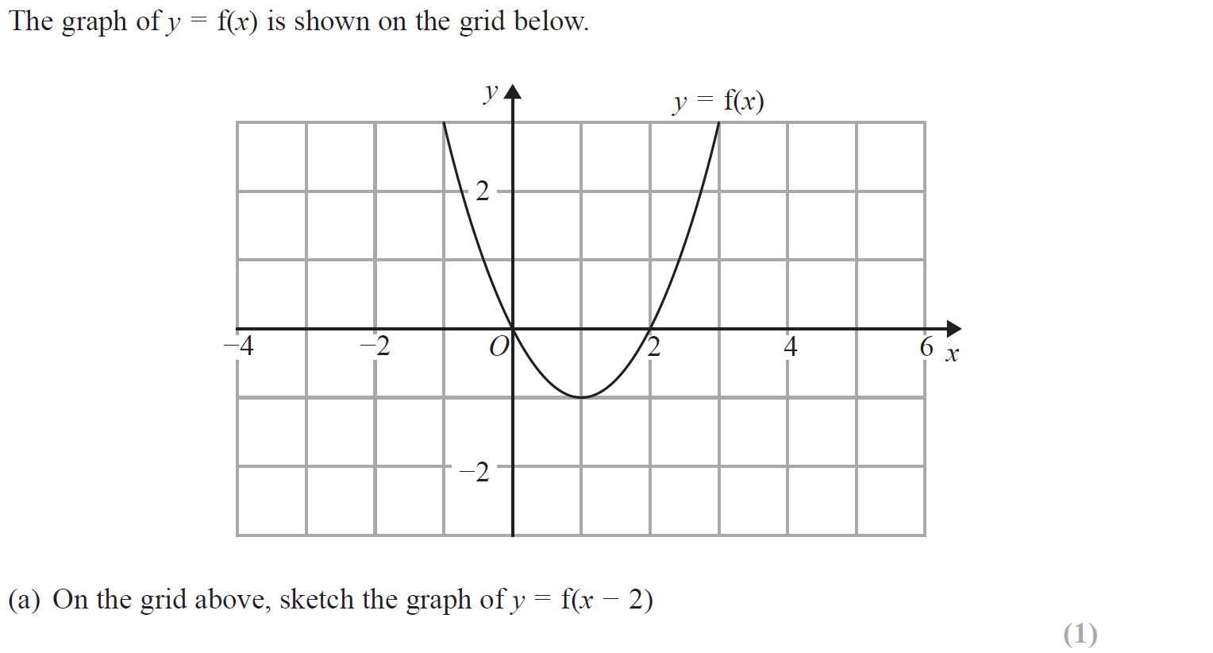
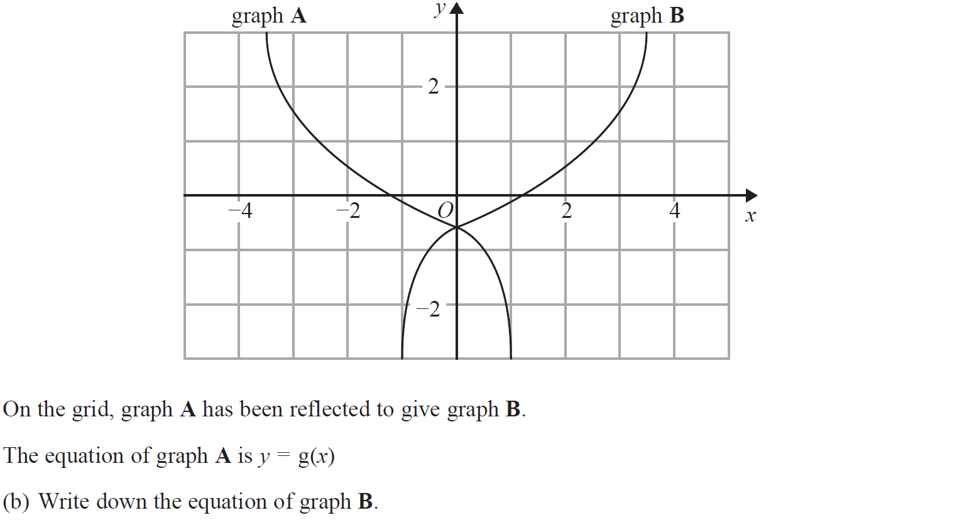
Graphical Transformations
Nov 2018 1H Q18
Reveal Graph (a)

Slide 13
Graphical Transformations
Nov 2018 1H Q18
A
B

Slide 14
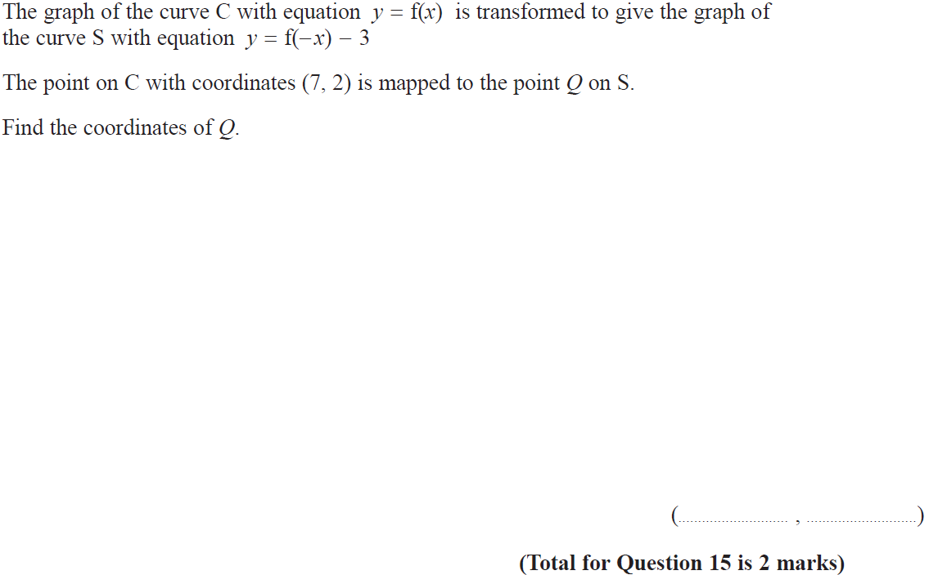
Graphical Transformations
June 2019 3H Q15

Slide 15
Graphical Transformations
June 2019 3H Q15
A
A SF

