Slide 1
Graphical Transformations
Graphical Transformations
NTSQ
Q1
NTSQ Q10
NTSQ
Q2
SAM
1H Q20
NTSQ
Q3
May 2018
1H Q18
NTSQ
Q4
June 2018
2HR Q21
NTSQ
Q5
Jan 2019
1H Q18
NTSQ
Q6
Jan 2019
2HR Q18
NTSQ
Q7
May 2019
1H Q22
NTSQ
Q8
Trig

Slide 2
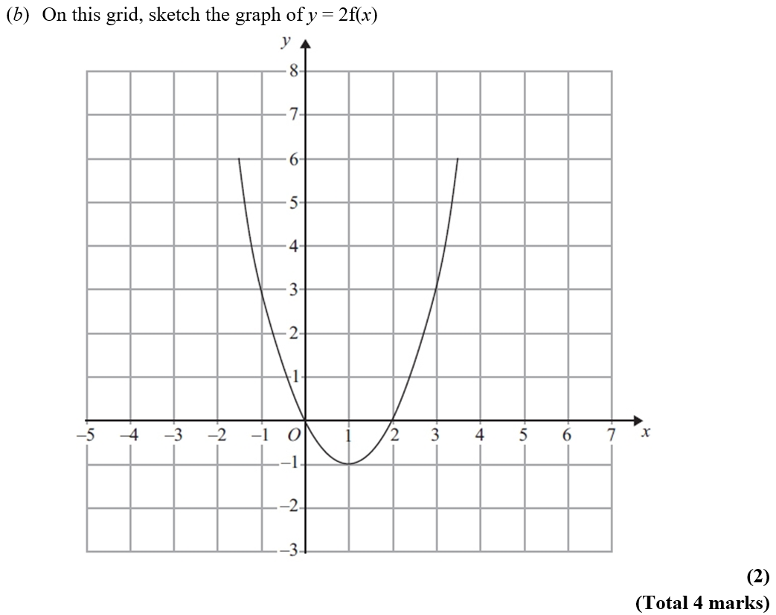
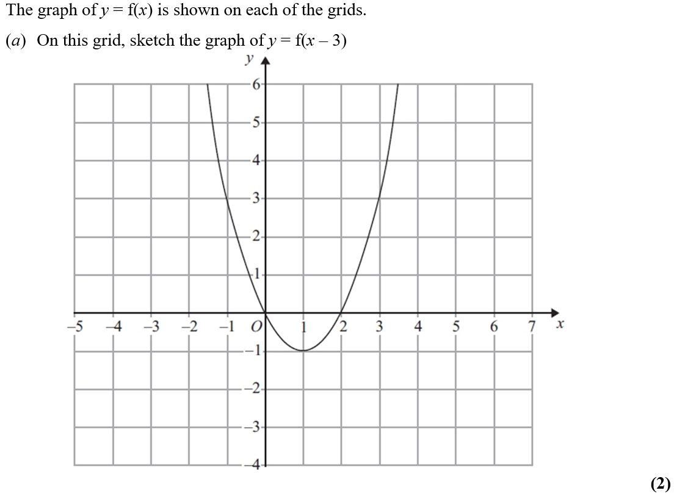
Graphical Transformations
NTSQ Q1
Reveal Graph (a)
Reveal Graph (b)

Slide 3
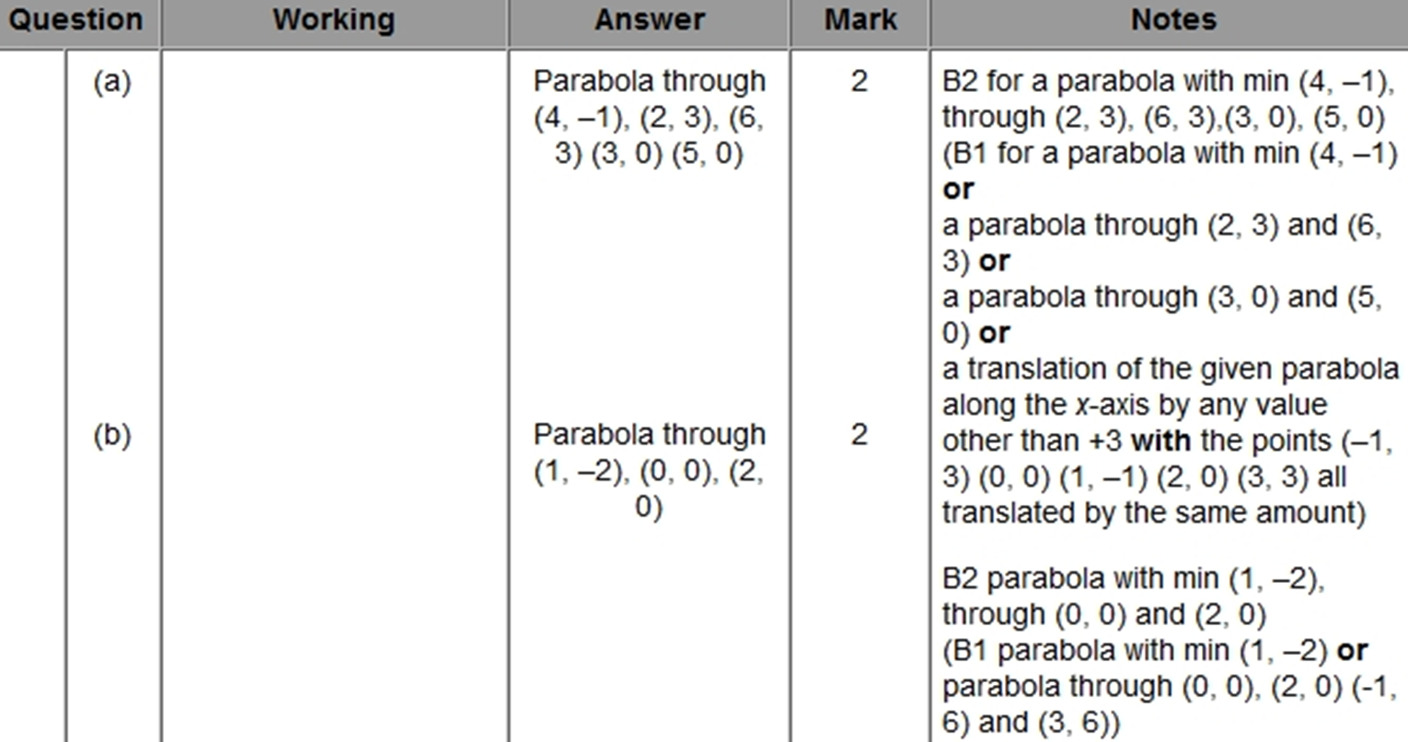
Graphical Transformations
NTSQ Q1
A
B
A
B

Slide 4
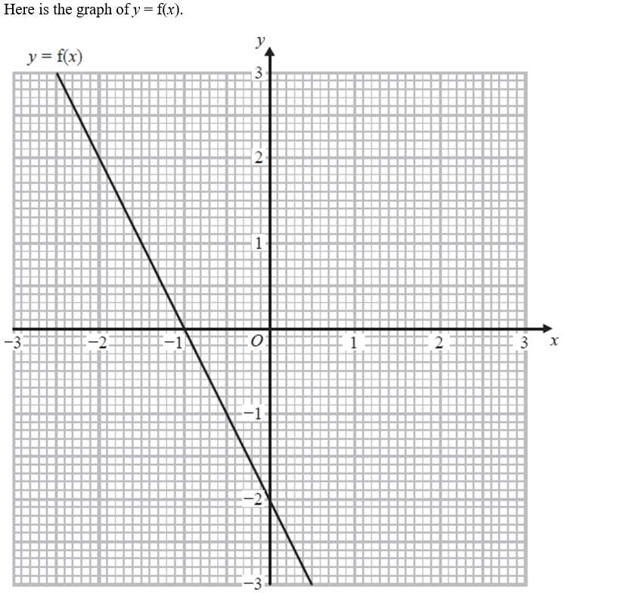
Graphical Transformations
NTSQ Q2
Reveal Graph (b)

Slide 5
Graphical Transformations
NTSQ Q2
A
B

Slide 6
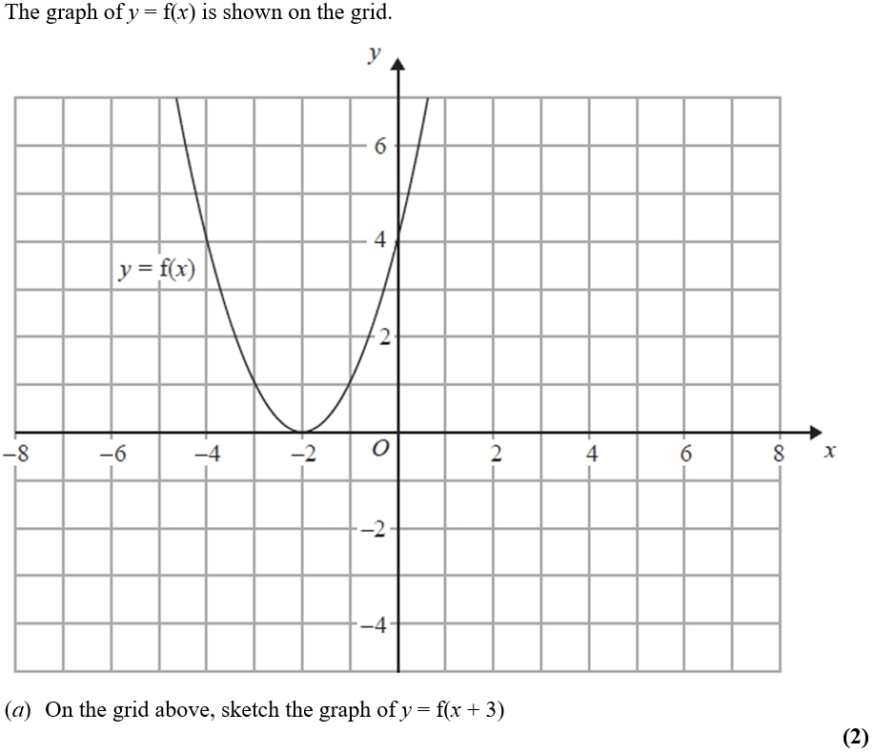
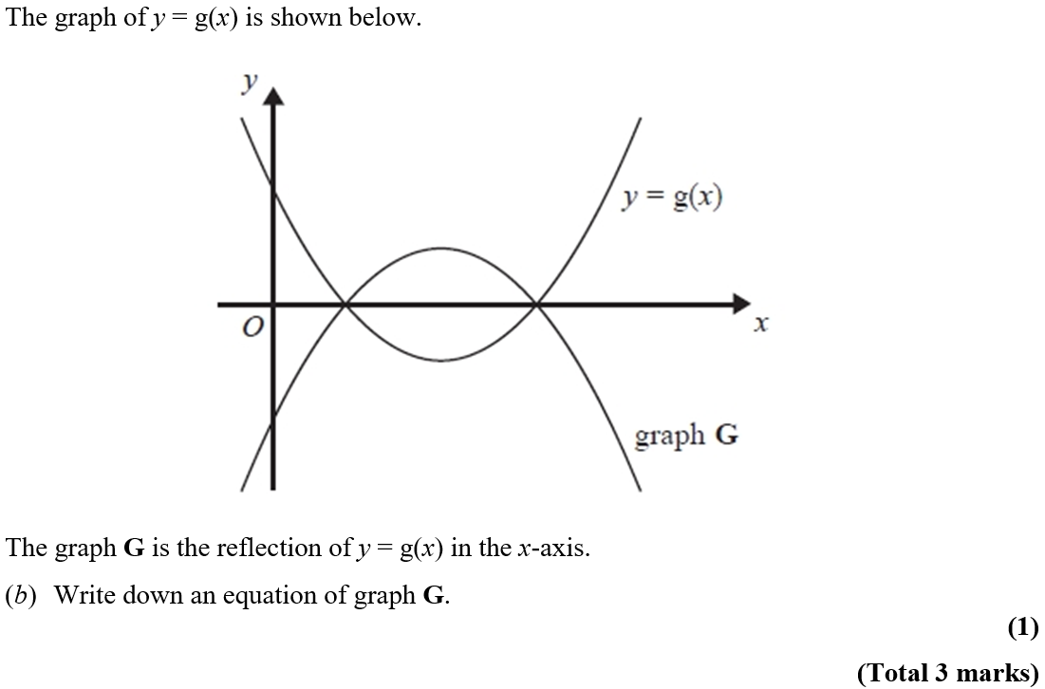
Graphical Transformations
NTSQ Q3
Reveal Graph (a)

Slide 7
Graphical Transformations
NTSQ Q3
A
B

Slide 8
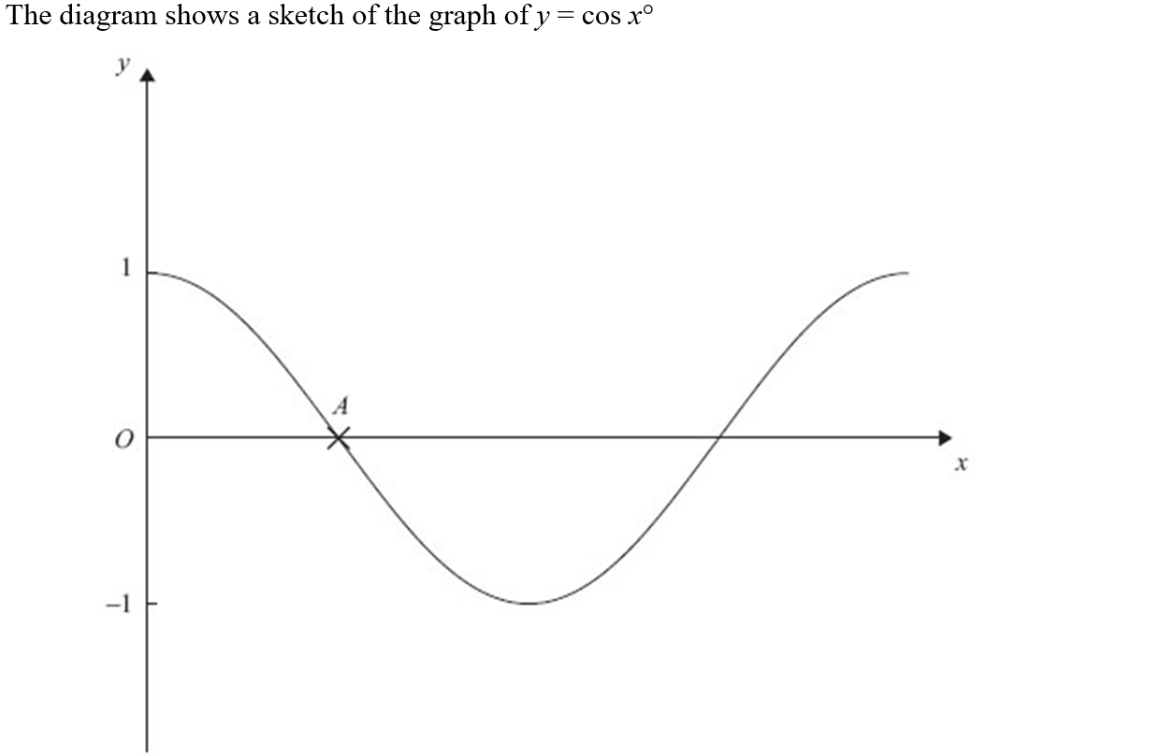
Graphical Transformations
NTSQ Q4

Slide 9
Graphical Transformations
NTSQ Q4
A
B

Slide 10
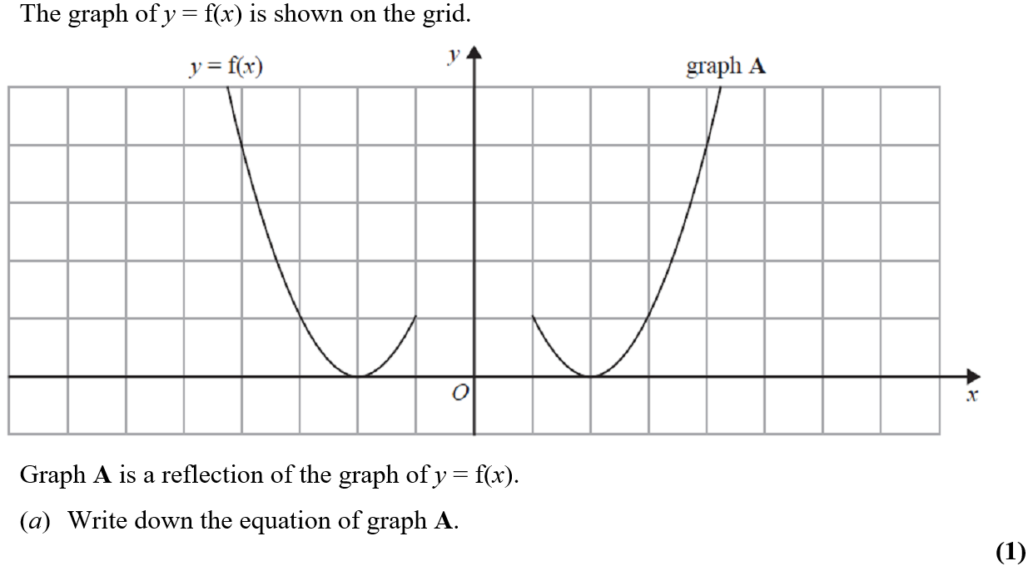
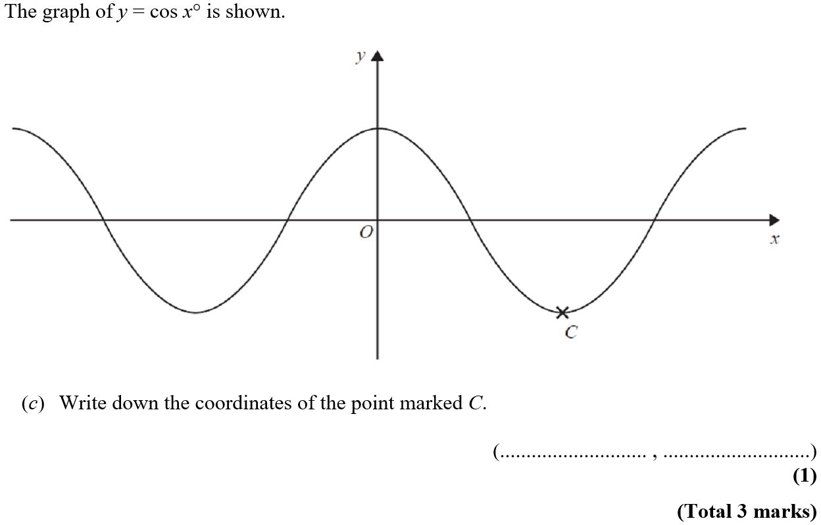
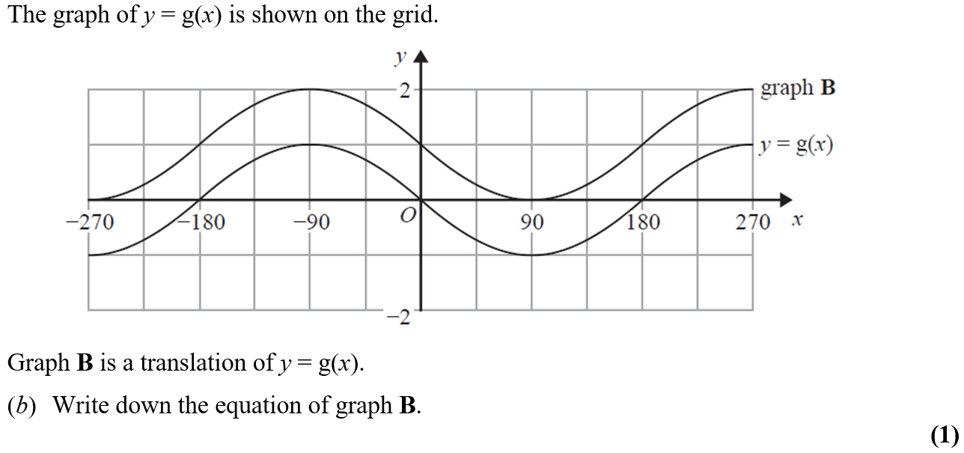
Graphical Transformations
NTSQ Q5

Slide 11
Graphical Transformations
NTSQ Q5
A
B
C

Slide 12
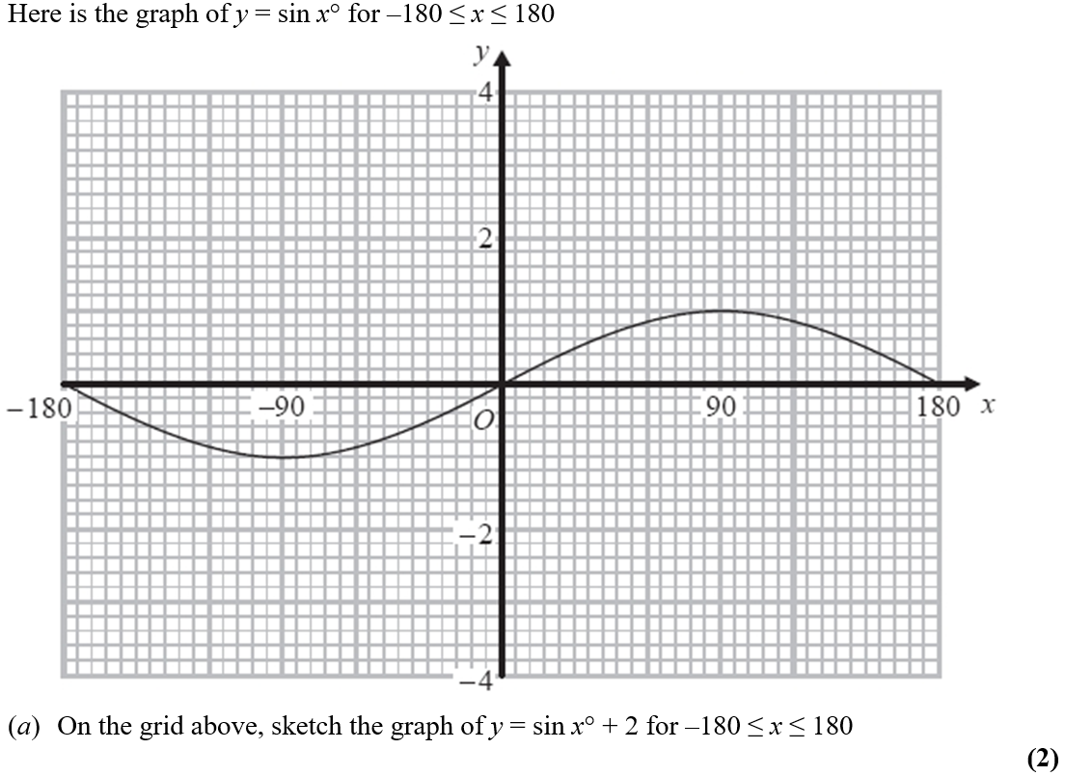
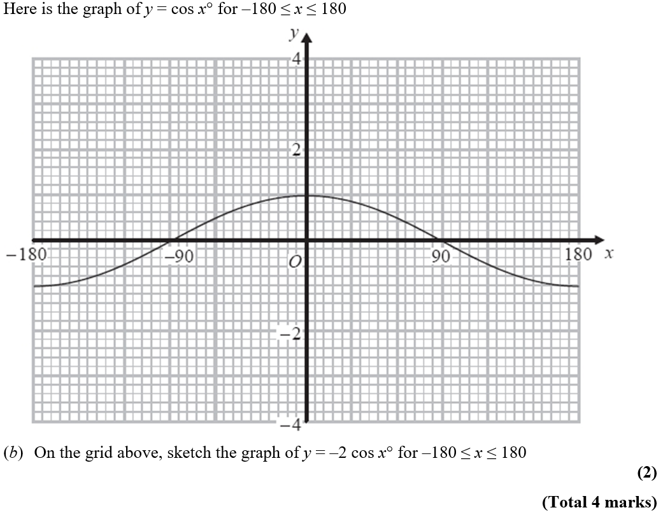
Graphical Transformations
NTSQ Q6
Reveal Graph (a)
Reveal Graph (b)

Slide 13
Graphical Transformations
NTSQ Q6
A
B

Slide 14
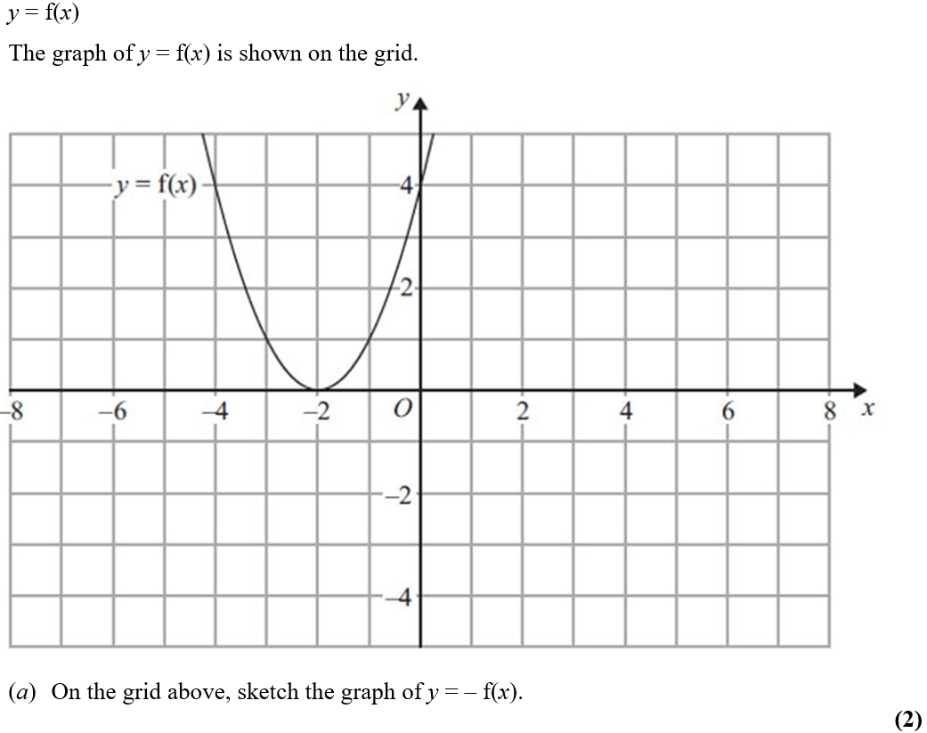
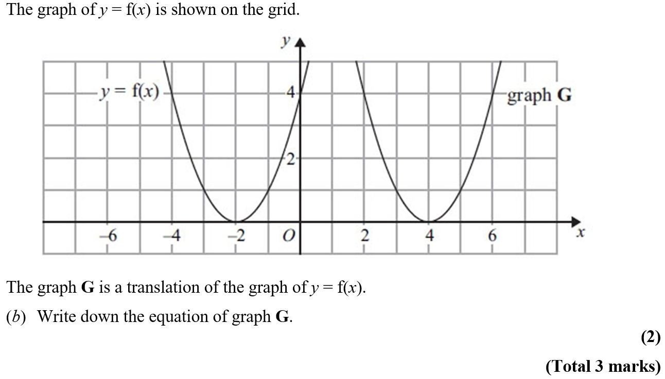
Graphical Transformations
NTSQ Q7

Slide 15
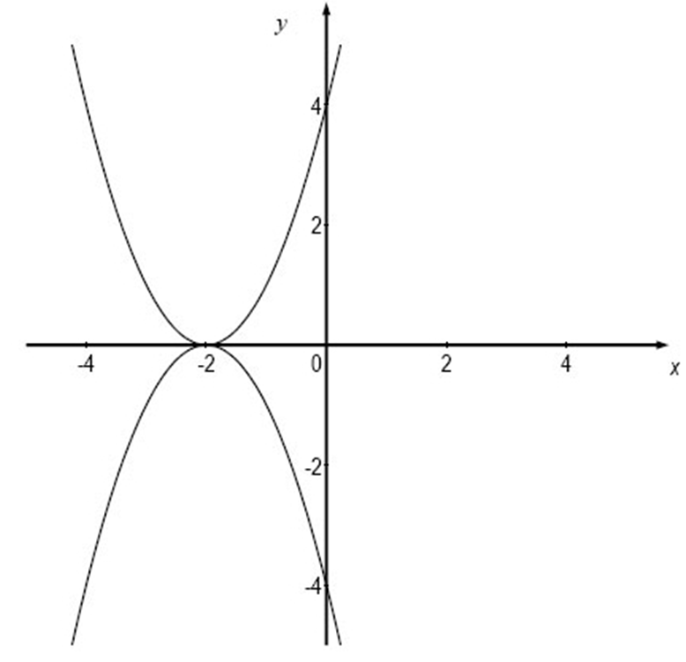
Graphical Transformations
NTSQ Q7
A
B
A
B

Slide 16
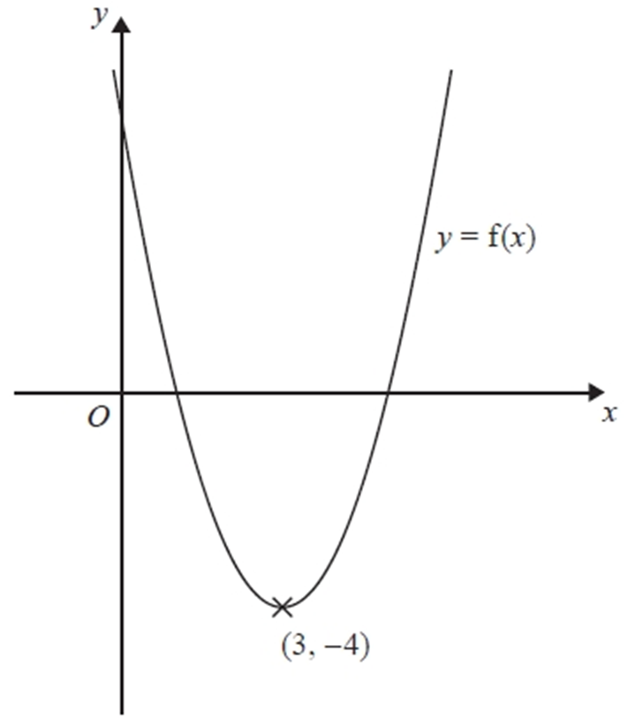
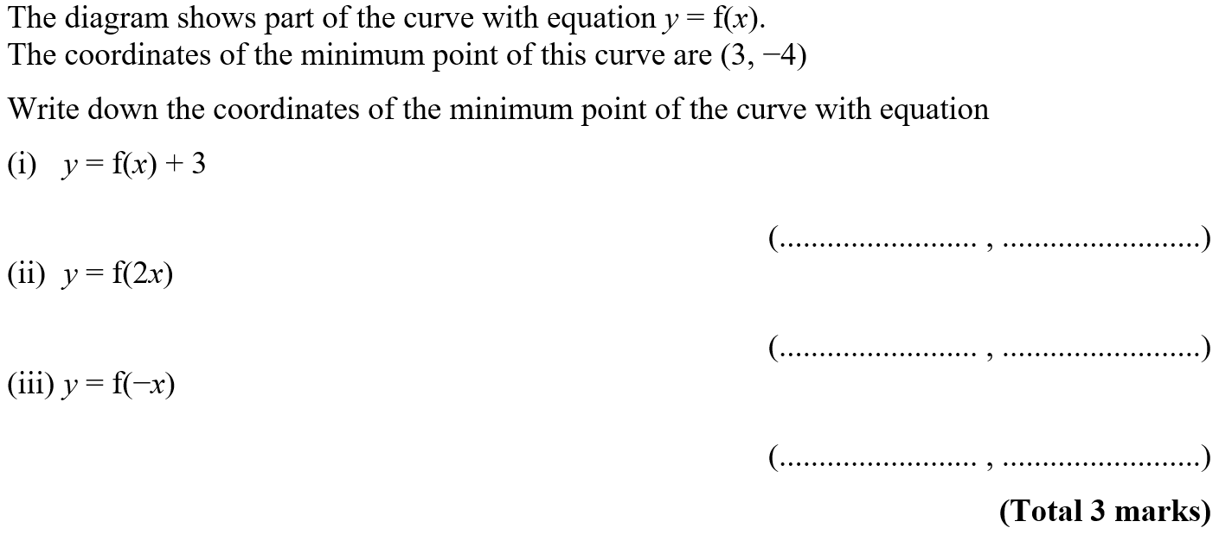
Graphical Transformations
NTSQ Q8

Slide 17
Graphical Transformations
NTSQ Q8
(i)
(ii)
(iii)

Slide 18
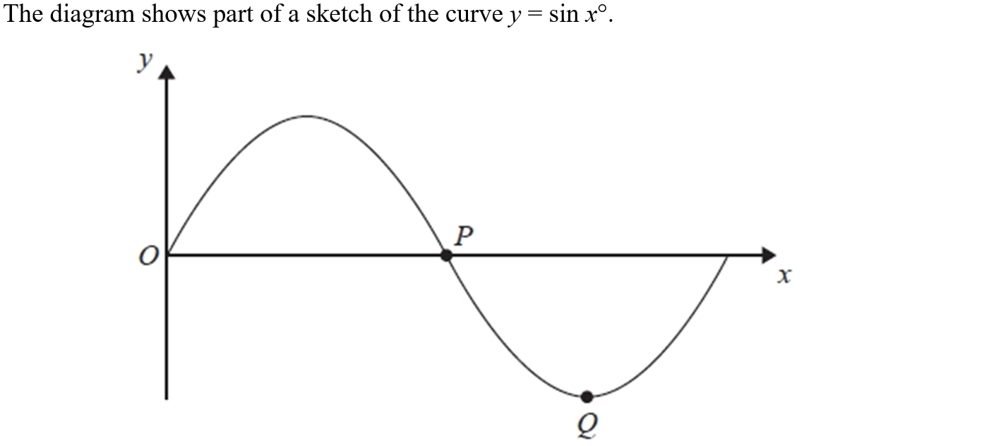
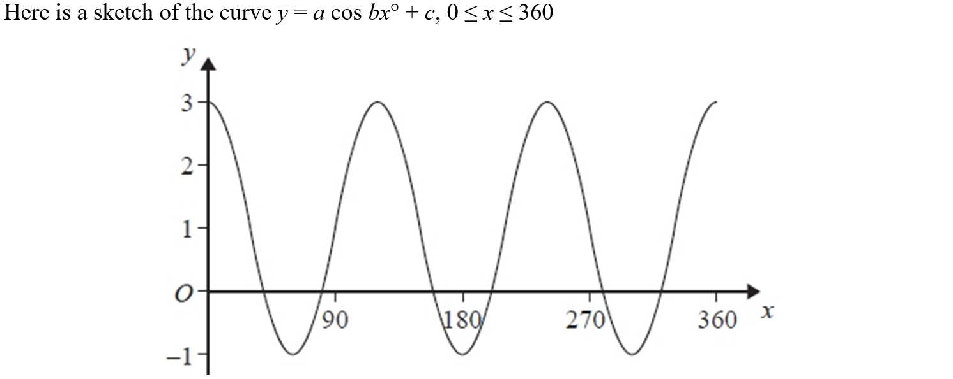
Graphical Transformations
NTSQ Q10

Slide 19
Graphical Transformations
NTSQ Q10
A
B
C

Slide 20
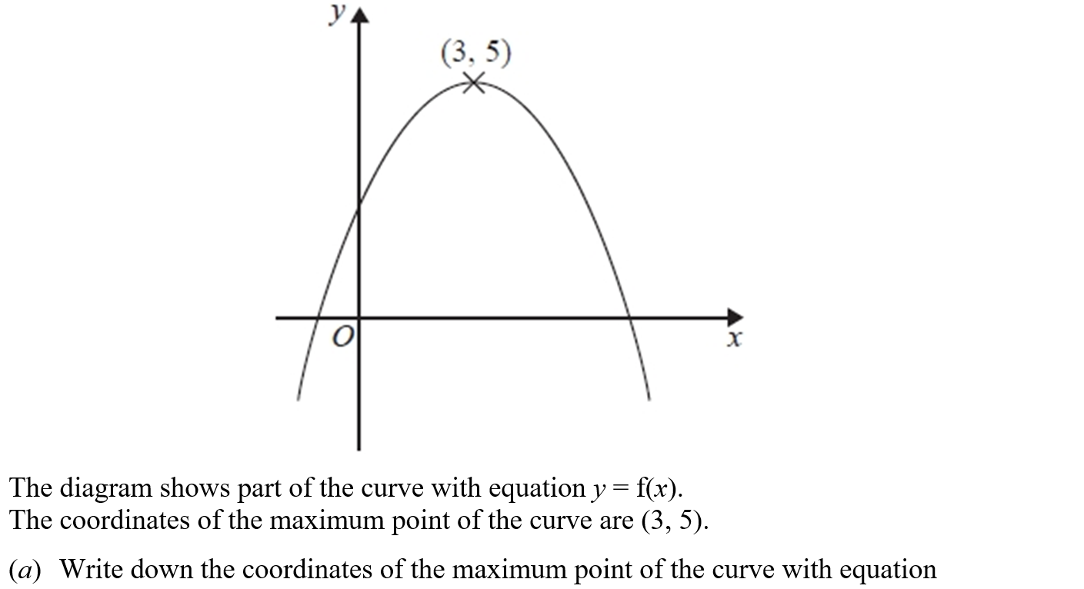
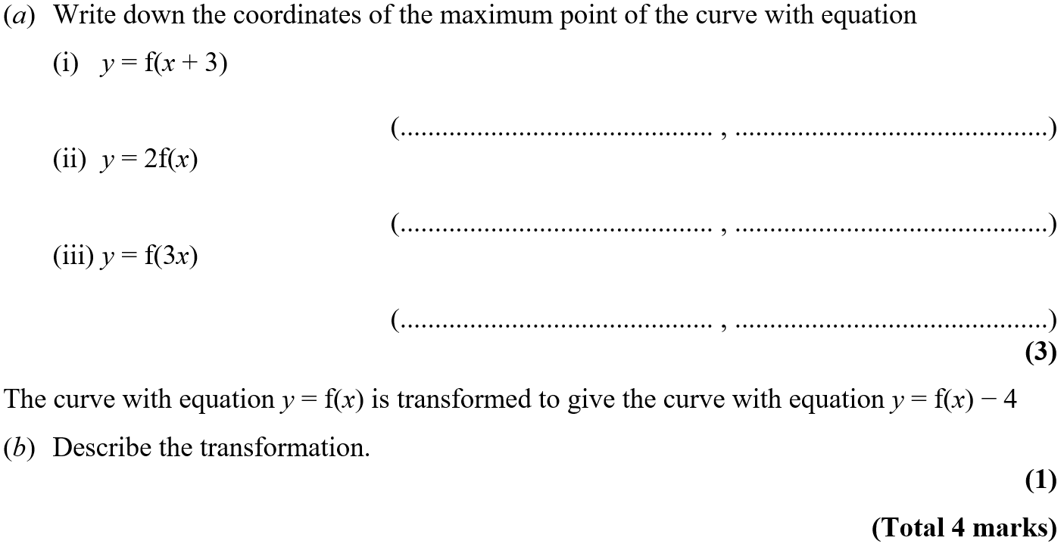
Graphical Transformations
SAM 1H Q20

Slide 21
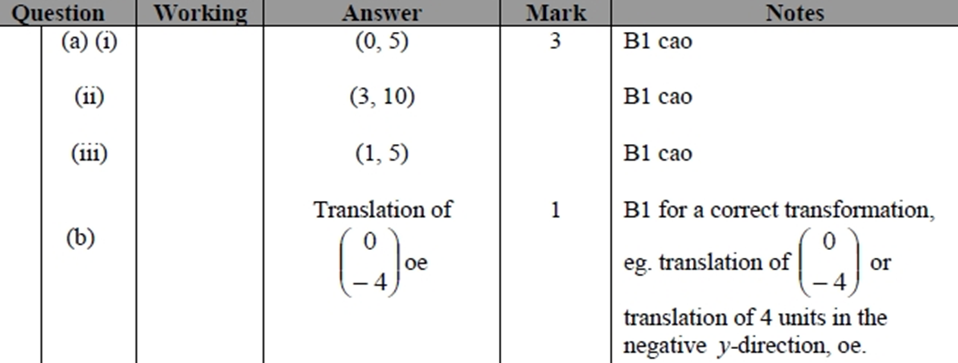
Graphical Transformations
SAM 1H Q20
A (i)
A (ii)
A (iii)
B

Slide 22
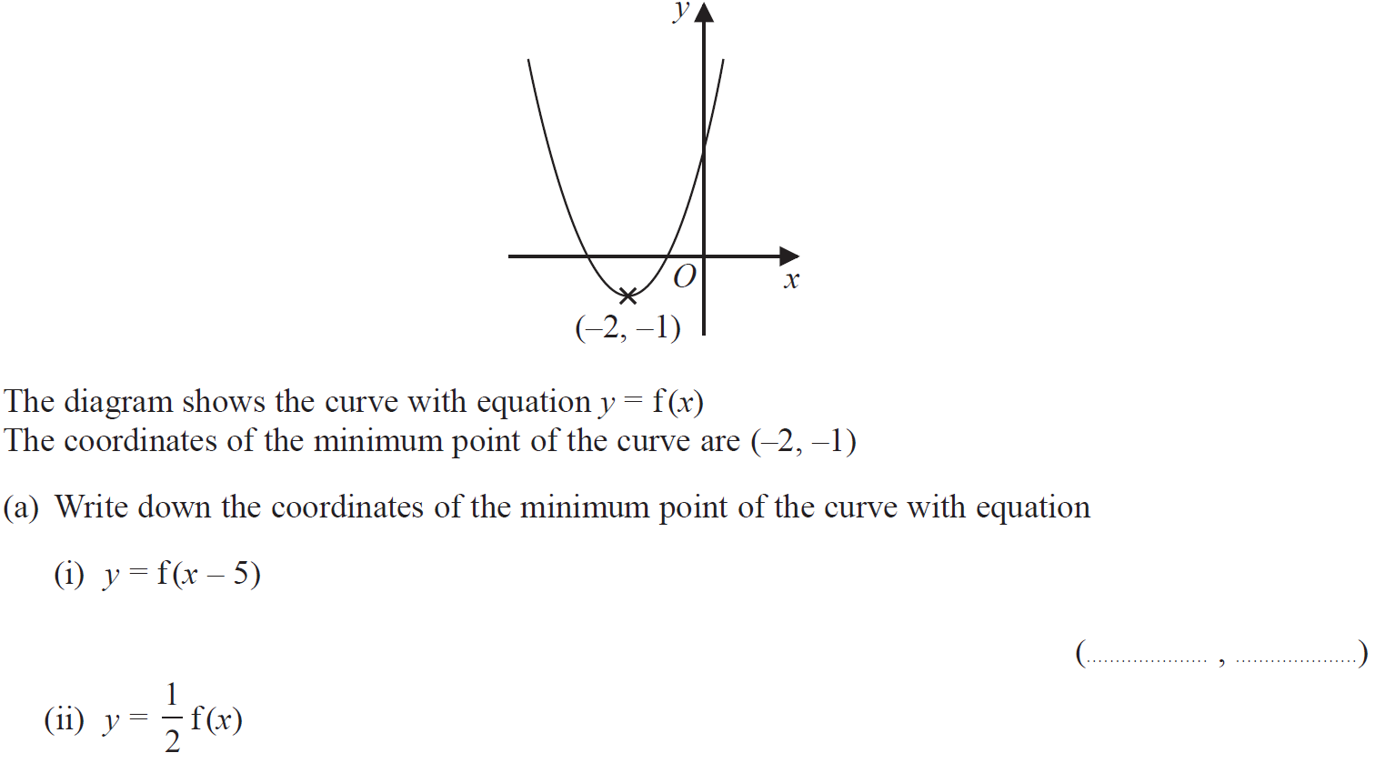
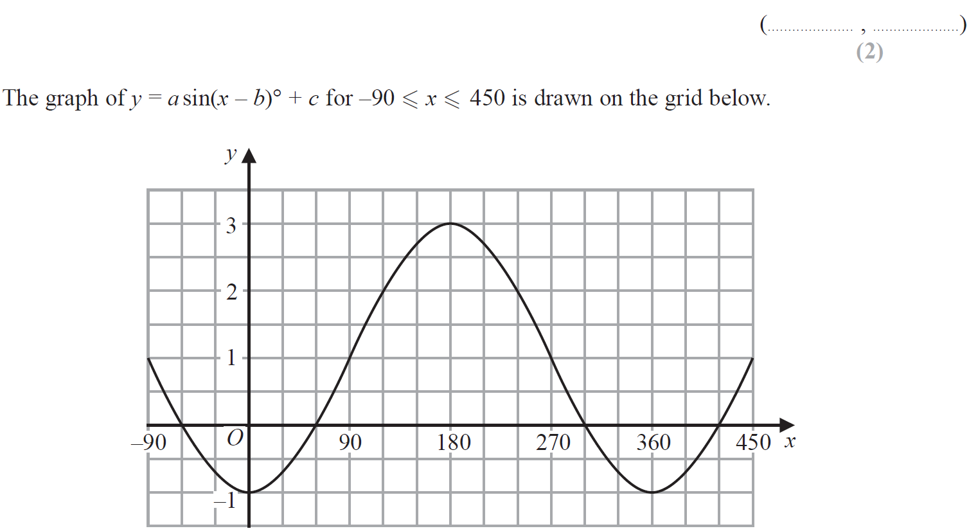
Graphical Transformations
May 2018 1H Q18

Slide 23
Graphical Transformations
May 2018 1H Q18
A (i)
A (ii)
B

Slide 24
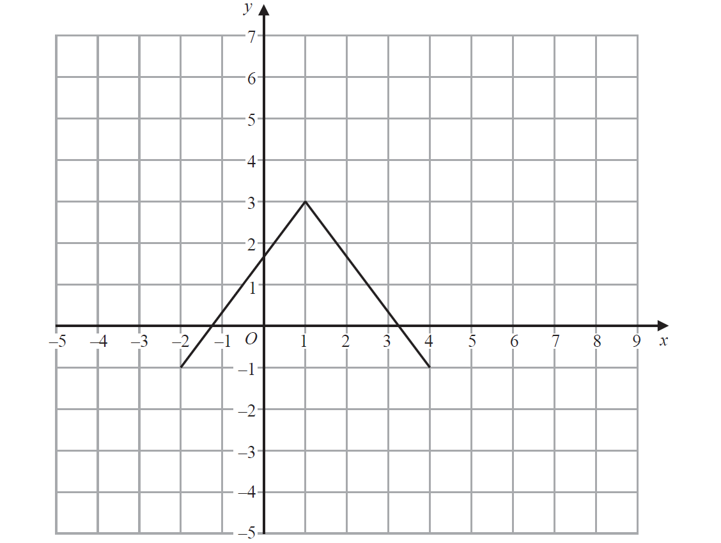
Graphical Transformations
June 2018 2HR Q21
Reveal Graph (a)
Reveal Graph (b)

Slide 25
Graphical Transformations
June 2018 2HR Q21
A
B

Slide 26
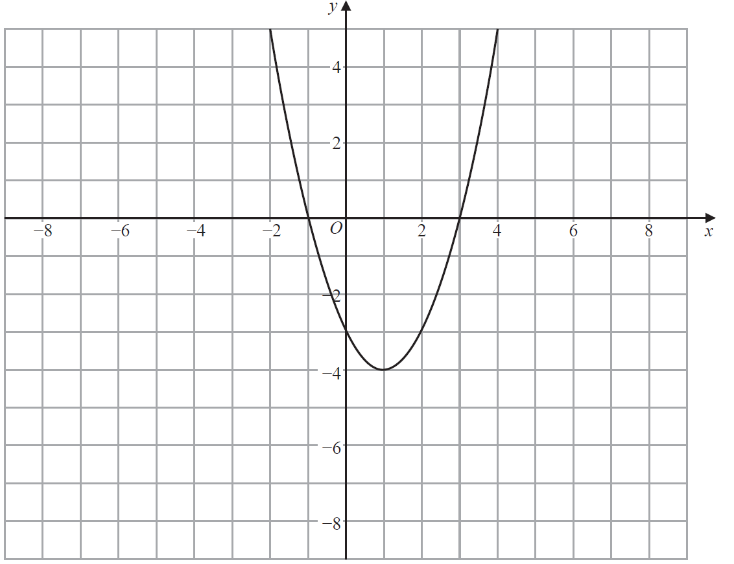
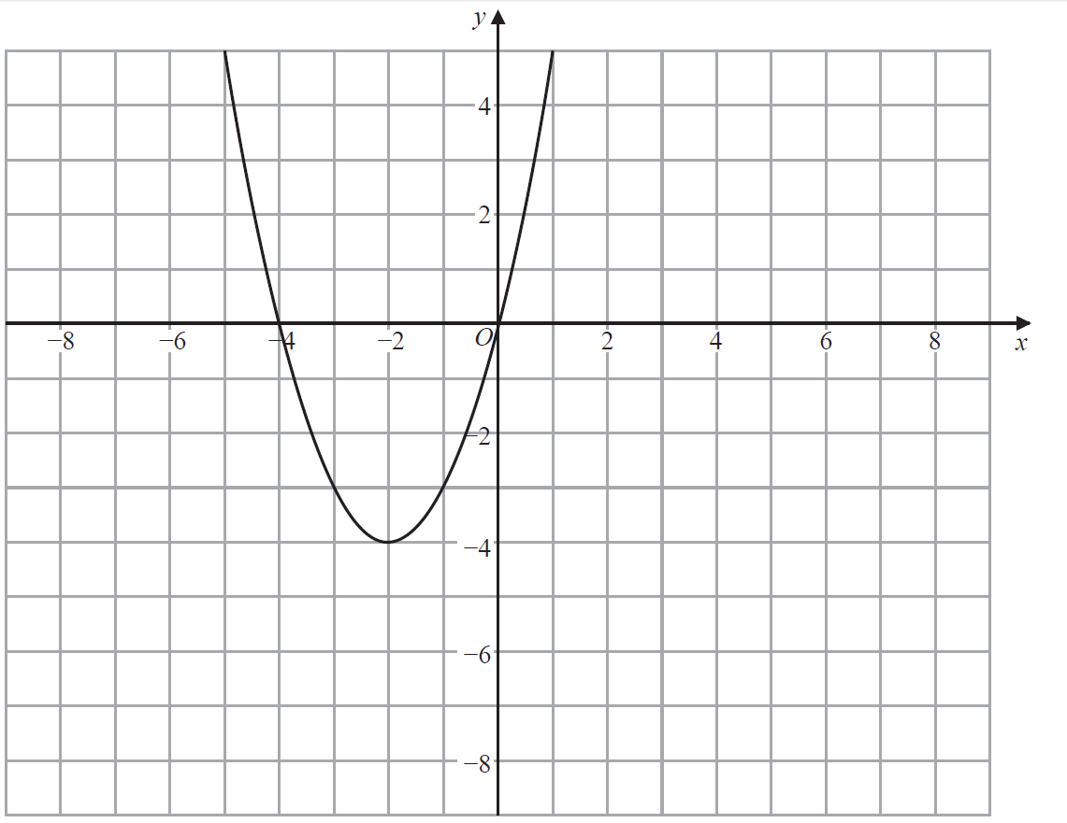
Graphical Transformations
Jan 2019 1H Q18
Reveal Graph (a)

Slide 27
Graphical Transformations
Jan 2019 1H Q18
A
B

Slide 28
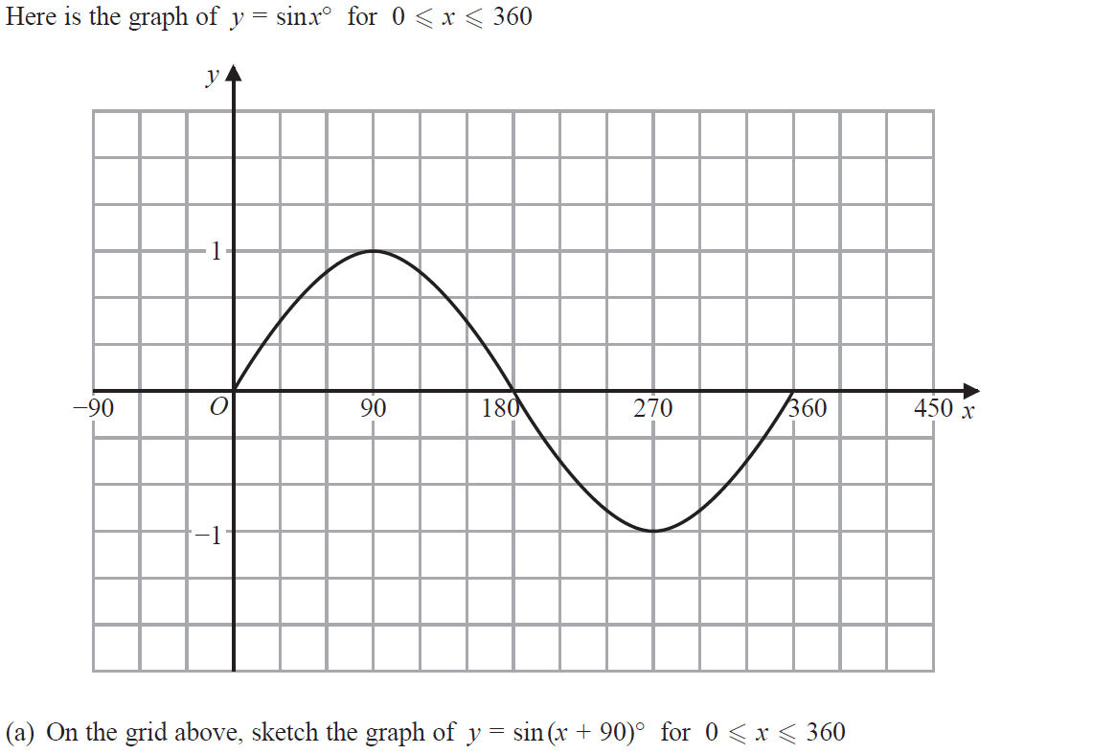
Graphical Transformations
Jan 2019 2HR Q18
Reveal Graph (a)

Slide 29
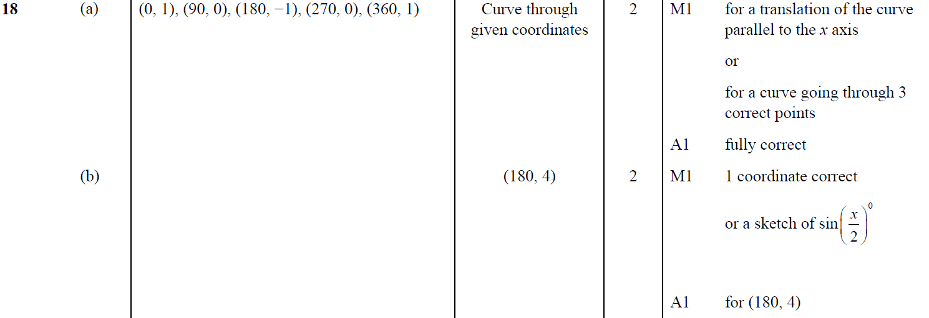
Graphical Transformations
Jan 2019 2HR Q18
A
B

Slide 30
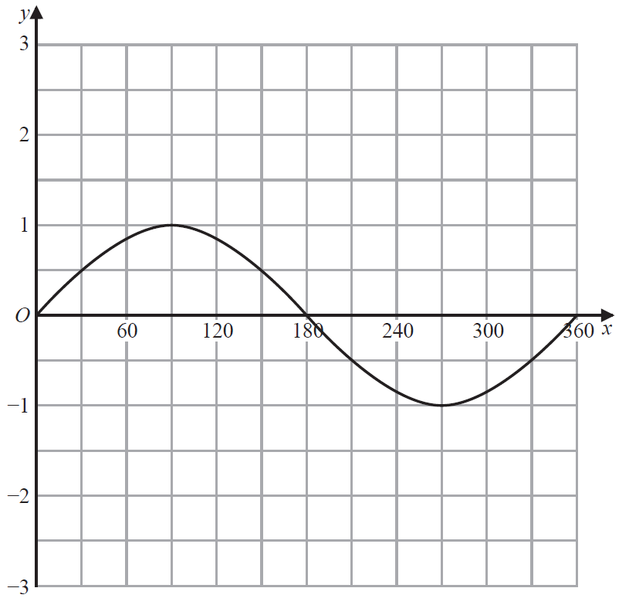
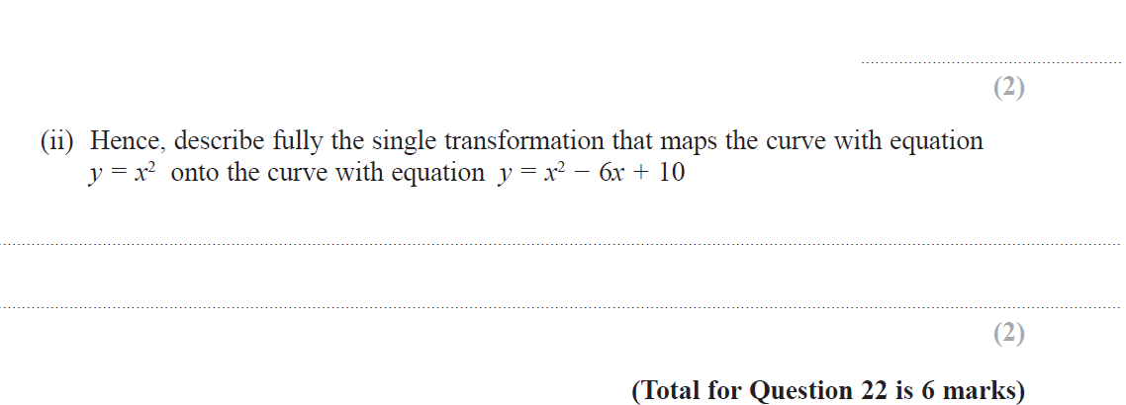
Graphical Transformations
May 2019 1H Q22
Reveal Graph (a)

Slide 31
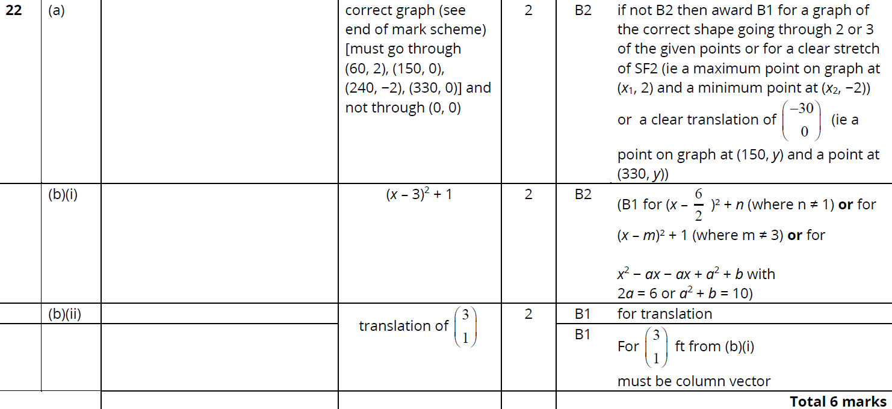
Graphical Transformations
May 2019 1H Q22
A
B (i)
B (ii)

