Slide 1
Functions
Functions
SAM
1H Q25
June 2017
2H Q27*
June 2018
2H Q28
SAM
2H Q19
Nov 2017
3H Q16
Nov 2018
2H Q26
1 Marker
SAM
3H Q19
Nov 2017
3H Q30
Nov 2018
3H Q26
With graphs
*mainly graphs

Slide 2
Functions
SAM 1H Q25

Slide 3
Functions
SAM 1H Q25
A

Slide 4
Functions
SAM 2H Q19

Slide 5
Functions
SAM 2H Q19
A

Slide 6
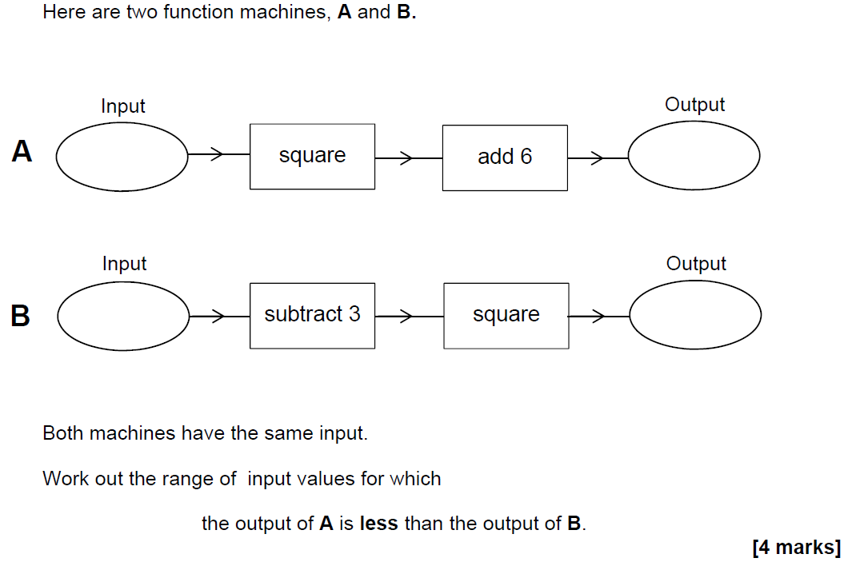
Functions
SAM 3H Q19

Slide 7
Functions
SAM 3H Q19
A

Slide 8
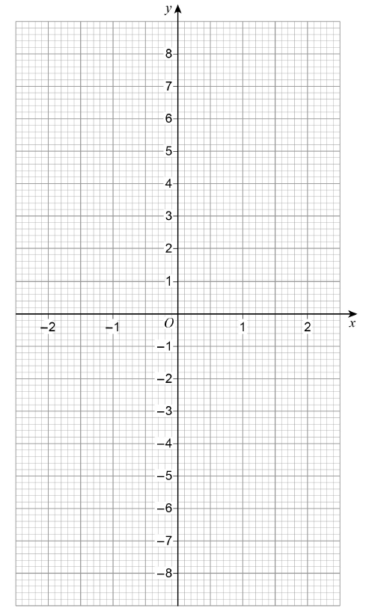
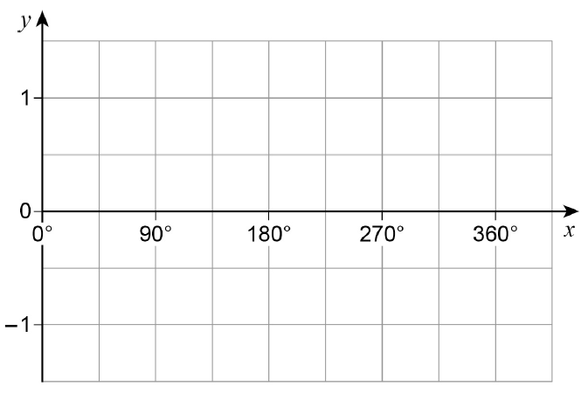
Functions
June 2017 2H Q27

Slide 9
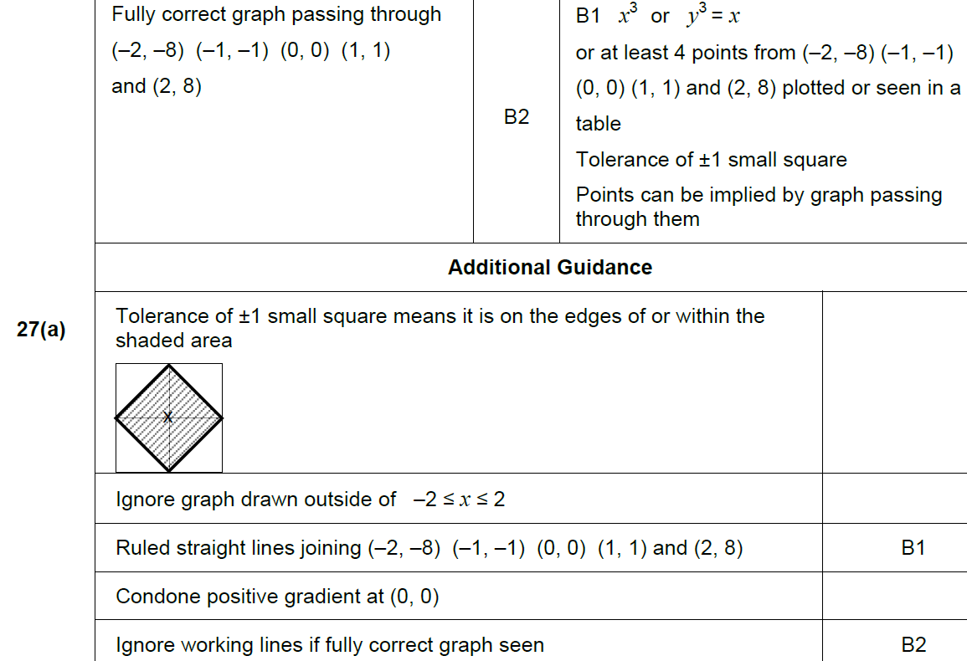
Functions
June 2017 2H Q27
A

Slide 10
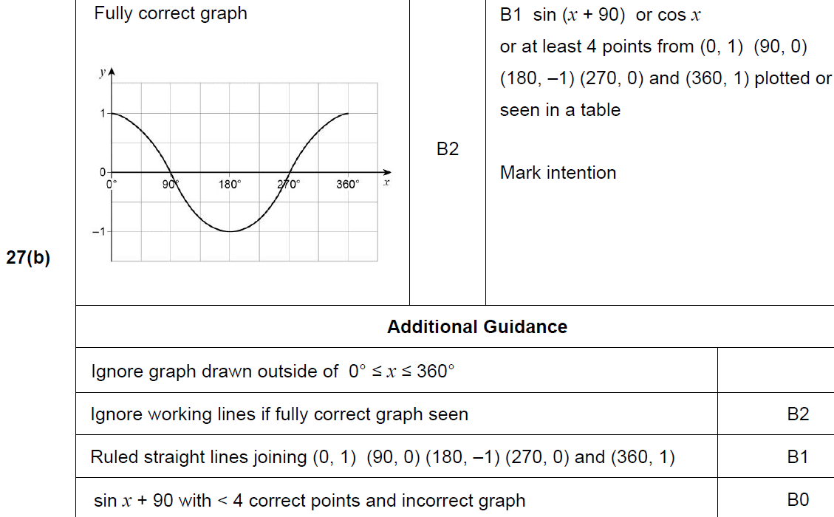
Functions
June 2017 2H Q27
B

Slide 11
Functions
Nov 2017 3H Q16

Slide 12
Functions
Nov 2017 3H Q16
A

Slide 13
Functions
Nov 2017 3H Q30

Slide 14
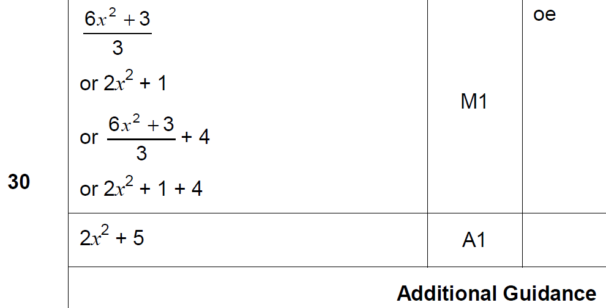
Functions
Nov 2017 3H Q30
A

Slide 15
Functions
June 2018 2H Q28

Slide 16
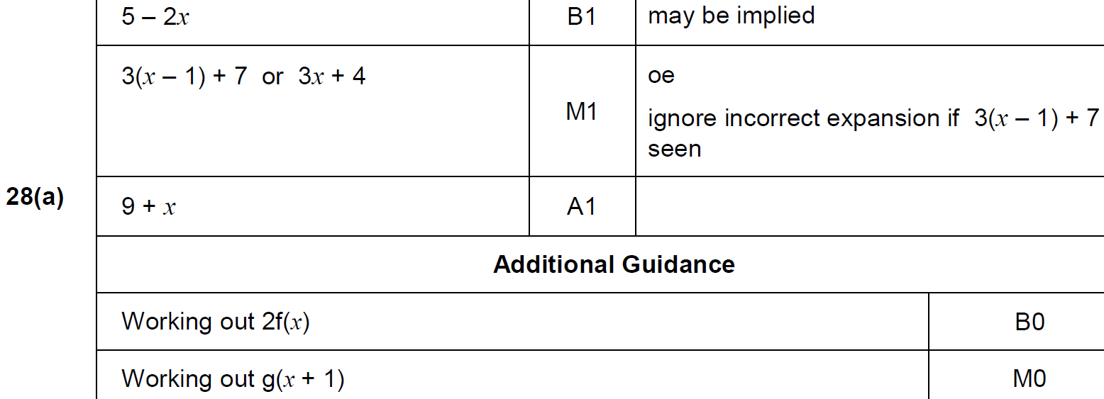
Functions
June 2018 2H Q28
A

Slide 17
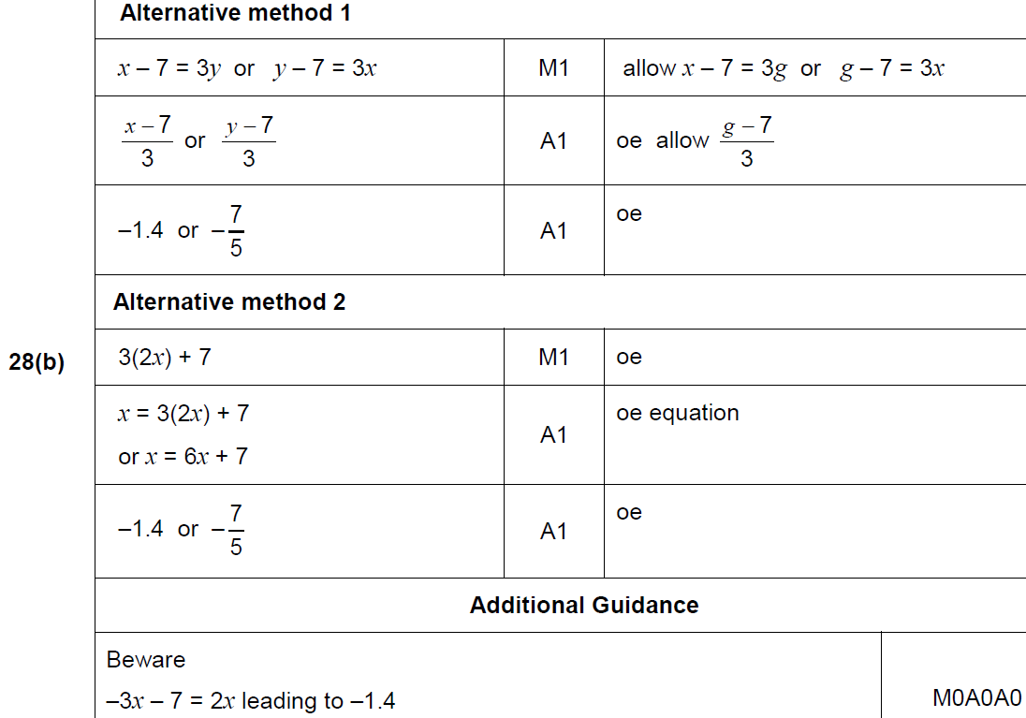
Functions
June 2018 2H Q28
A

Slide 18
Functions
Nov 2018 2H Q26

Slide 19
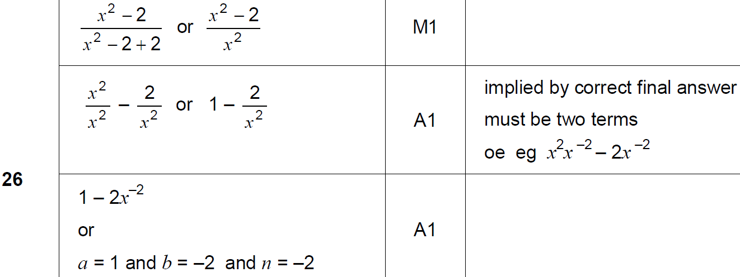
Functions
Nov 2018 2H Q26
A

Slide 20
Functions
Nov 2018 3H Q26

Slide 21
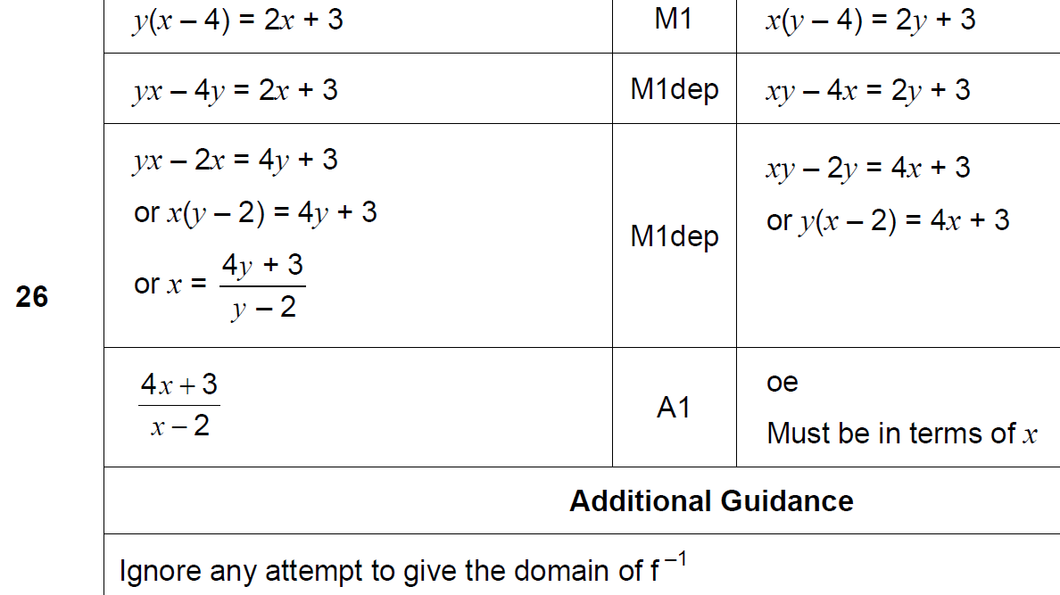
Functions
Nov 2018 3H Q26
A

