Slide 1
Functions
Functions
May 2017
1H Q11*
SAM
2H Q7*
Nov 2017
2H Q22
Edexcel
SAM
3H Q10
June 2018
2H Q11
AQA
Spec 1
2H Q18
Nov 2018
1H Q19
OCR
Spec 2
2H Q9
Nov 2018
3H Q10
May 2019
1H Q21
With graphs
*mainly graphs

Slide 2
Functions
Functions
Edexcel
SAM
1H Q25
June 2017
2H Q27*
June 2018
2H Q28
AQA
SAM
2H Q19
Nov 2017
3H Q16
Nov 2018
2H Q26
1 Marker
OCR
SAM
3H Q19
Nov 2017
3H Q30
Nov 2018
3H Q26
With graphs
*mainly graphs

Slide 3
Functions
Functions
Edexcel
June 2017
3H Q14
AQA
SAM
1H Q8
June 2018
3H Q17
OCR
Nov 2018
1H Q11
With graphs
*mainly graphs

Slide 4
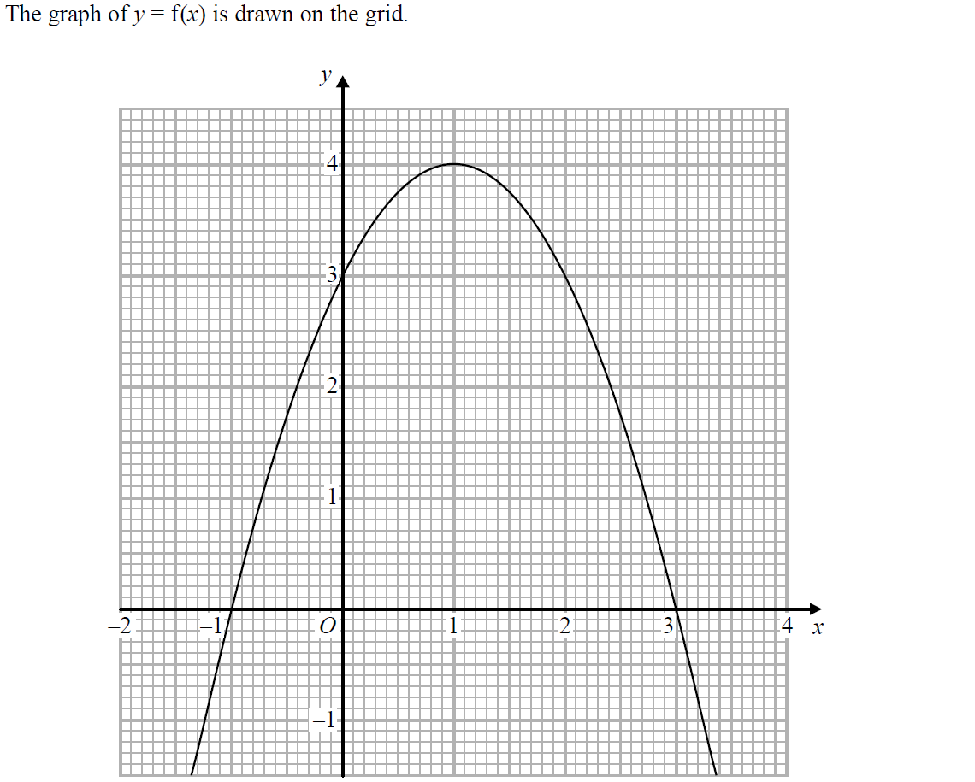
Functions
SAM 2H Q7

Slide 5
Functions
SAM 2H Q7
A
B
C

Slide 6
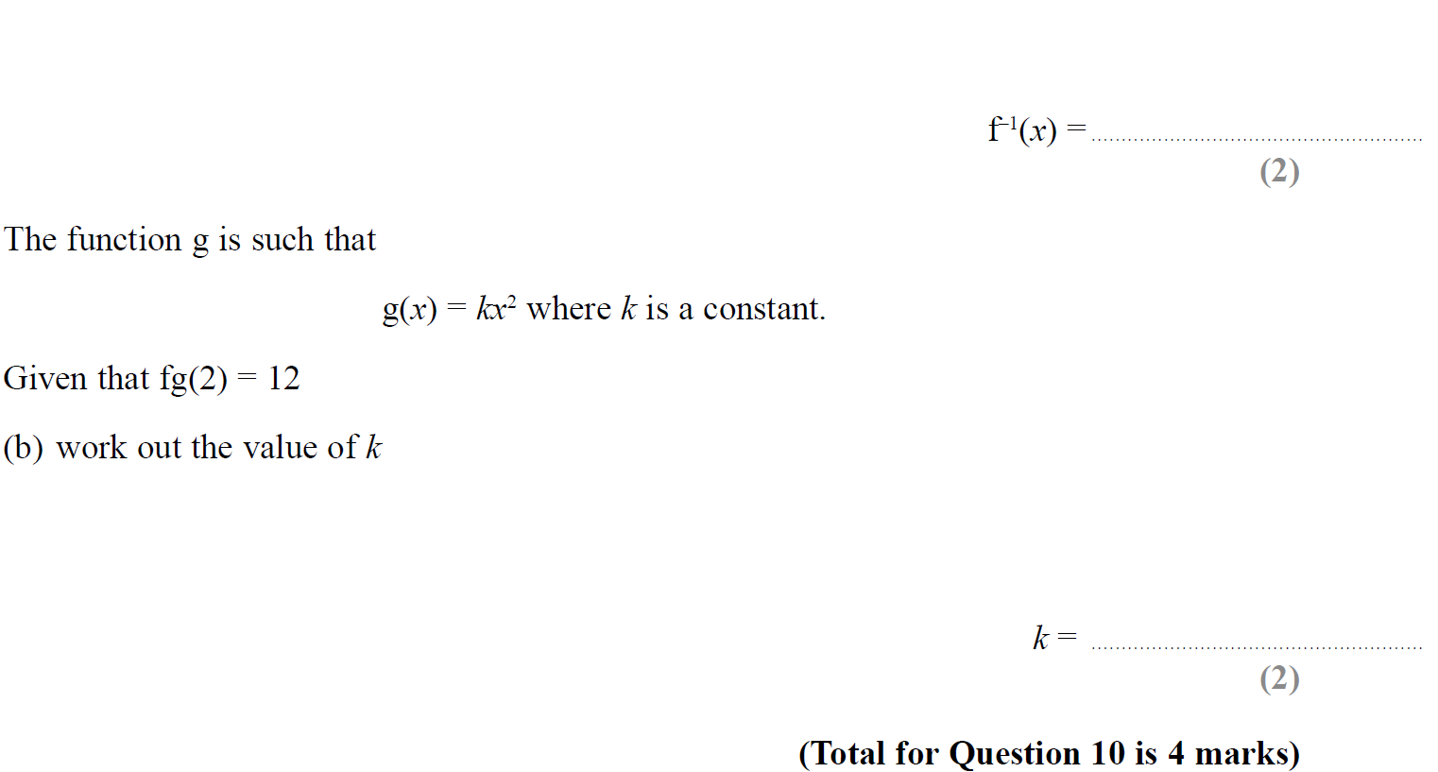
Functions
SAM 3H Q10

Slide 7
Functions
SAM 3H Q10
A
B

Slide 8
Functions
Specimen Set 1 2H Q18

Slide 9
Functions
Specimen Set 1 2H Q18
A

Slide 10
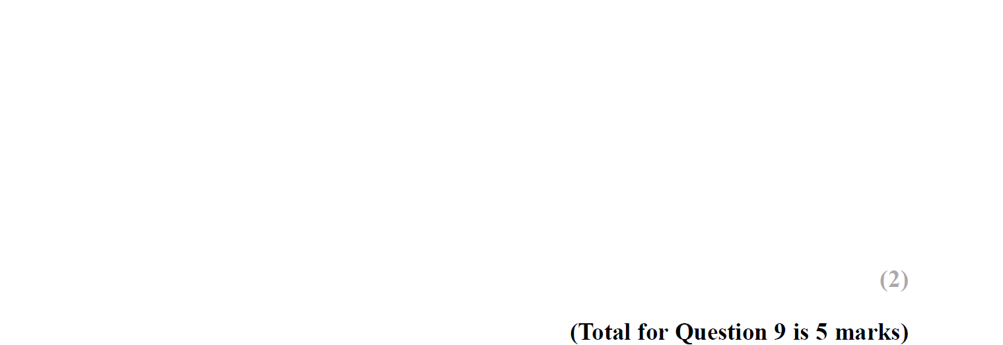
Functions
Specimen Set 2 2H Q9

Slide 11
Functions
Specimen Set 2 2H Q9
A
B
C

Slide 12
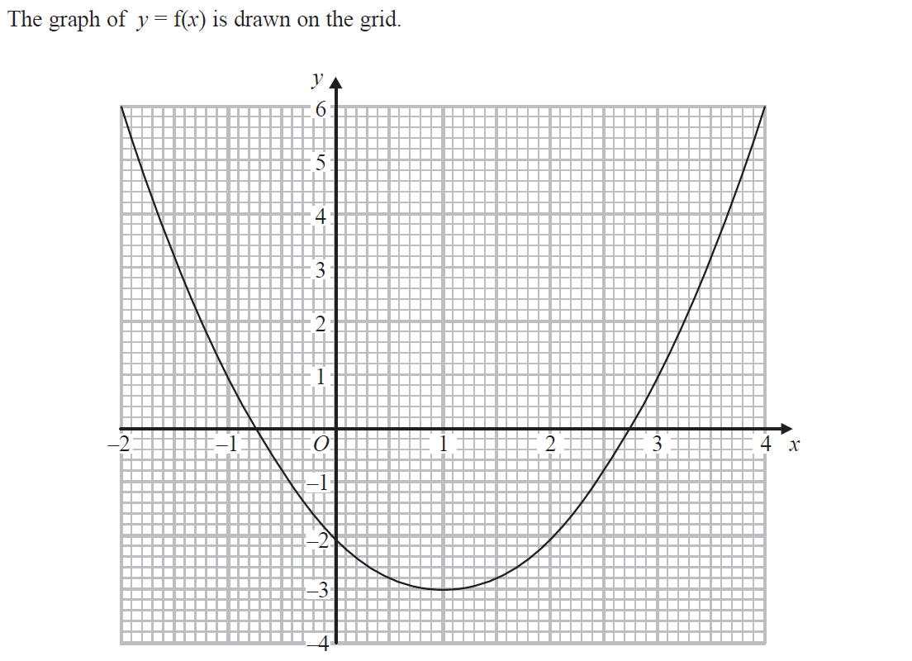
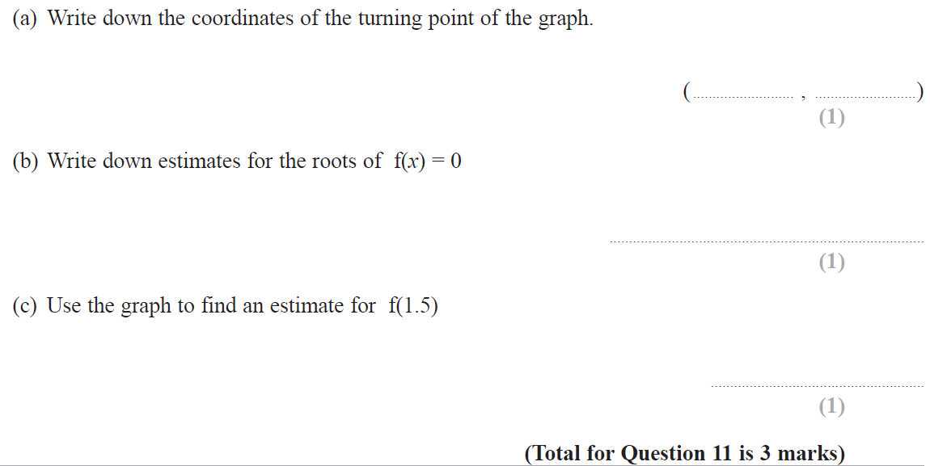
Functions
May 2017 1H Q11

Slide 13
Functions
May 2017 1H Q11
A
B
C

Slide 14
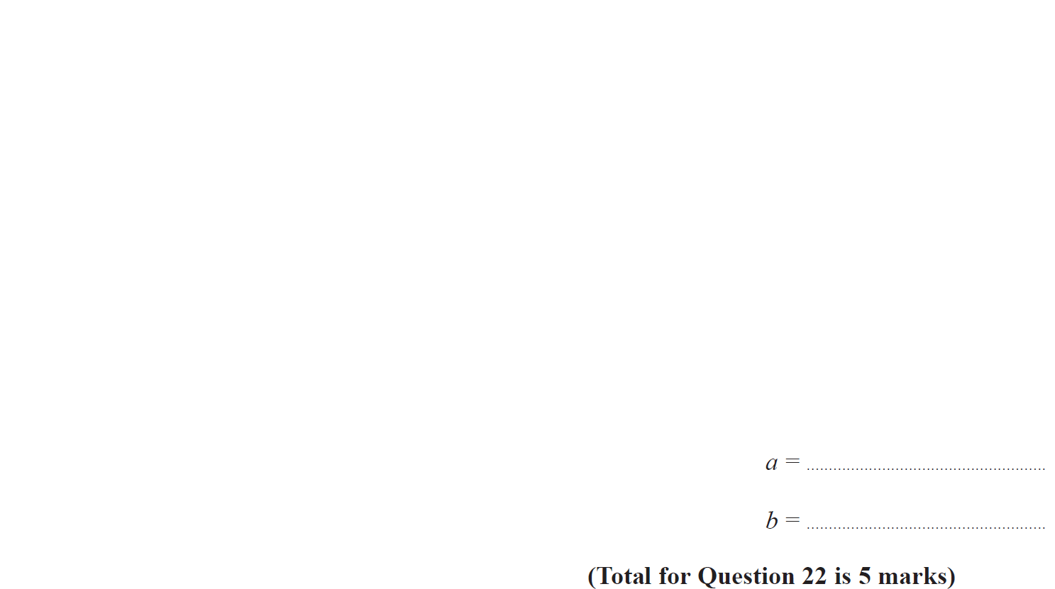
Functions
Nov 2017 2H Q22

Slide 15
Functions
Nov 2017 2H Q22
A

Slide 16
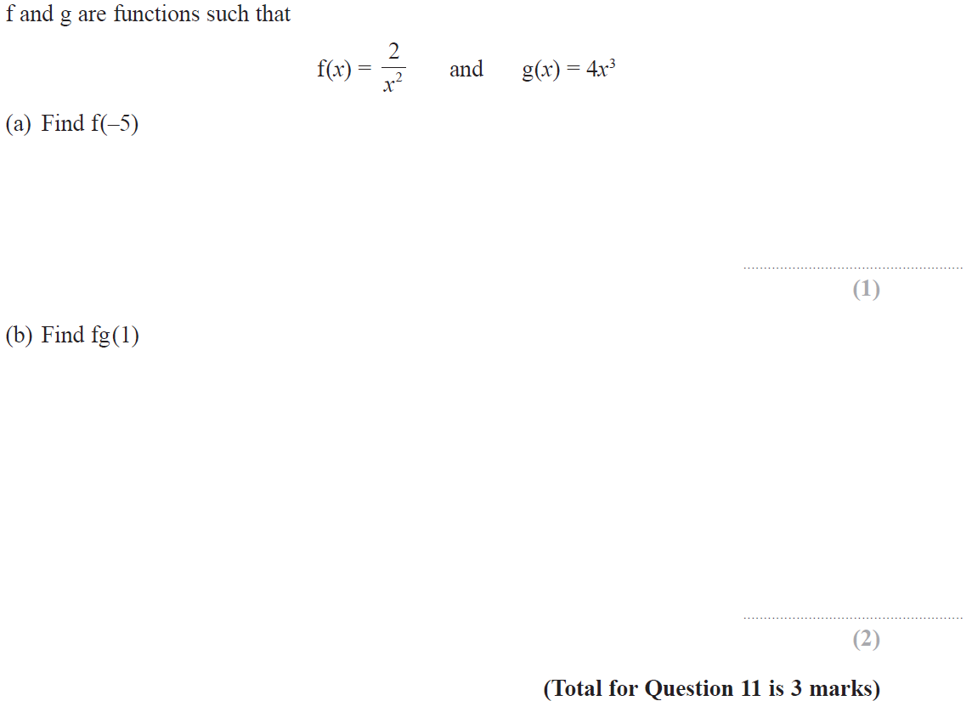
Functions
June 2018 2H Q11

Slide 17
Functions
June 2018 2H Q11
A
B

Slide 18
Functions
Nov 2018 1H Q19

Slide 19
Functions
Nov 2018 1H Q19
A
B

Slide 20
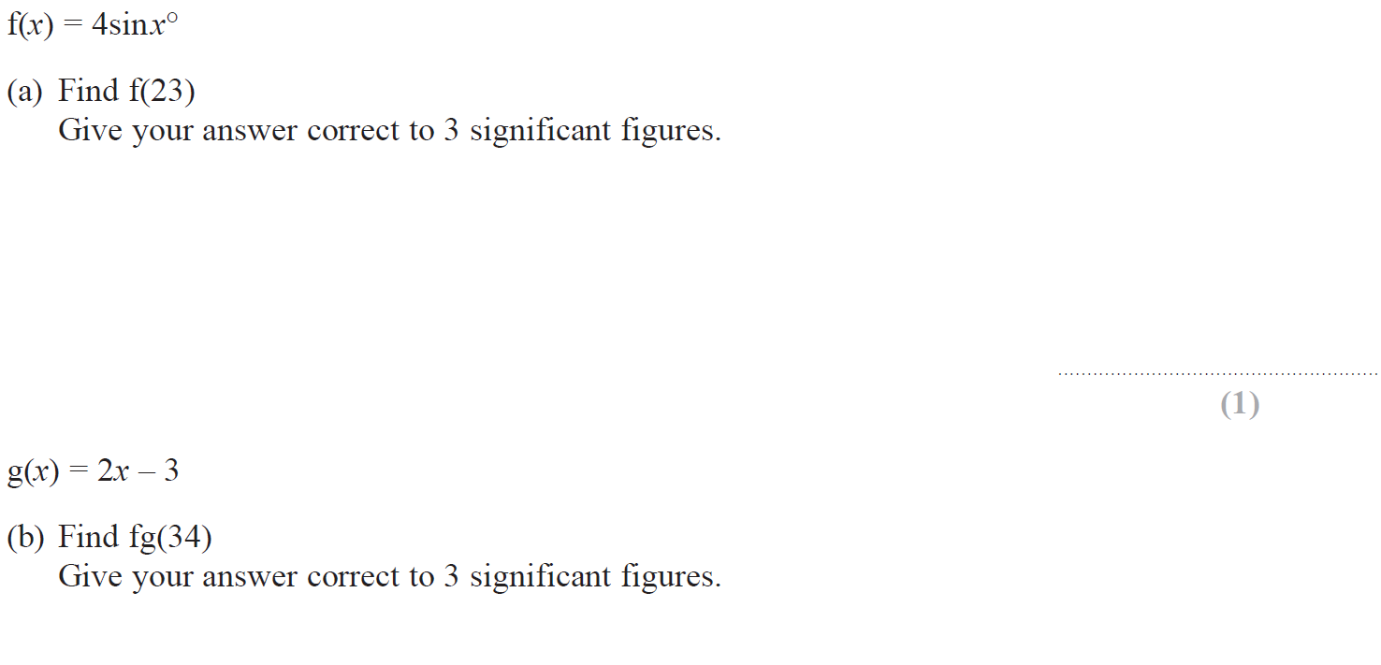
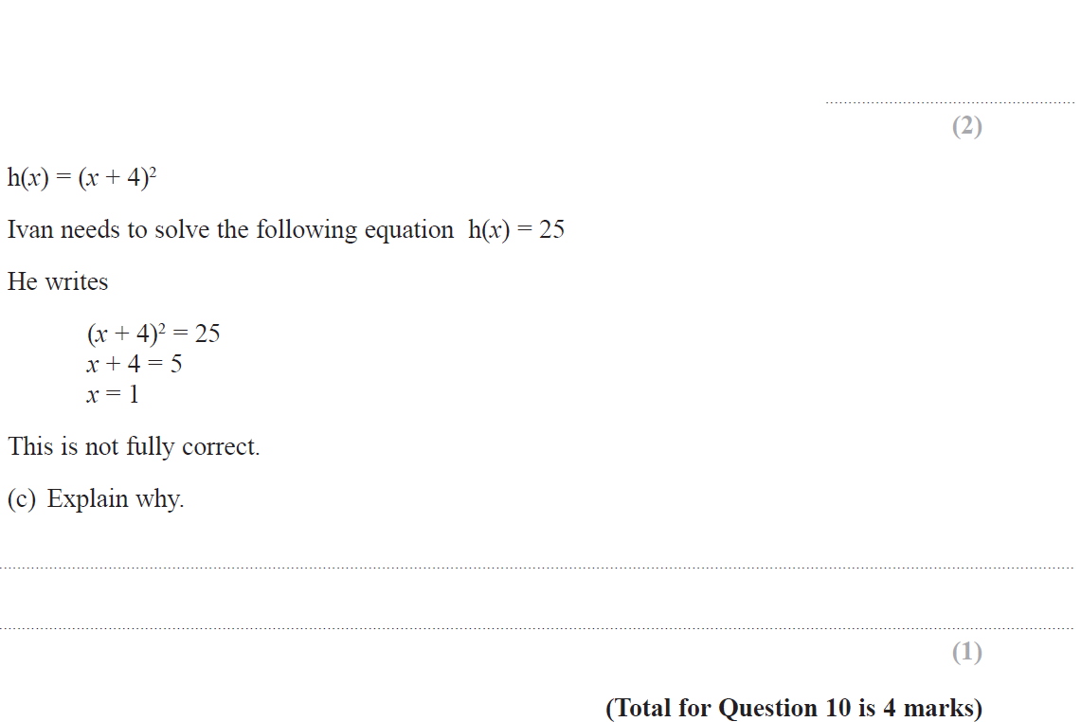
Functions
Nov 2018 3H Q10

Slide 21
Functions
Nov 2018 3H Q10
A
B
C

Slide 22
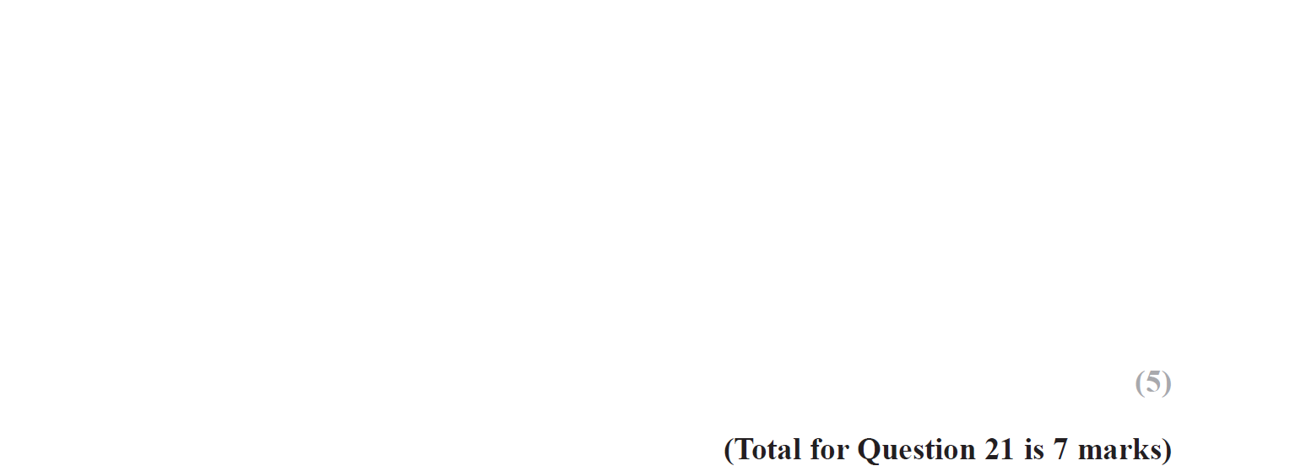
Functions
May 2019 1H Q21

Slide 23
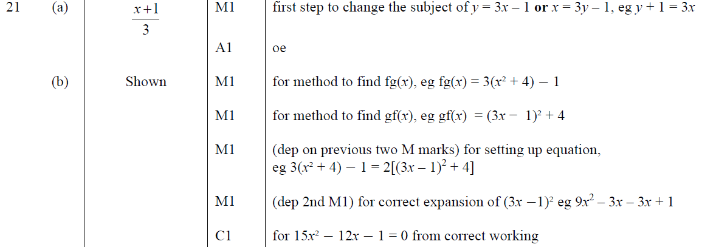
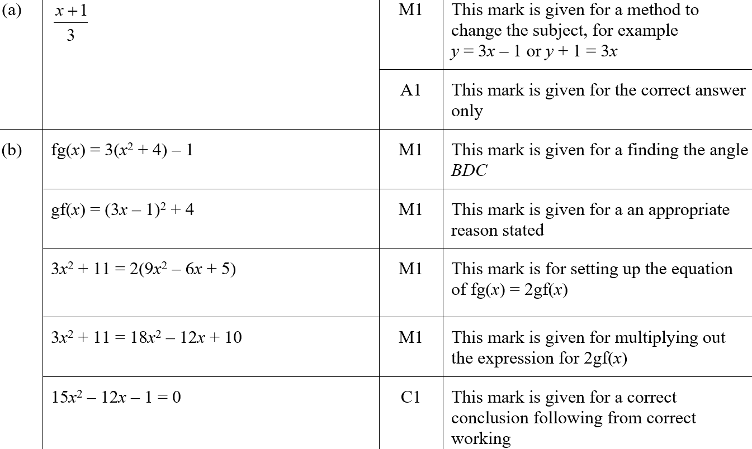
Functions
May 2019 1H Q21
A
B
A SF
B SF

Slide 24
Functions
SAM 1H Q25

Slide 25
Functions
SAM 1H Q25
A

Slide 26
Functions
SAM 2H Q19

Slide 27
Functions
SAM 2H Q19
A

Slide 28
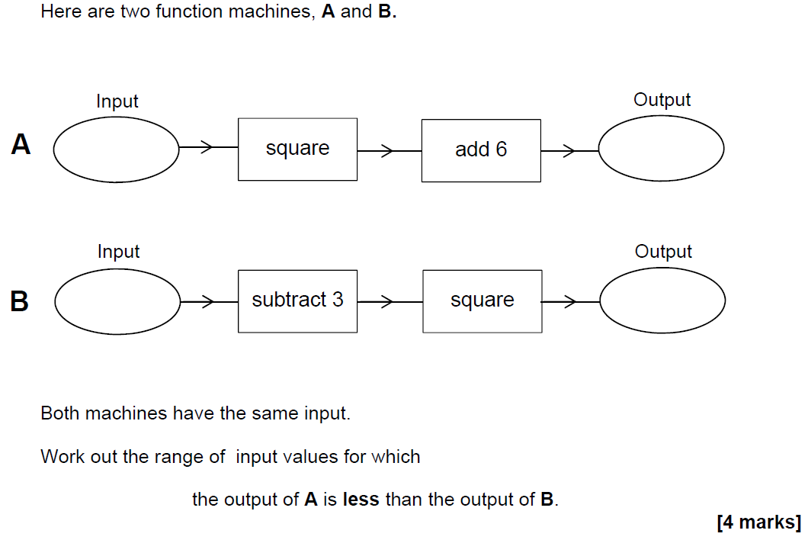
Functions
SAM 3H Q19

Slide 29
Functions
SAM 3H Q19
A

Slide 30
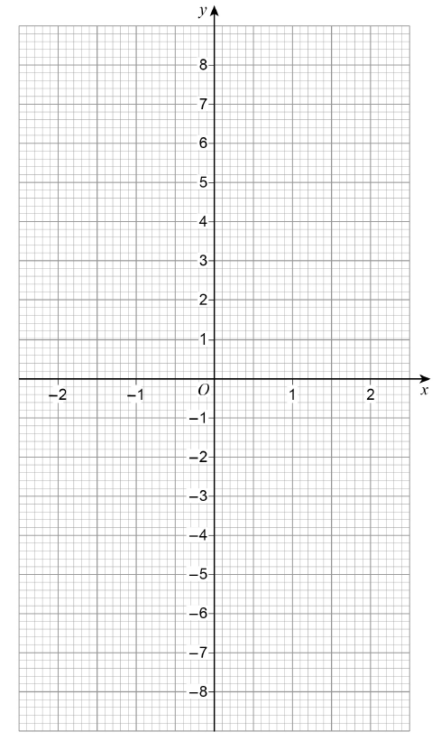
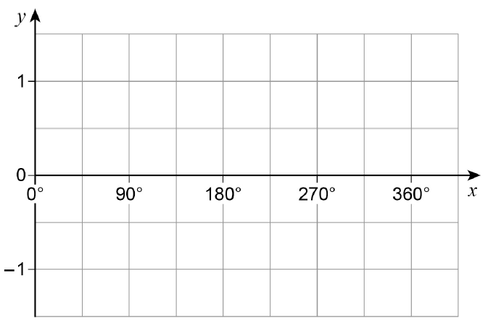
Functions
June 2017 2H Q27

Slide 31
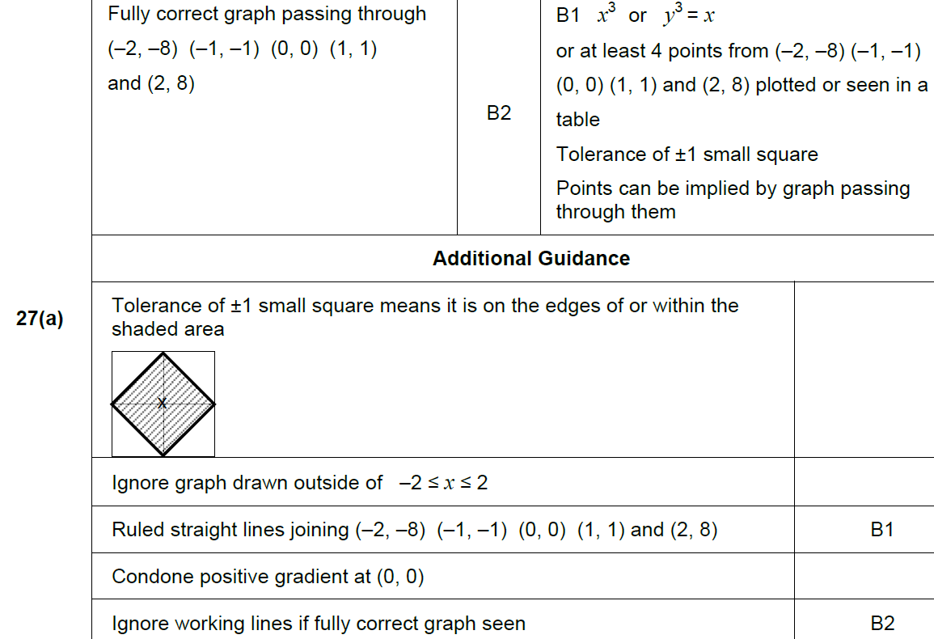
Functions
June 2017 2H Q27
A

Slide 32
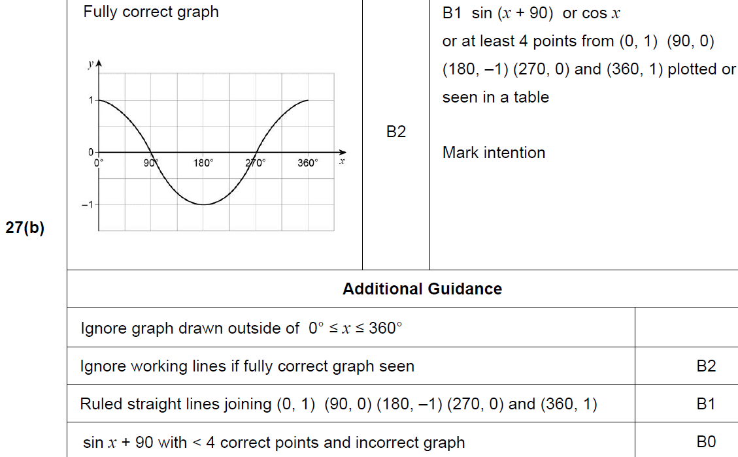
Functions
June 2017 2H Q27
B

Slide 33
Functions
Nov 2017 3H Q16

Slide 34
Functions
Nov 2017 3H Q16
A

Slide 35
Functions
Nov 2017 3H Q30

Slide 36
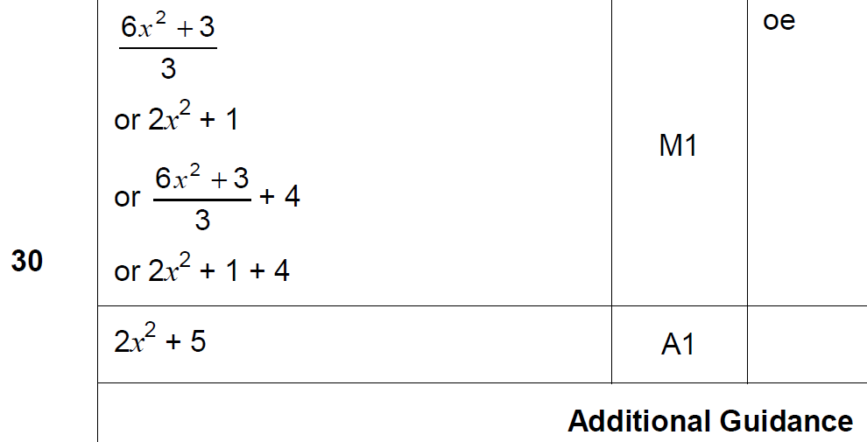
Functions
Nov 2017 3H Q30
A

Slide 37
Functions
June 2018 2H Q28

Slide 38
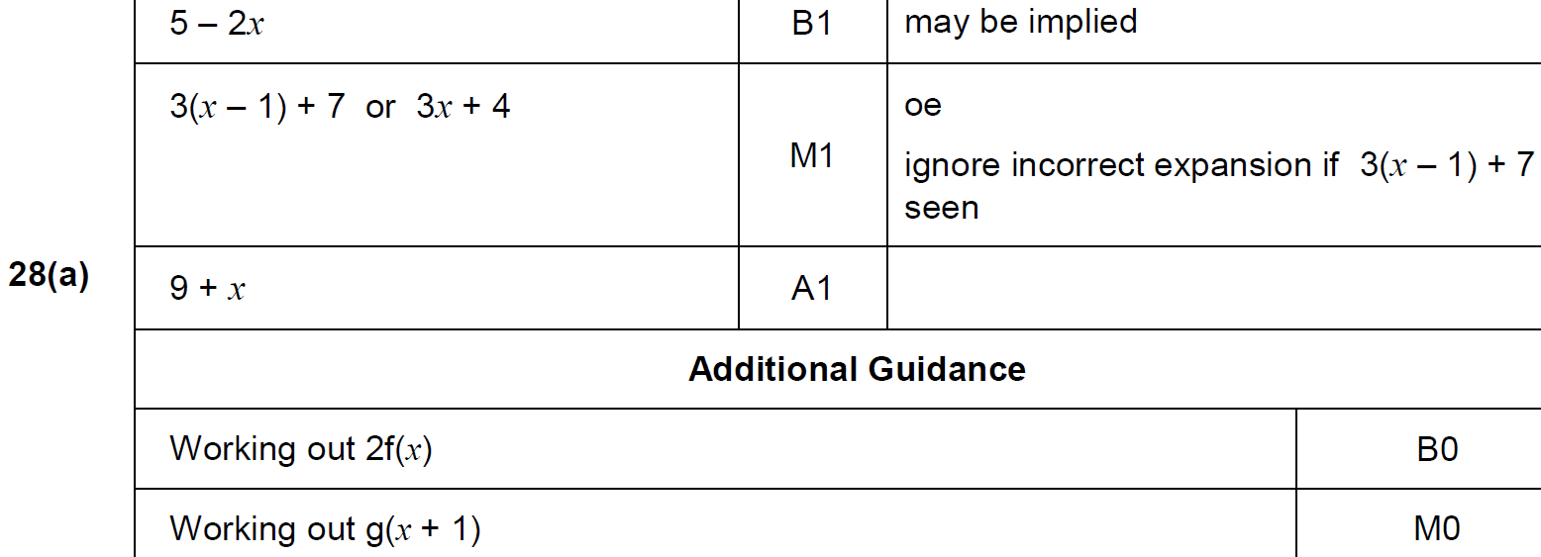
Functions
June 2018 2H Q28
A

Slide 39
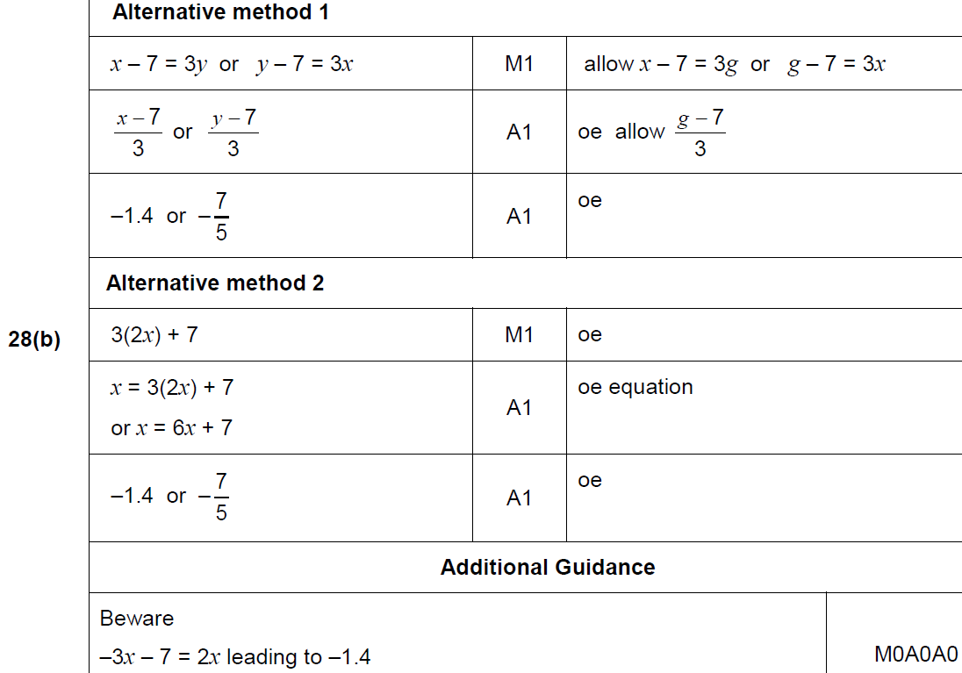
Functions
June 2018 2H Q28
A

Slide 40
Functions
Nov 2018 2H Q26

Slide 41
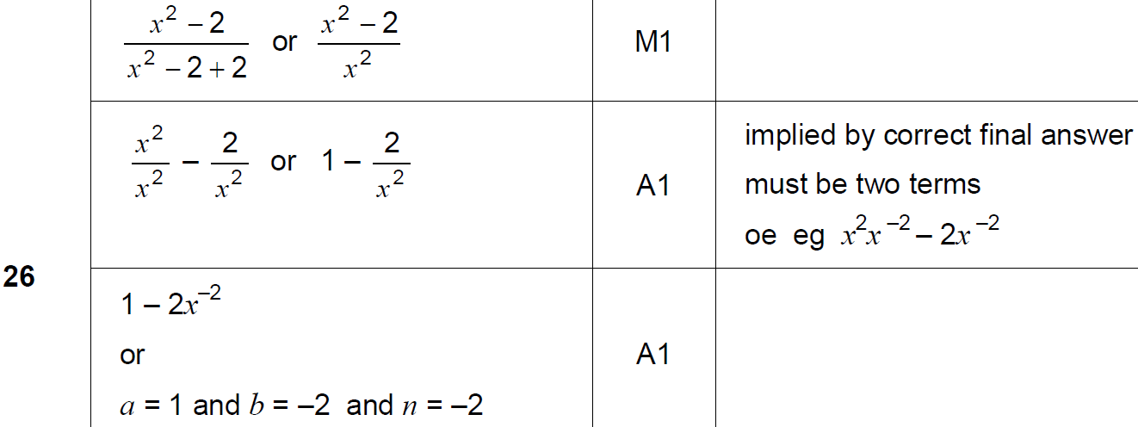
Functions
Nov 2018 2H Q26
A

Slide 42
Functions
Nov 2018 3H Q26

Slide 43
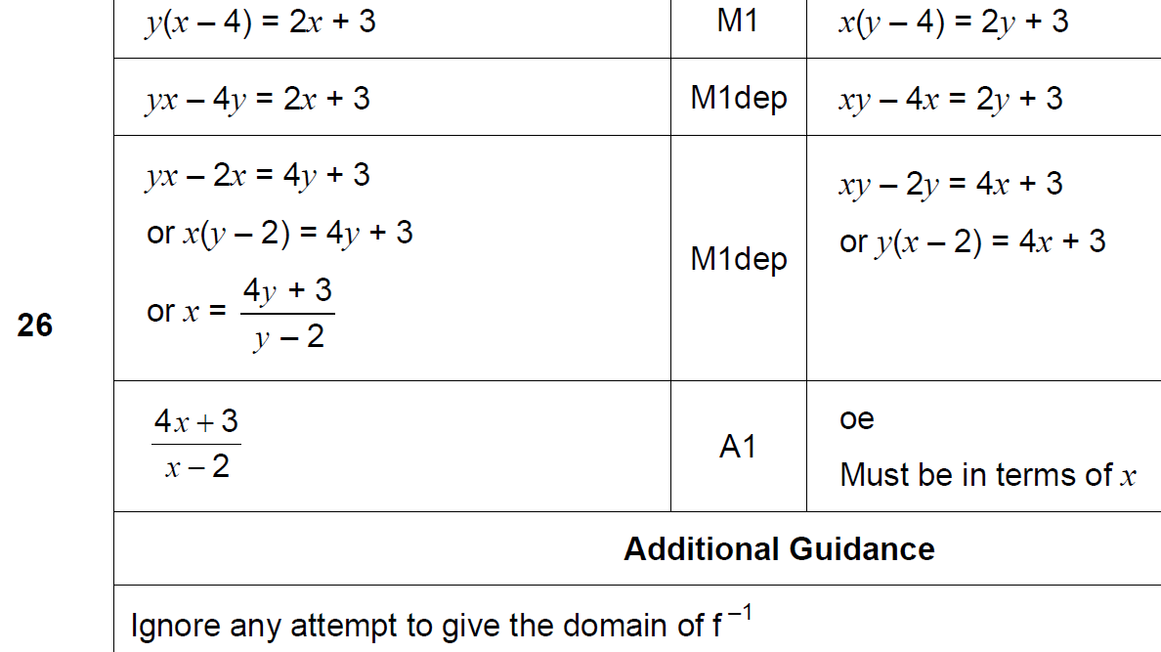
Functions
Nov 2018 3H Q26
A

Slide 44
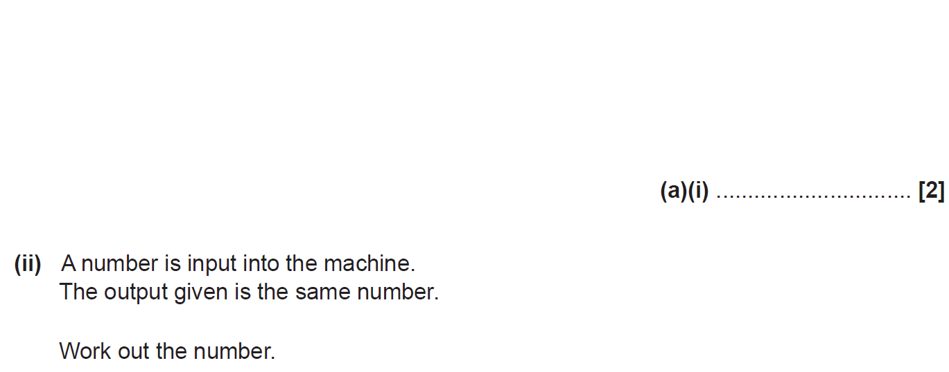
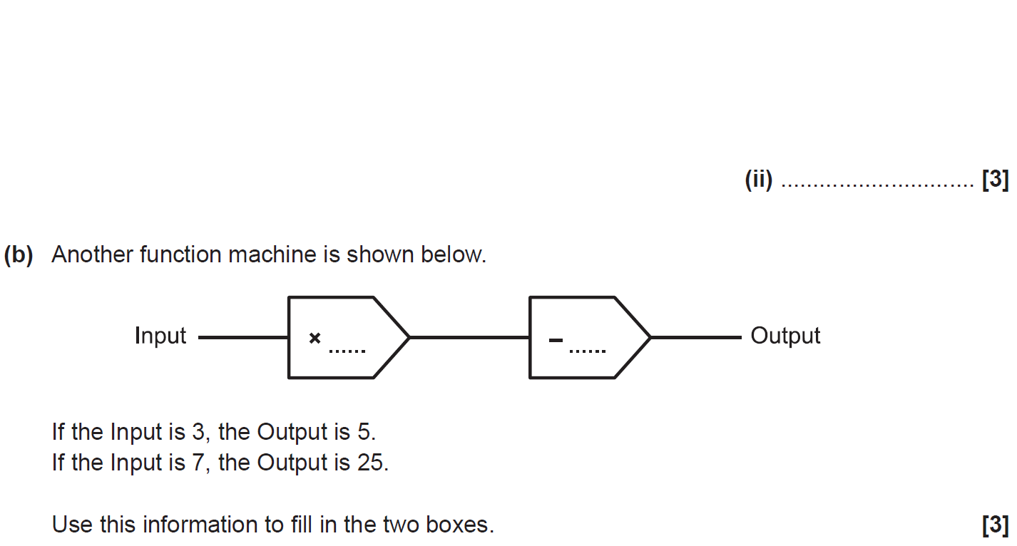
Functions
SAM 1H Q8

Slide 45
Functions
SAM 1H Q8
A (i)
A (ii)
B

Slide 46
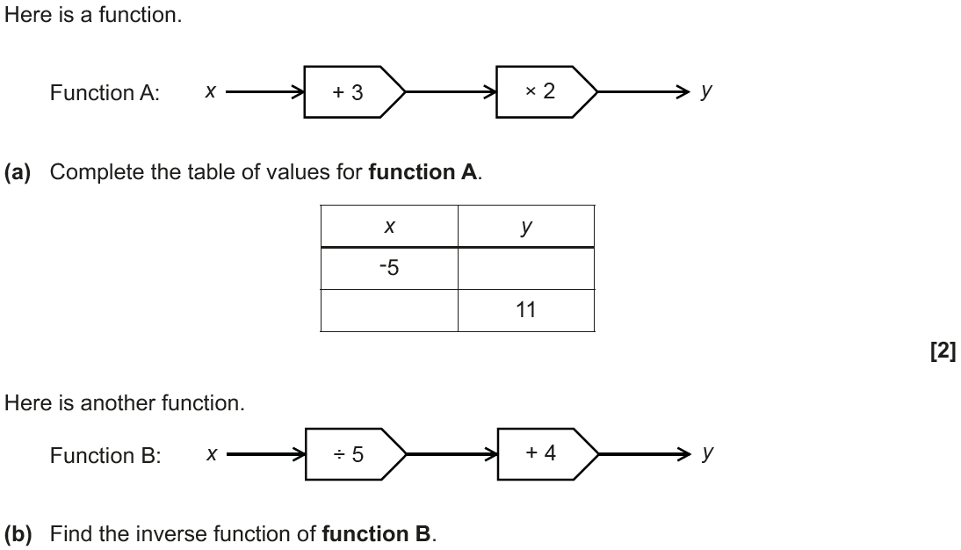
Functions
June 2017 3H Q14

Slide 47
Functions
June 2017 3H Q14
A
B

Slide 48
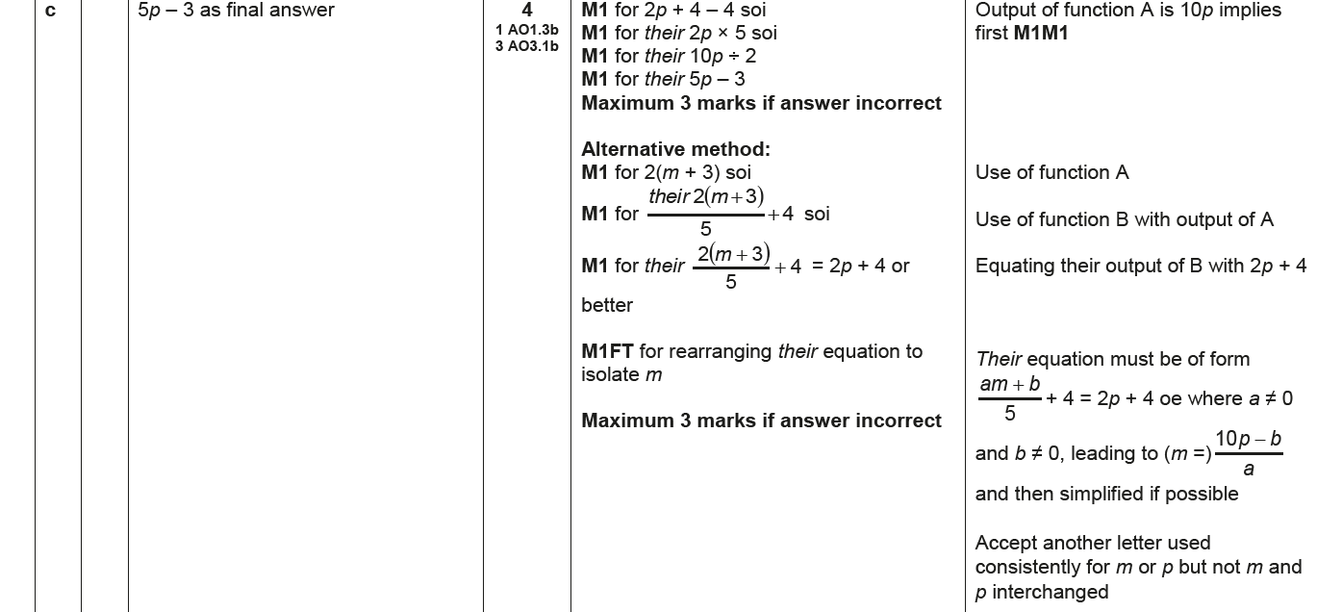
Functions
June 2017 3H Q14
C

Slide 49
Functions
June 2018 3H Q17

Slide 50
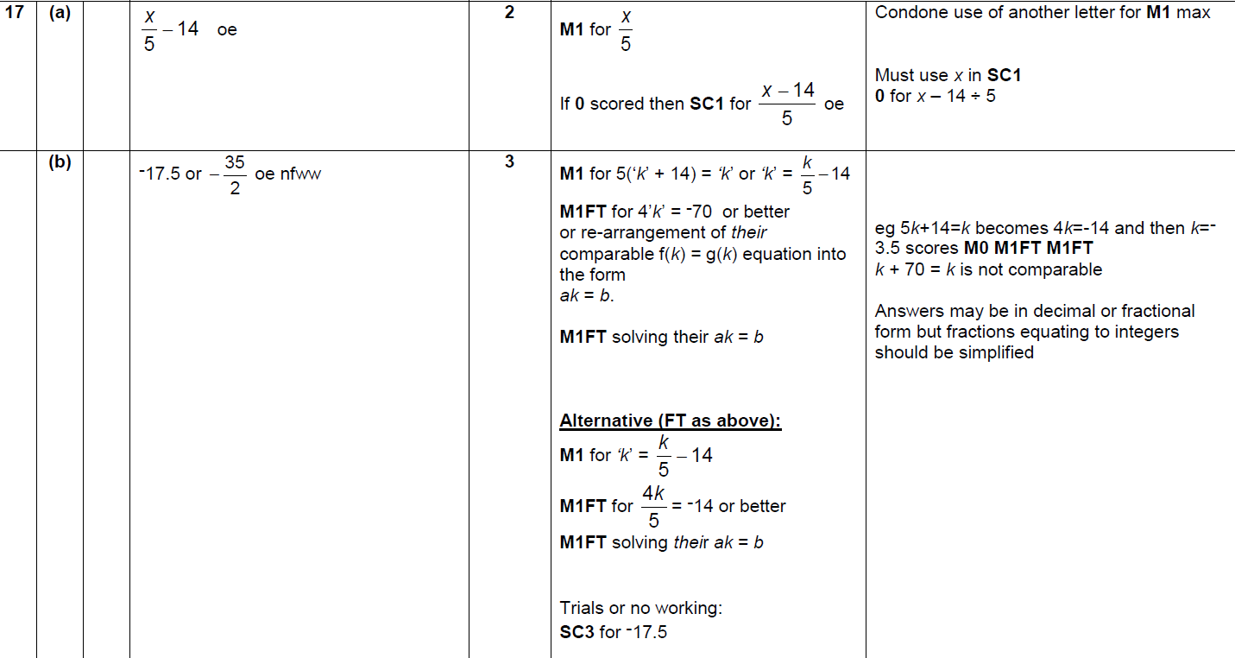
Functions
June 2018 3H Q17
A
B

Slide 51
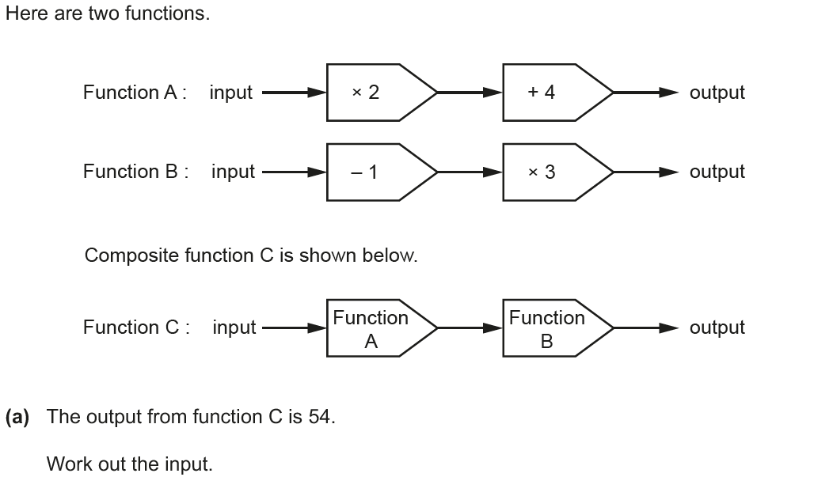
Functions
Nov 2018 1H Q11

Slide 52
Functions
Nov 2018 1H Q11
A
B

