Slide 1
Functions
Functions
Old Spec Q’s
SAM
2H Q17
May 2018
1H Q14
May 2018
1HR Q20
Jan 2019
1H Q19
Jan 2019
2H Q17
Jan 2019
1HR Q23
Jan 2019
2H Q24
With graphs
*mainly graphs

Slide 2
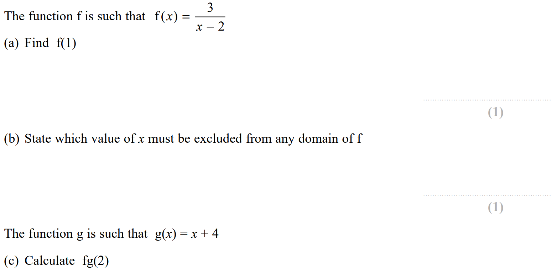
Functions
SAM 2H Q17

Slide 3
Functions
SAM 2H Q17
A
B
C

Slide 4
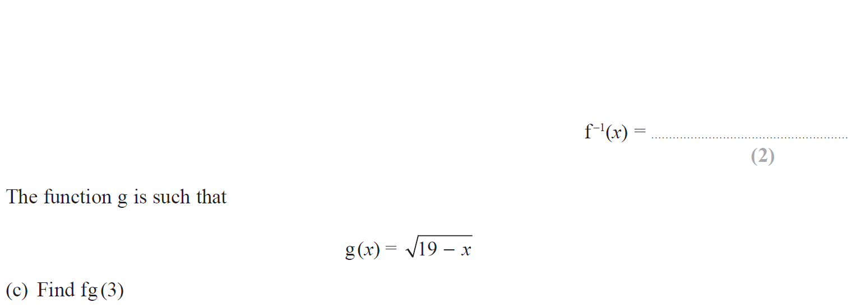
Functions
May 2018 1H Q14

Slide 5
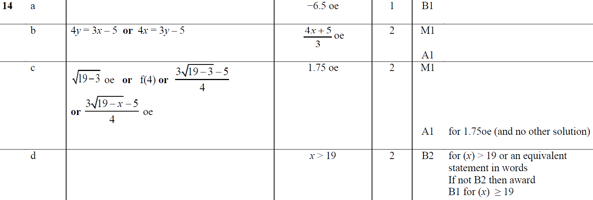
Functions
May 2018 1H Q14
A
B
C
D

Slide 6
Functions
May 2018 1HR Q20

Slide 7
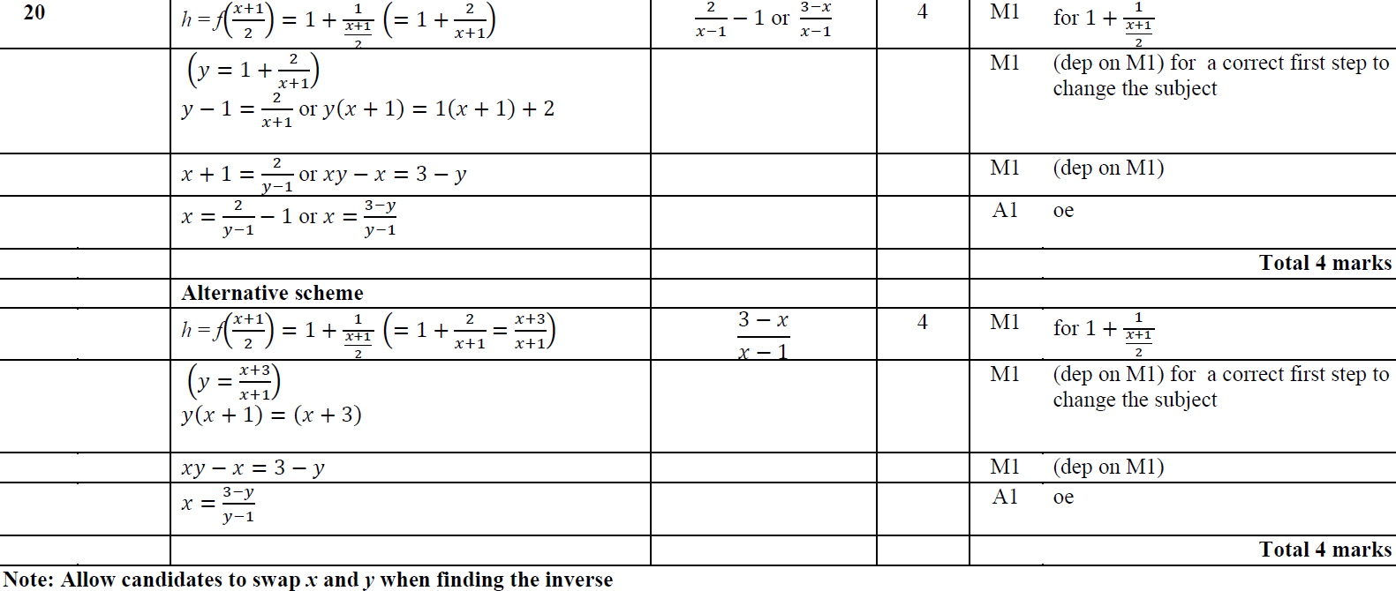
Functions
May 2018 1HR Q20
A

Slide 8
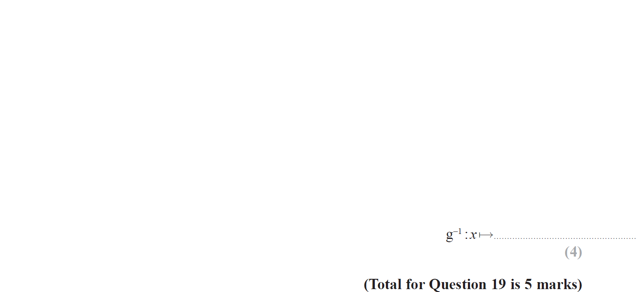
Functions
Jan 2019 1H Q19

Slide 9
Functions
Jan 2019 1H Q19
A
B

Slide 10
Functions
Jan 2019 2H Q17

Slide 11
Functions
Jan 2019 2H Q17
A
B
C

Slide 12
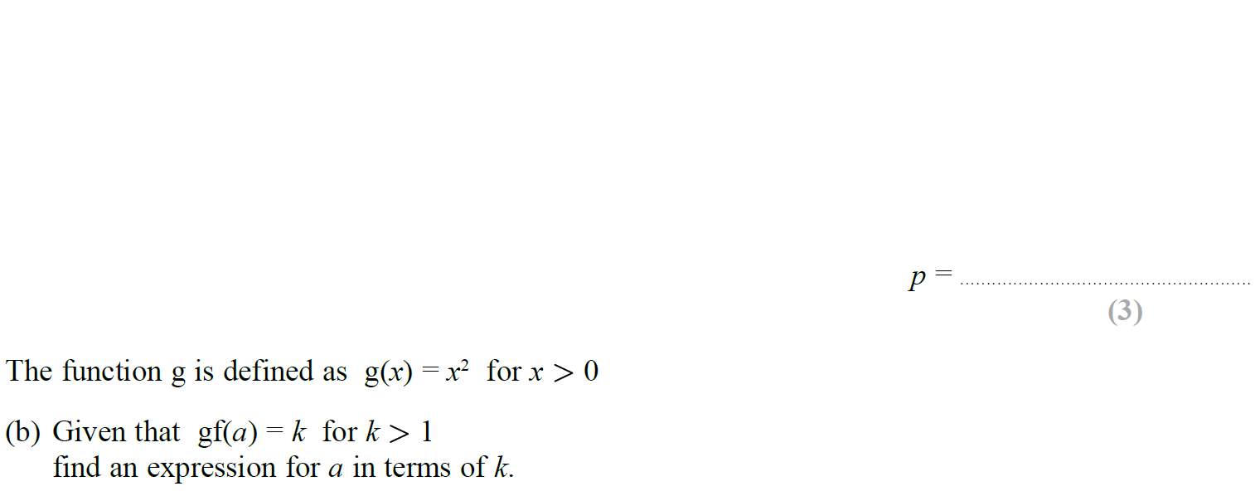
Functions
Jan 2019 1HR Q23

Slide 13
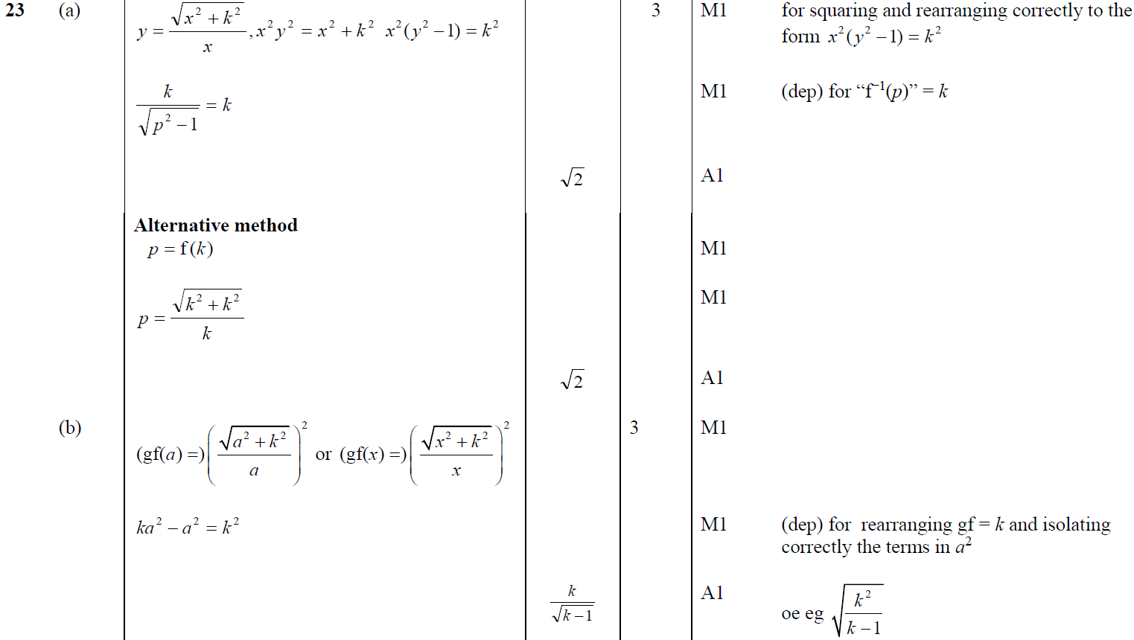
Functions
Jan 2019 1HR Q23
A
B

Slide 14
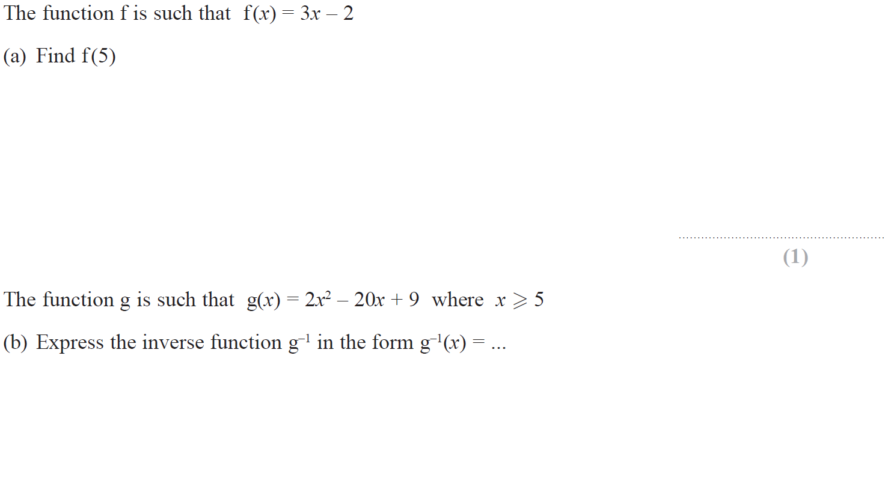
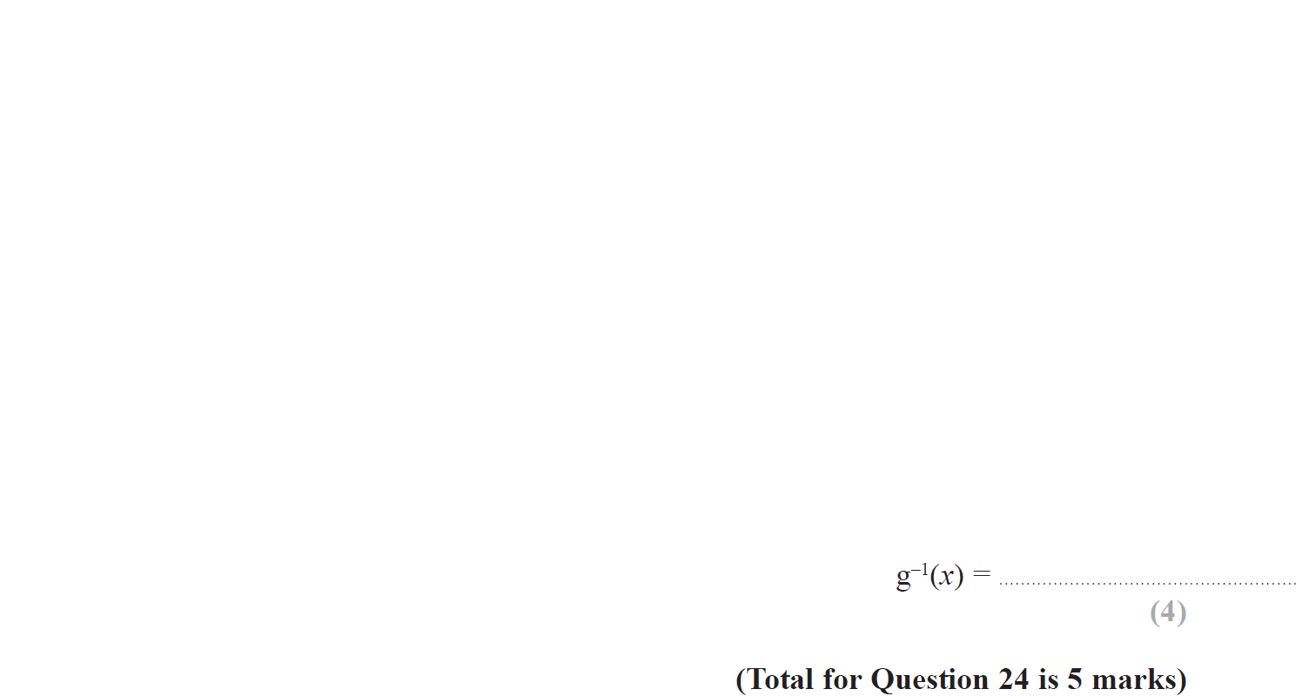
Functions
June 2019 2H Q24

Slide 15
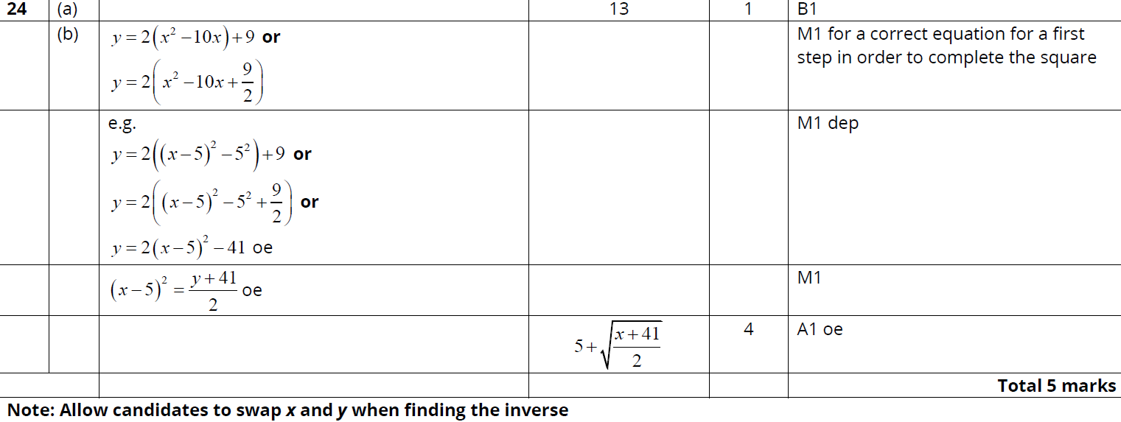
Functions
June 2019 2H Q24
A
B
B Alternative 1

Slide 16
Functions
June 2019 2H Q24
B Alternative 2

Slide 17
Functions
Functions
New Spec Q’s
May 2004
3H Q19
Nov 2007
4H Q23
June 2011 4H Q20
May 2014 3H Q21
June 2016 4H Q17
Jan 2018 3HR Q23
Nov 2004
4H Q22
May 2008
3H Q21
Jan 2012 4H Q17
May 2014 3HR Q11
May 2016 3HR Q18
May 2018 3H Q21
May 2005
4H Q13
May 2008
4H Q23
May 2012 4H Q19
Jan 2015 3H Q20
Jan 2017 4H Q18
May 2018 3HR Q23
Nov 2005
3H Q17
Nov 2008
4H Q21
Jan 2013 4H Q23
Jan 2015 3HR Q21
Jan 2017 4H Q19*
Nov 2005
4H Q17
May 2009
3H Q15
May 2013 4H Q17
May 2015 3H Q17
Jan 2017 3HR Q19
May 2006
3H Q23
Nov 2009
3H Q24
May 2013 4HR Q23
May 2015 3HR Q20
May 2017 3H Q19
Nov 2006
3H Q17
June 2010
4H Q20
Jan 2014 3H Q20
Jan 2016 3H Q15
June 2017 4HR Q20
May 2007
4H Q17
Nov 2010
3H Q21
Jan 2014 3HR Q22
Jan 2016 3HR Q16
Jan 2018 3H Q23
With graphs
*mainly graphs

Slide 18
Functions
May 2004 3H Q19

Slide 19
Functions
May 2004 3H Q19
A (i)
A (ii)
B
C (i)
C (ii)

Slide 20
Functions
Nov 2004 4H Q22

Slide 21
Functions
Nov 2004 4H Q22
A

Slide 22
Functions
May 2005 4H Q13

Slide 23
Functions
May 2005 4H Q13
A
B
C
D
E

Slide 24
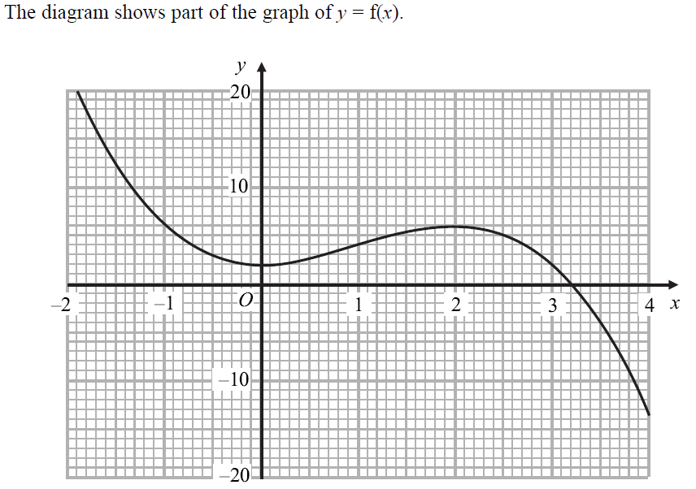
Functions
Nov 2005 3H Q17

Slide 25
Functions
Nov 2005 3H Q17
A
B
C
D
E

Slide 26
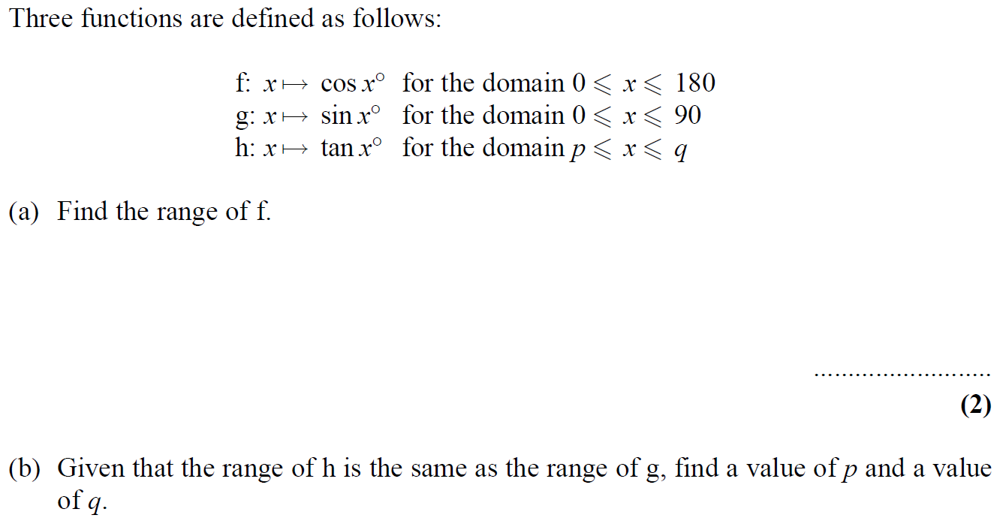
Functions
Nov 2005 4H Q17

Slide 27
Functions
Nov 2005 4H Q17
A
B

Slide 28
Functions
May 2006 3H Q23

Slide 29
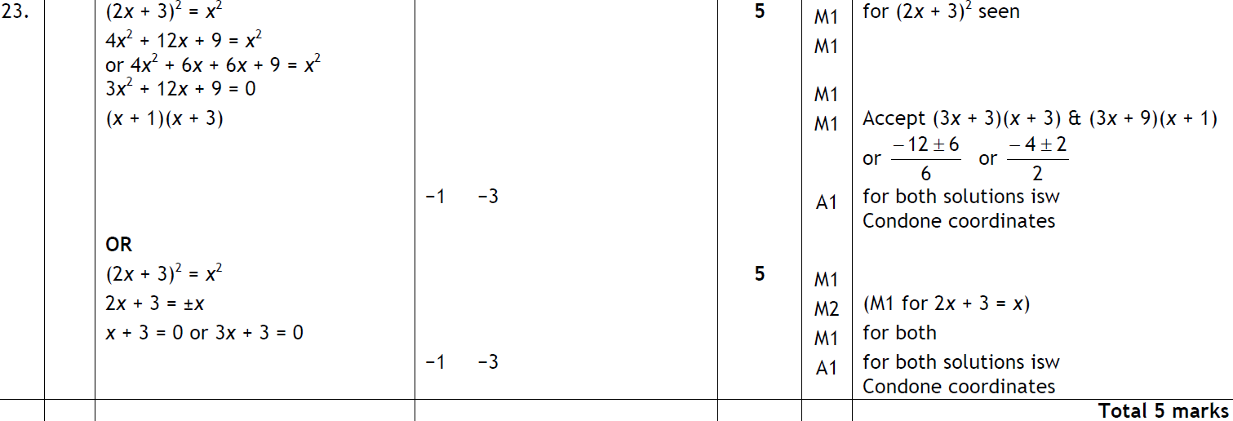
Functions
May 2006 3H Q23
A

Slide 30
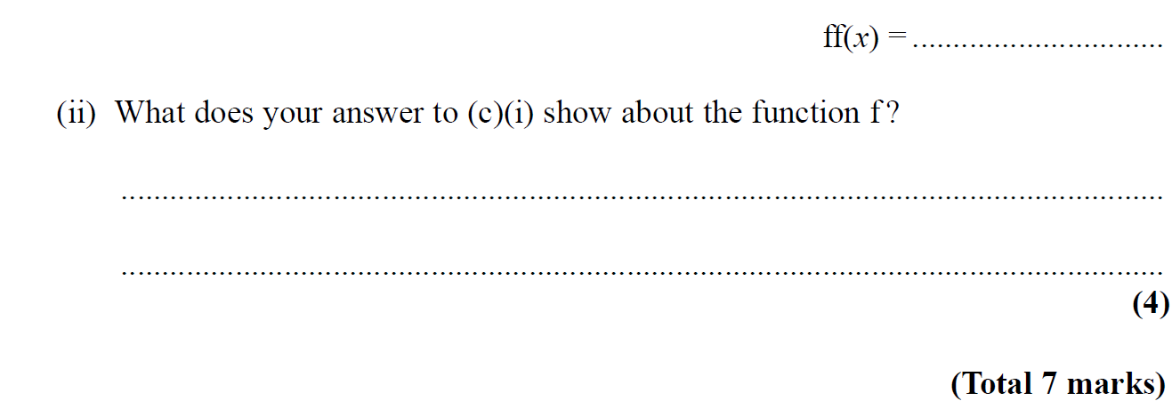
Functions
Nov 2006 3H Q17

Slide 31
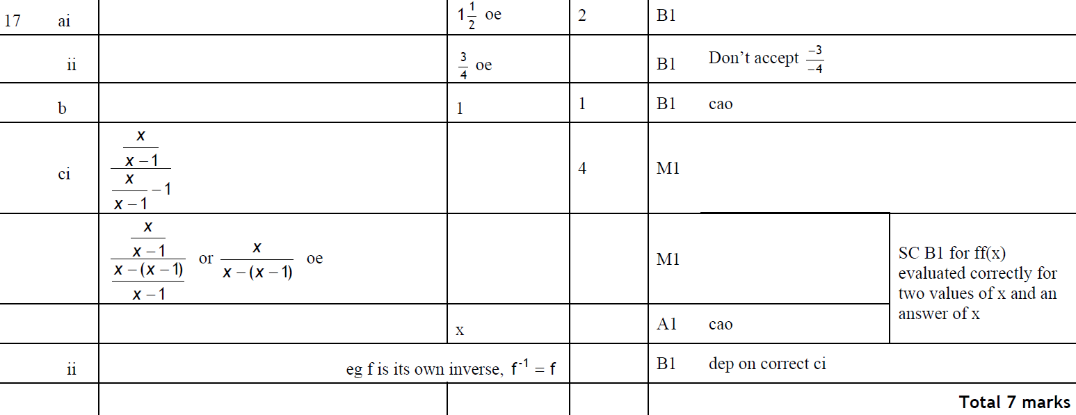
Functions
Nov 2006 3H Q17
A (i)
A (ii)
B
C (i)
C (ii)

Slide 32
Functions
May 2007 4H Q17

Slide 33
Functions
May 2007 4H Q17
A (i)
A (ii)
B
C

Slide 34
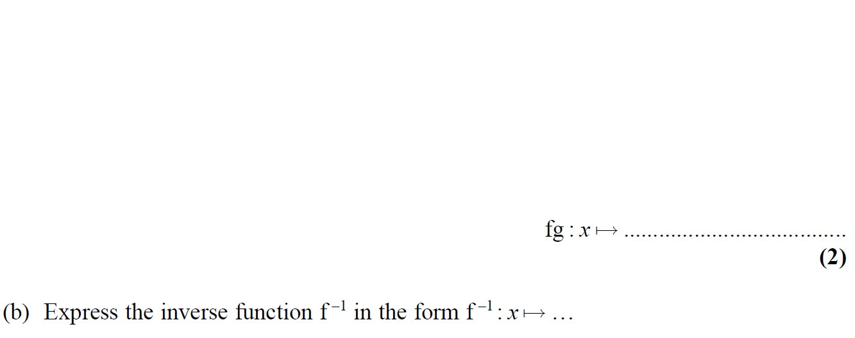
Functions
Nov 2007 4H Q23

Slide 35
Functions
Nov 2007 4H Q23
A
B

Slide 36
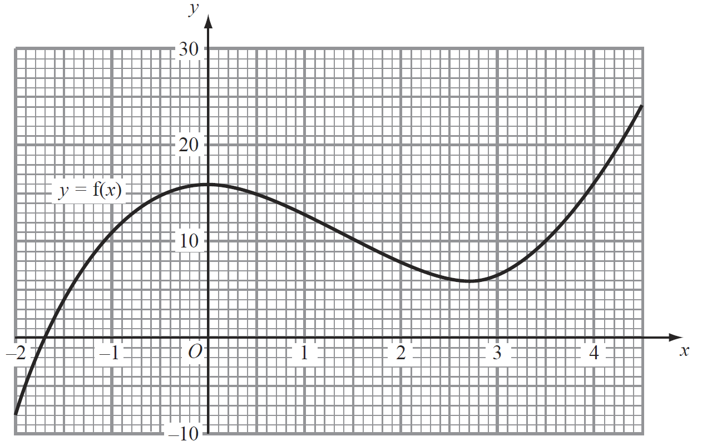
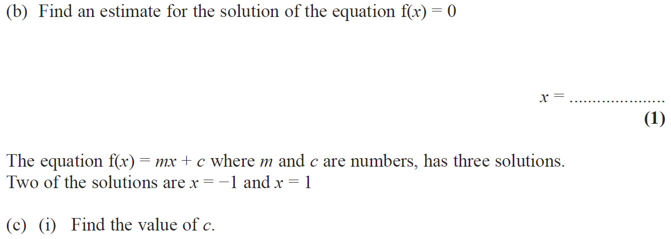
Functions
May 2008 3H Q21

Slide 37
Functions
May 2008 3H Q21
A
B
C (i)
C (ii)

Slide 38
Functions
May 2008 4H Q23

Slide 39
Functions
May 2008 4H Q23
A
B

Slide 40
Functions
Nov 2008 4H Q21

Slide 41
Functions
Nov 2008 4H Q21
A
B
C
D

Slide 42
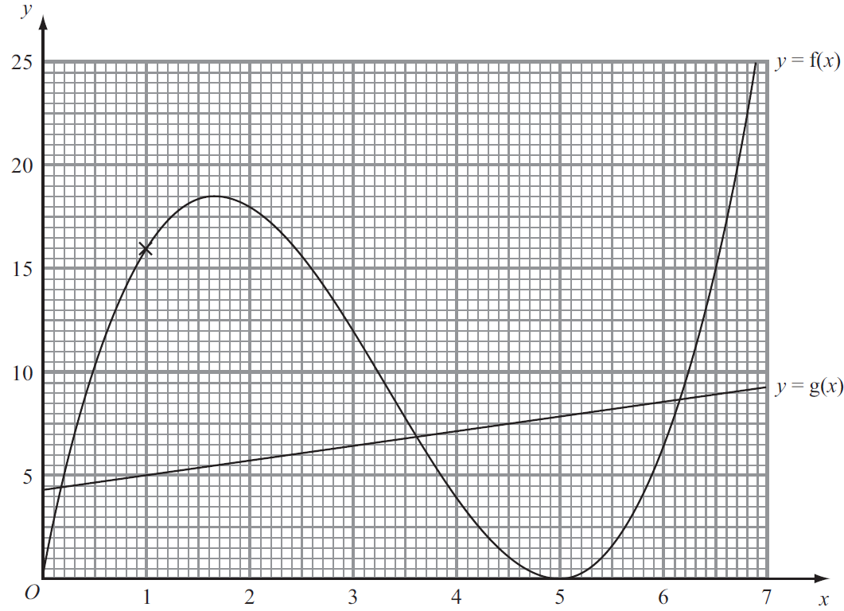
Functions
May 2009 3H Q15

Slide 43
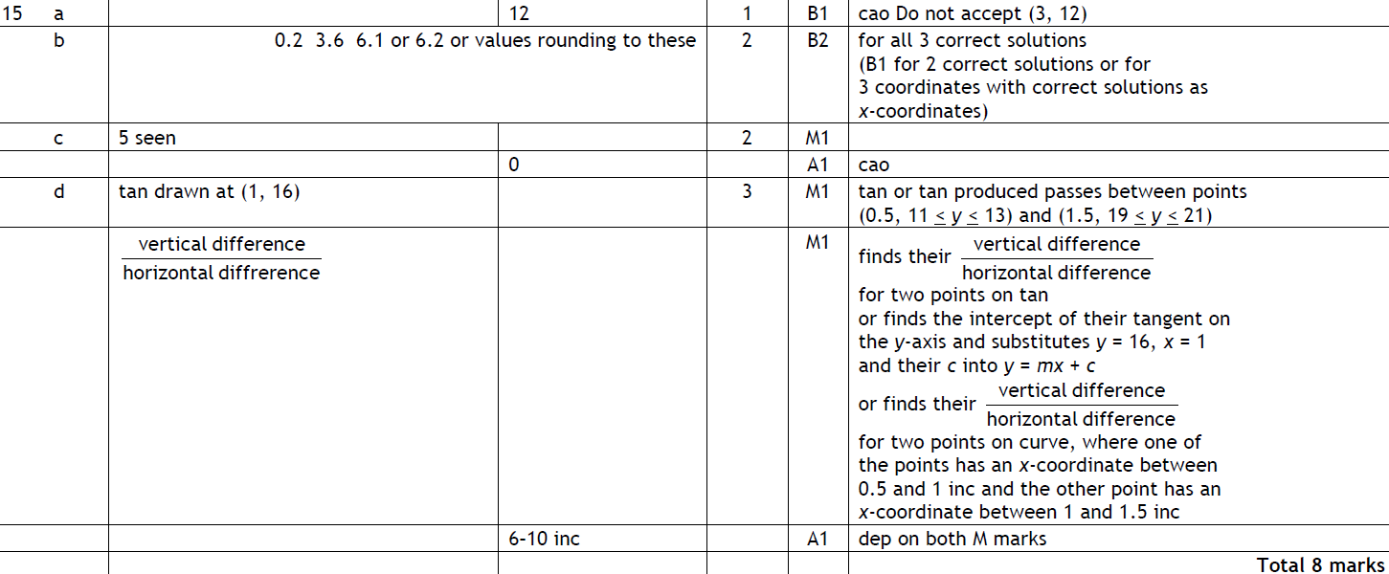
Functions
May 2009 3H Q15
A
B
C
D

Slide 44
Functions
Nov 2009 3H Q24

Slide 45
Functions
Nov 2009 3H Q24
A (i)
A (ii)
B

Slide 46
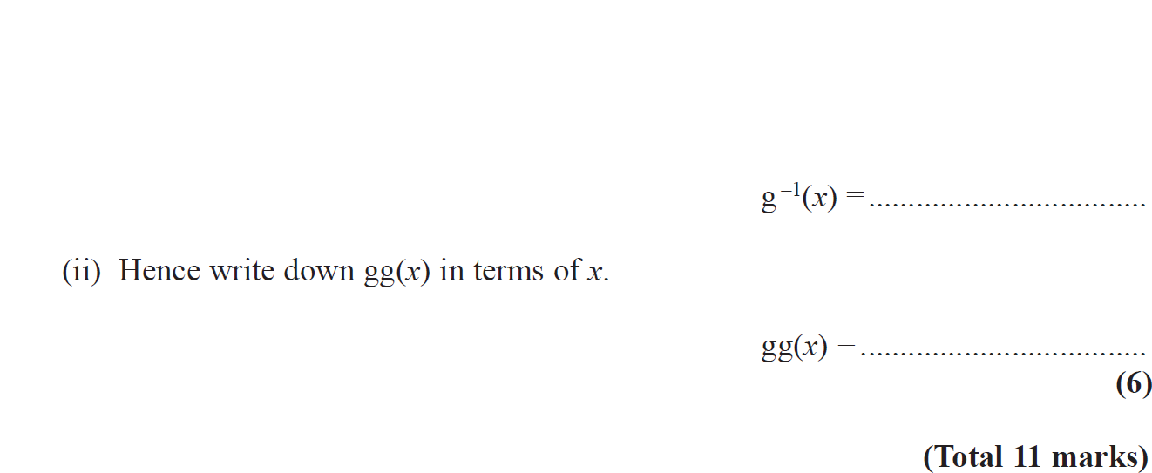
Functions
June 2010 4H Q20

Slide 47
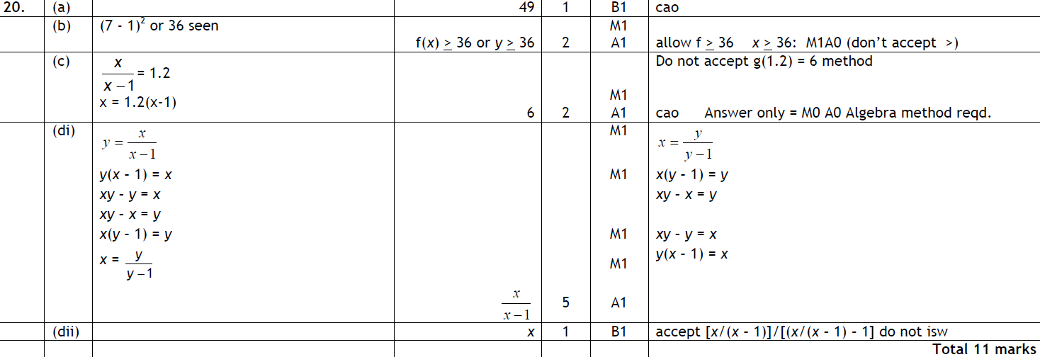
Functions
June 2010 4H Q20
A
B
C
D (i)
D (ii)

Slide 48
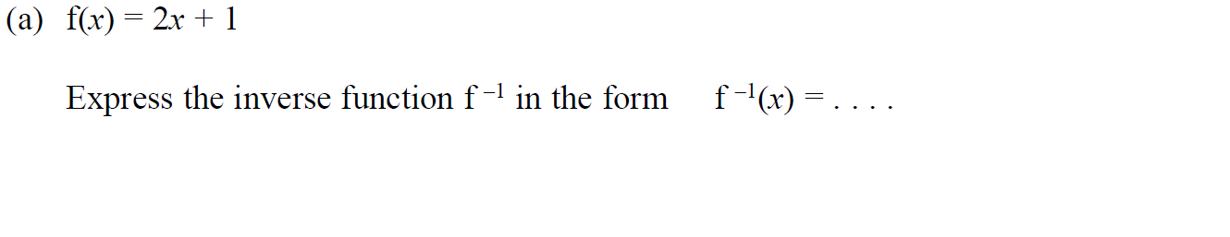
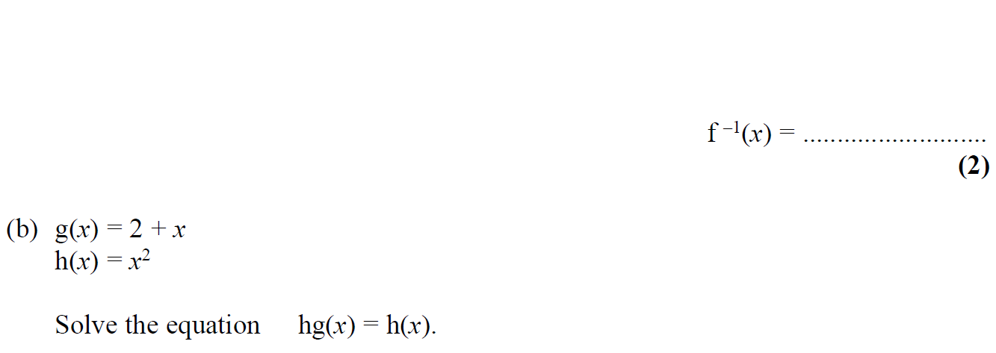
Functions
Nov 2010 3H Q21

Slide 49
Functions
Nov 2010 3H Q21
A
B

Slide 50
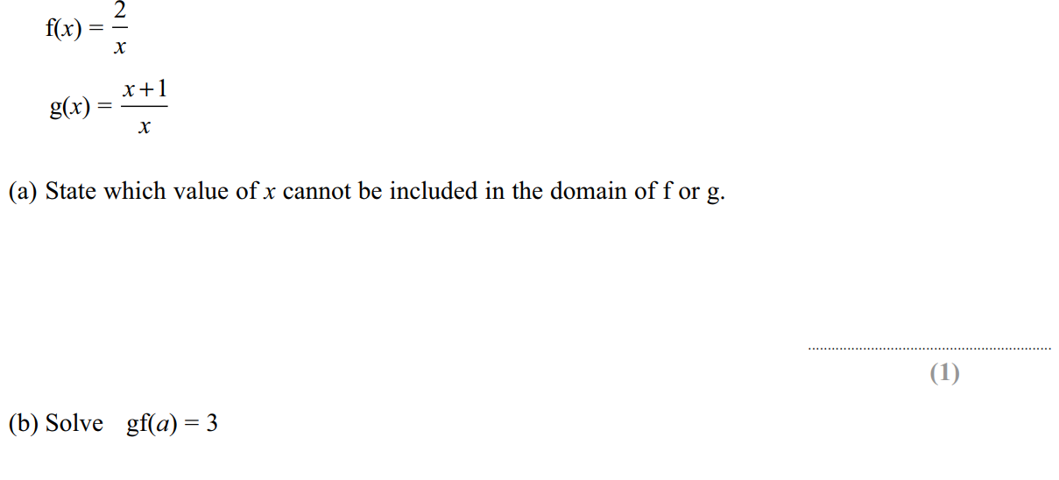
Functions
June 2011 4H Q20

Slide 51
Functions
June 2011 4H Q20
A
B
C

Slide 52
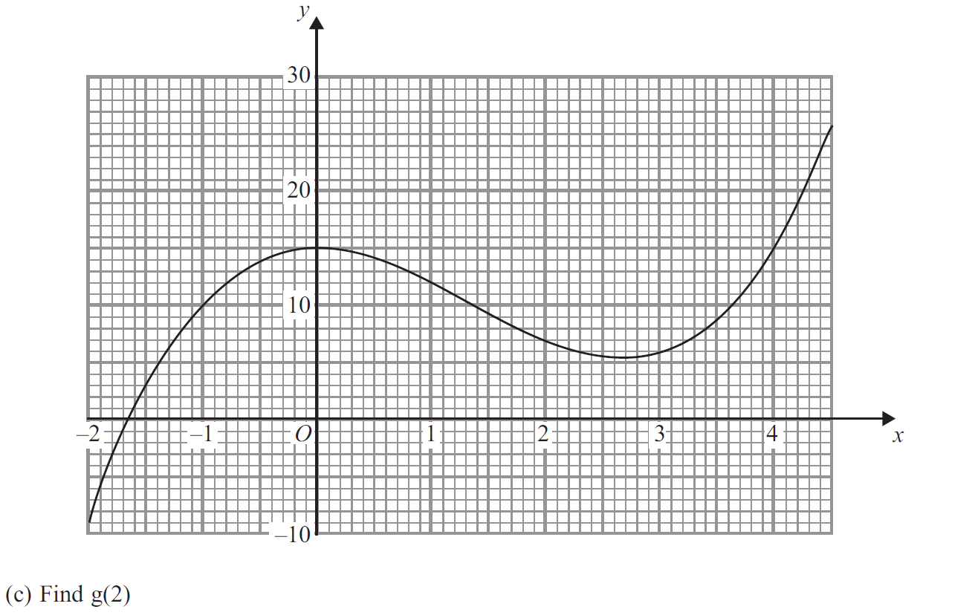
Functions
Jan 2012 4H Q17

Slide 53
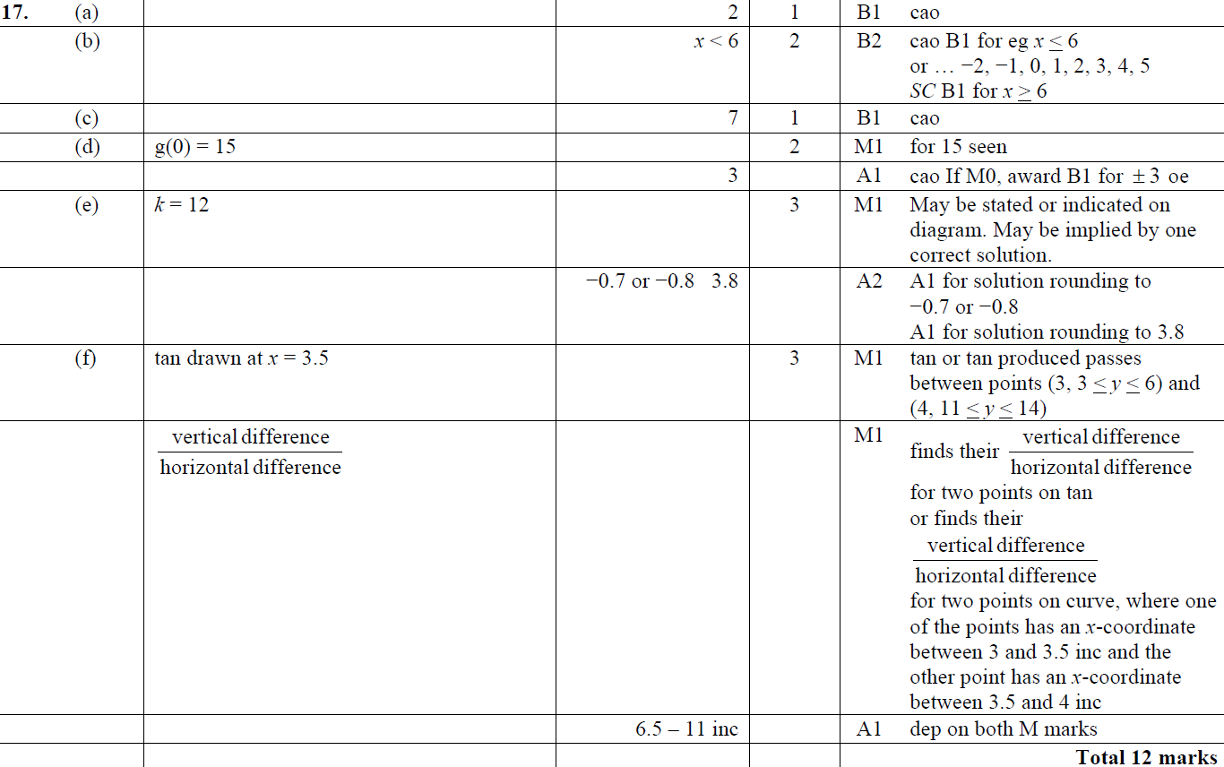
Functions
Jan 2012 4H Q17
A
B
C
D
E
F

Slide 54
Functions
May 2012 4H Q19

Slide 55
Functions
May 2012 4H Q19
A
B

Slide 56
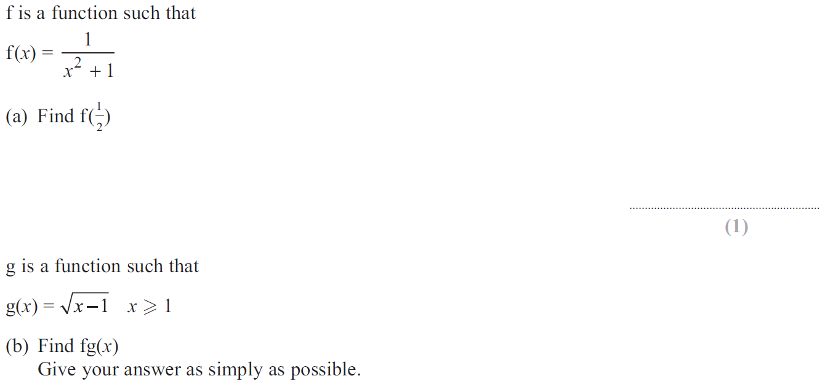
Functions
Jan 2013 4H Q23

Slide 57
Functions
Jan 2013 4H Q23
A
B

Slide 58
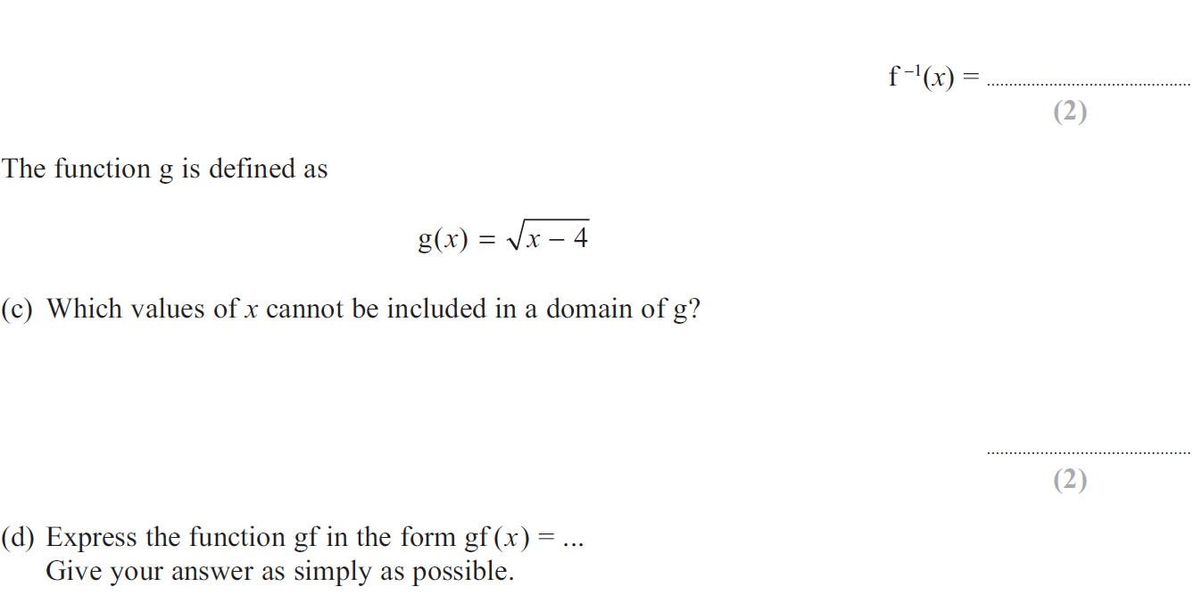
Functions
May 2013 4H Q17

Slide 59
Functions
May 2013 4H Q17
A
B
C
D

Slide 60
Functions
May 2013 4HR Q23

Slide 61
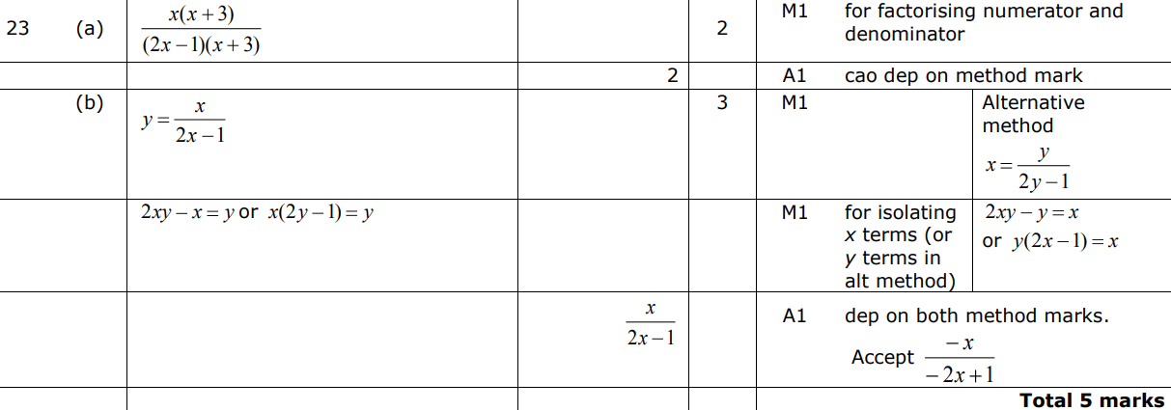
Functions
May 2013 4HR Q23
A
B

Slide 62
Functions
Jan 2014 3H Q20

Slide 63
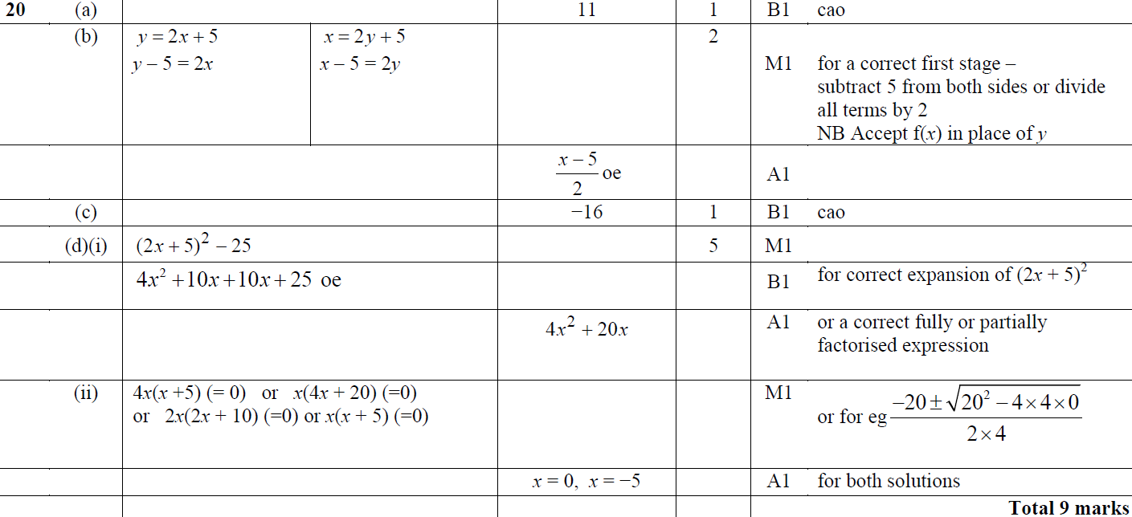
Functions
Jan 2014 3H Q20
A
B
C
D (i)
D (ii)

Slide 64
Functions
Jan 2014 3HR Q22

Slide 65
Functions
Jan 2014 3HR Q22
A
B

Slide 66
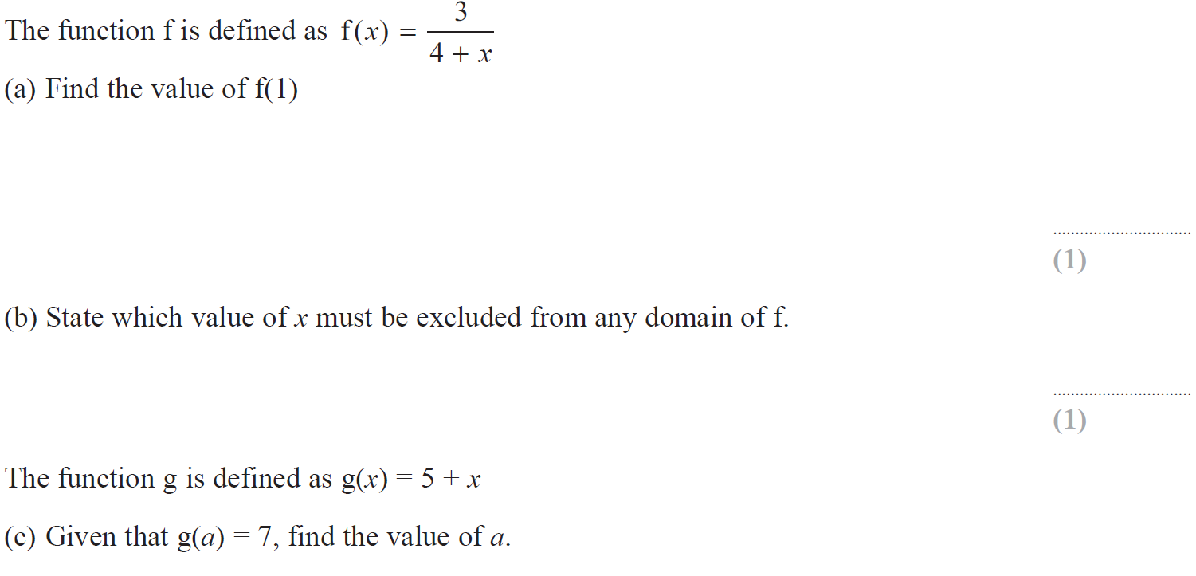
Functions
May 2014 3H Q21

Slide 67
Functions
May 2014 3H Q21
A
B
C
D
E

Slide 68
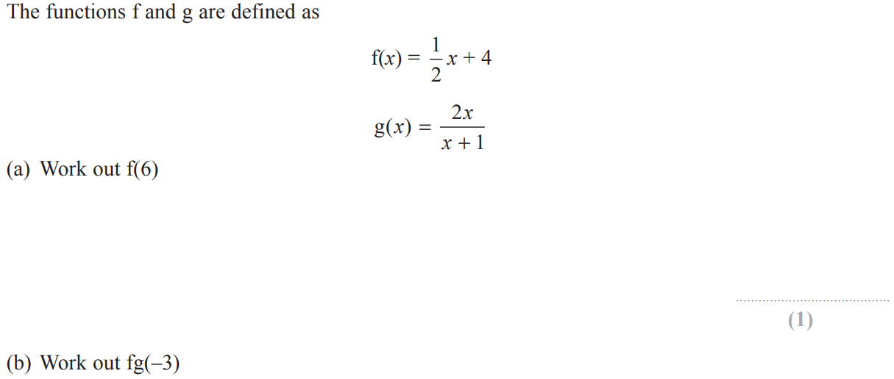
Functions
May 2014 3HR Q11

Slide 69
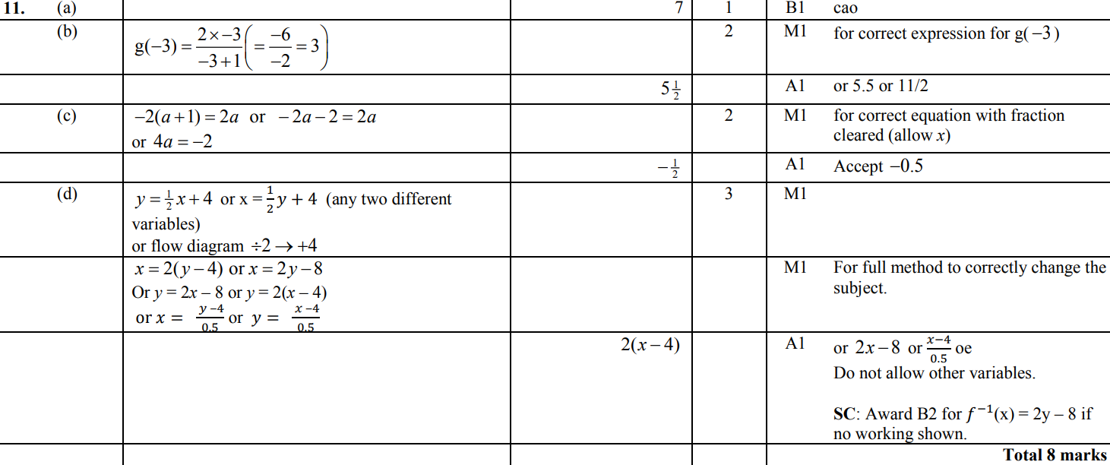
Functions
May 2014 3HR Q11
A
B
C
D

Slide 70
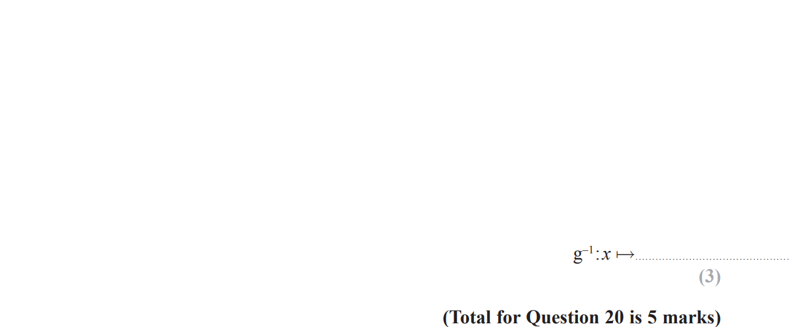
Functions
Jan 2015 3H Q20

Slide 71
Functions
Jan 2015 3H Q20
A
B

Slide 72
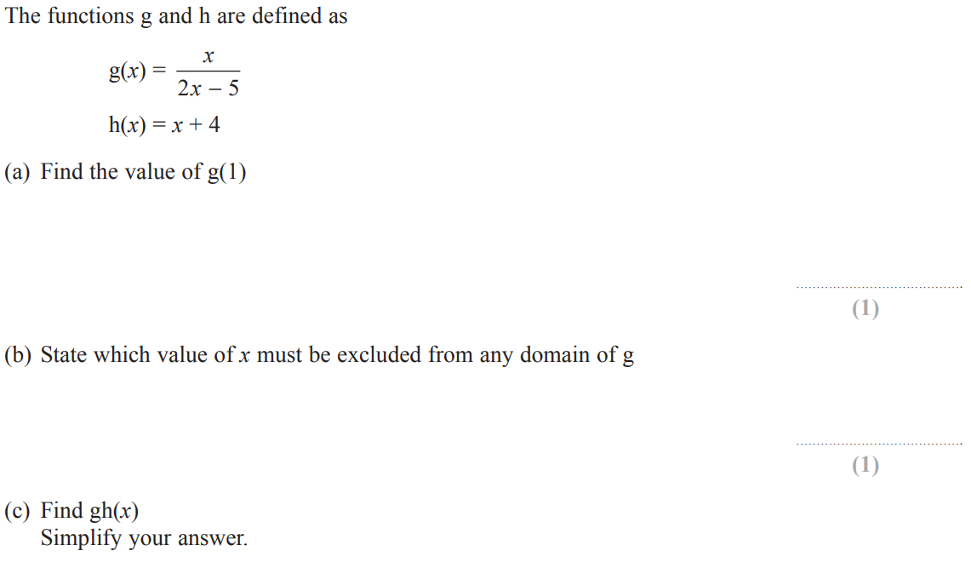
Functions
Jan 2015 3HR Q21

Slide 73
Functions
Jan 2015 3HR Q21
A
B
C
D

Slide 74
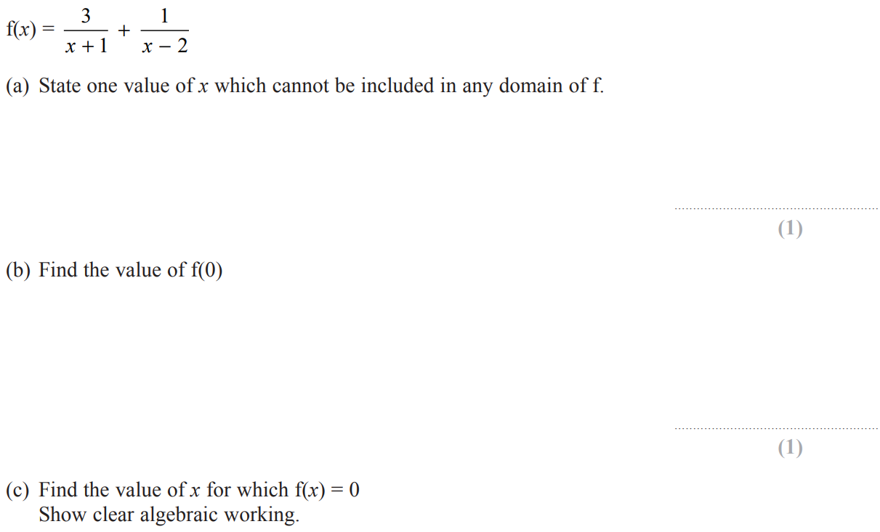
Functions
May 2015 3H Q17

Slide 75
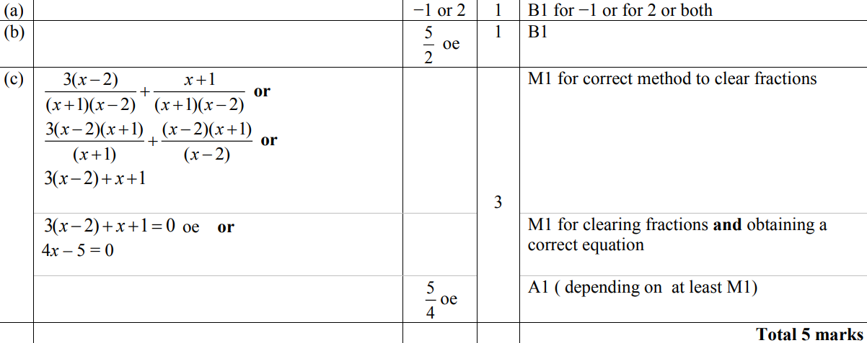
Functions
May 2015 3H Q17
A
B
C

Slide 76
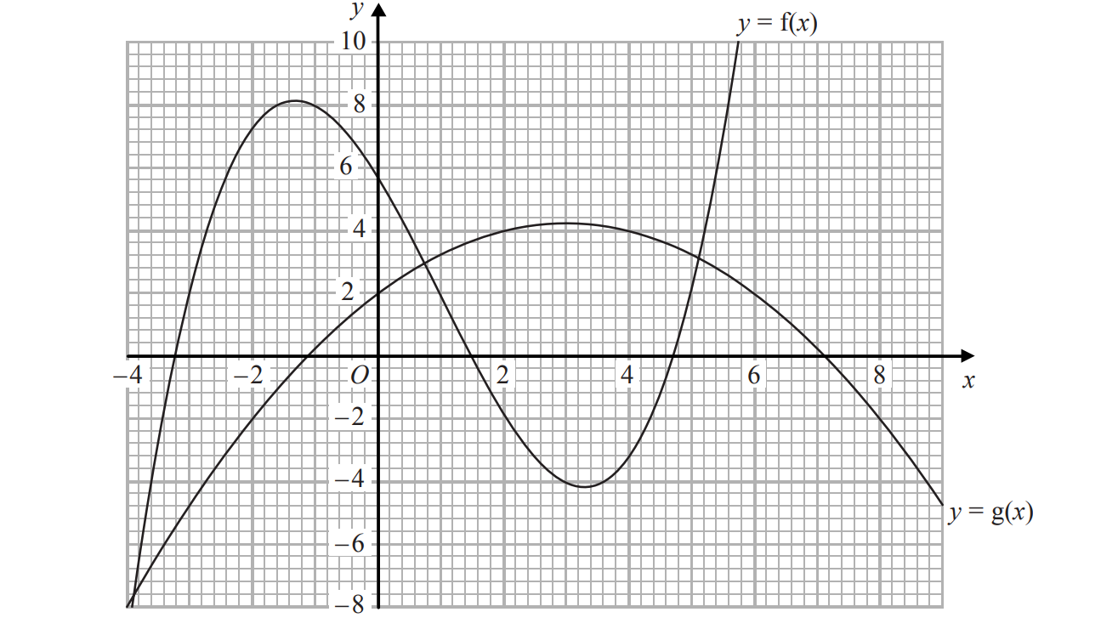
Functions
May 2015 3HR Q20

Slide 77
Functions
May 2015 3HR Q20
A
B
C

Slide 78
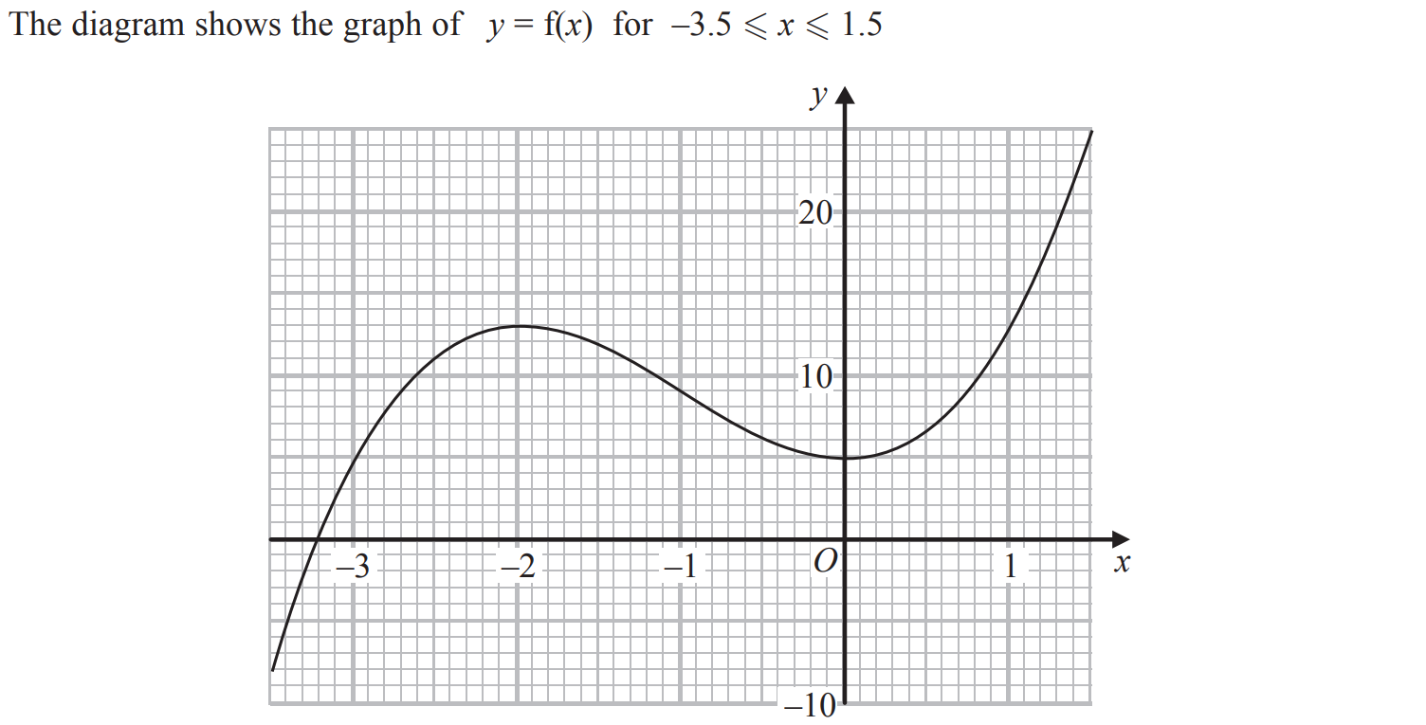
Functions
Jan 2016 3H Q15

Slide 79
Functions
Jan 2016 3H Q15
A
B
C
D
E

Slide 80
Functions
Jan 2016 3HR Q16

Slide 81
Functions
Jan 2016 3HR Q16
A
B
C
D

Slide 82
Functions
June 2016 4H Q17

Slide 83
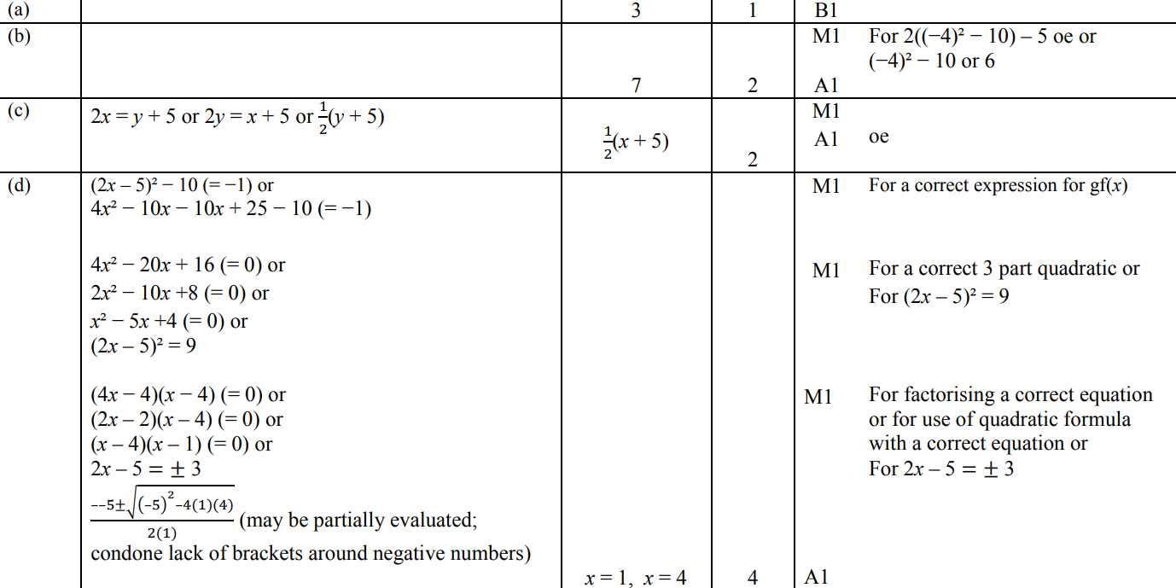
Functions
June 2016 4H Q17
A
B
C
D

Slide 84
Functions
May 2016 3HR Q18

Slide 85
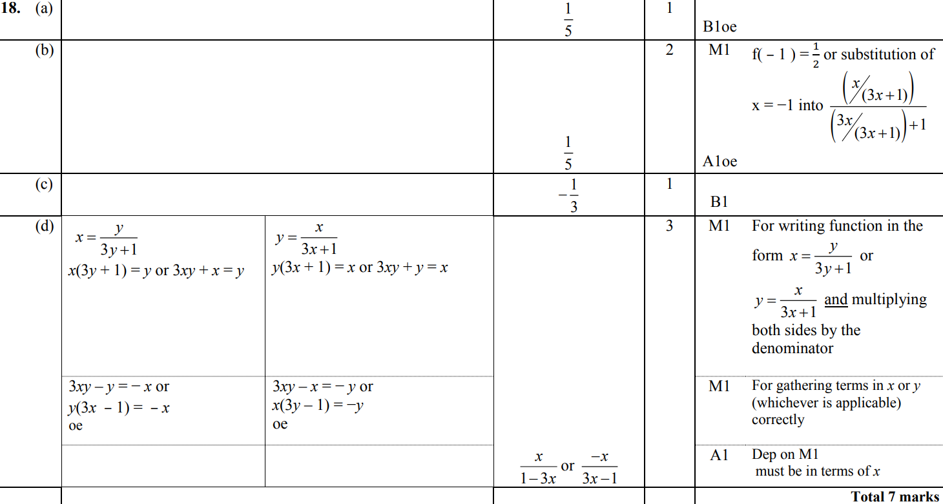
Functions
May 2016 3HR Q18
A
B
C
D

Slide 86
Functions
Jan 2017 4H Q18

Slide 87
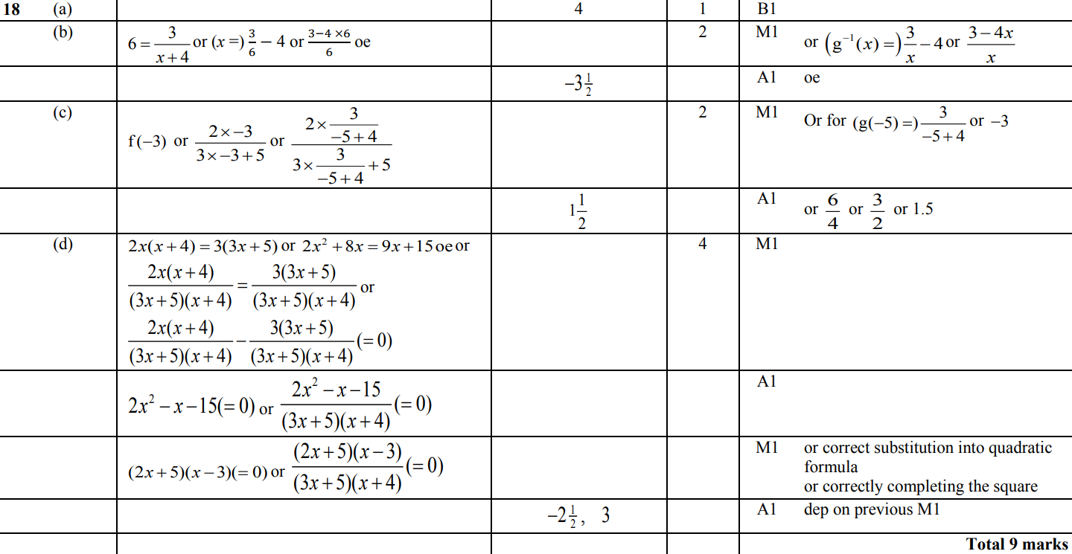
Functions
Jan 2017 4H Q18
A
B
C
D

Slide 88
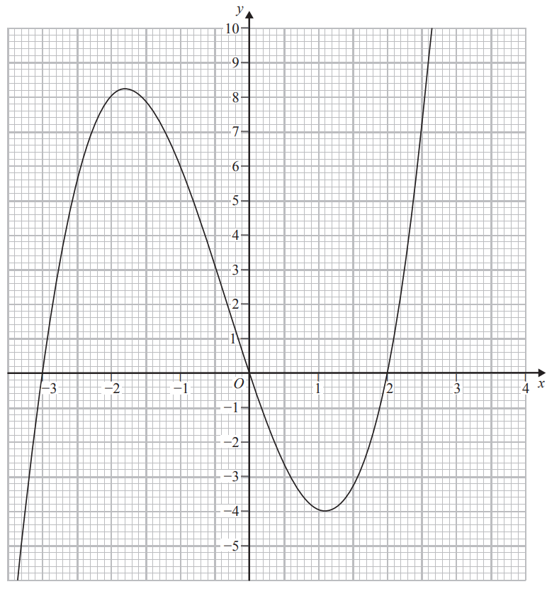
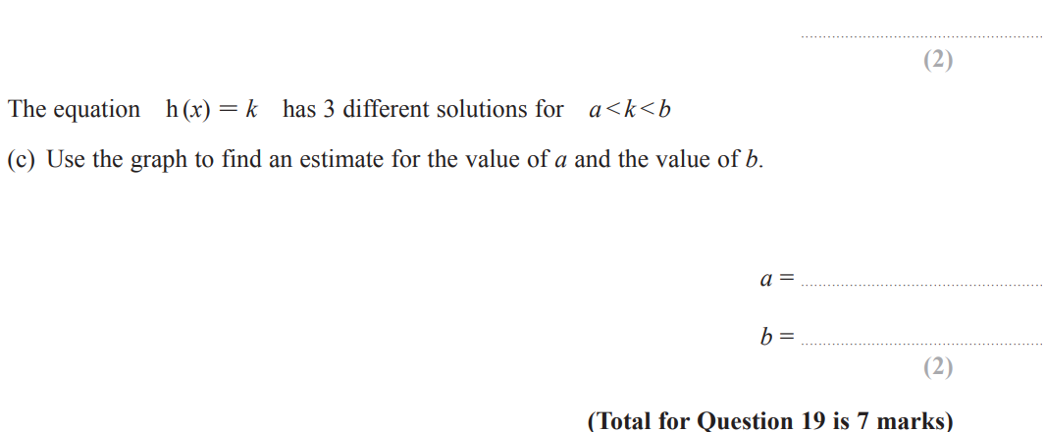
Functions
Jan 2017 4H Q19

Slide 89
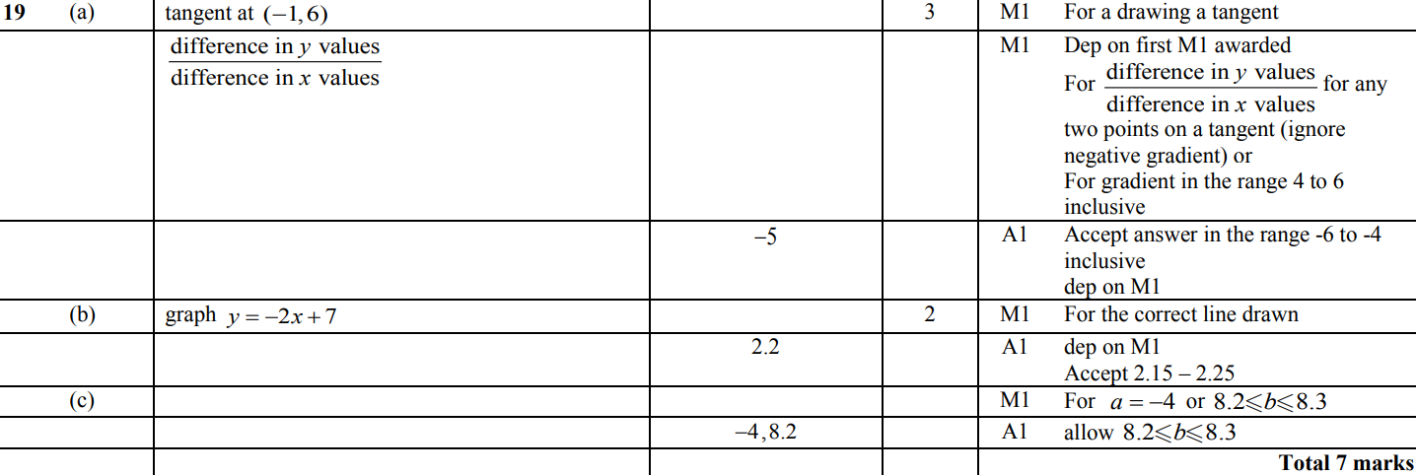
Functions
Jan 2017 4H Q19
A
B
C

Slide 90
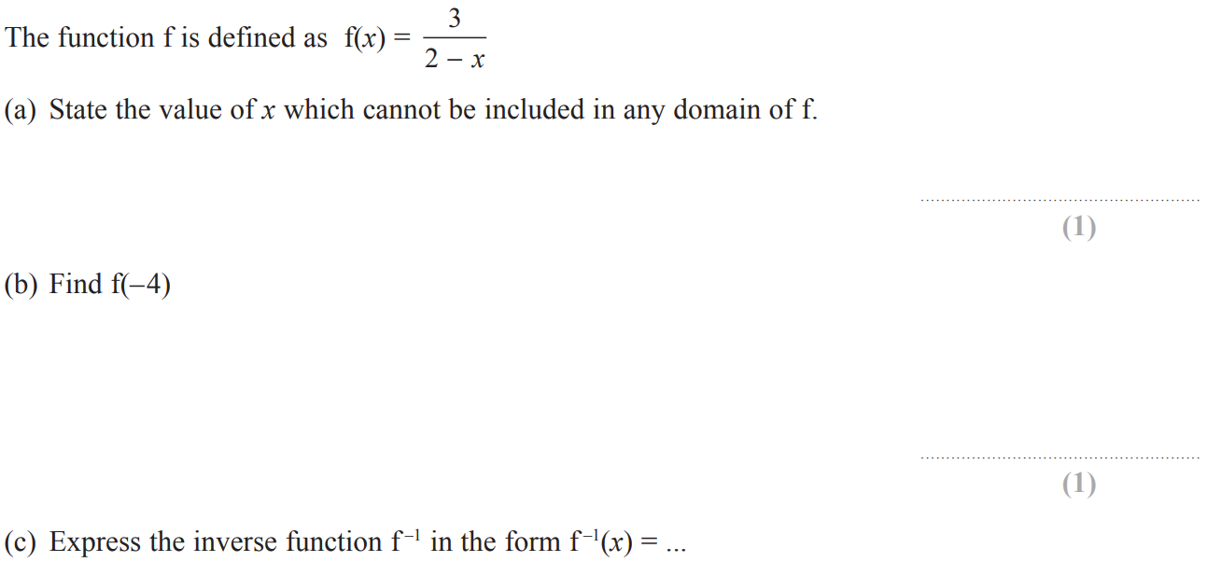
Functions
Jan 2017 3HR Q19

Slide 91
Functions
Jan 2017 3HR Q19
A
B
C
D

Slide 92
Functions
May 2017 3H Q19

Slide 93
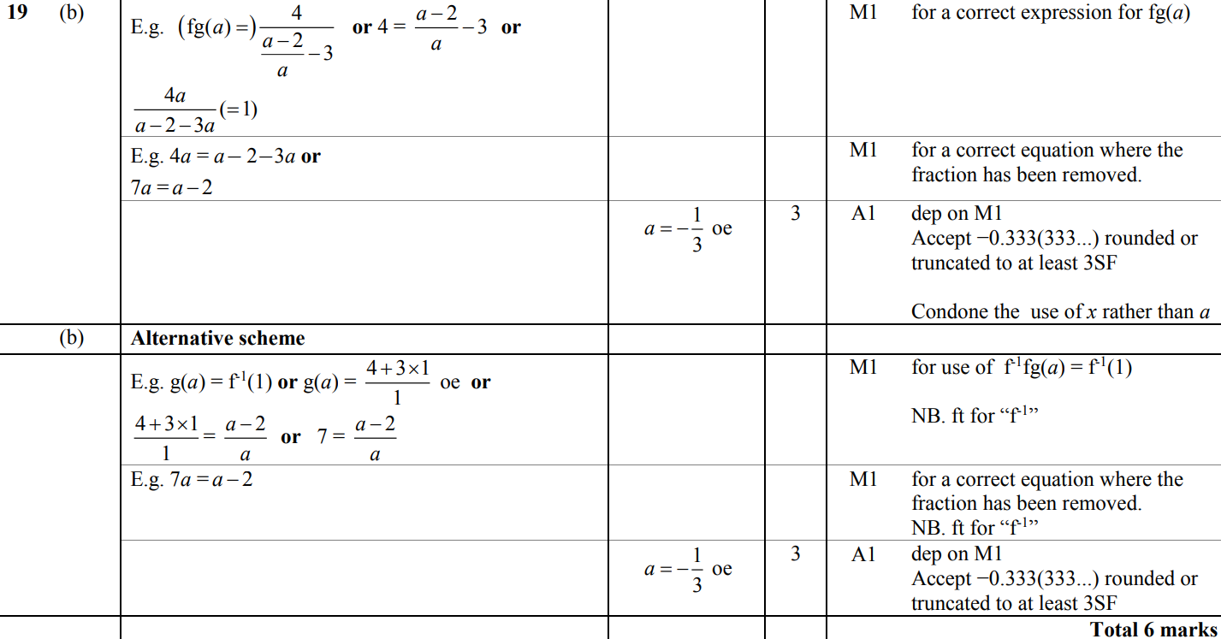
Functions
May 2017 3H Q19
A
B

Slide 94
Functions
June 2017 4HR Q20

Slide 95
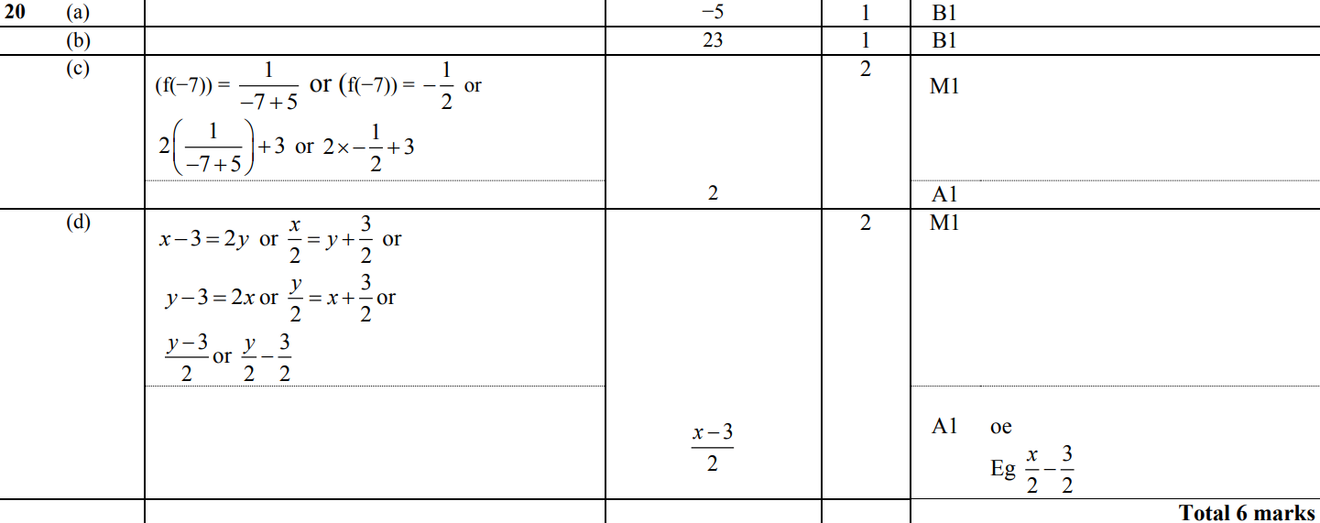
Functions
June 2017 4HR Q20
A
B
C
D

Slide 96
Functions
Jan 2018 3H Q23

Slide 97
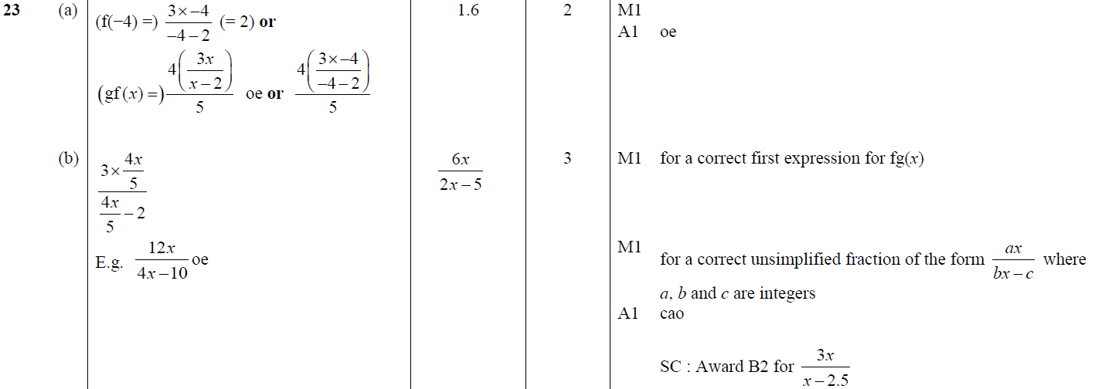
Functions
Jan 2018 3H Q23
A
B
C

Slide 98
Functions
Jan 2018 3HR Q23

Slide 99
Functions
Jan 2018 3HR Q23
A
B
C

Slide 100
Functions
May 2018 3H Q21

Slide 101
Functions
May 2018 3H Q21
A
B
C

Slide 102
Functions
May 2018 3HR Q23

Slide 103
Functions
May 2018 3HR Q23
A
B
C

