Slide 1
Frequency Polygons
Frequency Polygons
Nov 2018 3H Q6
1 Marker

Slide 2
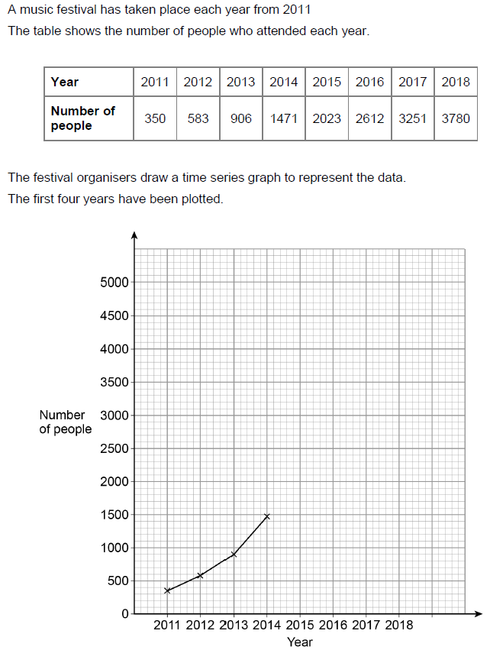
Frequency Polygons
Nov 2018 3H Q6
Reveal Graph

Slide 3
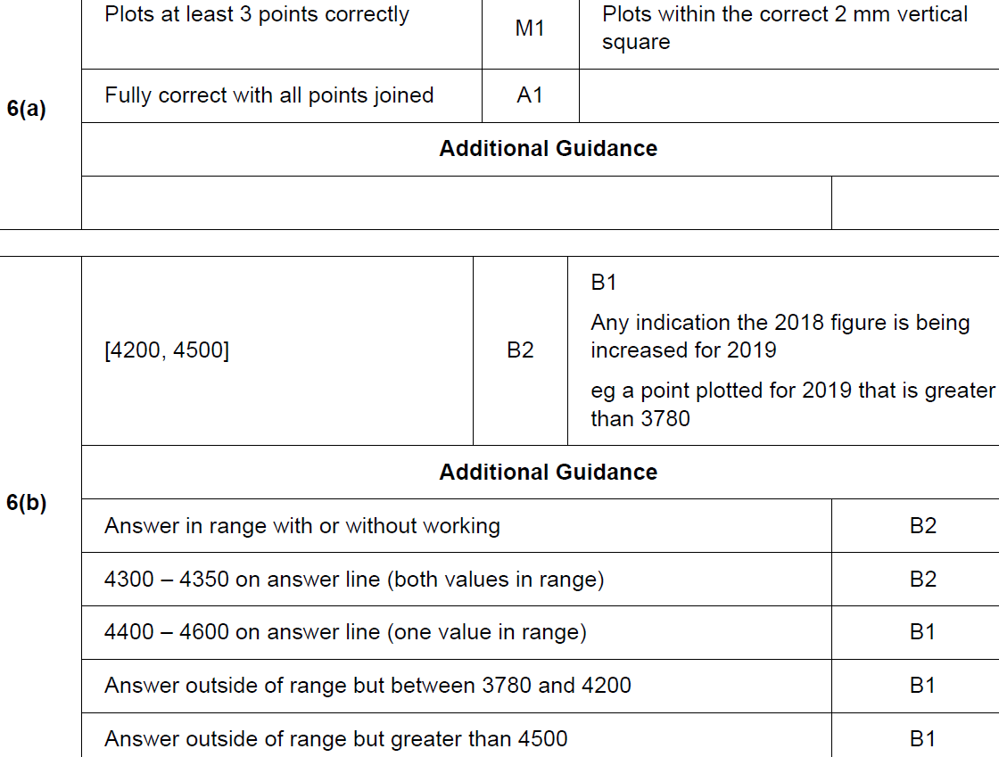
Frequency Polygons
Nov 2018 3H Q6
A
B

