Slide 1
Frequency Polygons
Frequency Polygons
Edexcel
Nov 2017
2H Q1
AQA
Spec 1
2H Q4
Nov 2018
3H Q7
OCR
June 2019
3H Q3

Slide 2
Frequency Polygons
Frequency Polygons
Edexcel
AQA
Nov 2018 3H Q6
1 Marker
OCR

Slide 3
Frequency Polygons
Frequency Polygons
Edexcel
May 2017
1H Q8
AQA
Nov 2018
2H Q8
OCR

Slide 4
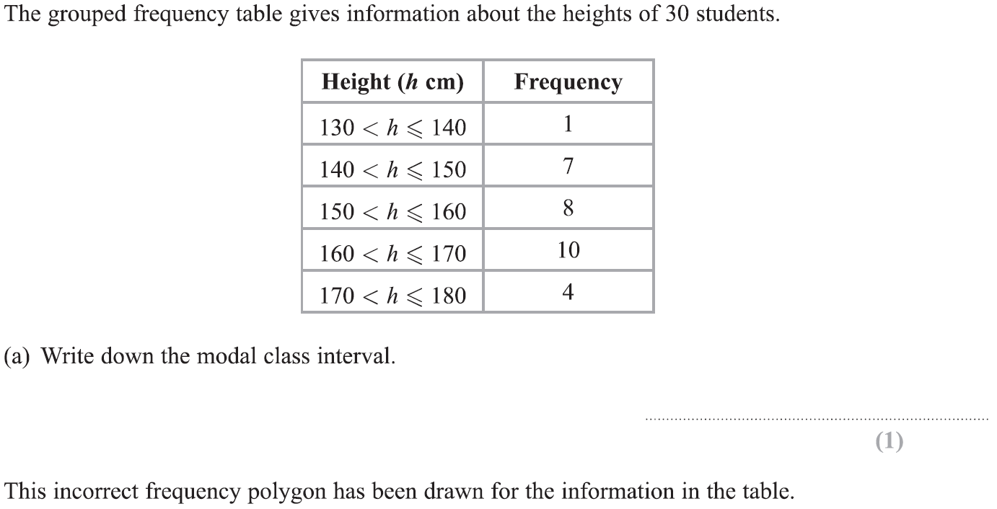
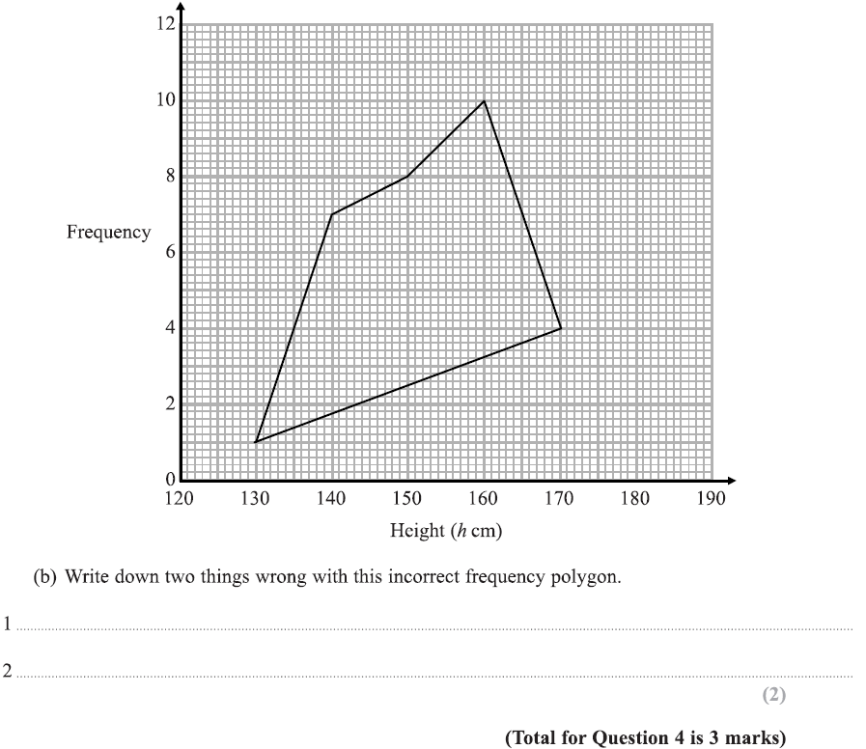
Frequency Polygons
Specimen Set 1 2H Q4

Slide 5
Frequency Polygons
Specimen Set 1 2H Q4
A
B

Slide 6
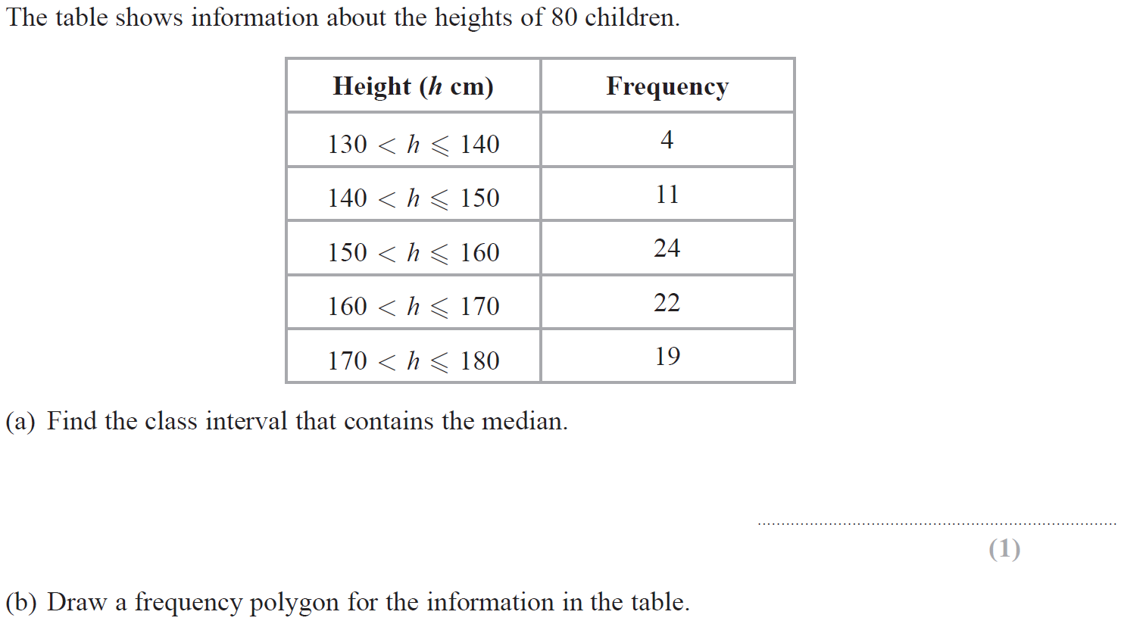
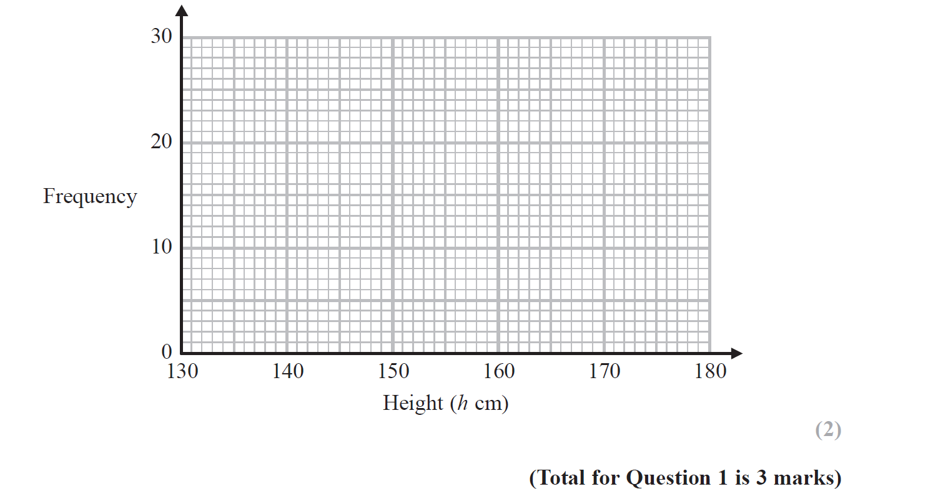
Frequency Polygons
Nov 2017 3H Q1
Reveal Graph (b)

Slide 7
Frequency Polygons
Nov 2017 3H Q1
A
B

Slide 8
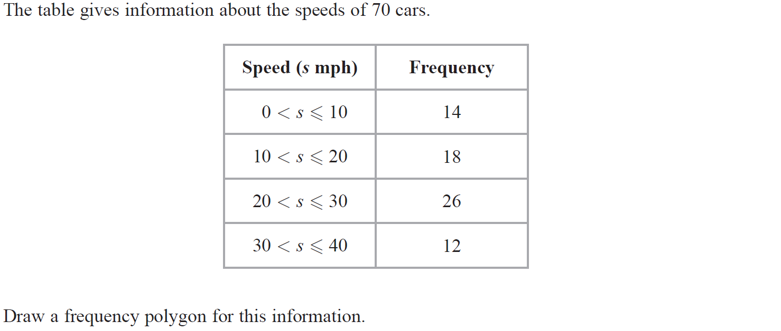
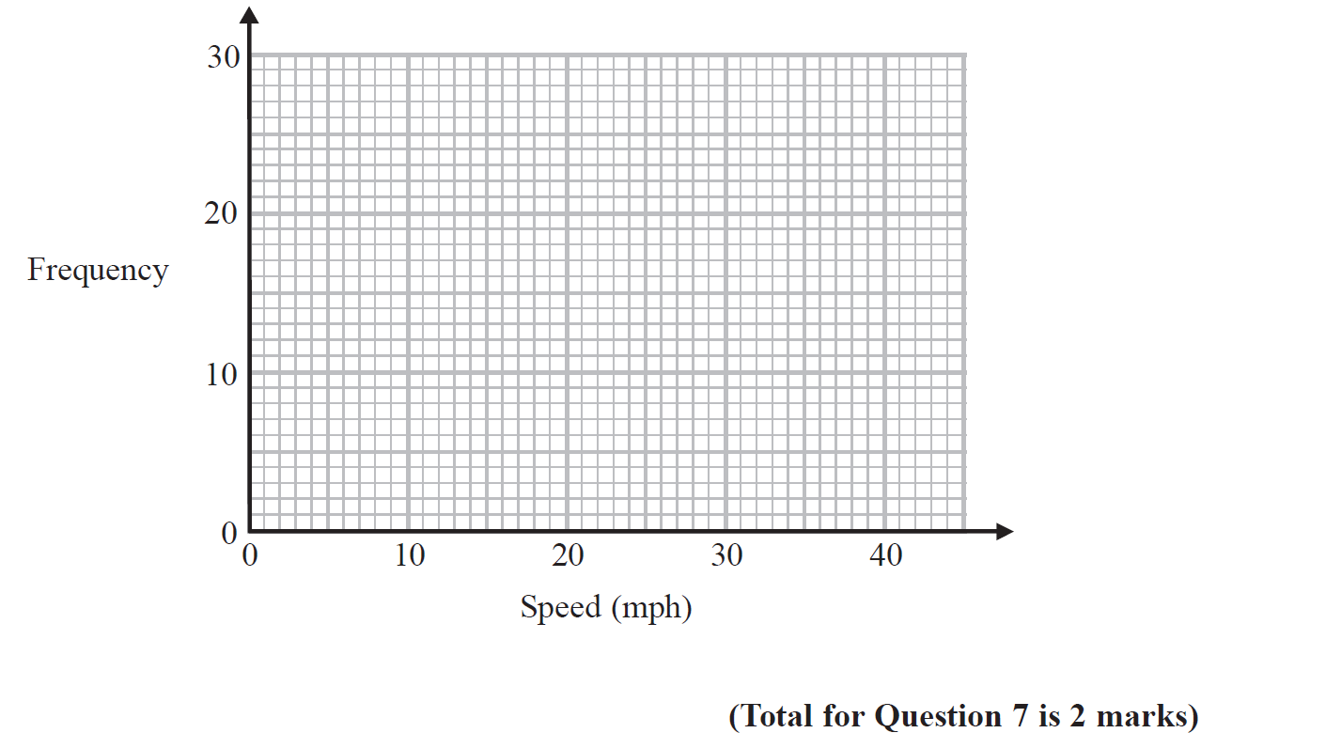
Frequency Polygons
Nov 2018 3H Q7
Reveal Graph

Slide 9
Frequency Polygons
Nov 2018 3H Q7
A

Slide 10
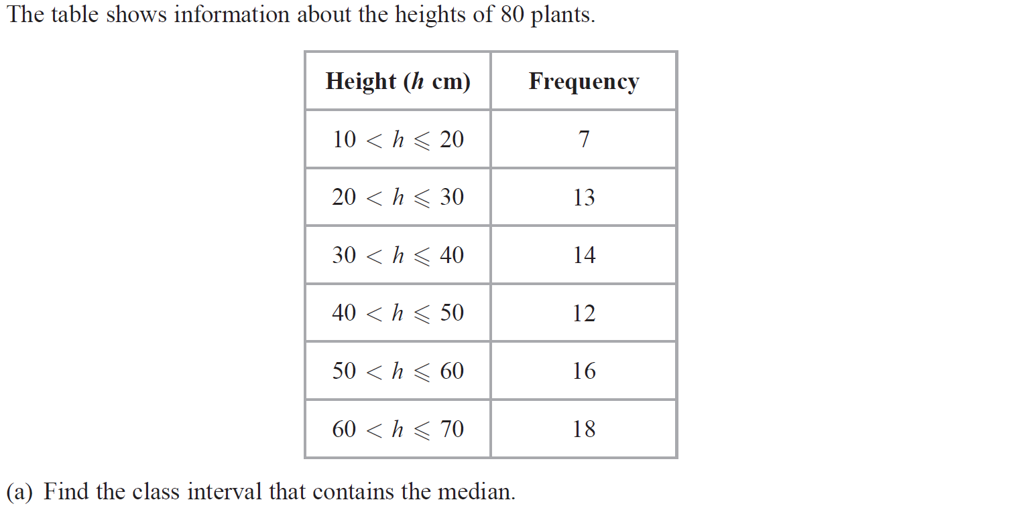
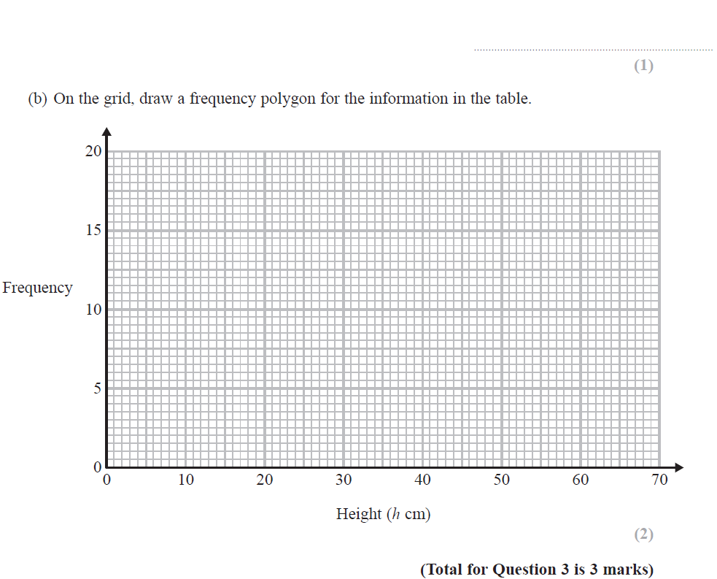
Frequency Polygons
June 2019 3H Q3

Slide 11
Frequency Polygons
June 2019 3H Q3
A
B
A SF
B SF

Slide 12
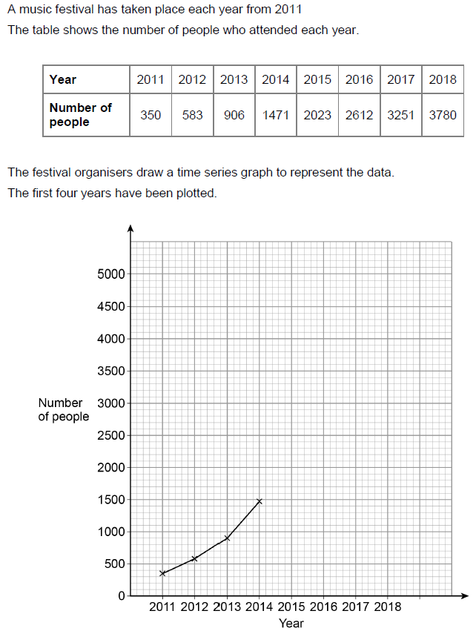
Frequency Polygons
Nov 2018 3H Q6
Reveal Graph

Slide 13
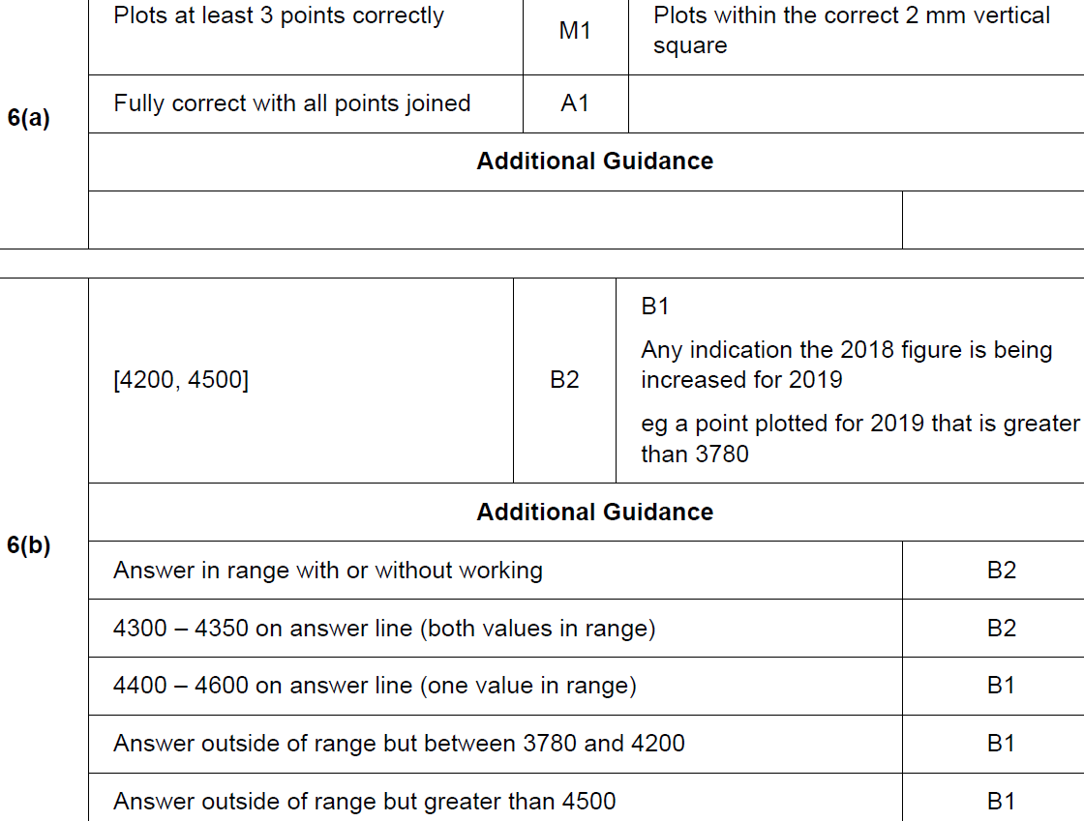
Frequency Polygons
Nov 2018 3H Q6
A
B

Slide 14
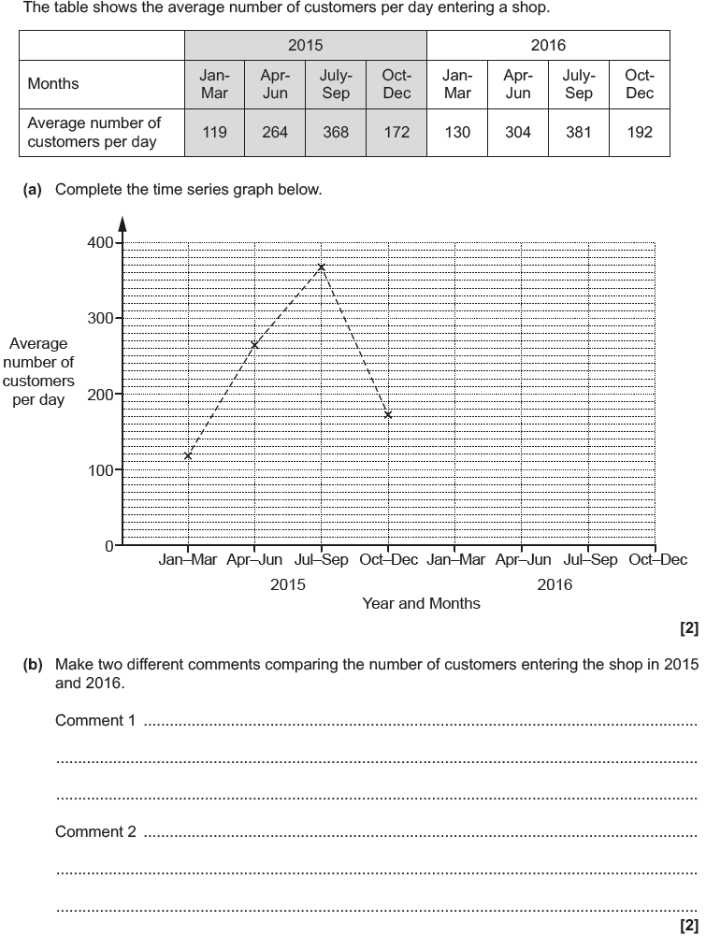
Frequency Polygons
May 2017 1H Q8
Reveal Graph

Slide 15
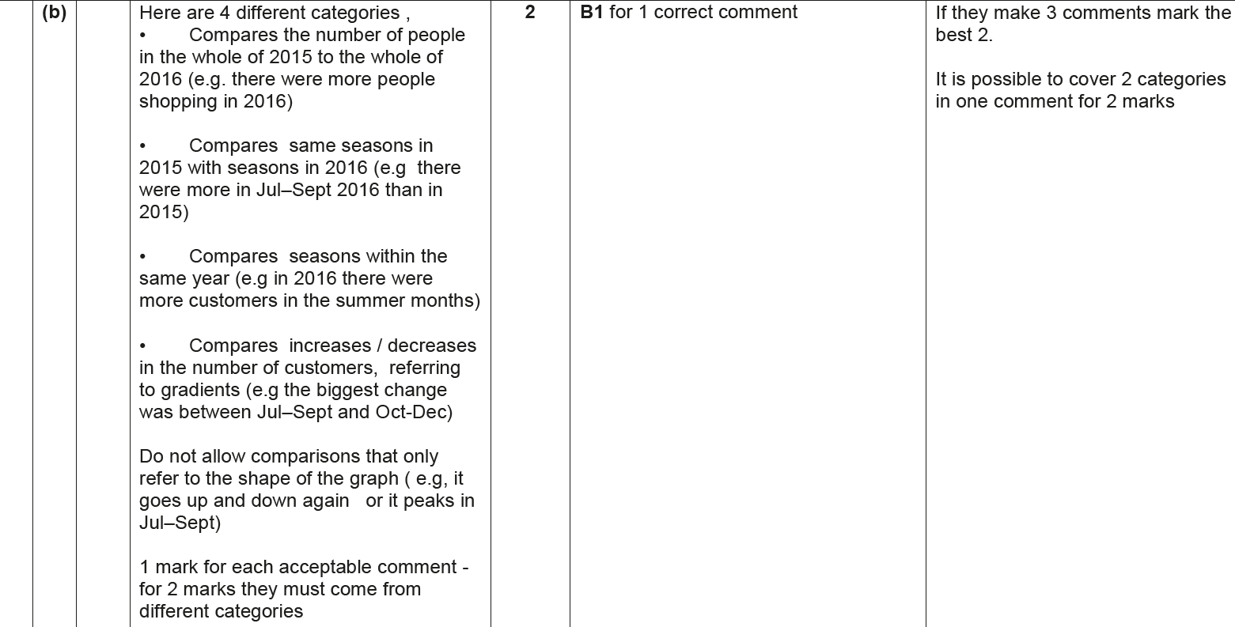
Frequency Polygons
May 2017 1H Q8
A
B

Slide 16
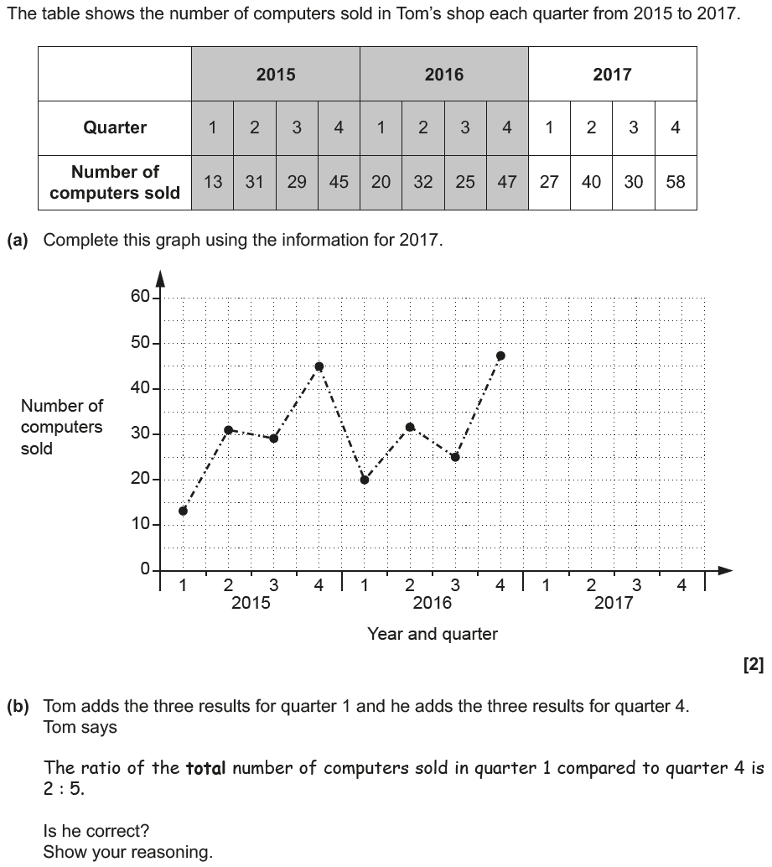
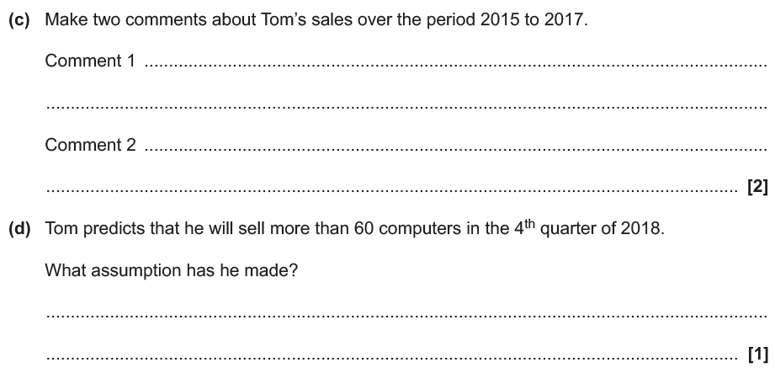
Frequency Polygons
Nov 2018 2H Q8
Reveal Graph

Slide 17
Frequency Polygons
Nov 2018 2H Q8
A
B
C
D

Slide 18
Frequency Polygons
Nov 2018 2H Q8
B Exemplar responses

Slide 19
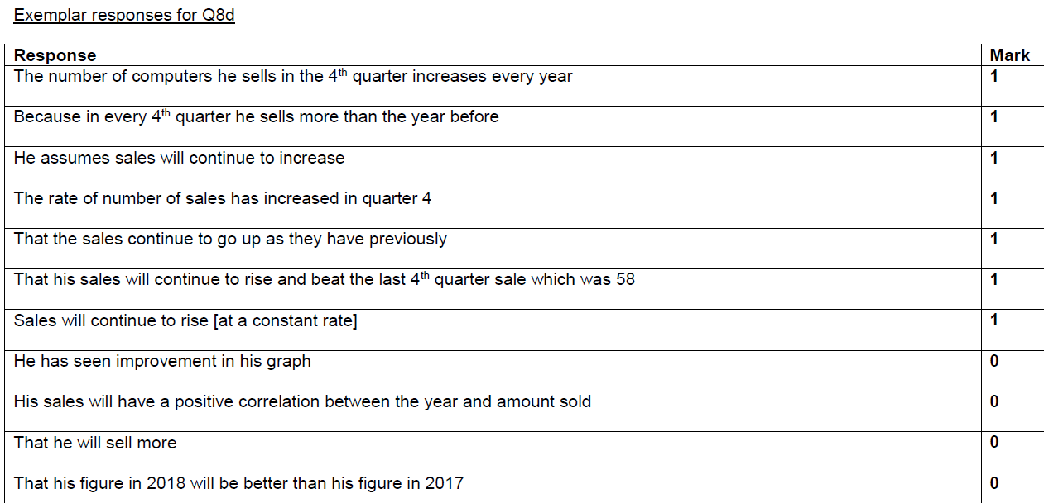
Frequency Polygons
Nov 2018 2H Q8
D Exemplar responses

