Slide 1
Frequency Polygons
Frequency Polygons
May 2017
1H Q8
Nov 2018
2H Q8

Slide 2
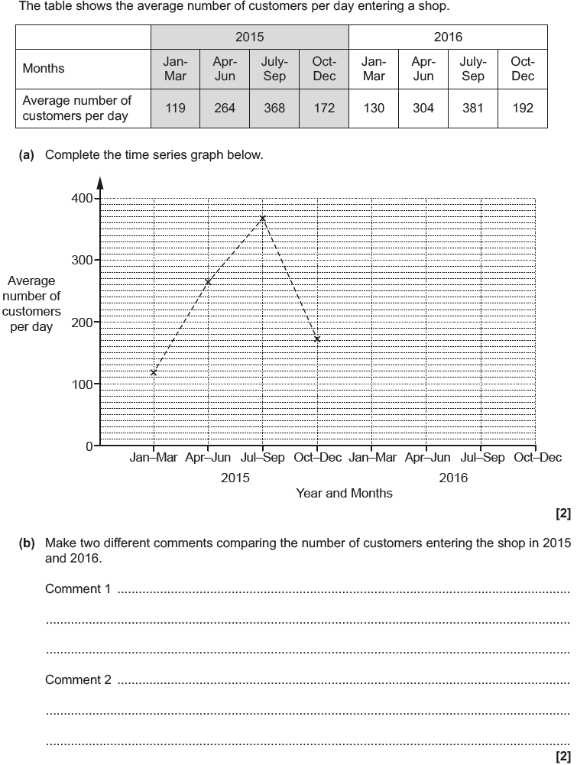
Frequency Polygons
May 2017 1H Q8
Reveal Graph

Slide 3
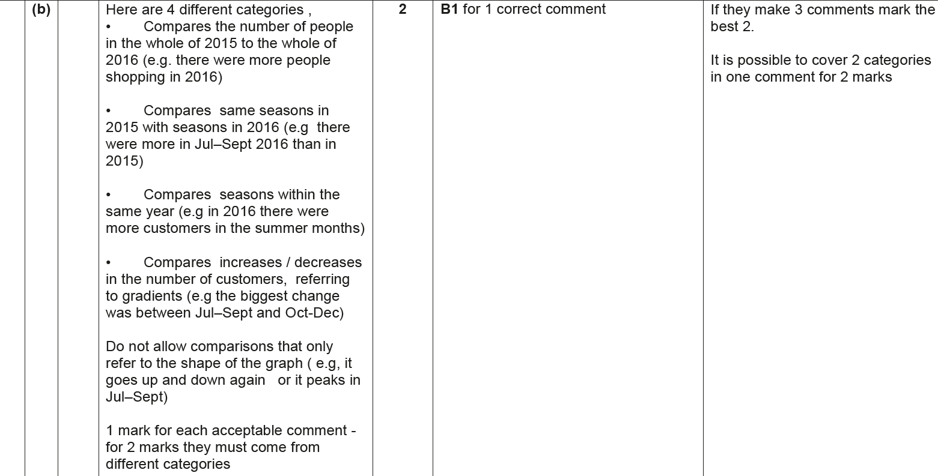
Frequency Polygons
May 2017 1H Q8
A
B

Slide 4
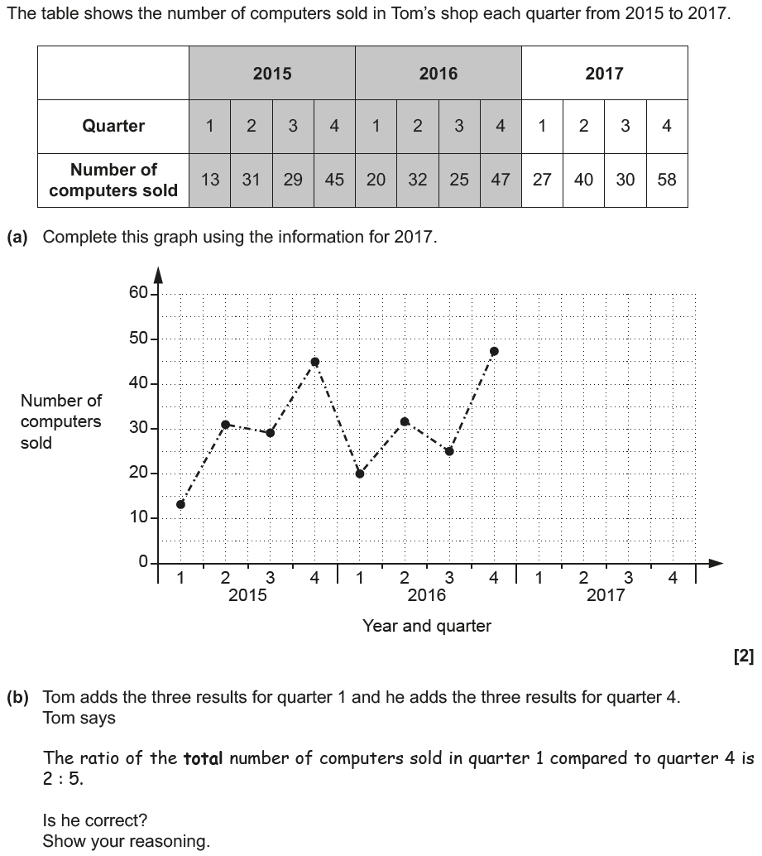
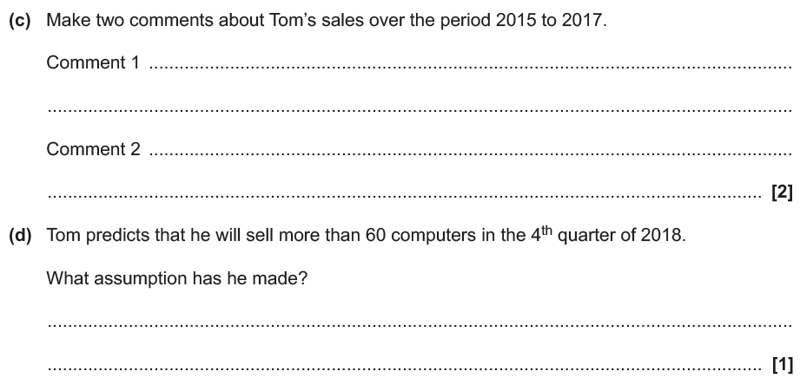
Frequency Polygons
Nov 2018 2H Q8
Reveal Graph

Slide 5
Frequency Polygons
Nov 2018 2H Q8
A
B
C
D

Slide 6
Frequency Polygons
Nov 2018 2H Q8
B Exemplar responses

Slide 7
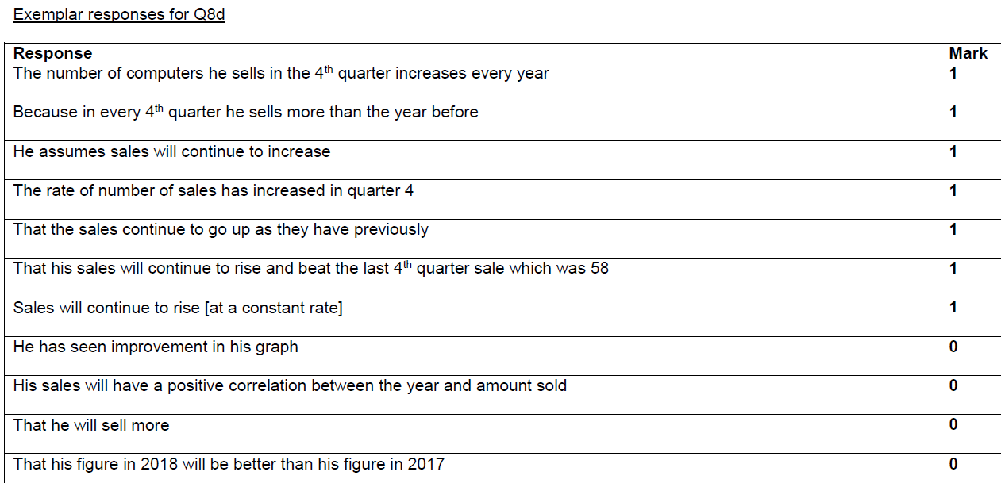
Frequency Polygons
Nov 2018 2H Q8
D Exemplar responses

