Slide 1
Frequency Polygons
Frequency Polygons
Nov 2017
2H Q1
Spec 1
2H Q4
Nov 2018
3H Q7
June 2019
3H Q3

Slide 2
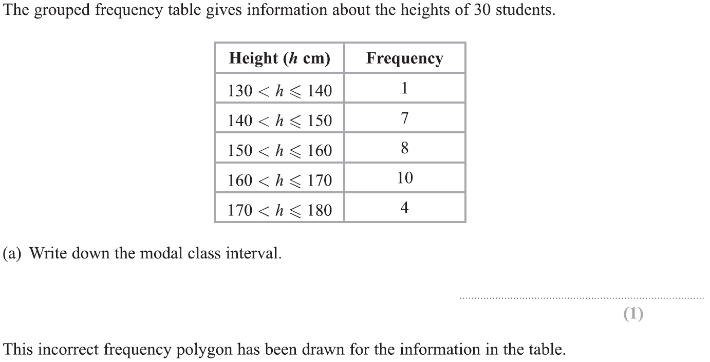
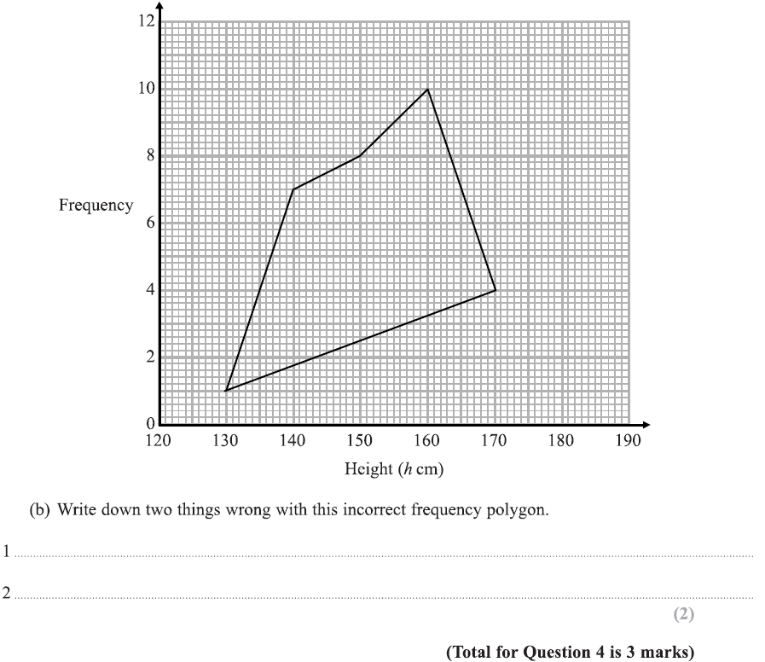
Frequency Polygons
Specimen Set 1 2H Q4

Slide 3
Frequency Polygons
Specimen Set 1 2H Q4
A
B

Slide 4
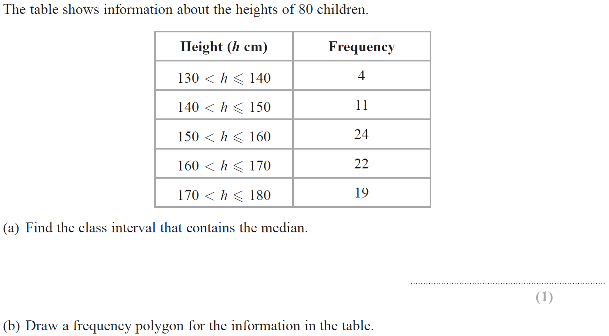
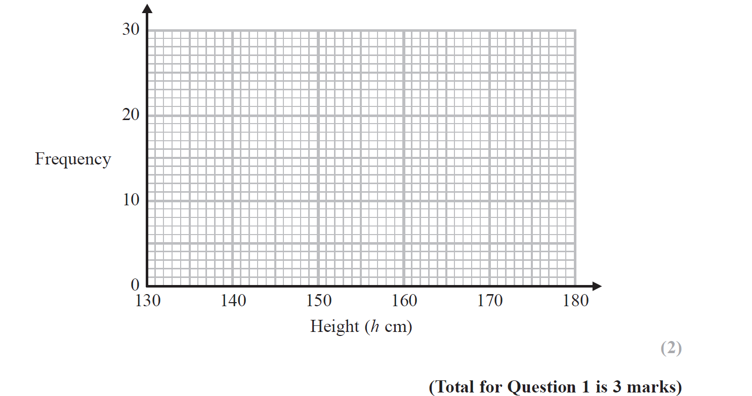
Frequency Polygons
Nov 2017 3H Q1
Reveal Graph (b)

Slide 5
Frequency Polygons
Nov 2017 3H Q1
A
B

Slide 6
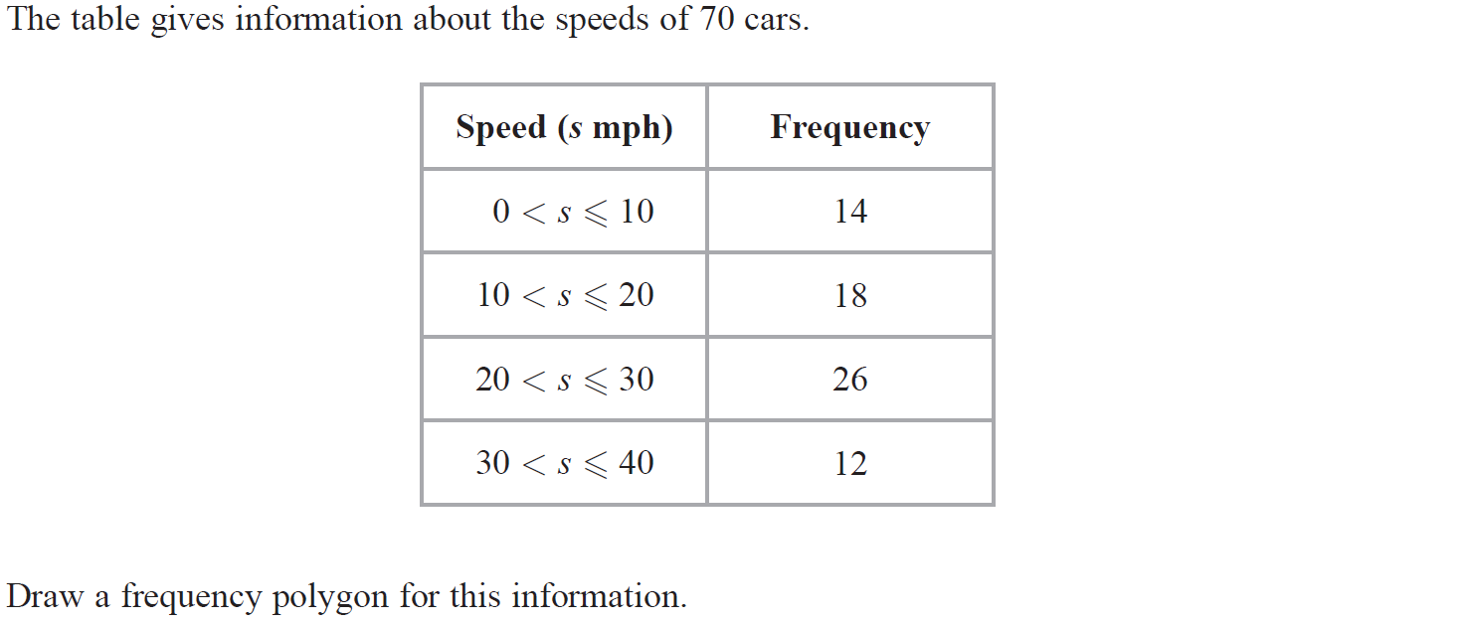
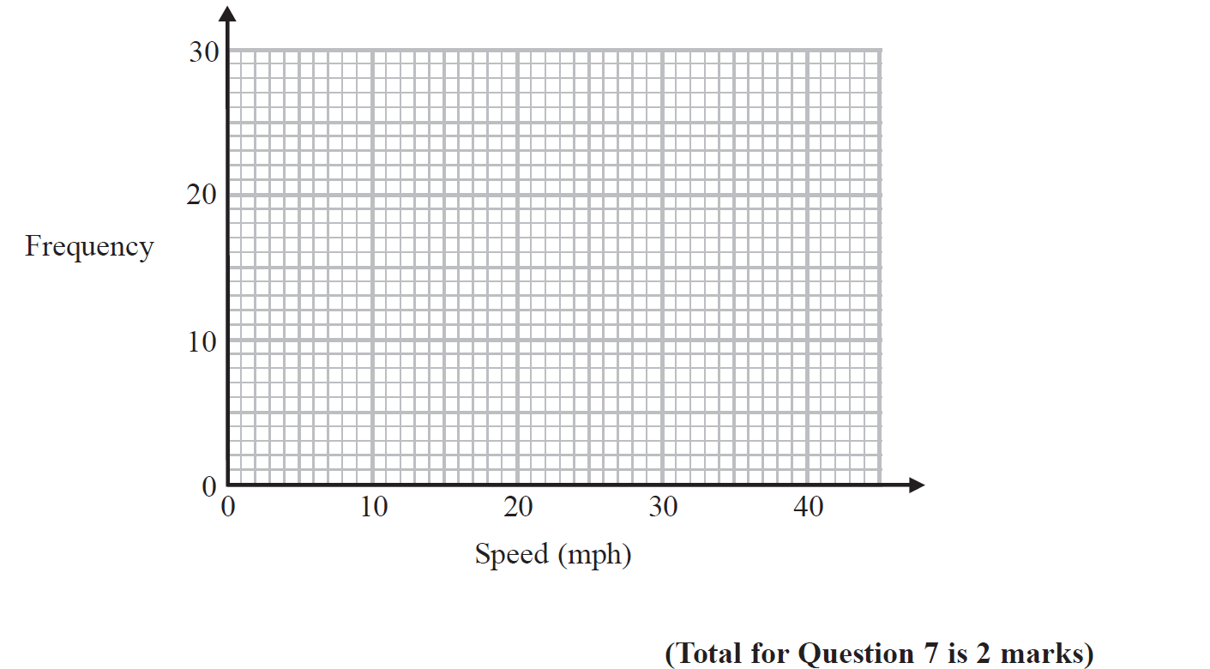
Frequency Polygons
Nov 2018 3H Q7
Reveal Graph

Slide 7
Frequency Polygons
Nov 2018 3H Q7
A

Slide 8
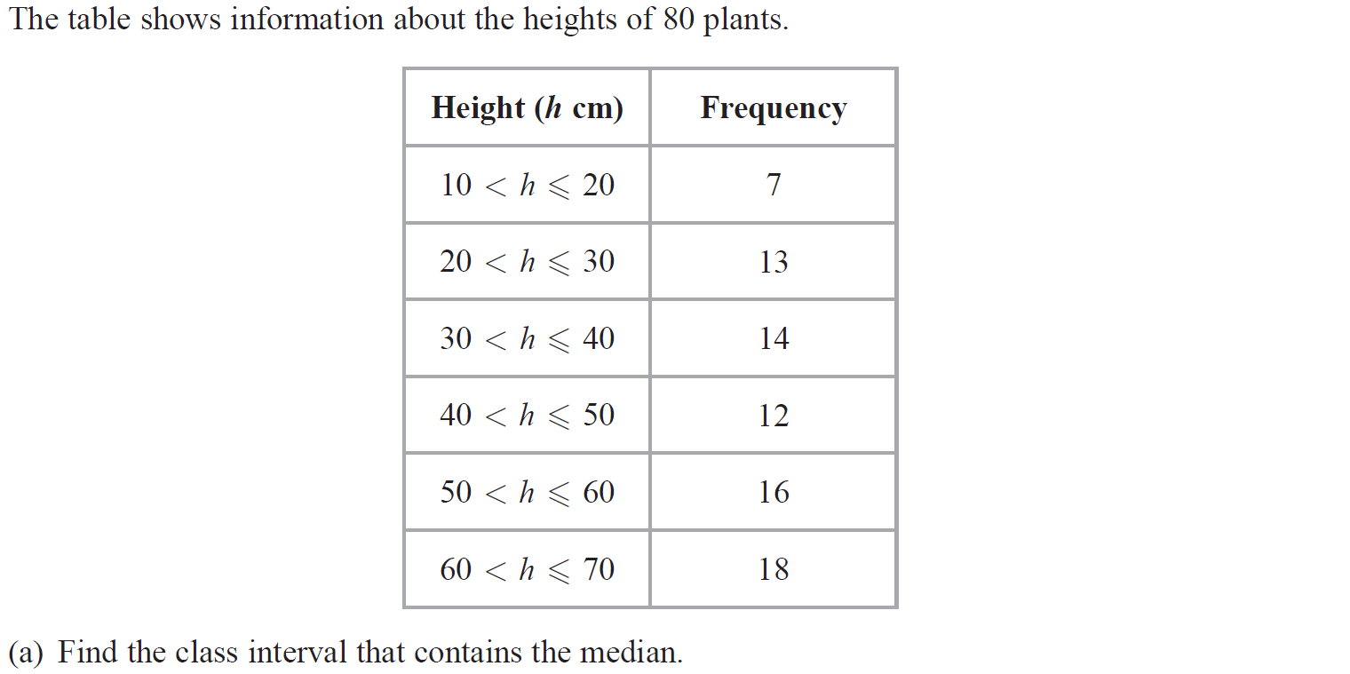
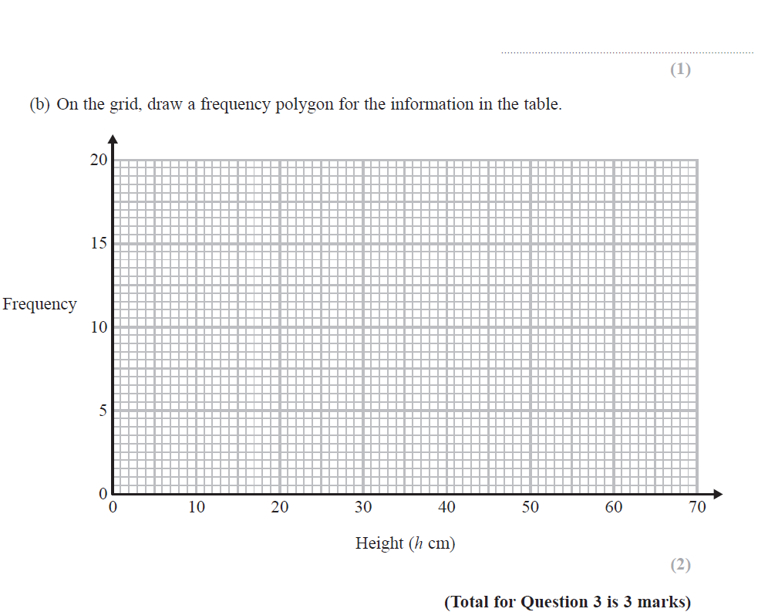
Frequency Polygons
June 2019 3H Q3

Slide 9
Frequency Polygons
June 2019 3H Q3
A
B
A SF
B SF

