Slide 1
Fractions
Fractions
Old Spec Q’s
SAM
1H Q4
June 2018
2HR Q3
SAM
2H Q10
Jan 2019
1HR Q1
May 2018
1H Q2
Jan 2019
1HR Q2
June 2018
2H Q4
May 2019
1H Q1
May 2018
1HR Q4
June 2019
2H Q5
May 2018
1HR Q13
Context

Slide 2
Fractions
SAM 1H Q4

Slide 3
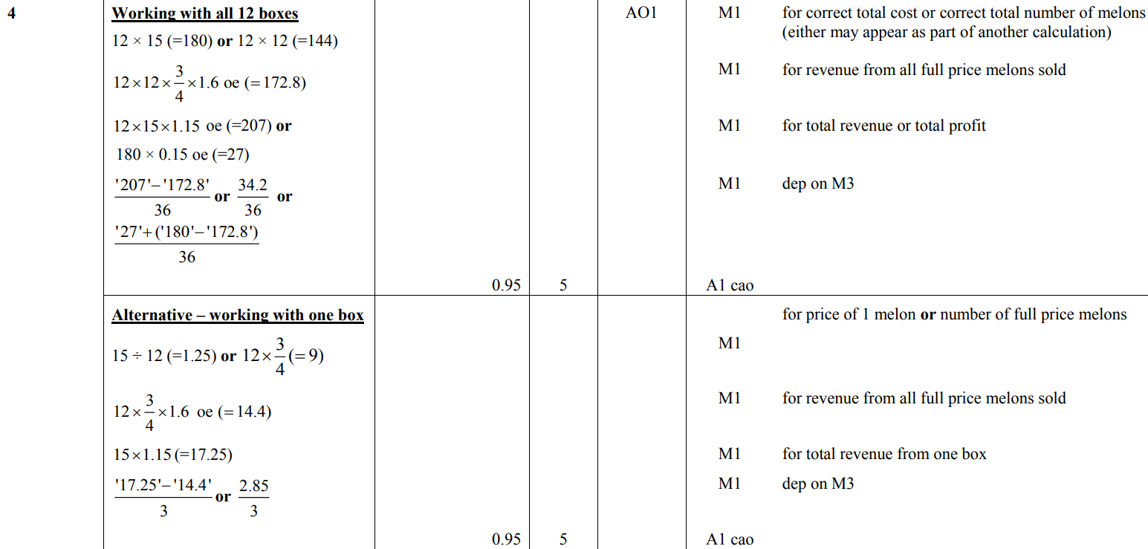
Fractions
SAM 1H Q4
A

Slide 4
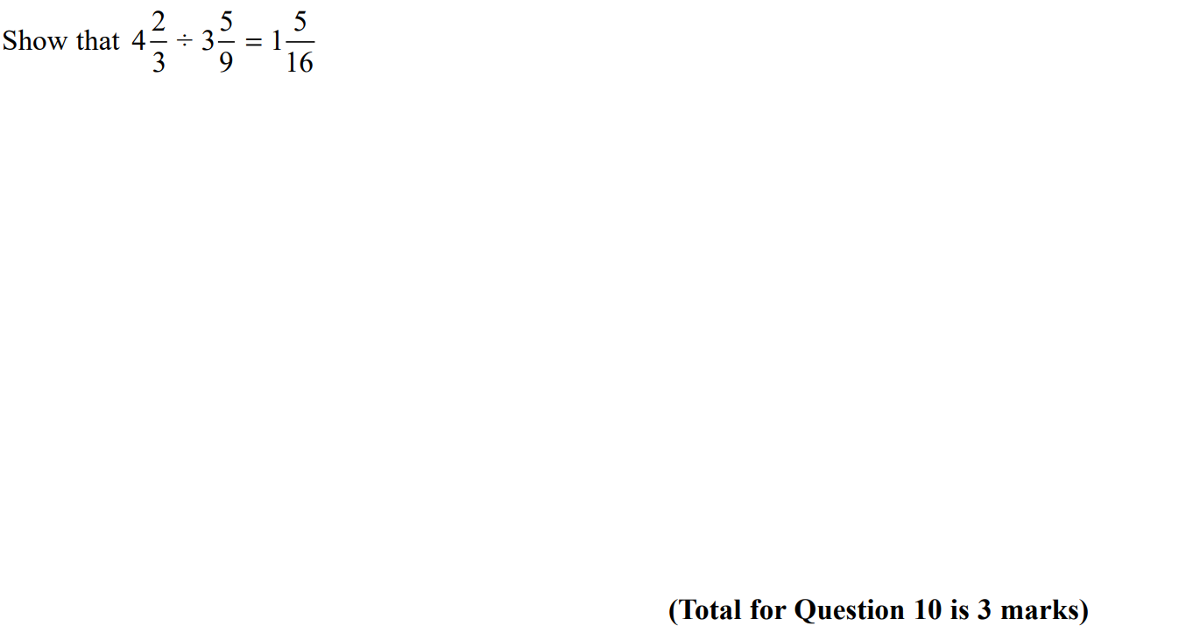
Fractions
SAM 2H Q10

Slide 5
Fractions
SAM 2H Q10
A

Slide 6
Fractions
May 2018 1H Q2

Slide 7
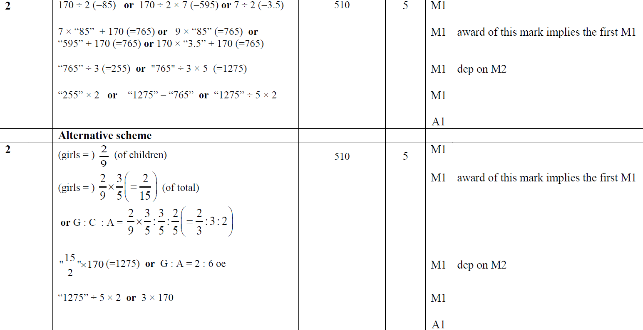
Fractions
May 2018 1H Q2
A

Slide 8
Fractions
June 2018 2H Q4

Slide 9
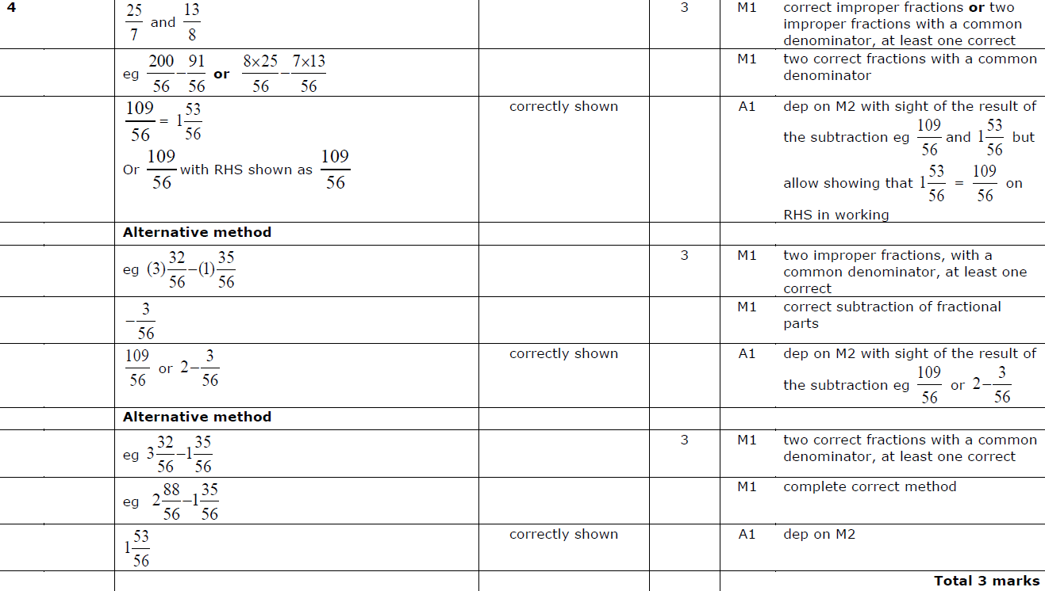
Fractions
June 2018 2H Q4
A

Slide 10
Fractions
May 2018 1HR Q4

Slide 11
Fractions
May 2018 1HR Q4
A

Slide 12
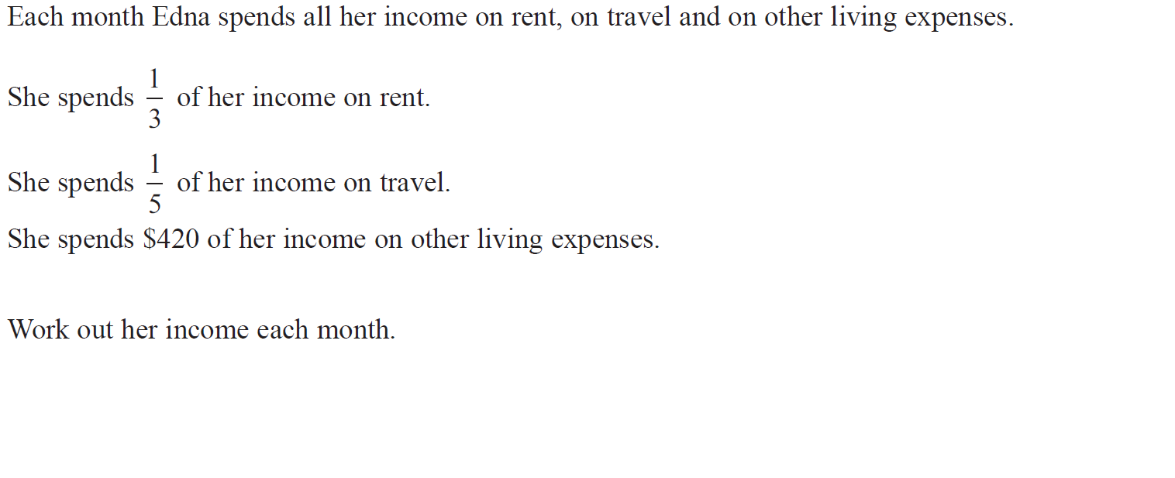
Fractions
May 2018 1HR Q13

Slide 13
Fractions
May 2018 1HR Q13
A

Slide 14
Fractions
June 2018 2HR Q3

Slide 15
Fractions
June 2018 2HR Q3
A

Slide 16
Fractions
Jan 2019 1HR Q1

Slide 17
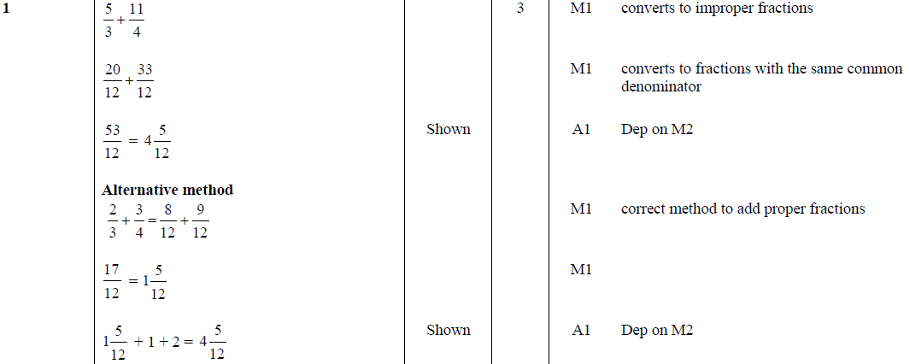
Fractions
Jan 2019 1HR Q1
A

Slide 18
Fractions
Jan 2019 1HR Q2

Slide 19
Fractions
Jan 2019 1HR Q2
A

Slide 20
Fractions
May 2019 1H Q1

Slide 21
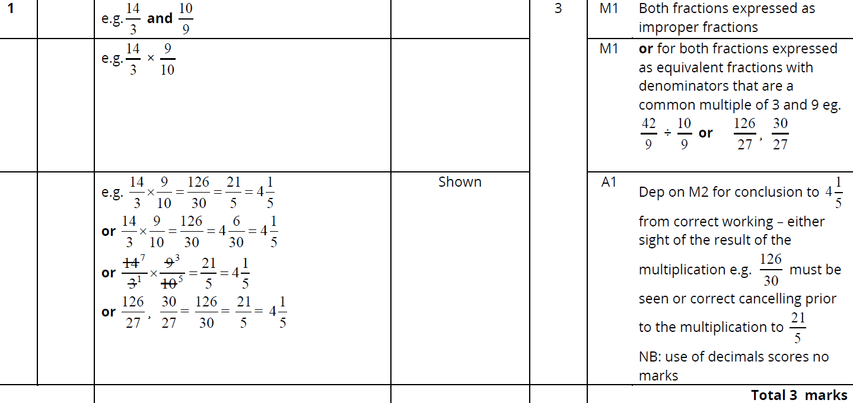
Fractions
May 2019 1H Q1
A

Slide 22
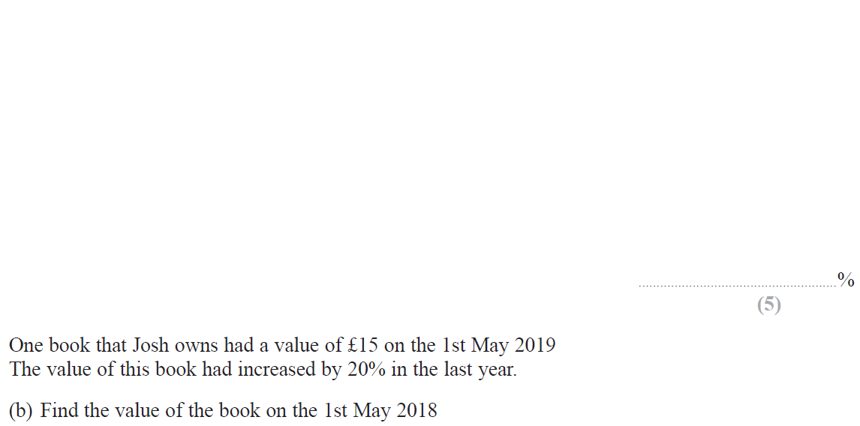
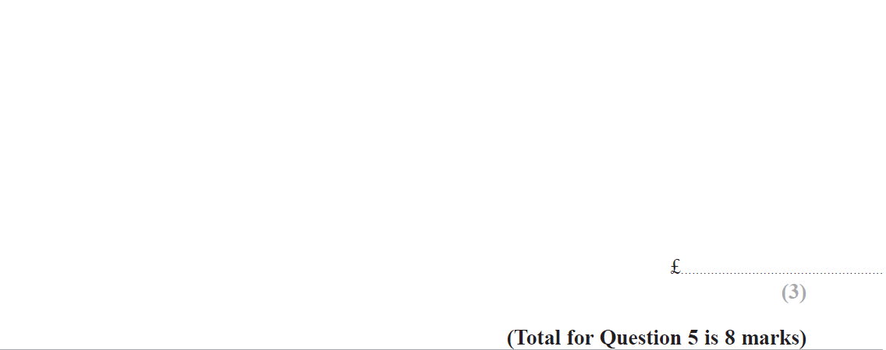
Fractions
June 2019 2H Q5

Slide 23
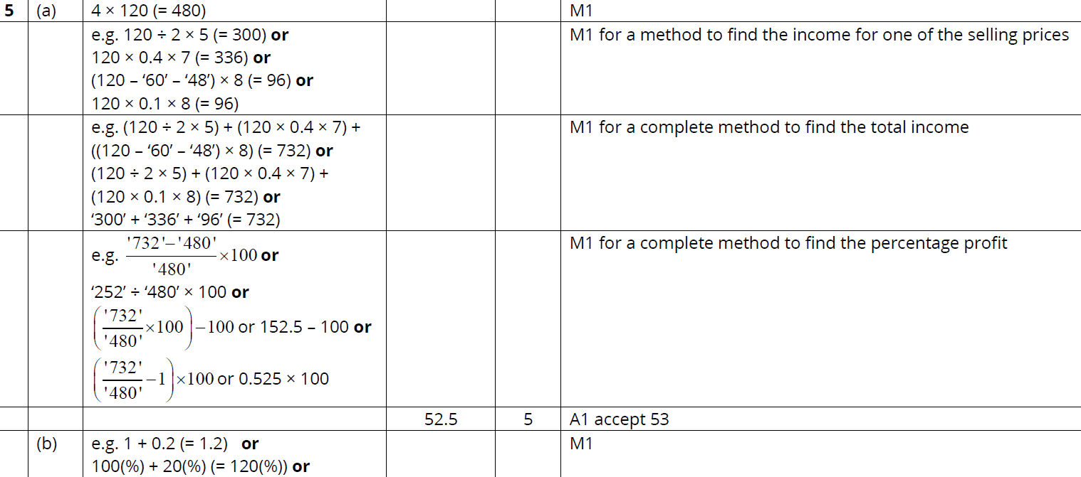
Fractions
June 2019 2H Q5
A
B

Slide 24
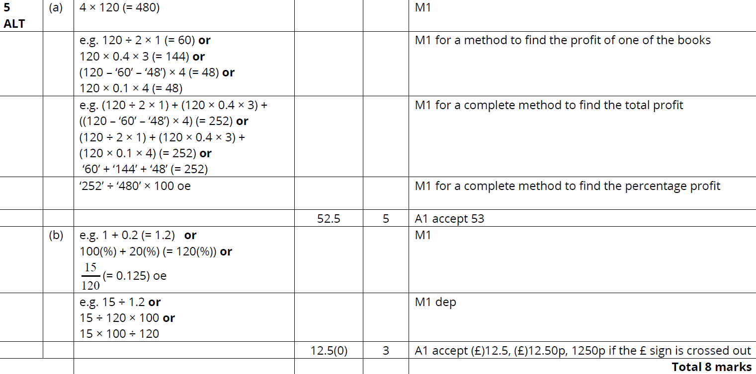
Fractions
June 2019 2H Q5
A
B

Slide 25
Fractions
Fractions
New Spec Q’s
May 2004
4H Q7
June 2009
4H Q1
May 2013 4H Q5
May 2016 3H Q6
May 2018 3HR Q2
Nov 2004
3H Q3
Nov 2009
3H Q1
May 2013 3HR Q5
Jan 2017 3H Q3
May 2018 3HR Q9
May 2005
3H Q3
June 2010
3H Q5
Jan 2014 4HR Q4
Jan 2017 3HR Q5
May 2006
3H Q6
June 2010
4H Q8
May 2014 3H Q2
June 2017 4H Q7
May 2006
3H Q17
Nov 2010
3H Q5
Jan 2015 3HR Q9
Jan 2018 4H Q3
Nov 2006
3H Q3
June 2011 3H Q5
June 2015 4H Q1
Jan 2018 3HR Q7
May 2008
4H Q6
May 2012 4H Q5
Jan 2016 3H Q3
Jan 2018 3HR Q9
Nov 2008
3H Q7
Jan 2013 4H Q6
Jan 2016 4HR Q3
June 2018 4H Q2
‘Show that’ from 2008
Context

Slide 26
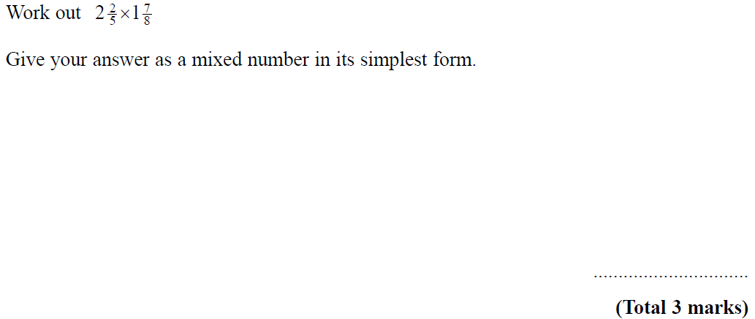
Fractions
May 2004 4H Q7

Slide 27
Fractions
May 2004 4H Q7
A

Slide 28
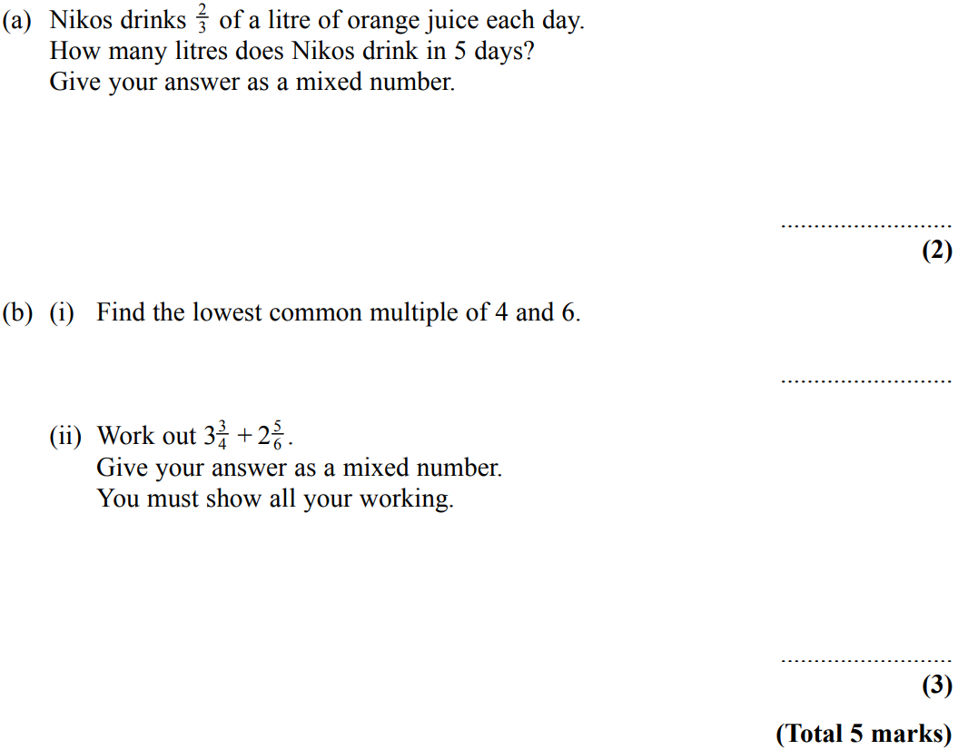
Fractions
Nov 2004 3H Q3

Slide 29
Fractions
Nov 2004 3H Q3
A
B (i)
B (ii)

Slide 30
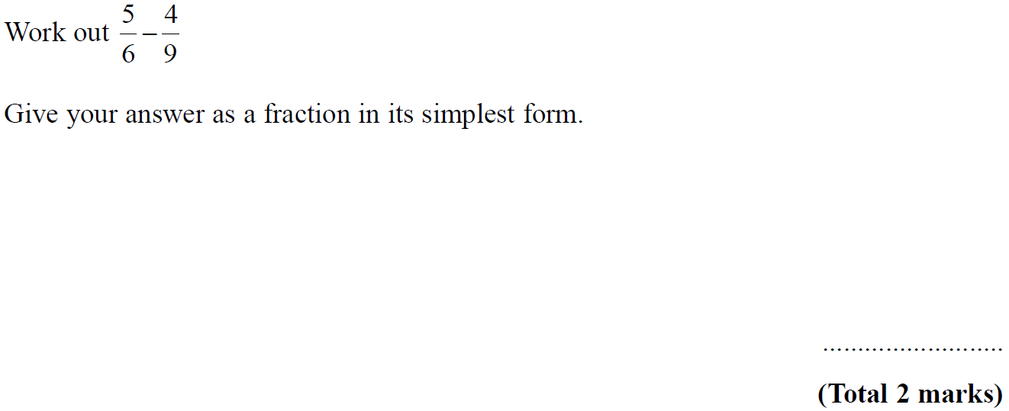
Fractions
May 2005 3H Q3

Slide 31
Fractions
May 2005 3H Q3
A

Slide 32
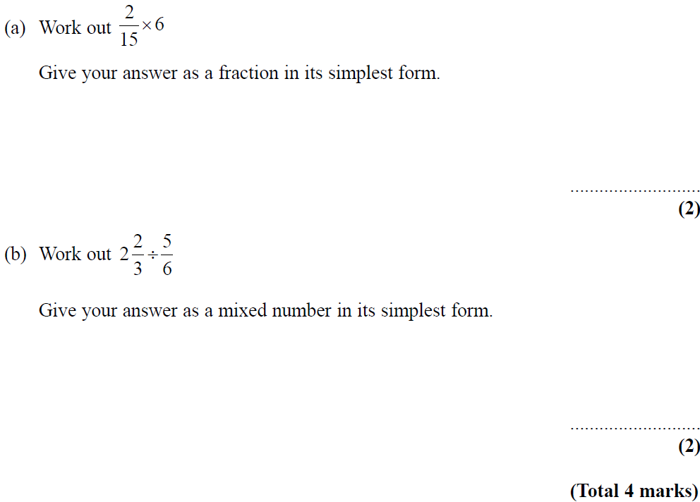
Fractions
May 2006 3H Q6

Slide 33
Fractions
May 2006 3H Q6
A
B

Slide 34
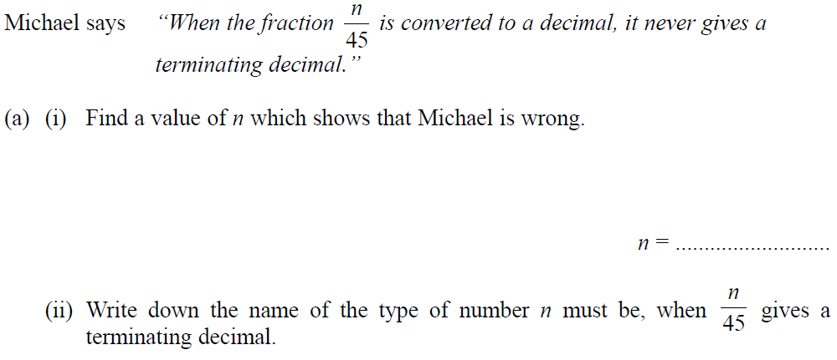
Fractions
May 2006 3H Q17

Slide 35
Fractions
May 2006 3H Q17
A (i)
A (ii)
B

Slide 36
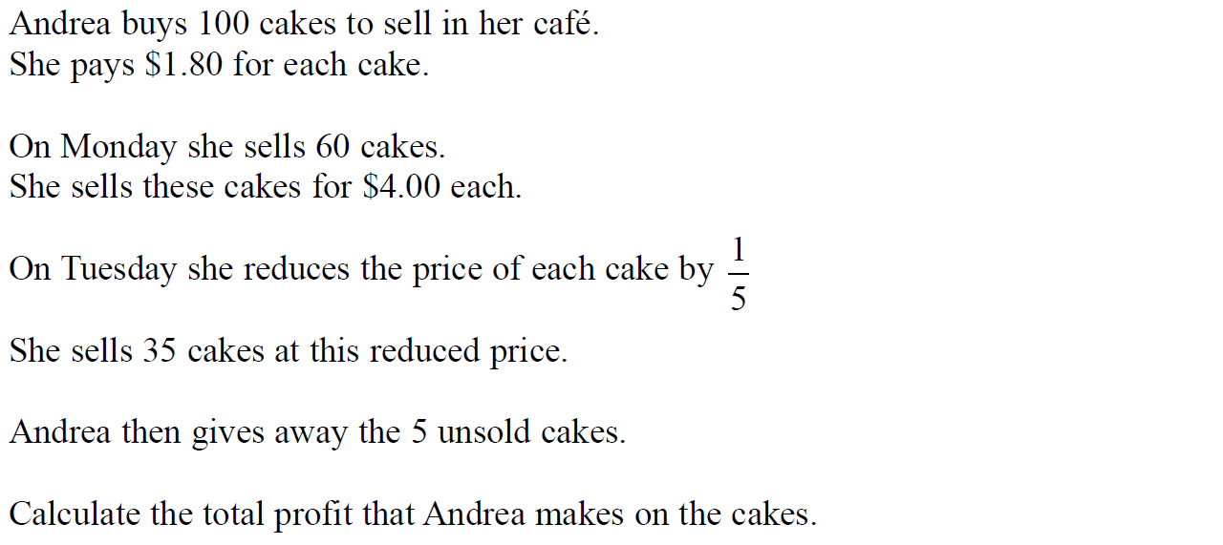
Fractions
Nov 2006 3H Q3

Slide 37
Fractions
Nov 2006 3H Q3
A

Slide 38
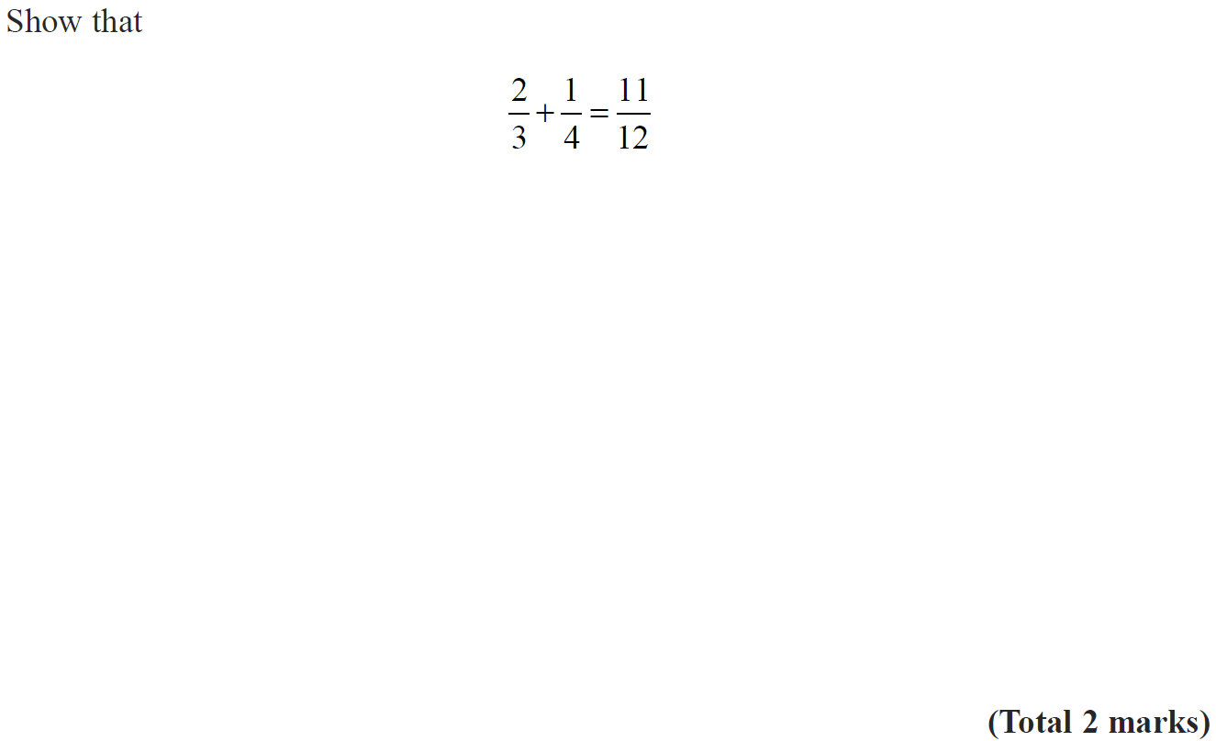
Fractions
May 2008 4H Q6

Slide 39
Fractions
May 2008 4H Q6
A

Slide 40
Fractions
Nov 2008 3H Q7

Slide 41
Fractions
Nov 2008 3H Q7
A

Slide 42
Fractions
June 2009 4H Q1

Slide 43
Fractions
June 2009 4H Q1
A

Slide 44
Fractions
Nov 2009 3H Q1

Slide 45
Fractions
Nov 2009 3H Q1
A

Slide 46
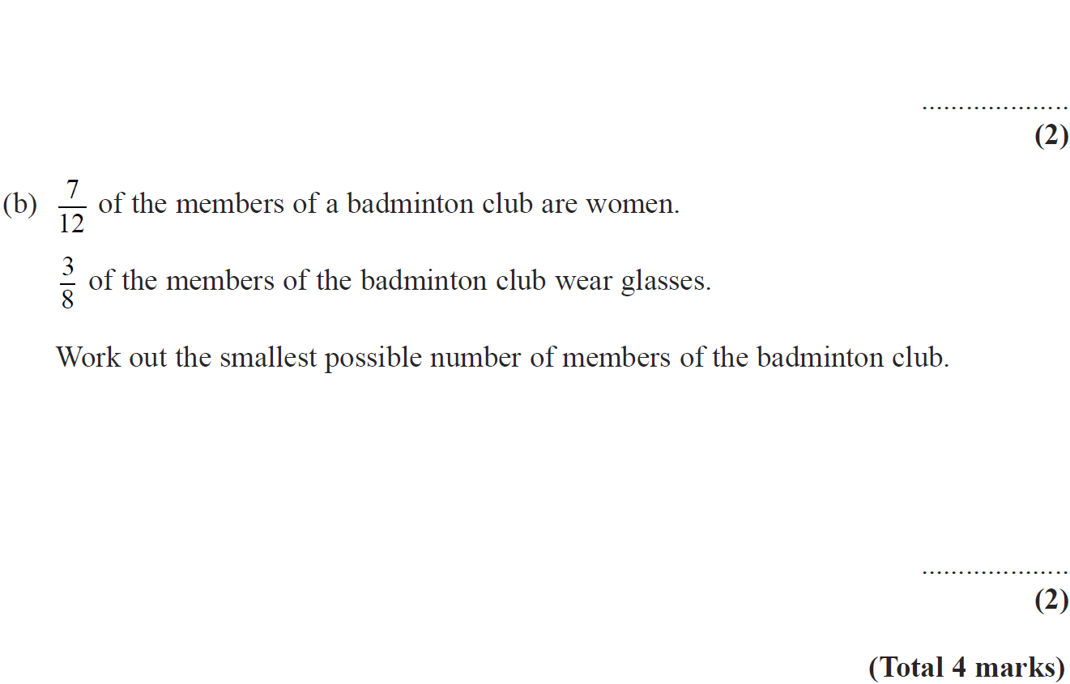
Fractions
June 2010 3H Q5

Slide 47
Fractions
June 2010 3H Q5
A
B

Slide 48
Fractions
June 2010 4H Q8

Slide 49
Fractions
June 2010 4H Q8
A

Slide 50
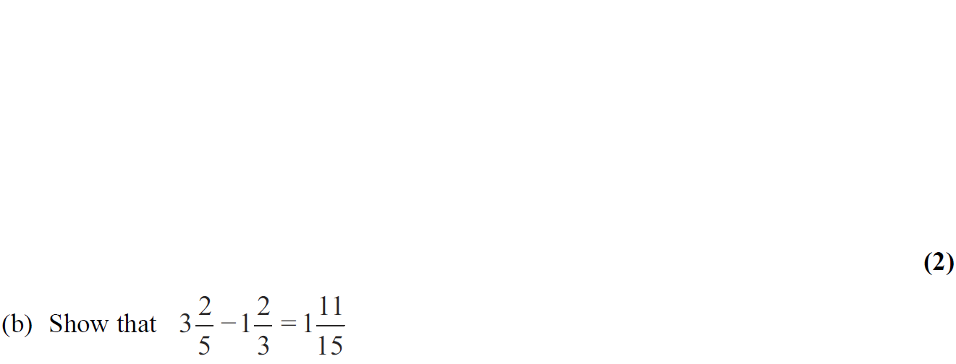
Fractions
Nov 2010 3H Q5

Slide 51
Fractions
Nov 2010 3H Q5
A
B

Slide 52
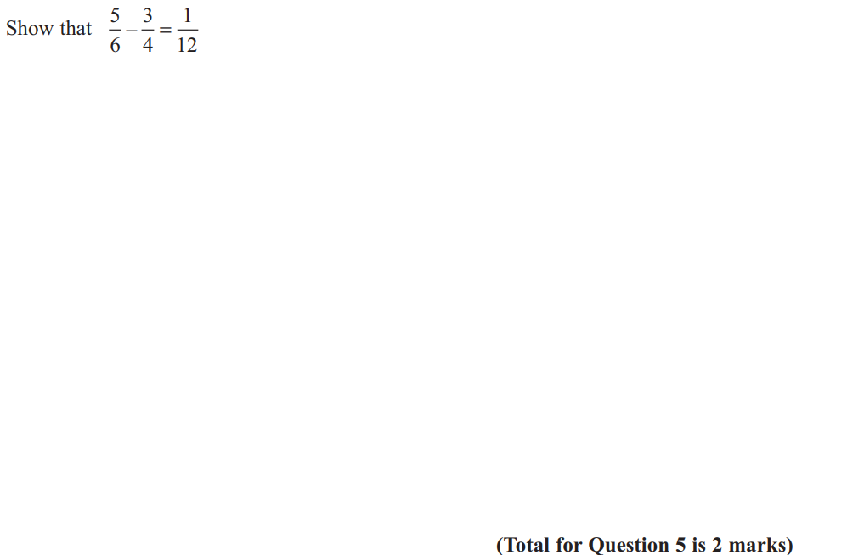
Fractions
June 2011 3H Q5

Slide 53
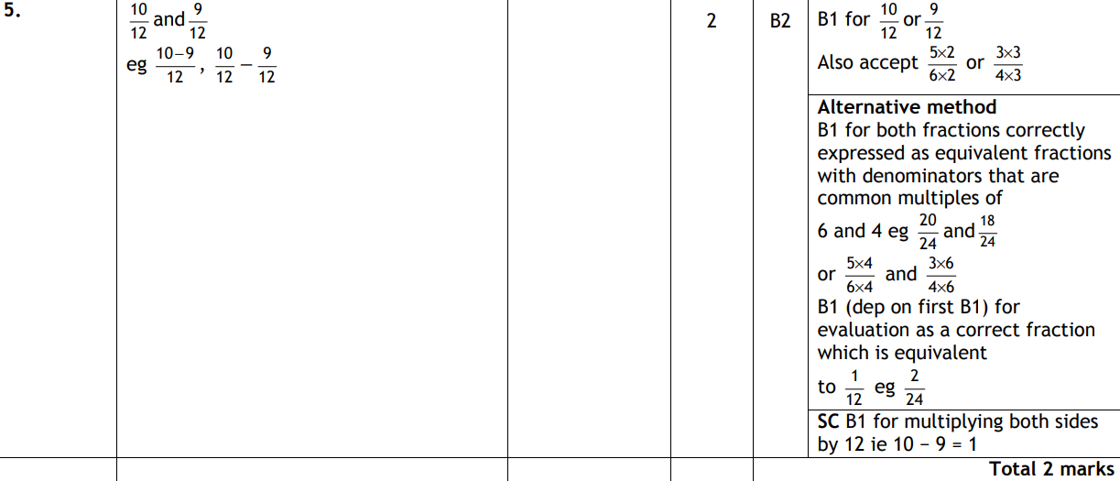
Fractions
June 2011 3H Q5
A

Slide 54
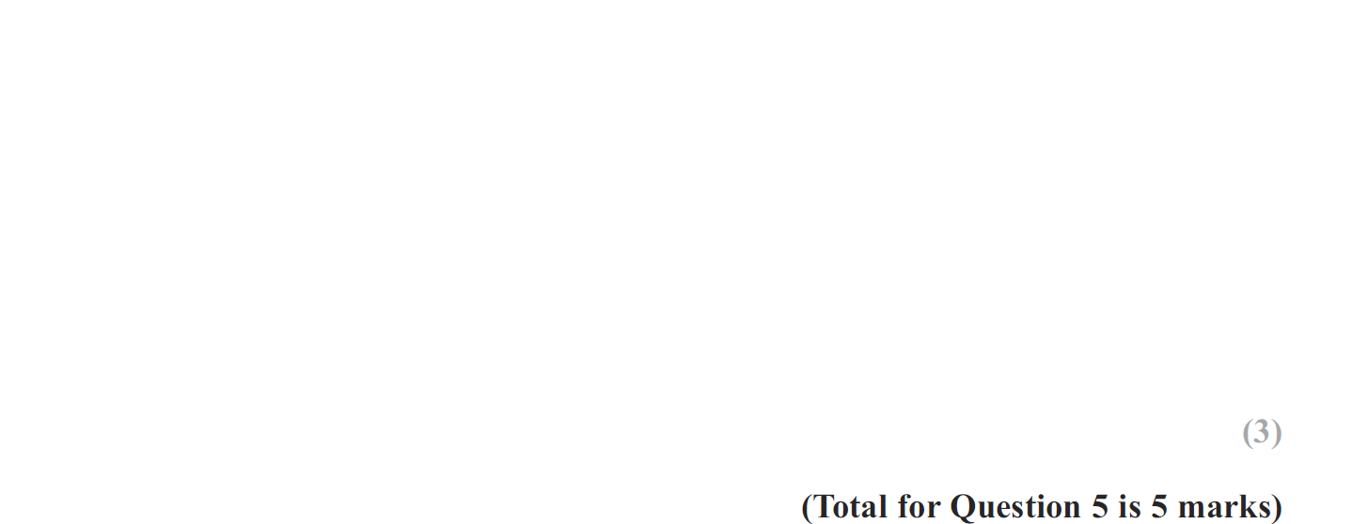
Fractions
May 2012 4H Q5

Slide 55
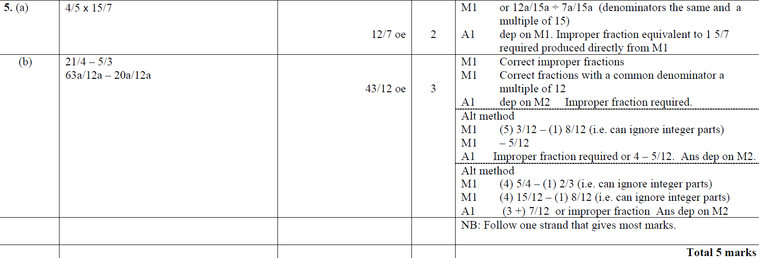
Fractions
May 2012 4H Q5
A
B

Slide 56
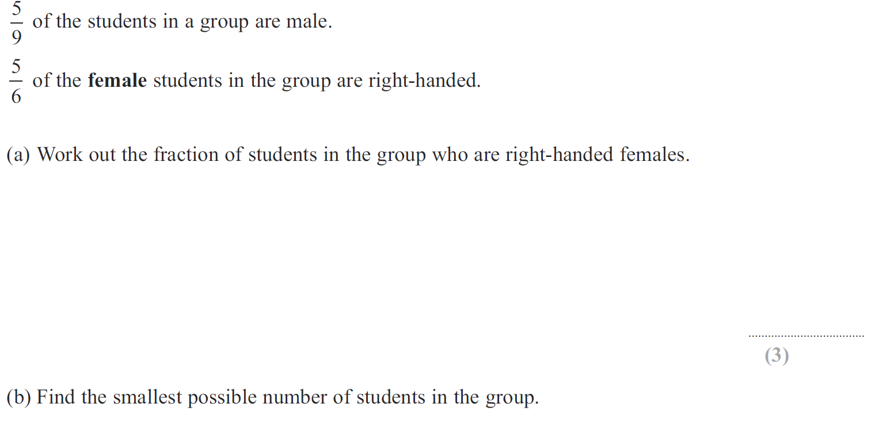
Fractions
Jan 2013 4H Q6

Slide 57
Fractions
Jan 2013 4H Q6
A
B

Slide 58
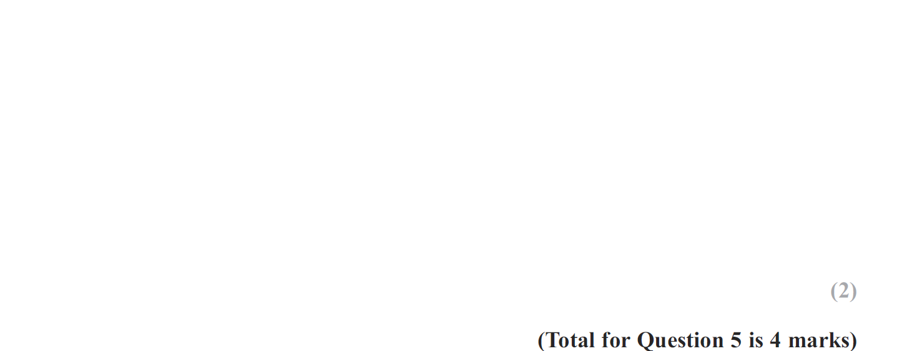
Fractions
May 2013 4H Q5

Slide 59
Fractions
May 2013 4H Q5
A
B

Slide 60
Fractions
May 2013 3HR Q5

Slide 61
Fractions
May 2013 3HR Q5
A

Slide 62
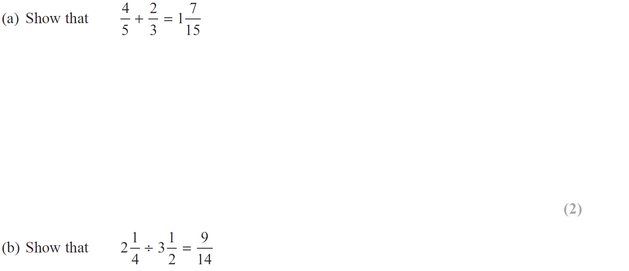
Fractions
Jan 2014 4HR Q4

Slide 63
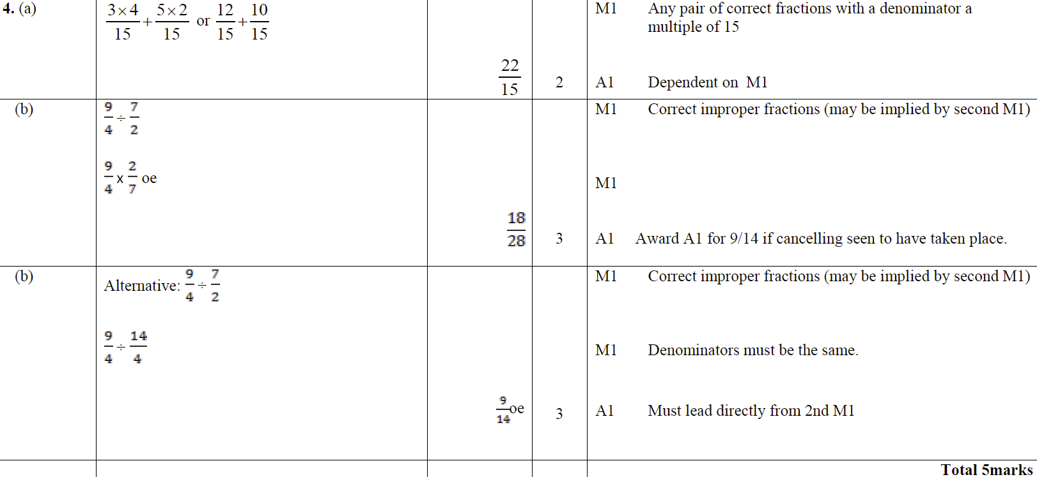
Fractions
Jan 2014 4HR Q4
A
B

Slide 64
Fractions
May 2014 3H Q2

Slide 65
Fractions
May 2014 3H Q2
A

Slide 66
Fractions
Jan 2015 3HR Q9

Slide 67
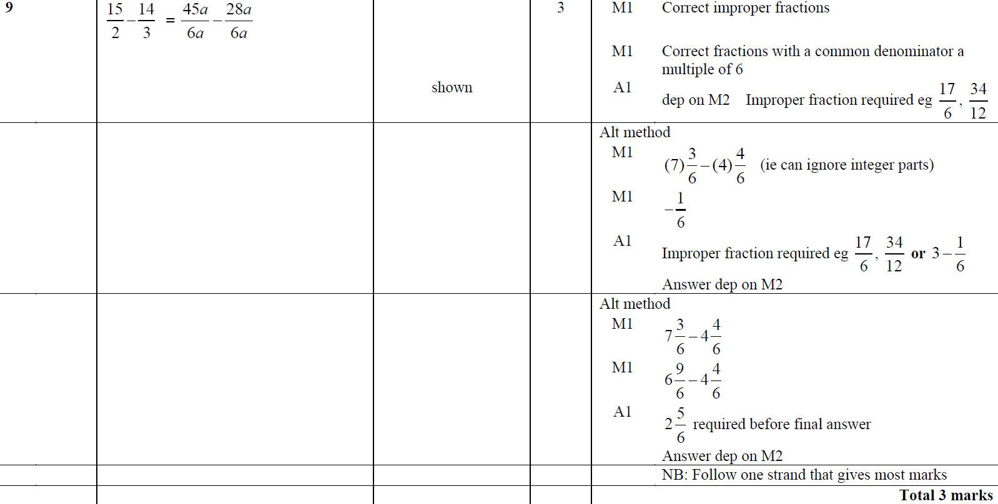
Fractions
Jan 2015 3HR Q9
A

Slide 68
Fractions
June 2015 4H Q1

Slide 69
Fractions
June 2015 4H Q1
A

Slide 70
Fractions
Jan 2016 3H Q3

Slide 71
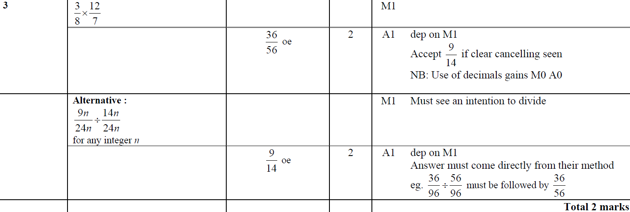
Fractions
Jan 2016 3H Q3
A

Slide 72
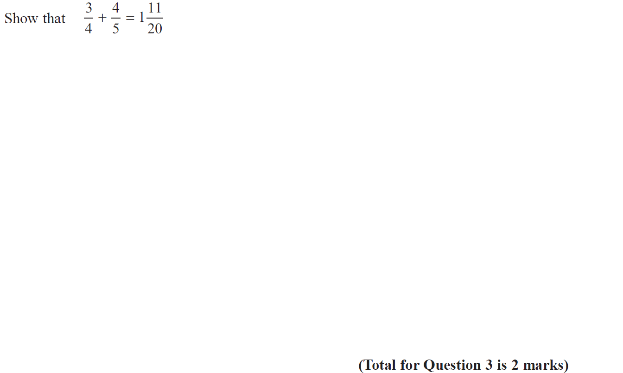
Fractions
Jan 2016 4HR Q3

Slide 73
Fractions
Jan 2016 4HR Q3
A

Slide 74
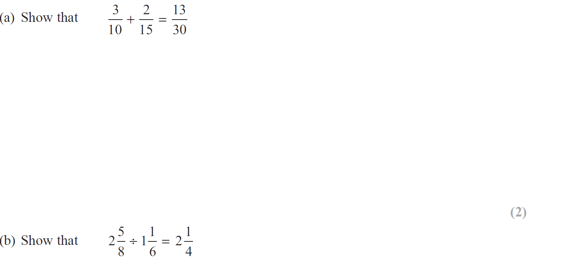
Fractions
May 2016 3H Q6

Slide 75
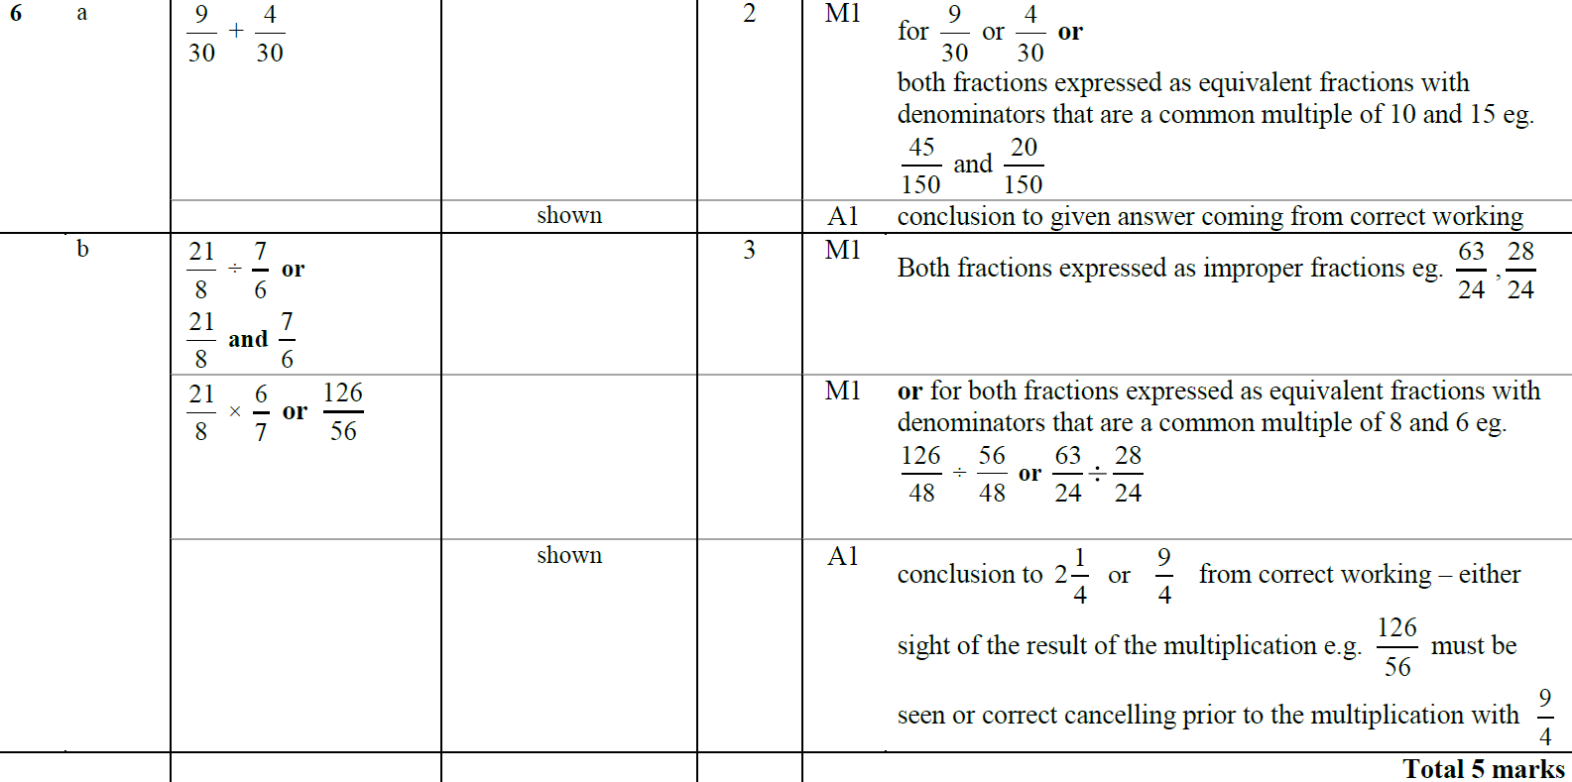
Fractions
May 2016 3H Q6
A
B

Slide 76
Fractions
Jan 2017 3H Q3

Slide 77
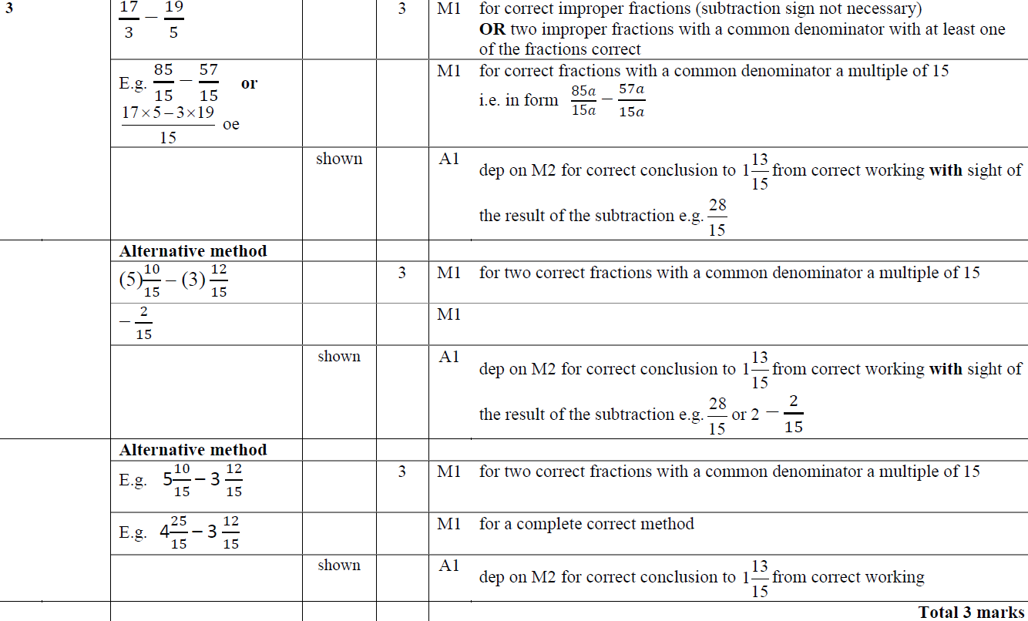
Fractions
Jan 2017 3H Q3
A

Slide 78
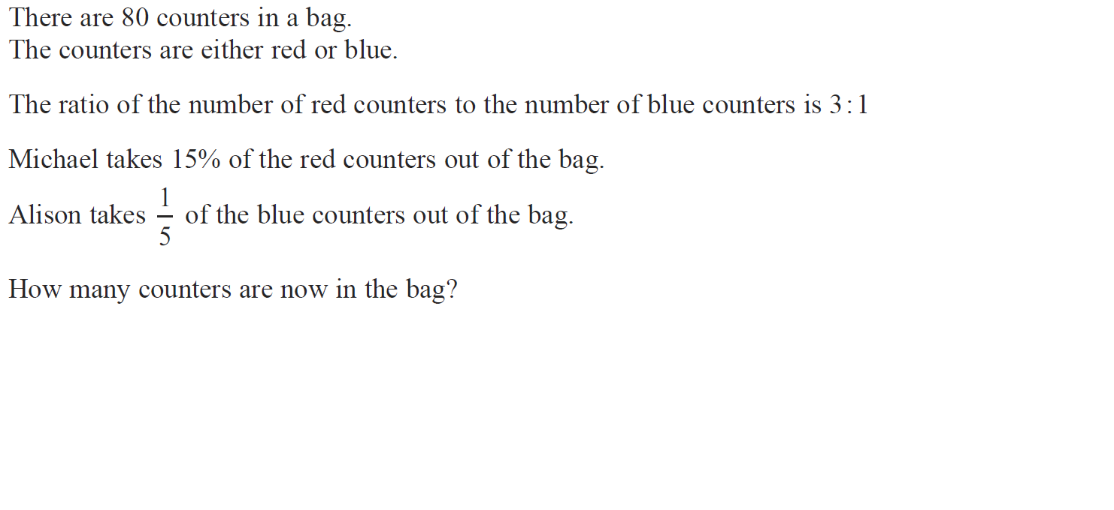
Fractions
Jan 2017 3HR Q5

Slide 79
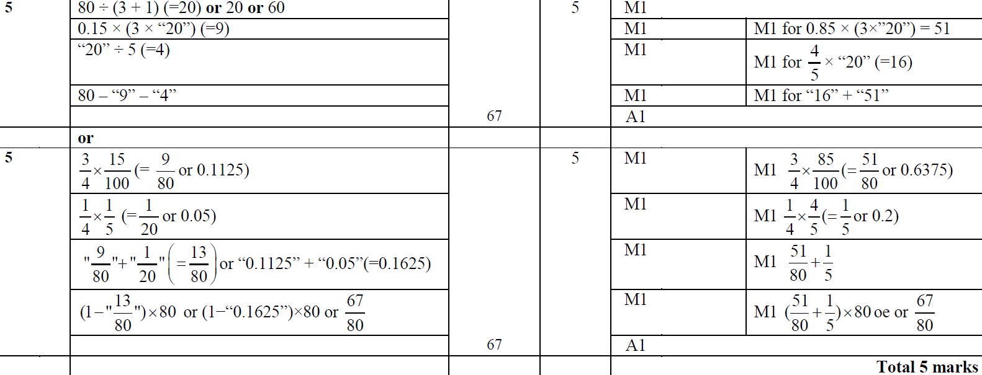
Fractions
Jan 2017 3HR Q5
A

Slide 80
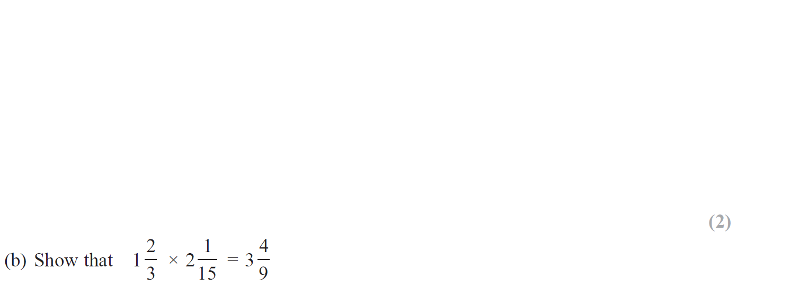
Fractions
June 2017 4H Q7

Slide 81
Fractions
June 2017 4H Q7
A
B

Slide 82
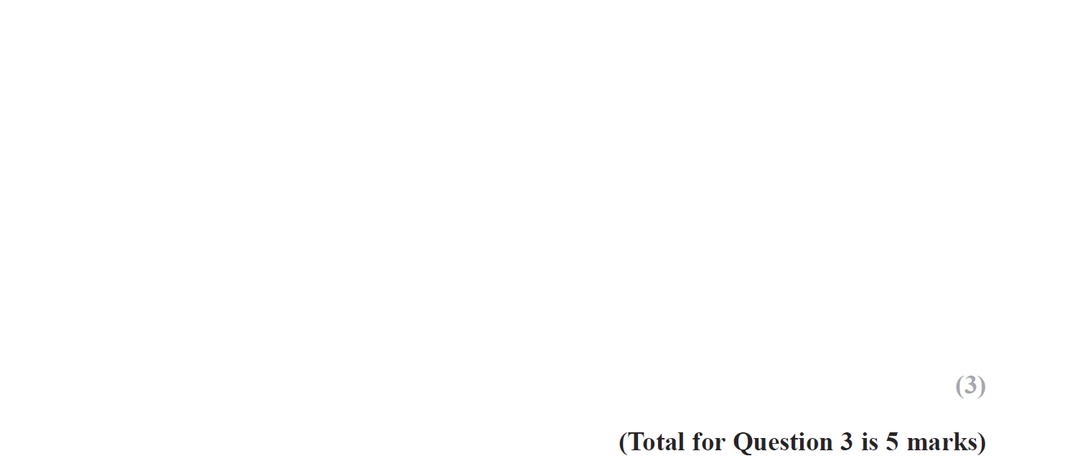
Fractions
Jan 2018 4H Q3

Slide 83
Fractions
Jan 2018 4H Q3
A
B

Slide 84
Fractions
Jan 2018 3HR Q7

Slide 85
Fractions
Jan 2018 3HR Q7
A

Slide 86
Fractions
Jan 2018 3HR Q9

Slide 87
Fractions
Jan 2018 3HR Q9
A

Slide 88
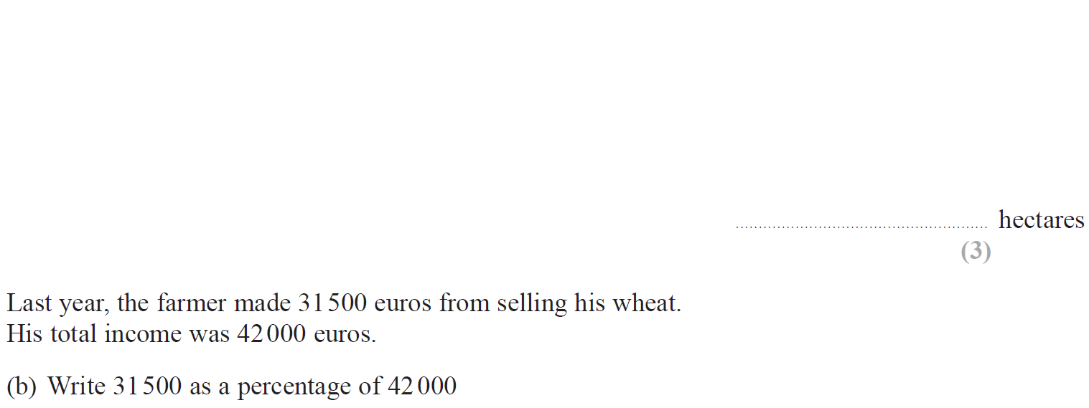
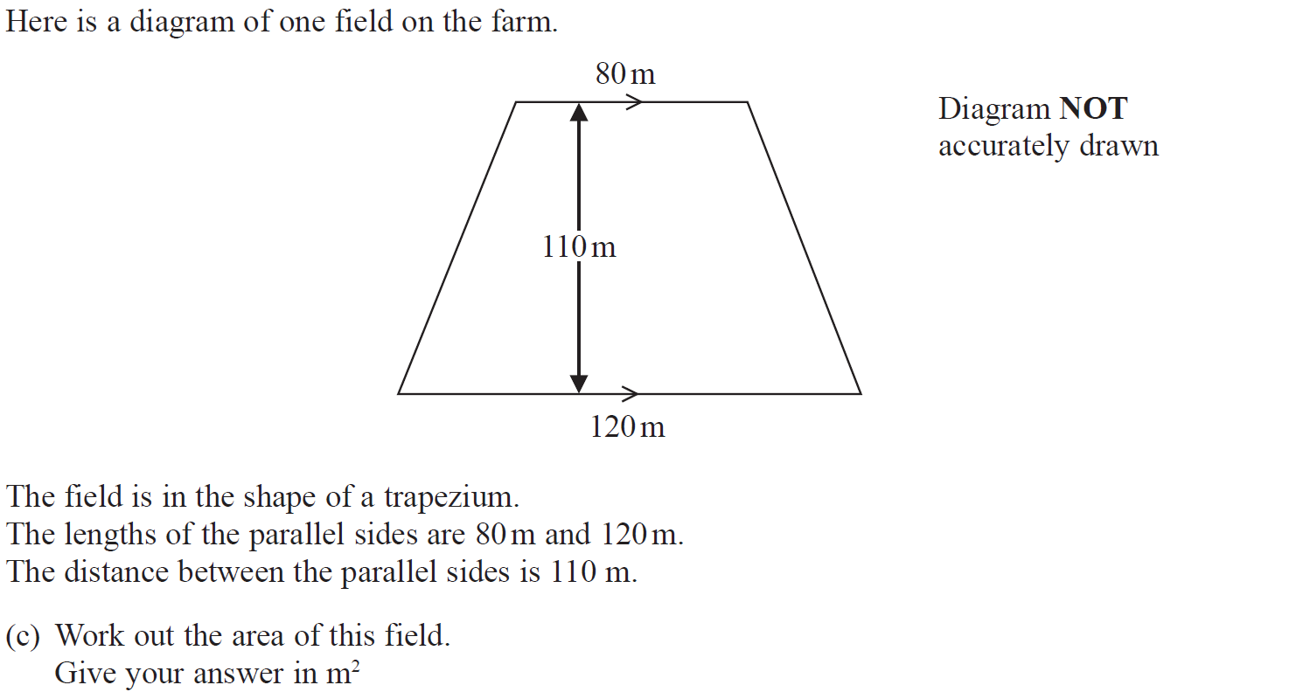
Fractions
June 2018 4H Q2

Slide 89
Fractions
June 2018 4H Q2
A
B
C

Slide 90
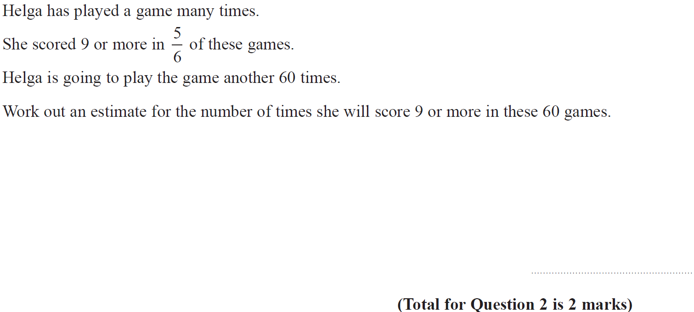
Fractions
May 2018 3HR Q2

Slide 91
Fractions
May 2018 3HR Q2
A

Slide 92
Fractions
May 2018 3HR Q9

Slide 93
Fractions
May 2018 3HR Q9
A

