Slide 1
Fractions
Fractions
Edexcel
Nov 2017
3H Q5
Spec 1
2H Q12
AQA
May 2018
1H Q1
Spec 2
1H Q6
OCR
May 2019
1H Q9
Context

Slide 2
Fractions
Fractions
May 2017
1H Q7
Nov 2017
2H Q1
Edexcel
May 2017
1H Q15
May 2018
1H Q6
AQA
SAM
1H Q7
1 Marker
May 2017
1H Q24
Nov 2018
1H Q5
OCR
June 2017
2H Q9
Nov 2018
3H Q2
Context

Slide 3
Fractions
Fractions
Edexcel
SAM
3H Q15
June 2017
2H Q1
AQA
Practice
2H Q9
June 2018
2H Q1
OCR
Practice
3H Q8
June 2018
2H Q6
Context

Slide 4
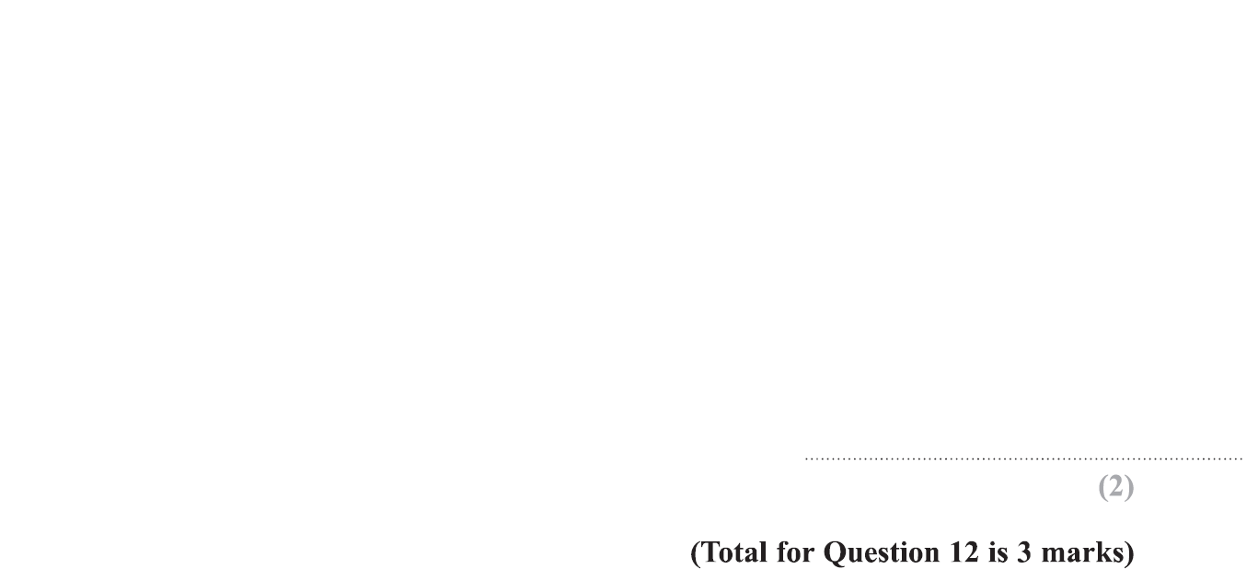
Fractions
Specimen Set 1 2H Q12

Slide 5
Fractions
Specimen Set 1 2H Q12
A
B

Slide 6
Fractions
Specimen Set 2 1H Q6

Slide 7
Fractions
Specimen Set 2 1H Q6
A
B

Slide 8
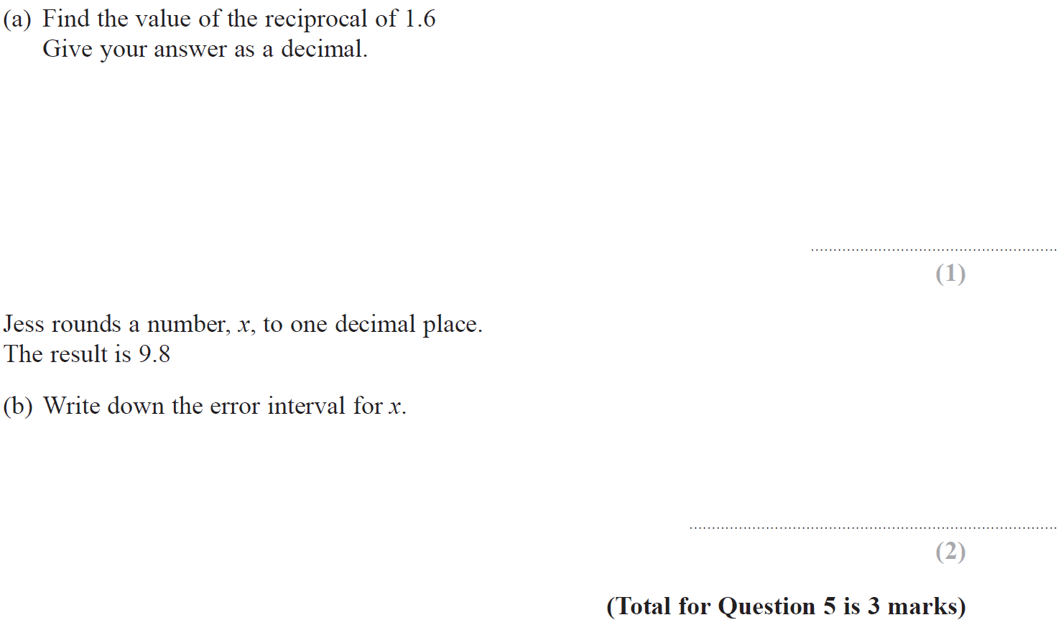
Fractions
Nov 2017 3H Q5

Slide 9
Fractions
Nov 2017 3H Q5
A
B

Slide 10
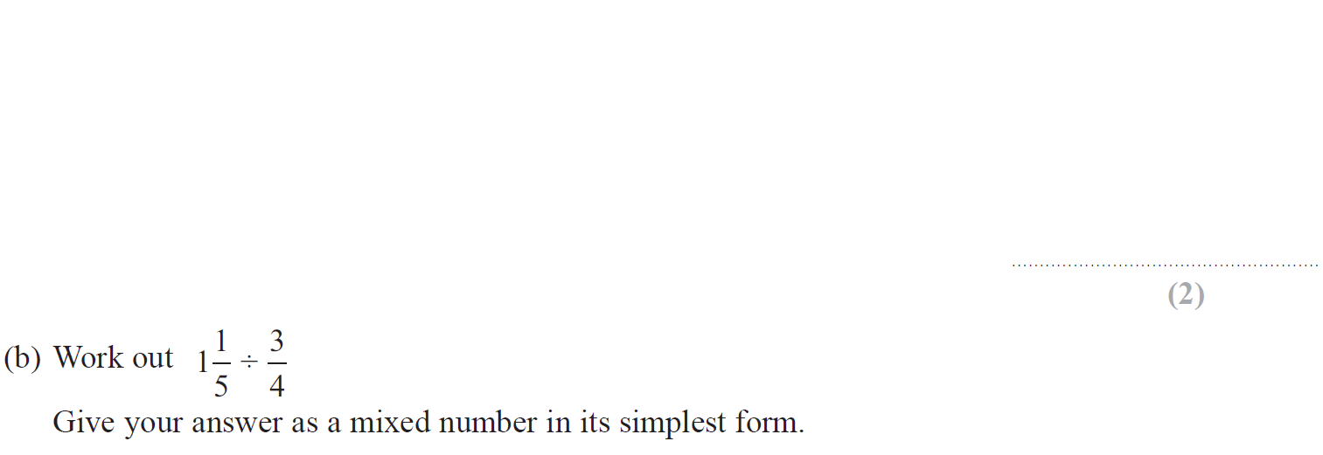
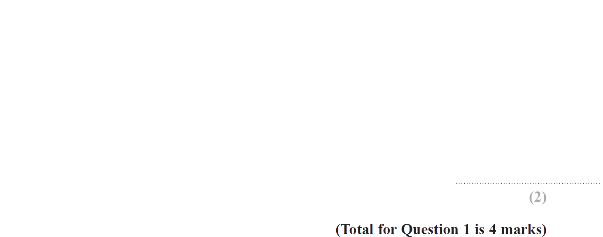
Fractions
May 2018 1H Q1

Slide 11
Fractions
May 2018 1H Q1
A
B

Slide 12
Fractions
May 2019 1H Q9

Slide 13
Fractions
May 2019 1H Q9
A
A SF

Slide 14
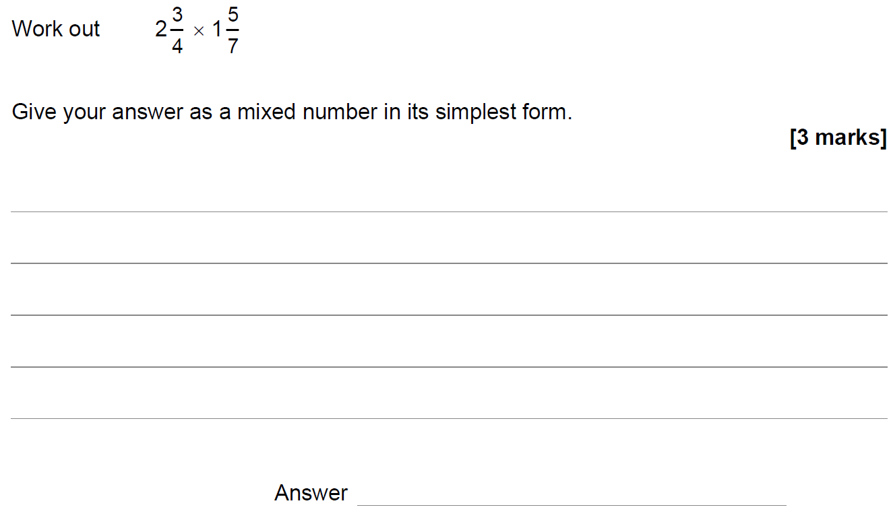
Fractions
SAM 1H Q7

Slide 15
Fractions
SAM 1H Q7
A

Slide 16
Fractions
May 2017 1H Q7

Slide 17
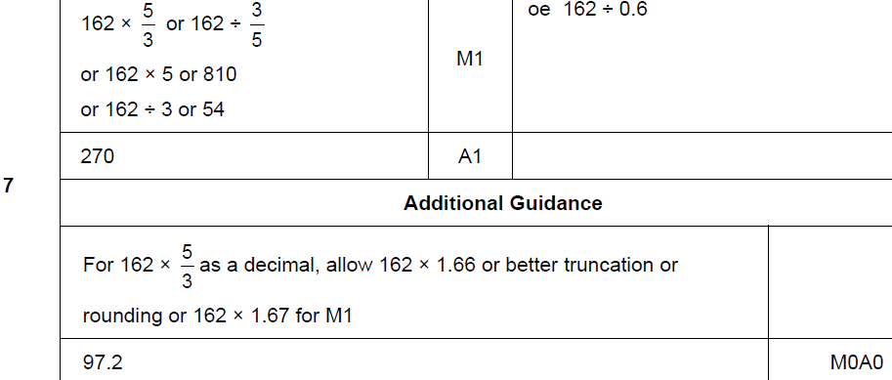
Fractions
May 2017 1H Q7
A

Slide 18
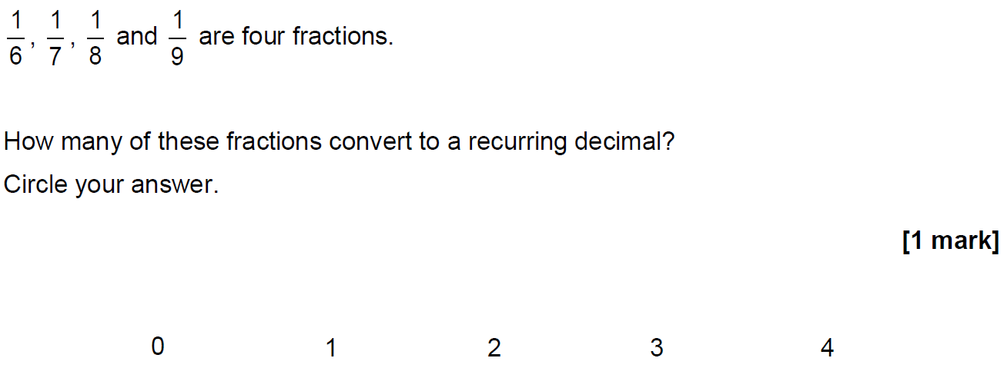
Fractions
May 2017 1H Q15

Slide 19
Fractions
May 2017 1H Q15
A

Slide 20
Fractions
May 2017 1H Q24

Slide 21
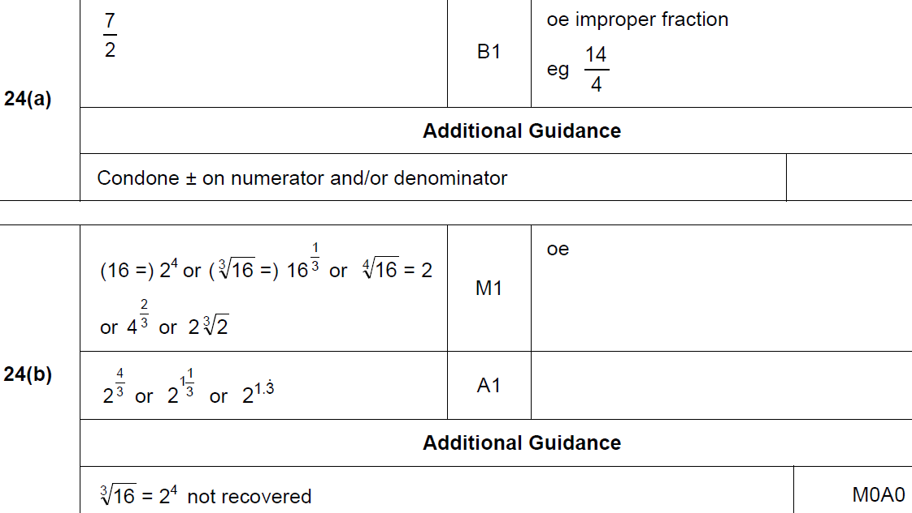
Fractions
May 2017 1H Q24
A
B

Slide 22
Fractions
June 2017 3H Q9

Slide 23
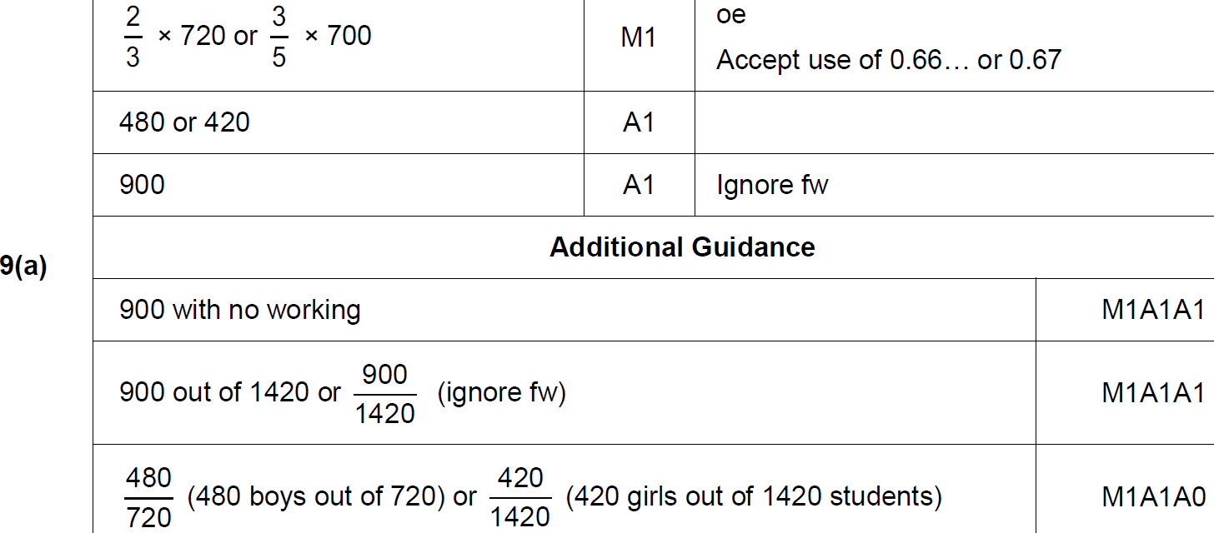
Fractions
June 2017 3H Q9
A

Slide 24
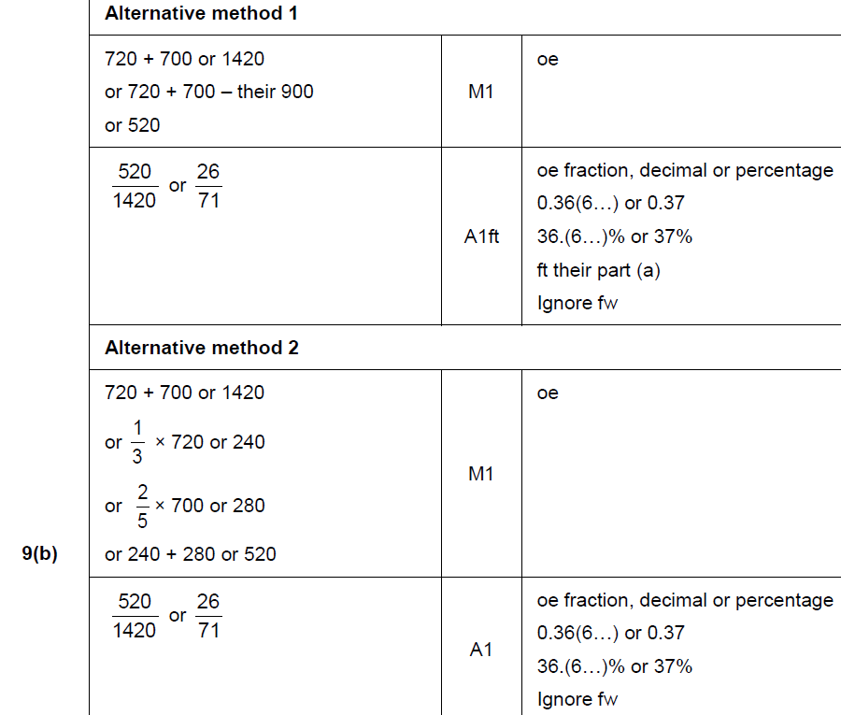
Fractions
June 2017 3H Q9
B

Slide 25
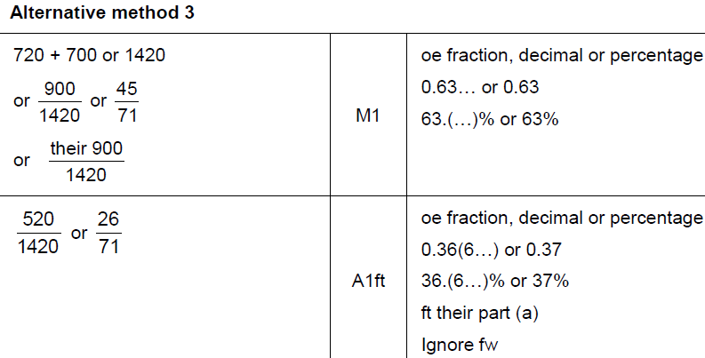
Fractions
June 2017 3H Q9
B Alternative & notes

Slide 26
Fractions
Nov 2017 2H Q1

Slide 27
Fractions
Nov 2017 2H Q1
A

Slide 28
Fractions
May 2018 1H Q6
The height of Zak is 1.86 metres.
The height of Fred is 1.6 metres.
Write the height of Zak as a fraction of the height of Fred.
Give your answer in its simplest form.
[3 marks]

Slide 29
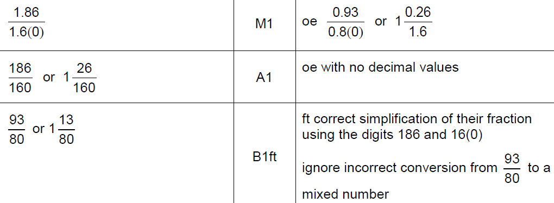
Fractions
May 2018 1H Q6
A

Slide 30
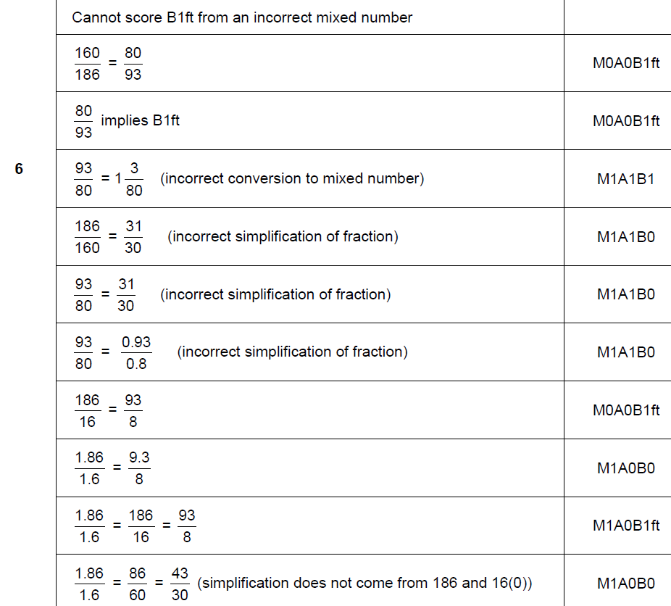
Fractions
May 2018 1H Q6
A notes

Slide 31
Fractions
Nov 2018 1H Q5

Slide 32
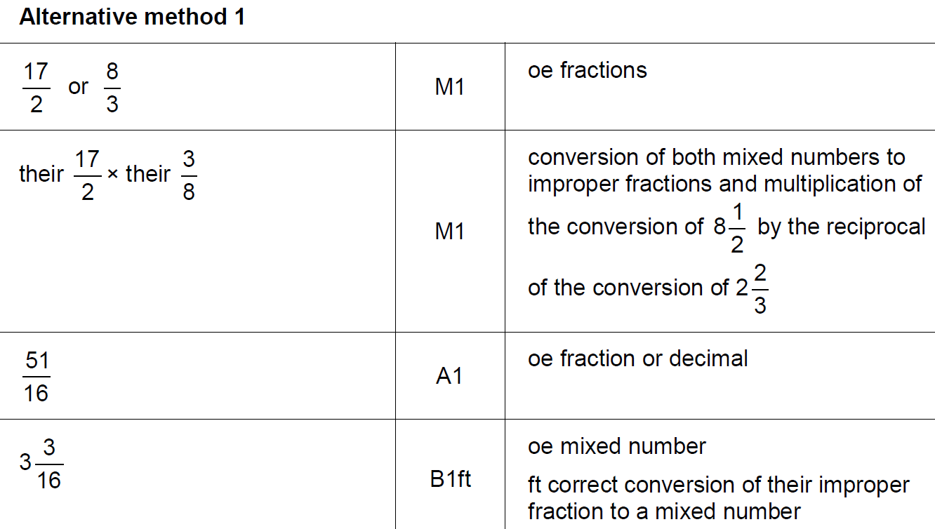
Fractions
Nov 2018 1H Q5
A

Slide 33
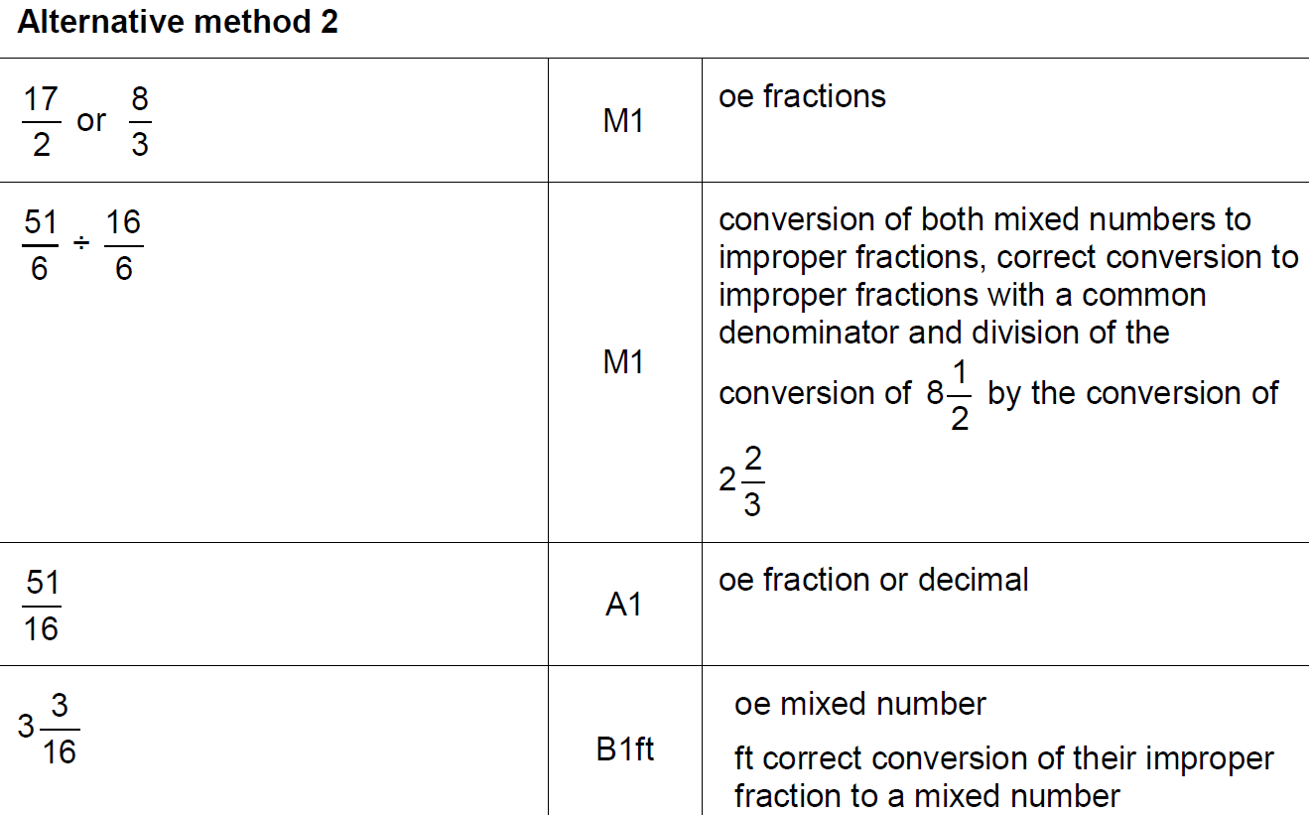
Fractions
Nov 2018 1H Q5
A Alternative

Slide 34
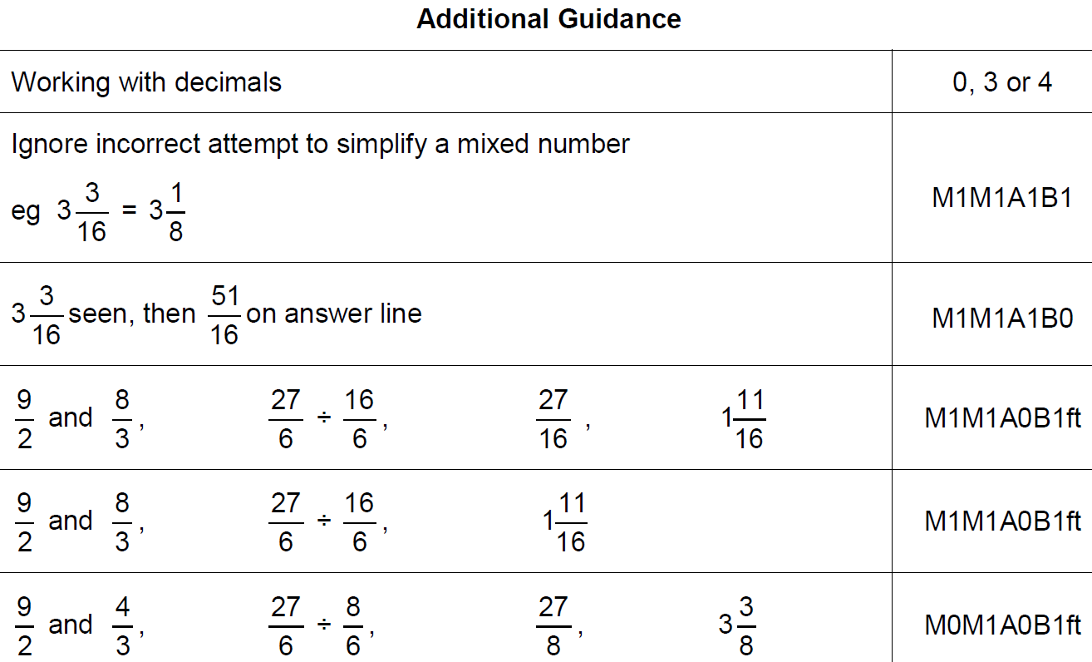
Fractions
Nov 2018 1H Q5
A notes

Slide 35
Fractions
Nov 2018 3H Q2

Slide 36
Fractions
Nov 2018 3H Q2
A

Slide 37
Fractions
SAM 3H Q15

Slide 38
Fractions
SAM 3H Q15
A

Slide 39
Fractions
Practice 2H Q9

Slide 40
Fractions
Practice 2H Q9
A
B
C

Slide 41
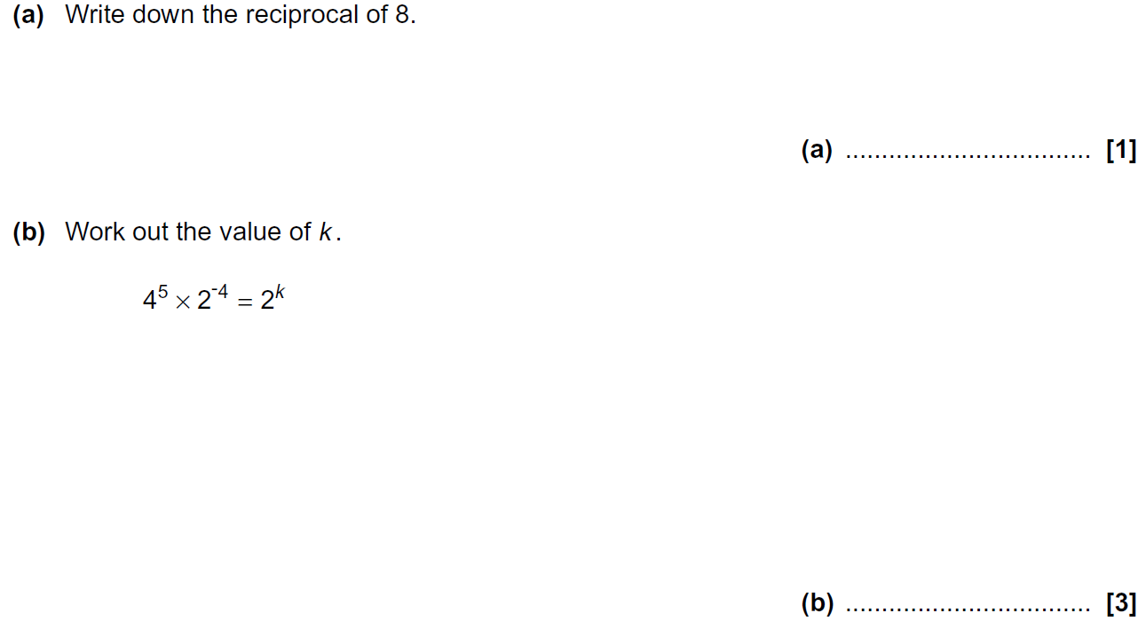
Fractions
Practice 3H Q8

Slide 42
Fractions
Practice 3H Q8
A
B

Slide 43
Fractions
June 2017 2H Q1

Slide 44
Fractions
June 2017 2H Q1
A

Slide 45
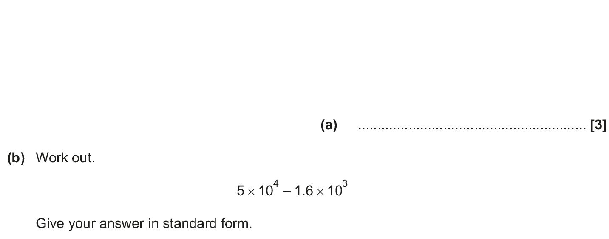
Fractions
June 2018 2H Q1

Slide 46
Fractions
June 2018 2H Q1
A
B

Slide 47
Fractions
Nov 2018 2H Q6

Slide 48
Fractions
Nov 2018 2H Q6
A

