Slide 1
Fractions
Fractions
SAM
3H Q15
June 2017
2H Q1
Practice
2H Q9
June 2018
2H Q1
Practice
3H Q8
June 2018
2H Q6
Context

Slide 2
Fractions
SAM 3H Q15

Slide 3
Fractions
SAM 3H Q15
A

Slide 4
Fractions
Practice 2H Q9

Slide 5
Fractions
Practice 2H Q9
A
B
C

Slide 6
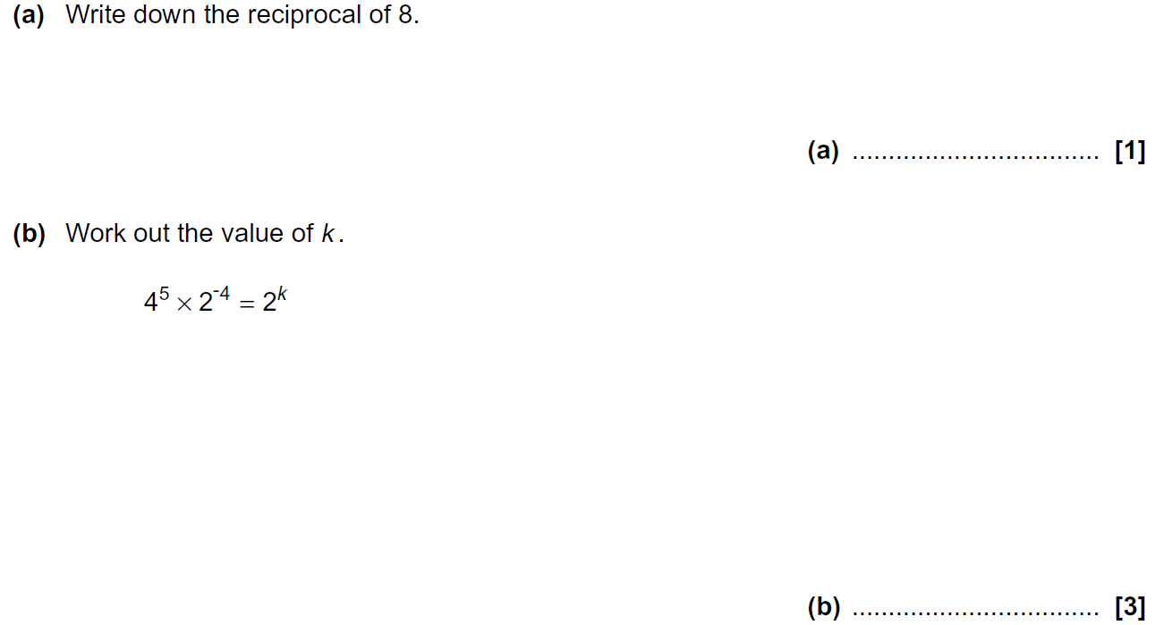
Fractions
Practice 3H Q8

Slide 7
Fractions
Practice 3H Q8
A
B

Slide 8
Fractions
June 2017 2H Q1

Slide 9
Fractions
June 2017 2H Q1
A

Slide 10
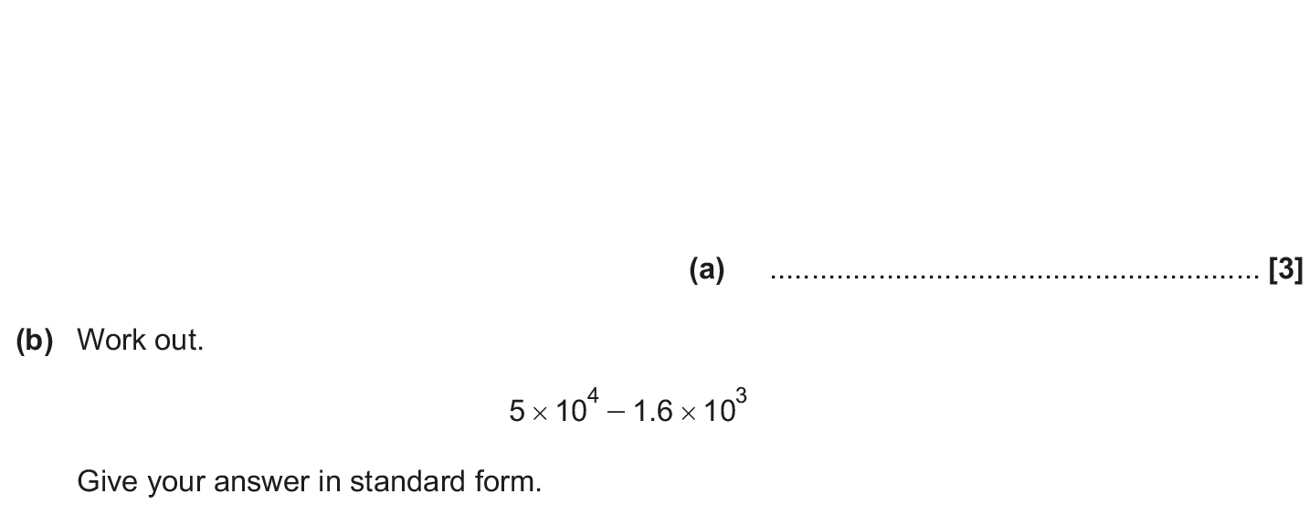
Fractions
June 2018 2H Q1

Slide 11
Fractions
June 2018 2H Q1
A
B

Slide 12
Fractions
Nov 2018 2H Q6

Slide 13
Fractions
Nov 2018 2H Q6
A

