Slide 1
Fractions
Fractions
Nov 2017
3H Q5
Spec 1
2H Q12
May 2018
1H Q1
Spec 2
1H Q6
May 2019
1H Q9
Context

Slide 2
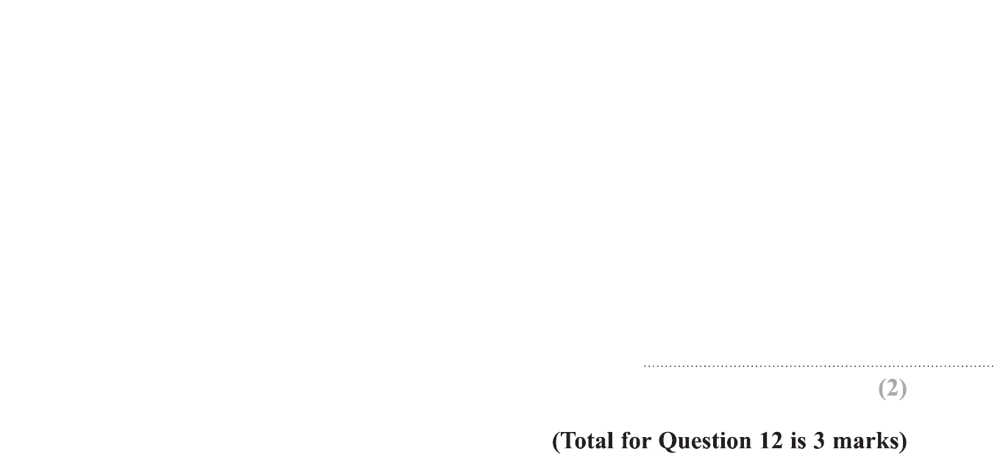
Fractions
Specimen Set 1 2H Q12

Slide 3
Fractions
Specimen Set 1 2H Q12
A
B

Slide 4
Fractions
Specimen Set 2 1H Q6

Slide 5
Fractions
Specimen Set 2 1H Q6
A
B

Slide 6
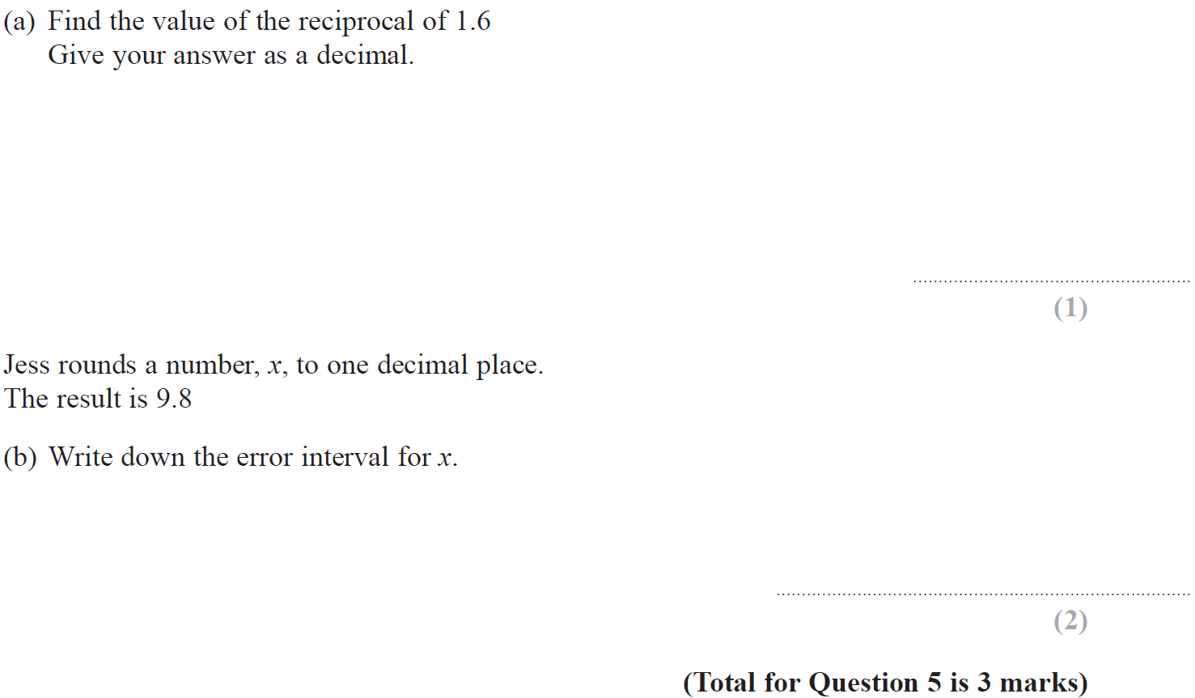
Fractions
Nov 2017 3H Q5

Slide 7
Fractions
Nov 2017 3H Q5
A
B

Slide 8
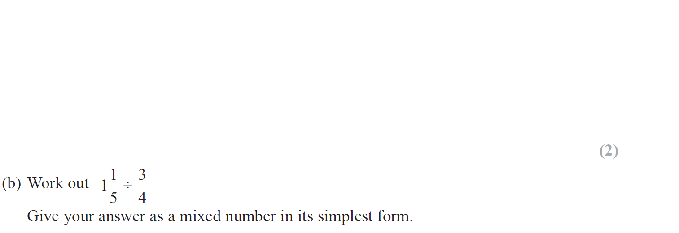
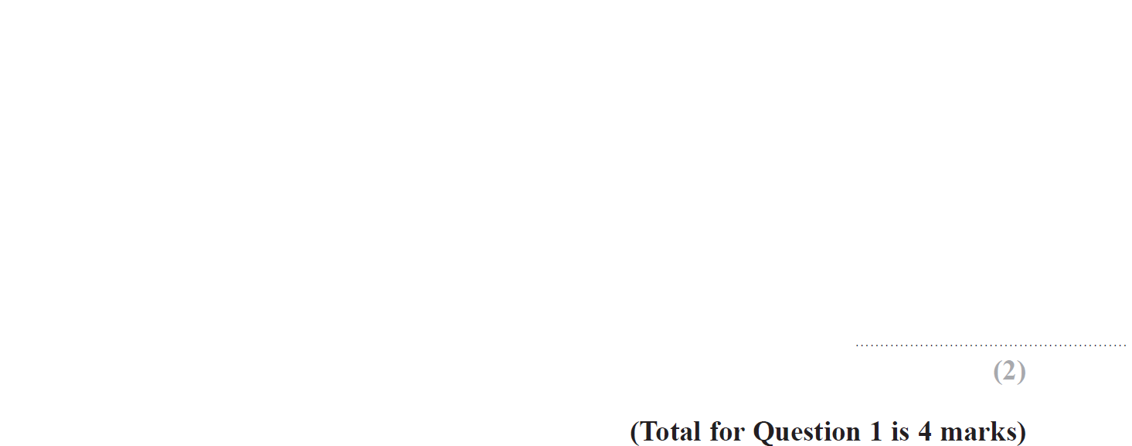
Fractions
May 2018 1H Q1

Slide 9
Fractions
May 2018 1H Q1
A
B

Slide 10
Fractions
May 2019 1H Q9

Slide 11
Fractions
May 2019 1H Q9
A
A SF

