Slide 1
Forming Equations
Forming Equations
SAM
1H Q8
Spec 1
2H Q19
May 2017 1H Q4
Edexcel
SAM
2H Q9
Nov 2017 1H Q23
Spec 2
1H Q9
Nov 2017 1H Q2
AQA
SAM
3H Q3
Nov 2017 3H Q6
Spec 2
1H Q11
Nov 2017 1H Q6
OCR
Spec 1
1H Q1
June 2018 3H Q19
Spec 2
3H Q7
Nov 2017 1H Q11
Spec 1
1H Q4

Slide 2
Forming Equations
Forming Equations
June 2017
2H Q9
Nov 2017
3H Q8
SAM
1H Q12
June 2017
3H Q10
May 2018
1H Q11
Edexcel
SAM
1H Q16
June 2017
3H Q26
June 2018
2H Q25
AQA
SAM
3H Q6
1 Marker
Nov 2017
1H Q11
June 2018
3H Q15
OCR
SAM
3H Q18
Nov 2017
1H Q24
Nov 2018
1H Q19
SAM
3H Q19
Nov 2017
2H Q19
Nov 2018
2H Q10

Slide 3
Forming Equations
Forming Equations
May 2017
1H Q9
SAM
3H Q9
SAM
1H Q5
Nov 2017
2H Q6
Edexcel
Practice
1H Q4
SAM
2H Q5
May 2018
1H Q9
AQA
Practice
1H Q8
SAM
2H Q6
Nov 2018
1H Q5
OCR
Practice
2H Q6
SAM
2H Q19
Nov 2018
3H Q11
Practice
3H Q17
Nov 2018
3H Q12

Slide 4
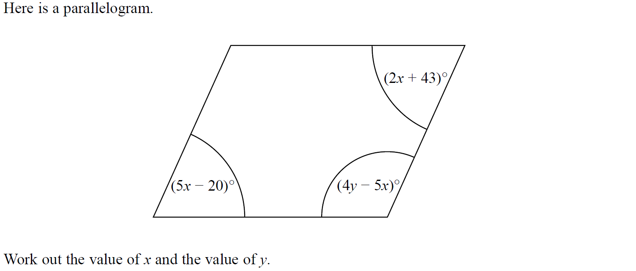
Forming Equations
SAM 1H Q8

Slide 5
Forming Equations
SAM 1H Q8
A

Slide 6
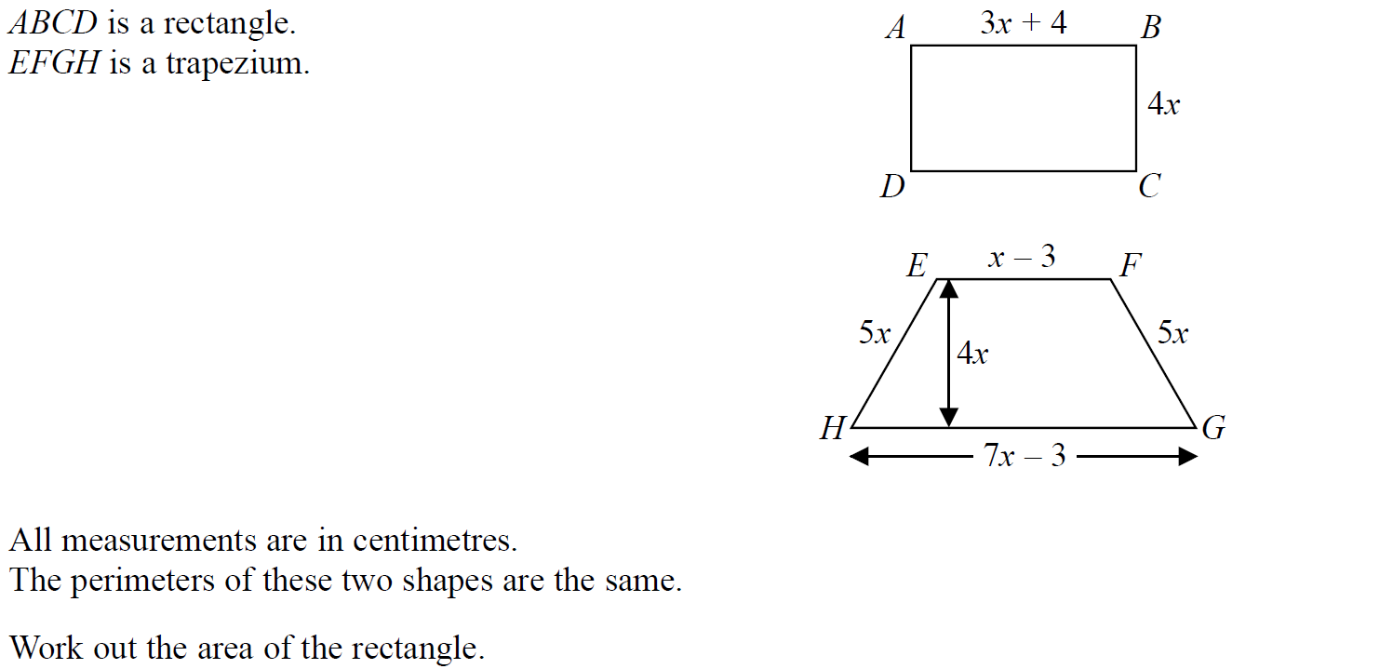
Forming Equations
SAM 2H Q9

Slide 7
Forming Equations
SAM 2H Q9
A

Slide 8
Forming Equations
SAM 3H Q3

Slide 9
Forming Equations
SAM 3H Q3
A
B
C

Slide 10
Forming Equations
Specimen Set 1 1H Q1

Slide 11
Forming Equations
Specimen Set 1 1H Q1
A

Slide 12
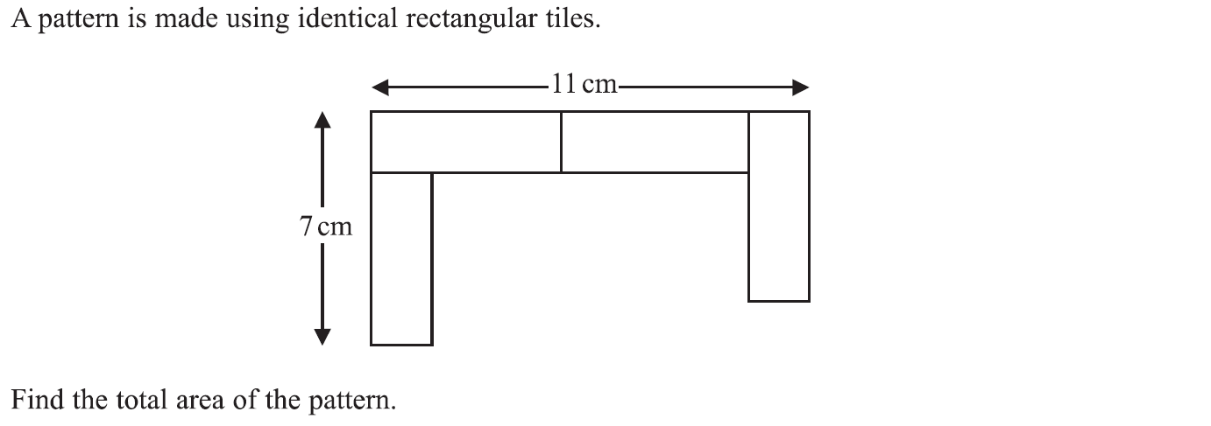
Forming Equations
Specimen Set 1 1H Q4

Slide 13
Forming Equations
Specimen Set 1 1H Q4
A

Slide 14
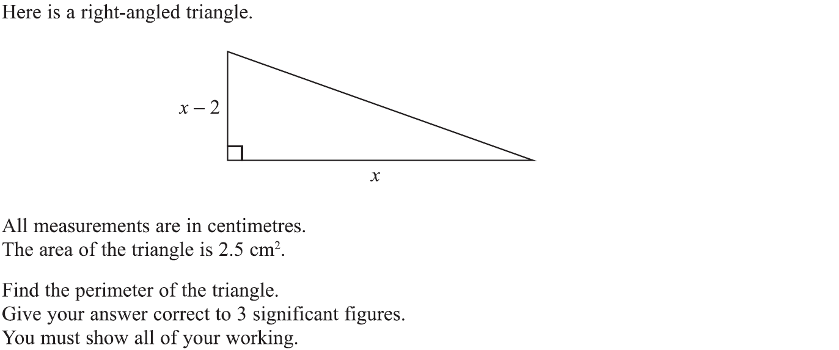
Forming Equations
Specimen Set 1 2H Q19

Slide 15
Forming Equations
Specimen Set 1 2H Q19
A

Slide 16
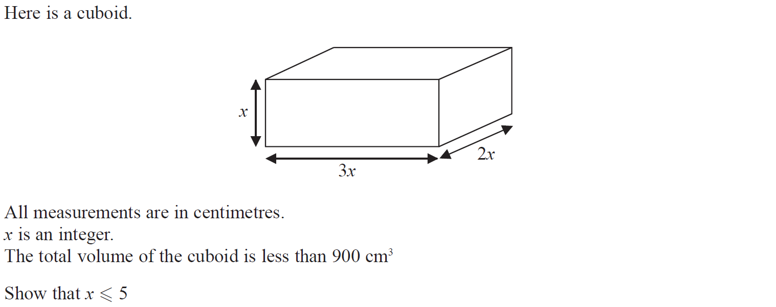
Forming Equations
Specimen Set 2 1H Q9

Slide 17
Forming Equations
Specimen Set 2 1H Q9
A

Slide 18
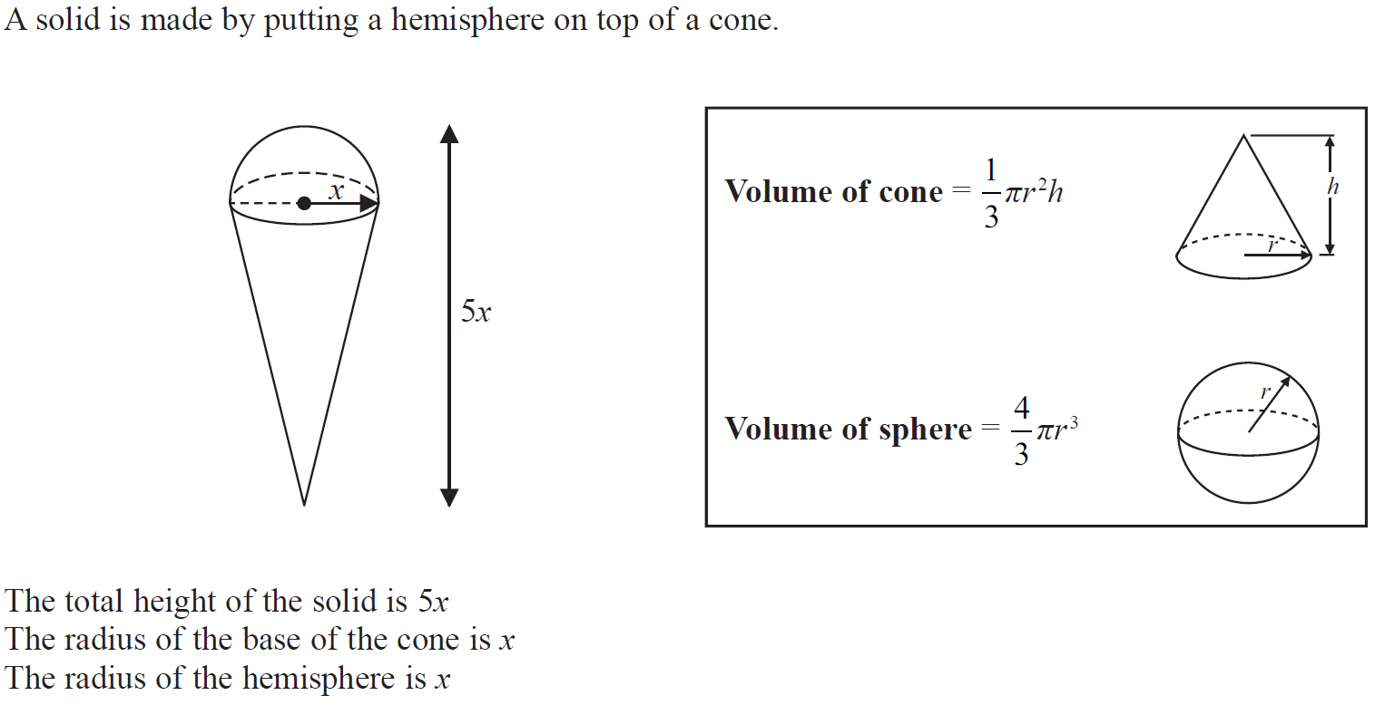
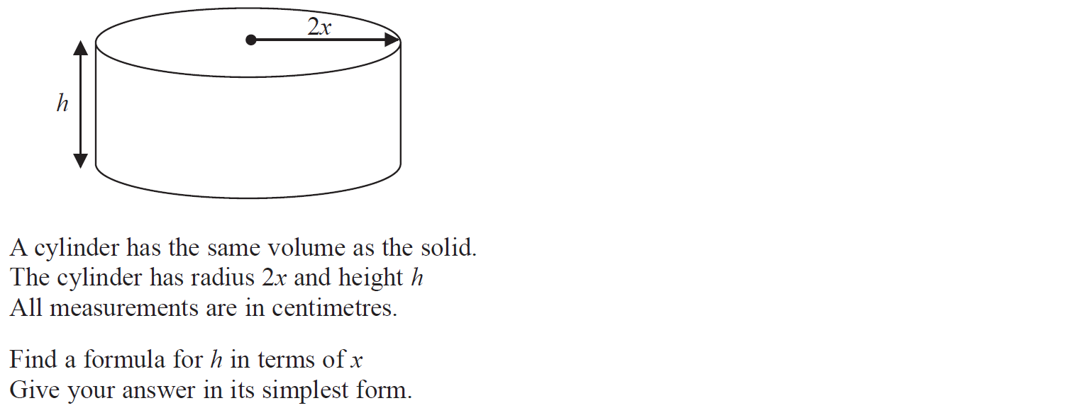
Forming Equations
Specimen Set 2 1H Q11

Slide 19
Forming Equations
Specimen Set 2 1H Q11
A

Slide 20
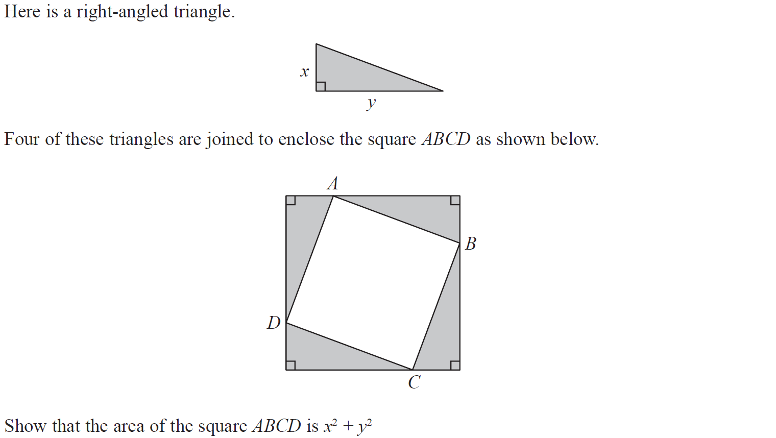
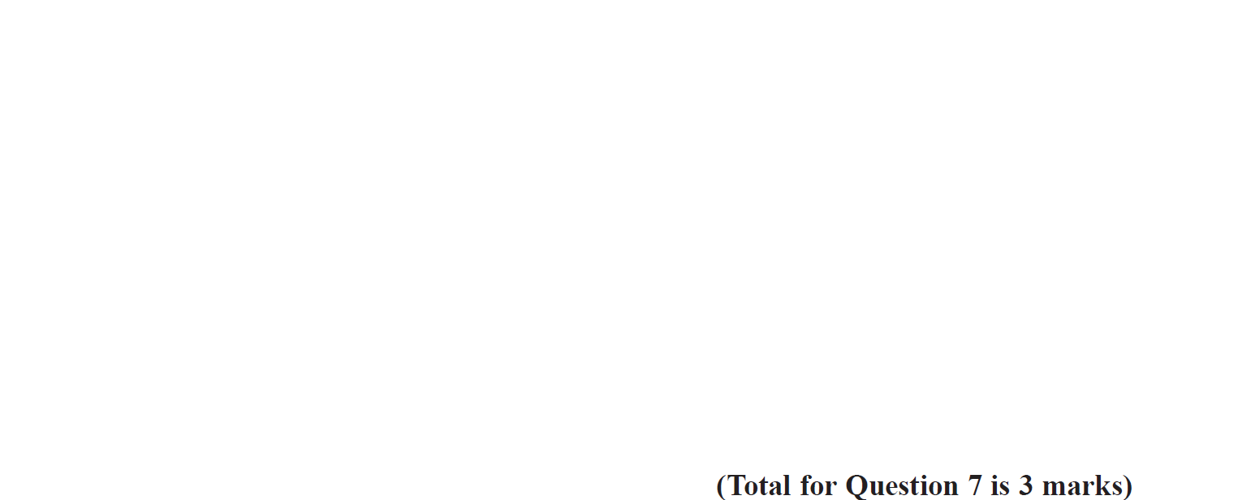
Forming Equations
Specimen Set 2 3H Q7

Slide 21
Forming Equations
Specimen Set 2 3H Q7
A

Slide 22
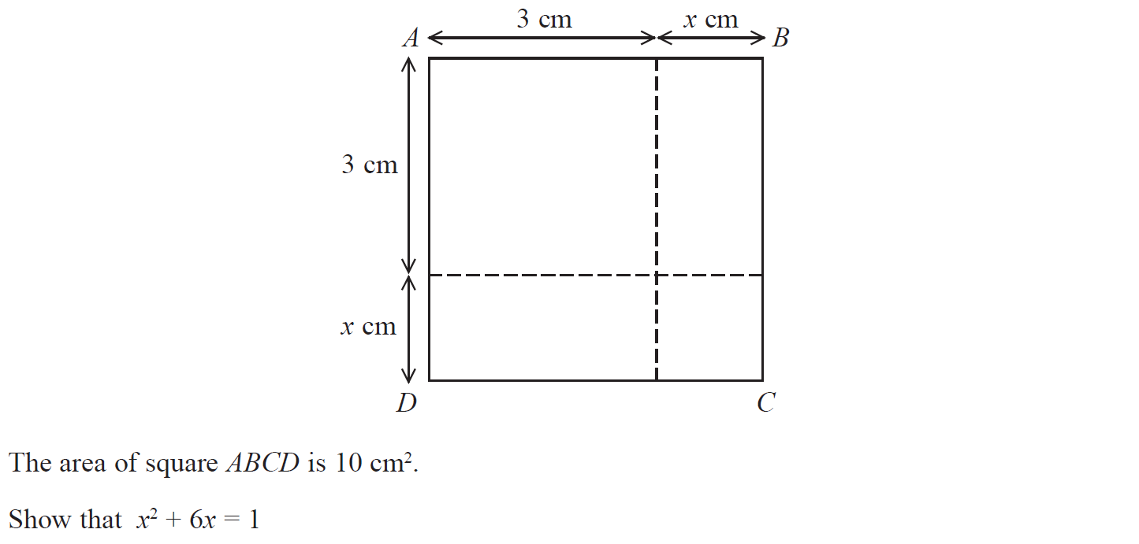
Forming Equations
May 2017 1H Q4

Slide 23
Forming Equations
May 2017 1H Q4
A

Slide 24
Forming Equations
Nov 2017 1H Q2

Slide 25
Forming Equations
Nov 2017 1H Q2
A

Slide 26
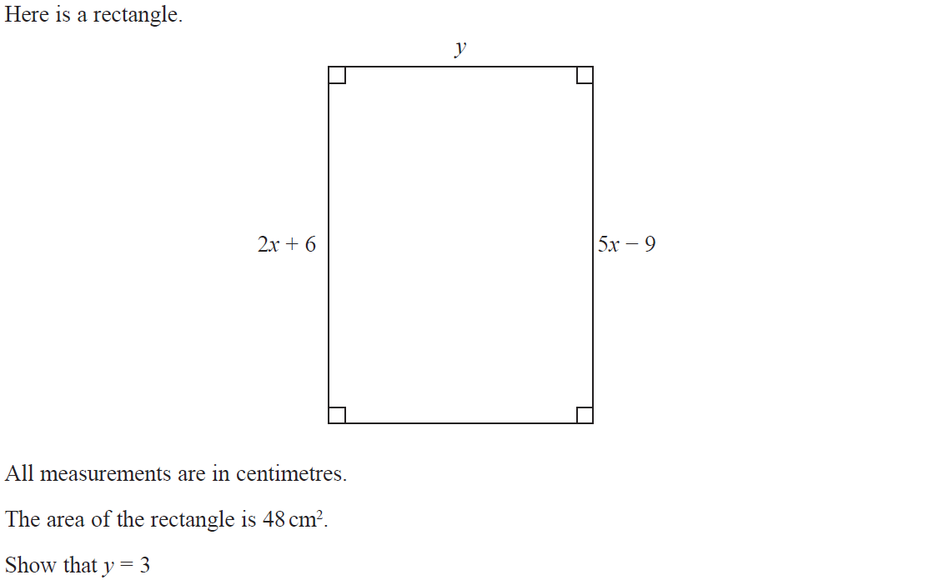
Forming Equations
Nov 2017 1H Q6

Slide 27
Forming Equations
Nov 2017 1H Q6
A

Slide 28
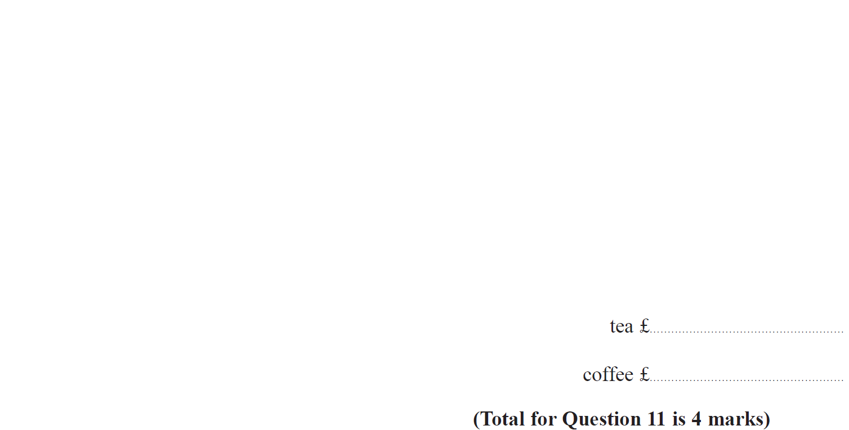
Forming Equations
Nov 2017 1H Q11

Slide 29
Forming Equations
Nov 2017 1H Q11
A

Slide 30
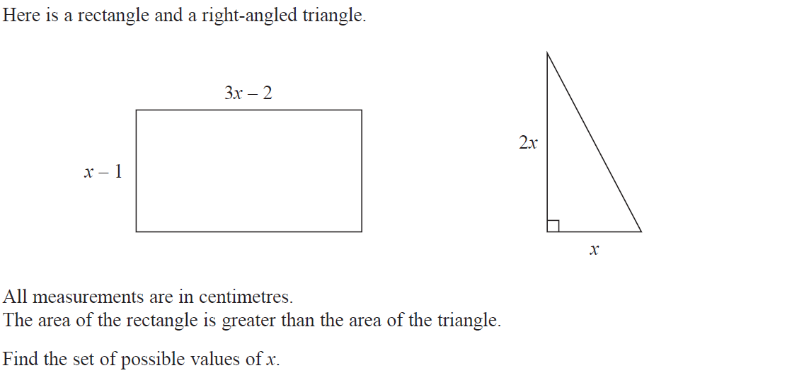
Forming Equations
Nov 2017 1H Q23

Slide 31
Forming Equations
Nov 2017 1H Q23
A

Slide 32
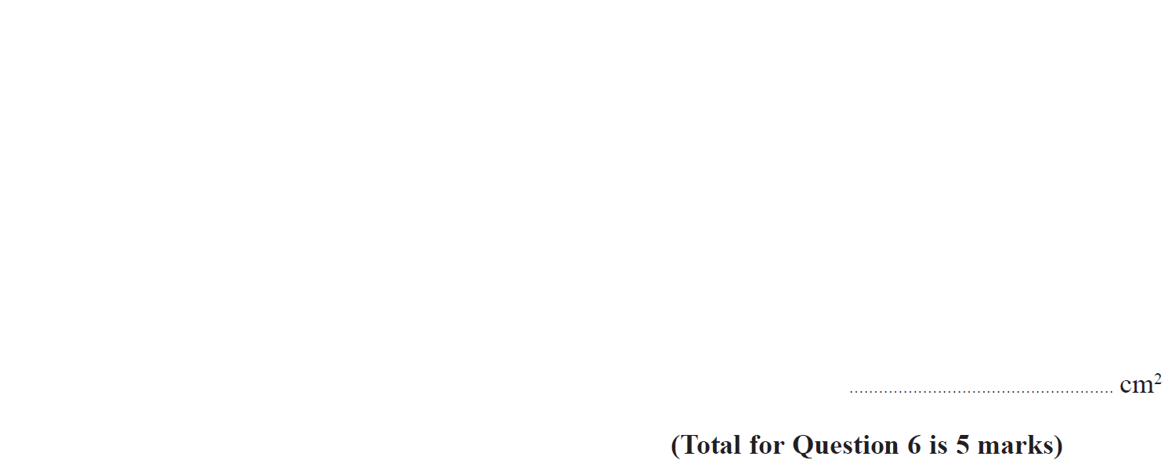
Forming Equations
Nov 2017 3H Q6

Slide 33
Forming Equations
Nov 2017 3H Q6
A

Slide 34
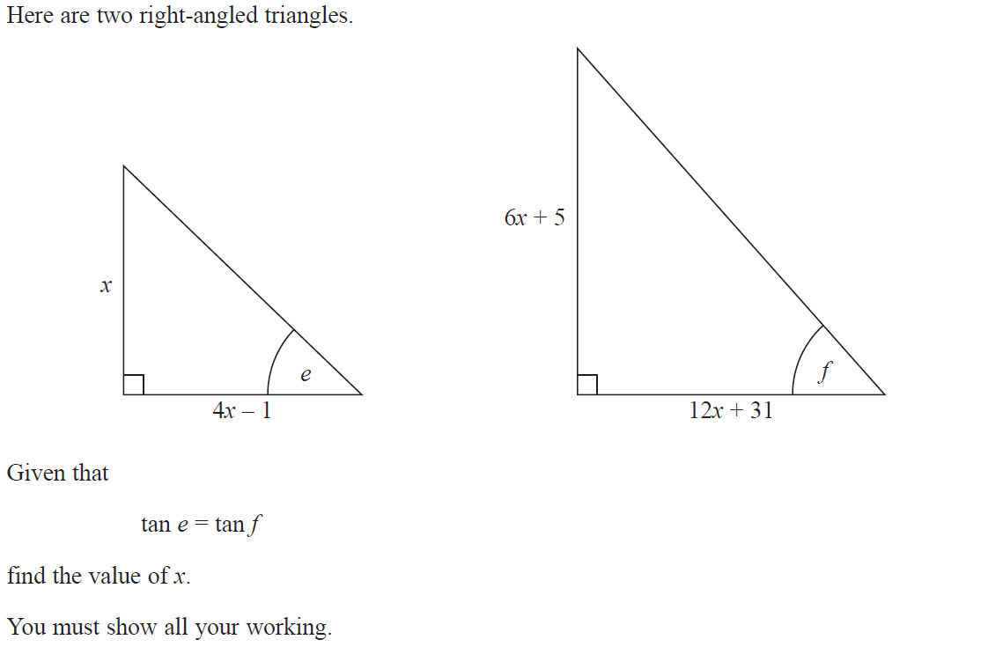
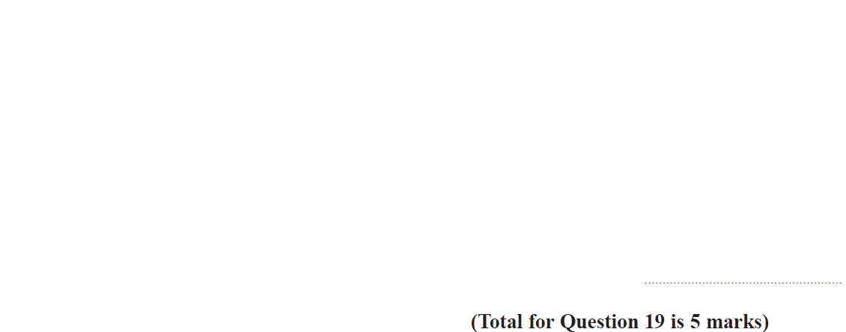
Forming Equations
June 2018 3H Q19

Slide 35
Forming Equations
June 2018 3H Q19
A

Slide 36
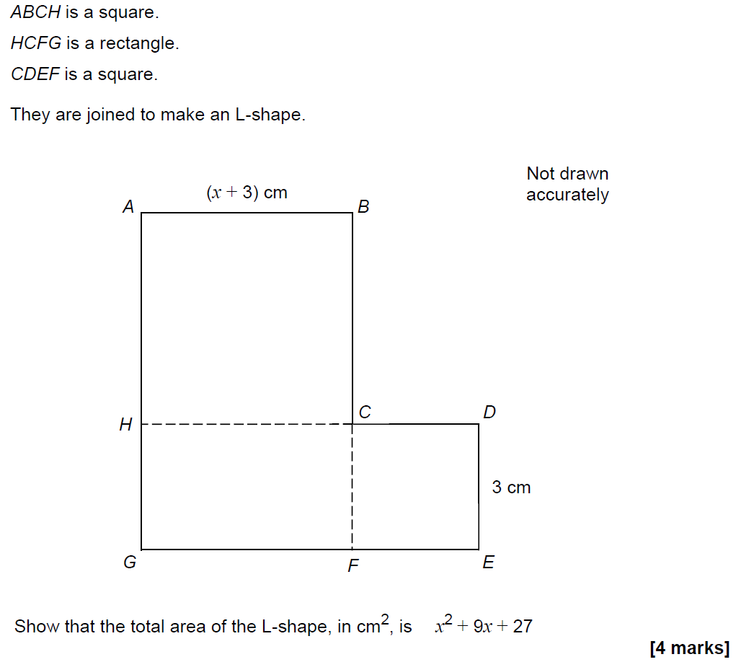
Forming Equations
SAM 1H Q12

Slide 37
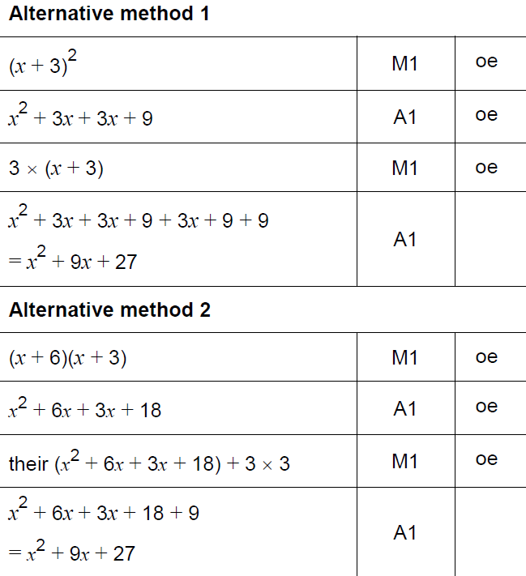
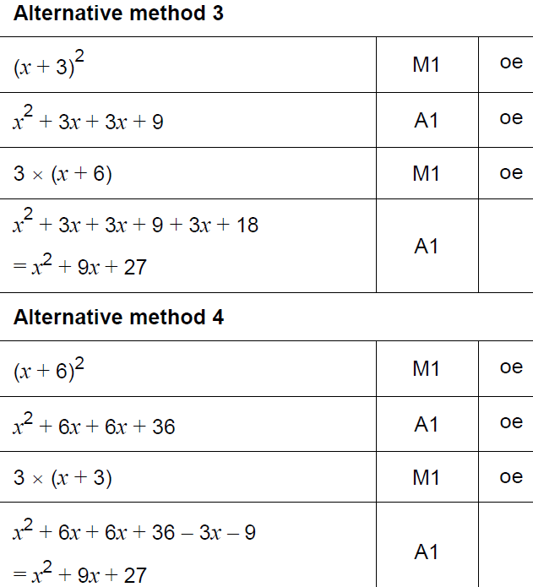
Forming Equations
SAM 1H Q12
A

Slide 38
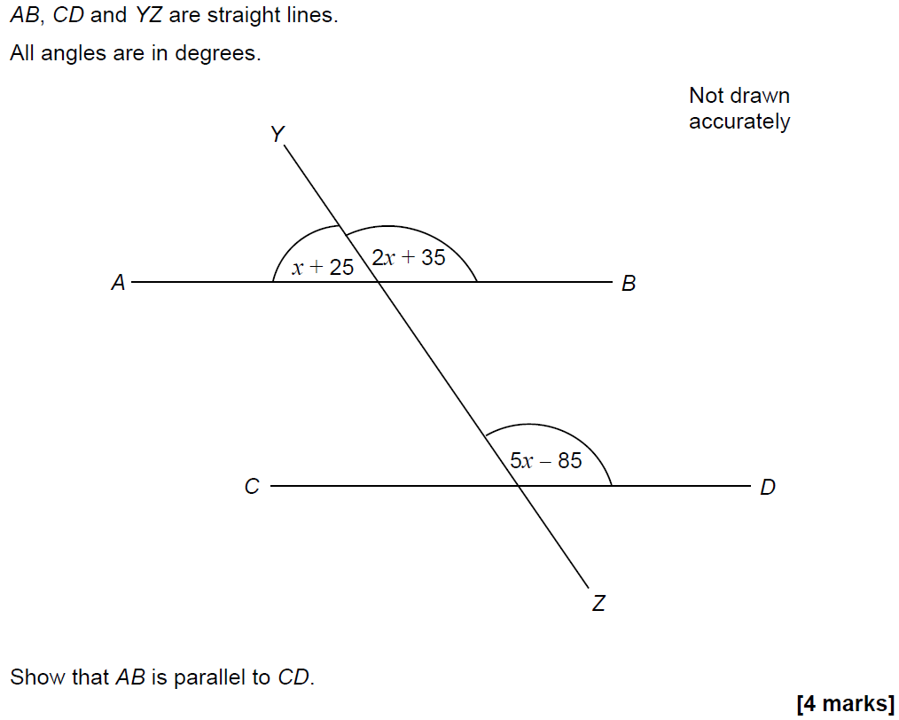
Forming Equations
SAM 1H Q16

Slide 39
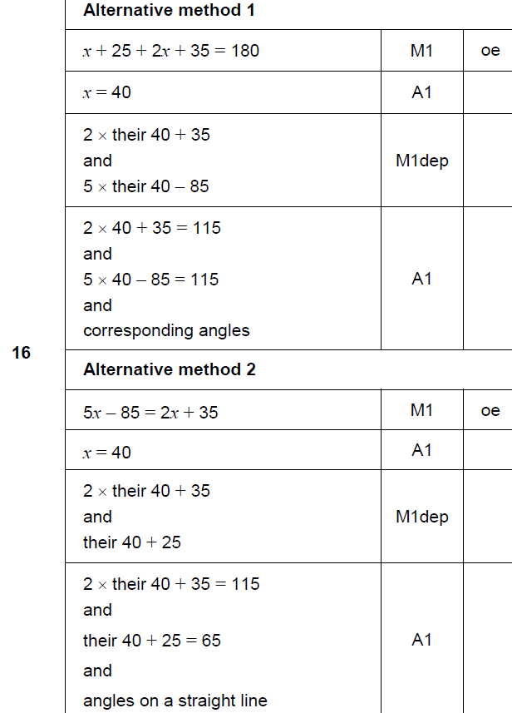
Forming Equations
SAM 1H Q16
A

Slide 40
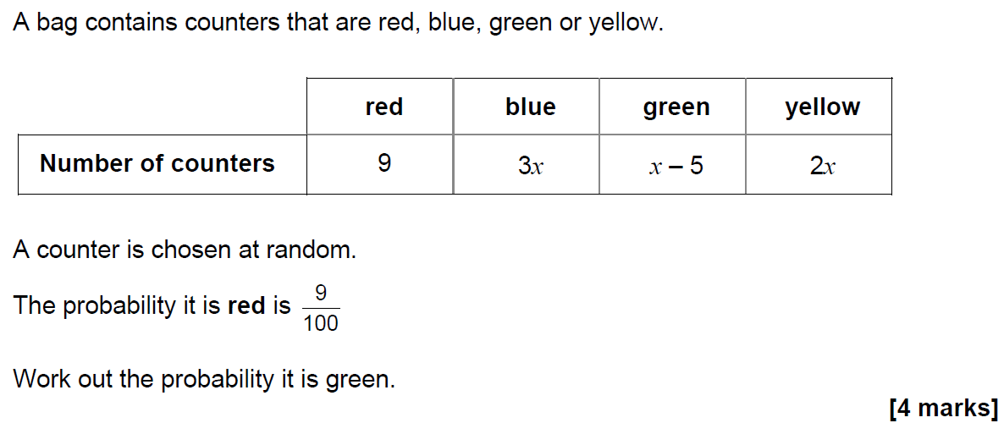
Forming Equations
SAM 3H Q6

Slide 41
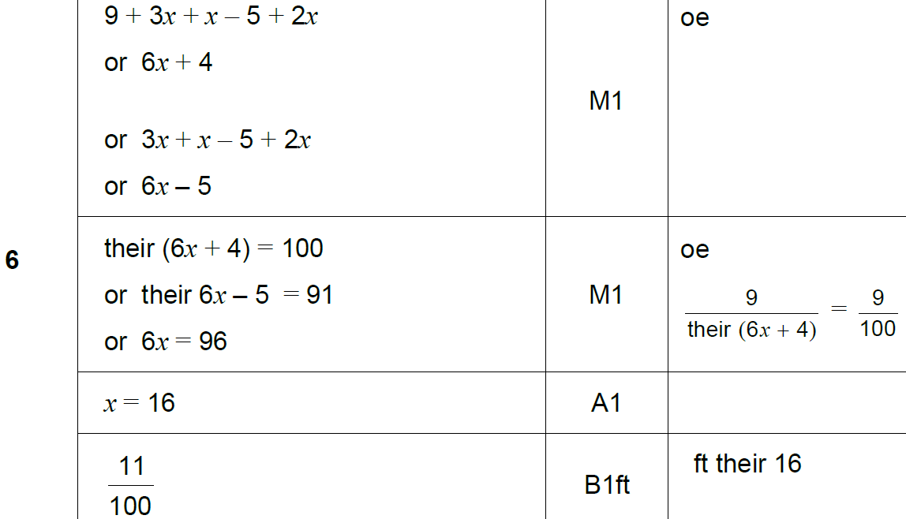
Forming Equations
SAM 3H Q6
A

Slide 42
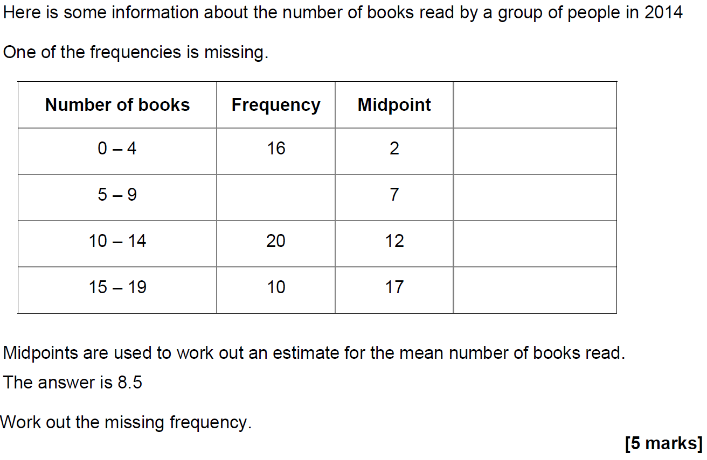
Forming Equations
SAM 3H Q18

Slide 43
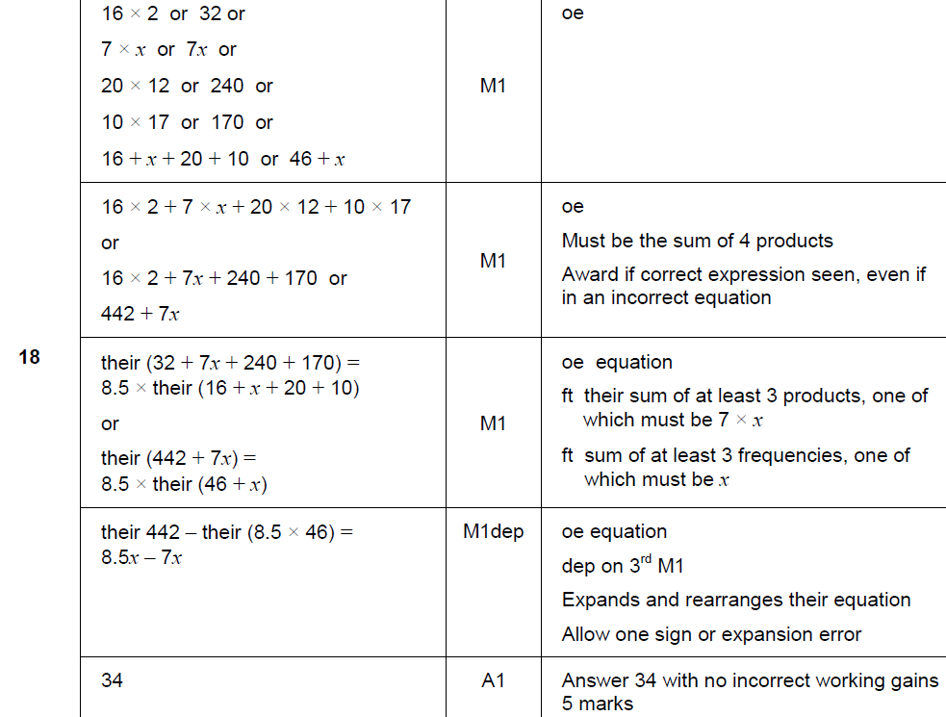
Forming Equations
SAM 3H Q18
A

Slide 44
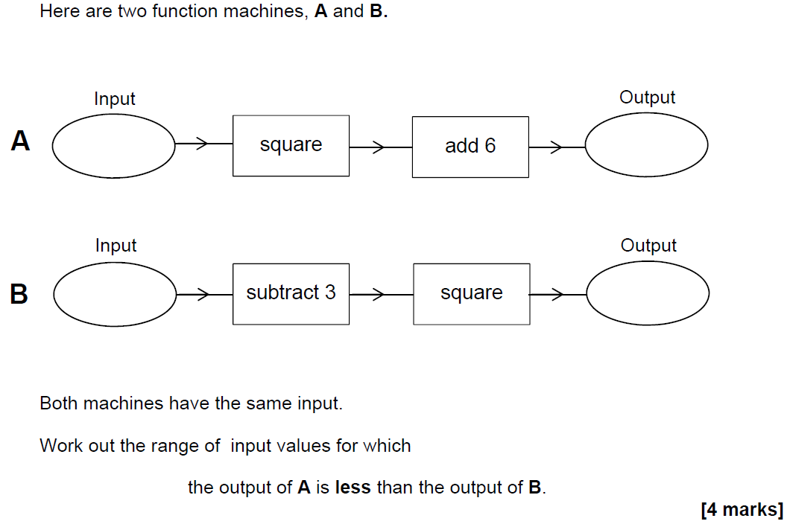
Forming Equations
SAM 3H Q19

Slide 45
Forming Equations
SAM 3H Q19
A

Slide 46
Forming Equations
June 2017 2H Q9

Slide 47
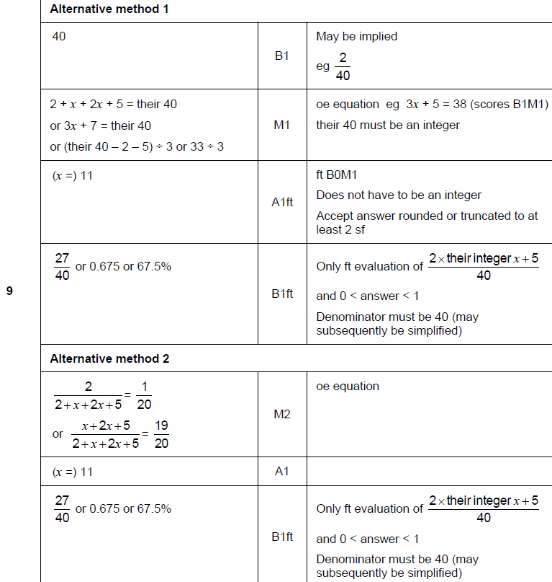
Forming Equations
June 2017 2H Q9
A

Slide 48
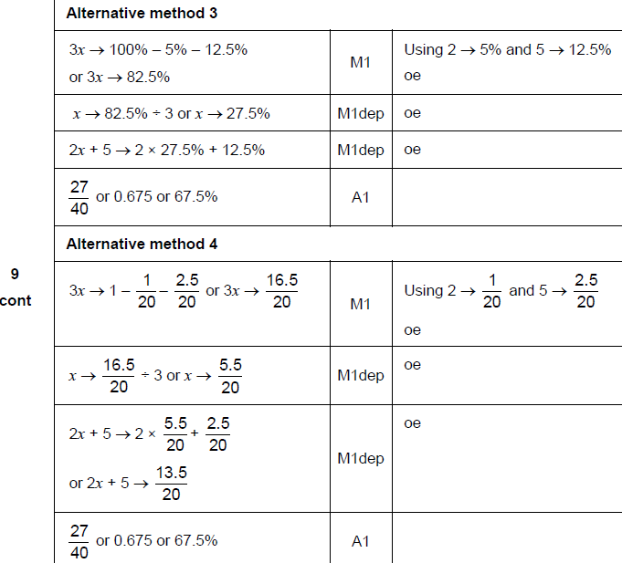
Forming Equations
June 2017 2H Q9
A Alternatives

Slide 49
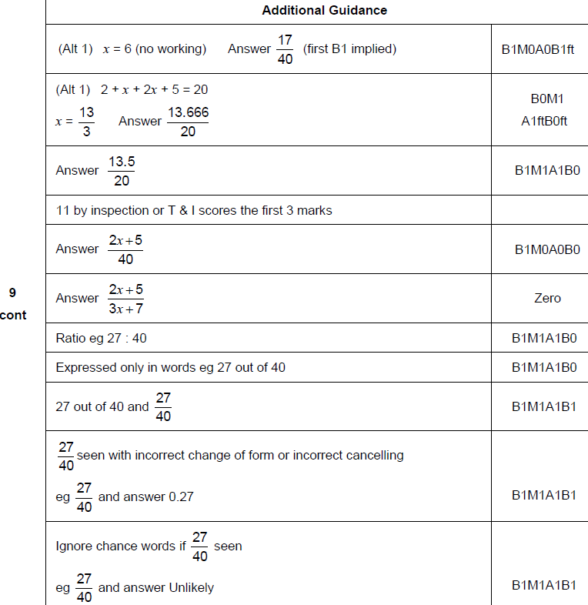
Forming Equations
June 2017 2H Q9
A notes

Slide 50
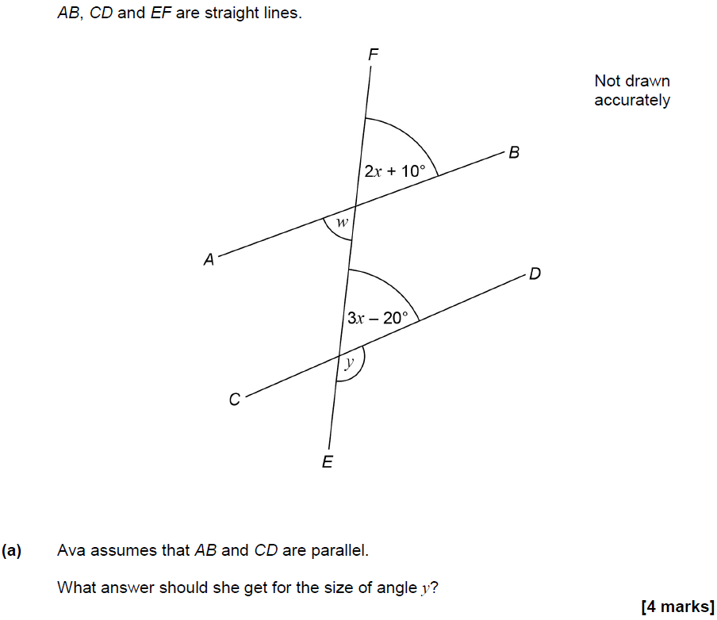
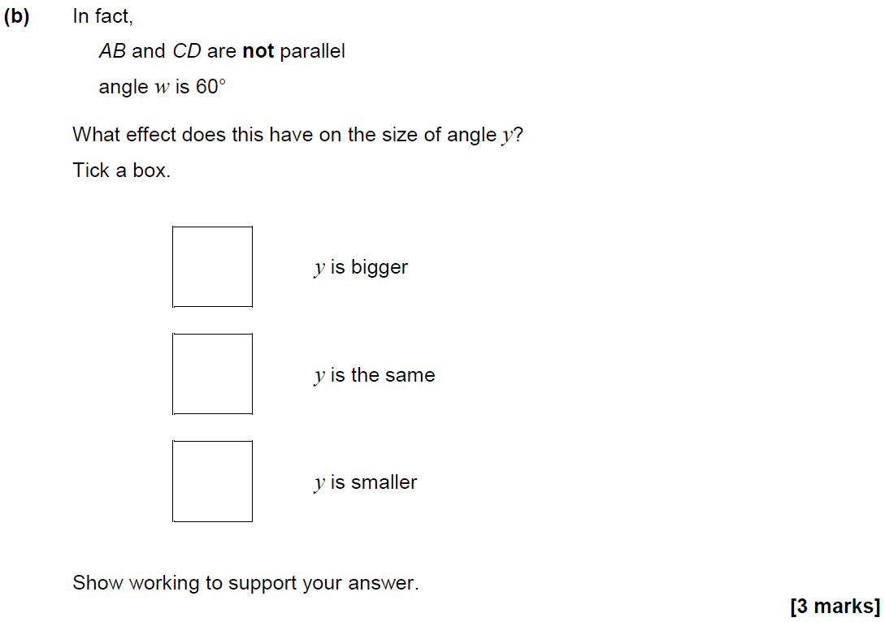
Forming Equations
June 2017 3H Q10

Slide 51
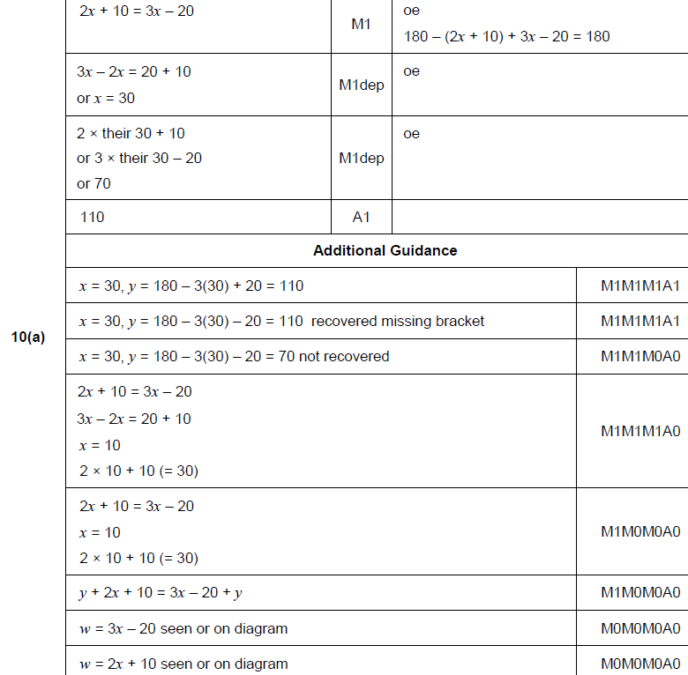
Forming Equations
June 2017 3H Q10
A

Slide 52
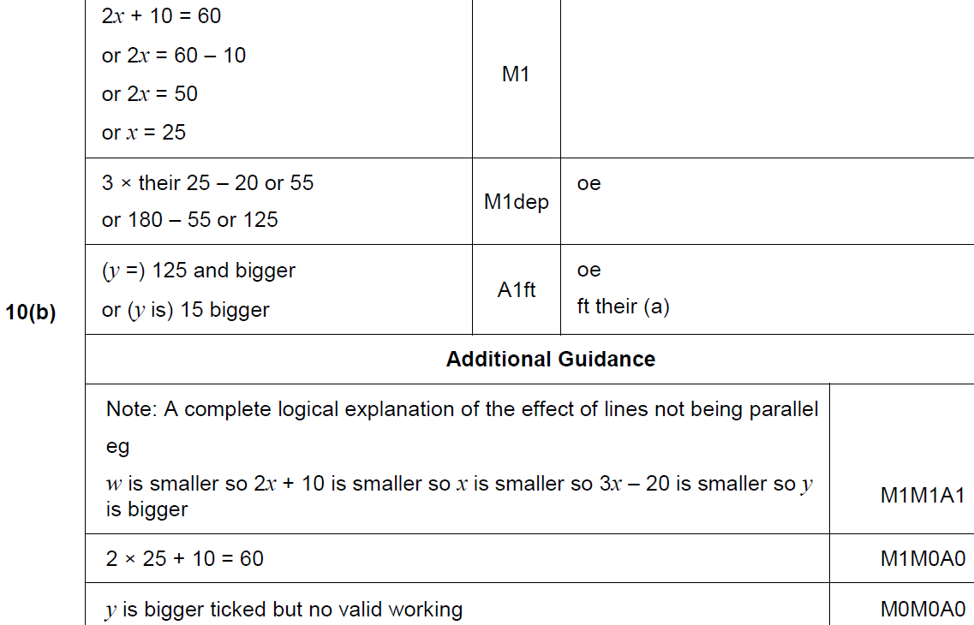
Forming Equations
June 2017 3H Q10
B

Slide 53
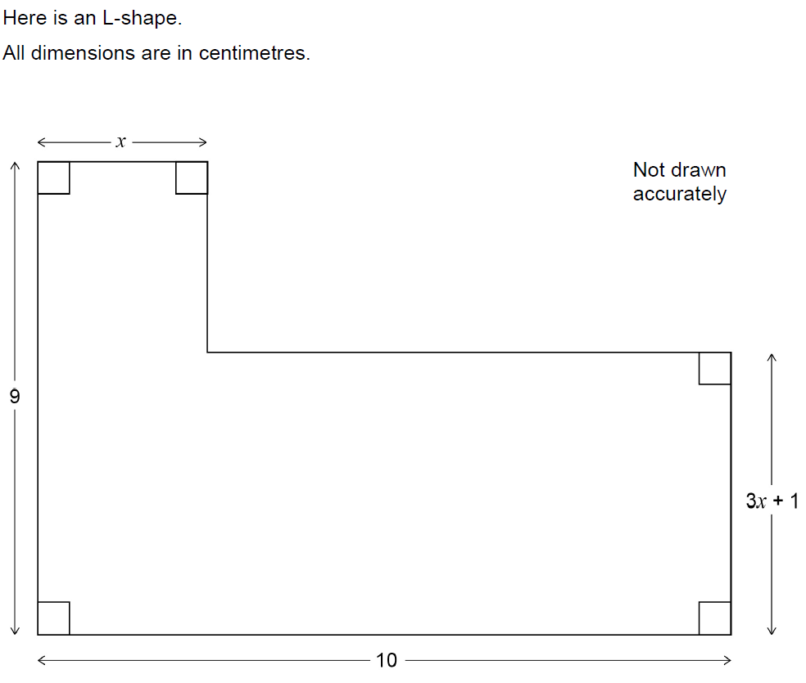
Forming Equations
June 2017 3H Q26

Slide 54
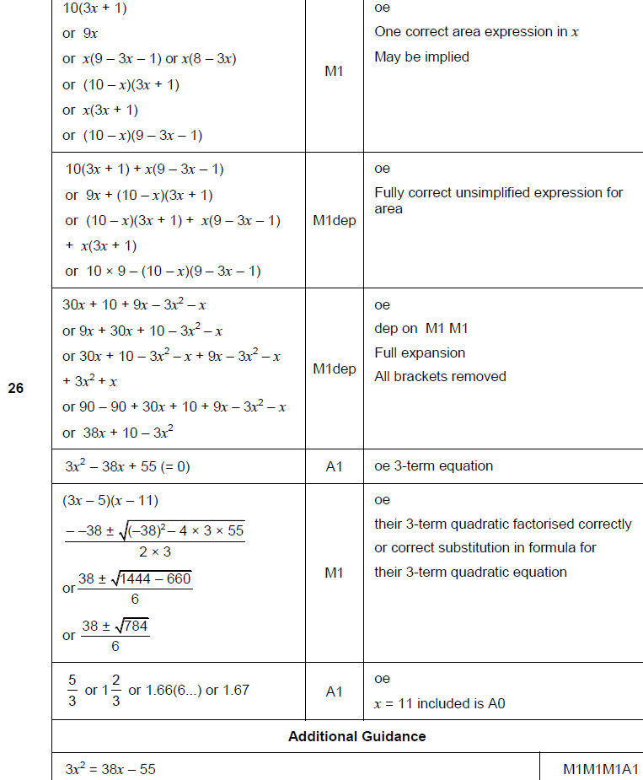
Forming Equations
June 2017 3H Q26
A

Slide 55
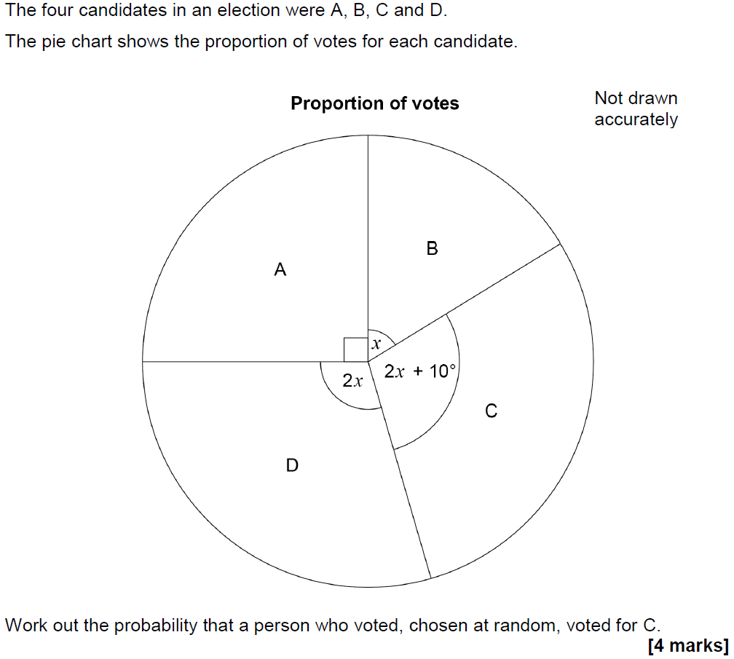
Forming Equations
Nov 2017 1H Q11

Slide 56
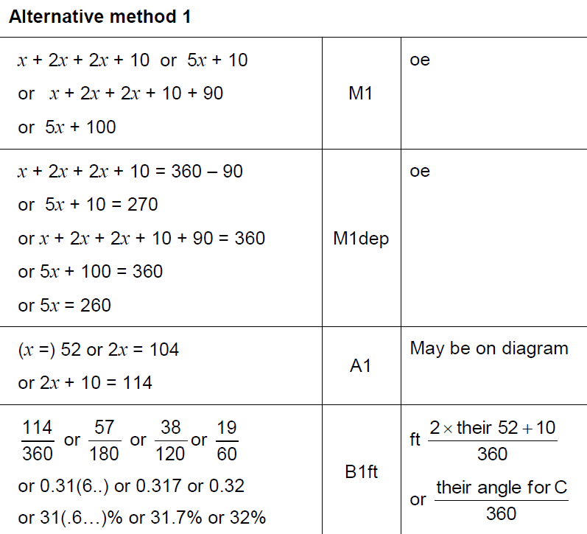
Forming Equations
Nov 2017 1H Q11
A

Slide 57
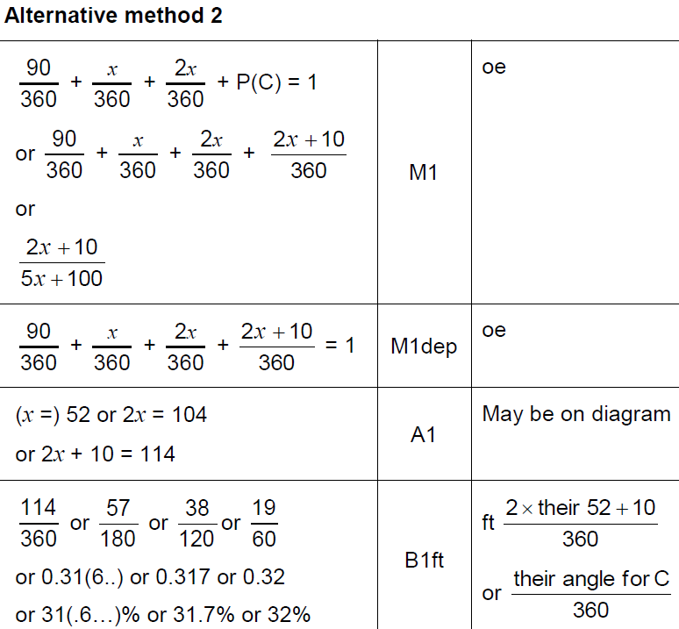
Forming Equations
Nov 2017 1H Q11
A Alternative

Slide 58
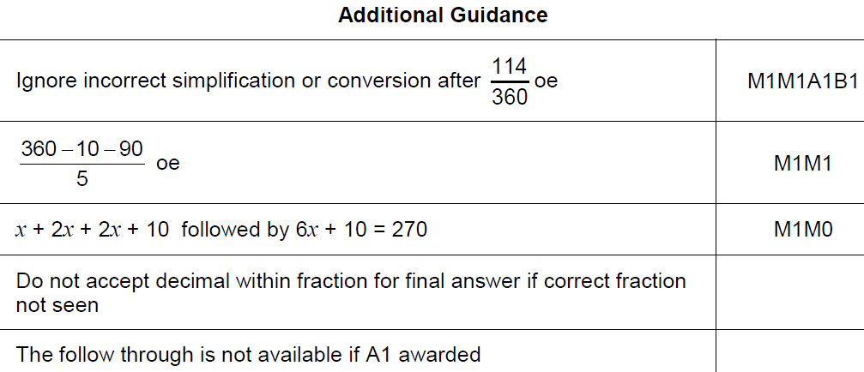
Forming Equations
Nov 2017 1H Q11
A notes

Slide 59
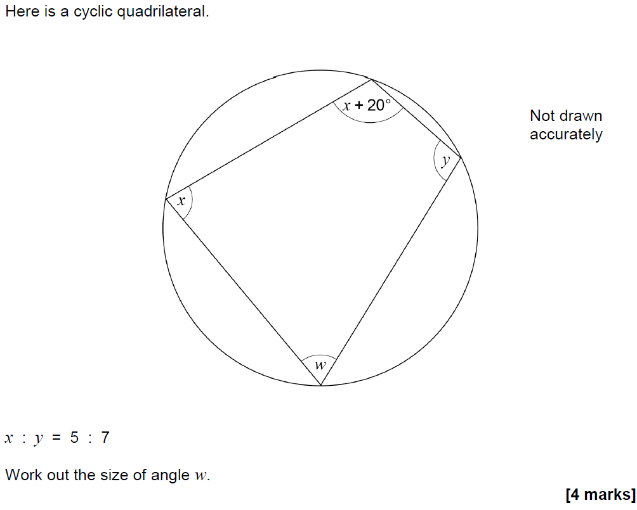
Forming Equations
Nov 2017 1H Q24

Slide 60
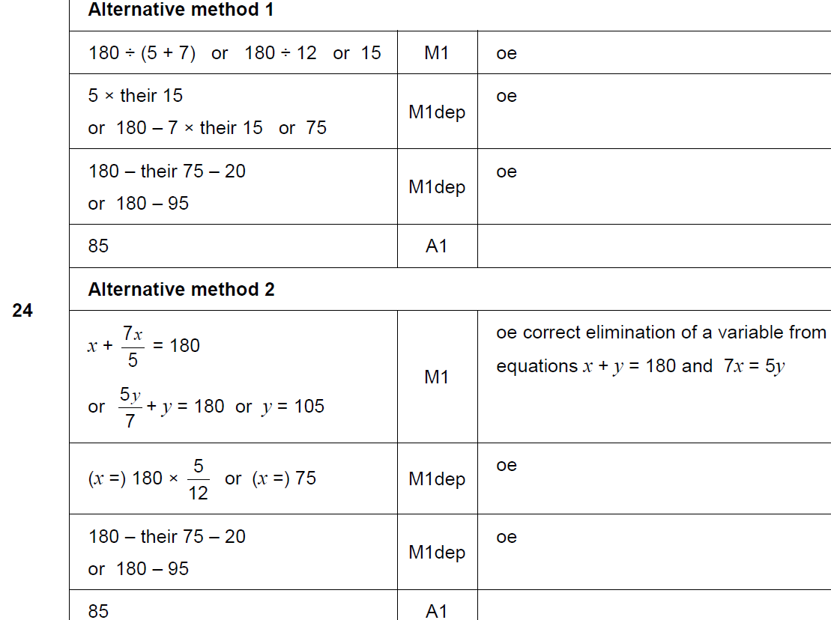
Forming Equations
Nov 2017 1H Q24
A

Slide 61
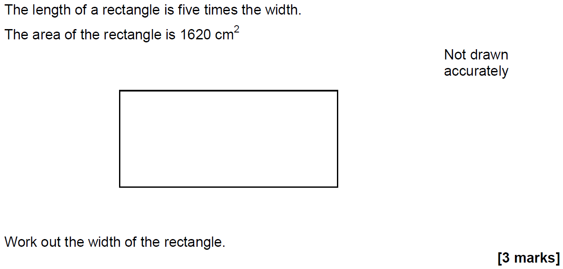
Forming Equations
Nov 2017 2H Q19

Slide 62
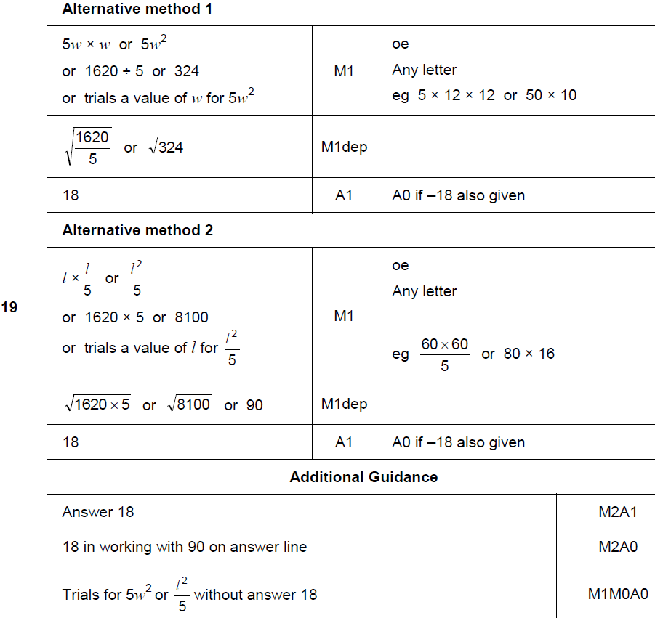
Forming Equations
Nov 2017 2H Q19
A

Slide 63
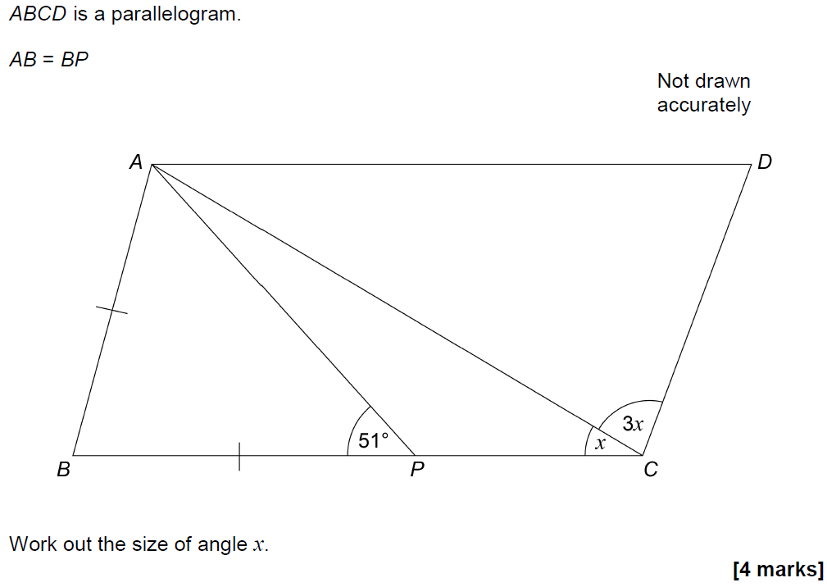
Forming Equations
Nov 2017 3H Q8

Slide 64
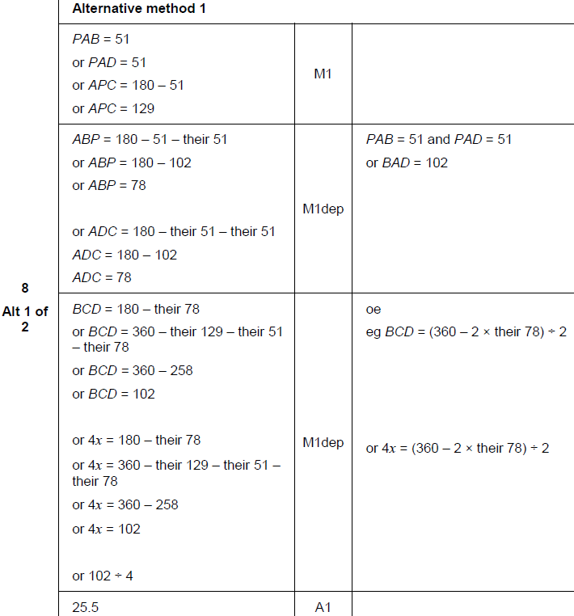
Forming Equations
Nov 2017 3H Q8
A

Slide 65
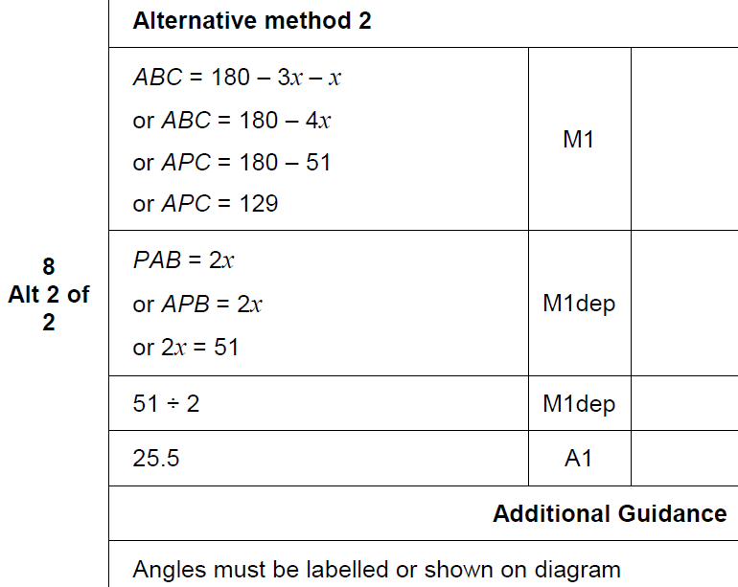
Forming Equations
Nov 2017 3H Q8
A Alternative & notes

Slide 66
Forming Equations
May 2018 1H Q11

Slide 67
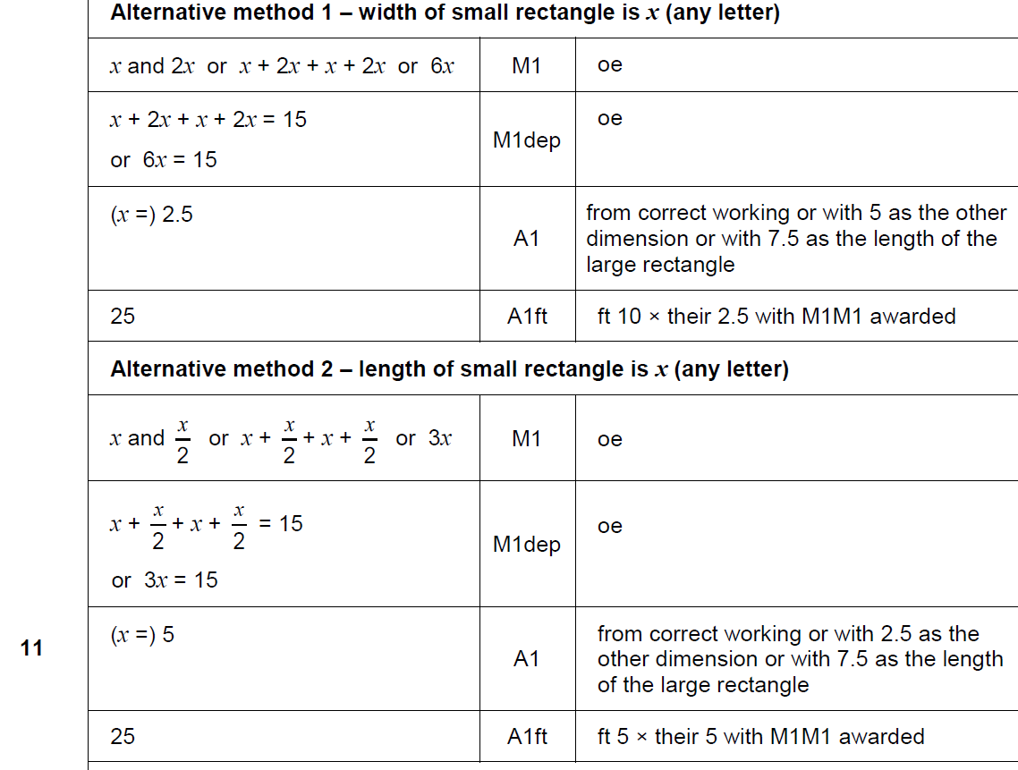
Forming Equations
May 2018 1H Q11
A

Slide 68
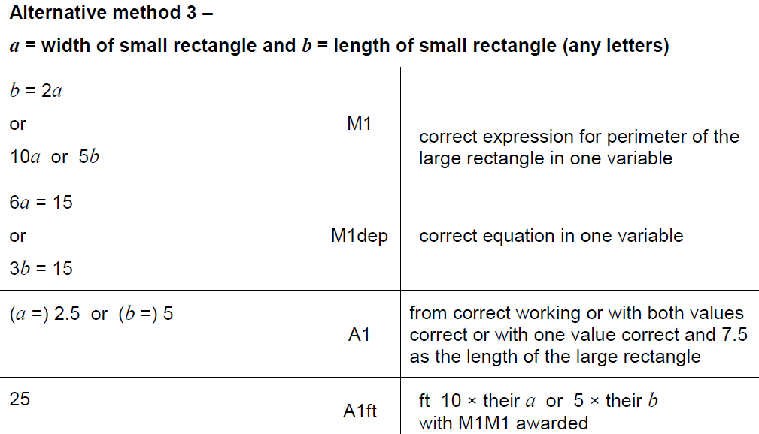
Forming Equations
May 2018 1H Q11
A Alternative 2

Slide 69
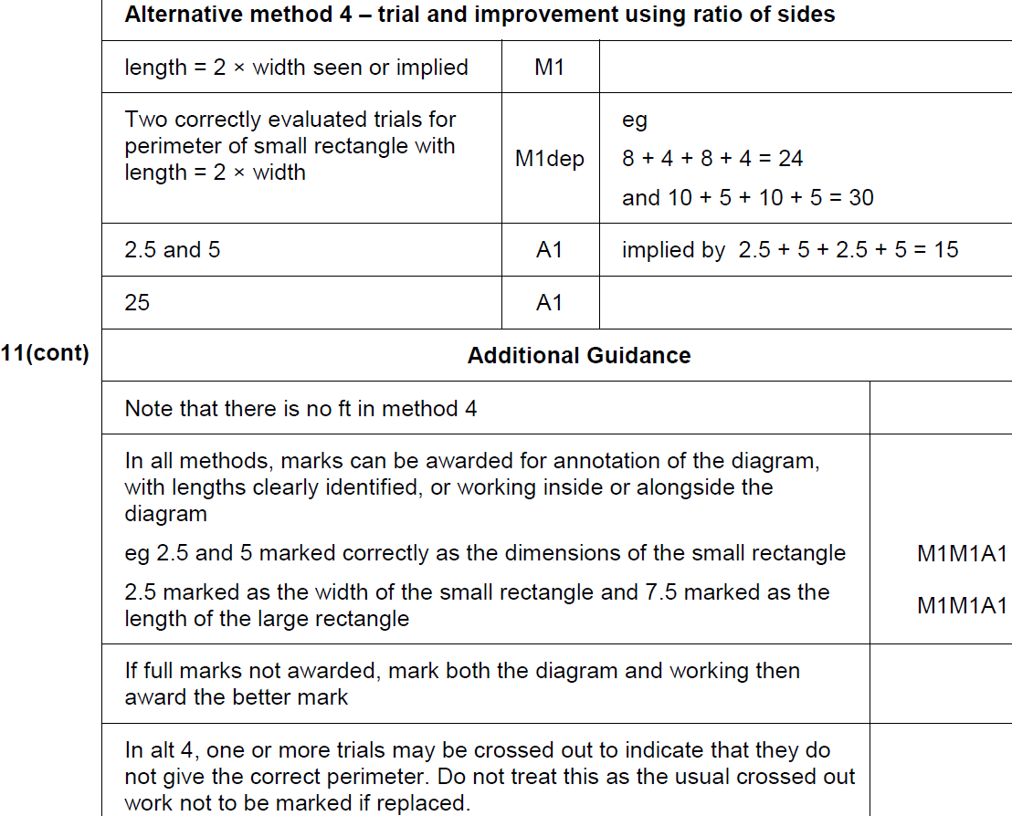
Forming Equations
May 2018 1H Q11
A Alternative 2 & notes

Slide 70
Forming Equations
June 2018 2H Q25

Slide 71
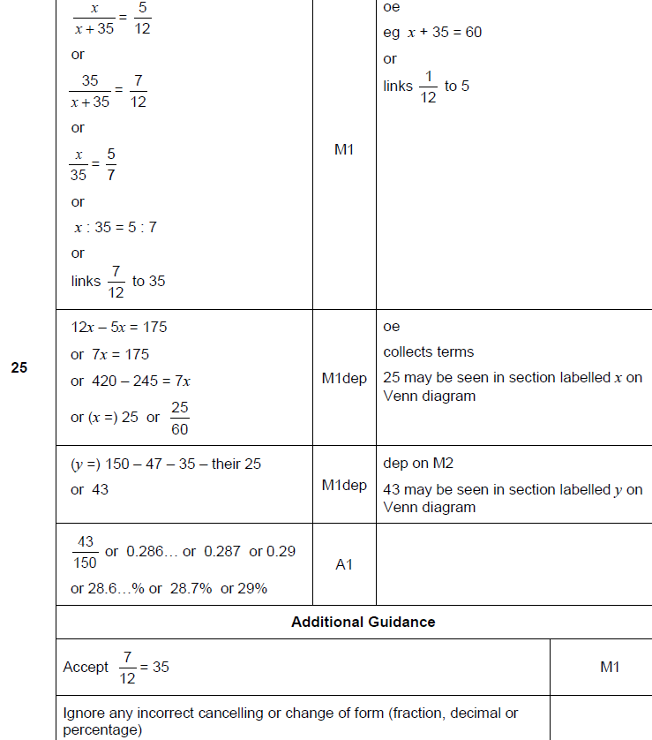
Forming Equations
June 2018 2H Q25
A

Slide 72
Forming Equations
June 2018 3H Q15

Slide 73
Forming Equations
June 2018 3H Q15
A

Slide 74
Forming Equations
Nov 2018 1H Q19
In a chess club, there are x boys and y girls.
(a) If 5 more boys and 8 more girls join, there would be half as many boys as girls.
Show that y = 2x + 2
[2 marks]
(b) If instead,
10 more boys and 1 more girl join, there would be the same number of boys and girls.
Work out x and y.
[3 marks]

Slide 75
Forming Equations
Nov 2018 1H Q19
A
B

Slide 76
Forming Equations
Nov 2018 2H Q10

Slide 77
Forming Equations
Nov 2018 2H Q10
A

Slide 78
Forming Equations
SAM 1H Q5

Slide 79
Forming Equations
SAM 1H Q5
A

Slide 80
Forming Equations
SAM 2H Q5

Slide 81
Forming Equations
SAM 2H Q5
A

Slide 82
Forming Equations
SAM 2H Q6

Slide 83
Forming Equations
SAM 2H Q6
A

Slide 84
Forming Equations
SAM 2H Q19

Slide 85
Forming Equations
SAM 2H Q19
A

Slide 86
Forming Equations
SAM 3H Q9

Slide 87
Forming Equations
SAM 3H Q9
A

Slide 88
Forming Equations
Practice 1H Q4

Slide 89
Forming Equations
Practice 1H Q4
A

Slide 90
Forming Equations
Practice 1H Q8

Slide 91
Forming Equations
Practice 1H Q8
A

Slide 92
Forming Equations
Practice 2H Q6

Slide 93
Forming Equations
Practice 2H Q6
A

Slide 94
Forming Equations
Practice 3H Q17

Slide 95
Forming Equations
Practice 3H Q17
A
B

Slide 96
Forming Equations
May 2017 1H Q9

Slide 97
Forming Equations
May 2017 1H Q9
A
B

Slide 98
Forming Equations
Nov 2017 2H Q6

Slide 99
Forming Equations
Nov 2017 2H Q6
A

Slide 100
Forming Equations
May 2018 1H Q9

Slide 101
Forming Equations
May 2018 1H Q9
A

Slide 102
Forming Equations
Nov 2018 1H Q5

Slide 103
Forming Equations
Nov 2018 1H Q5
A

Slide 104
Forming Equations
Nov 2018 3H Q11

Slide 105
Forming Equations
Nov 2018 3H Q11
A

Slide 106
Forming Equations
Nov 2018 3H Q12

Slide 107
Forming Equations
Nov 2018 3H Q12
A

