Slide 1
Forming Equations
Forming Equations
June 2017
2H Q9
Nov 2017
3H Q8
SAM
1H Q12
June 2017
3H Q10
May 2018
1H Q11
SAM
1H Q16
June 2017
3H Q26
June 2018
2H Q25
SAM
3H Q6
1 Marker
Nov 2017
1H Q11
June 2018
3H Q15
SAM
3H Q18
Nov 2017
1H Q24
Nov 2018
1H Q19
SAM
3H Q19
Nov 2017
2H Q19
Nov 2018
2H Q10

Slide 2
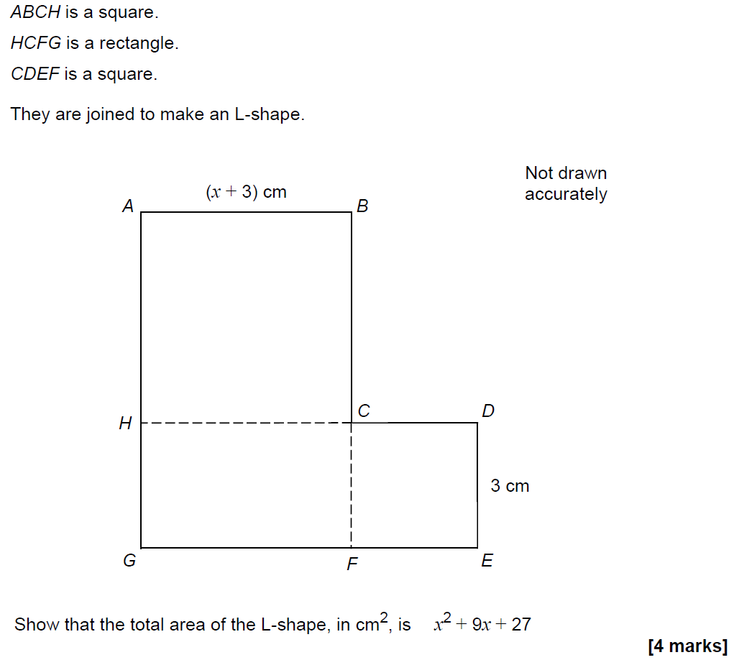
Forming Equations
SAM 1H Q12

Slide 3
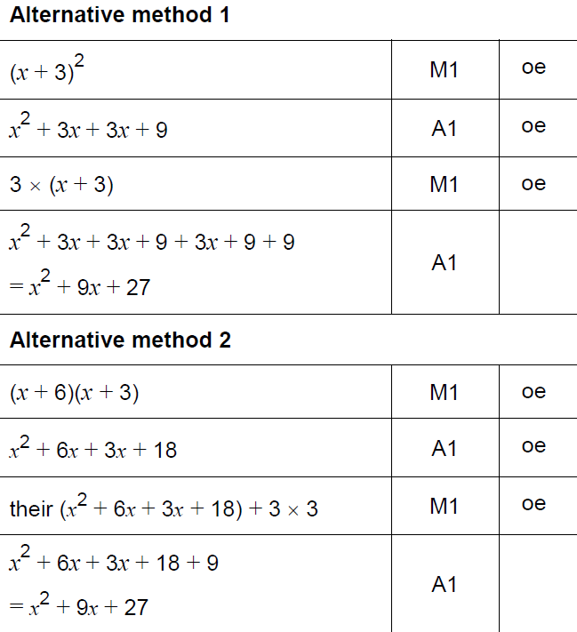
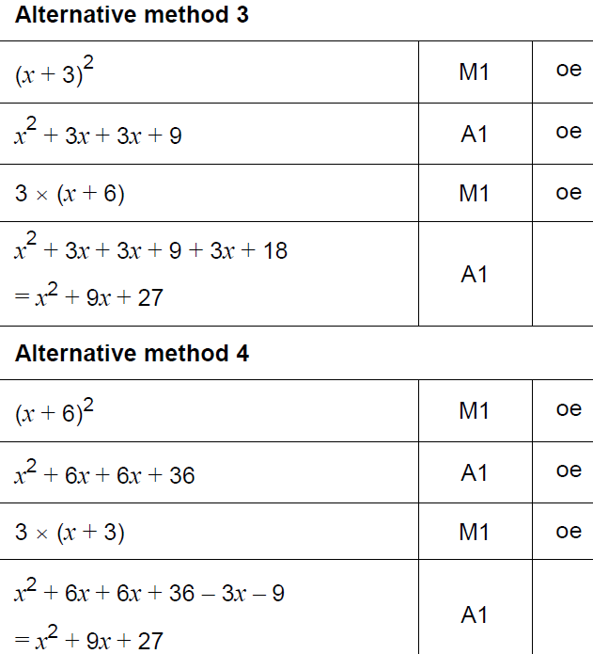
Forming Equations
SAM 1H Q12
A

Slide 4
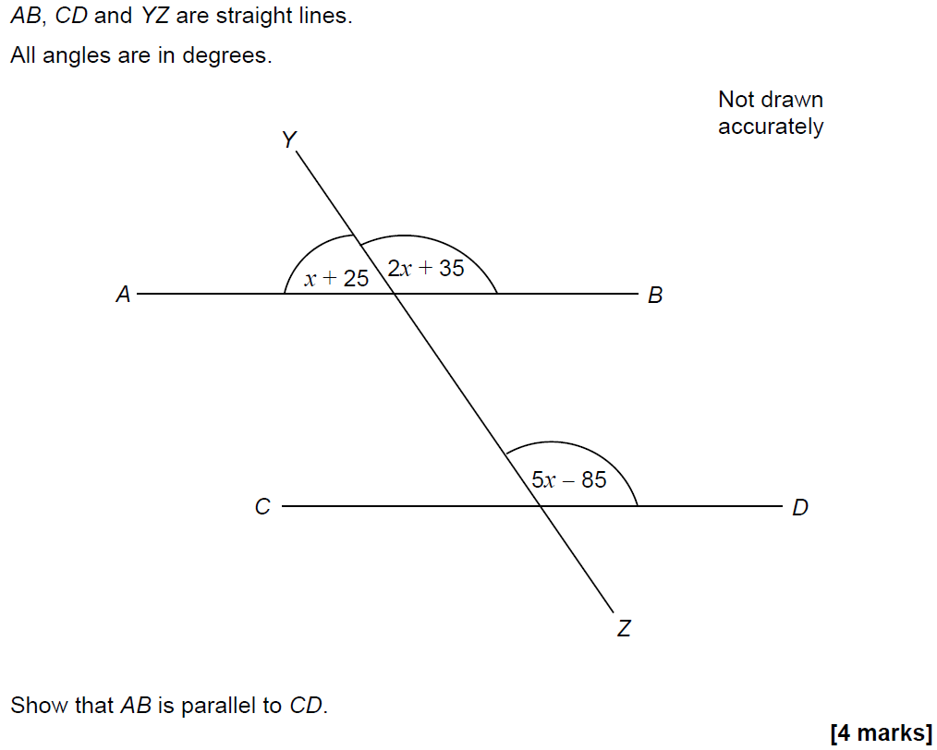
Forming Equations
SAM 1H Q16

Slide 5
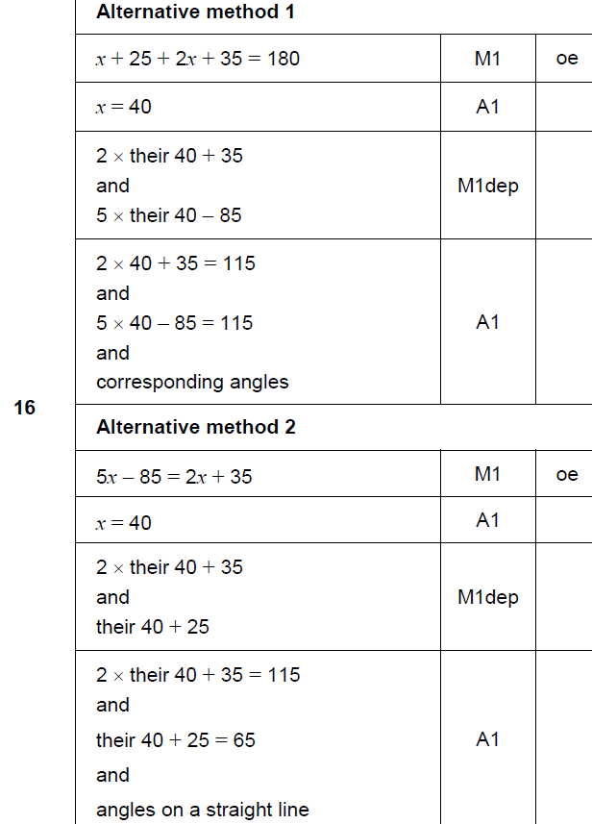
Forming Equations
SAM 1H Q16
A

Slide 6
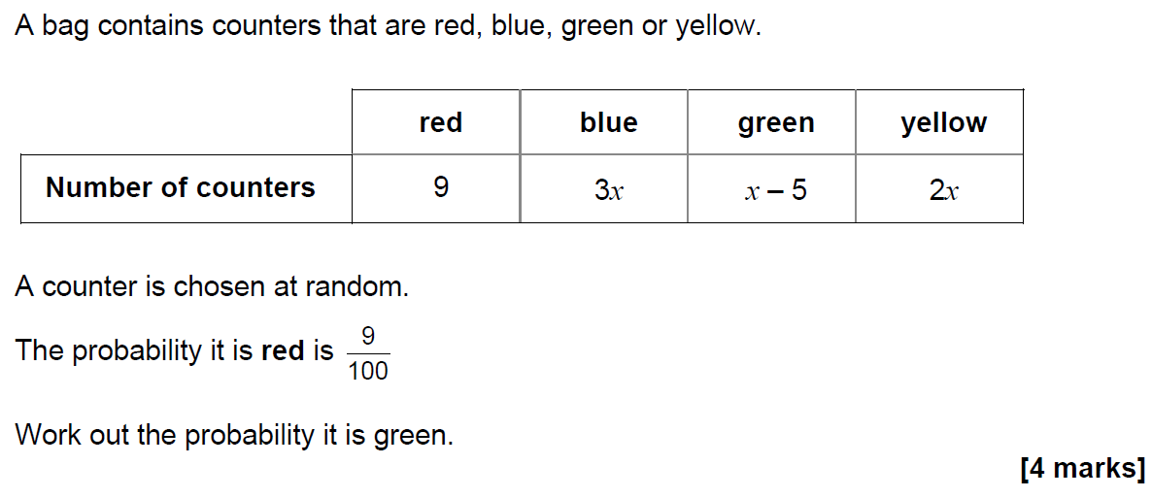
Forming Equations
SAM 3H Q6

Slide 7
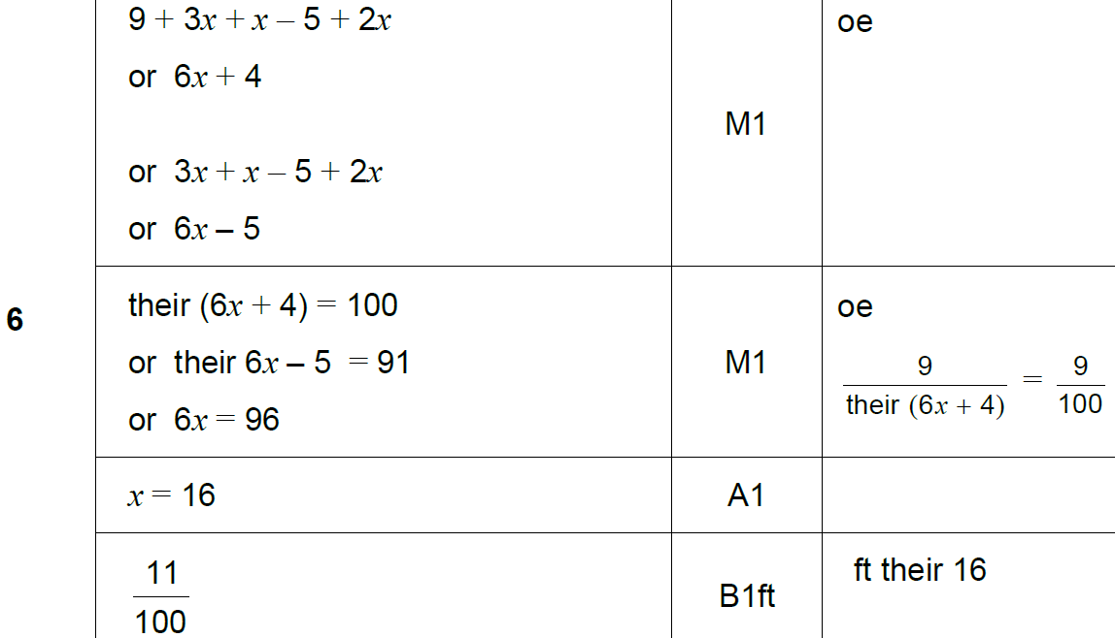
Forming Equations
SAM 3H Q6
A

Slide 8
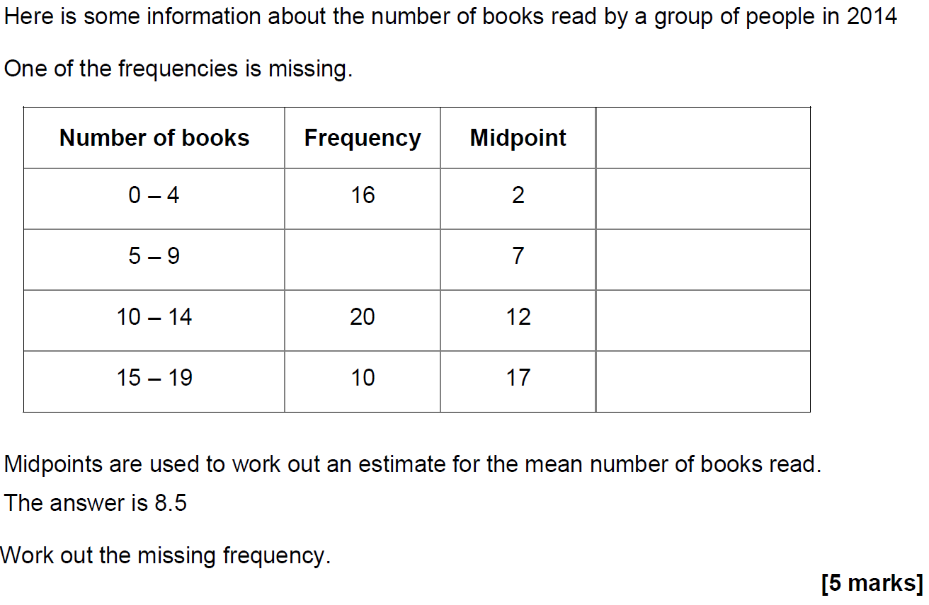
Forming Equations
SAM 3H Q18

Slide 9
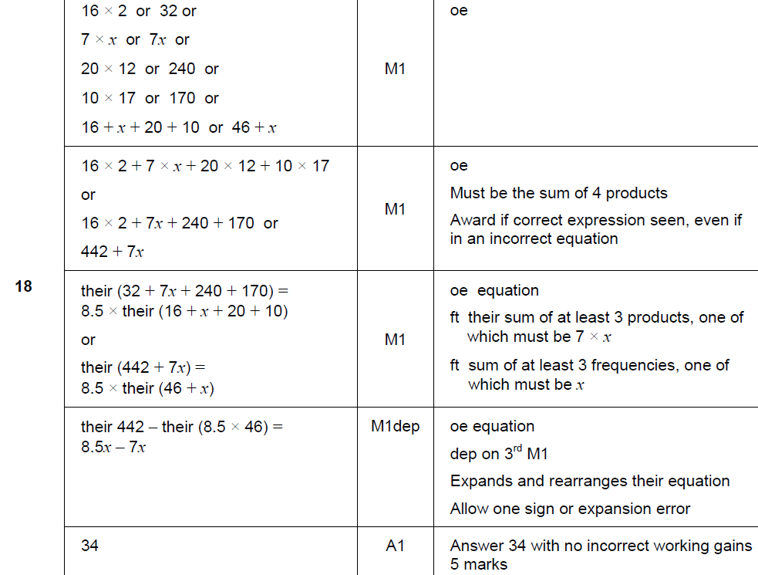
Forming Equations
SAM 3H Q18
A

Slide 10
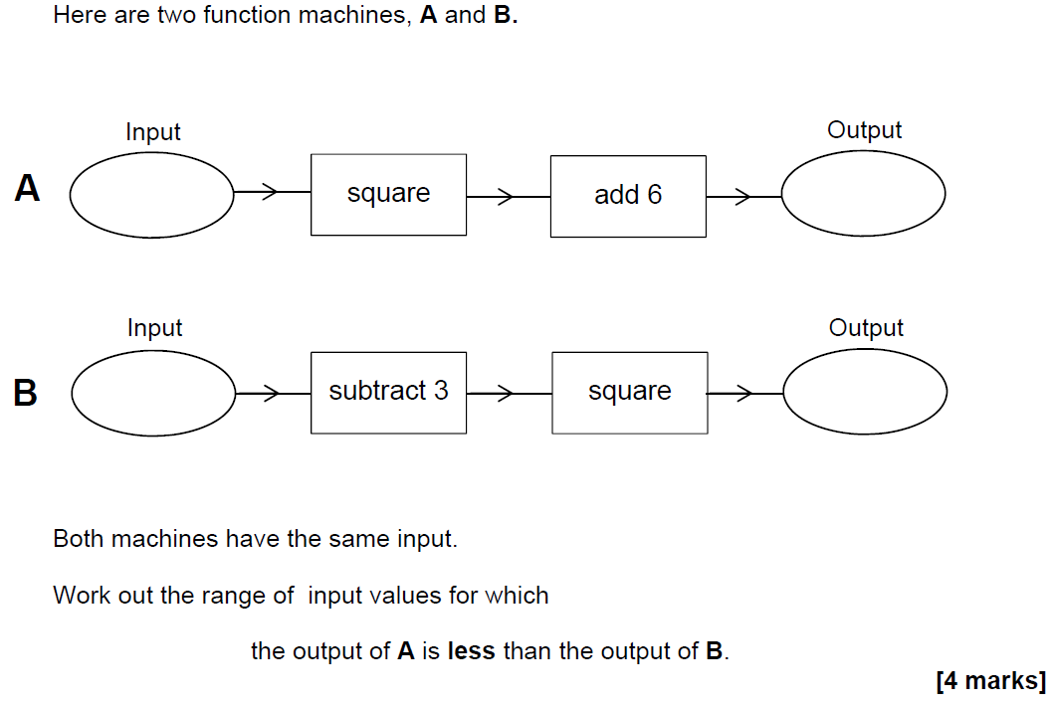
Forming Equations
SAM 3H Q19

Slide 11
Forming Equations
SAM 3H Q19
A

Slide 12
Forming Equations
June 2017 2H Q9

Slide 13
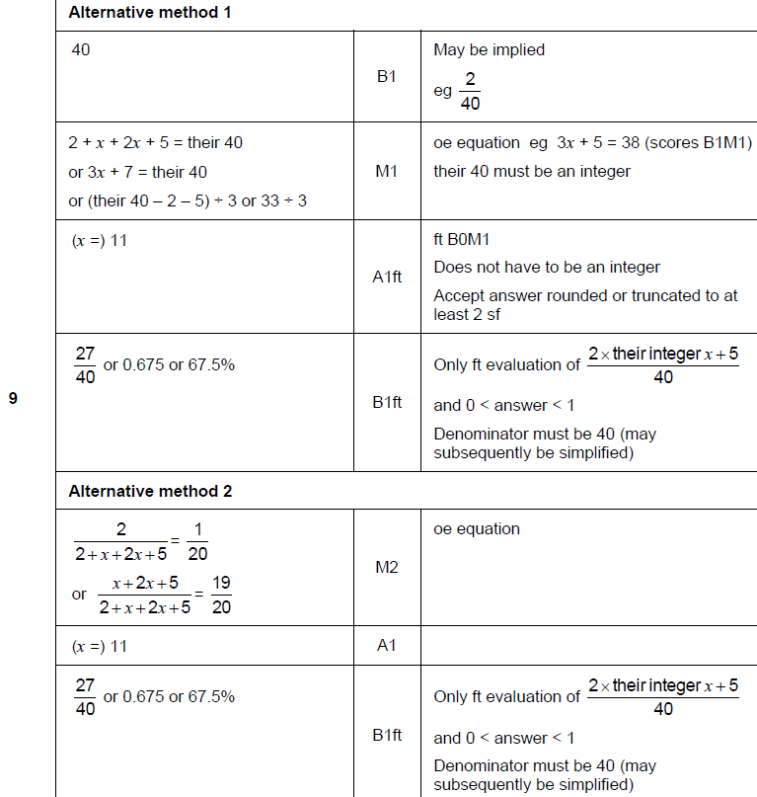
Forming Equations
June 2017 2H Q9
A

Slide 14
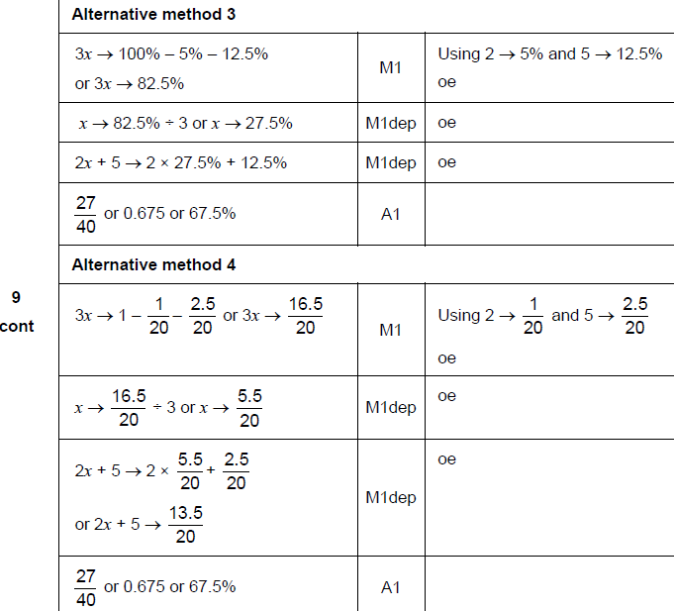
Forming Equations
June 2017 2H Q9
A Alternatives

Slide 15
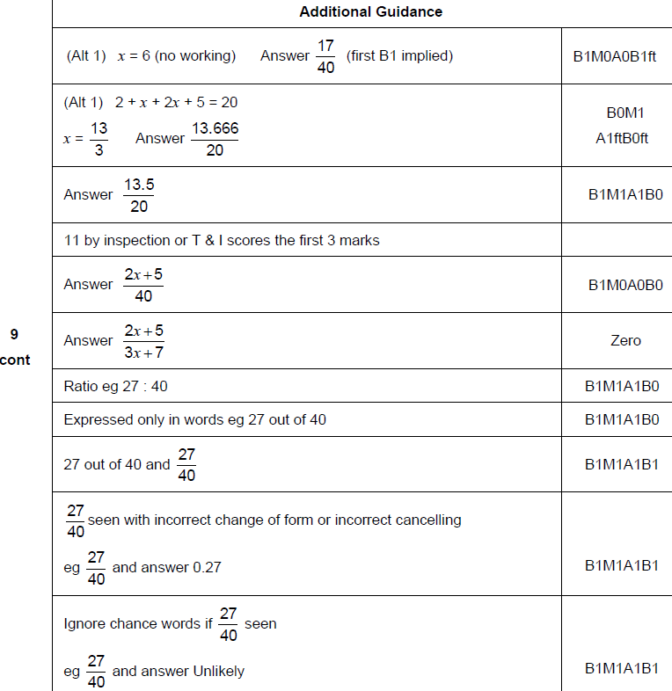
Forming Equations
June 2017 2H Q9
A notes

Slide 16
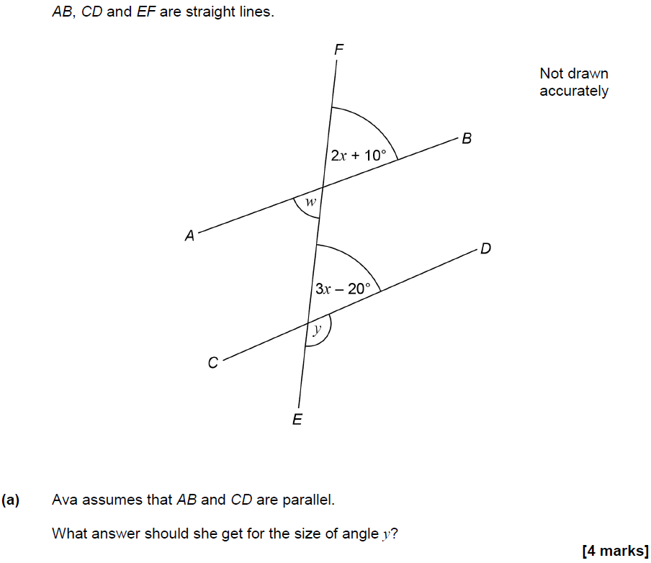
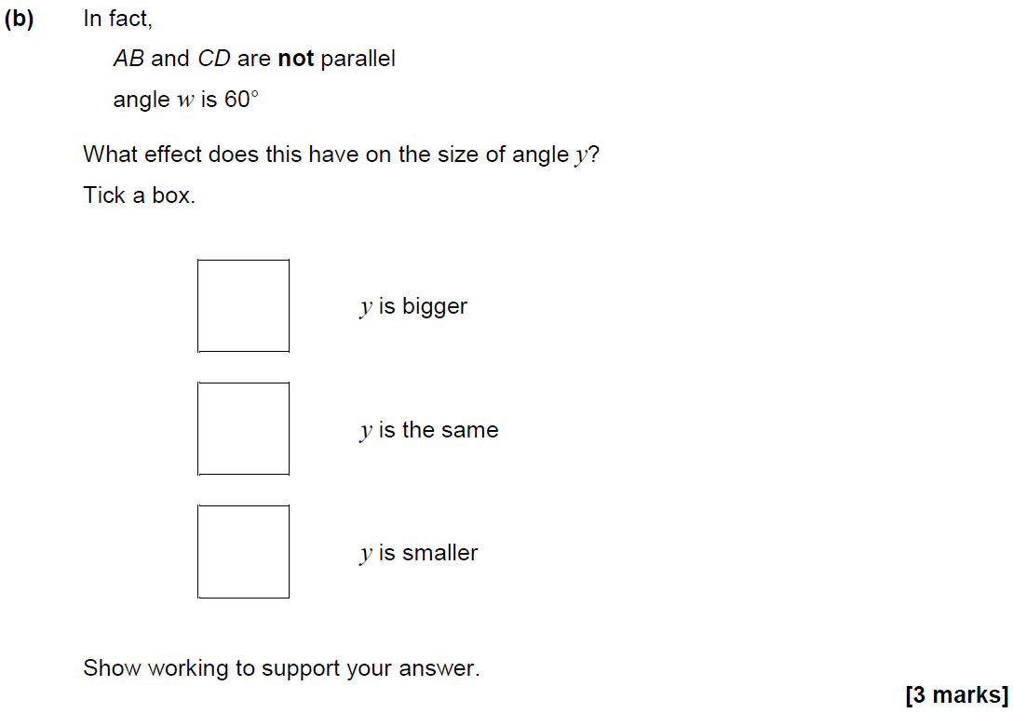
Forming Equations
June 2017 3H Q10

Slide 17
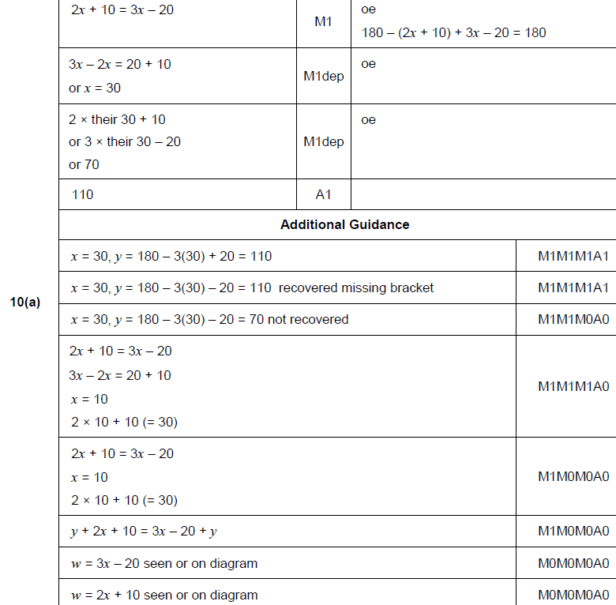
Forming Equations
June 2017 3H Q10
A

Slide 18
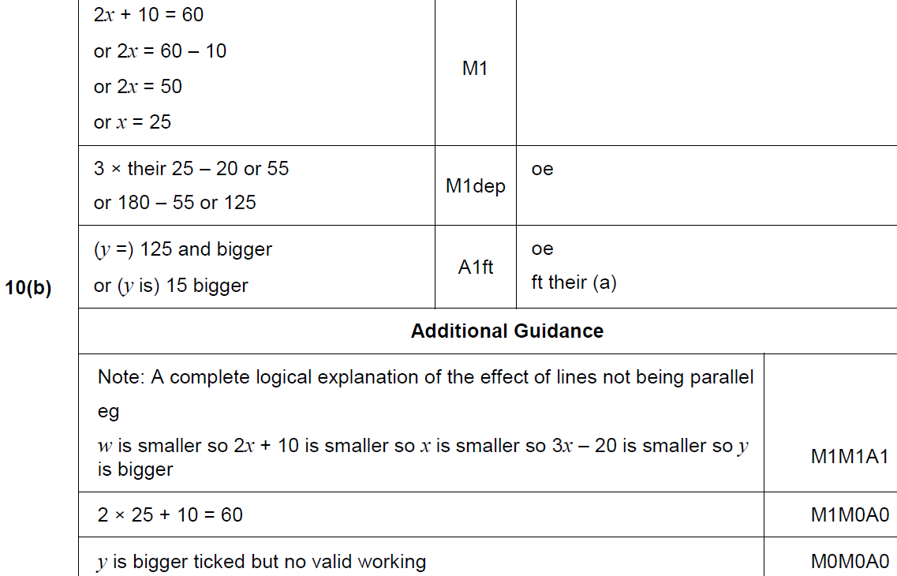
Forming Equations
June 2017 3H Q10
B

Slide 19
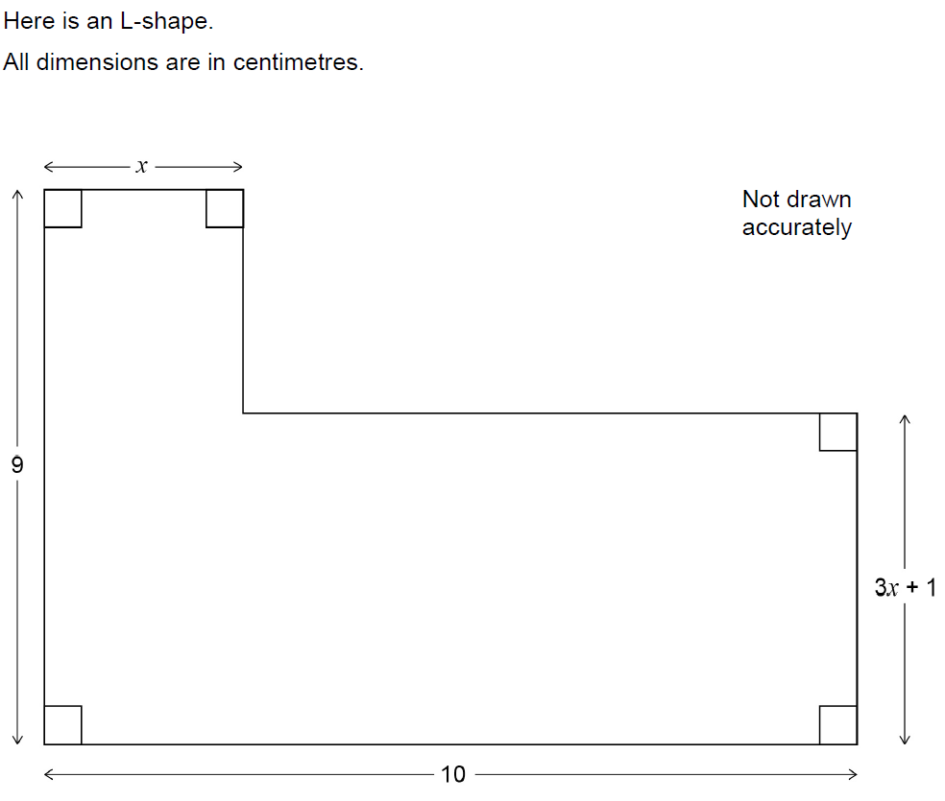
Forming Equations
June 2017 3H Q26

Slide 20
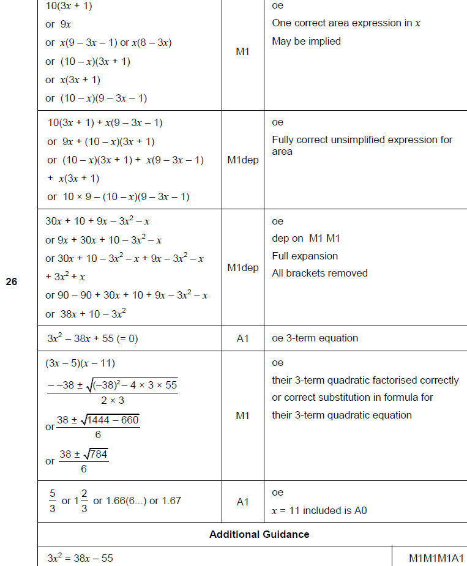
Forming Equations
June 2017 3H Q26
A

Slide 21
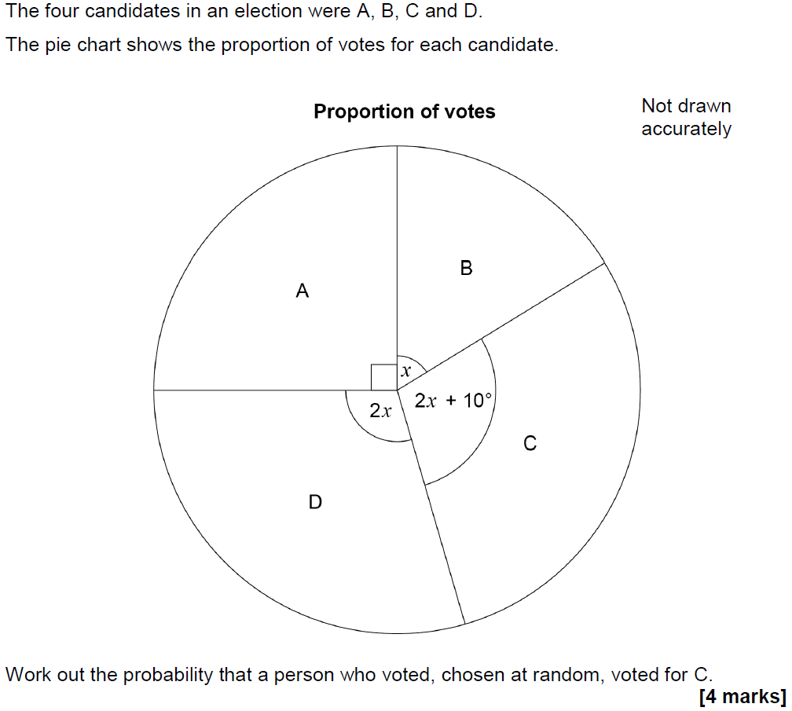
Forming Equations
Nov 2017 1H Q11

Slide 22
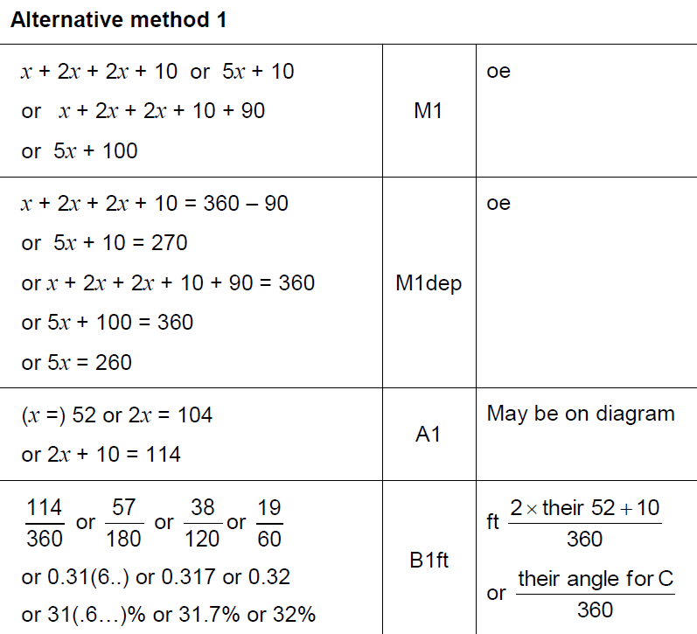
Forming Equations
Nov 2017 1H Q11
A

Slide 23
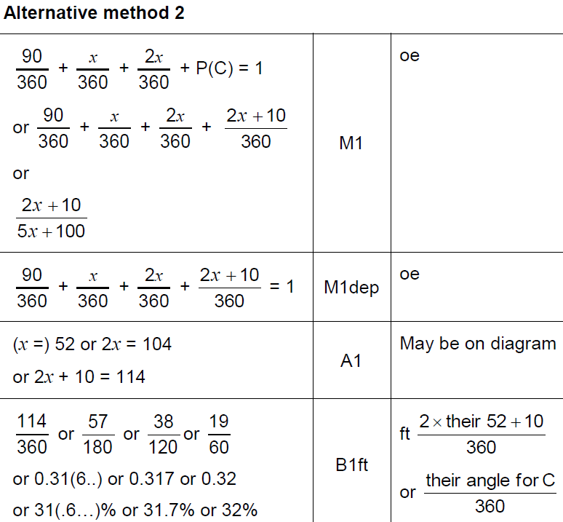
Forming Equations
Nov 2017 1H Q11
A Alternative

Slide 24
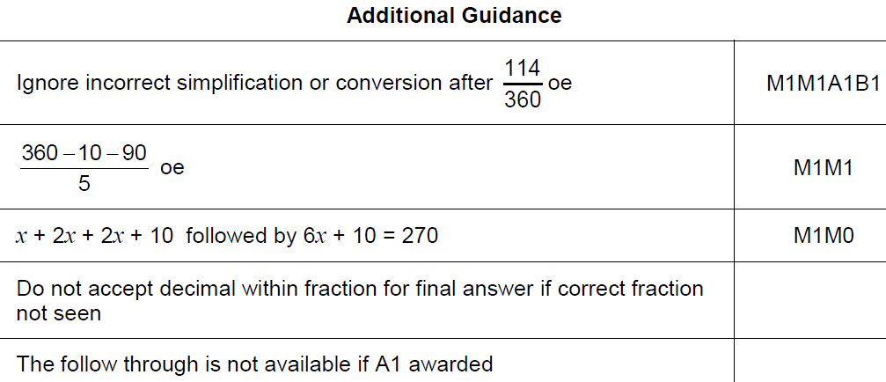
Forming Equations
Nov 2017 1H Q11
A notes

Slide 25
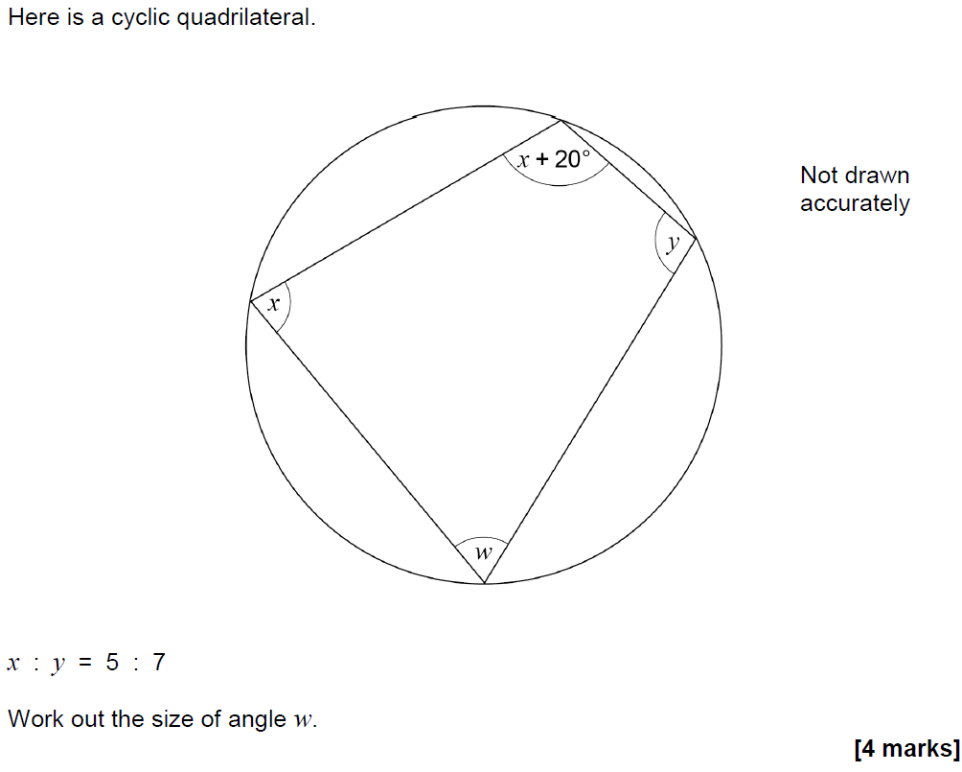
Forming Equations
Nov 2017 1H Q24

Slide 26
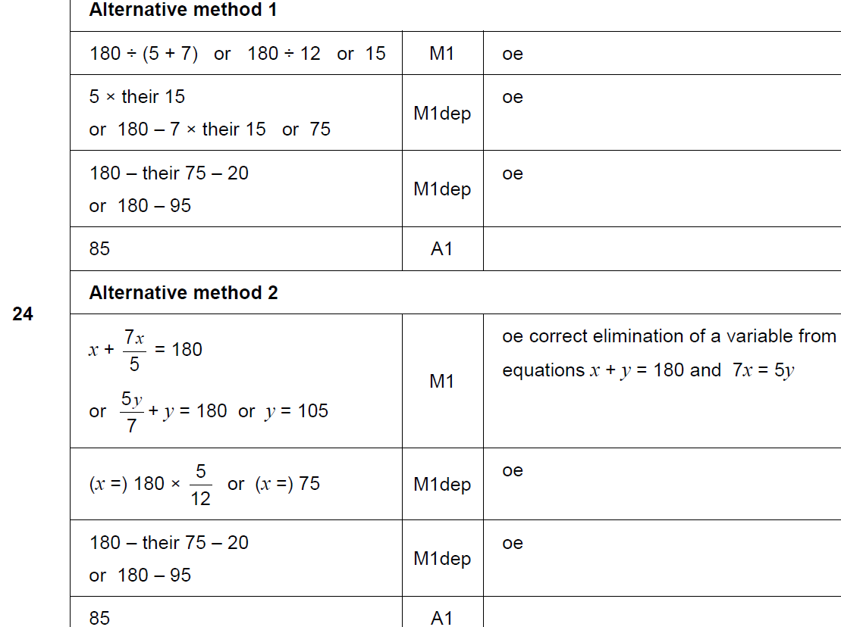
Forming Equations
Nov 2017 1H Q24
A

Slide 27
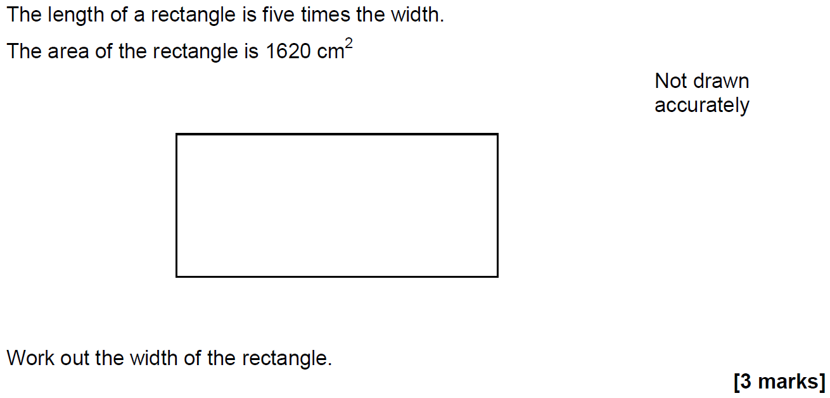
Forming Equations
Nov 2017 2H Q19

Slide 28
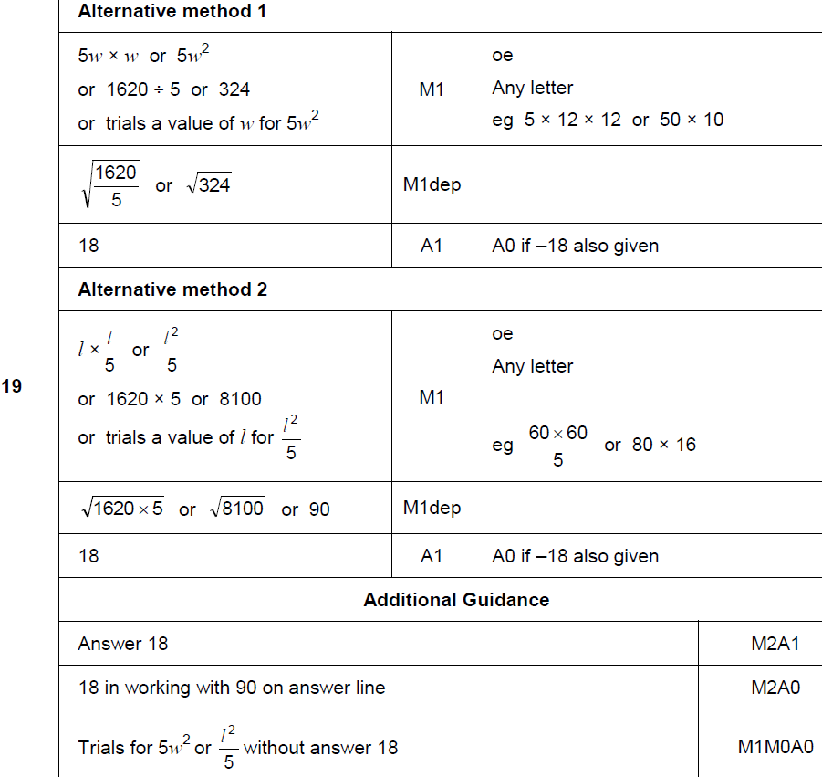
Forming Equations
Nov 2017 2H Q19
A

Slide 29
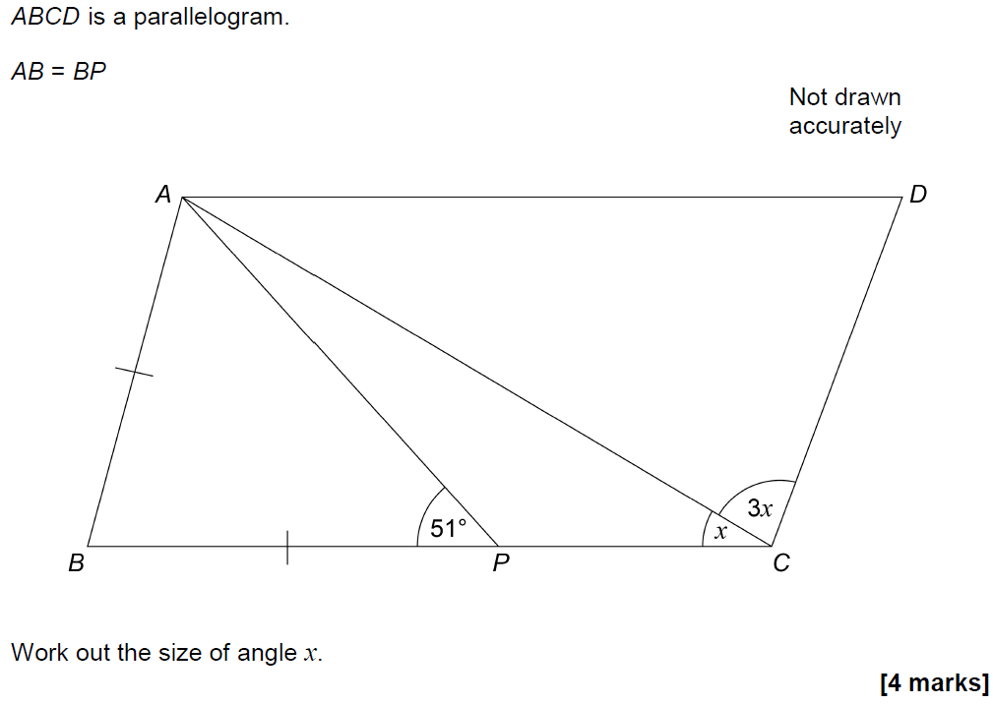
Forming Equations
Nov 2017 3H Q8

Slide 30
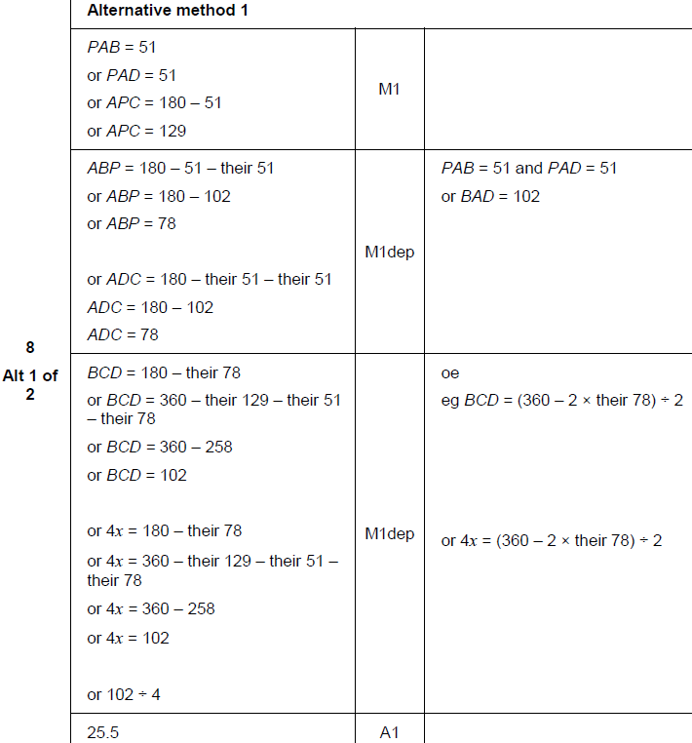
Forming Equations
Nov 2017 3H Q8
A

Slide 31
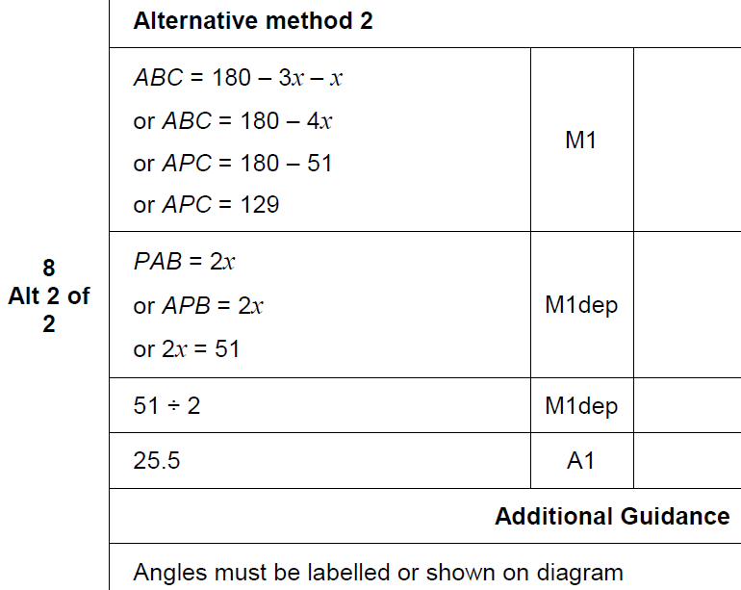
Forming Equations
Nov 2017 3H Q8
A Alternative & notes

Slide 32
Forming Equations
May 2018 1H Q11

Slide 33
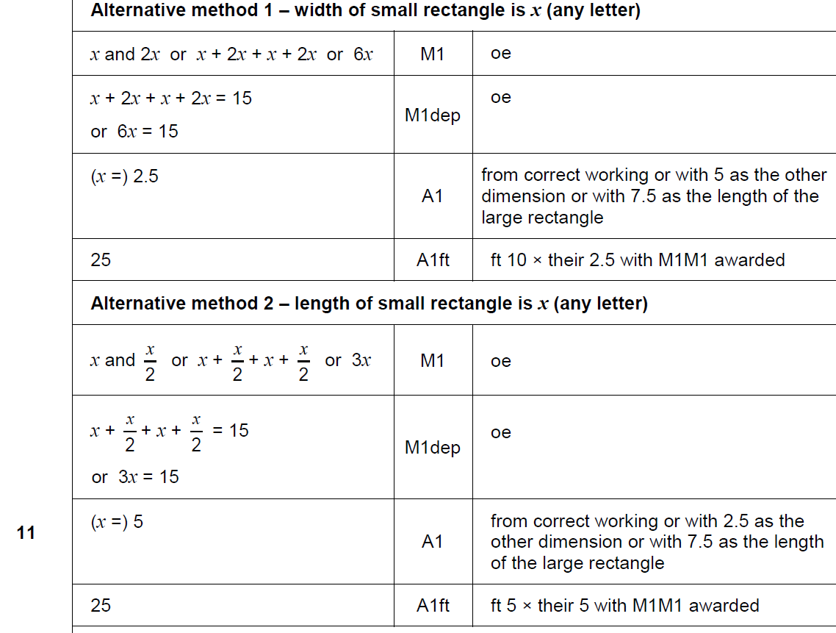
Forming Equations
May 2018 1H Q11
A

Slide 34
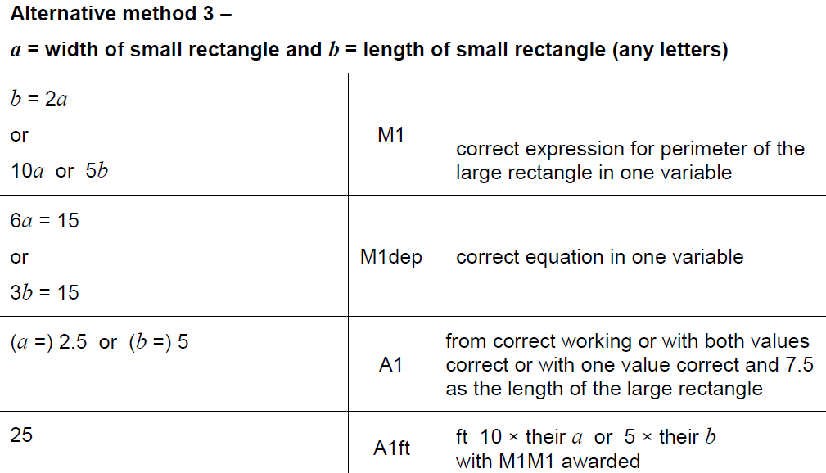
Forming Equations
May 2018 1H Q11
A Alternative 2

Slide 35
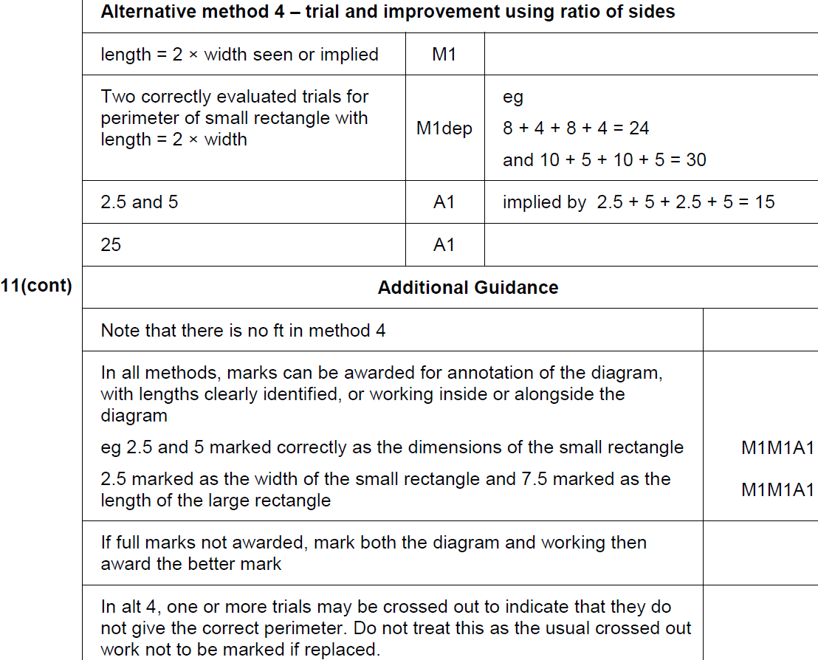
Forming Equations
May 2018 1H Q11
A Alternative 2 & notes

Slide 36
Forming Equations
June 2018 2H Q25

Slide 37
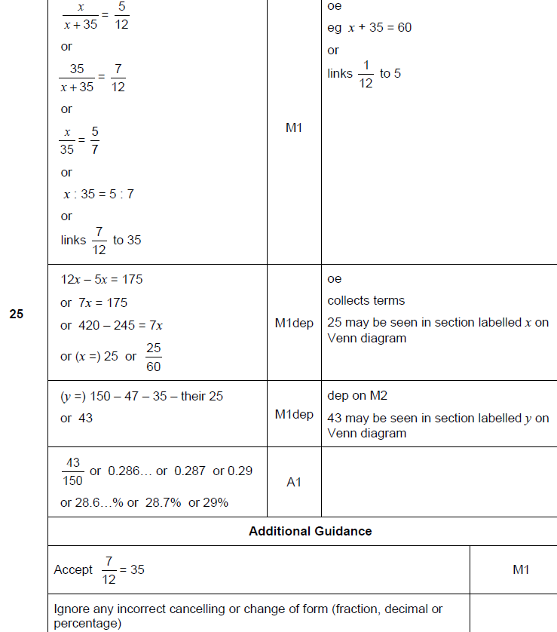
Forming Equations
June 2018 2H Q25
A

Slide 38
Forming Equations
June 2018 3H Q15

Slide 39
Forming Equations
June 2018 3H Q15
A

Slide 40
Forming Equations
Nov 2018 1H Q19
In a chess club, there are x boys and y girls.
(a) If 5 more boys and 8 more girls join, there would be half as many boys as girls.
Show that y = 2x + 2
[2 marks]
(b) If instead,
10 more boys and 1 more girl join, there would be the same number of boys and girls.
Work out x and y.
[3 marks]

Slide 41
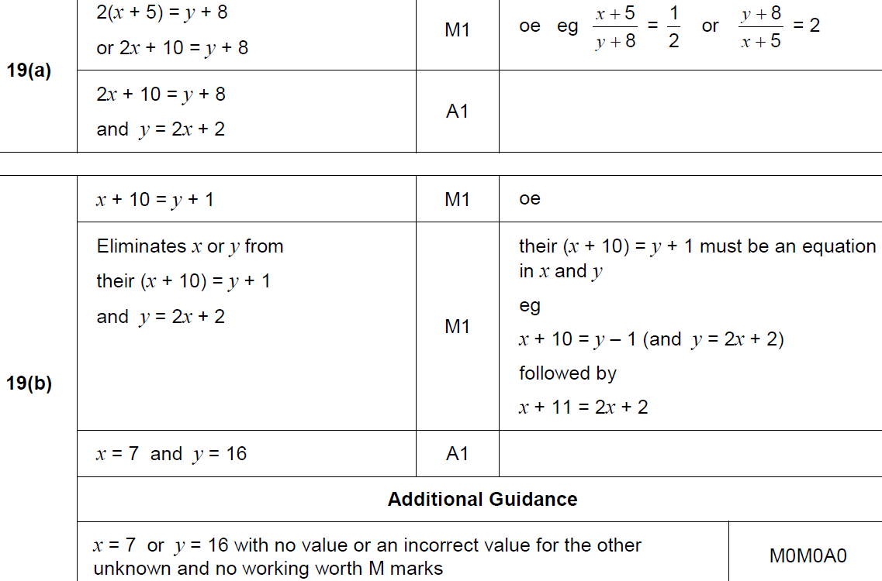
Forming Equations
Nov 2018 1H Q19
A
B

Slide 42
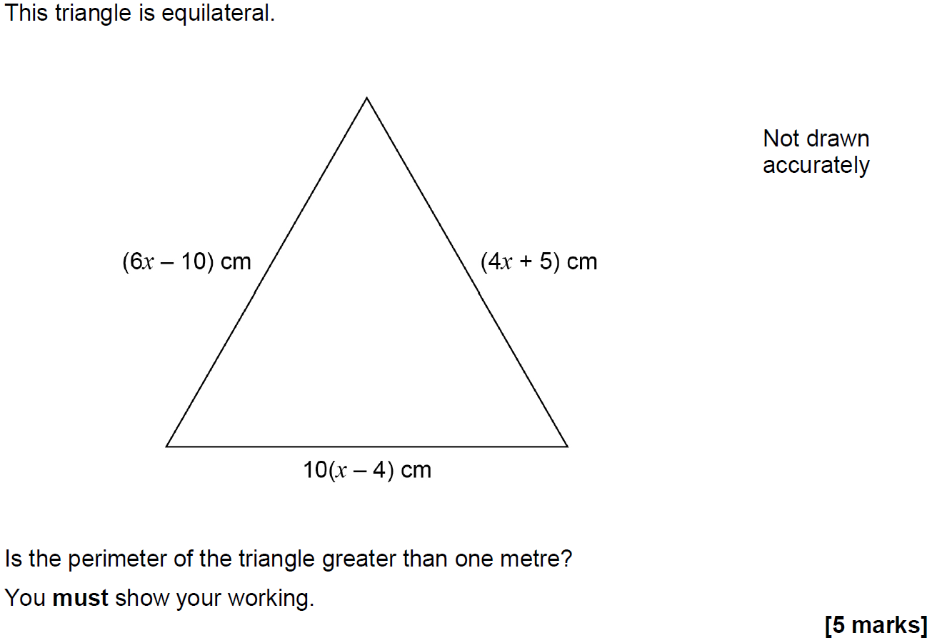
Forming Equations
Nov 2018 2H Q10

Slide 43
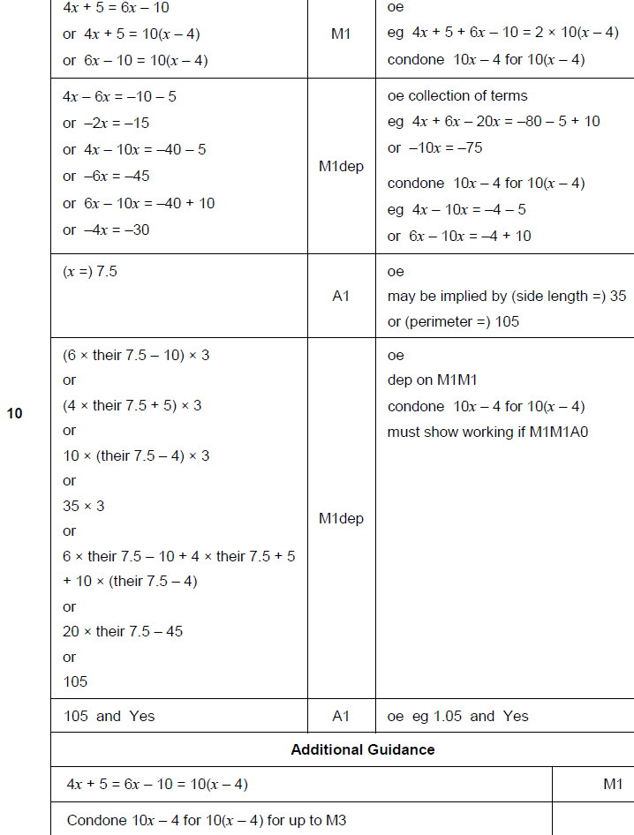
Forming Equations
Nov 2018 2H Q10
A

