Slide 1
Forming Equations
Forming Equations
May 2017
1H Q9
SAM
3H Q9
SAM
1H Q5
Nov 2017
2H Q6
Practice
1H Q4
SAM
2H Q5
May 2018
1H Q9
Practice
1H Q8
SAM
2H Q6
Nov 2018
1H Q5
Practice
2H Q6
SAM
2H Q19
Nov 2018
3H Q11
Practice
3H Q17
Nov 2018
3H Q12

Slide 2
Forming Equations
SAM 1H Q5

Slide 3
Forming Equations
SAM 1H Q5
A

Slide 4
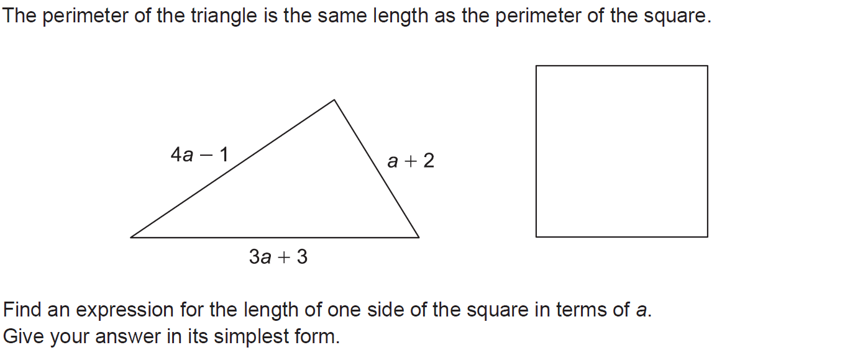
Forming Equations
SAM 2H Q5

Slide 5
Forming Equations
SAM 2H Q5
A

Slide 6
Forming Equations
SAM 2H Q6

Slide 7
Forming Equations
SAM 2H Q6
A

Slide 8
Forming Equations
SAM 2H Q19

Slide 9
Forming Equations
SAM 2H Q19
A

Slide 10
Forming Equations
SAM 3H Q9

Slide 11
Forming Equations
SAM 3H Q9
A

Slide 12
Forming Equations
Practice 1H Q4

Slide 13
Forming Equations
Practice 1H Q4
A

Slide 14
Forming Equations
Practice 1H Q8

Slide 15
Forming Equations
Practice 1H Q8
A

Slide 16
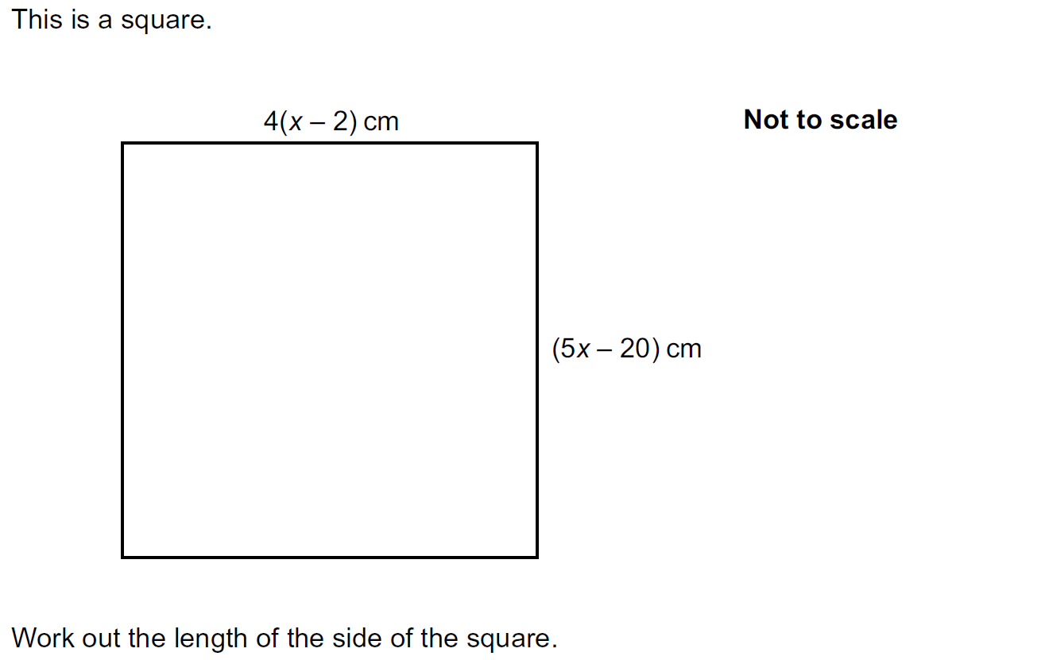
Forming Equations
Practice 2H Q6

Slide 17
Forming Equations
Practice 2H Q6
A

Slide 18
Forming Equations
Practice 3H Q17

Slide 19
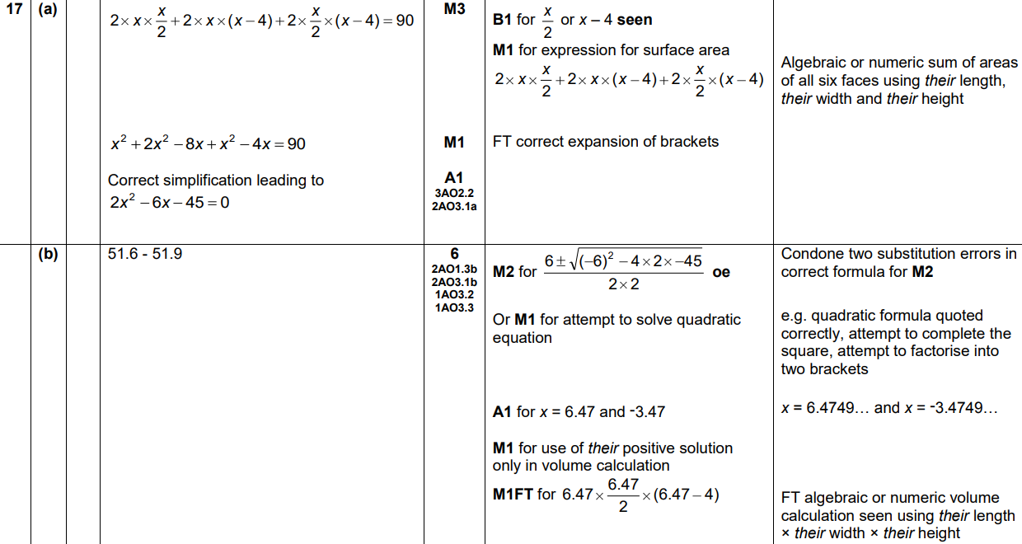
Forming Equations
Practice 3H Q17
A
B

Slide 20
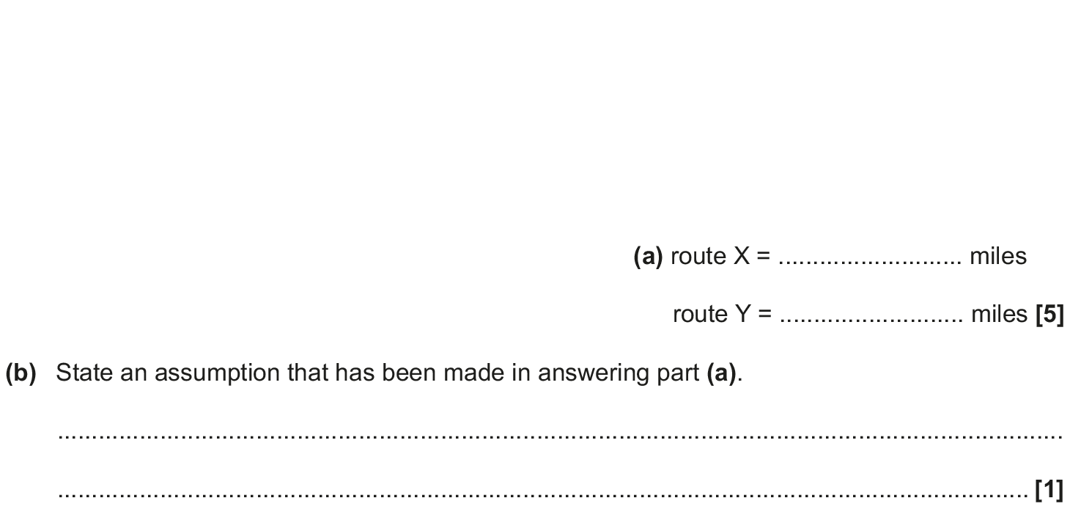
Forming Equations
May 2017 1H Q9

Slide 21
Forming Equations
May 2017 1H Q9
A
B

Slide 22
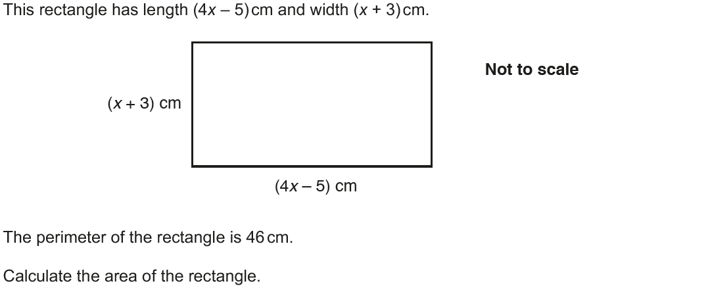
Forming Equations
Nov 2017 2H Q6

Slide 23
Forming Equations
Nov 2017 2H Q6
A

Slide 24
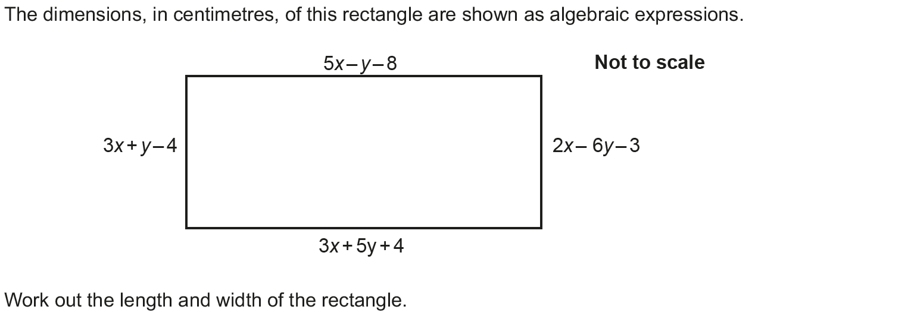
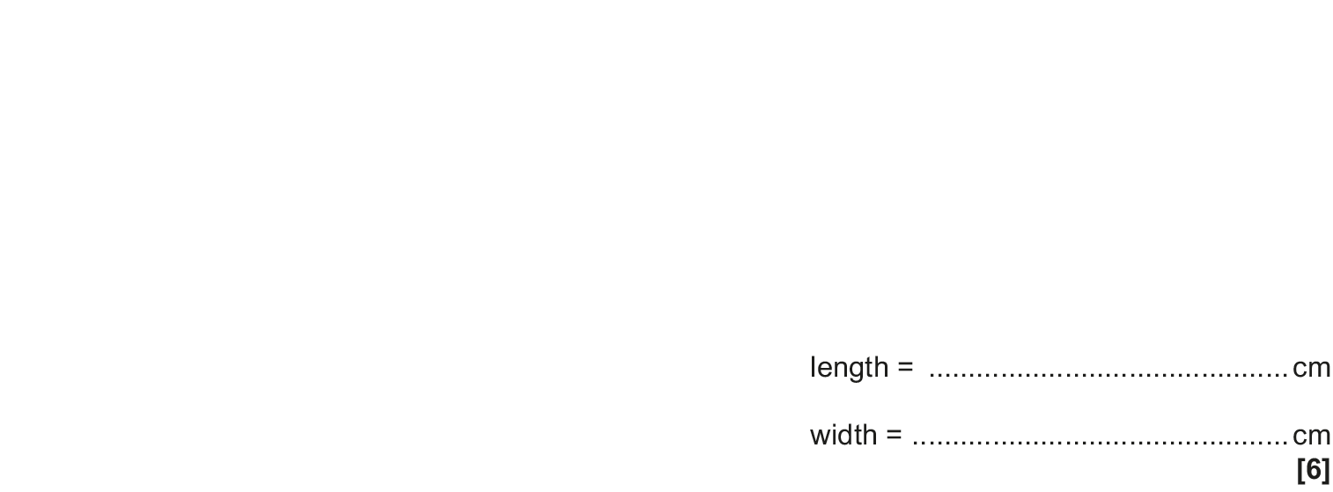
Forming Equations
May 2018 1H Q9

Slide 25
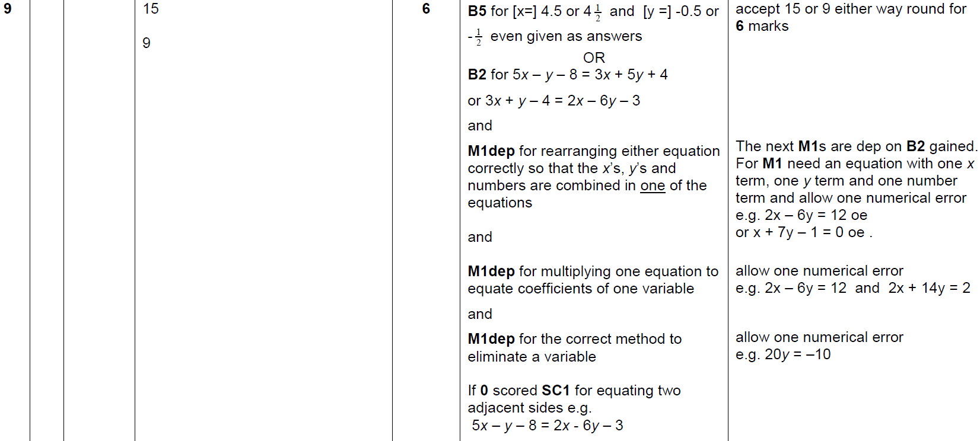
Forming Equations
May 2018 1H Q9
A

Slide 26
Forming Equations
Nov 2018 1H Q5

Slide 27
Forming Equations
Nov 2018 1H Q5
A

Slide 28
Forming Equations
Nov 2018 3H Q11

Slide 29
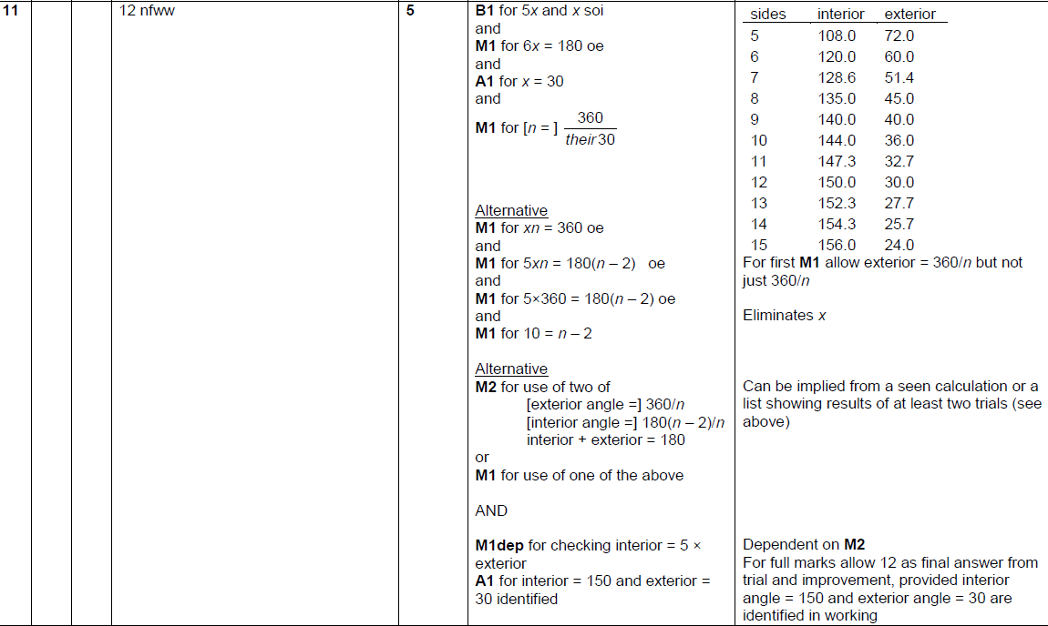
Forming Equations
Nov 2018 3H Q11
A

Slide 30
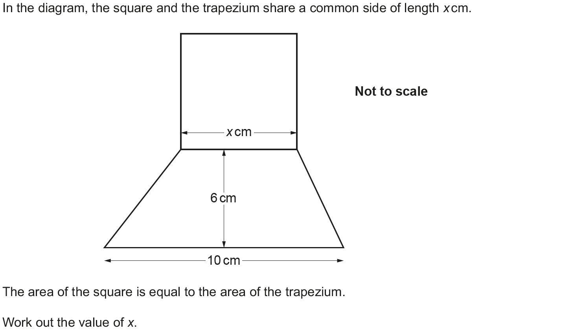
Forming Equations
Nov 2018 3H Q12

Slide 31
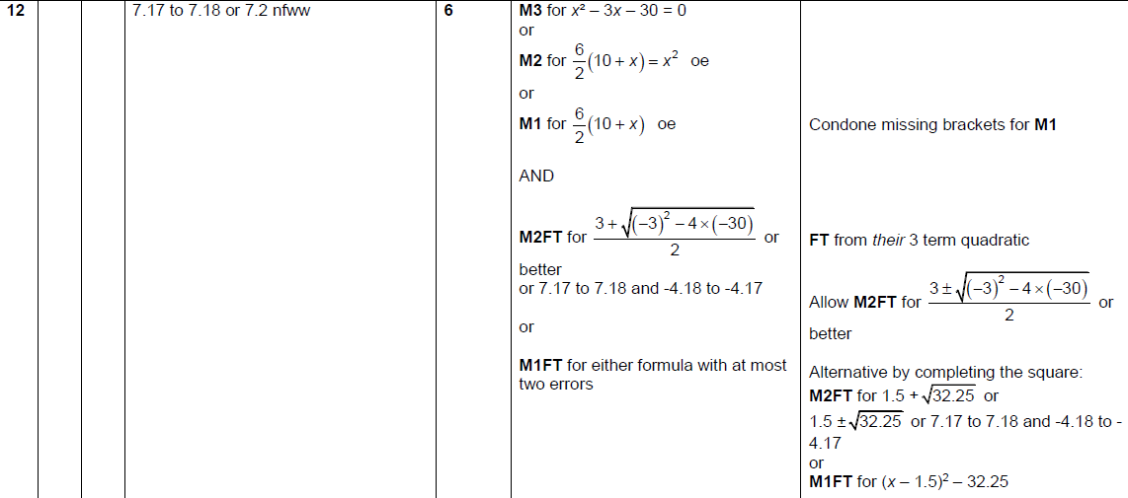
Forming Equations
Nov 2018 3H Q12
A

