Slide 1
Forming Equations
Forming Equations
SAM
1H Q8
Spec 1
2H Q19
May 2017 1H Q4
SAM
2H Q9
Nov 2017 1H Q23
Spec 2
1H Q9
Nov 2017 1H Q2
SAM
3H Q3
Nov 2017 3H Q6
Spec 2
1H Q11
Nov 2017 1H Q6
Spec 1
1H Q1
June 2018 3H Q19
Spec 2
3H Q7
Nov 2017 1H Q11
Spec 1
1H Q4

Slide 2
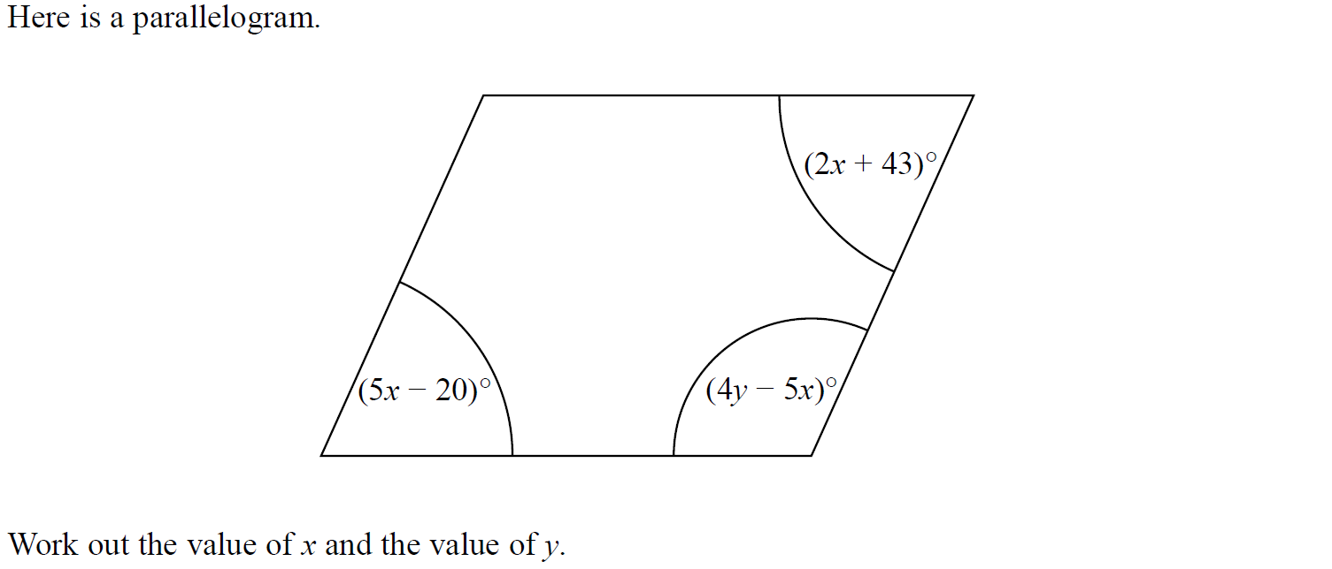
Forming Equations
SAM 1H Q8

Slide 3
Forming Equations
SAM 1H Q8
A

Slide 4
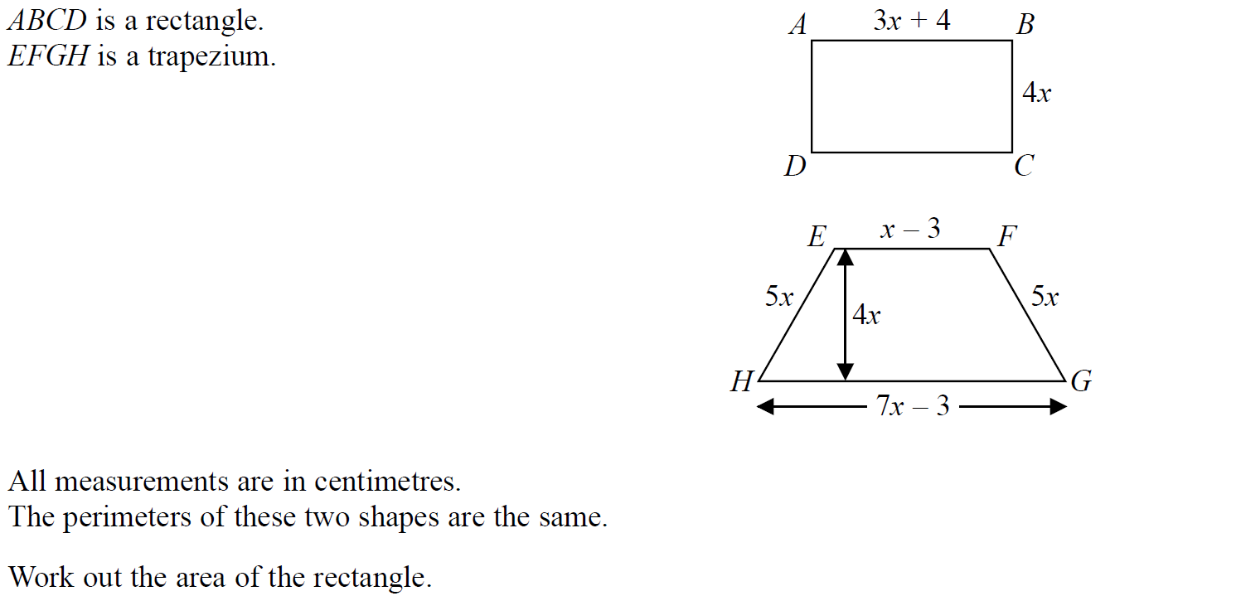
Forming Equations
SAM 2H Q9

Slide 5
Forming Equations
SAM 2H Q9
A

Slide 6
Forming Equations
SAM 3H Q3

Slide 7
Forming Equations
SAM 3H Q3
A
B
C

Slide 8
Forming Equations
Specimen Set 1 1H Q1

Slide 9
Forming Equations
Specimen Set 1 1H Q1
A

Slide 10
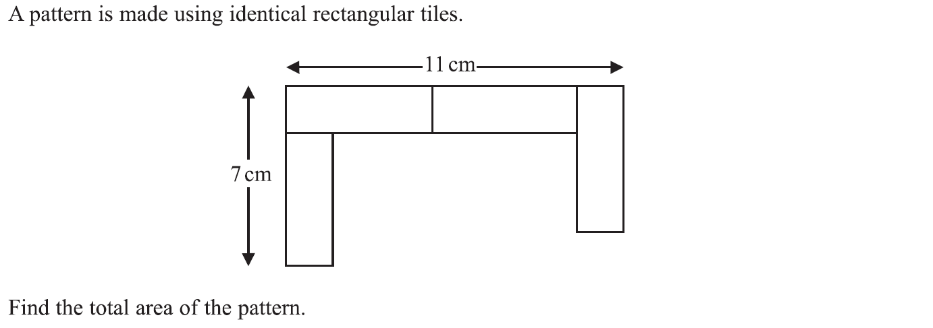
Forming Equations
Specimen Set 1 1H Q4

Slide 11
Forming Equations
Specimen Set 1 1H Q4
A

Slide 12
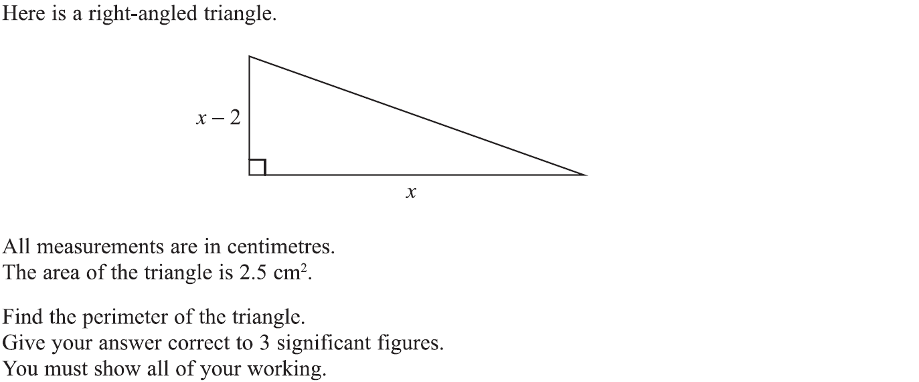
Forming Equations
Specimen Set 1 2H Q19

Slide 13
Forming Equations
Specimen Set 1 2H Q19
A

Slide 14
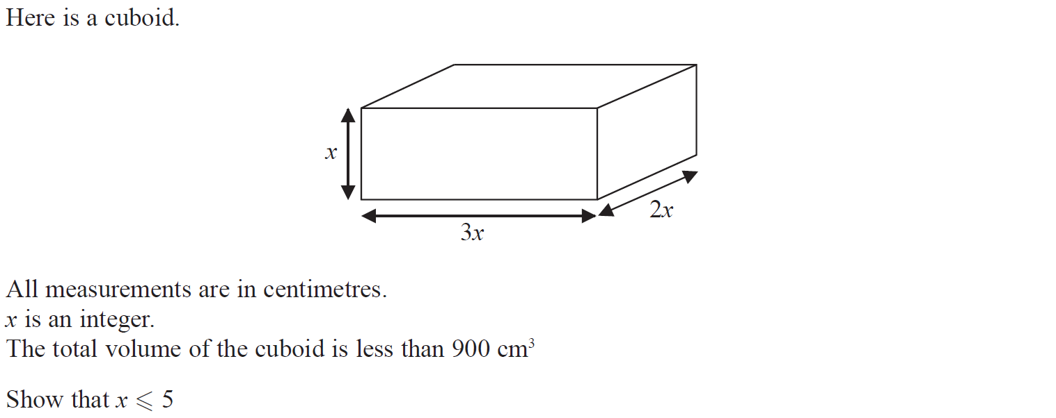
Forming Equations
Specimen Set 2 1H Q9

Slide 15
Forming Equations
Specimen Set 2 1H Q9
A

Slide 16
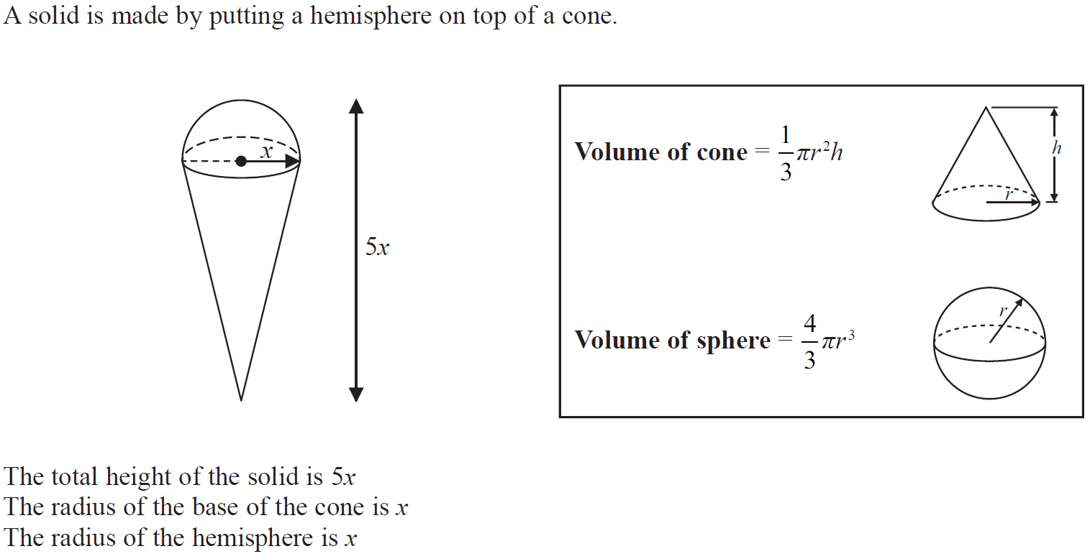
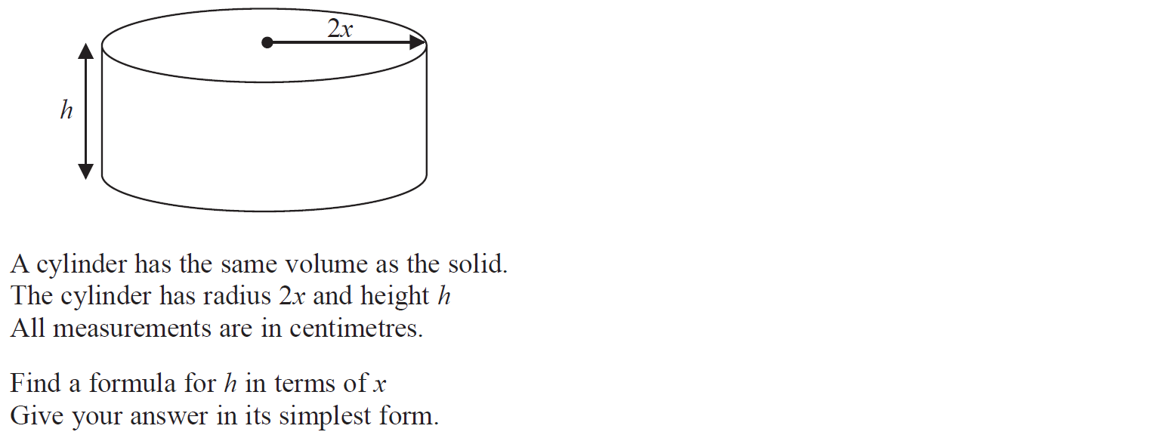
Forming Equations
Specimen Set 2 1H Q11

Slide 17
Forming Equations
Specimen Set 2 1H Q11
A

Slide 18
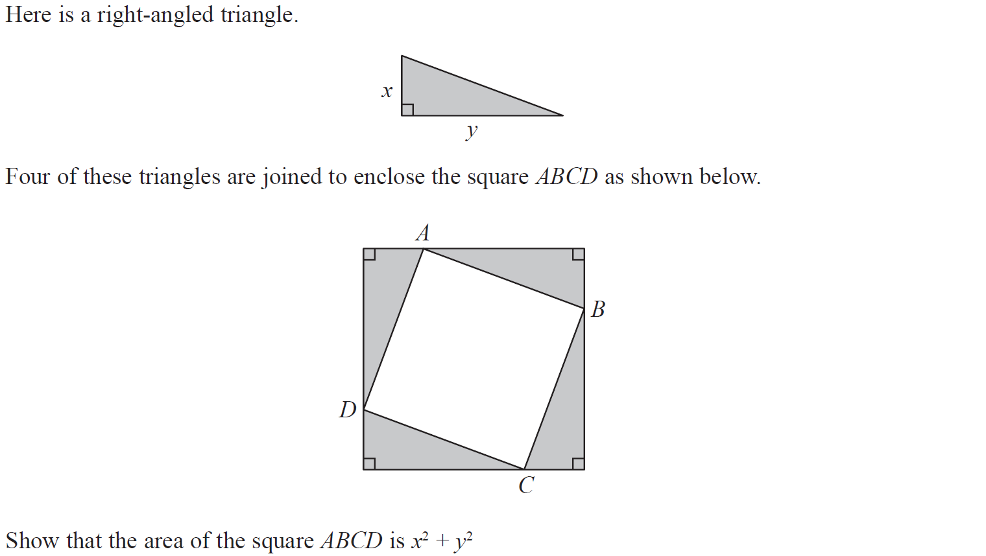
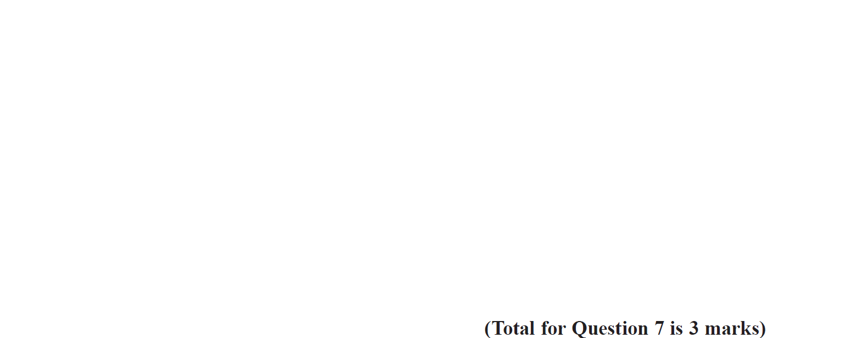
Forming Equations
Specimen Set 2 3H Q7

Slide 19
Forming Equations
Specimen Set 2 3H Q7
A

Slide 20
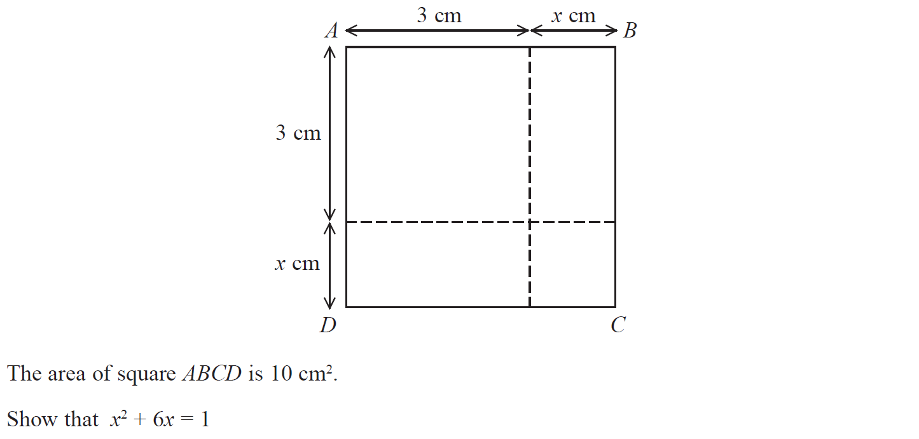
Forming Equations
May 2017 1H Q4

Slide 21
Forming Equations
May 2017 1H Q4
A

Slide 22
Forming Equations
Nov 2017 1H Q2

Slide 23
Forming Equations
Nov 2017 1H Q2
A

Slide 24
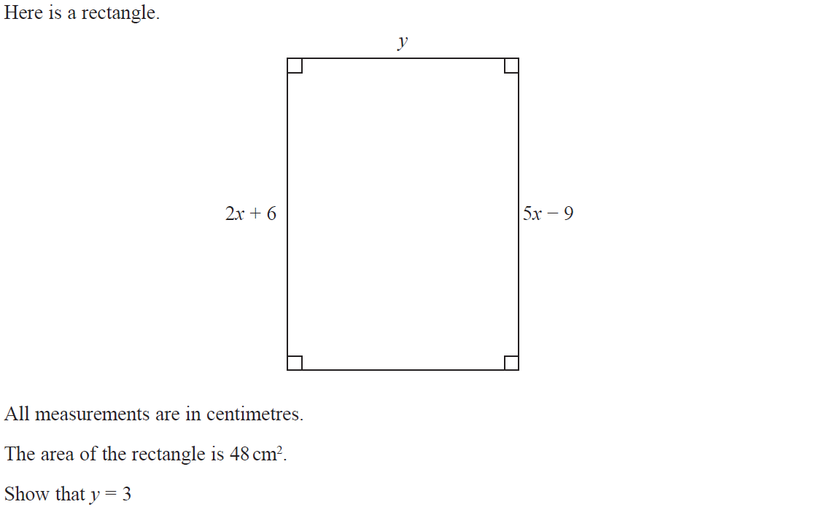
Forming Equations
Nov 2017 1H Q6

Slide 25
Forming Equations
Nov 2017 1H Q6
A

Slide 26
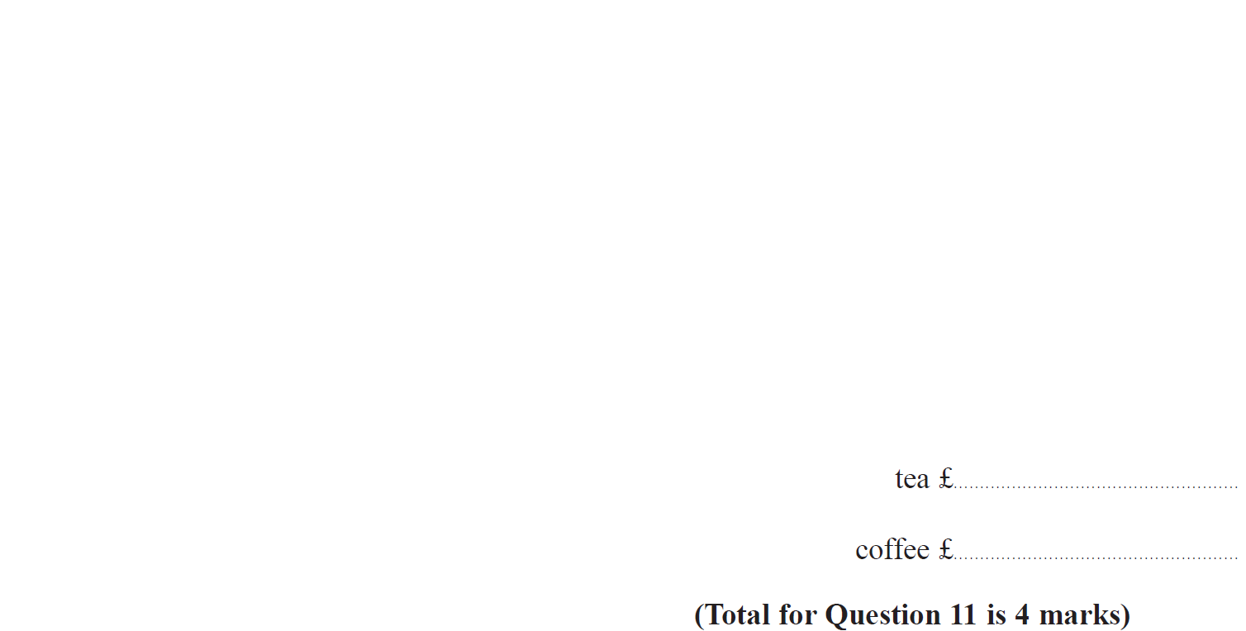
Forming Equations
Nov 2017 1H Q11

Slide 27
Forming Equations
Nov 2017 1H Q11
A

Slide 28
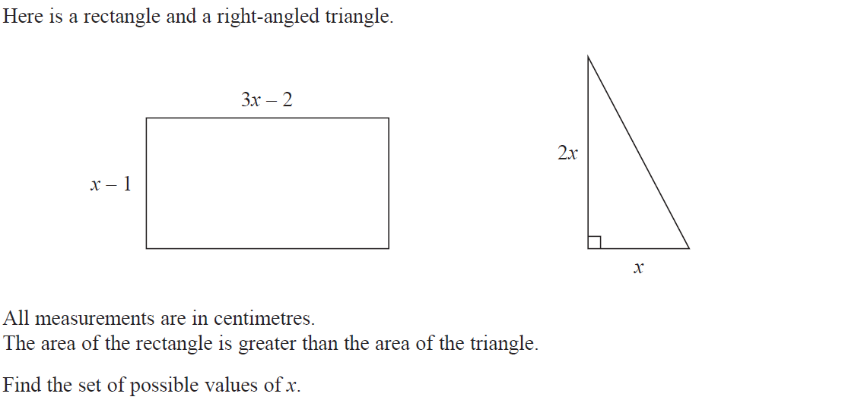
Forming Equations
Nov 2017 1H Q23

Slide 29
Forming Equations
Nov 2017 1H Q23
A

Slide 30
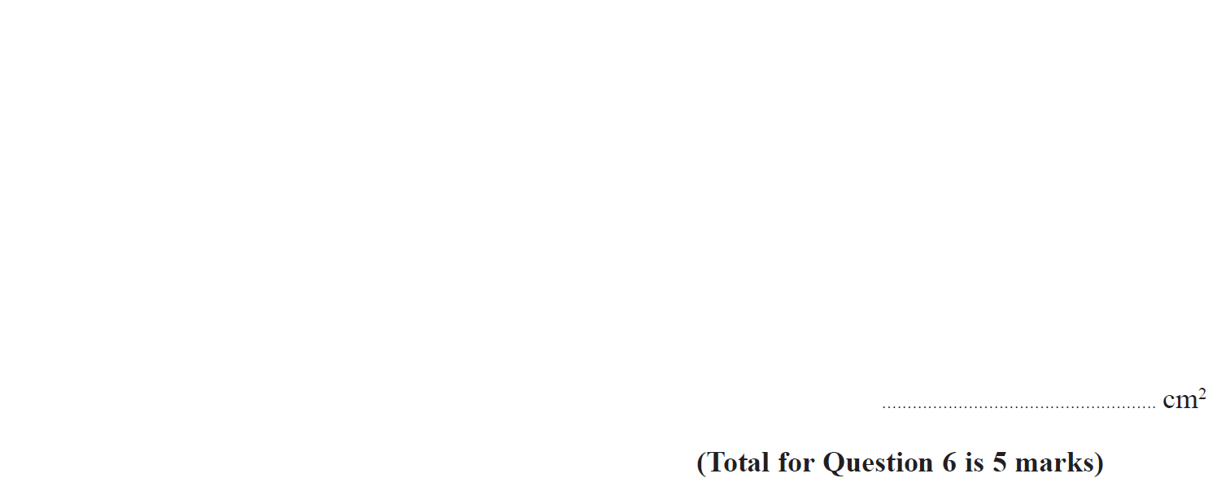
Forming Equations
Nov 2017 3H Q6

Slide 31
Forming Equations
Nov 2017 3H Q6
A

Slide 32
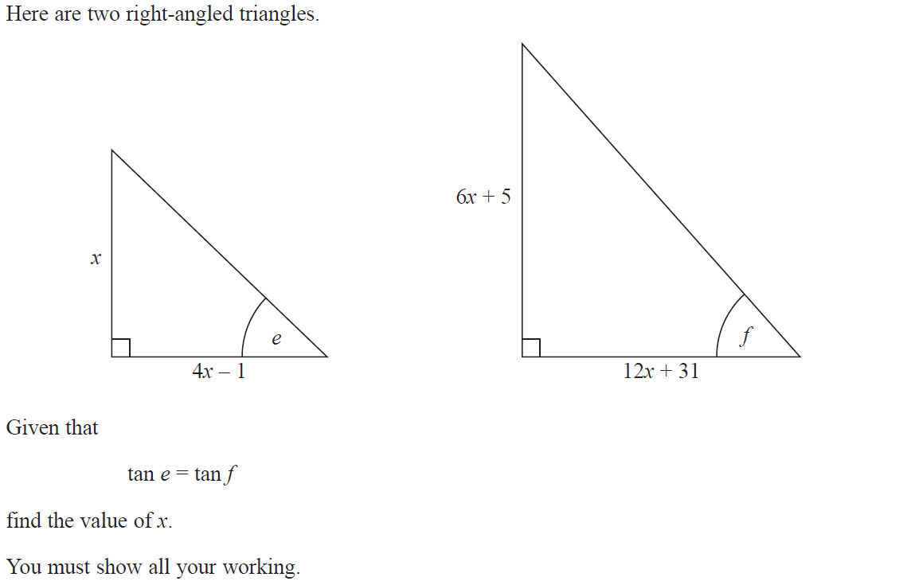
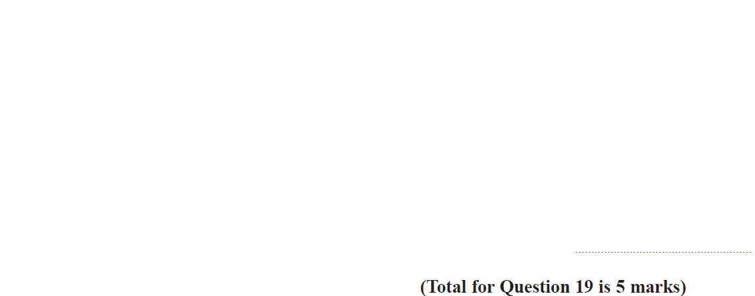
Forming Equations
June 2018 3H Q19

Slide 33
Forming Equations
June 2018 3H Q19
A

