Slide 1
FDPR mixed context
FDPR mixed context
May 2017
1H Q14
Edexcel
SAM
1H Q5
June 2017
2H Q2
AQA
SAM
3H Q5*
June 2017
3H Q4
OCR
Spec 2
1H Q7
June 2018
2H Q4
May 2019
1H Q12
Fractions
Decimals
Percentages
Ratios
*Just problem solving in context

Slide 2
FDPR mixed context
FDPR mixed context
May 2017
1H Q25
Nov 2017
3H Q2
Edexcel
June 2017
2H Q1
May 2018
1H Q16
AQA
SAM
3H Q3
1 Marker
June 2017
2H Q17
May 2018
1H Q23
OCR
Nov 2017
2H Q1
June 2018
3H Q1
Fractions
Decimals
Percentages
Ratios

Slide 3
FDPR mixed context
FDPR mixed context
June 2017
3H Q4
Edexcel
Nov 2017
3H Q6
AQA
SAM
2H Q15*
June 2018
2H Q4
OCR
June 2018
3H Q2
Fractions
Decimals
Percentages
Ratios
*And Surds!

Slide 4
FDPR mixed context
SAM 1H Q5

Slide 5
FDPR mixed context
SAM 1H Q5
A

Slide 6
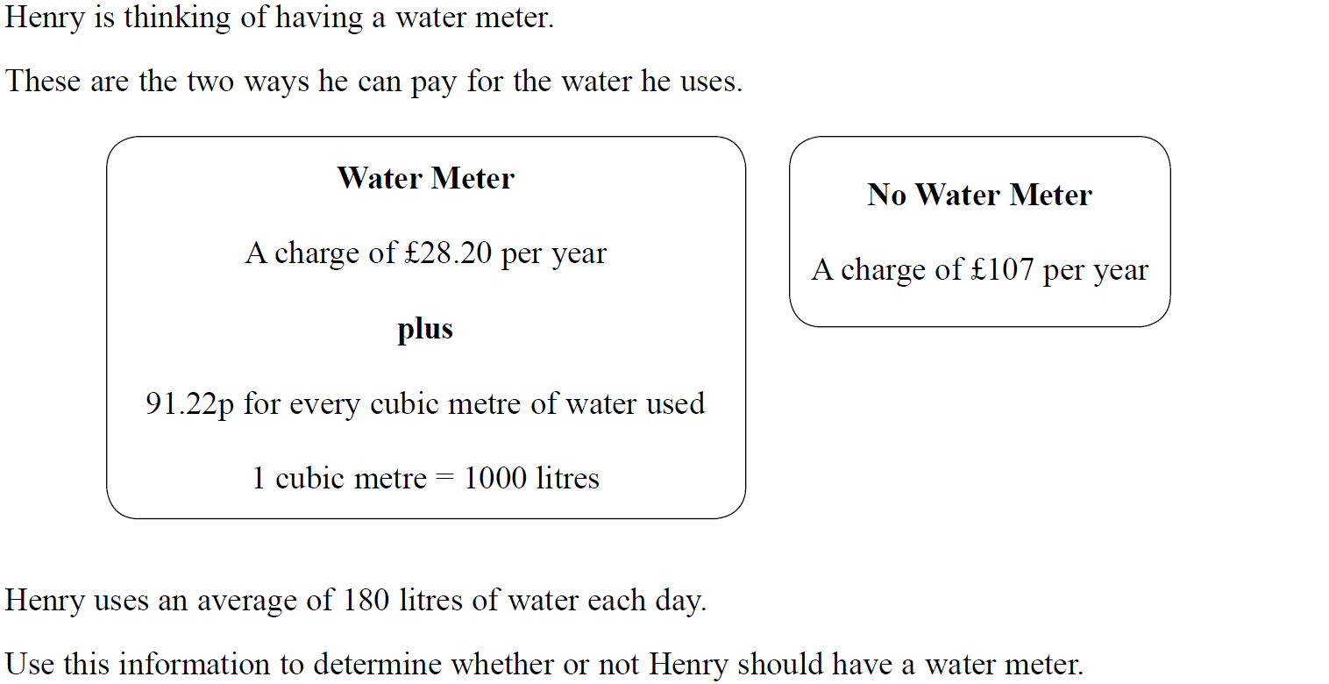
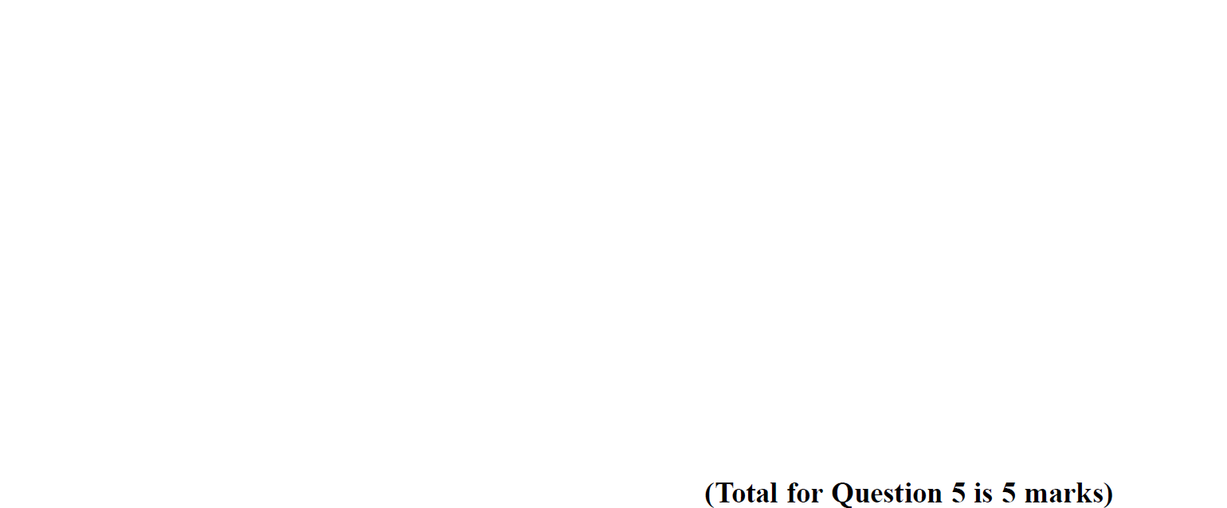
FDPR mixed context
SAM 3H Q5

Slide 7
FDPR mixed context
SAM 3H Q5
A

Slide 8
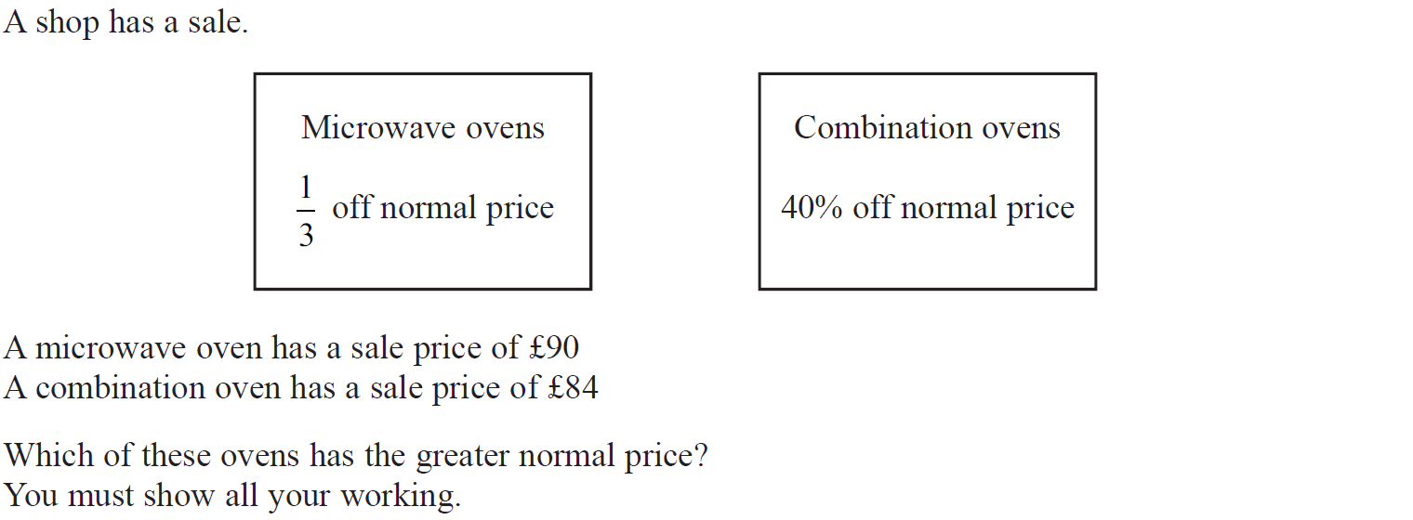
FDPR mixed context
Specimen Set 2 1H Q7

Slide 9
FDPR mixed context
Specimen Set 2 1H Q7
A

Slide 10
FDPR mixed context
May 2017 1H Q14

Slide 11
FDPR mixed context
May 2017 1H Q14
A

Slide 12
FDPR mixed context
May 2017 2H Q2

Slide 13
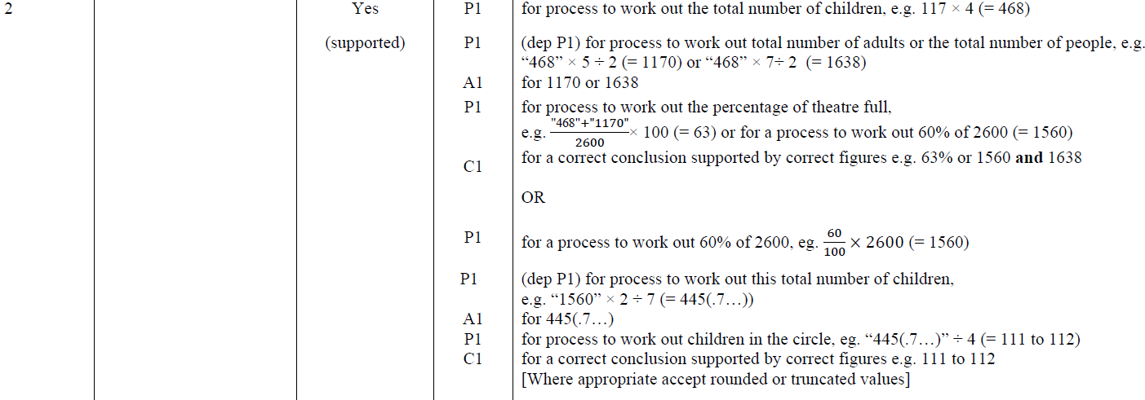
FDPR mixed context
May 2017 2H Q2
A

Slide 14
FDPR mixed context
June 2017 3H Q4

Slide 15
FDPR mixed context
June 2017 3H Q4
A

Slide 16
FDPR mixed context
June 2018 2H Q4

Slide 17
FDPR mixed context
June 2018 2H Q4
A

Slide 18
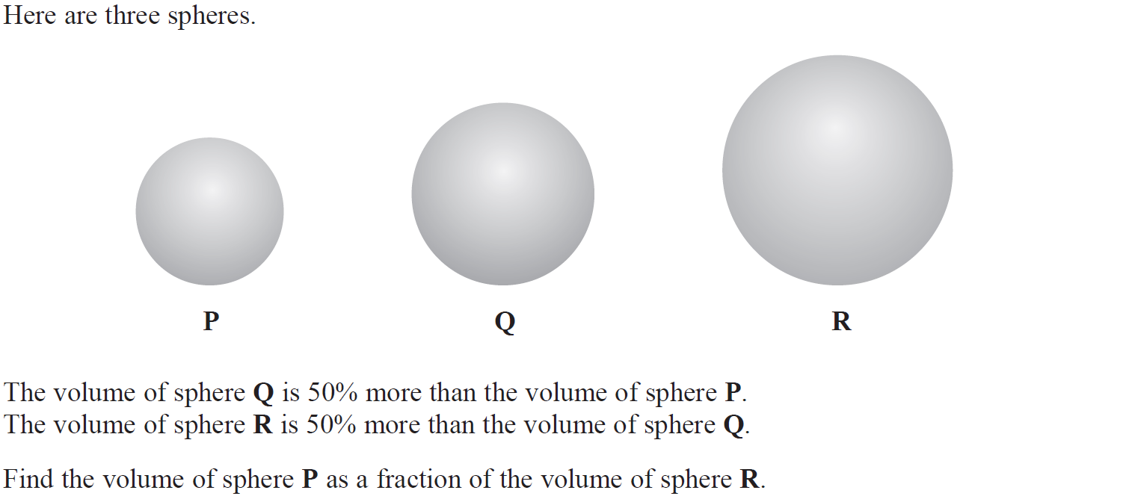
FDPR mixed context
May 2019 1H Q12

Slide 19
FDPR mixed context
May 2019 1H Q12
A
A SF

Slide 20
FDPR mixed context
SAM 3H Q3

Slide 21
FDPR mixed context
SAM 3H Q3
A

Slide 22
FDPR mixed context
May 2017 1H Q25

Slide 23
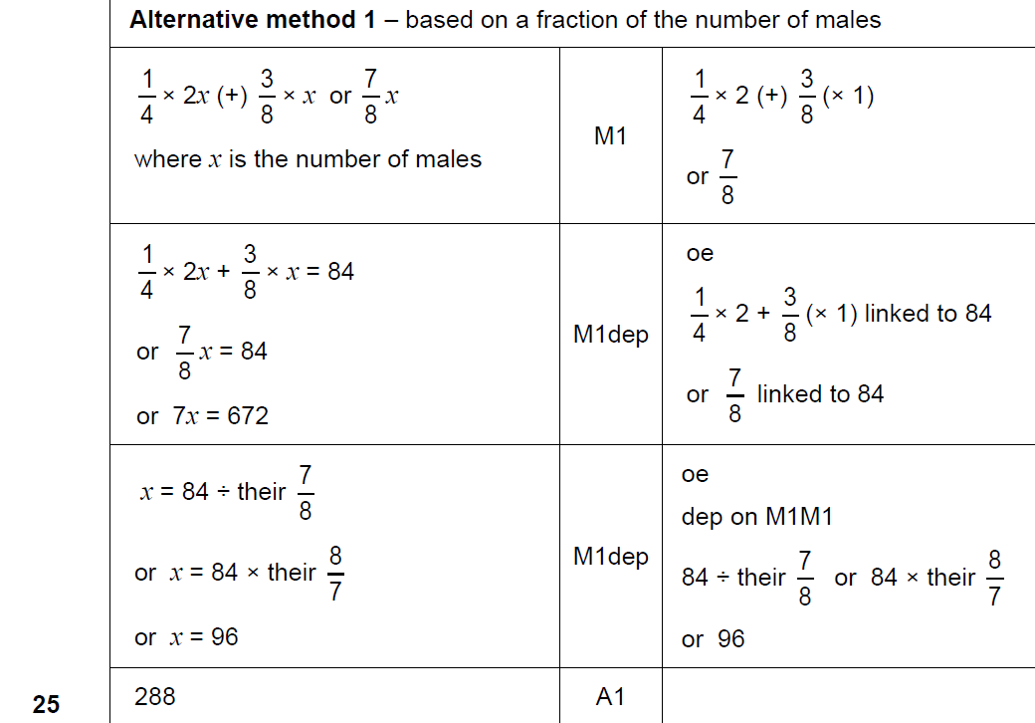
FDPR mixed context
May 2017 1H Q25
A

Slide 24
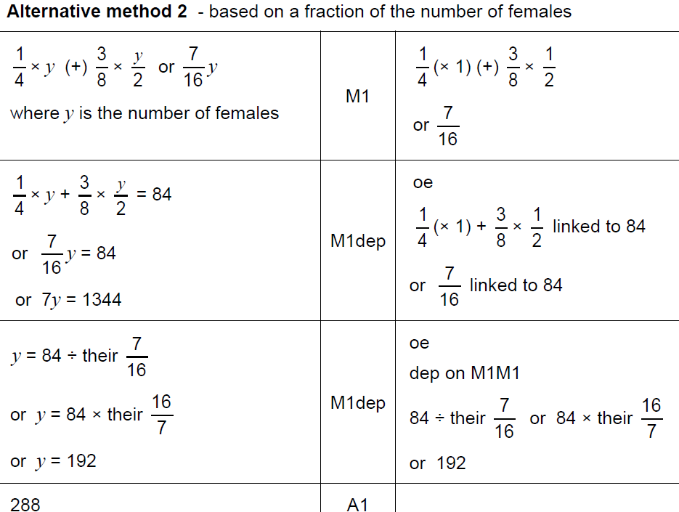
FDPR mixed context
May 2017 1H Q25
A Alternative 1

Slide 25
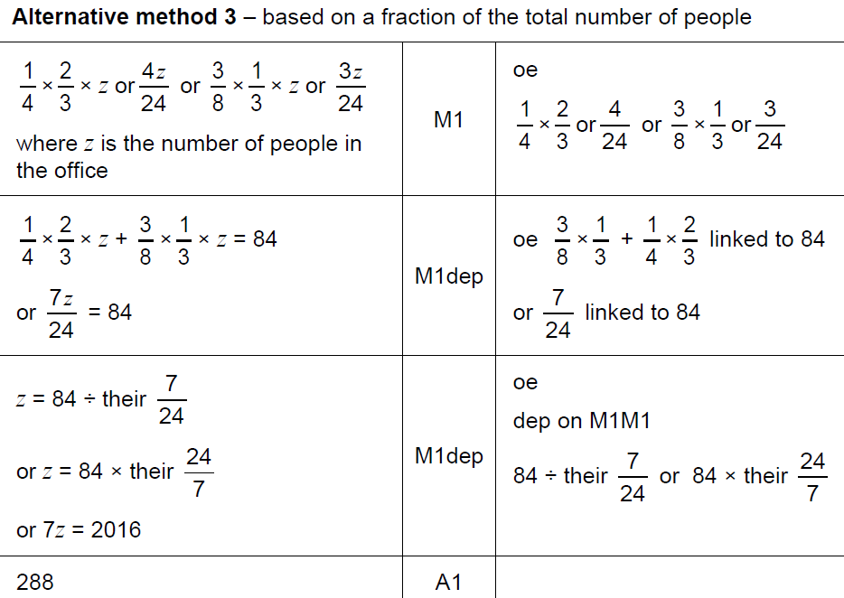
FDPR mixed context
May 2017 1H Q25
A Alternative 2

Slide 26
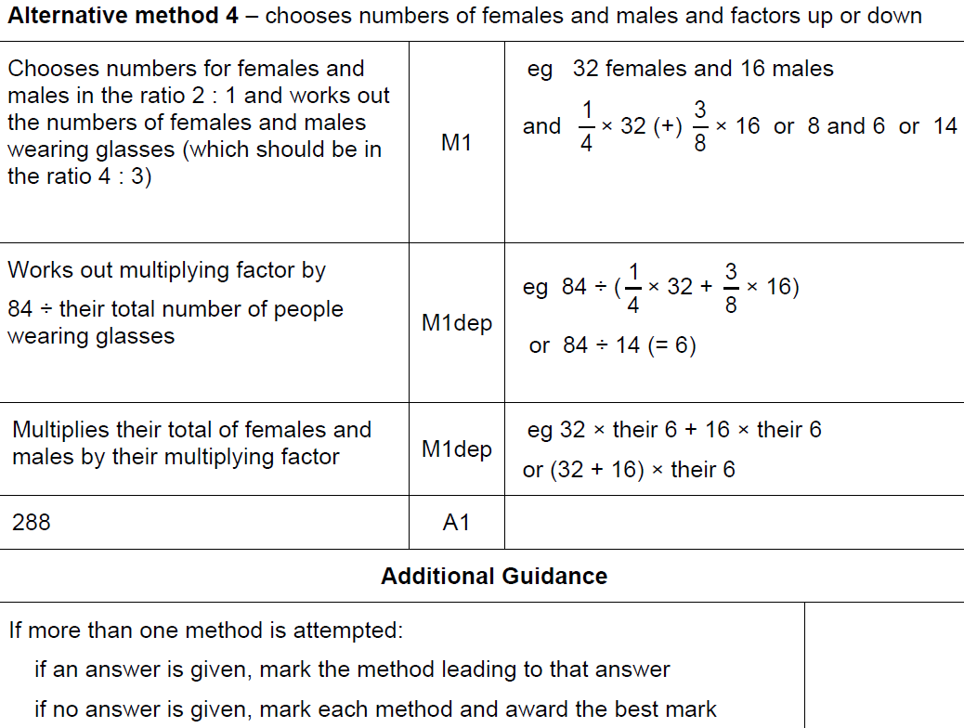
FDPR mixed context
May 2017 1H Q25
A Alternative 3

Slide 27
FDPR mixed context
June 2017 2H Q1

Slide 28
FDPR mixed context
June 2017 2H Q1
A

Slide 29
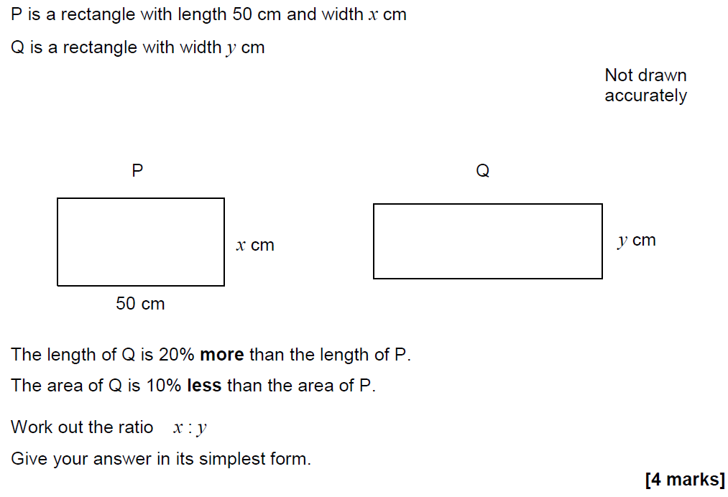
FDPR mixed context
June 2017 2H Q17

Slide 30
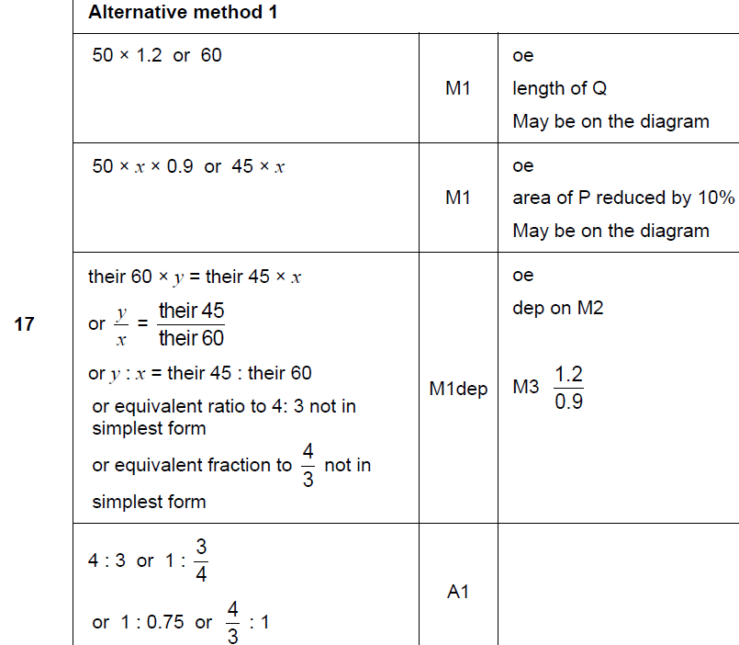
FDPR mixed context
June 2017 2H Q17
A

Slide 31
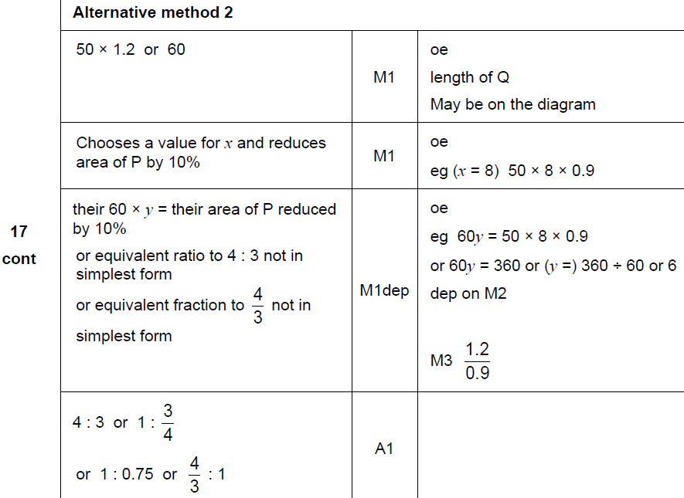
FDPR mixed context
June 2017 2H Q17
A Alternative

Slide 32
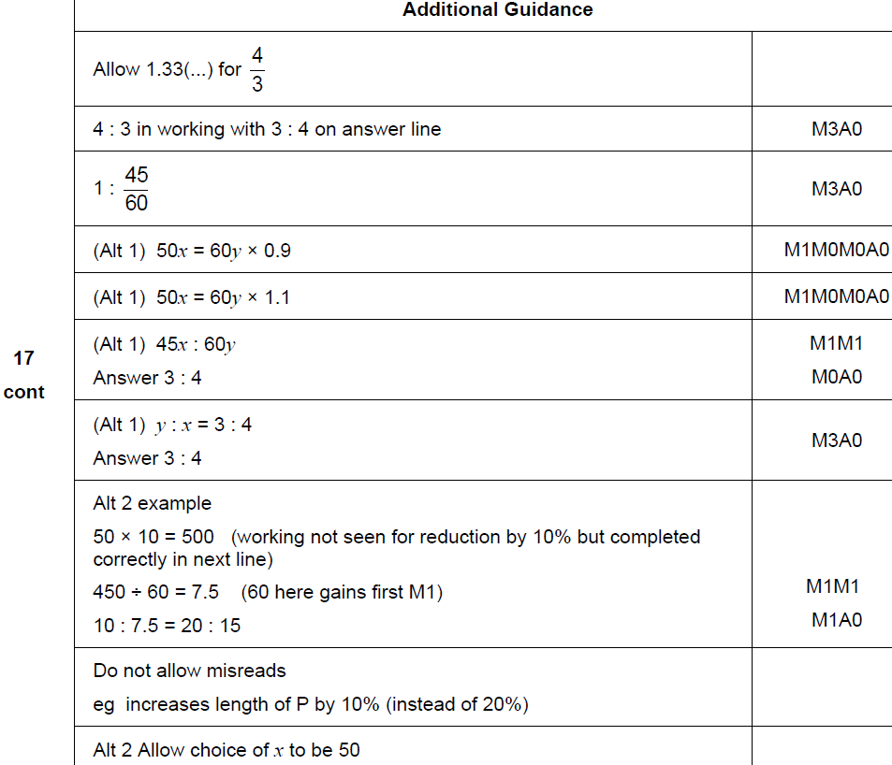
FDPR mixed context
June 2017 2H Q17
A notes

Slide 33
FDPR mixed context
Nov 2017 2H Q1

Slide 34
FDPR mixed context
Nov 2017 2H Q1
A

Slide 35
FDPR mixed context
Nov 2017 3H Q2

Slide 36
FDPR mixed context
Nov 2017 3H Q2
A

Slide 37
FDPR mixed context
May 2018 1H Q16

Slide 38
FDPR mixed context
May 2018 1H Q16
A

Slide 39
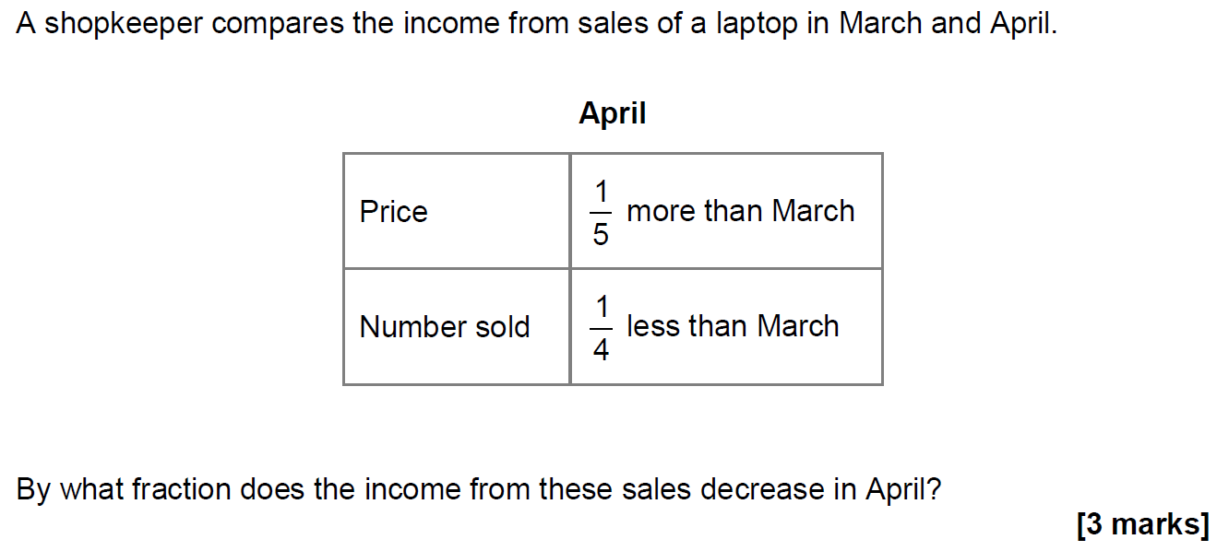
FDPR mixed context
May 2018 1H Q23

Slide 40
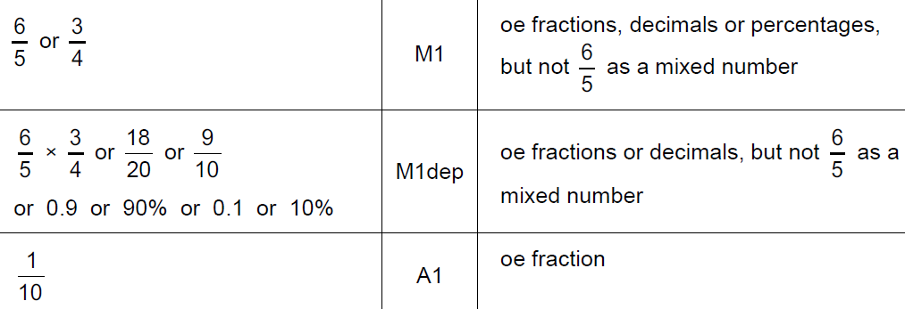
FDPR mixed context
May 2018 1H Q23
A

Slide 41
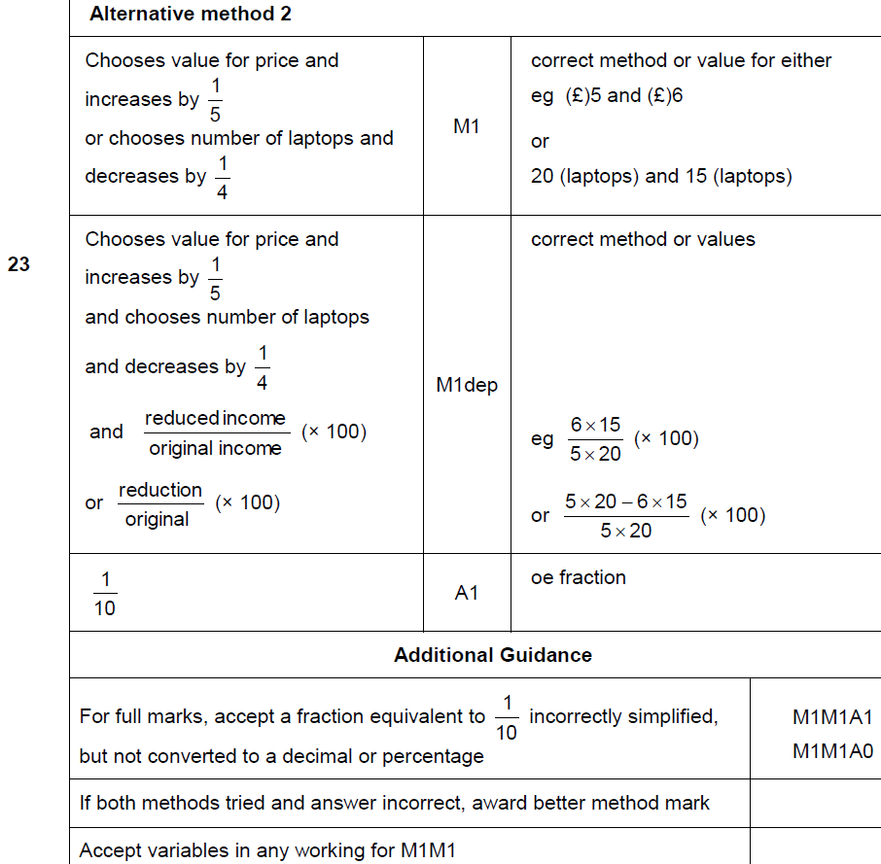
FDPR mixed context
May 2018 1H Q23
A Alternative & notes

Slide 42
FDPR mixed context
June 2018 3H Q1

Slide 43
FDPR mixed context
June 2018 3H Q1
A

Slide 44
FDPR mixed context
SAM 2H Q15

Slide 45
FDPR mixed context
SAM 2H Q15
A
B

Slide 46
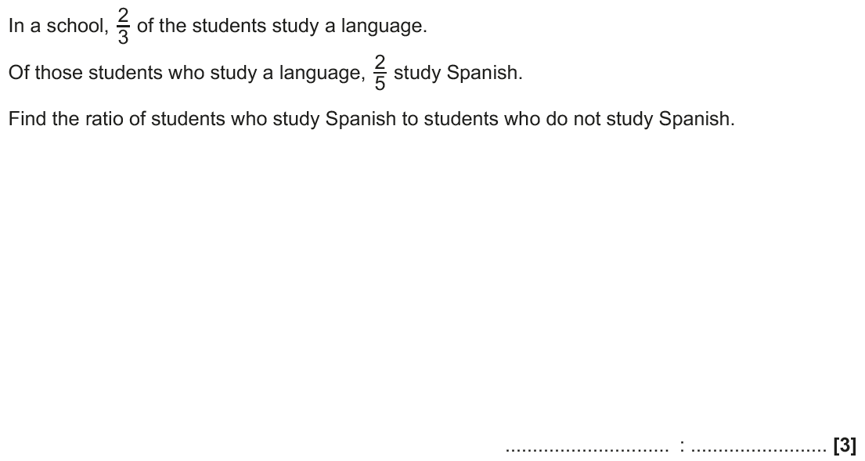
FDPR mixed context
June 2017 3H Q4

Slide 47
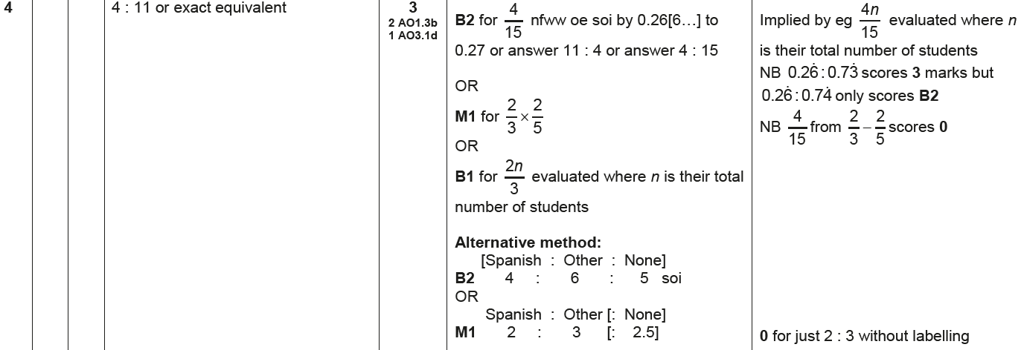
FDPR mixed context
June 2017 3H Q4
A

Slide 48
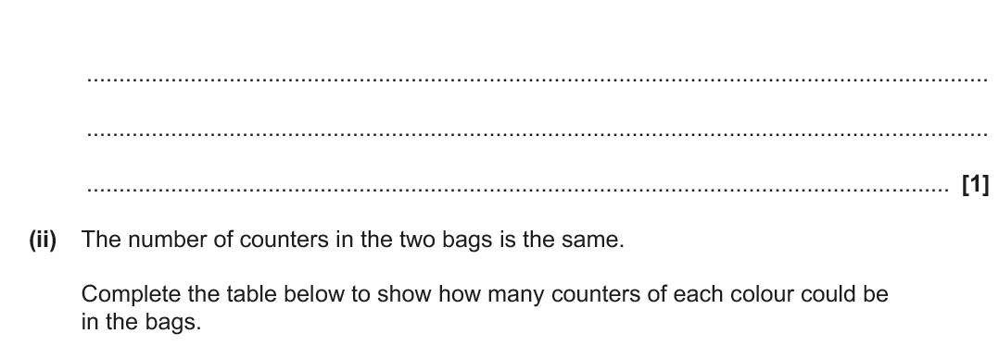
FDPR mixed context
Nov 2017 3H Q6

Slide 49
FDPR mixed context
Nov 2017 3H Q6
A (i)
A (ii)
B

Slide 50
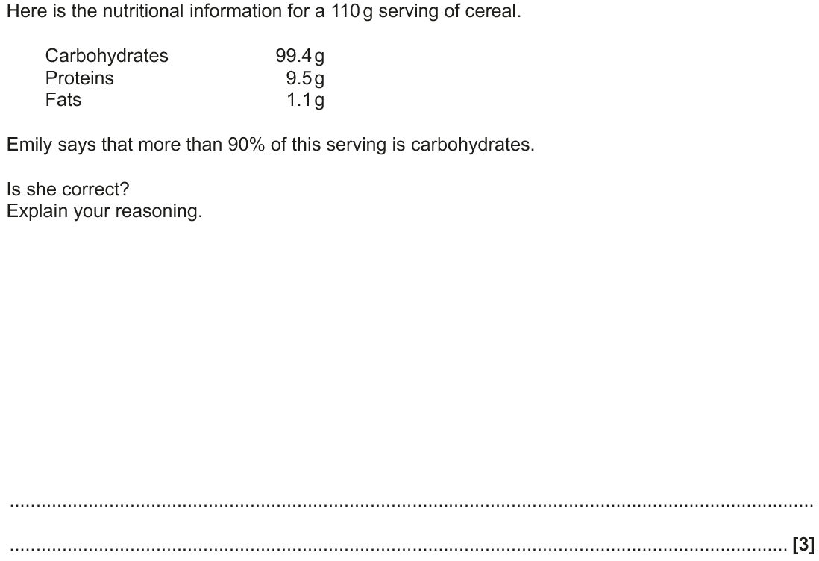
FDPR mixed context
June 2018 2H Q4

Slide 51
FDPR mixed context
June 2018 2H Q4
A

Slide 52
FDPR mixed context
June 2018 3H Q2

Slide 53
FDPR mixed context
June 2018 3H Q2
A

