Slide 1
FDPR mixed context
FDPR mixed context
May 2017
1H Q14
SAM
1H Q5
June 2017
2H Q2
SAM
3H Q5*
June 2017
3H Q4
Spec 2
1H Q7
June 2018
2H Q4
May 2019
1H Q12
Fractions
Decimals
Percentages
Ratios
*Just problem solving in context

Slide 2
FDPR mixed context
SAM 1H Q5

Slide 3
FDPR mixed context
SAM 1H Q5
A

Slide 4
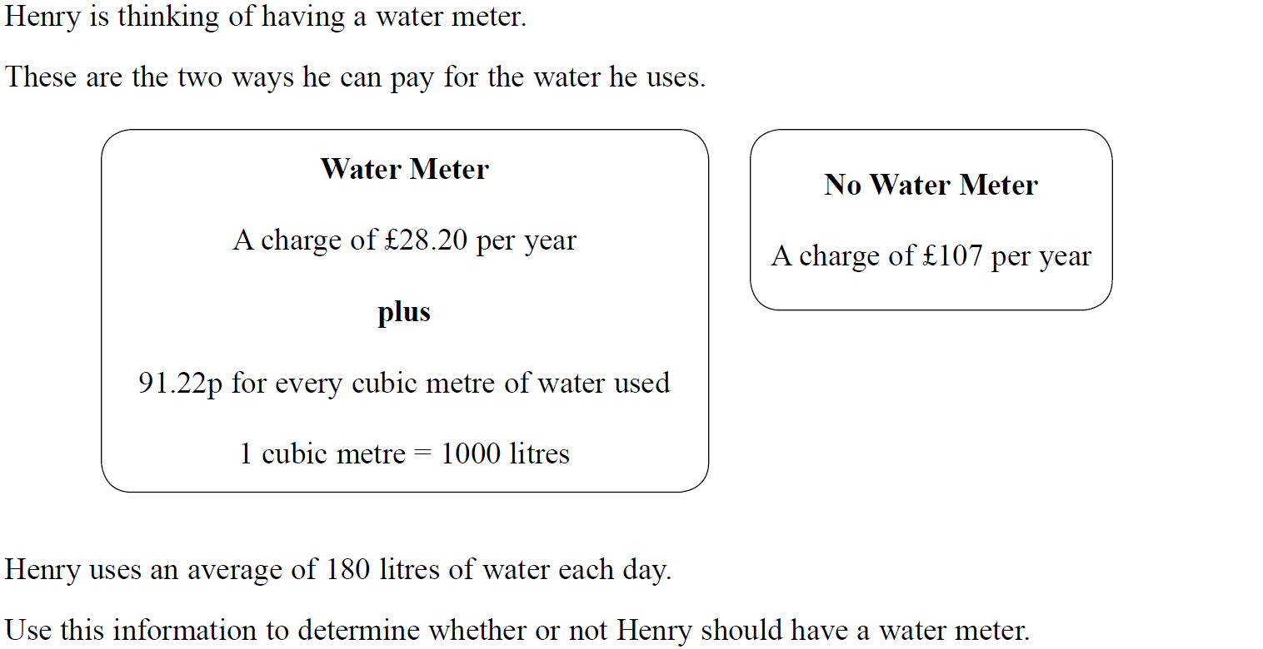
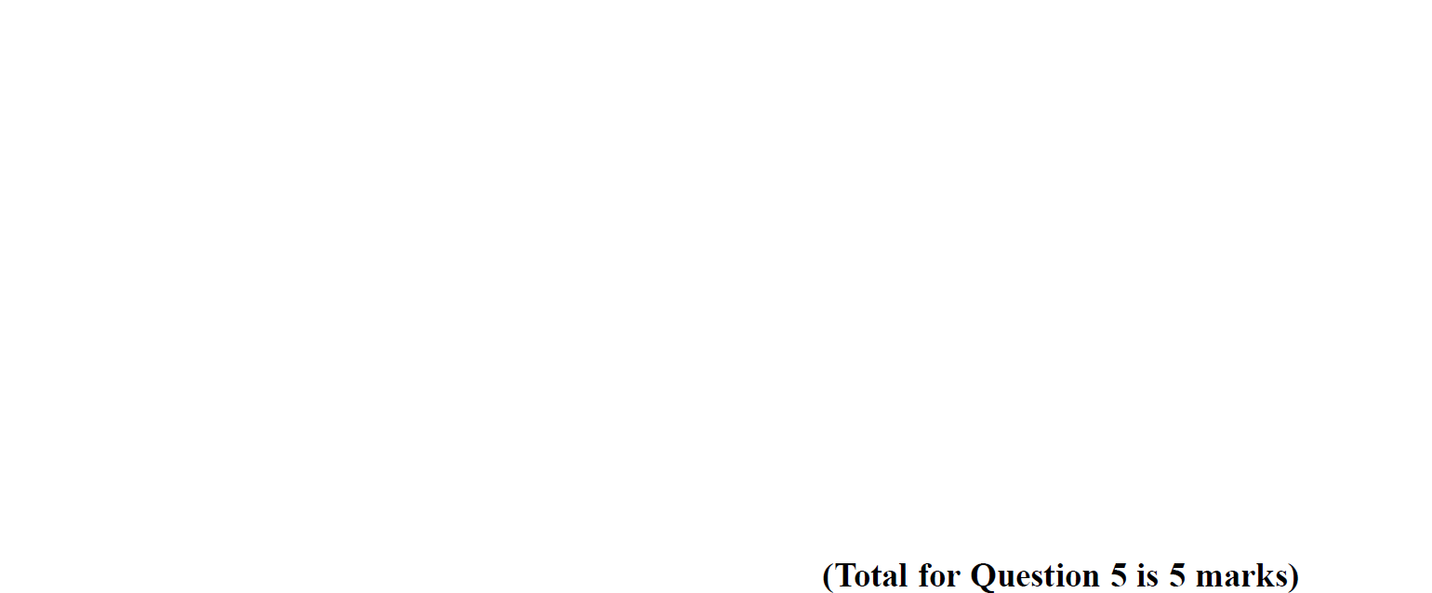
FDPR mixed context
SAM 3H Q5

Slide 5
FDPR mixed context
SAM 3H Q5
A

Slide 6
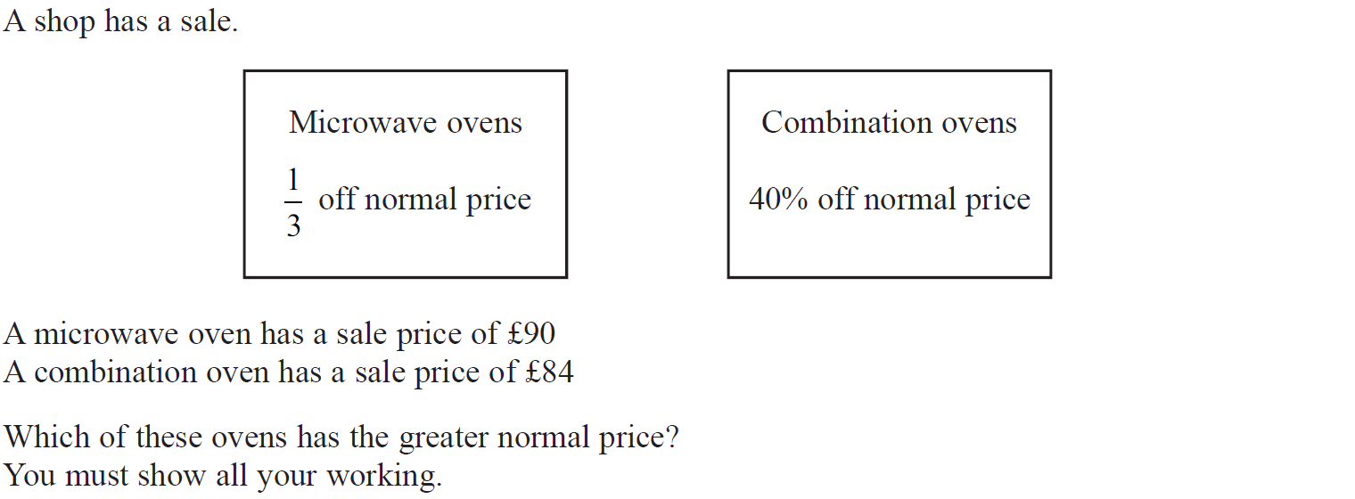
FDPR mixed context
Specimen Set 2 1H Q7

Slide 7
FDPR mixed context
Specimen Set 2 1H Q7
A

Slide 8
FDPR mixed context
May 2017 1H Q14

Slide 9
FDPR mixed context
May 2017 1H Q14
A

Slide 10
FDPR mixed context
May 2017 2H Q2

Slide 11
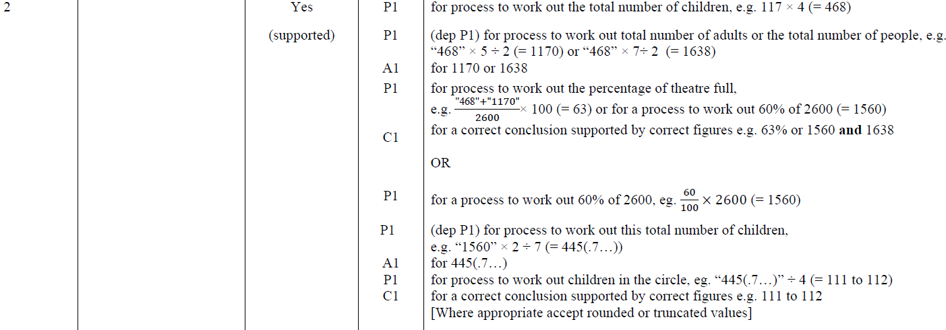
FDPR mixed context
May 2017 2H Q2
A

Slide 12
FDPR mixed context
June 2017 3H Q4

Slide 13
FDPR mixed context
June 2017 3H Q4
A

Slide 14
FDPR mixed context
June 2018 2H Q4

Slide 15
FDPR mixed context
June 2018 2H Q4
A

Slide 16
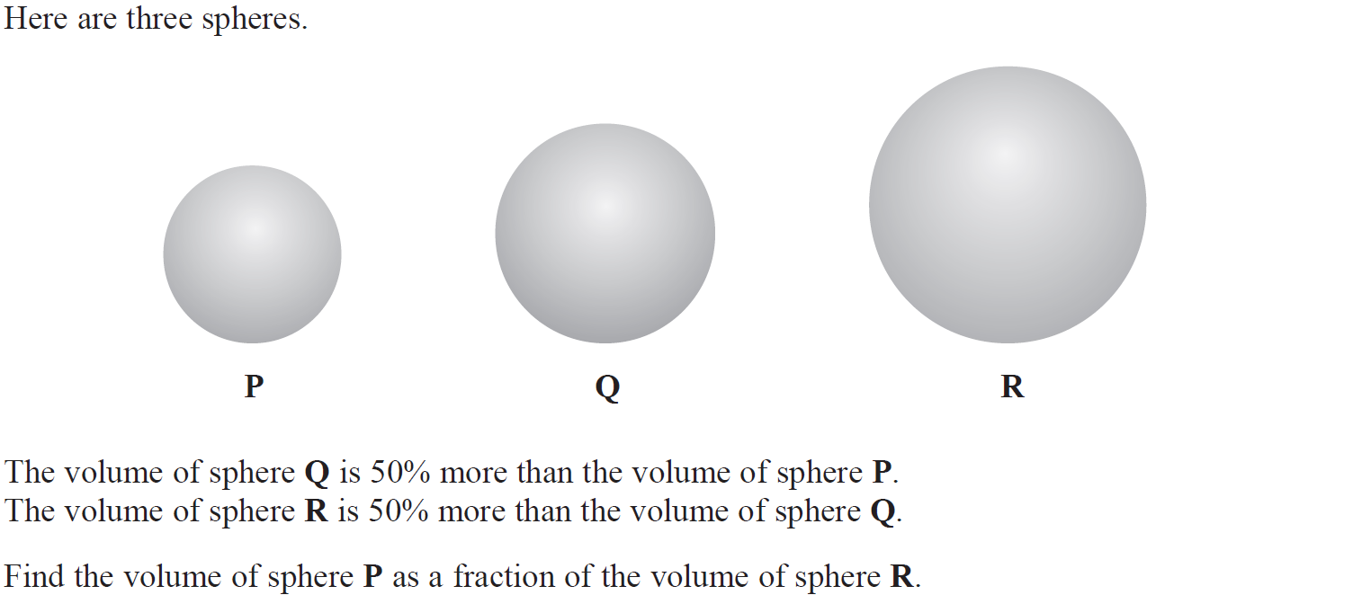
FDPR mixed context
May 2019 1H Q12

Slide 17
FDPR mixed context
May 2019 1H Q12
A
A SF

