Slide 1
FDPR mixed context
FDPR mixed context
June 2017
3H Q4
Nov 2017
3H Q6
SAM
2H Q15*
June 2018
2H Q4
June 2018
3H Q2
Fractions
Decimals
Percentages
Ratios
*And Surds!

Slide 2
FDPR mixed context
SAM 2H Q15

Slide 3
FDPR mixed context
SAM 2H Q15
A
B

Slide 4
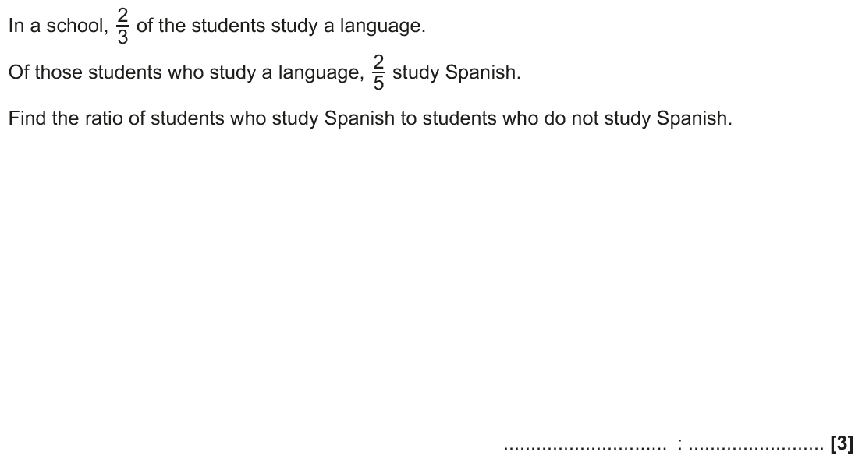
FDPR mixed context
June 2017 3H Q4

Slide 5
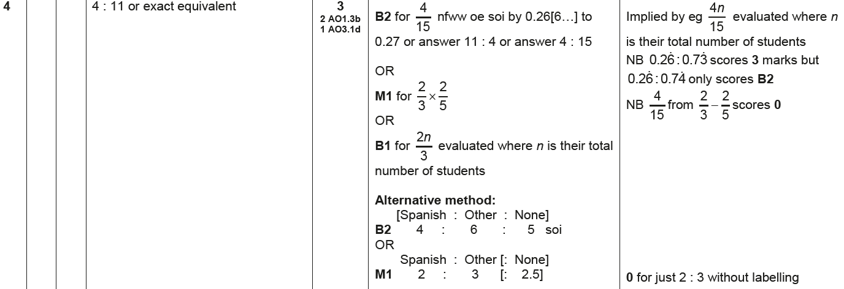
FDPR mixed context
June 2017 3H Q4
A

Slide 6
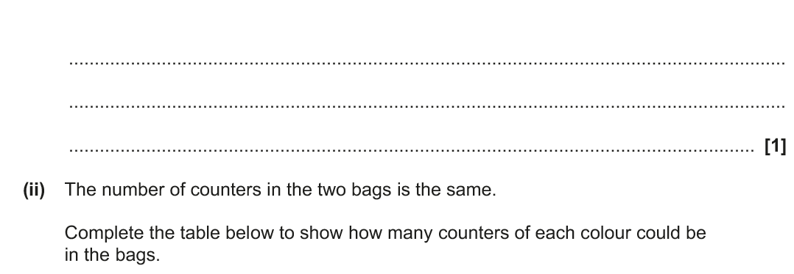
FDPR mixed context
Nov 2017 3H Q6

Slide 7
FDPR mixed context
Nov 2017 3H Q6
A (i)
A (ii)
B

Slide 8
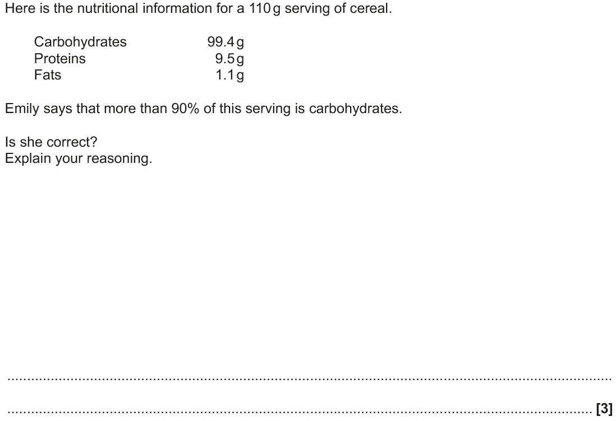
FDPR mixed context
June 2018 2H Q4

Slide 9
FDPR mixed context
June 2018 2H Q4
A

Slide 10
FDPR mixed context
June 2018 3H Q2

Slide 11
FDPR mixed context
June 2018 3H Q2
A

