Slide 1
Fractions
Fractions
May 2017
1H Q7
Nov 2017
2H Q1
May 2017
1H Q15
May 2018
1H Q6
SAM
1H Q7
1 Marker
May 2017
1H Q24
Nov 2018
1H Q5
June 2017
2H Q9
Nov 2018
3H Q2
Context

Slide 2
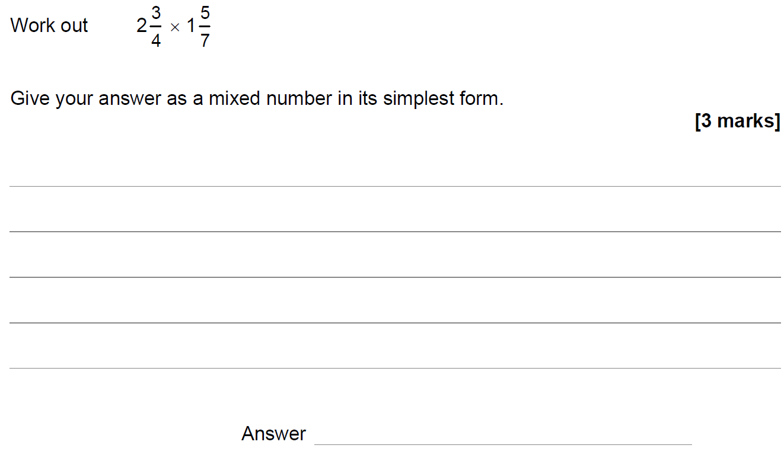
Fractions
SAM 1H Q7

Slide 3
Fractions
SAM 1H Q7
A

Slide 4
Fractions
May 2017 1H Q7

Slide 5
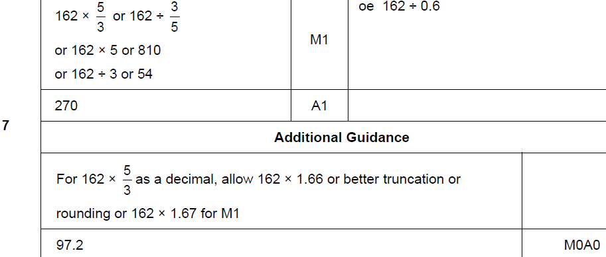
Fractions
May 2017 1H Q7
A

Slide 6
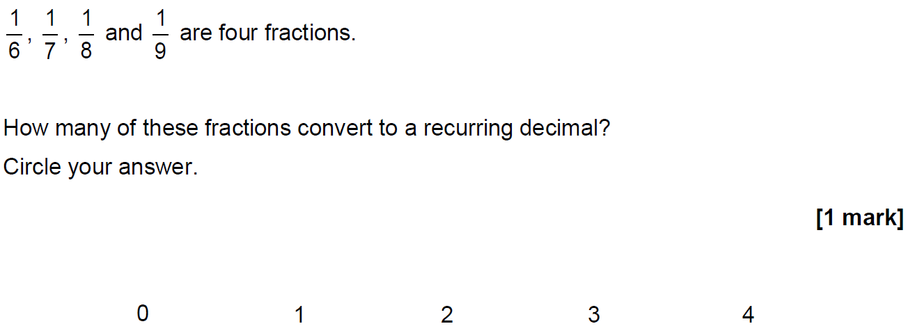
Fractions
May 2017 1H Q15

Slide 7
Fractions
May 2017 1H Q15
A

Slide 8
Fractions
May 2017 1H Q24

Slide 9
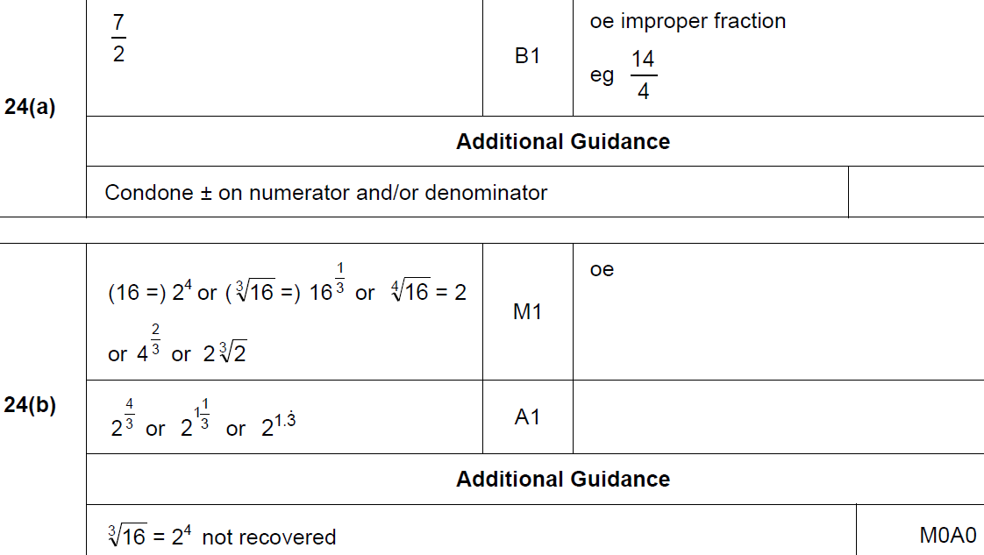
Fractions
May 2017 1H Q24
A
B

Slide 10
Fractions
June 2017 3H Q9

Slide 11
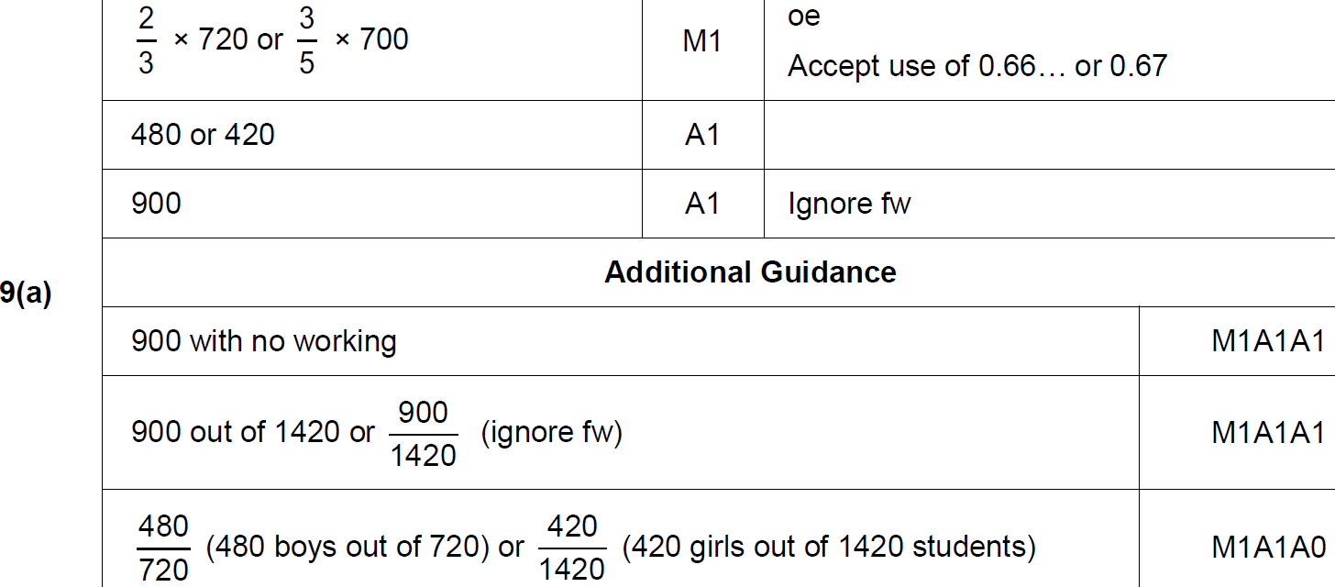
Fractions
June 2017 3H Q9
A

Slide 12
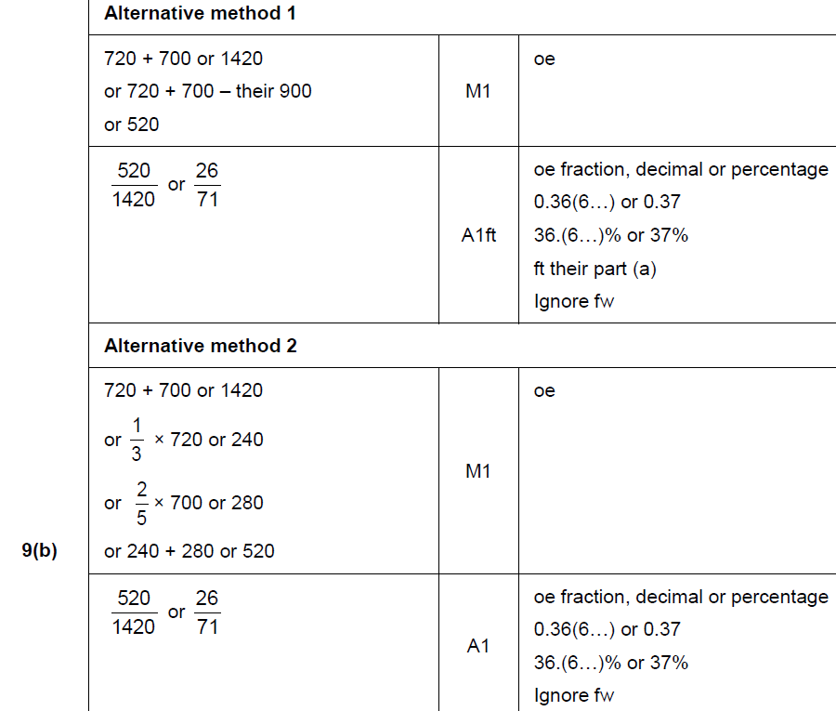
Fractions
June 2017 3H Q9
B

Slide 13
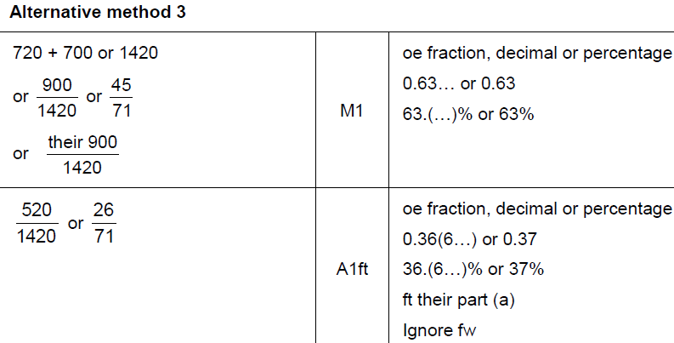
Fractions
June 2017 3H Q9
B Alternative & notes

Slide 14
Fractions
Nov 2017 2H Q1

Slide 15
Fractions
Nov 2017 2H Q1
A

Slide 16
Fractions
May 2018 1H Q6
The height of Zak is 1.86 metres.
The height of Fred is 1.6 metres.
Write the height of Zak as a fraction of the height of Fred.
Give your answer in its simplest form.
[3 marks]

Slide 17
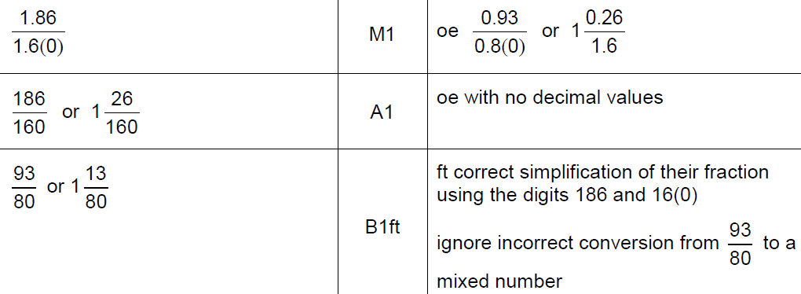
Fractions
May 2018 1H Q6
A

Slide 18
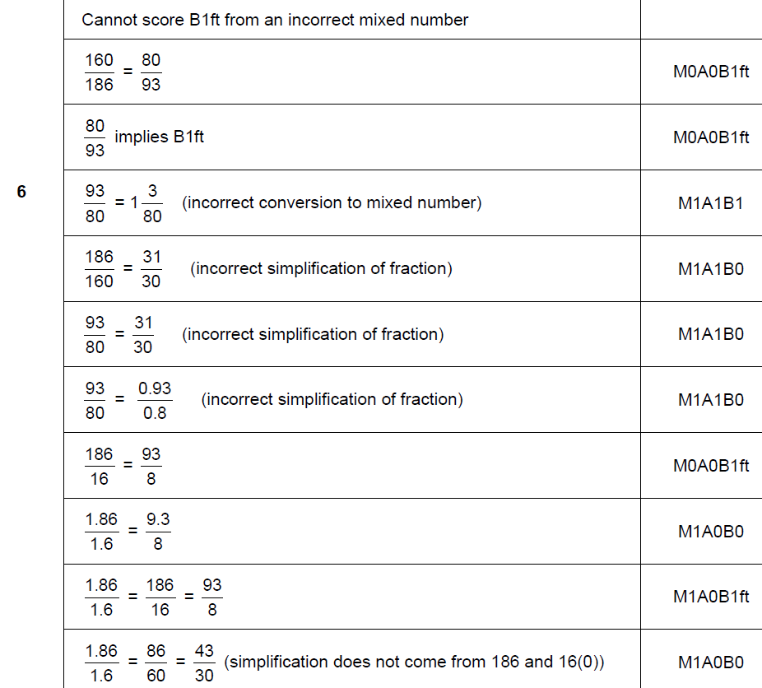
Fractions
May 2018 1H Q6
A notes

Slide 19
Fractions
Nov 2018 1H Q5

Slide 20
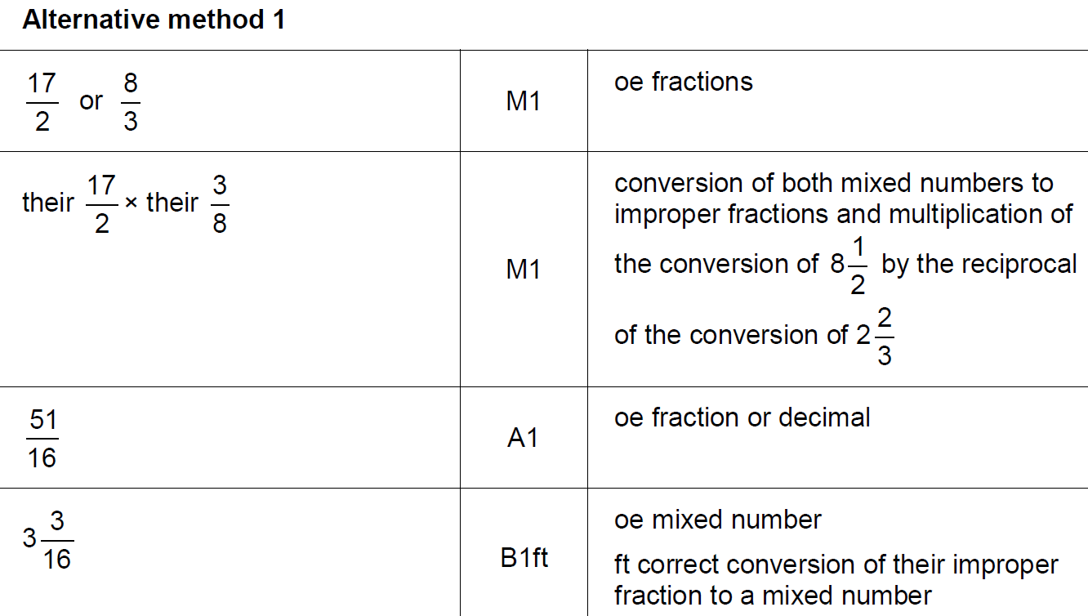
Fractions
Nov 2018 1H Q5
A

Slide 21
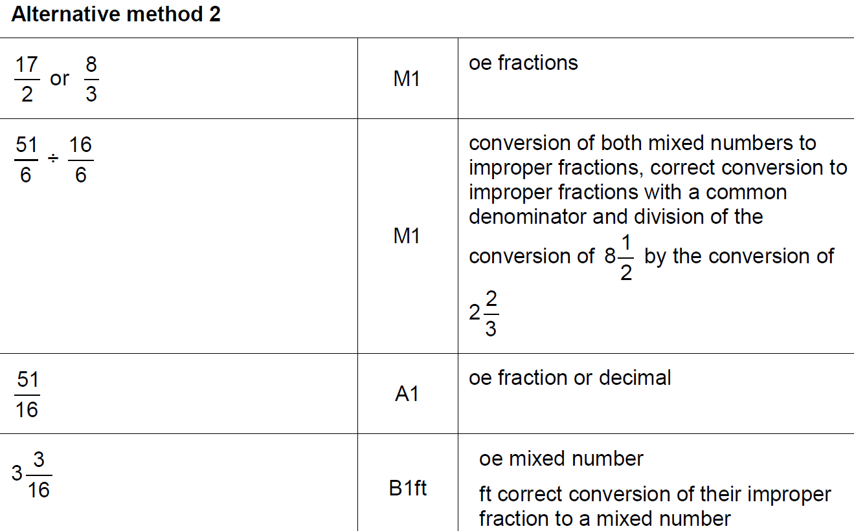
Fractions
Nov 2018 1H Q5
A Alternative

Slide 22
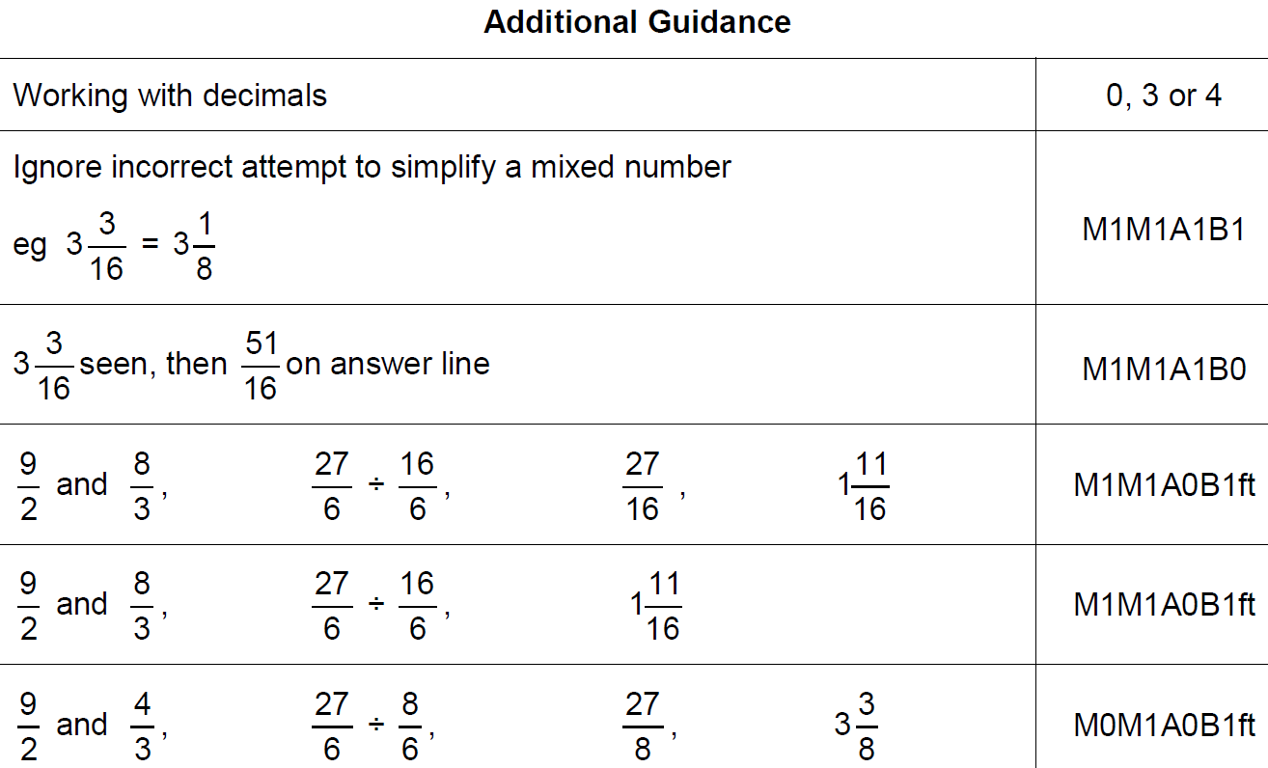
Fractions
Nov 2018 1H Q5
A notes

Slide 23
Fractions
Nov 2018 3H Q2

Slide 24
Fractions
Nov 2018 3H Q2
A

