Slide 1
Trig Exact Values & Graphs
Trig Exact Values & Graphs
May 2017 1H Q29
May 2018 1H Q30
SAM
1H Q19
June 2017 2H Q27
Nov 2018 1H Q4
1 Marker
SAM
2H Q24
Nov 2017 1H Q29
Nov 2018 1H Q26
May 2018 1H Q25
Nov 2018 1H Q27
Graphs

Slide 2

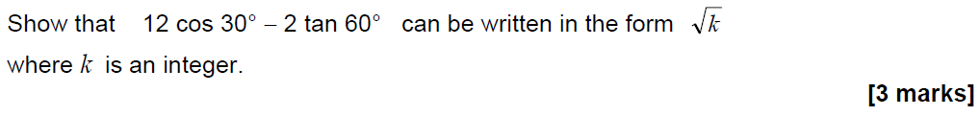

Trig Exact Values & Graphs
SAM 1H Q19

Slide 3
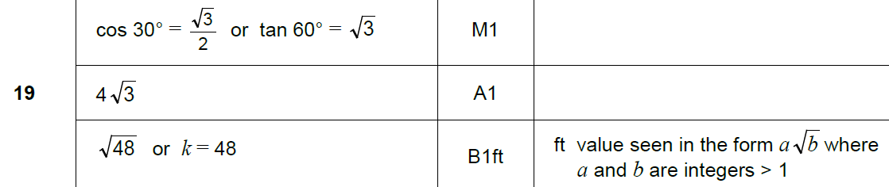

Trig Exact Values & Graphs
SAM 1H Q19
A

Slide 4
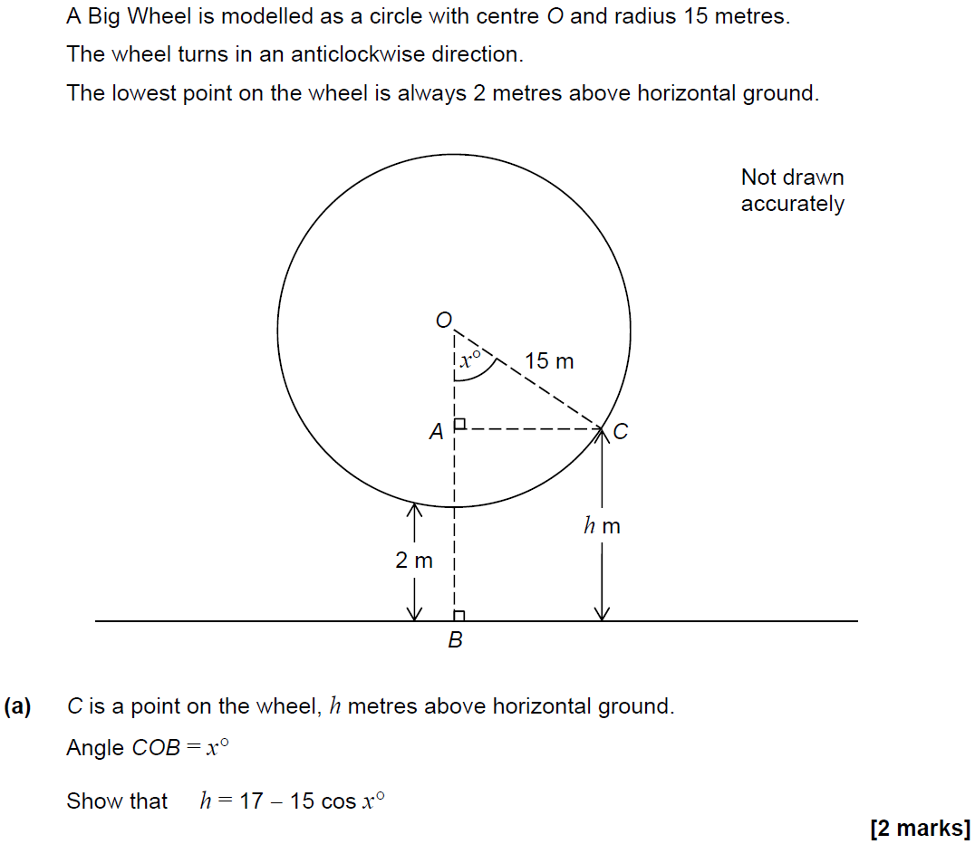
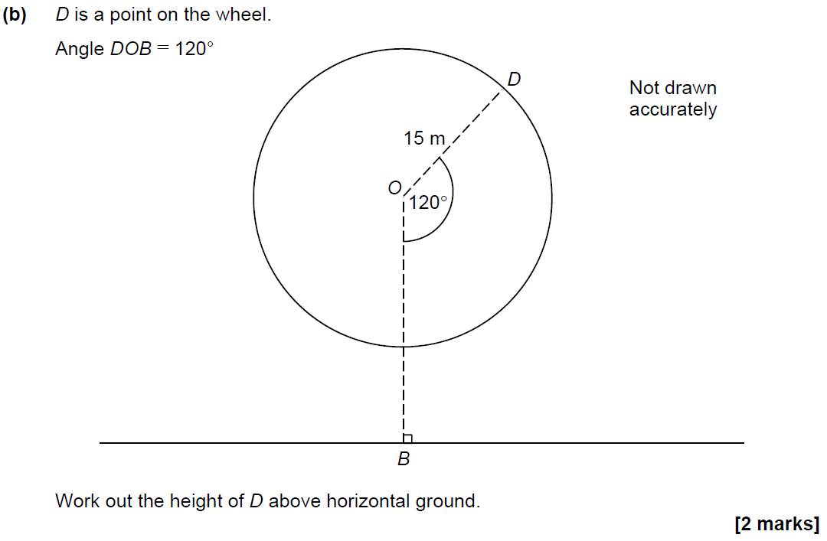
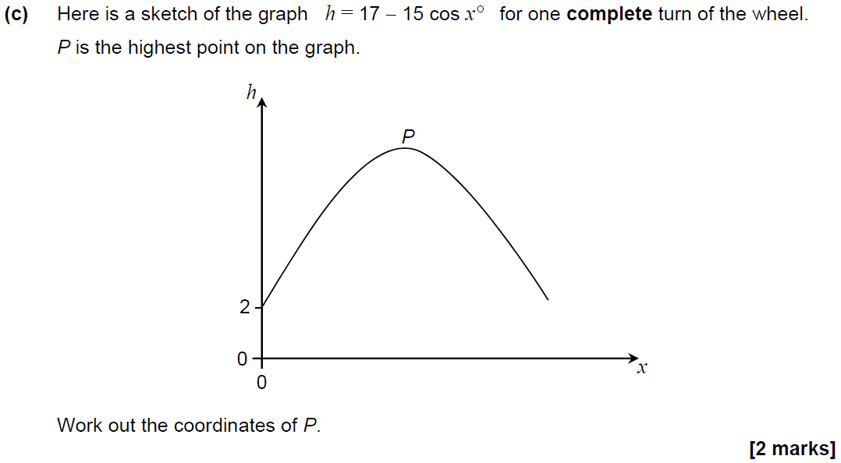
Trig Exact Values & Graphs
SAM 2H Q24

Slide 5
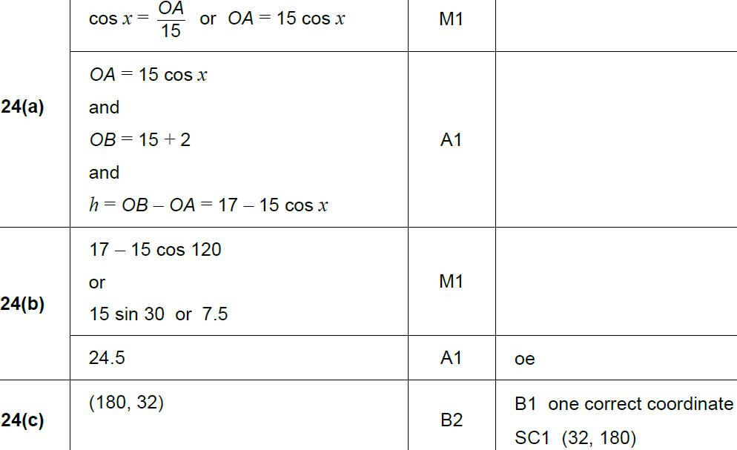
Trig Exact Values & Graphs
SAM 2H Q24
A
B
C

Slide 6
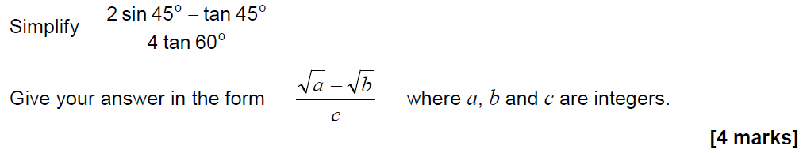
Trig Exact Values & Graphs
May 2017 1H Q29

Slide 7
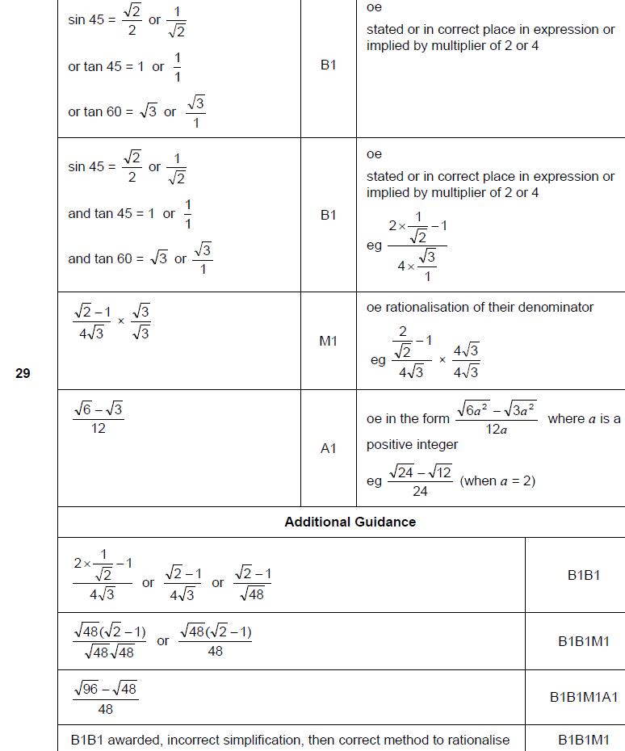
Trig Exact Values & Graphs
May 2017 1H Q29
A

Slide 8
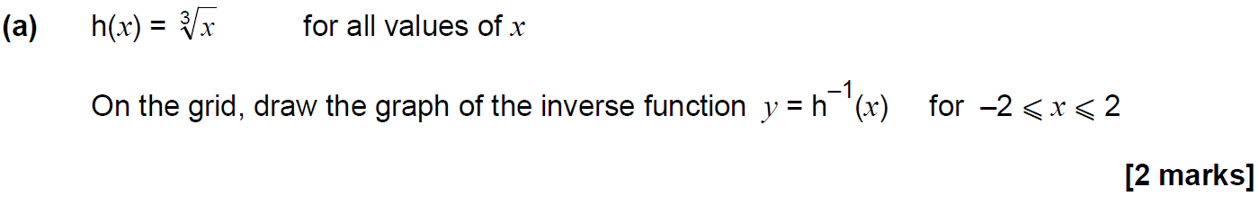
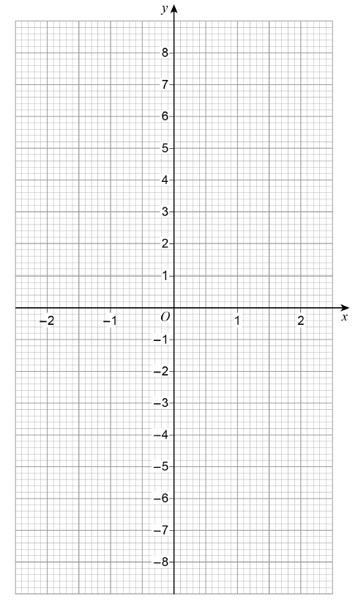
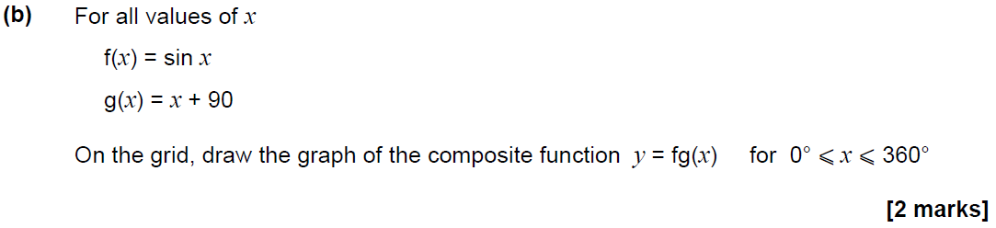
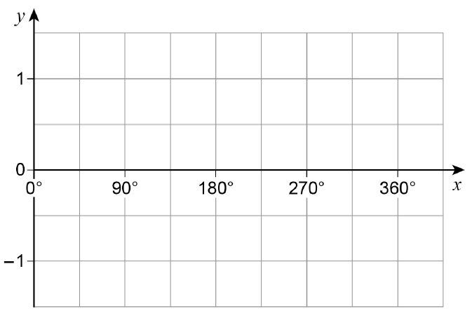
Trig Exact Values & Graphs
June 2017 2H Q27

Slide 9
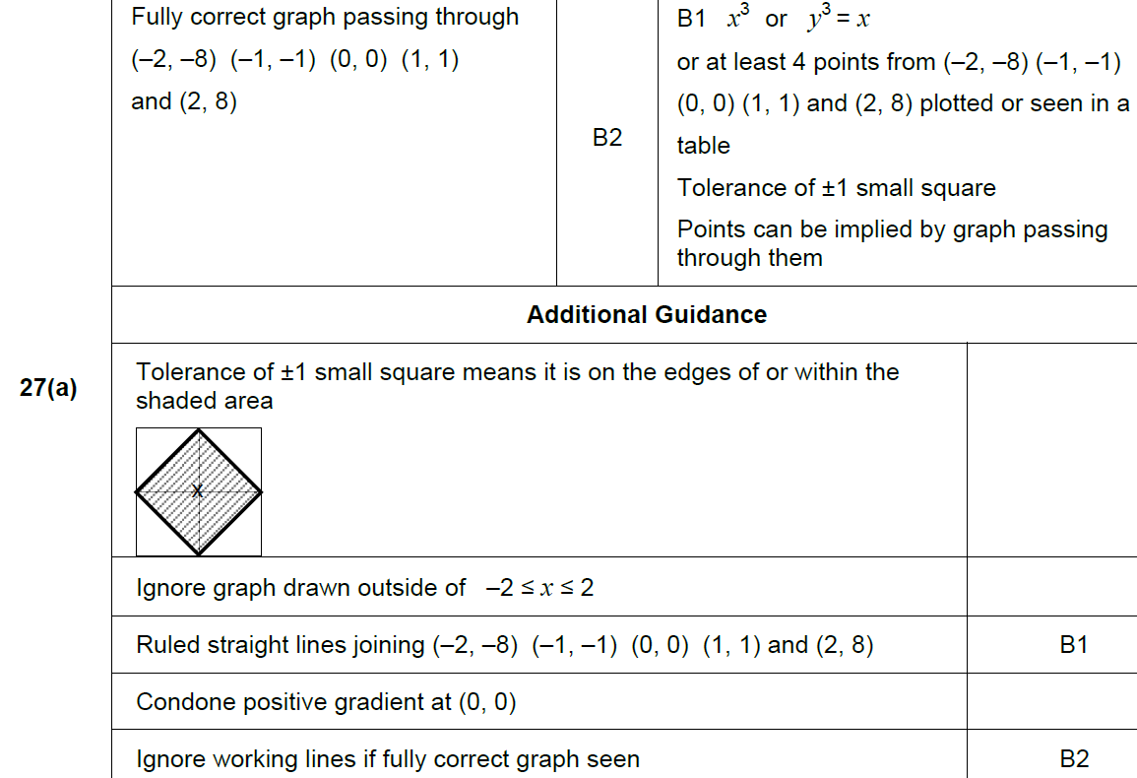
Trig Exact Values & Graphs
June 2017 2H Q27
A

Slide 10
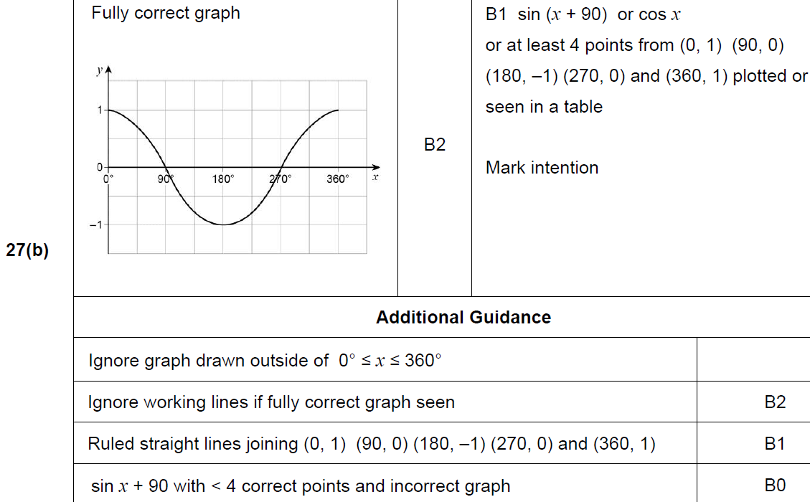
Trig Exact Values & Graphs
June 2017 2H Q27
B

Slide 11
Trig Exact Values & Graphs
Nov 2017 1H Q29
Here is a sketch of y = sin x° for –360 ⩽ x ⩽ 360
(a) Write down the coordinates of P.
[1 mark]
(b) Write down the coordinates of Q.
[1 mark]

Slide 12
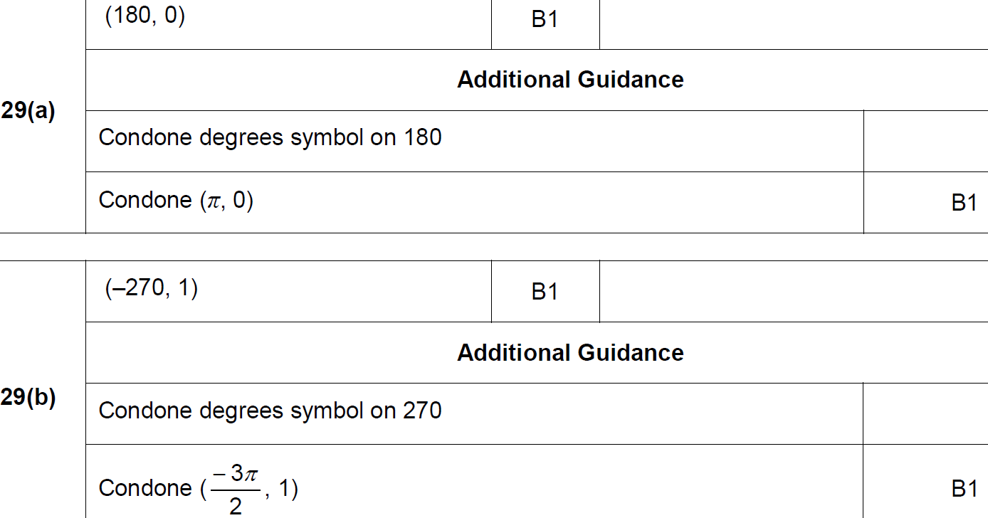
Trig Exact Values & Graphs
Nov 2017 1H Q29
A
B

Slide 13
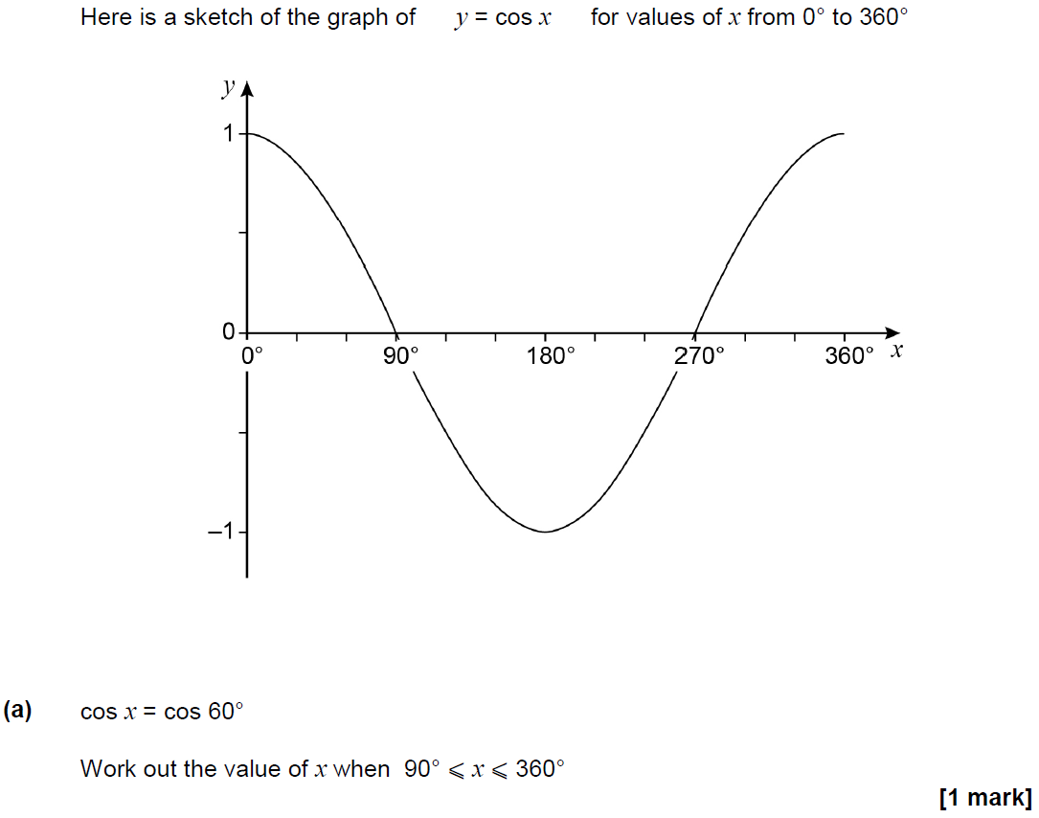
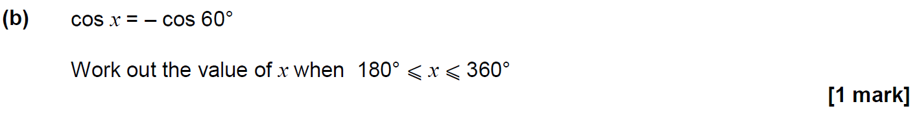
Trig Exact Values & Graphs
May 2018 1H Q25

Slide 14
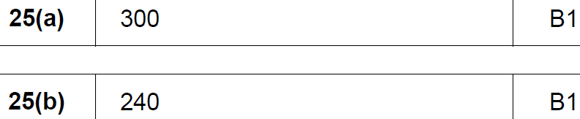
Trig Exact Values & Graphs
May 2018 1H Q25
A
B

Slide 15
Trig Exact Values & Graphs
May 2018 1H Q30
Show that the value of cos 30° × tan 60° + sin 30° is an integer.
[3 marks]

Slide 16
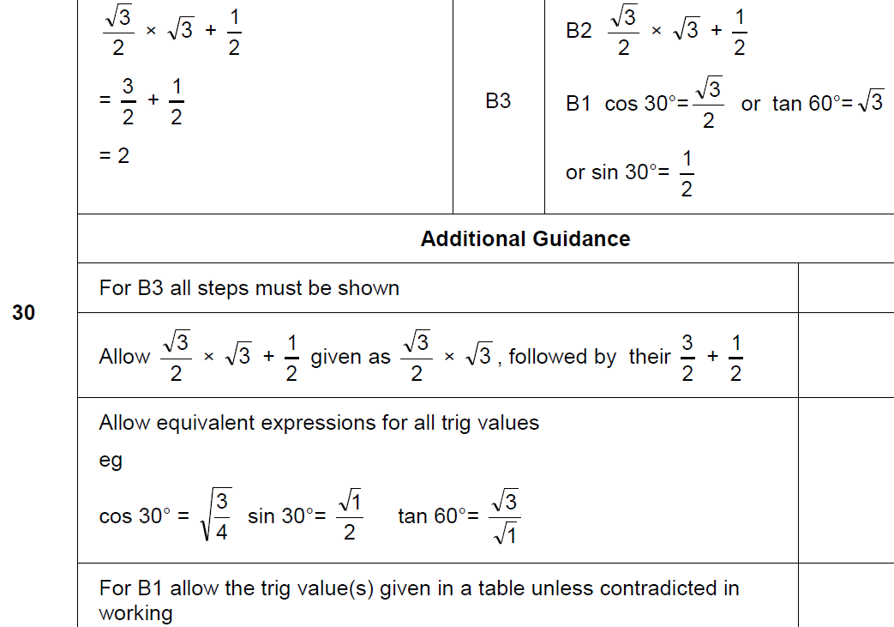
Trig Exact Values & Graphs
May 2018 1H Q30
A

Slide 17
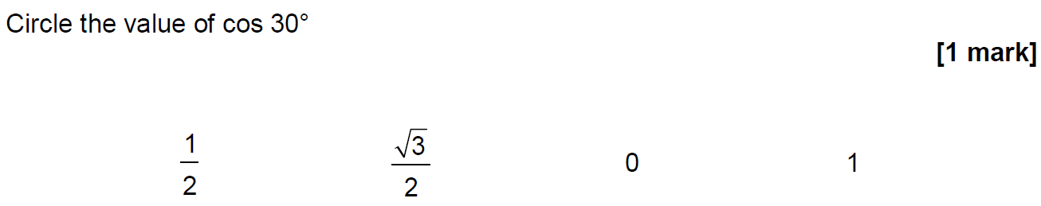
Trig Exact Values & Graphs
Nov 2018 1H Q4

Slide 18

Trig Exact Values & Graphs
Nov 2018 1H Q4
A

Slide 19
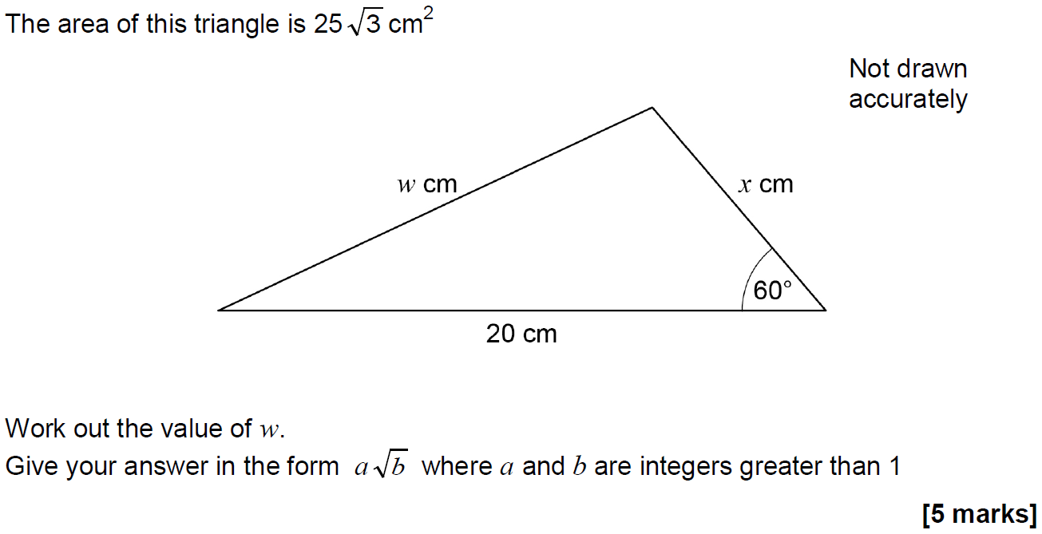
Trig Exact Values & Graphs
Nov 2018 1H Q26

Slide 20
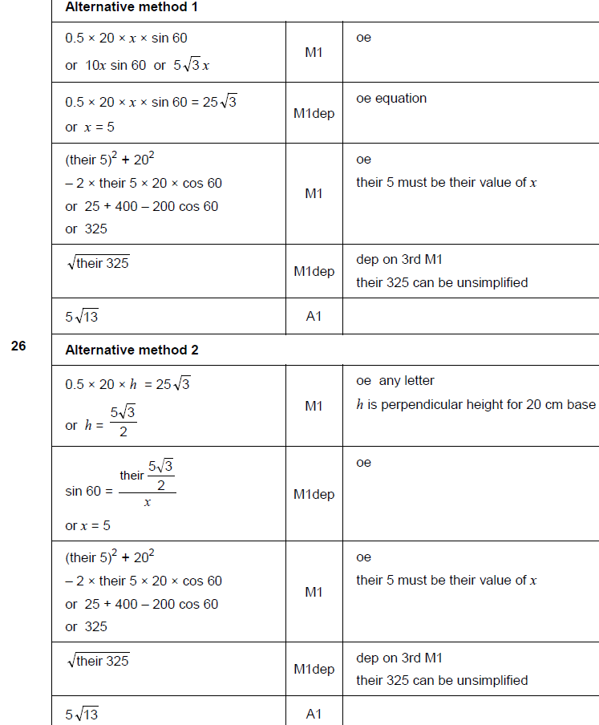
Trig Exact Values & Graphs
Nov 2018 1H Q26
A

Slide 21
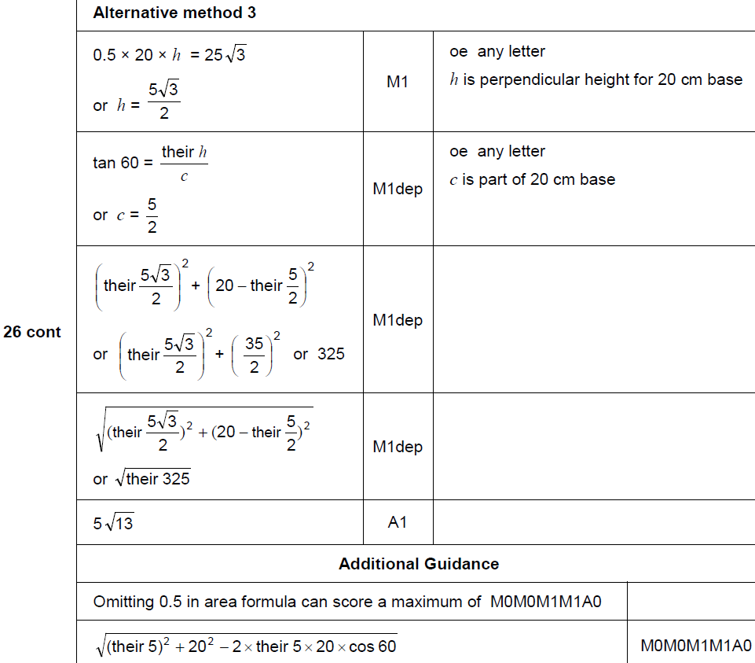
Trig Exact Values & Graphs
Nov 2018 1H Q26
A Alternative & notes

Slide 22
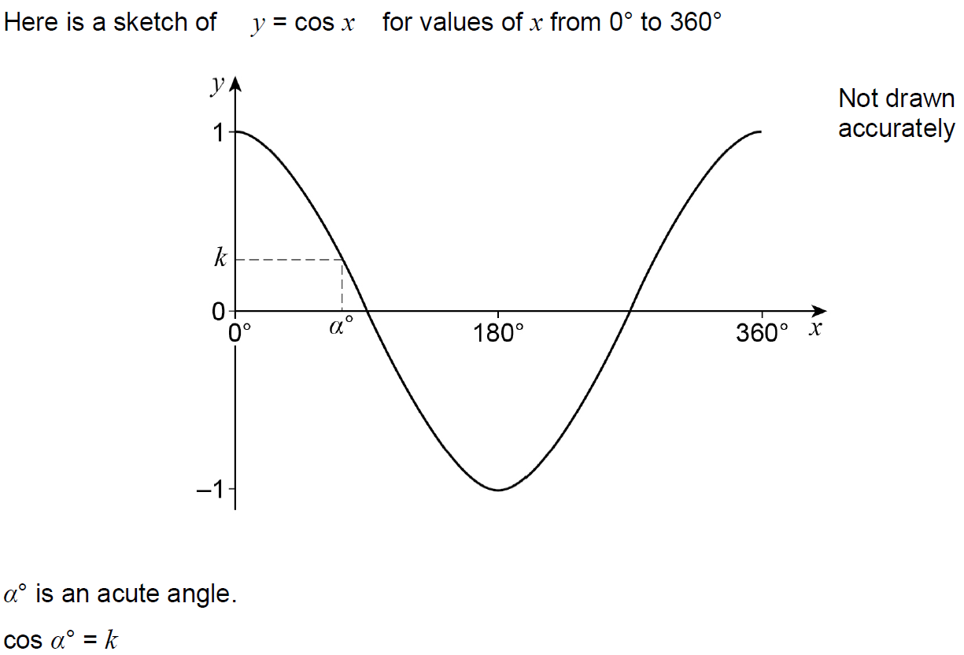
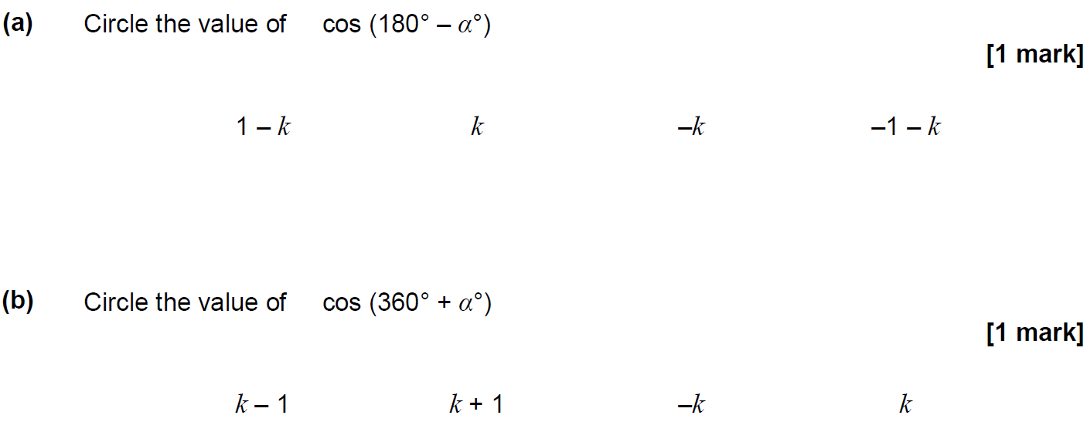
Trig Exact Values & Graphs
Nov 2018 1H Q27

Slide 23
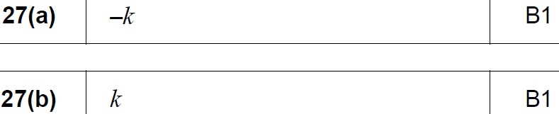
Trig Exact Values & Graphs
Nov 2018 1H Q27
A
B

