Slide 1
Drawing and Using Graphs
Drawing and Using Graphs
June 2017 2H Q14
Nov 2018 1H Q17
June 2017 2H Q20
Nov 2018 2H Q14
Edexcel
June 2017 3H Q20
SAM
3H Q17
Nov 2018 2H Q15
AQA
Nov 2017 1H Q7
Spec 1
1H Q16
Nov 2018 3H Q3
OCR
June 2018 2H Q5
June 2019 3H Q17
June 2018 2H Q12
June 2019 3H Q21
June 2018 2H Q16
Intercepts and roots
Circles
Recognising shapes of graphs

Slide 2
Drawing and Using Graphs
Drawing and Using Graphs
May 2017
1H Q20
Nov 2017
1H Q28
Nov 2018
1H Q25
Edexcel
June 2017
2H Q6
Nov 2017
2H Q3
Nov 2018
2H Q27
AQA
June 2017
2H Q27
Nov 2017
2H Q21
1 Marker
Nov 2018
3H Q12
OCR
June 2017
3H Q18
June 2018
2H Q22
Nov 2018
3H Q28
June 2017
3H Q23
June 2018
3H Q14
Intercepts and roots
Circles
Recognising shapes of graphs

Slide 3
Drawing and Using Graphs
Drawing and Using Graphs
May 2017
1H Q17
Nov 2017
3H Q17
Edexcel
SAM
1H Q4*
Nov 2018
1H Q10
June 2017
2H Q19
May 2018
1H Q17
AQA
Practice
1H Q15
Nov 2018
1H Q21
June 2017
3H Q7
June 2018
2H Q9
OCR
Practice
2H Q18
Nov 2018
3H Q10*
Nov 2017
1H Q5
June 2018
3H Q9
*Mainly Proportion
Intercepts and roots
Circles
Recognising shapes of graphs

Slide 4
Drawing and Using Graphs
SAM 3H Q17

Slide 5
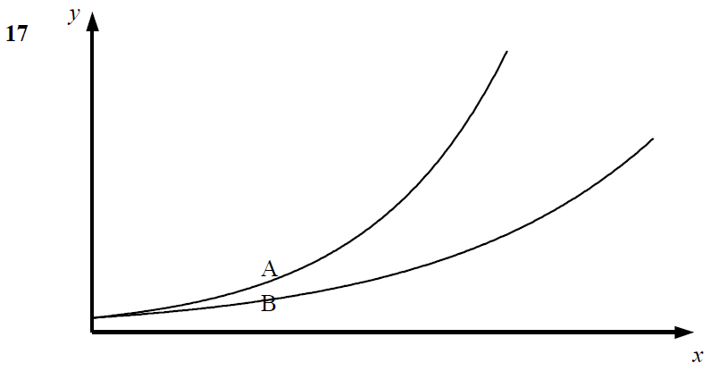
Drawing and Using Graphs
SAM 3H Q17
A
B
C

Slide 6
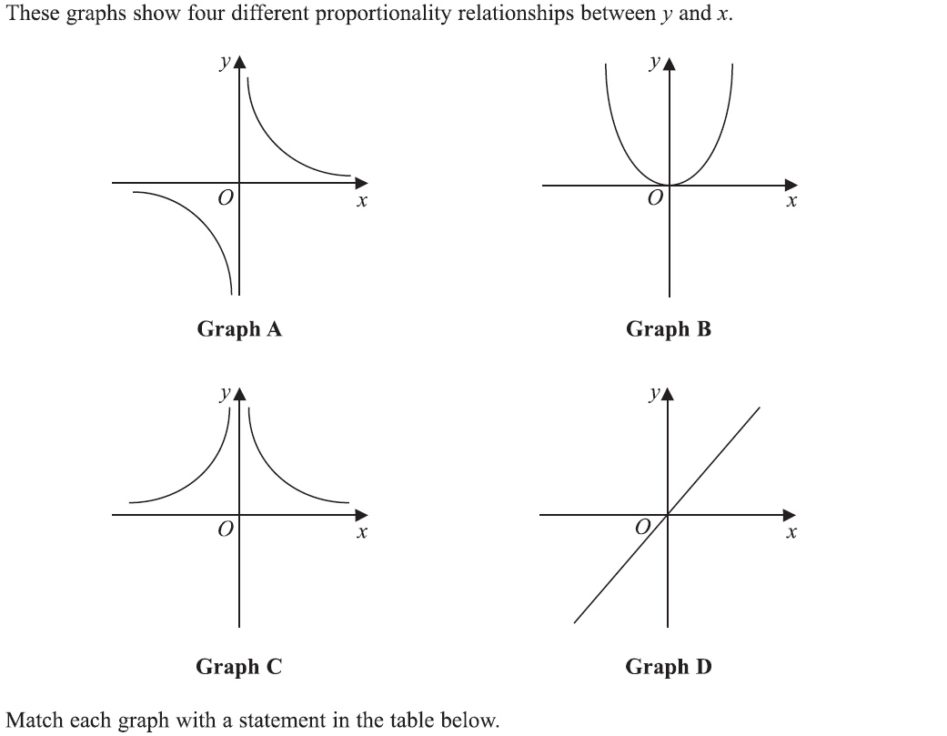
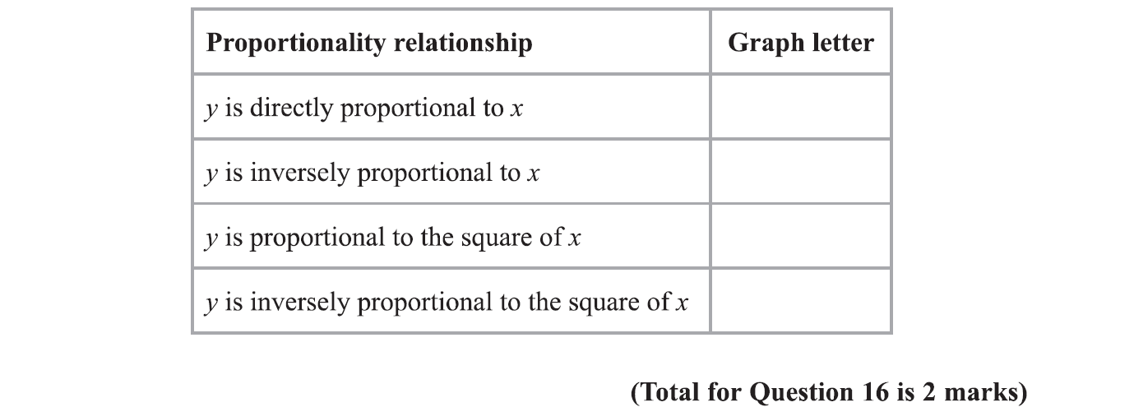
Drawing and Using Graphs
Specimen Set 1 1H Q16

Slide 7
Drawing and Using Graphs
Specimen Set 1 1H Q16
A

Slide 8
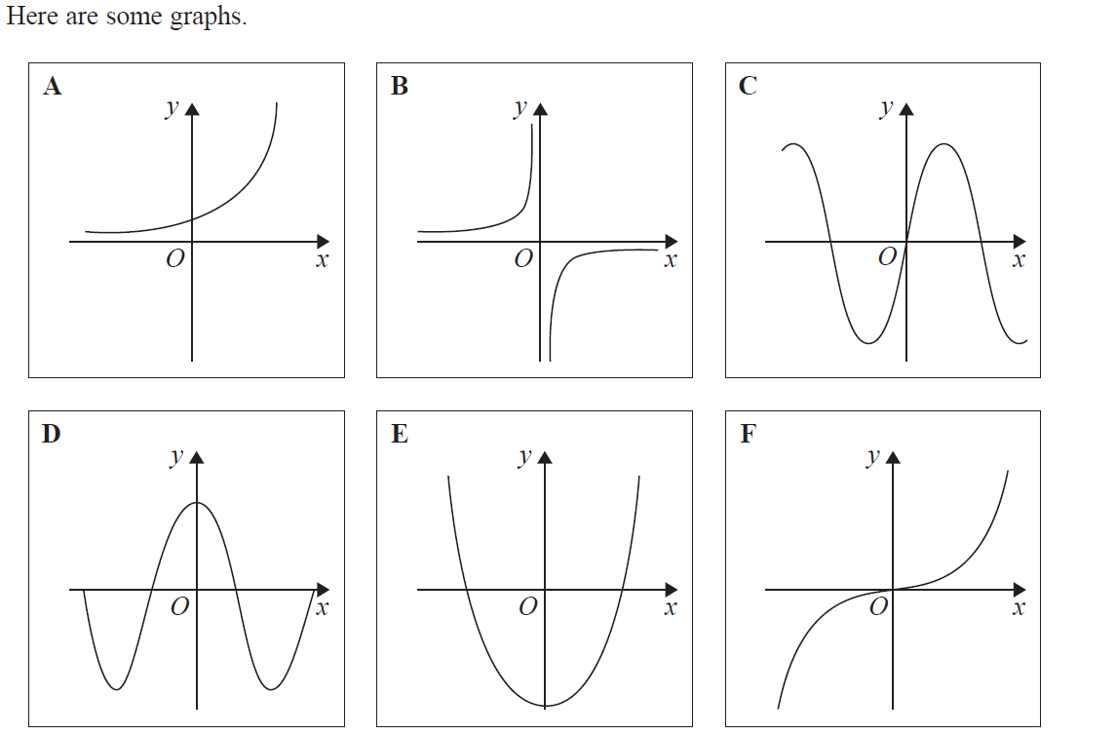
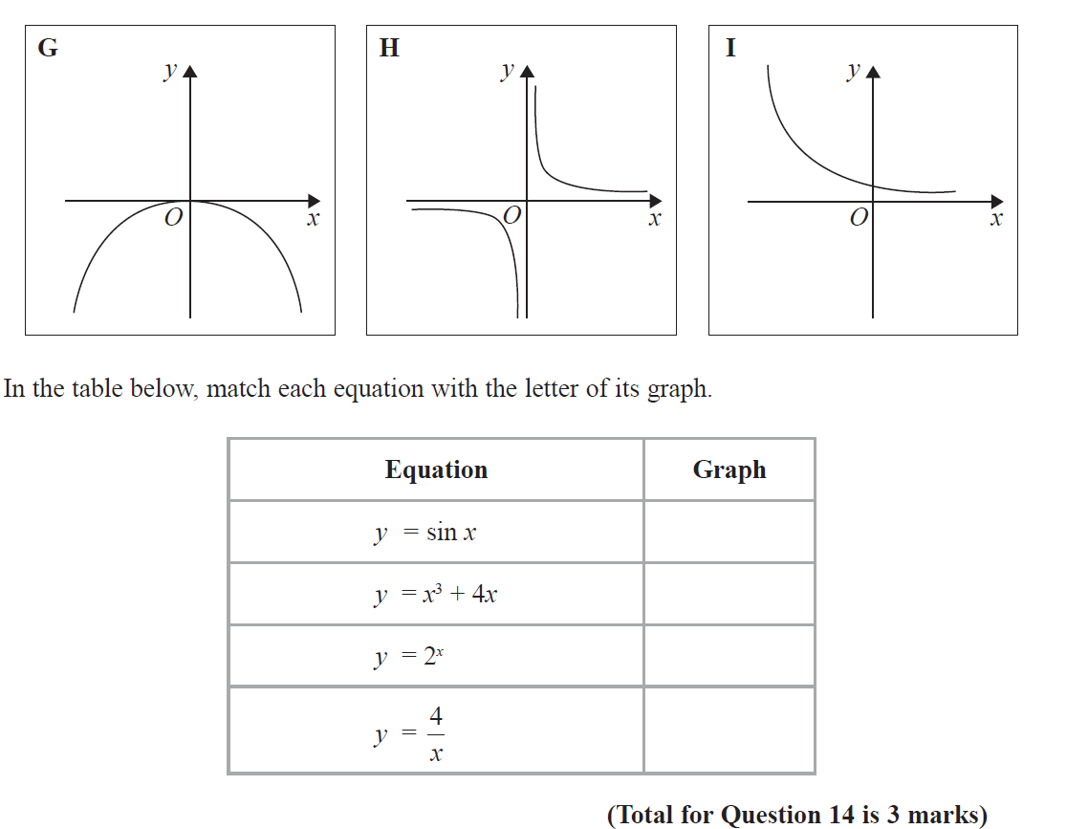
Drawing and Using Graphs
June 2017 2H Q14

Slide 9
Drawing and Using Graphs
June 2017 2H Q14
A

Slide 10
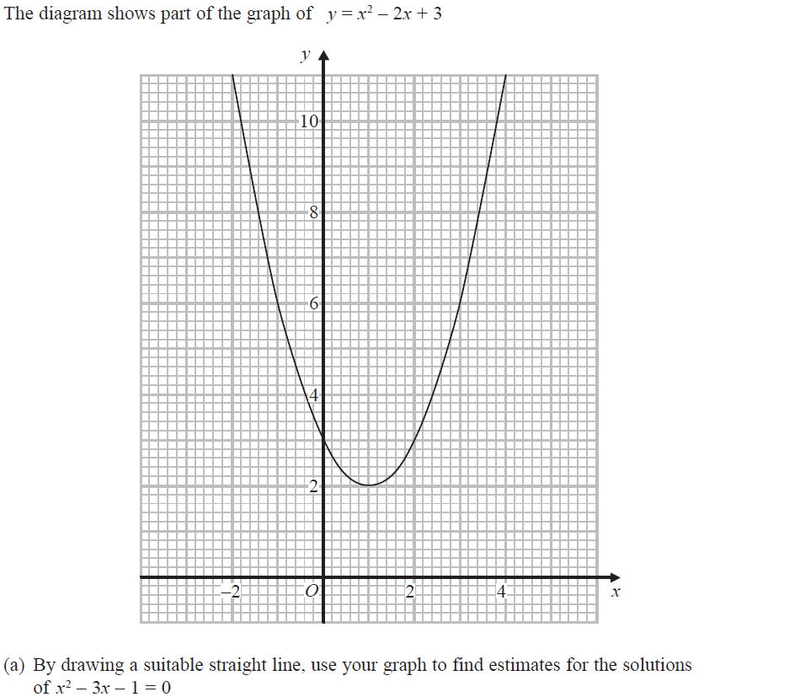
Drawing and Using Graphs
June 2017 2H Q20
Reveal Line for (a)

Slide 11
Drawing and Using Graphs
June 2017 2H Q20
A
B

Slide 12
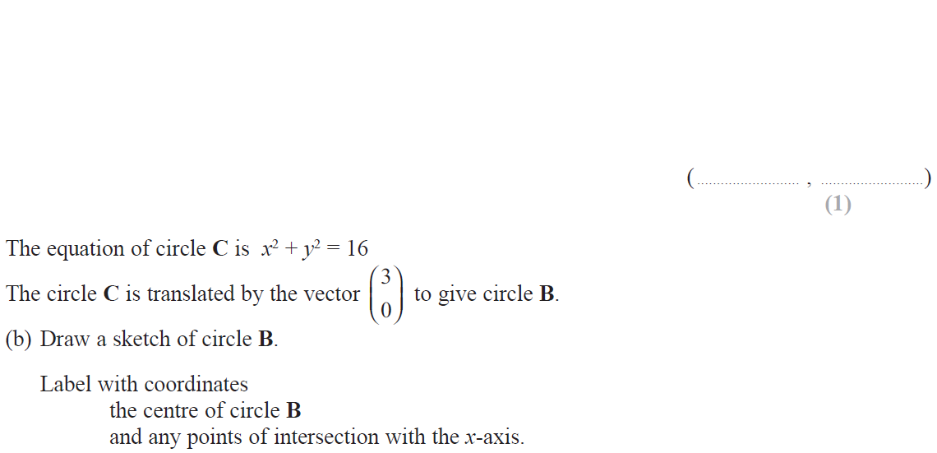
Drawing and Using Graphs
June 2017 3H Q20

Slide 13
Drawing and Using Graphs
June 2017 3H Q20
A
B

Slide 14
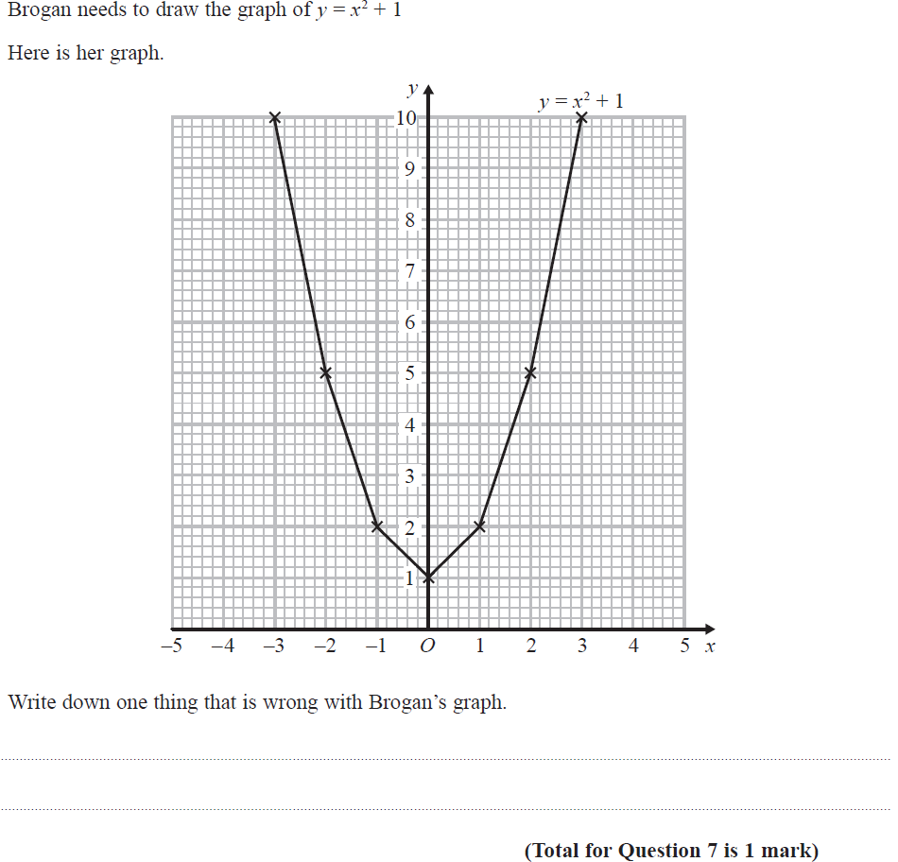
Drawing and Using Graphs
Nov 2017 1H Q7

Slide 15
Drawing and Using Graphs
Nov 2017 1H Q7
A

Slide 16
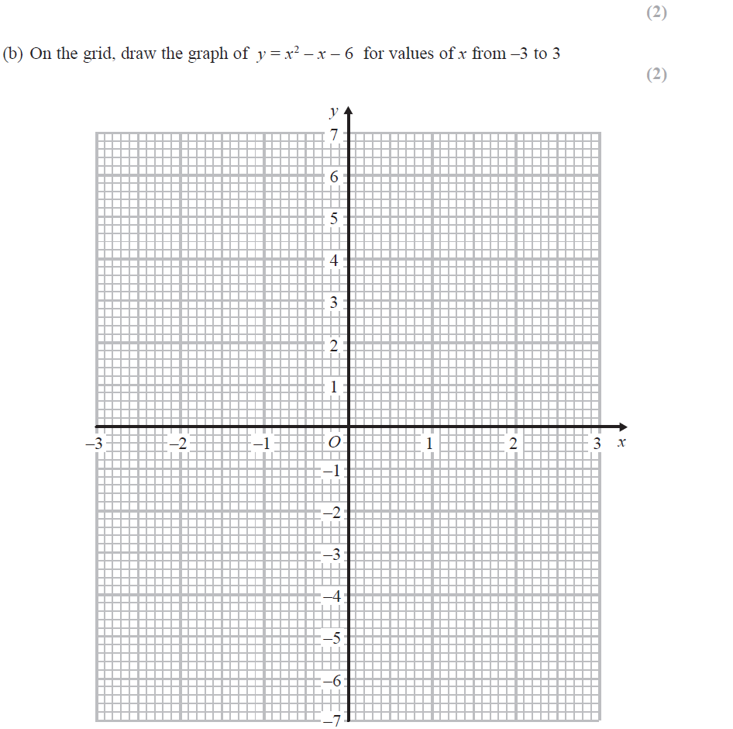
Drawing and Using Graphs
June 2018 2H Q5
Reveal Line for (b)

Slide 17
Drawing and Using Graphs
June 2018 2H Q5
A
B
C

Slide 18
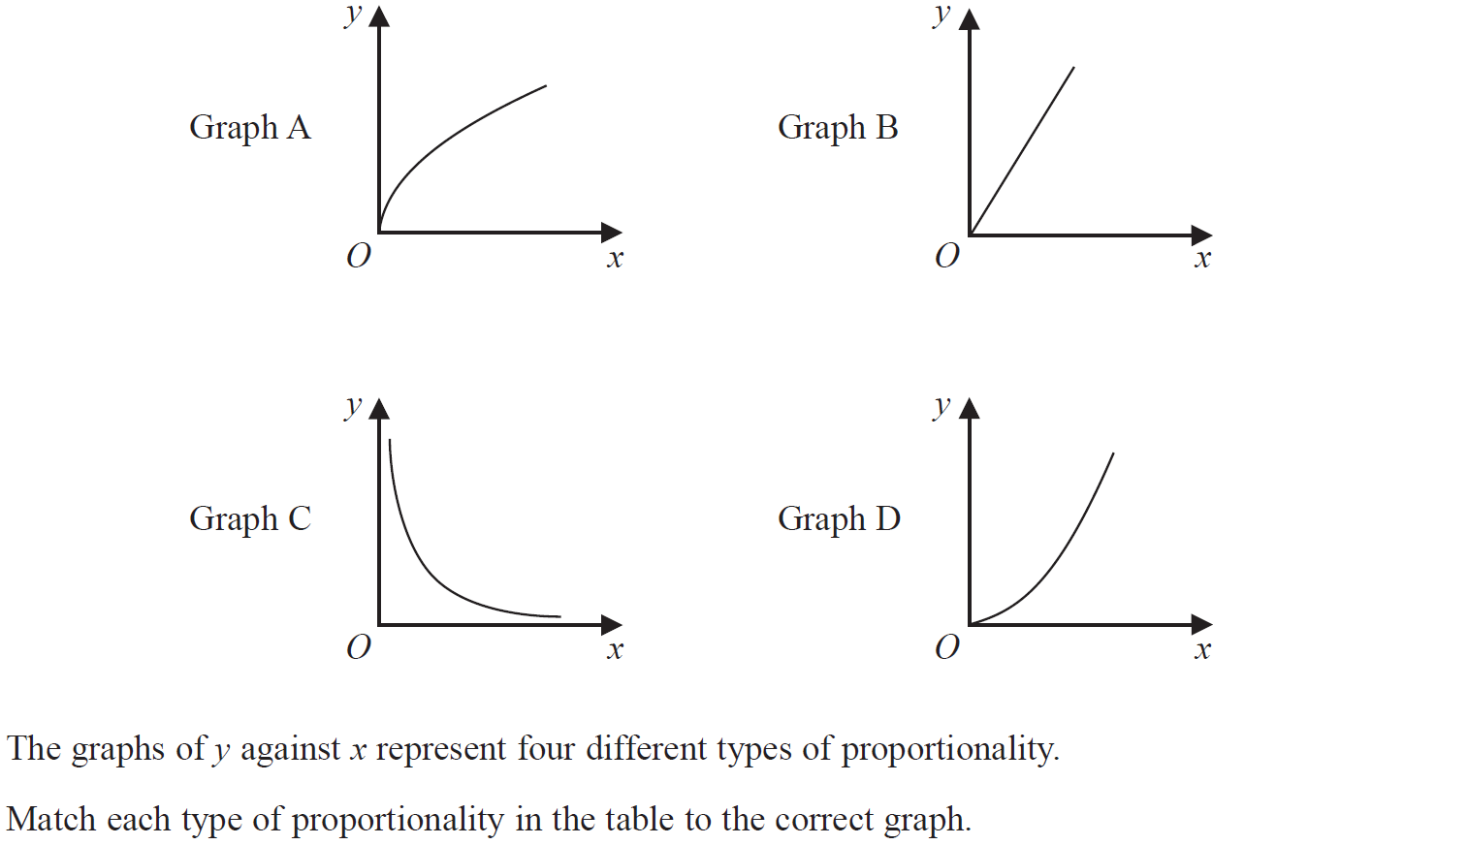
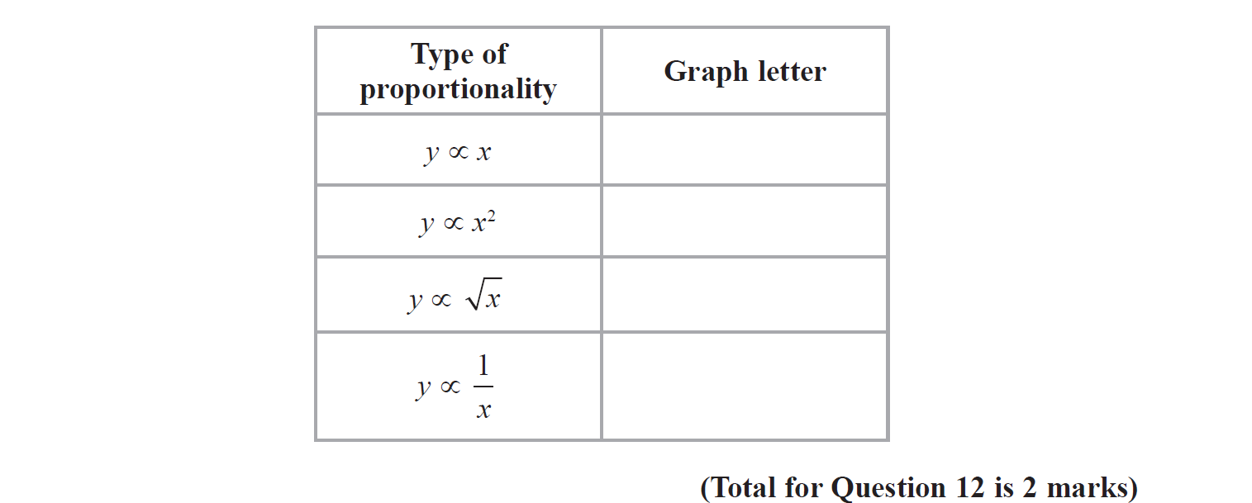
Drawing and Using Graphs
June 2018 2H Q12

Slide 19
Drawing and Using Graphs
June 2018 2H Q12
A

Slide 20
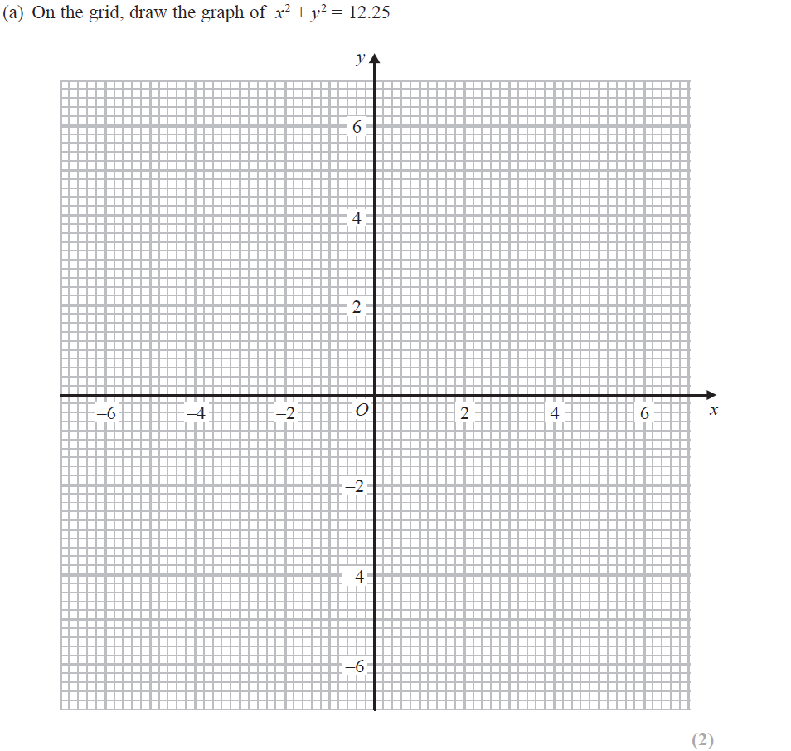
Drawing and Using Graphs
June 2018 2H Q16
Reveal Line (a)
Reveal Line 2x+y=1

Slide 21
Drawing and Using Graphs
June 2018 2H Q16
A
B

Slide 22
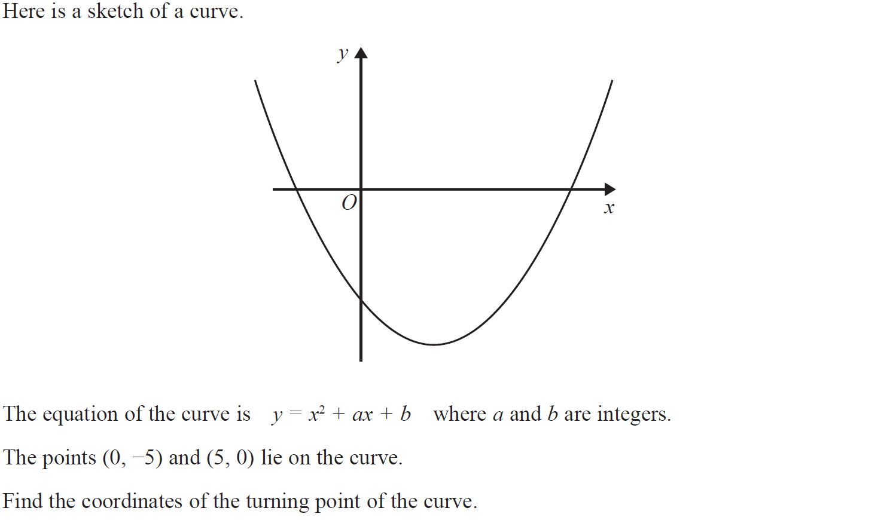
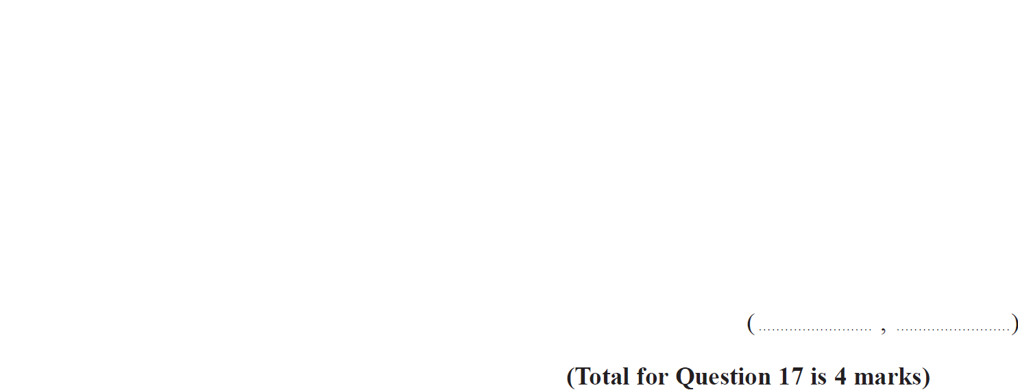
Drawing and Using Graphs
Nov 2018 1H Q17

Slide 23
Drawing and Using Graphs
Nov 2018 1H Q17
A

Slide 24
Drawing and Using Graphs
Nov 2018 2H Q14
Reveal Line

Slide 25
Drawing and Using Graphs
Nov 2018 2H Q14
A

Slide 26
Drawing and Using Graphs
Nov 2018 2H Q15

Slide 27
Drawing and Using Graphs
Nov 2018 2H Q15
A

Slide 28
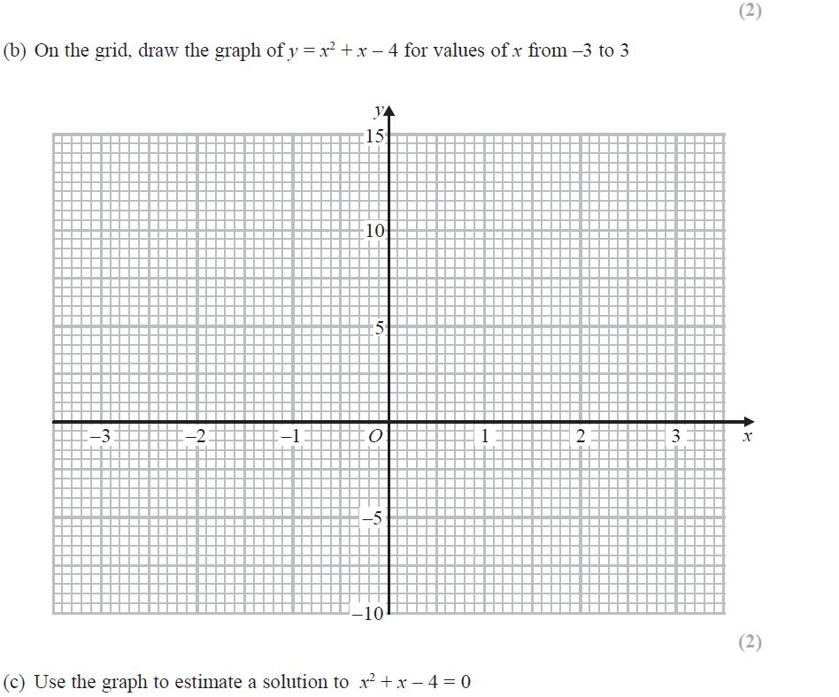
Drawing and Using Graphs
Nov 2018 3H Q3
Reveal Graph (b)

Slide 29
Drawing and Using Graphs
Nov 2018 3H Q3
A
B
C

Slide 30
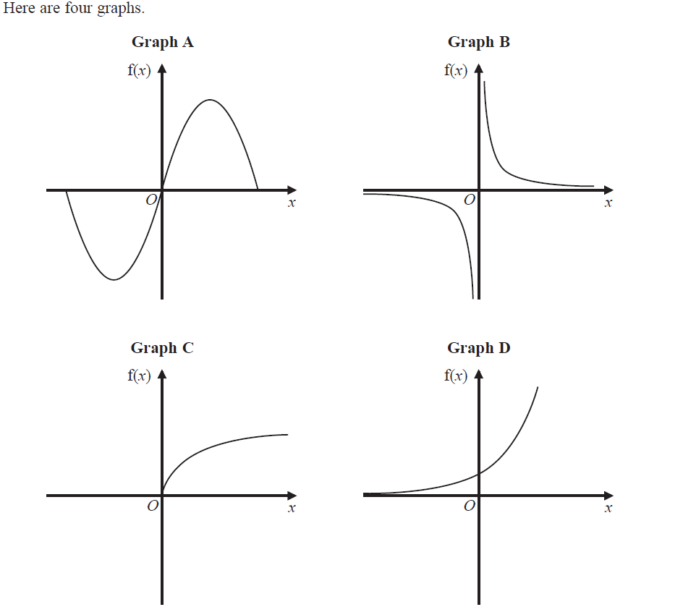
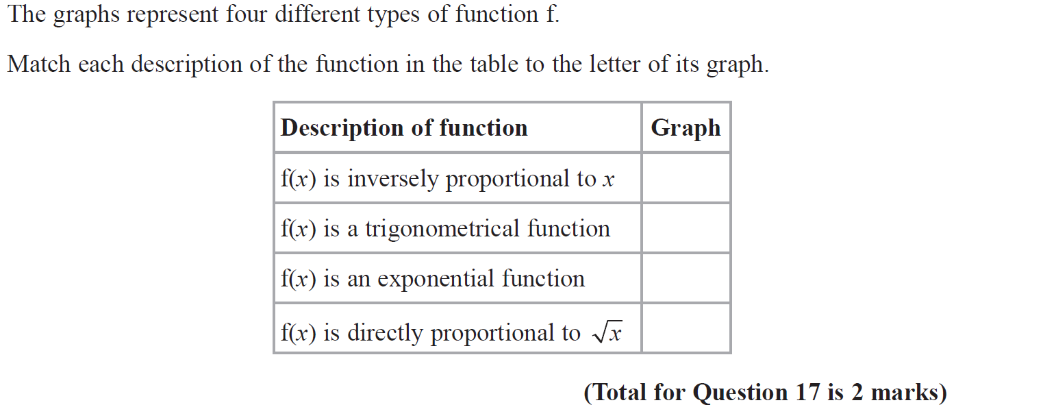
Drawing and Using Graphs
June 2019 3H Q17

Slide 31
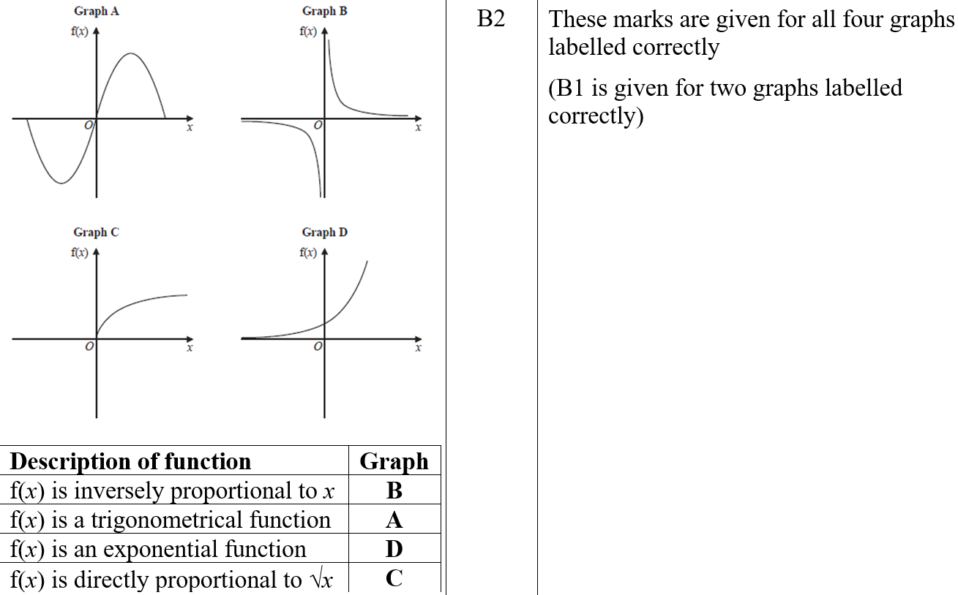
Drawing and Using Graphs
June 2019 3H Q17
A
A SF

Slide 32
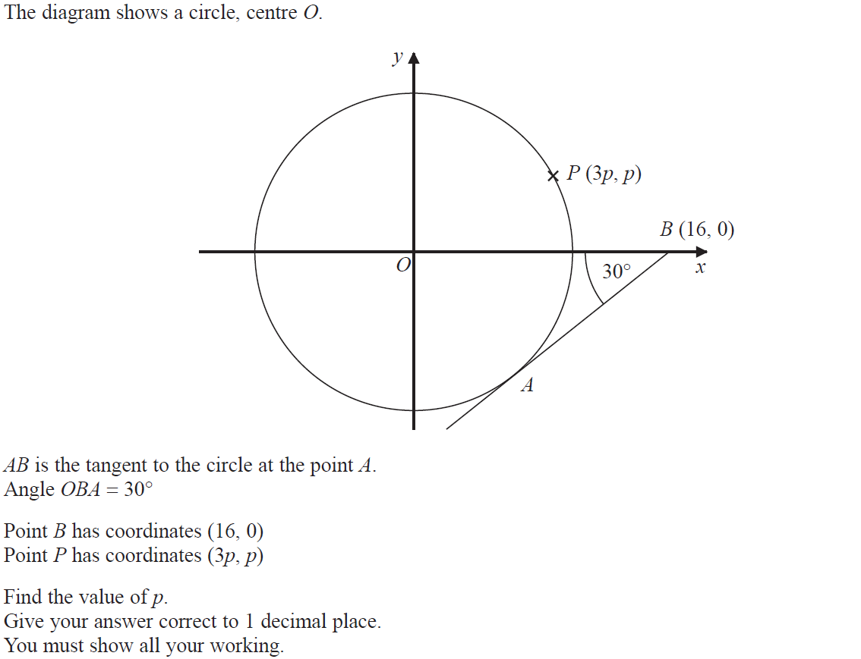
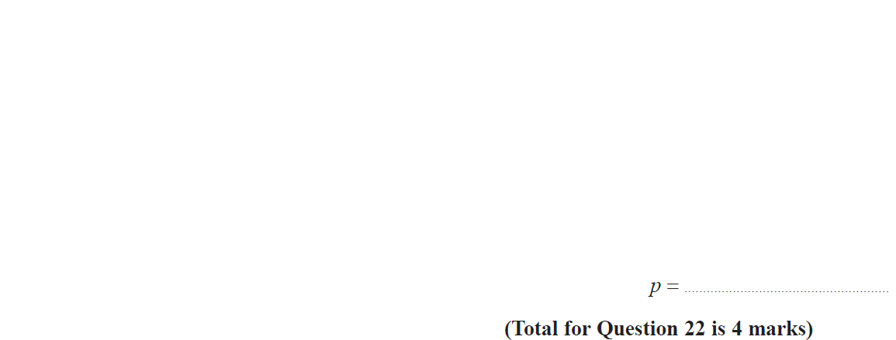
Drawing and Using Graphs
June 2019 3H Q22

Slide 33
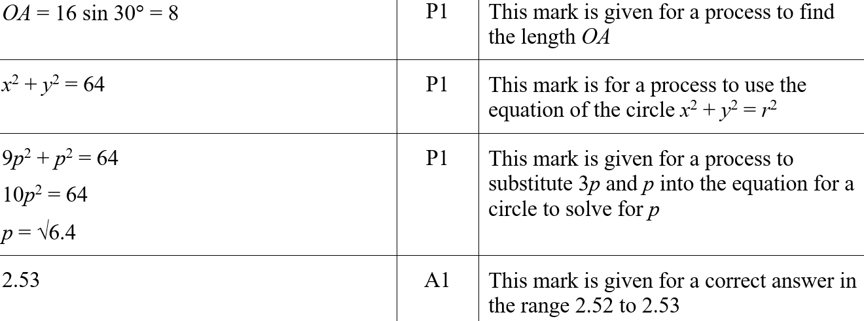
Drawing and Using Graphs
June 2019 3H Q22
A
A SF

Slide 34
Drawing and Using Graphs
May 2017 1H Q20

Slide 35
Drawing and Using Graphs
May 2017 1H Q20
A

Slide 36
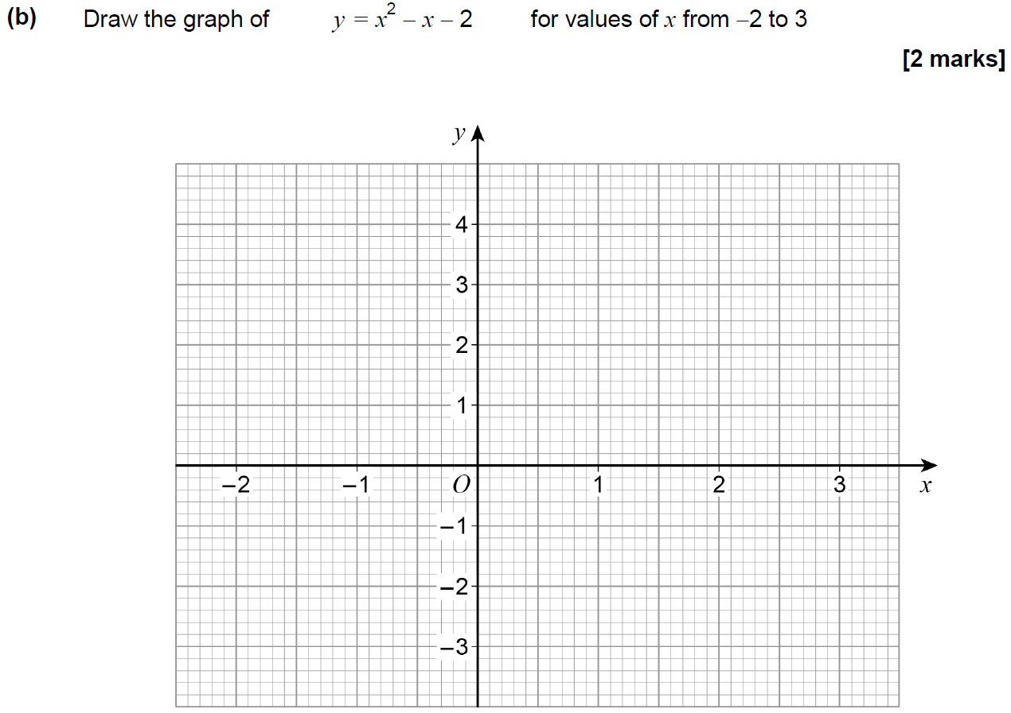
Drawing and Using Graphs
June 2017 2H Q6
Reveal Graph (b)

Slide 37
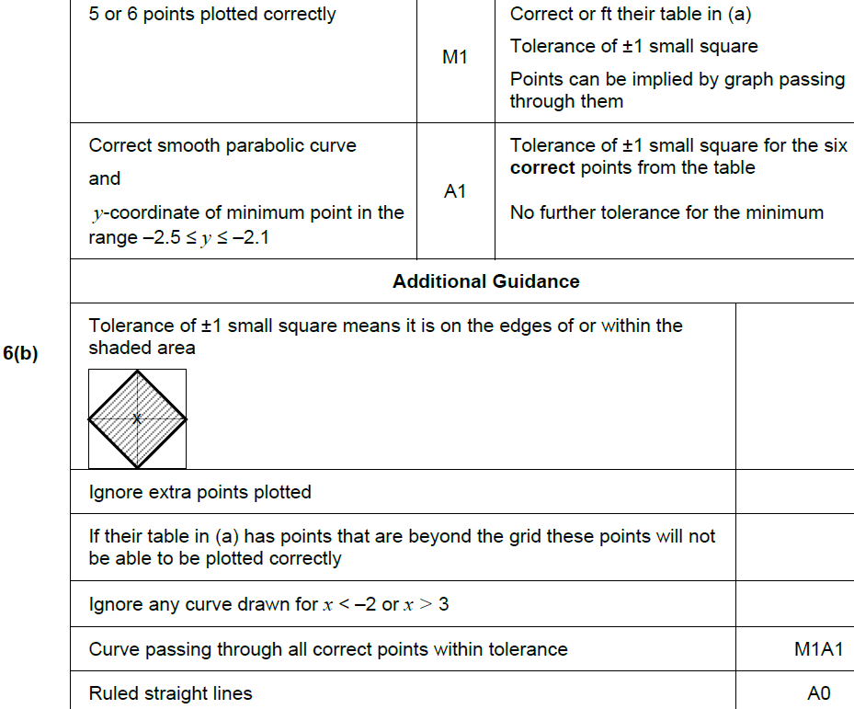
Drawing and Using Graphs
June 2017 2H Q6
A
B
C

Slide 38
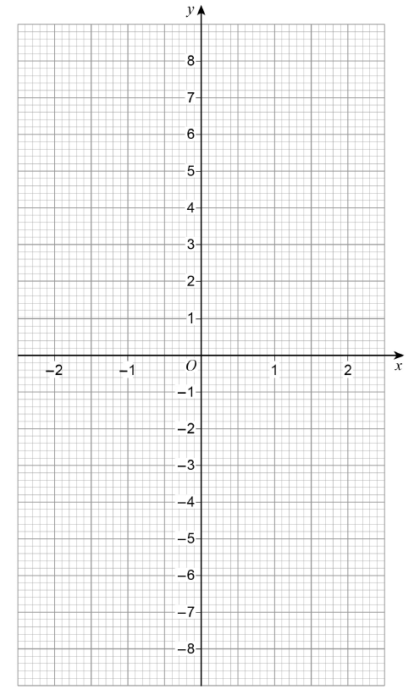
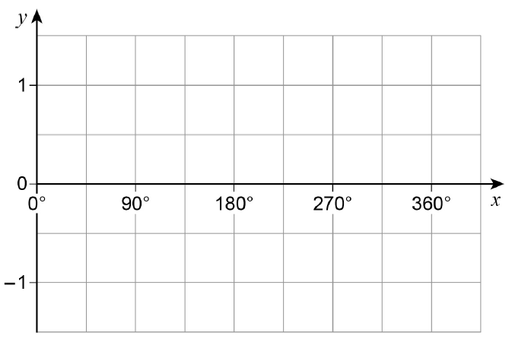
Drawing and Using Graphs
June 2017 2H Q27

Slide 39
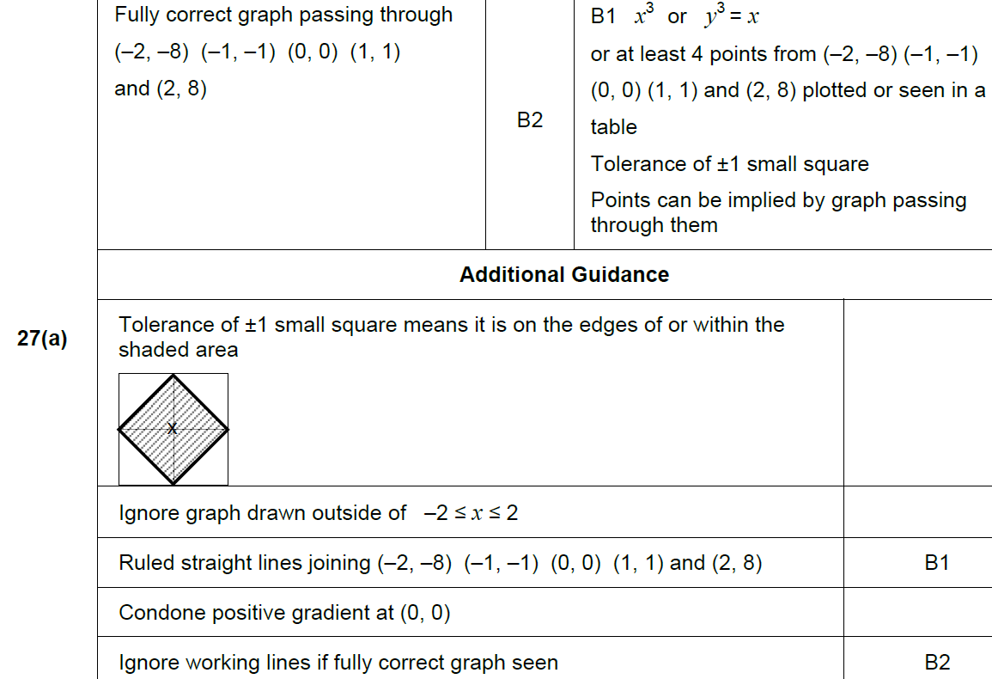
Drawing and Using Graphs
June 2017 2H Q27
A

Slide 40
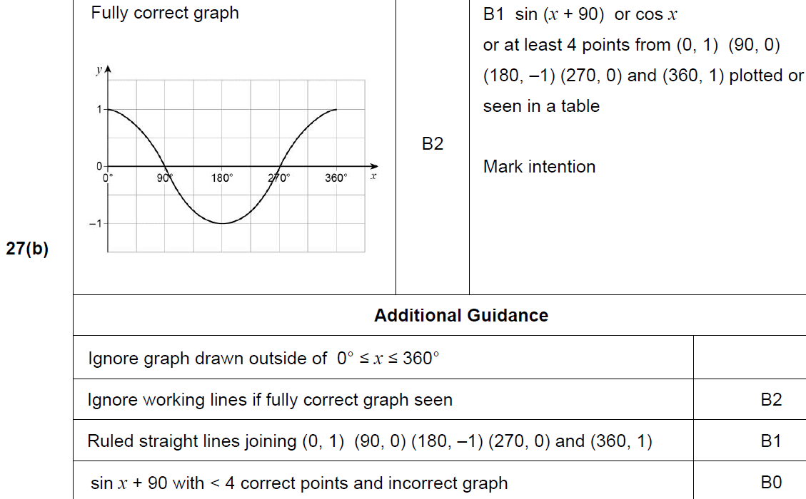
Drawing and Using Graphs
June 2017 2H Q27
B

Slide 41
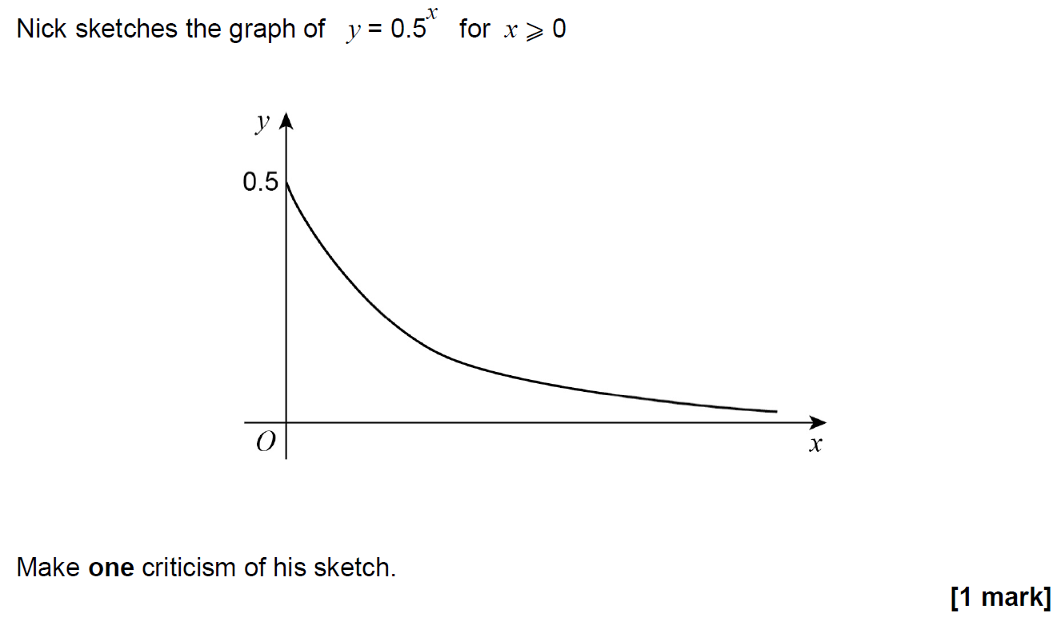
Drawing and Using Graphs
June 2017 3H Q18

Slide 42
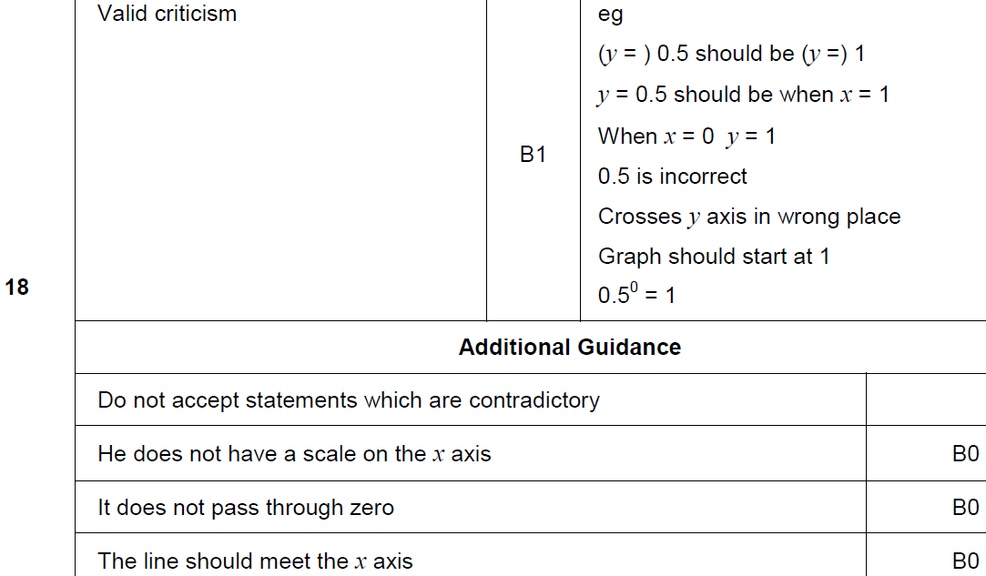
Drawing and Using Graphs
June 2017 2H Q27
A

Slide 43
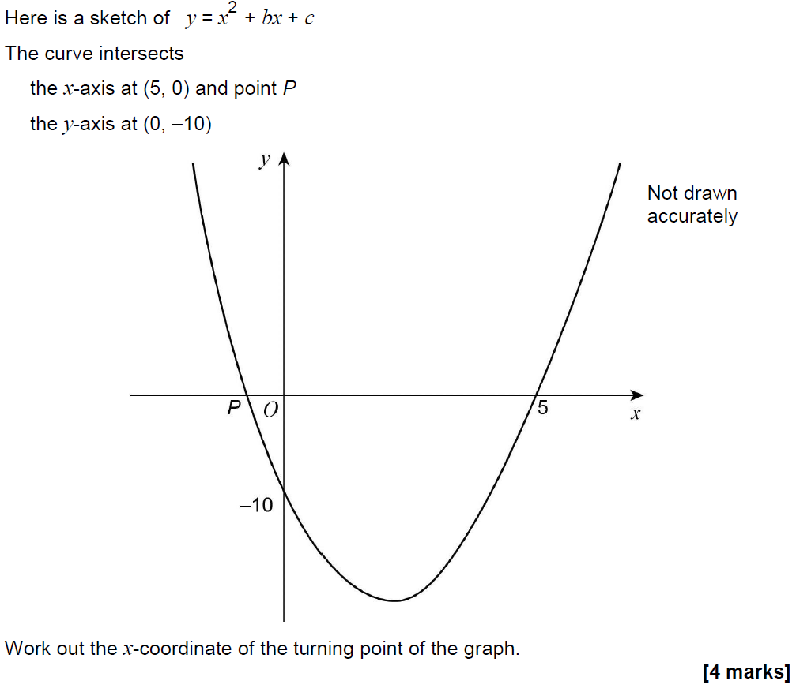
Drawing and Using Graphs
June 2017 3H Q23

Slide 44
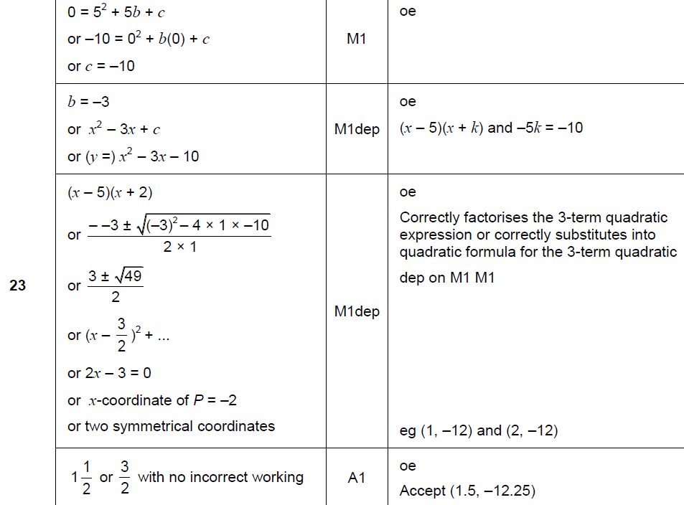
Drawing and Using Graphs
June 2017 3H Q23
A

Slide 45
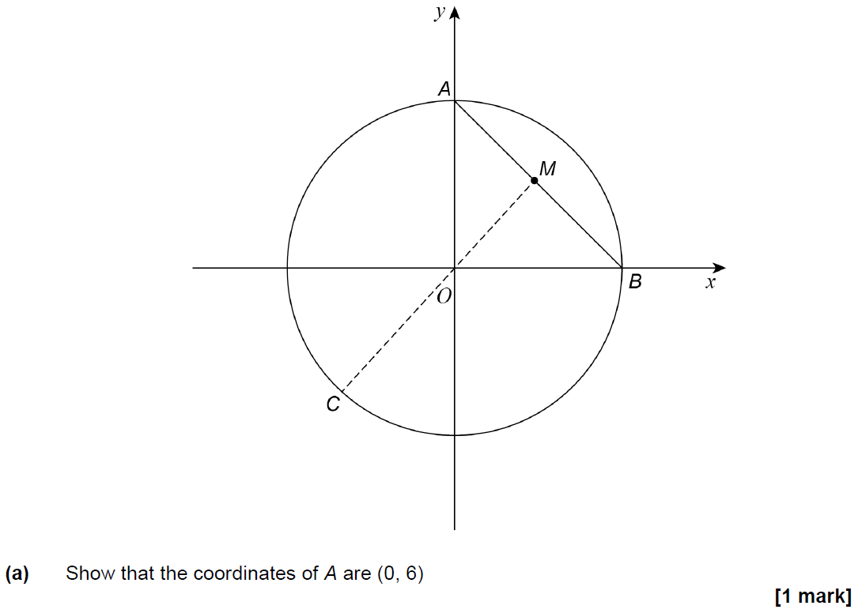
Drawing and Using Graphs
Nov 2017 1H Q28

Slide 46
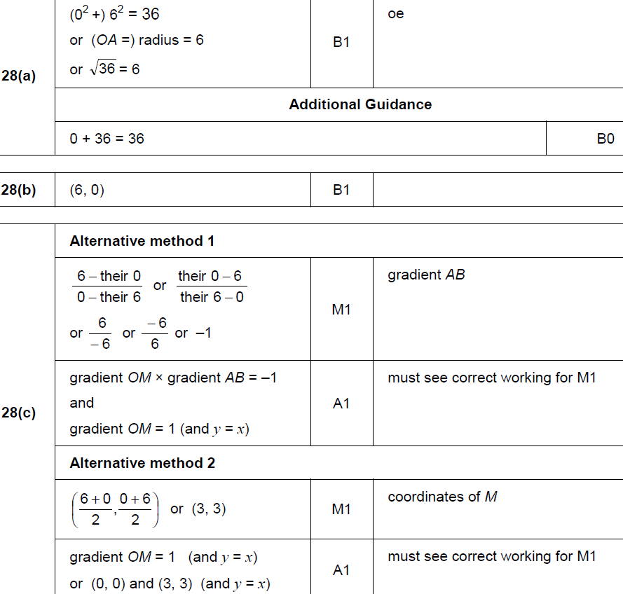
Drawing and Using Graphs
Nov 2017 1H Q28
A
B
C

Slide 47
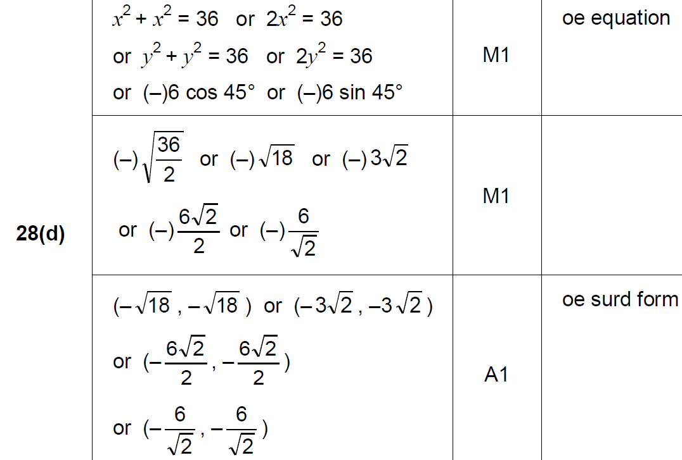
Drawing and Using Graphs
Nov 2017 1H Q28
D

Slide 48
Drawing and Using Graphs
Nov 2017 2H Q3

Slide 49
Drawing and Using Graphs
Nov 2017 2H Q3
A

Slide 50
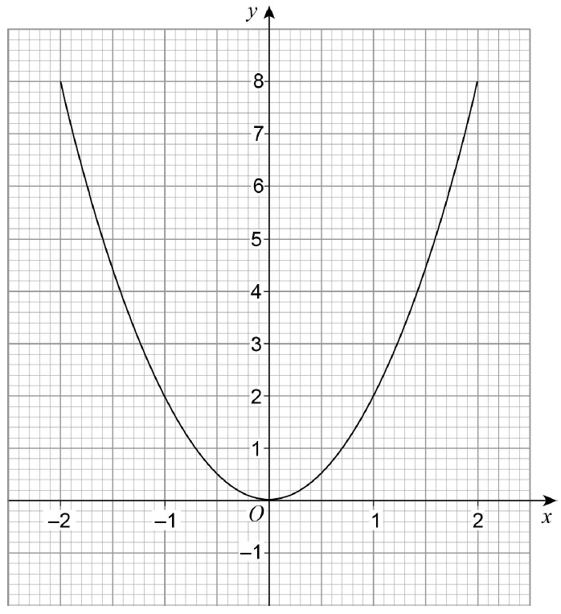
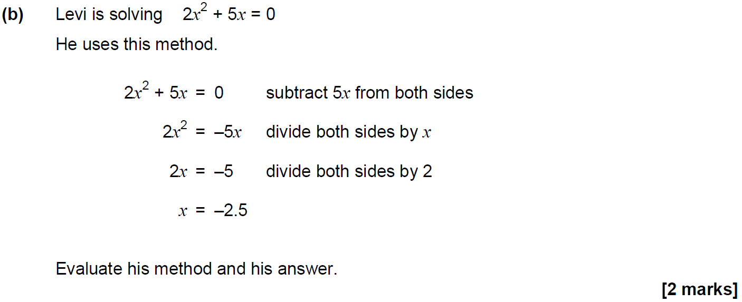
Drawing and Using Graphs
Nov 2017 2H Q21

Slide 51
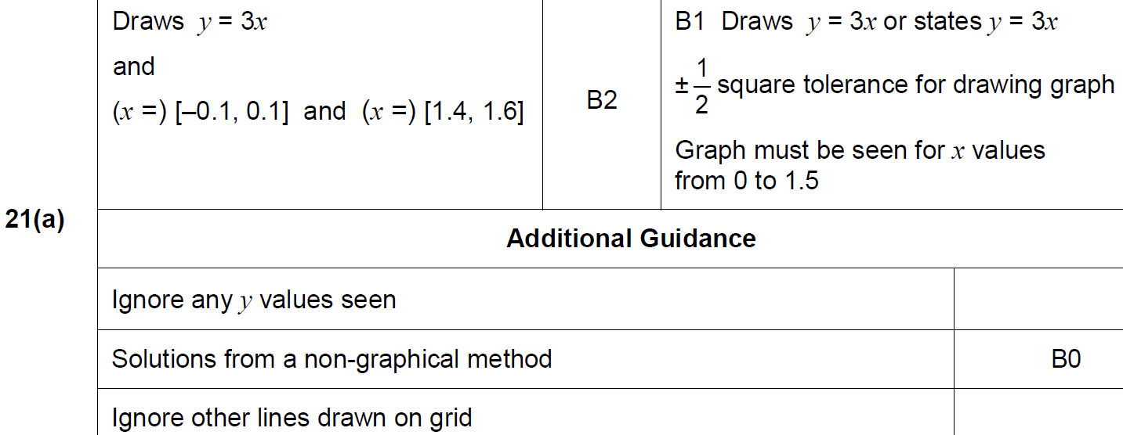
Drawing and Using Graphs
Nov 2017 2H Q21
A

Slide 52
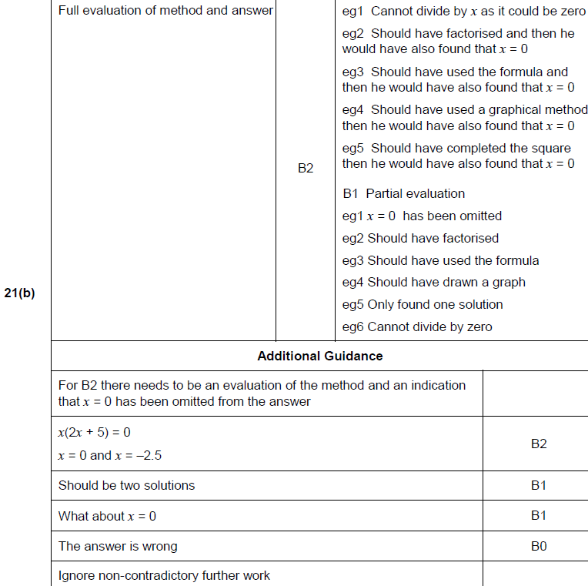
Drawing and Using Graphs
Nov 2017 2H Q21
B

Slide 53
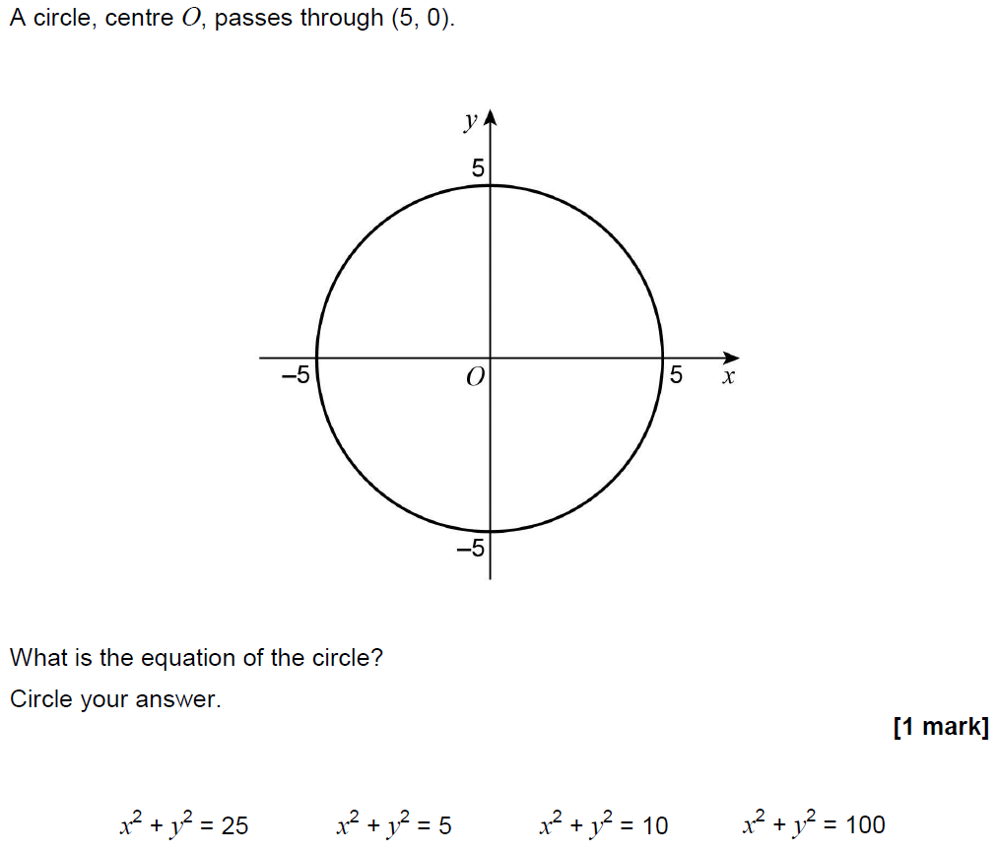
Drawing and Using Graphs
June 2018 2H Q22

Slide 54
Drawing and Using Graphs
June 2018 2H Q22
A

Slide 55
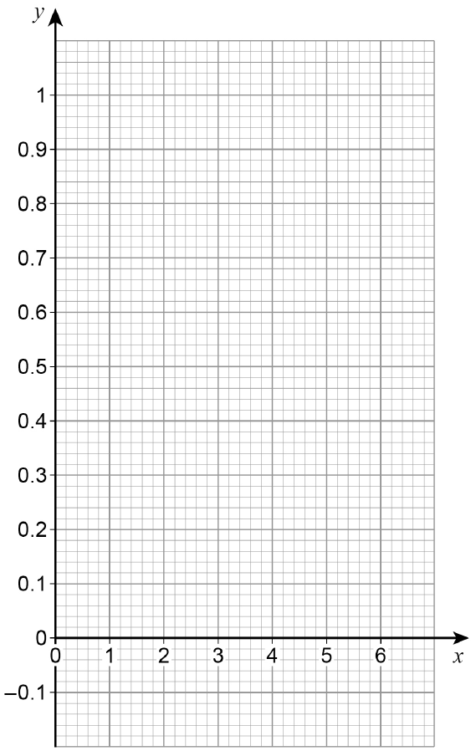
Drawing and Using Graphs
June 2018 3H Q14
Reveal Graph

Slide 56
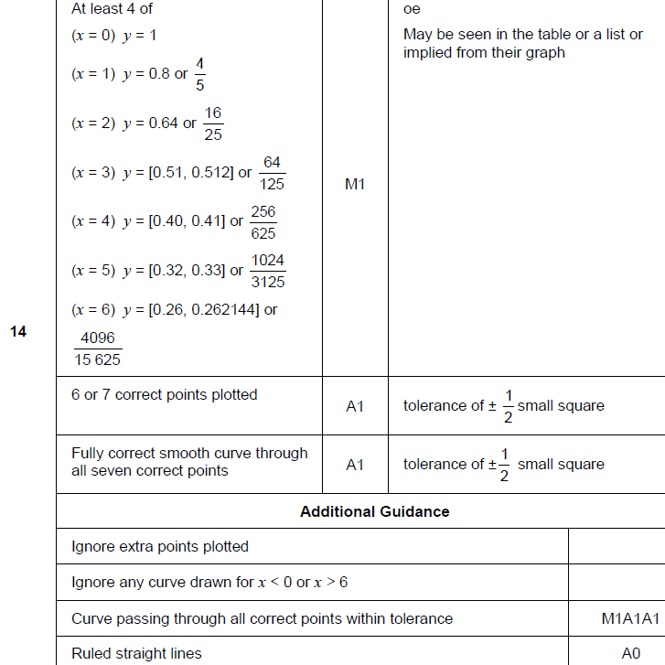
Drawing and Using Graphs
June 2018 3H Q14
A

Slide 57
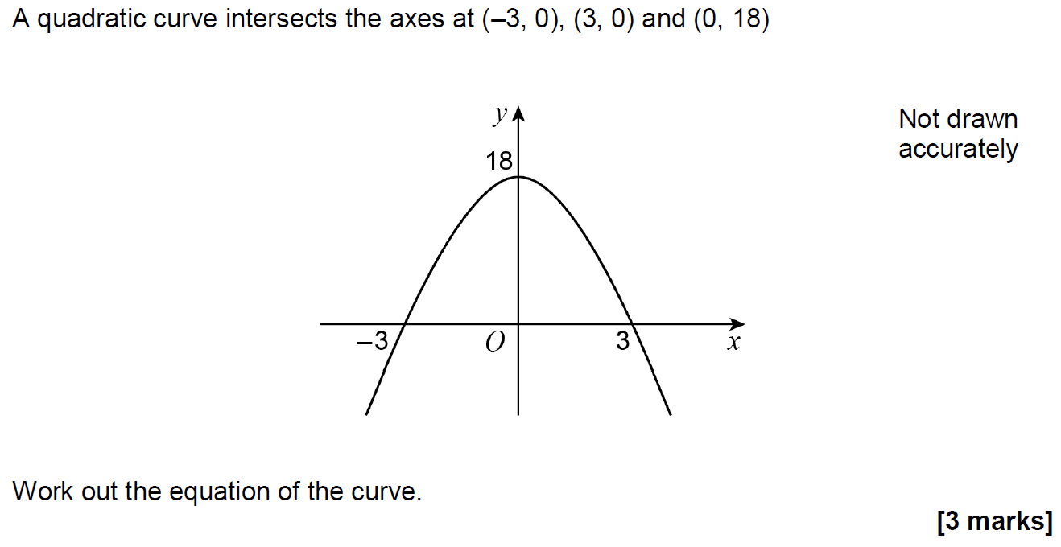
Drawing and Using Graphs
Nov 2018 1H Q25

Slide 58
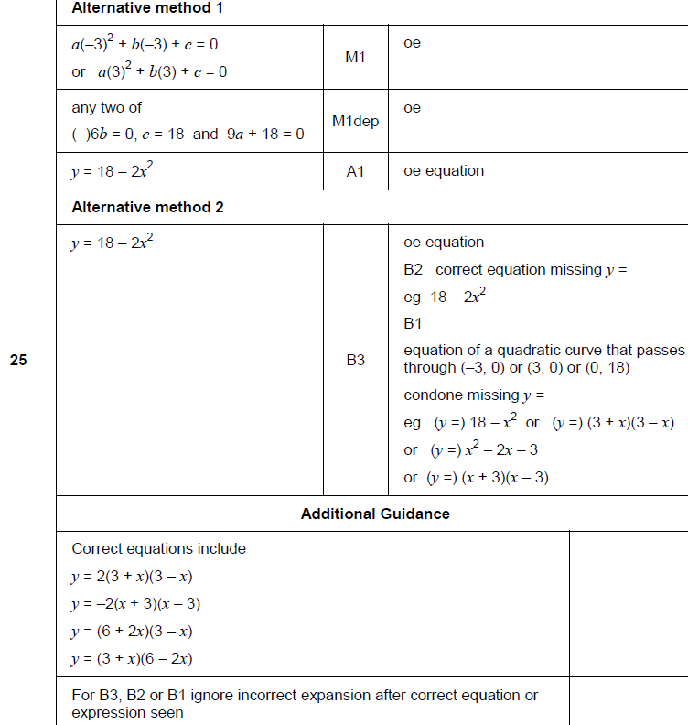
Drawing and Using Graphs
Nov 2018 1H Q25
A

Slide 59
Drawing and Using Graphs
Nov 2018 2H Q27

Slide 60
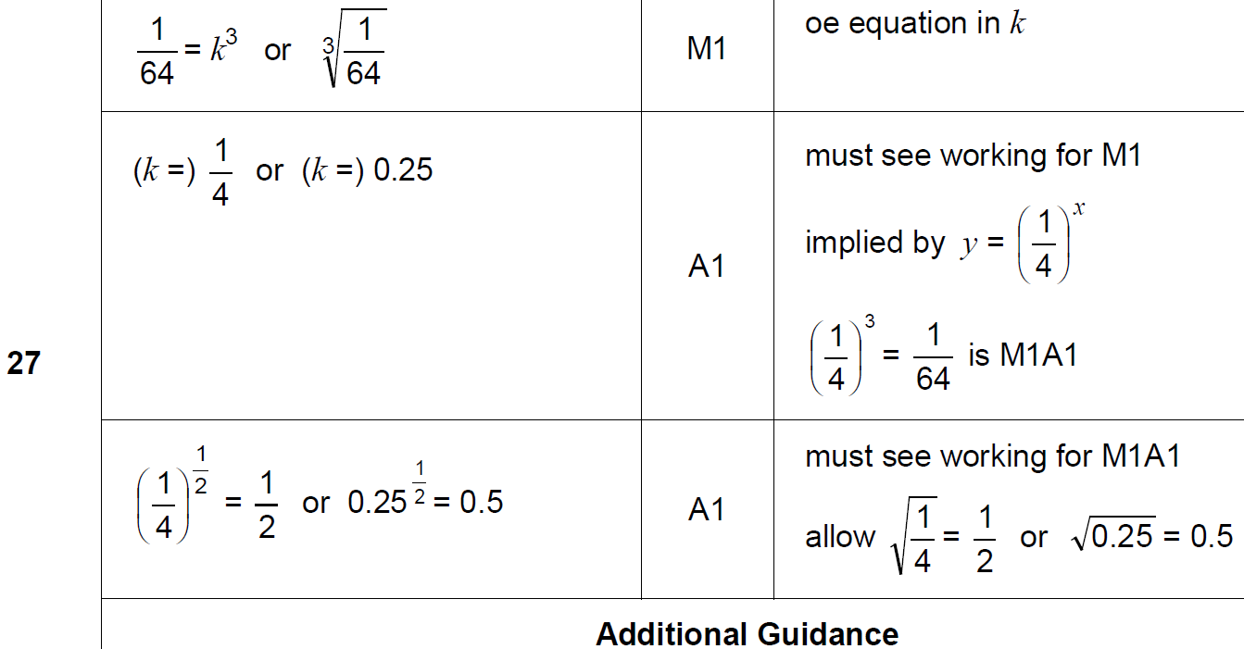
Drawing and Using Graphs
Nov 2018 2H Q27
A

Slide 61
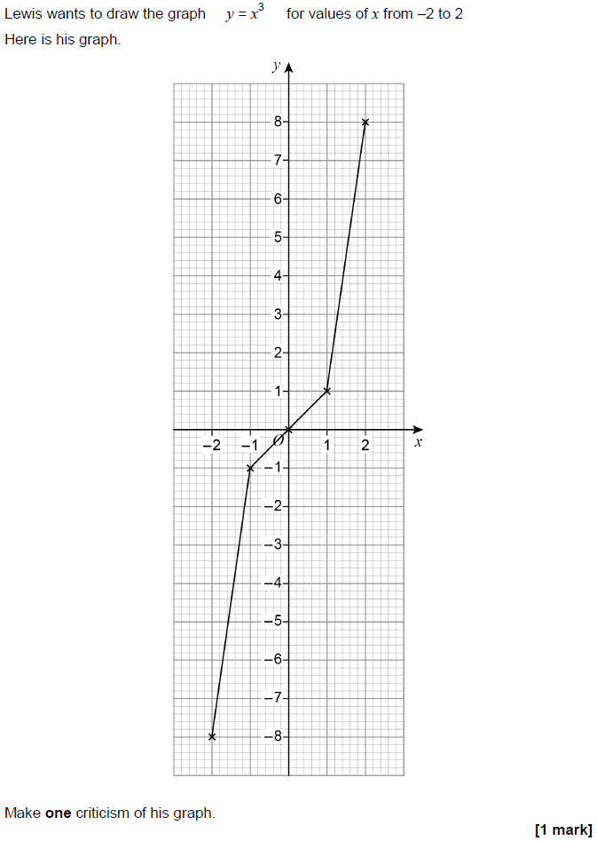
Drawing and Using Graphs
Nov 2018 3H Q12

Slide 62
Drawing and Using Graphs
Nov 2018 3H Q12
A

Slide 63
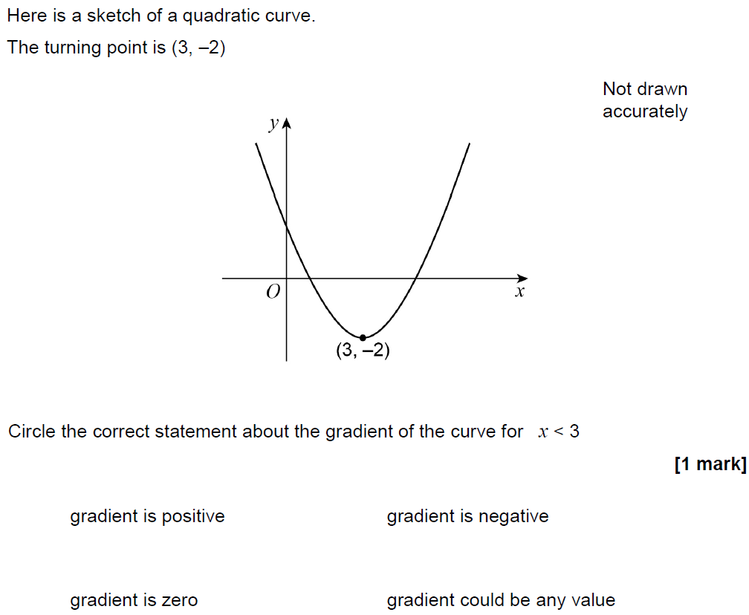
Drawing and Using Graphs
Nov 2018 3H Q28

Slide 64
Drawing and Using Graphs
Nov 2018 3H Q28
A

Slide 65
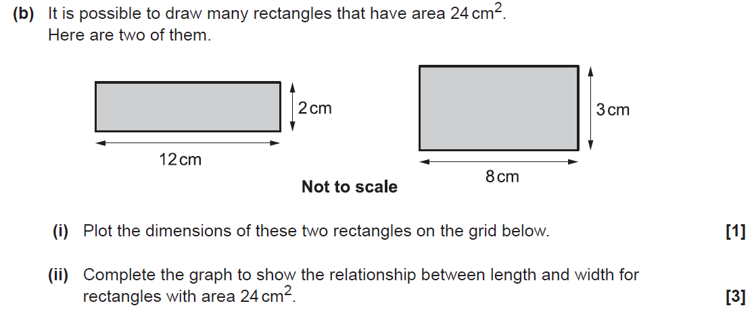
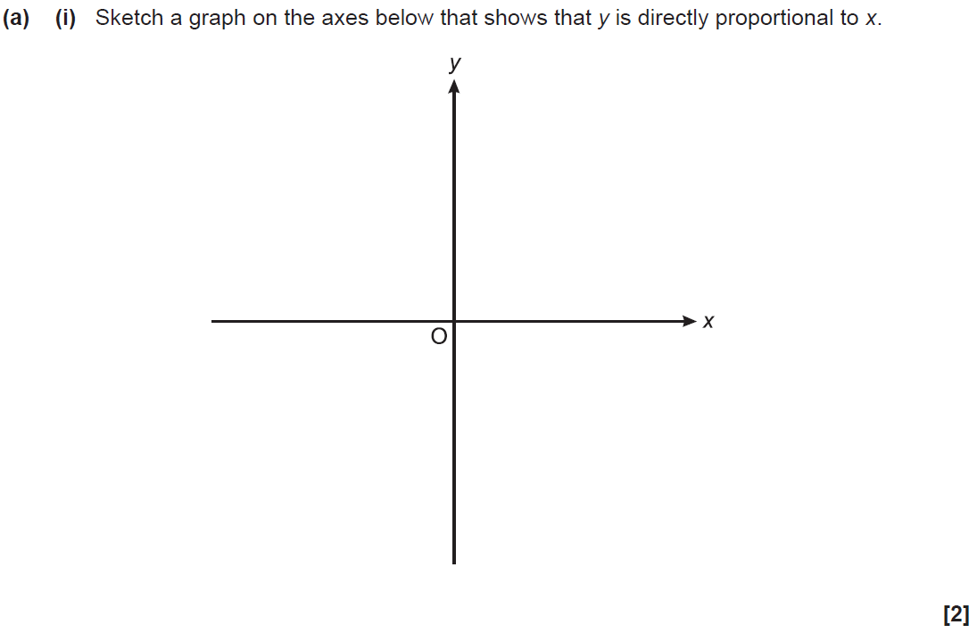
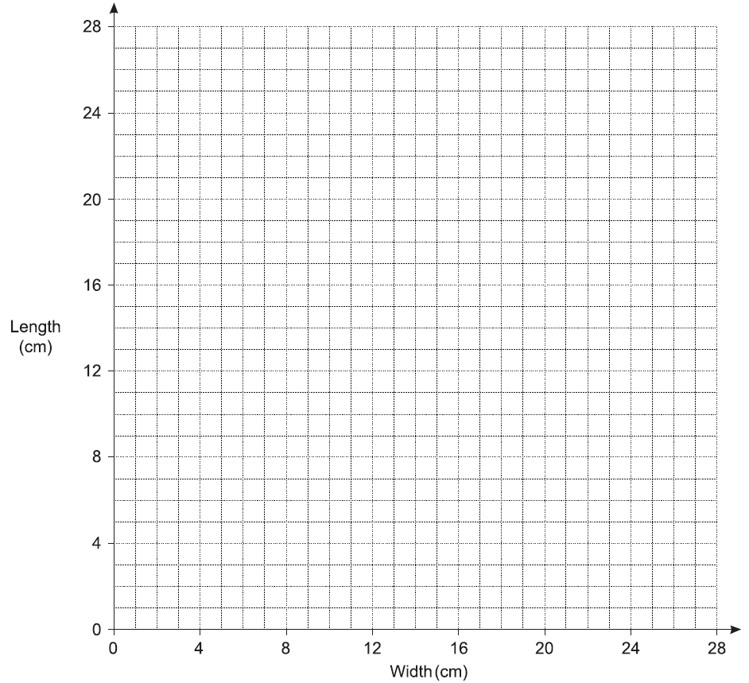
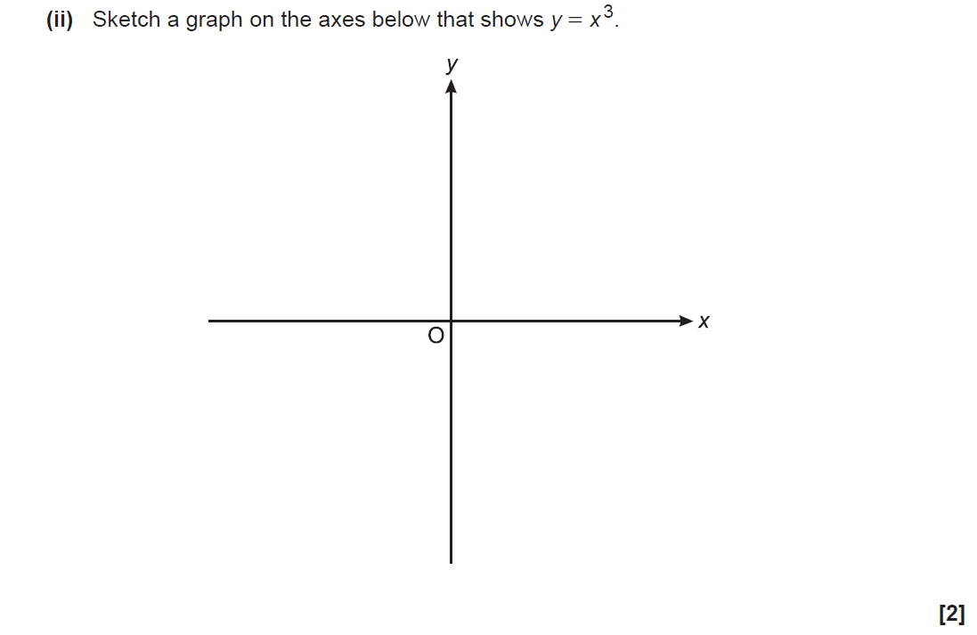
Drawing and Using Graphs
SAM 1H Q4

Slide 66
Drawing and Using Graphs
SAM 1H Q4
A (i)
A (ii)
B (i)
B (ii)

Slide 67
Drawing and Using Graphs
Practice 1H Q15

Slide 68
Drawing and Using Graphs
Practice 1H Q15
A
B (i)
B (ii)
B (iii)

Slide 69
Drawing and Using Graphs
Practice 2H Q18

Slide 70
Drawing and Using Graphs
Practice 2H Q18
A
B

Slide 71
Drawing and Using Graphs
May 2017 1H Q17

Slide 72
Drawing and Using Graphs
May 2017 1H Q17
A

Slide 73
Drawing and Using Graphs
June 2017 2H Q19

Slide 74
Drawing and Using Graphs
June 2017 2H Q19
A
B

Slide 75
Drawing and Using Graphs
June 2017 3H Q7

Slide 76
Drawing and Using Graphs
June 2017 3H Q7
A
B
C

Slide 77
Drawing and Using Graphs
Nov 2017 1H Q5
Reveal Graph (b)
Reveal Graph (d)

Slide 78
Drawing and Using Graphs
Nov 2017 1H Q5
A
B
C
D
E

Slide 79
Drawing and Using Graphs
Nov 2017 3H Q17

Slide 80
Drawing and Using Graphs
Nov 2017 3H Q17
A
B
C

Slide 81
Drawing and Using Graphs
May 2018 1H Q17

Slide 82
Drawing and Using Graphs
May 2018 1H Q17
A
B
C

Slide 83
Drawing and Using Graphs
June 2018 2H Q9
Reveal graph

Slide 84
Drawing and Using Graphs
June 2018 2H Q9
A
B
C

Slide 85
Drawing and Using Graphs
June 2018 3H Q9

Slide 86
Drawing and Using Graphs
June 2018 3H Q9
A
B
C

Slide 87
Drawing and Using Graphs
Nov 2018 1H Q10

Slide 88
Drawing and Using Graphs
Nov 2018 1H Q10
A

Slide 89
Drawing and Using Graphs
Nov 2018 1H Q21
Reveal graph

Slide 90
Drawing and Using Graphs
Nov 2018 1H Q21
A
B
C

Slide 91
Drawing and Using Graphs
Nov 2018 3H Q10

Slide 92
Drawing and Using Graphs
Nov 2018 3H Q10
A

