Slide 1
Drawing and Using Graphs
Drawing and Using Graphs
Old Spec Q’s
NTSQ
Q1
June 2018
2H Q14
NTSQ
Q3
Jan 2019
1H Q6
NTSQ
Q4
May 2019
1H Q4
NTSQ
Q5
NTSQ
Q6
NTSQ
Q7
SAM
2H Q19
Recognising shapes of graphs

Slide 2
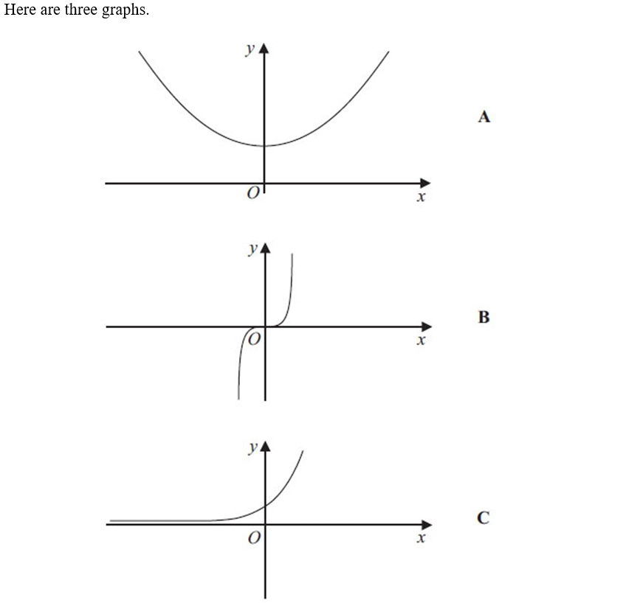
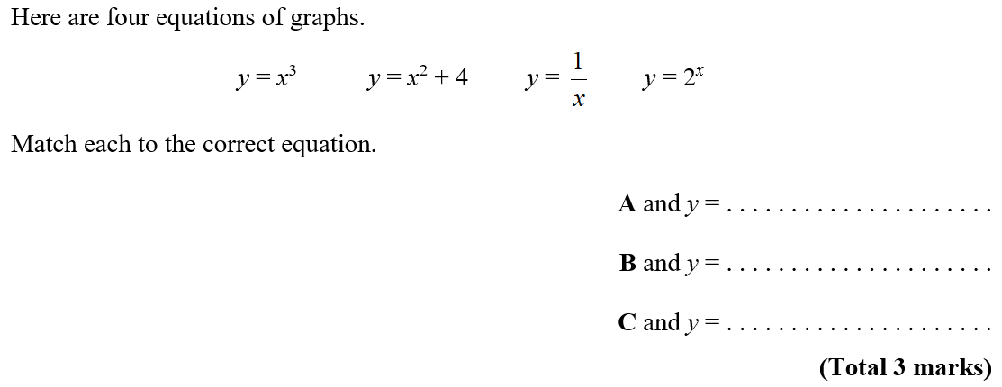
Drawing and Using Graphs
NTSQ Q1

Slide 3
Drawing and Using Graphs
NTSQ Q1
A

Slide 4
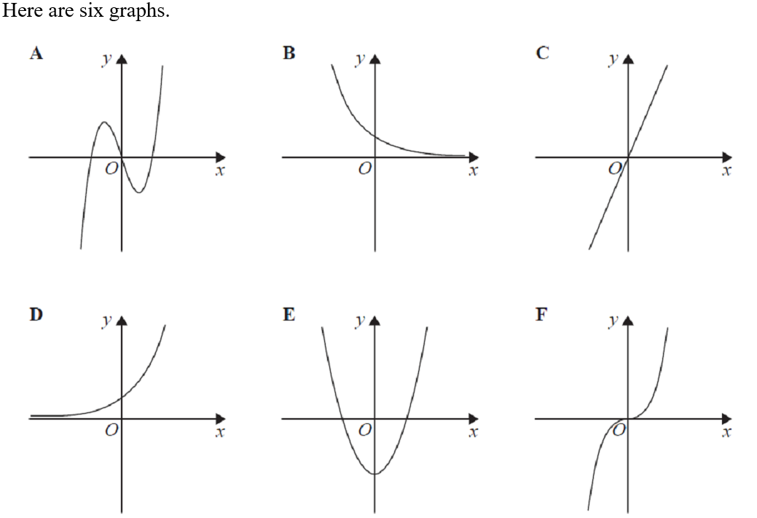
Drawing and Using Graphs
NTSQ Q3

Slide 5
Drawing and Using Graphs
NTSQ Q3
(i)
(ii)

Slide 6
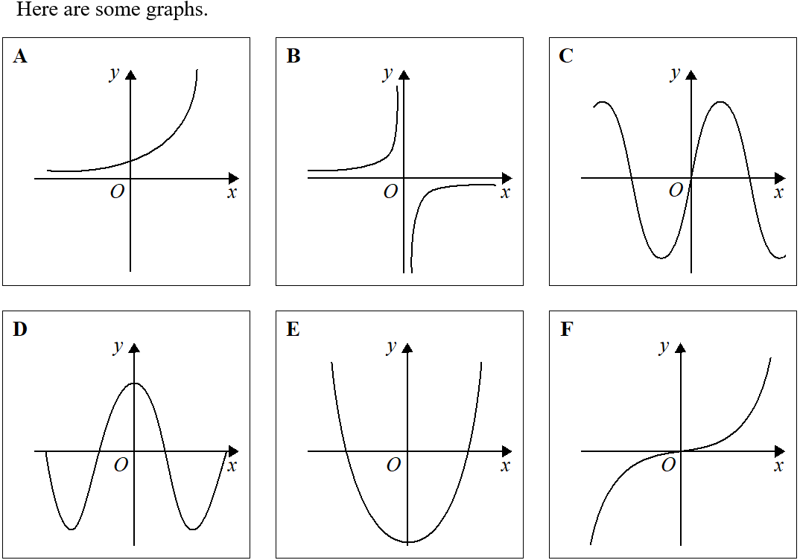
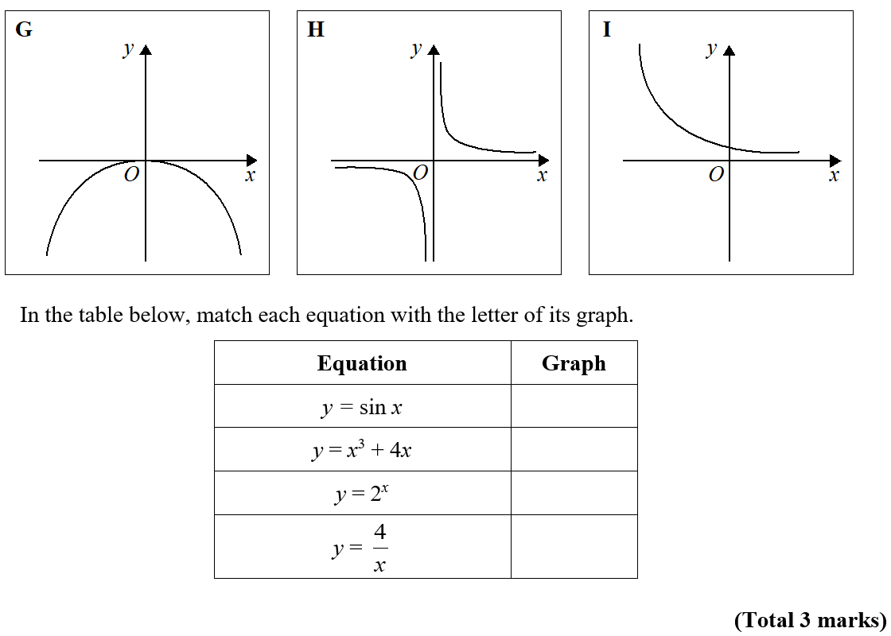
Drawing and Using Graphs
NTSQ Q4

Slide 7
Drawing and Using Graphs
NTSQ Q4
A

Slide 8
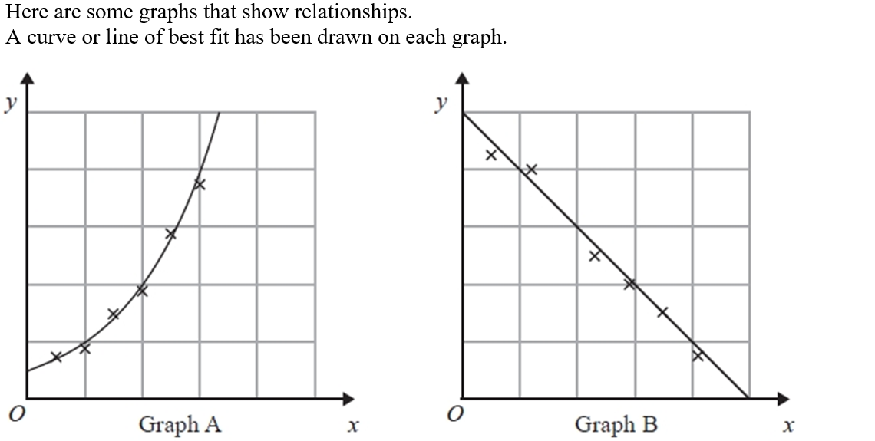
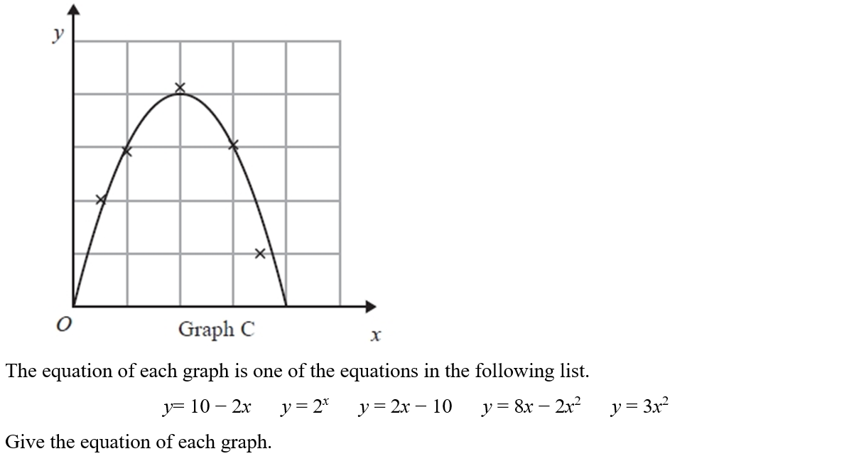
Drawing and Using Graphs
NTSQ Q5

Slide 9
Drawing and Using Graphs
NTSQ Q5
A

Slide 10
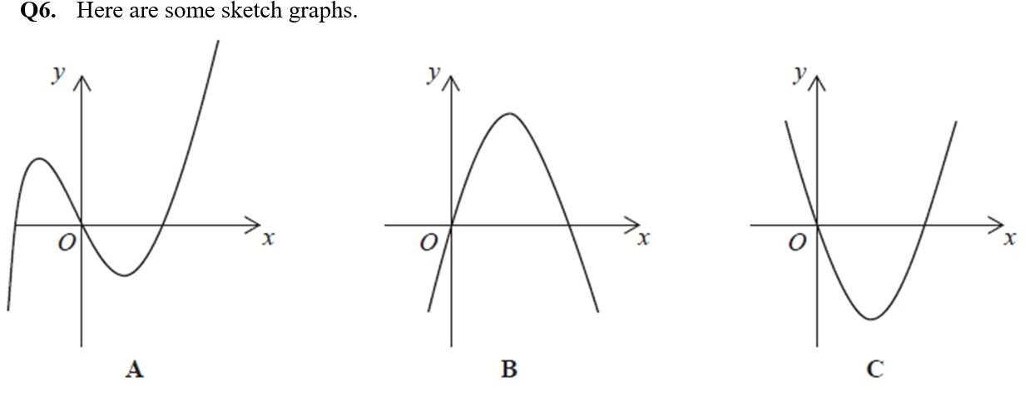
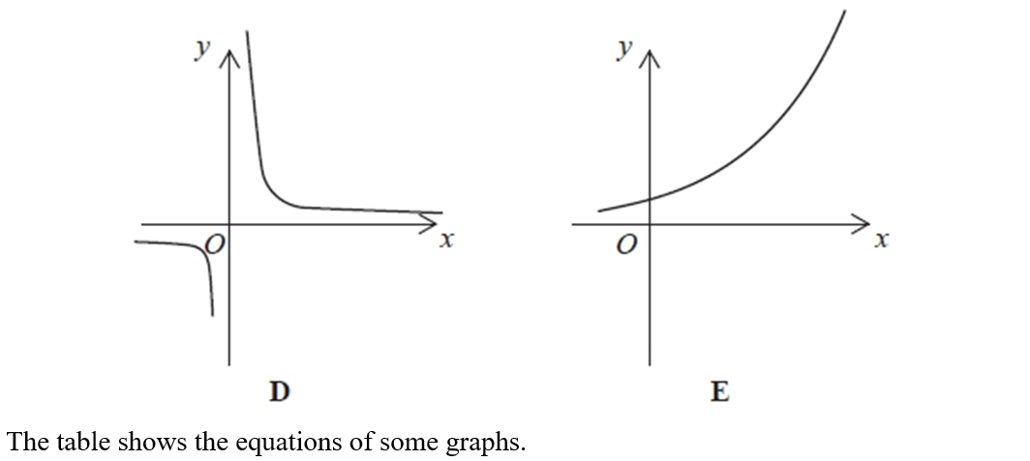
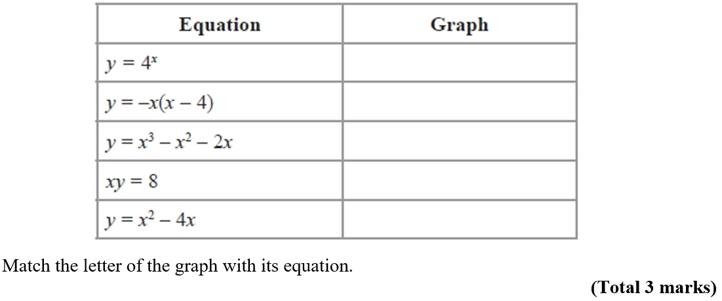
Drawing and Using Graphs
NTSQ Q6

Slide 11
Drawing and Using Graphs
NTSQ Q6
A

Slide 12
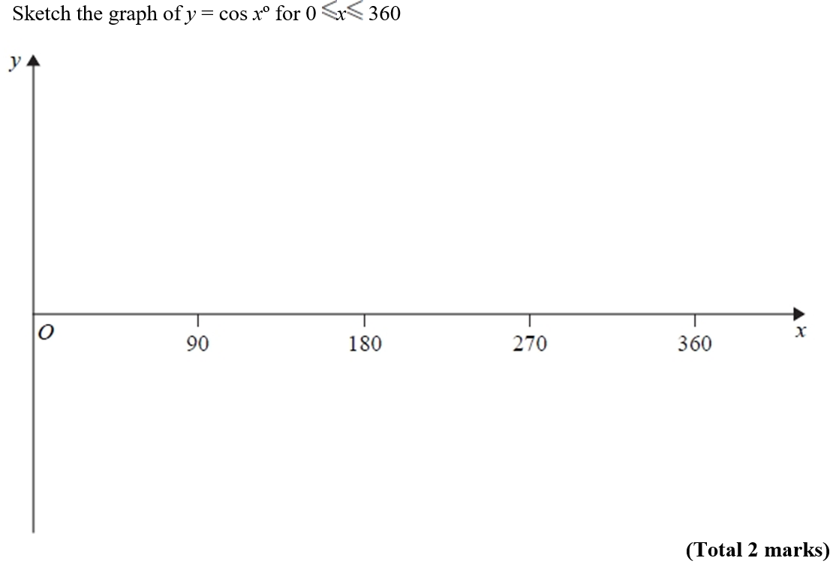
Drawing and Using Graphs
NTSQ Q7
1
-1
Reveal Graph

Slide 13
Drawing and Using Graphs
NTSQ Q7
A

Slide 14
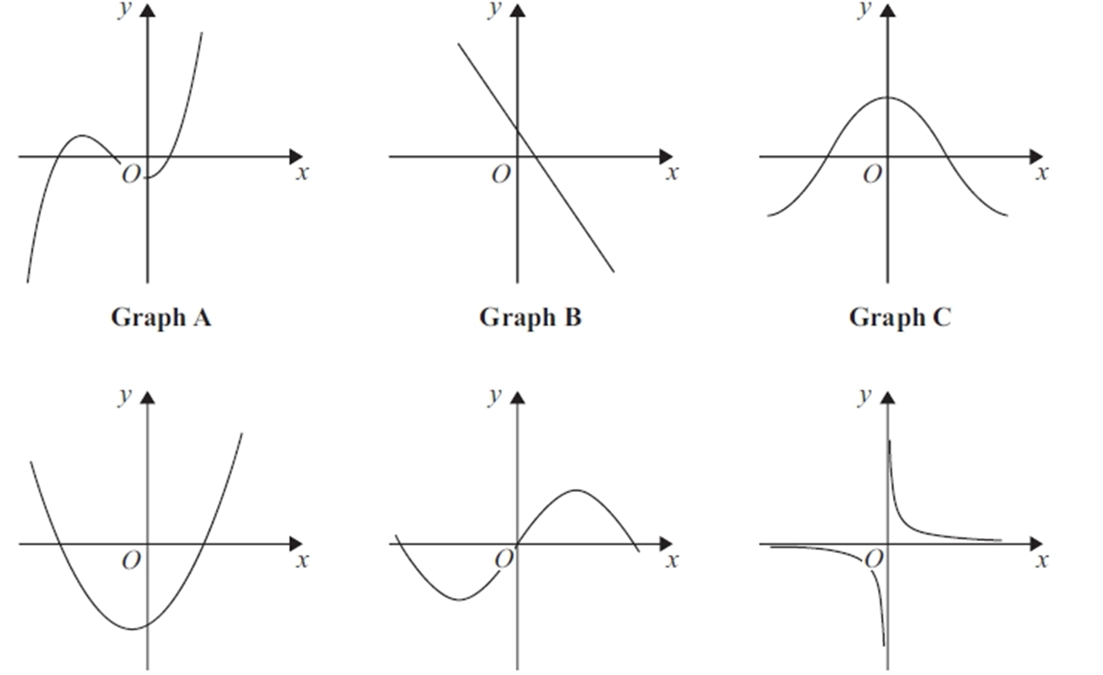
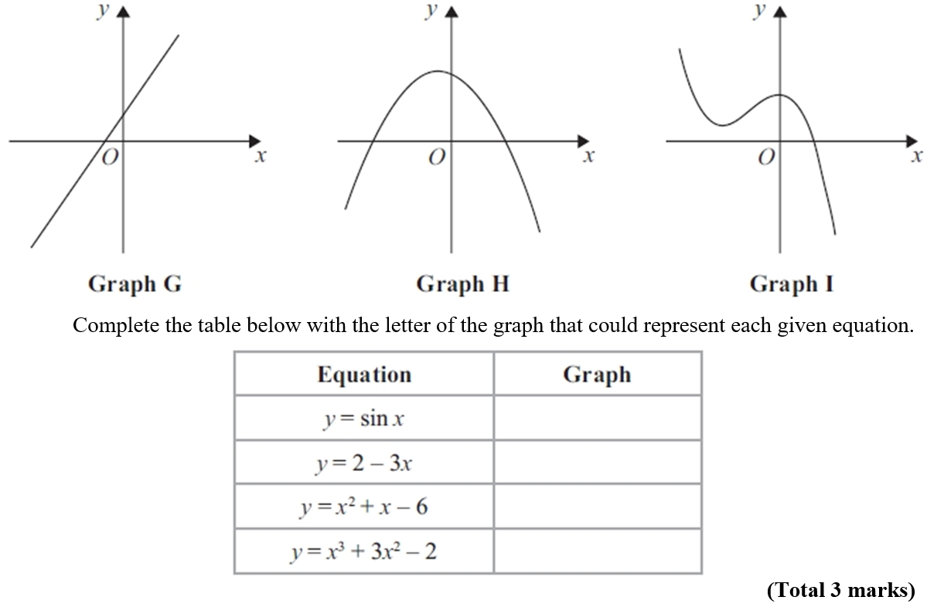
Drawing and Using Graphs
SAM 2H Q19

Slide 15
Drawing and Using Graphs
SAM 2H Q19
A

Slide 16
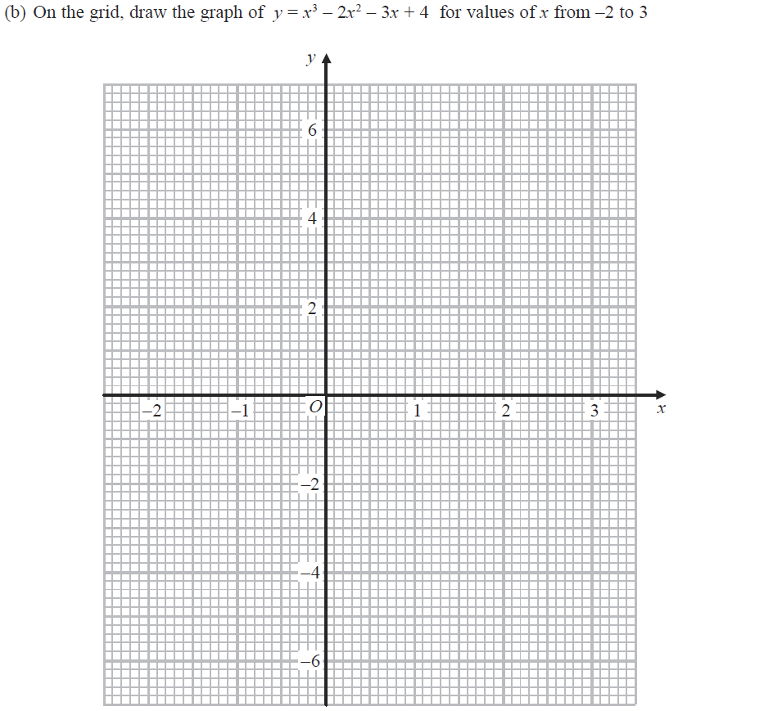
Drawing and Using Graphs
2018 2H Q14
Reveal Graph (b)

Slide 17
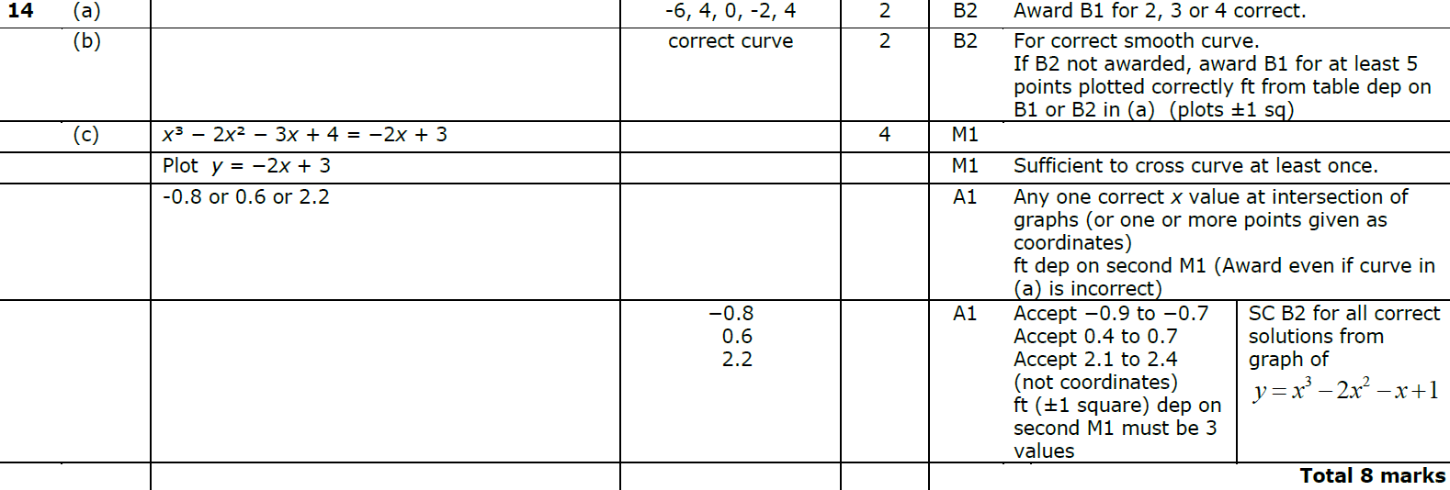
Drawing and Using Graphs
June 2018 2H Q14
A
B
C

Slide 18
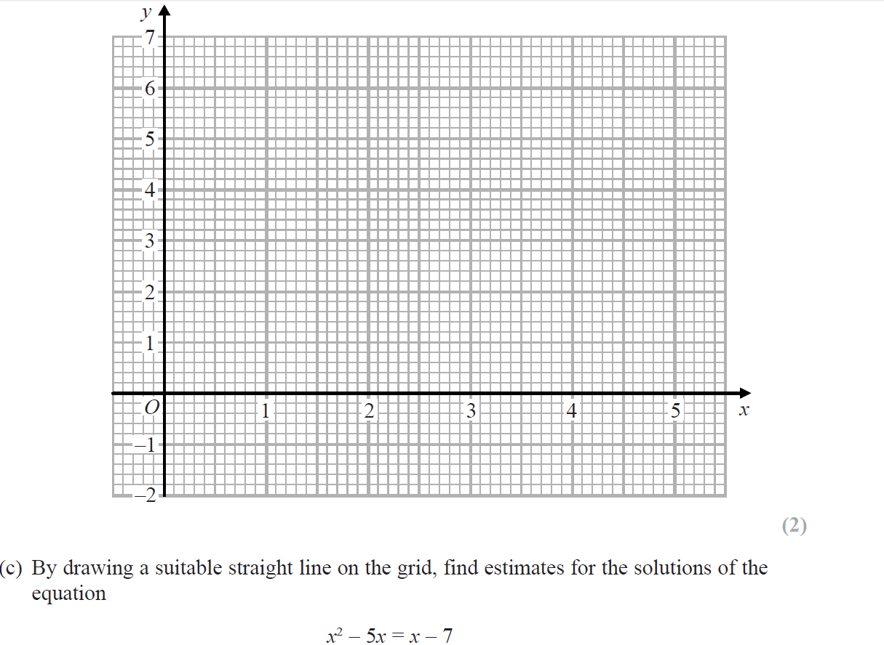
Drawing and Using Graphs
Jan 2019 1H Q6
Reveal Graph (b)

Slide 19
Drawing and Using Graphs
Jan 2019 1H Q6
A
B
C

Slide 20
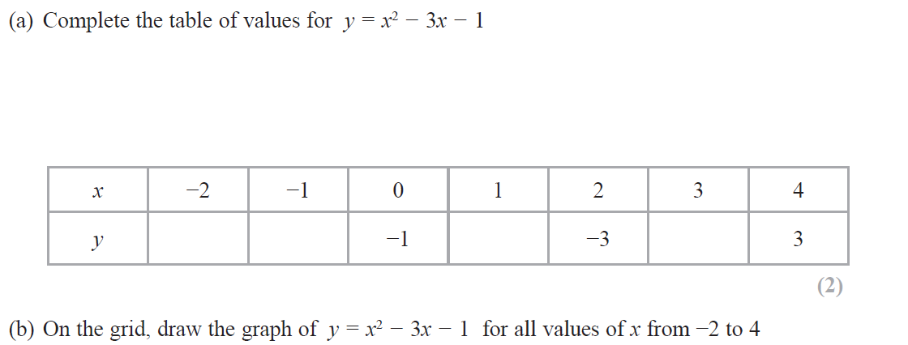
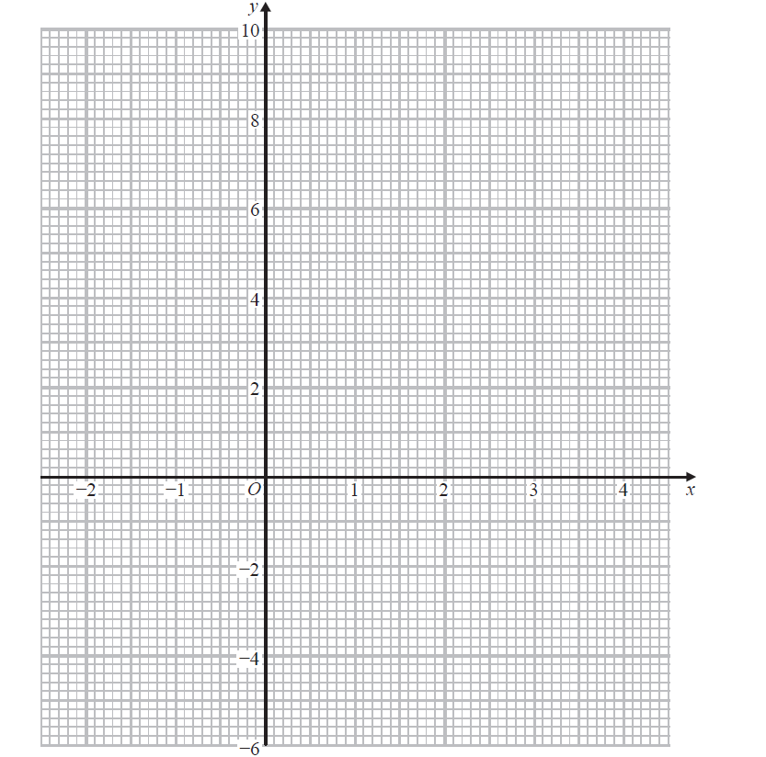
Drawing and Using Graphs
May 2019 1H Q4
Reveal Graph (b)

Slide 21
Drawing and Using Graphs
May 2019 1H Q4
A
B

Slide 22
Drawing and Using Graphs
Drawing and Using Graphs
New Sec Q’s
May 2004
4H Q18
Nov 2008
3H Q13
May 2013
4HR Q20
June 2016
4H Q7
Nov 2004
4H Q19
May 2009
3H Q15
May 2014
4H Q11
June 2016
4HR Q5
May 2005
3H Q20
Nov 2009
4H Q14
May 2014
3HR Q8
Jan 2017
4H Q19
Nov 2005
3H Q17
June 2010
3H Q12
Jan 2015
4H Q15
Jan 2017
4HR Q18
May 2006
3H Q16
Nov 2010
3H Q14
Jan 2015
4HR Q19
Jan 2018
4H Q14
Nov 2006
4H Q18
Jan 2012
4H Q17
May 2015
3H Q16
Jan 2018
4HR Q13
Nov 2007
4H Q10
May 2012
4H Q13
June 2015
4HR Q15
June 2018
4H Q8
May 2008
3H Q21
May 2013
4H Q11
Jan 2016
4HR Q14
June 2018
4HR Q15

Slide 23
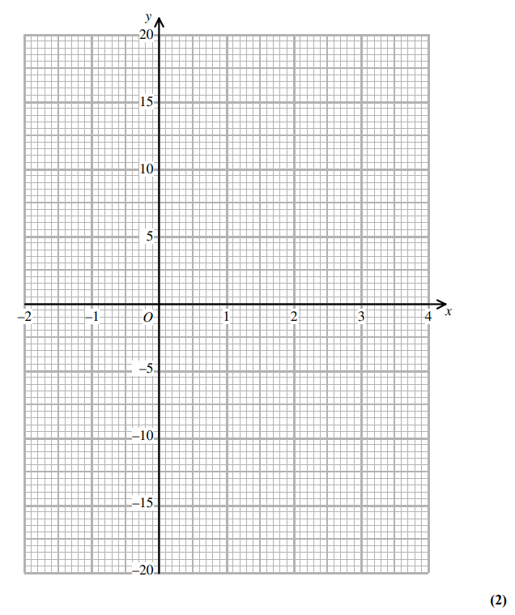
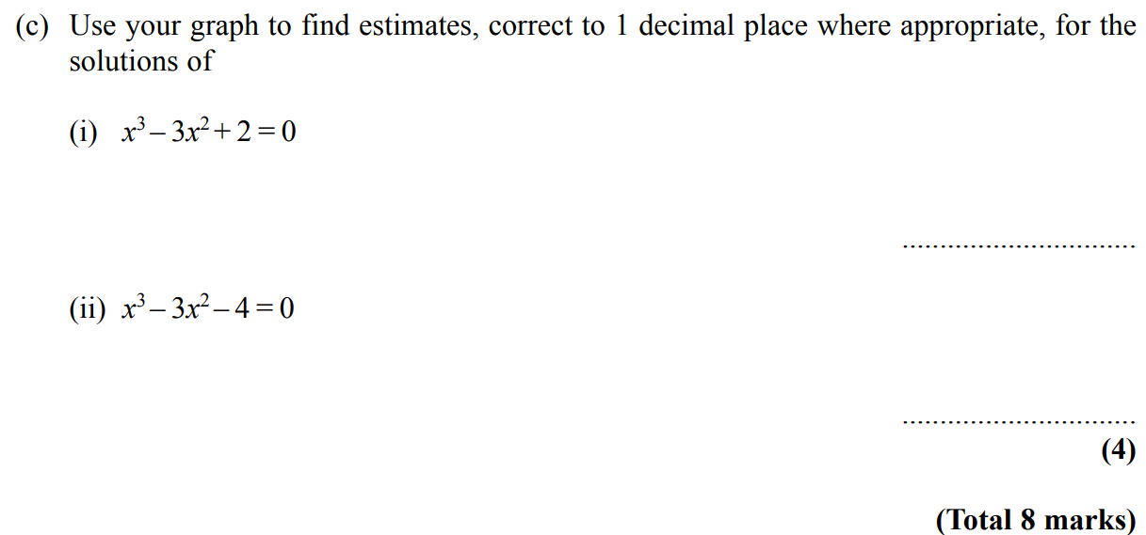
Drawing and Using Graphs
May 2004 4H Q18
Reveal graph

Slide 24
Drawing and Using Graphs
May 2004 4H Q18
A
B
C (i)
C (ii)

Slide 25
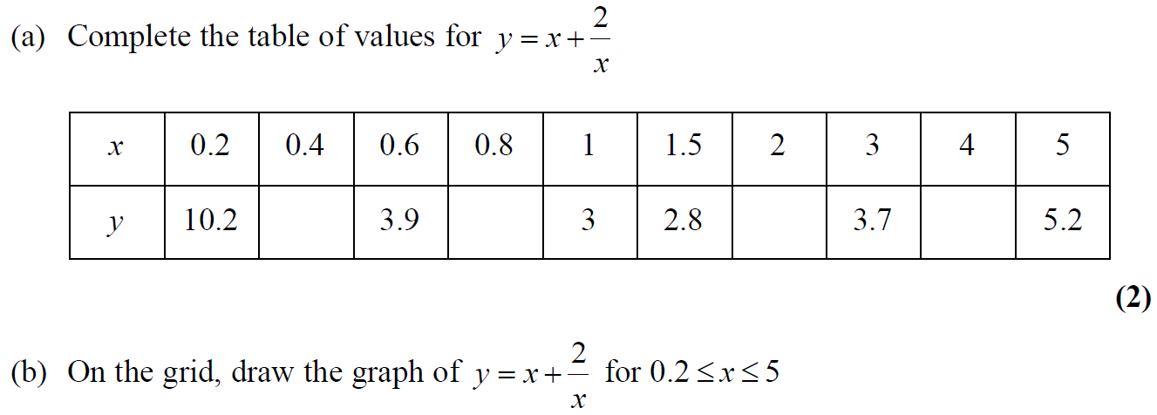
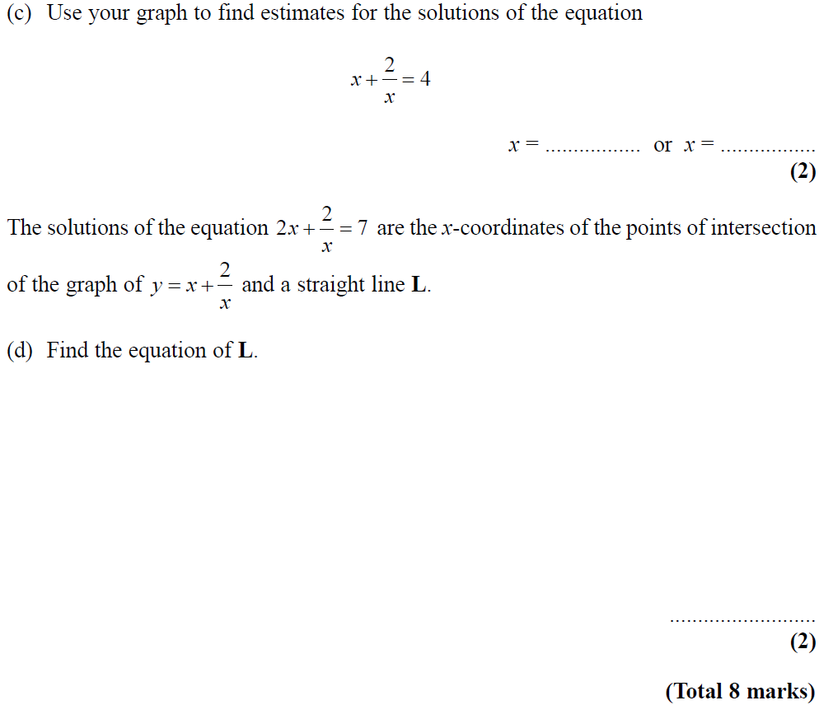
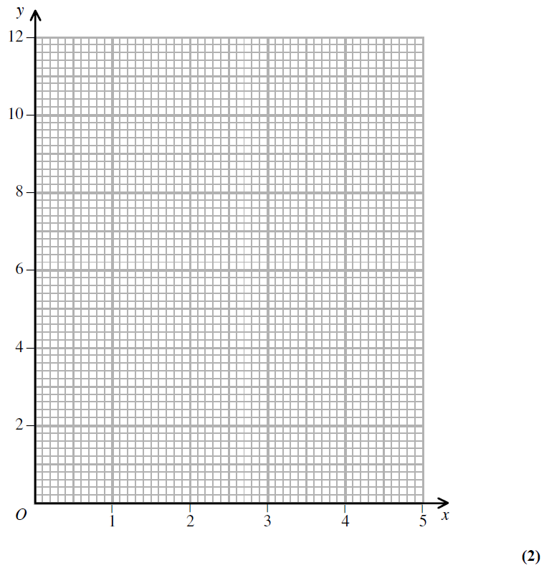
Drawing and Using Graphs
Nov 2004 4H Q19
Reveal graph

Slide 26
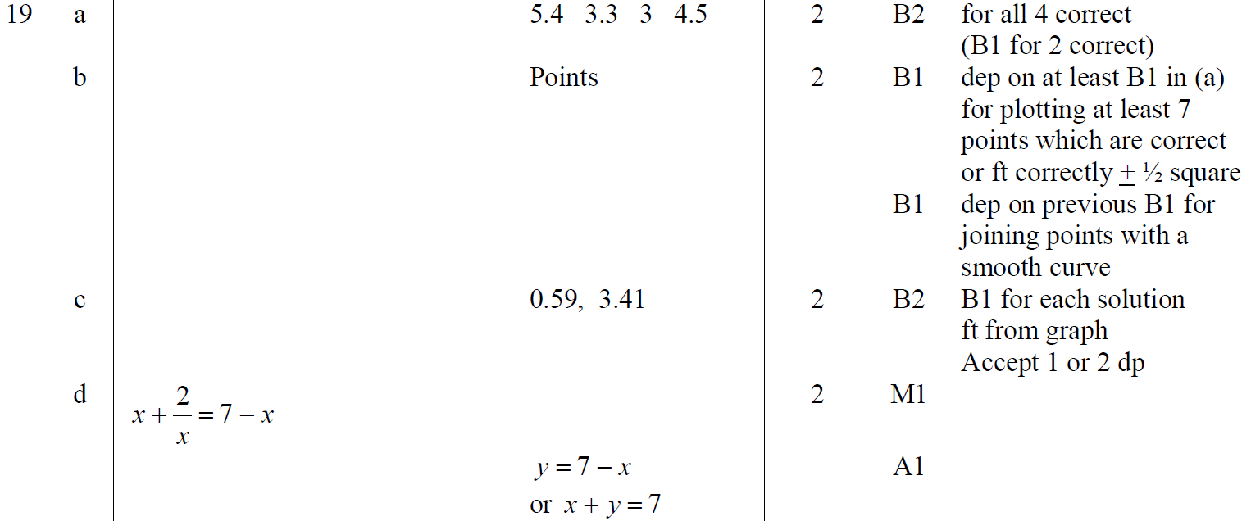
Drawing and Using Graphs
Nov 2004 4H Q19
A
B
C
D

Slide 27
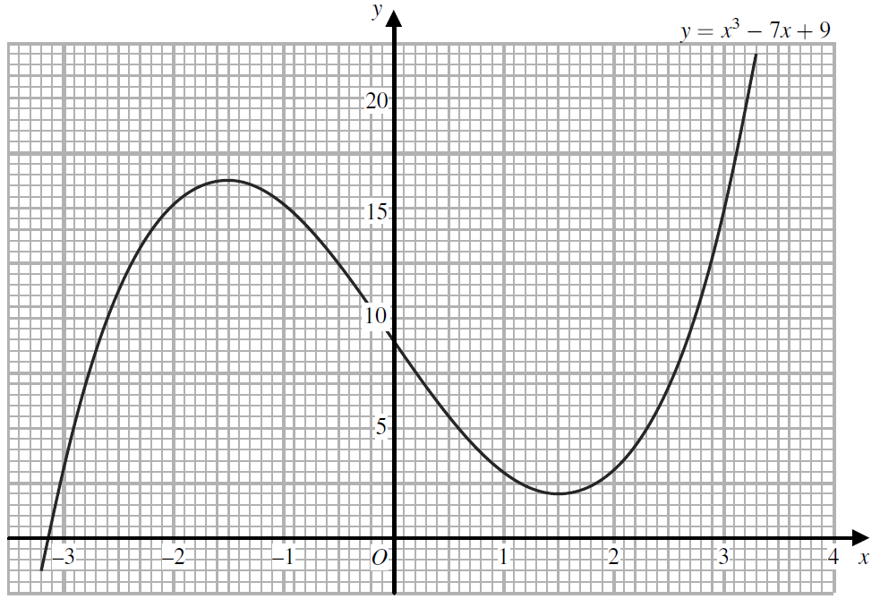
Drawing and Using Graphs
May 2005 3H Q20

Slide 28
Drawing and Using Graphs
May 2005 3H Q20
A
B

Slide 29
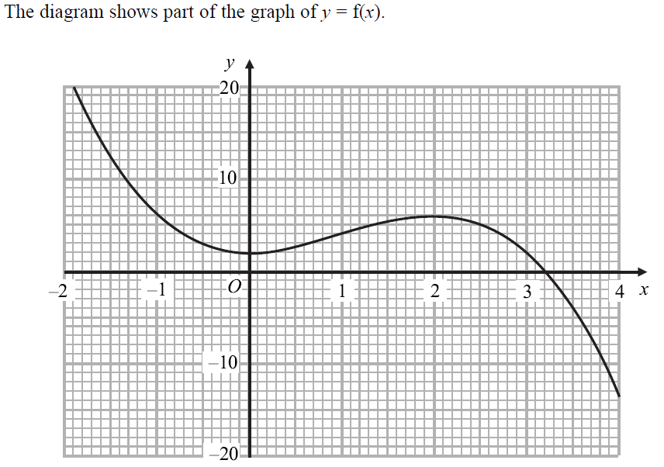
Drawing and Using Graphs
May 2005 3H Q17

Slide 30
Drawing and Using Graphs
May 2005 3H Q17
A
B
C
D
E

Slide 31
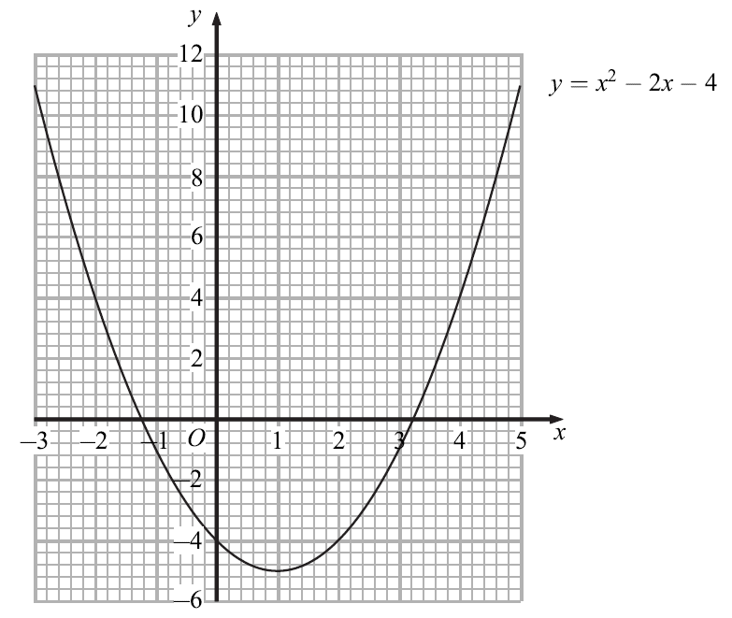
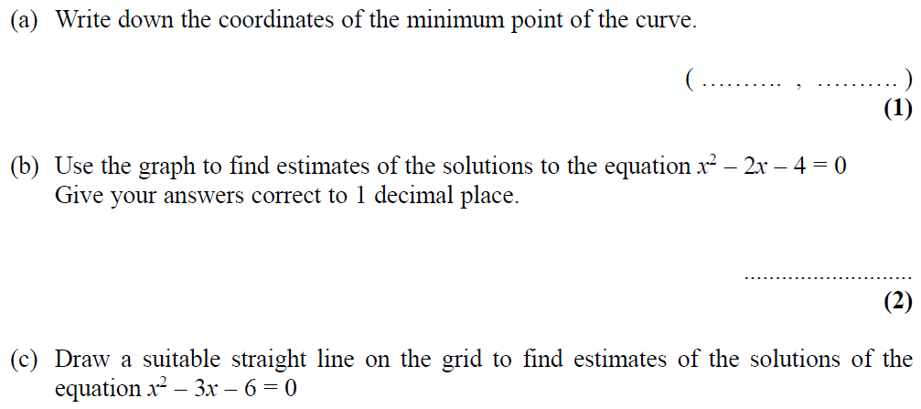
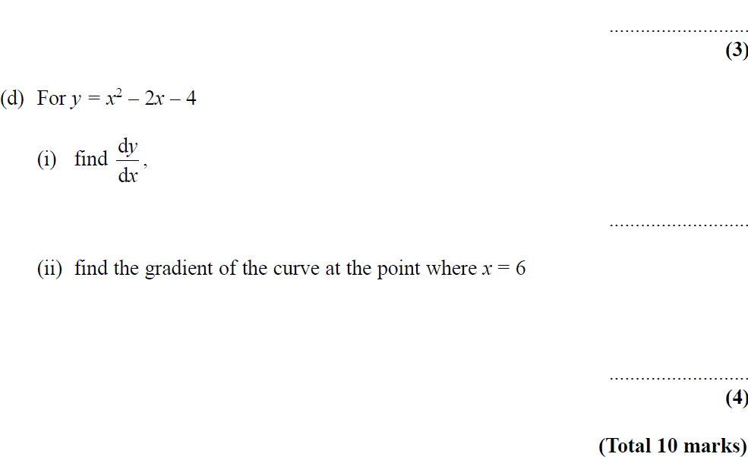
Drawing and Using Graphs
May 2006 3H Q16

Slide 32
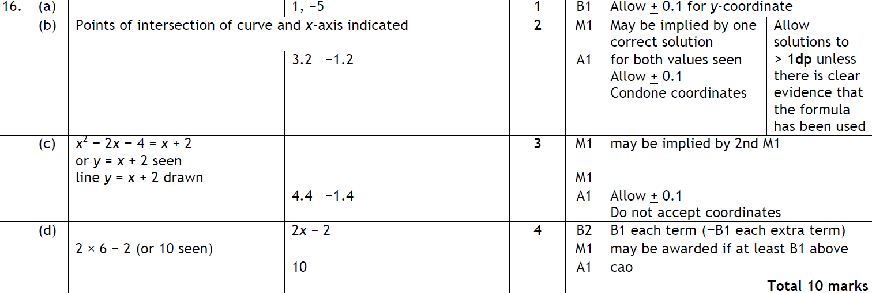
Drawing and Using Graphs
May 2006 3H Q16
A
B
C
D (i)
D (ii)

Slide 33
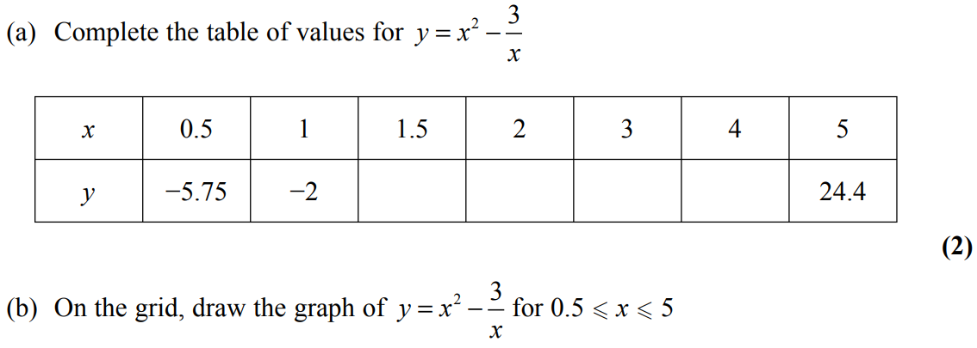
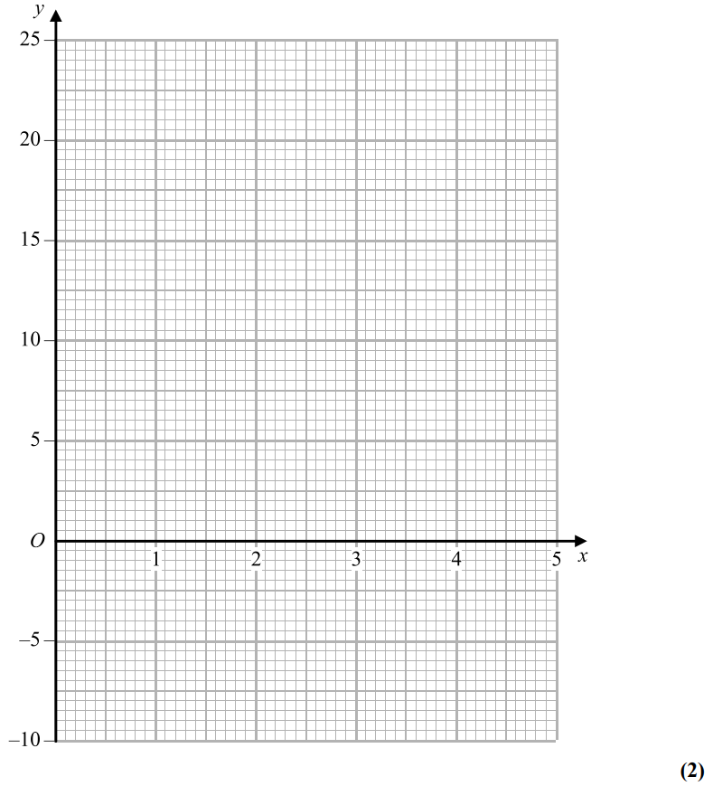
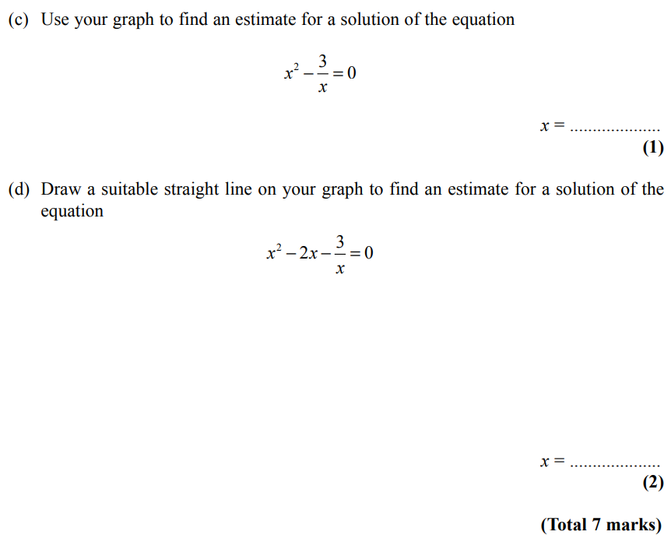
Drawing and Using Graphs
Nov 2006 4H Q18
Reveal graph (b)
Reveal graph (d)

Slide 34
Drawing and Using Graphs
Nov 2006 4H Q18
A
B
C
D

Slide 35
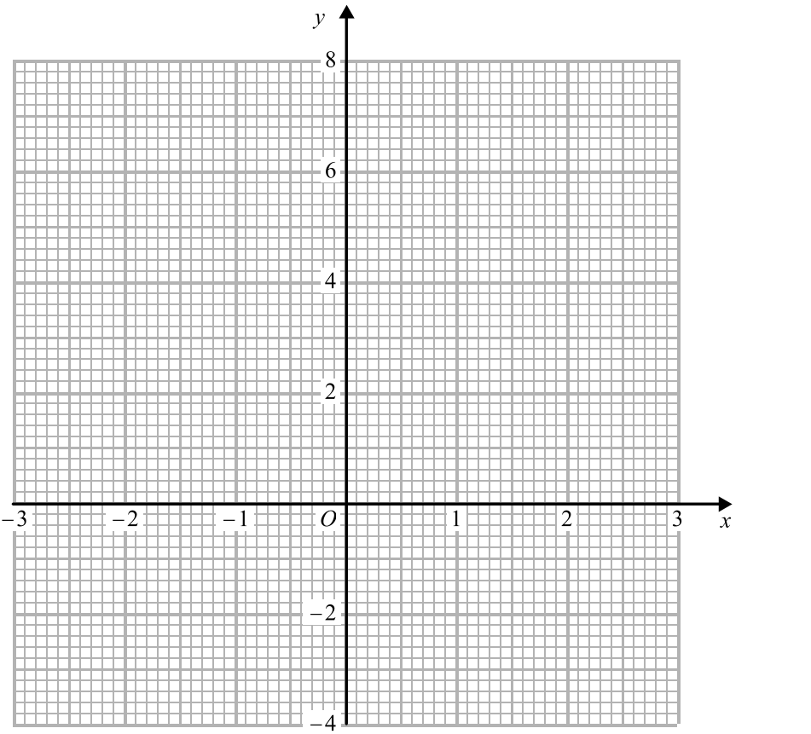
Drawing and Using Graphs
Nov 2007 4H Q10
Reveal graph

Slide 36
Drawing and Using Graphs
Nov 2007 4H Q10
A
B

Slide 37
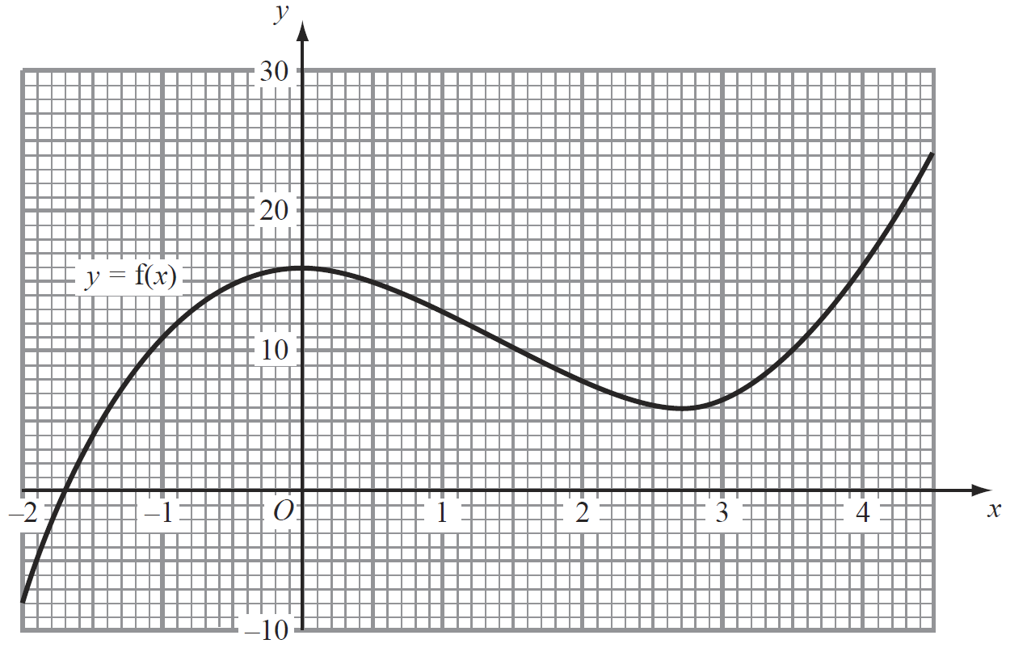
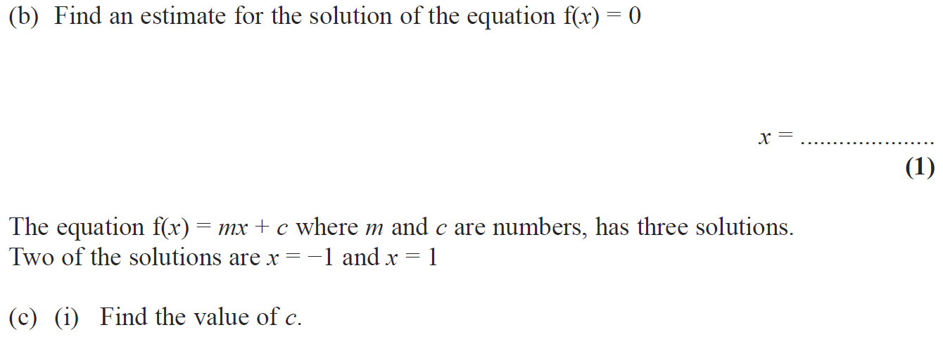
Drawing and Using Graphs
May 2008 3H Q21

Slide 38
Drawing and Using Graphs
May 2008 3H Q21
A
B
C (i)
C (ii)

Slide 39
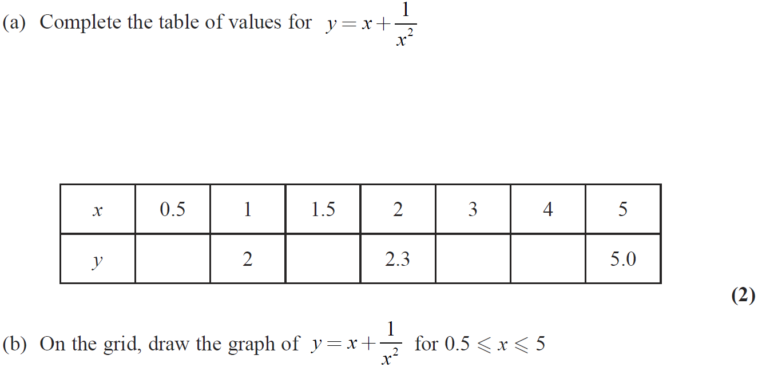
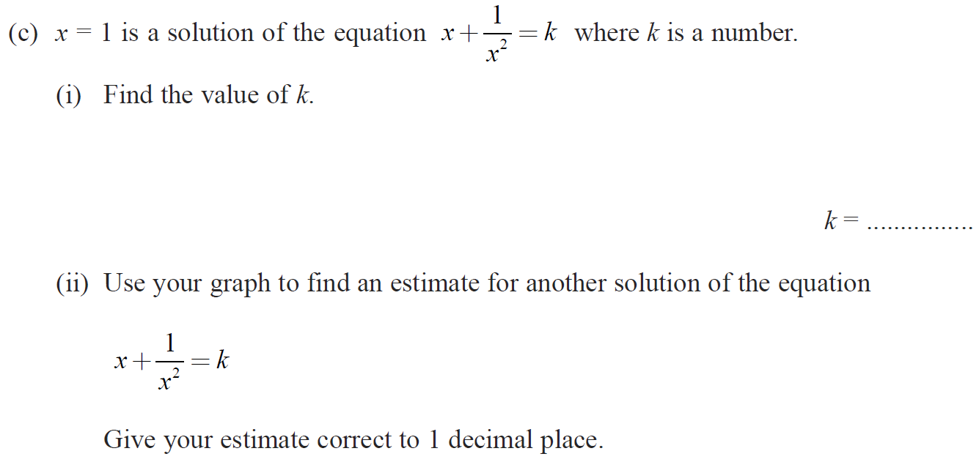
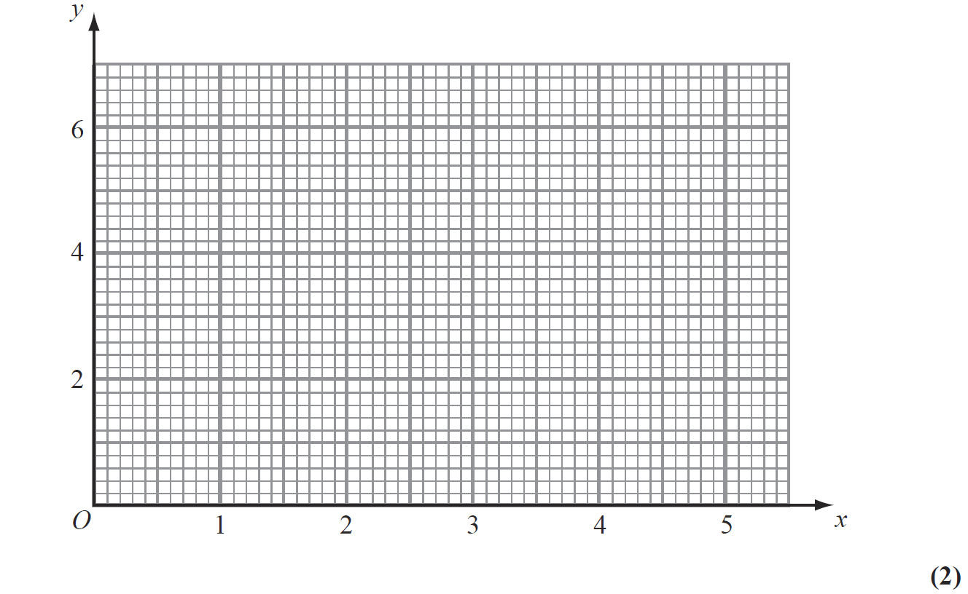
Drawing and Using Graphs
Nov 2008 3H Q13
Reveal graph

Slide 40
Drawing and Using Graphs
Nov 2008 3H Q13
A
B
C (i)
C (ii)

Slide 41
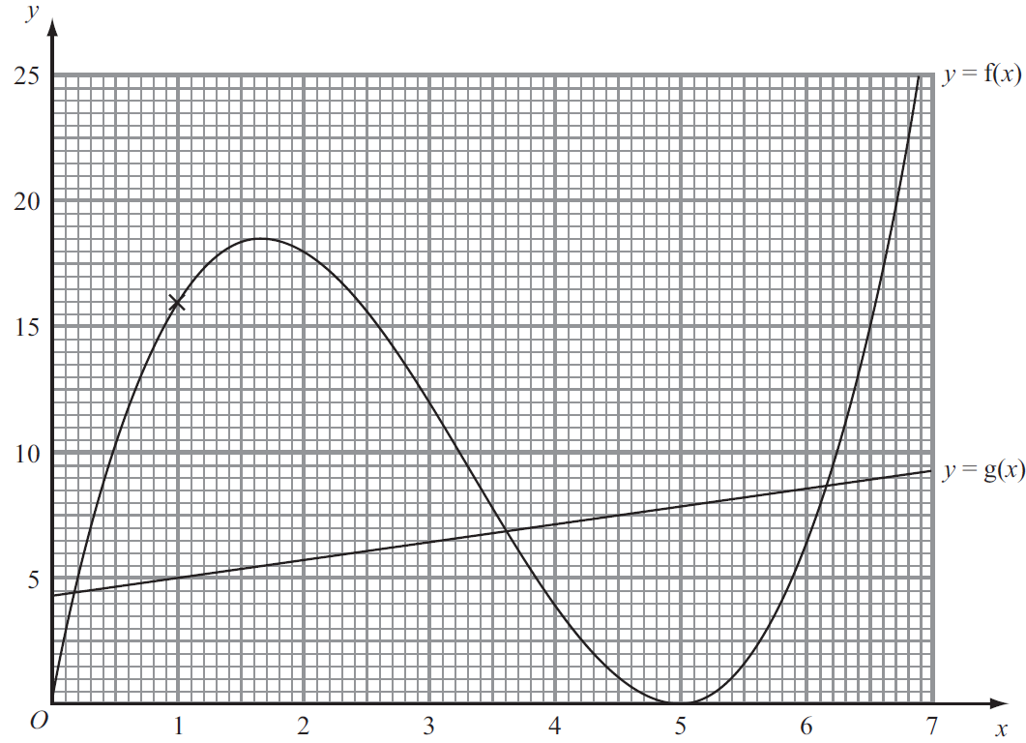
Drawing and Using Graphs
May 2009 3H Q15

Slide 42
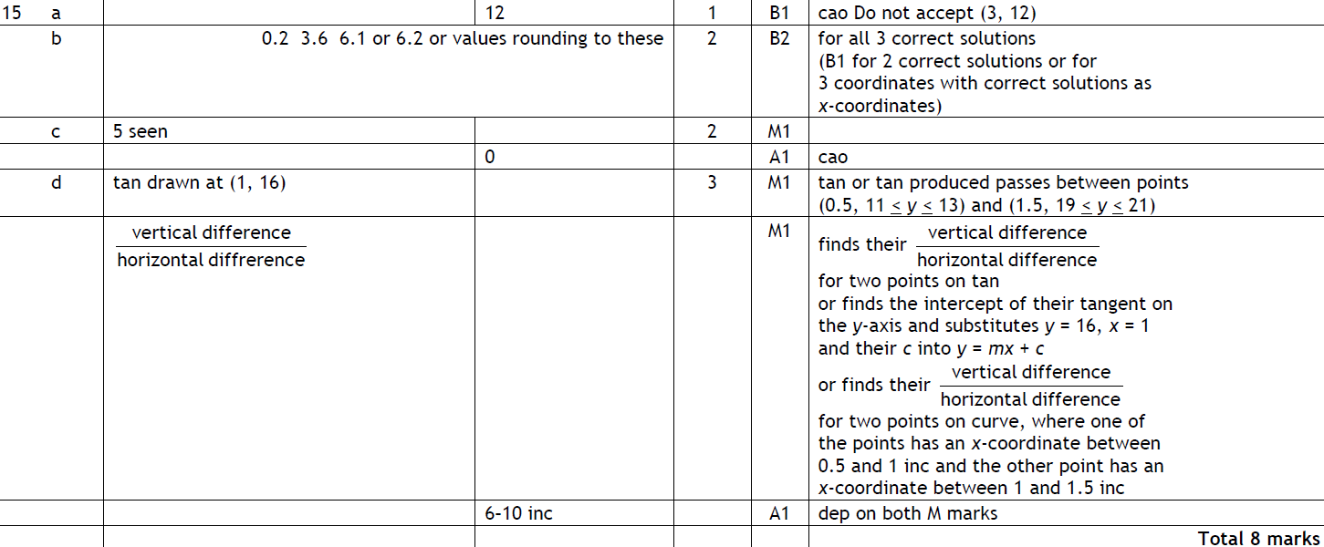
Drawing and Using Graphs
May 2009 3H Q15
A
B
C
D

Slide 43
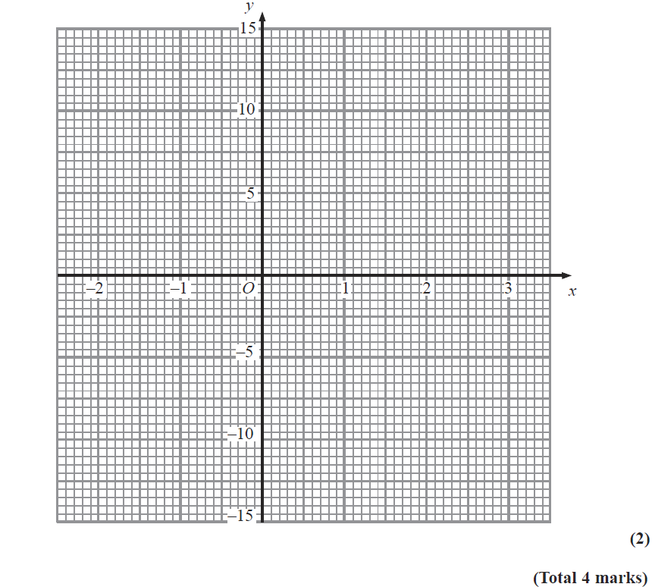
Drawing and Using Graphs
Nov 2009 4H Q14
Reveal graph

Slide 44
Drawing and Using Graphs
Nov 2009 4H Q14
A
B

Slide 45
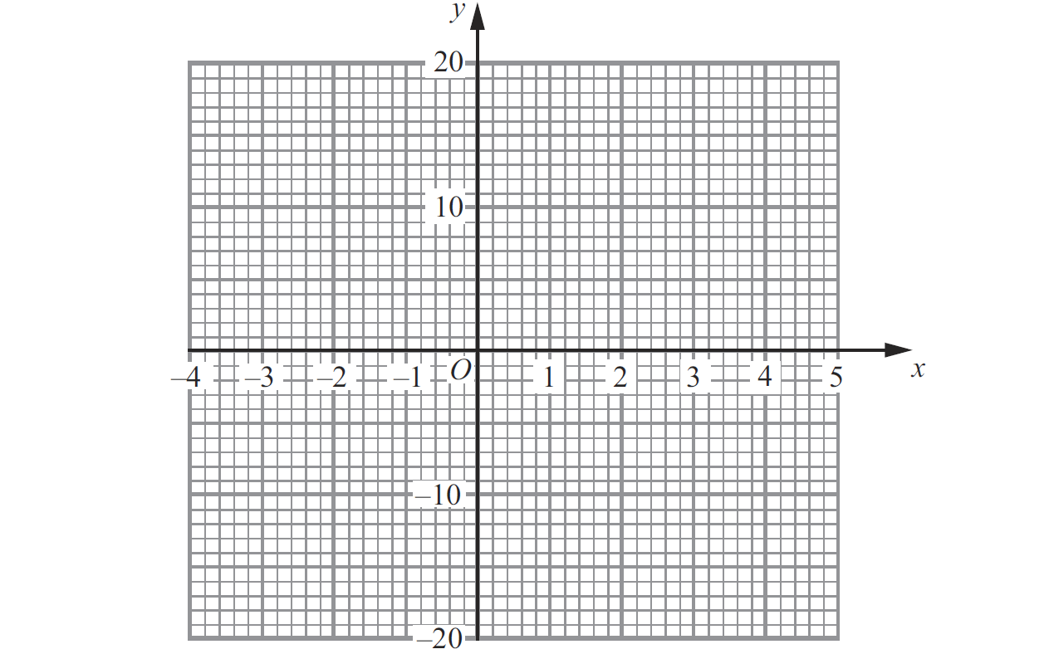
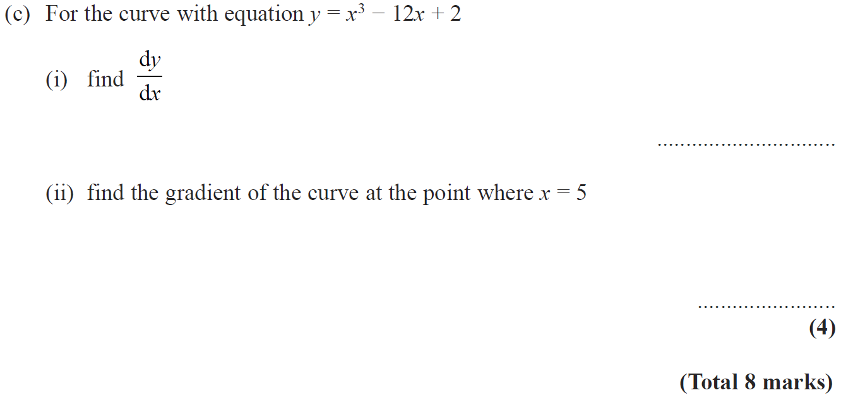
Drawing and Using Graphs
June 2010 3H Q12
Reveal graph

Slide 46
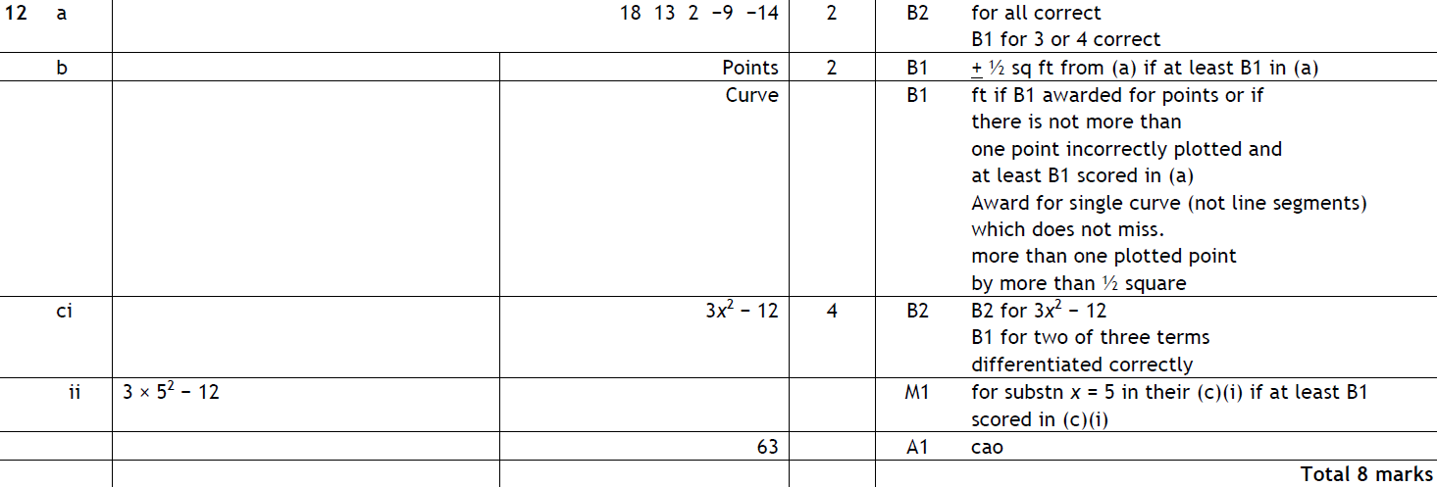
Drawing and Using Graphs
June 2010 3H Q12
A
B
C (i)
C (ii)

Slide 47
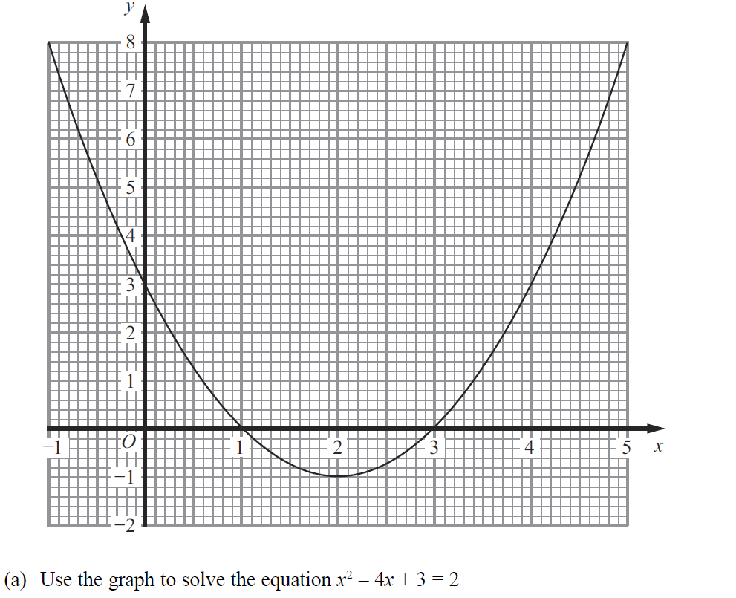
Drawing and Using Graphs
Nov 2010 3H Q14

Slide 48
Drawing and Using Graphs
Nov 2010 3H Q14
A
B

Slide 49
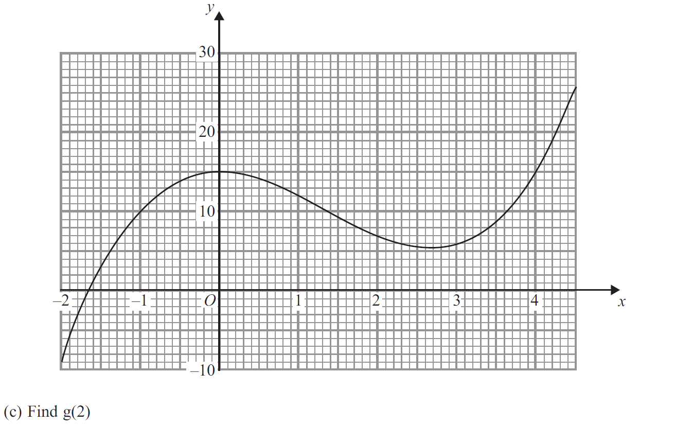
Drawing and Using Graphs
Jan 2012 4H Q17

Slide 50
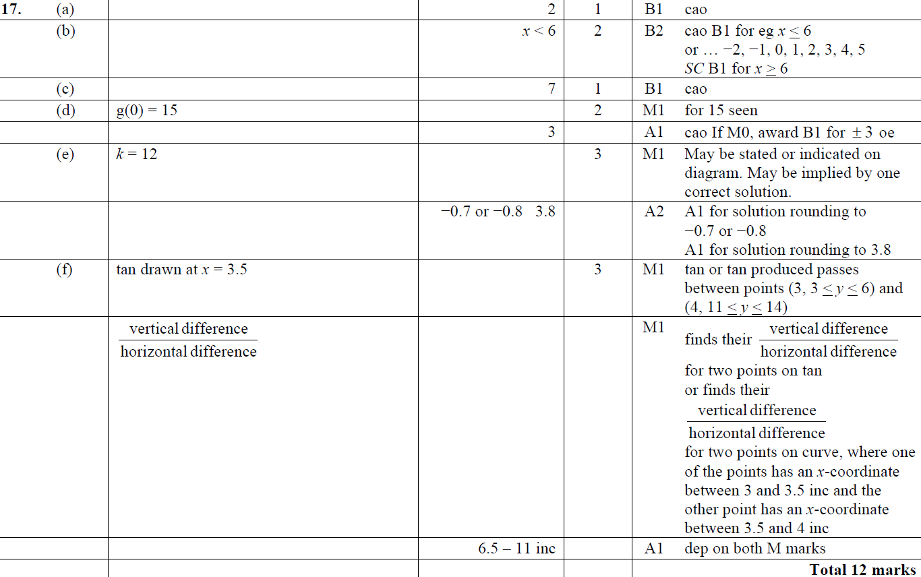
Drawing and Using Graphs
Jan 2012 4H Q17
A
B
C
D
E
F

Slide 51
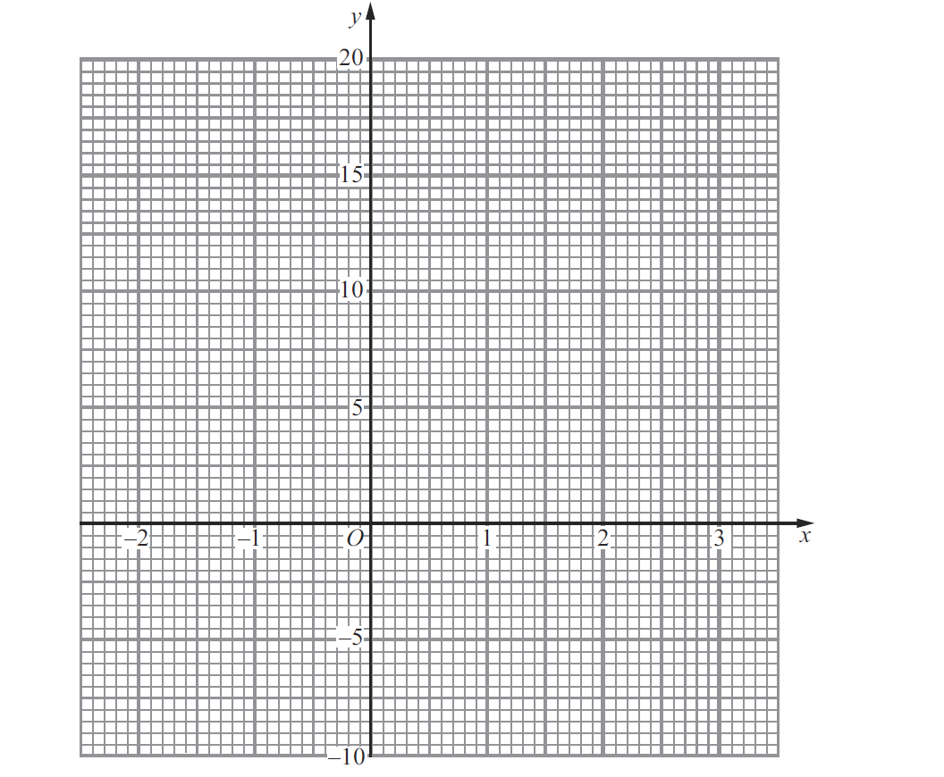
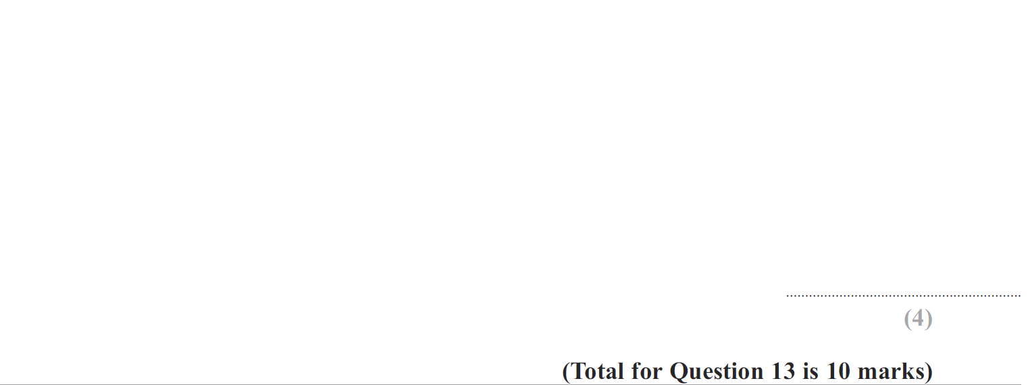
Drawing and Using Graphs
May 2012 4H Q13
Reveal graph

Slide 52
Drawing and Using Graphs
May 2012 4H Q13
A
B
C
D
E

Slide 53
Drawing and Using Graphs
May 2013 4H Q11
Reveal graph

Slide 54
Drawing and Using Graphs
May 2013 4H Q11
A (i)
A (ii)
B
C (i)
C (ii)

Slide 55
Drawing and Using Graphs
May 2013 4HR Q20
Reveal graph (dii)
Reveal graph (b)

Slide 56
Drawing and Using Graphs
May 2013 4HR Q20
A
B
C
D (i)
D (ii)

Slide 57
Drawing and Using Graphs
May 2014 4H Q11
Reveal graph (b)

Slide 58
Drawing and Using Graphs
May 2014 4H Q11
A
B

Slide 59
Drawing and Using Graphs
May 2014 3HR Q8
Reveal graph (b)

Slide 60
Drawing and Using Graphs
May 2014 3HR Q8
A
B

Slide 61
Drawing and Using Graphs
Jan 2015 4H Q15

Slide 62
Drawing and Using Graphs
Jan 2015 4H Q15
A
B

Slide 63
Drawing and Using Graphs
Jan 2015 4HR Q19

Slide 64
Drawing and Using Graphs
Jan 2015 4HR Q19
A
B

Slide 65
Drawing and Using Graphs
May 2015 3H Q16
Reveal graph (b)

Slide 66
Drawing and Using Graphs
May 2015 3H Q16
A
B
C

Slide 67
Drawing and Using Graphs
June 2015 4HR Q15
Reveal graph (d)
Reveal graph (b)

Slide 68
Drawing and Using Graphs
June 2015 4HR Q15
A
B
C
D

Slide 69
Drawing and Using Graphs
Jan 2016 4HR Q14
Reveal graph (d)
Reveal graph (b)

Slide 70
Drawing and Using Graphs
Jan 2016 4HR Q14
A
B
C
D

Slide 71
Drawing and Using Graphs
June 2016 4H Q7
Reveal graph (b)

Slide 72
Drawing and Using Graphs
June 2016 4H Q7
A
B

Slide 73
Drawing and Using Graphs
June 2016 4HR Q5
Reveal graph (b)

Slide 74
Drawing and Using Graphs
June 2016 4HR Q5
A
B
C

Slide 75
Drawing and Using Graphs
Jan 2017 4H Q19

Slide 76
Drawing and Using Graphs
Jan 2017 4H Q19
A
B
C

Slide 77
Drawing and Using Graphs
Jan 2017 4HR Q18

Slide 78
Drawing and Using Graphs
Jan 2017 4HR Q18
A
B

Slide 79
Drawing and Using Graphs
Jan 2018 4H Q14
Reveal graph (b)

Slide 80
Drawing and Using Graphs
Jan 2018 4H Q14
A
B
C

Slide 81
Drawing and Using Graphs
Jan 2018 4HR Q13

Slide 82
Drawing and Using Graphs
Jan 2018 4HR Q13
A
B
C

Slide 83
Drawing and Using Graphs
June 2018 4H Q8
Reveal graph (b)

Slide 84
Drawing and Using Graphs
June 2018 4H Q8
A
B
C

Slide 85
Drawing and Using Graphs
June 2018 4HR Q15
Reveal graph (b)

Slide 86
Drawing and Using Graphs
June 2018 4HR Q15
A
B
C

