Slide 1
Drawing and Using Graphs
Drawing and Using Graphs
May 2017
1H Q17
Nov 2017
3H Q17
SAM
1H Q4*
Nov 2018
1H Q10
June 2017
2H Q19
May 2018
1H Q17
Practice
1H Q15
Nov 2018
1H Q21
June 2017
3H Q7
June 2018
2H Q9
Practice
2H Q18
Nov 2018
3H Q10*
Nov 2017
1H Q5
June 2018
3H Q9
*Mainly Proportion
Intercepts and roots
Circles
Recognising shapes of graphs

Slide 2
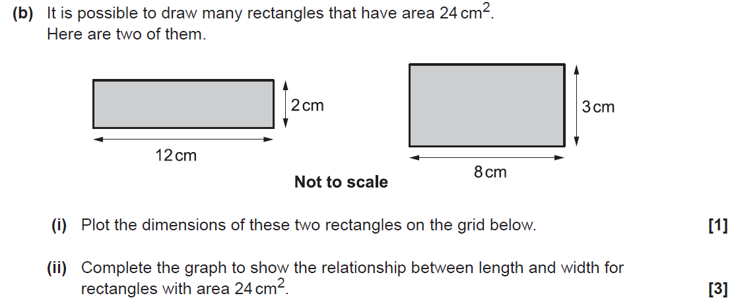
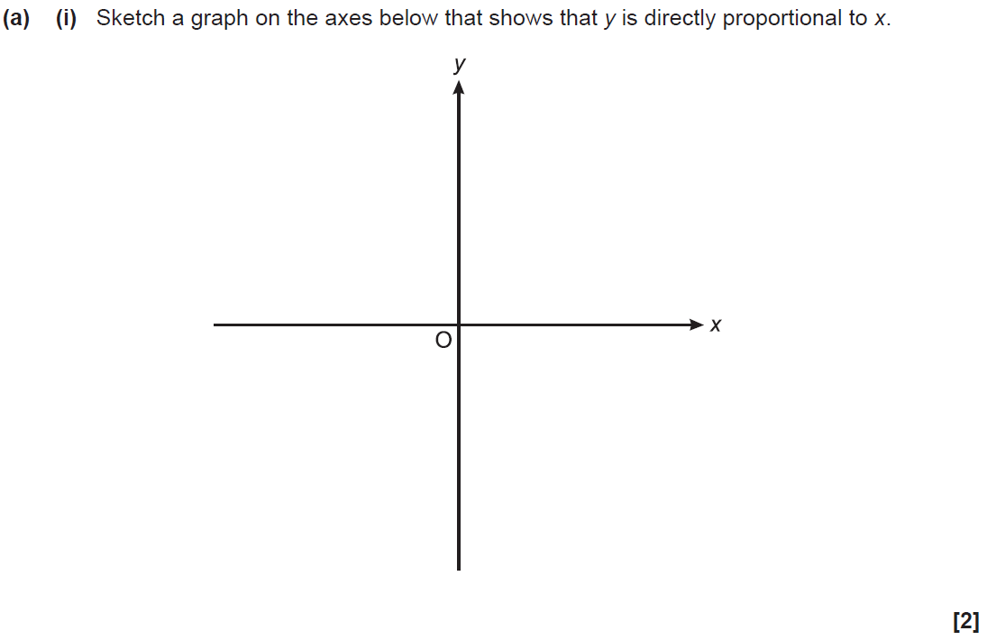
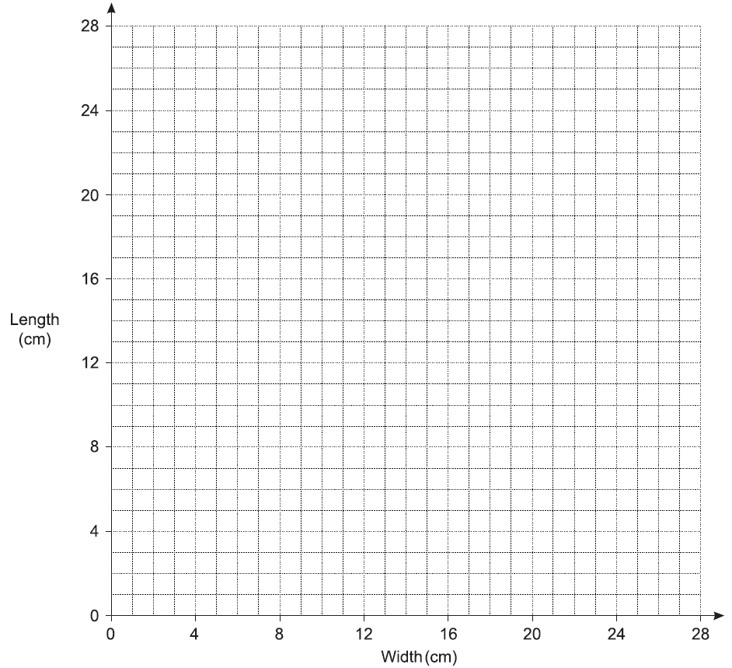
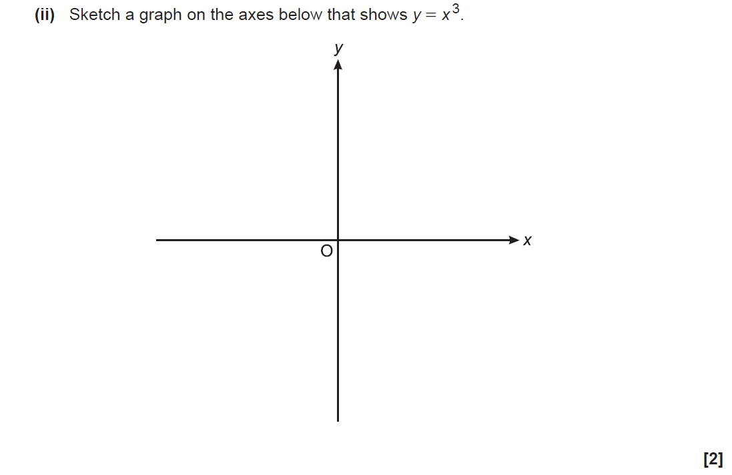
Drawing and Using Graphs
SAM 1H Q4

Slide 3
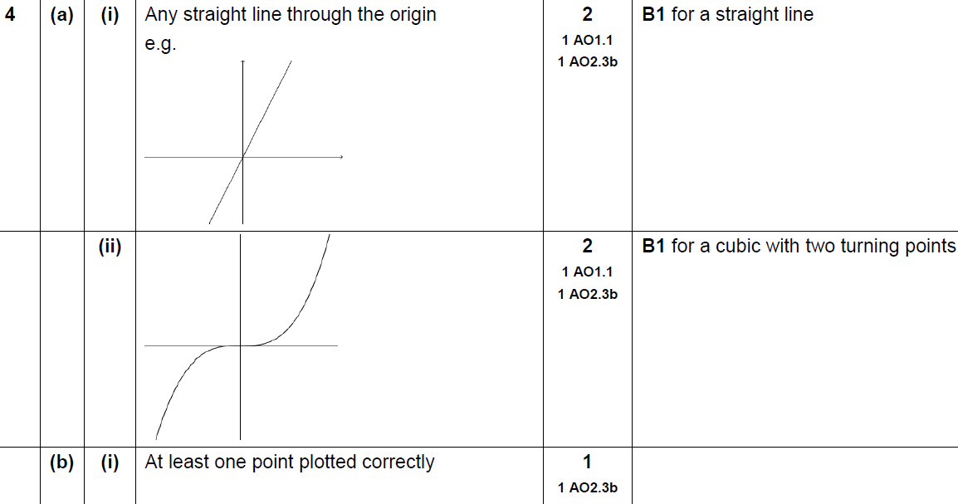
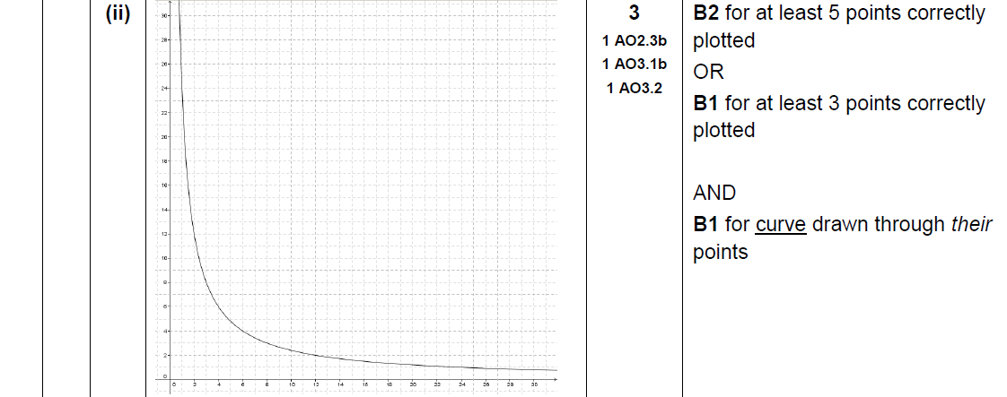
Drawing and Using Graphs
SAM 1H Q4
A (i)
A (ii)
B (i)
B (ii)

Slide 4
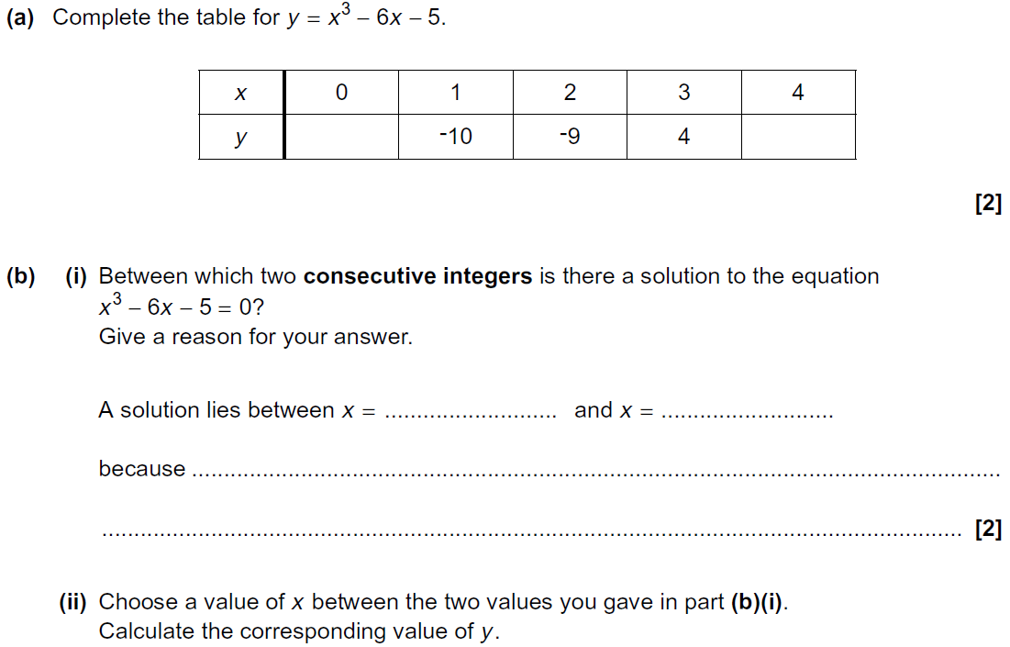
Drawing and Using Graphs
Practice 1H Q15

Slide 5
Drawing and Using Graphs
Practice 1H Q15
A
B (i)
B (ii)
B (iii)

Slide 6
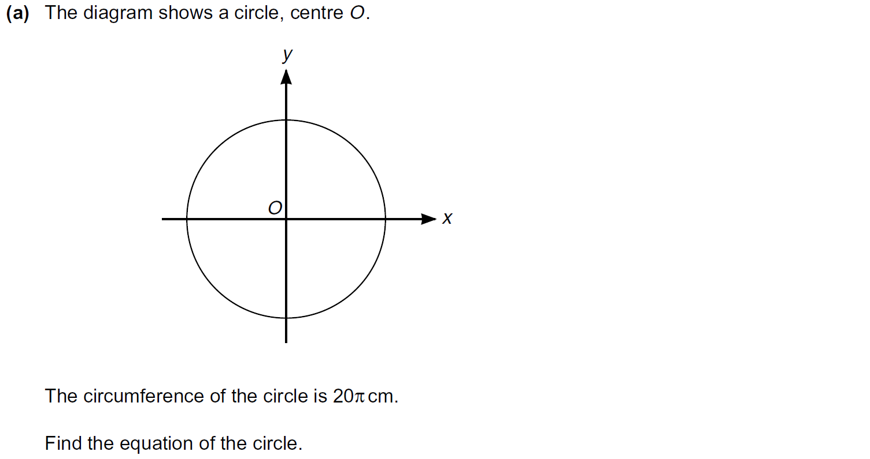
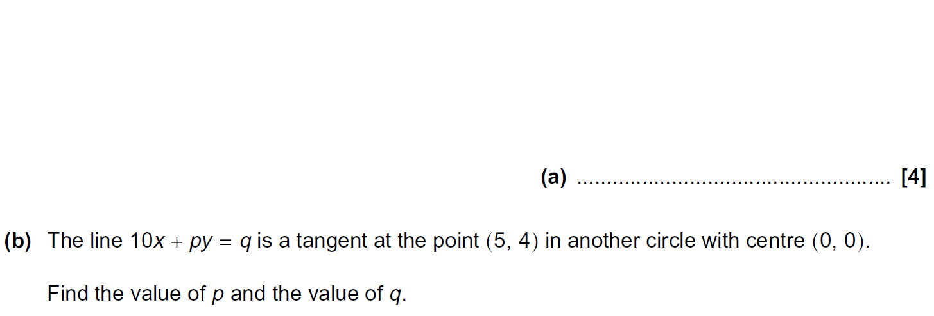
Drawing and Using Graphs
Practice 2H Q18

Slide 7
Drawing and Using Graphs
Practice 2H Q18
A
B

Slide 8
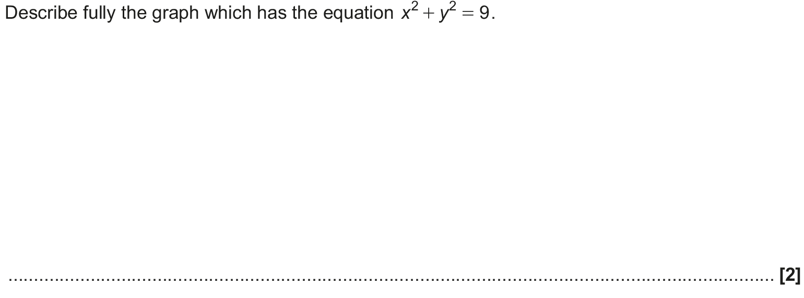
Drawing and Using Graphs
May 2017 1H Q17

Slide 9
Drawing and Using Graphs
May 2017 1H Q17
A

Slide 10
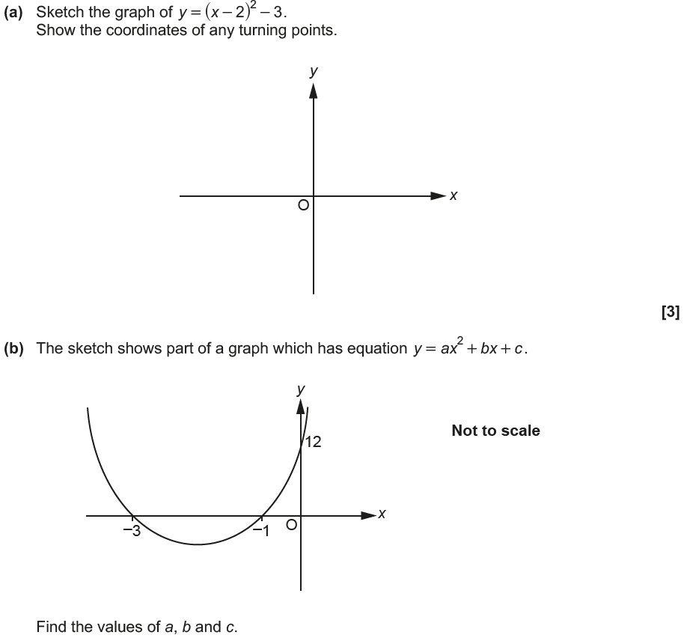
Drawing and Using Graphs
June 2017 2H Q19

Slide 11
Drawing and Using Graphs
June 2017 2H Q19
A
B

Slide 12
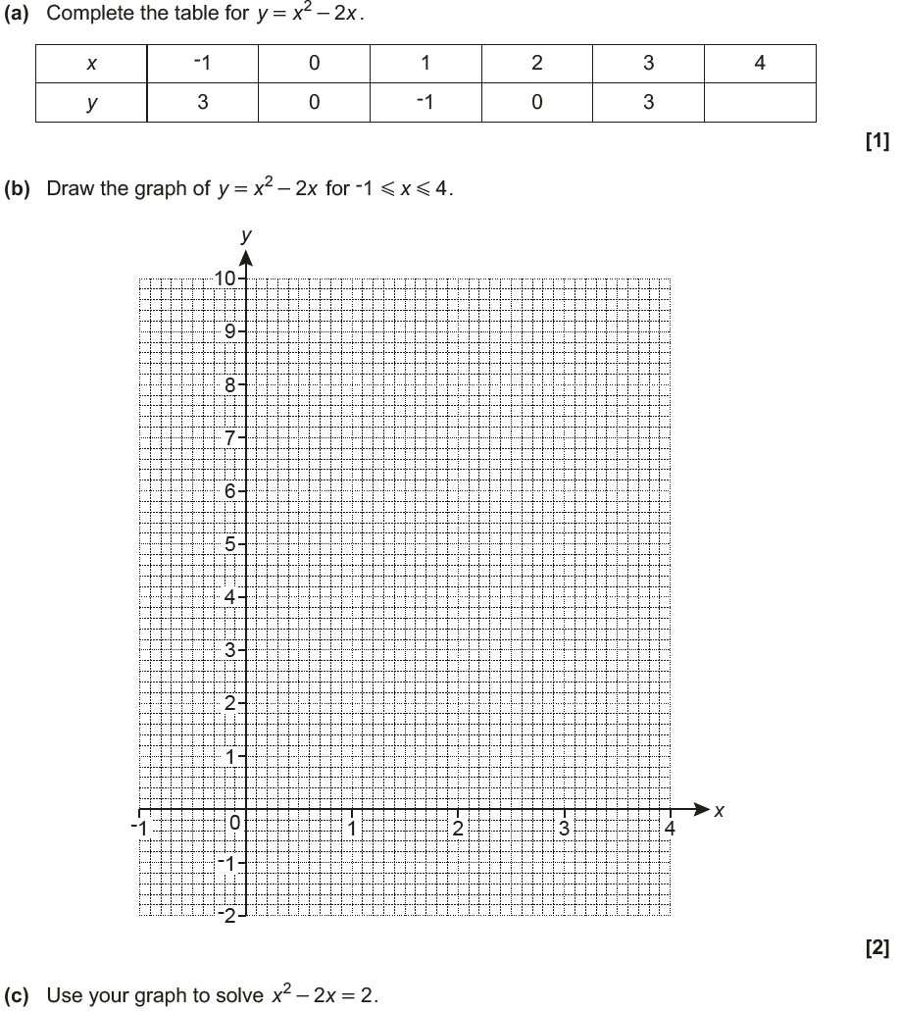
Drawing and Using Graphs
June 2017 3H Q7

Slide 13
Drawing and Using Graphs
June 2017 3H Q7
A
B
C

Slide 14
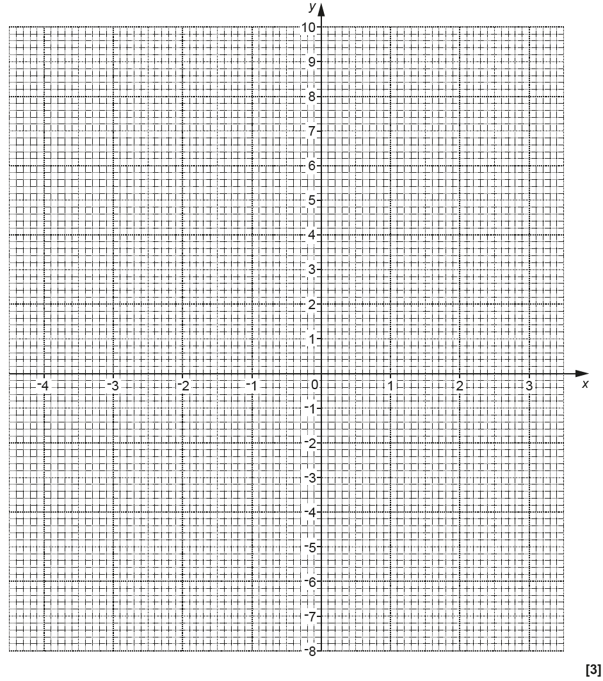
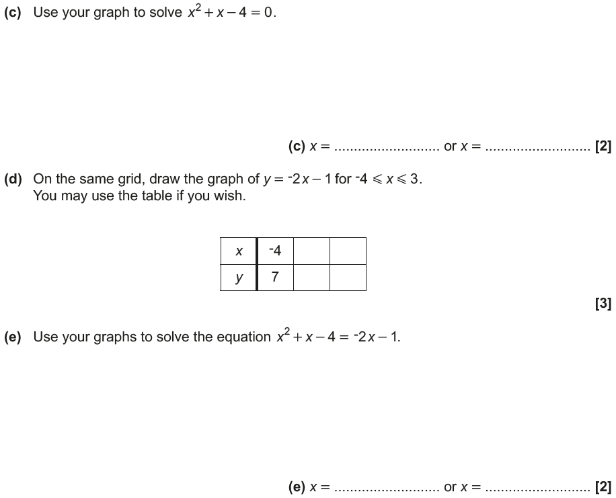
Drawing and Using Graphs
Nov 2017 1H Q5
Reveal Graph (b)
Reveal Graph (d)

Slide 15
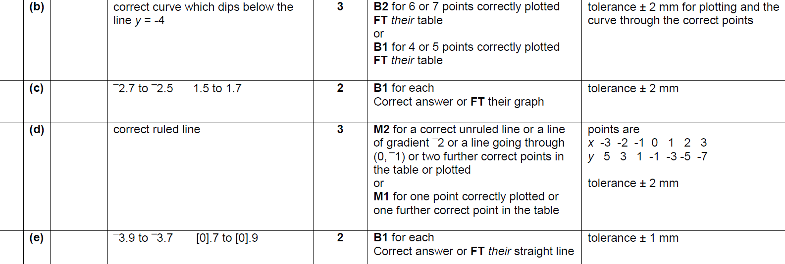
Drawing and Using Graphs
Nov 2017 1H Q5
A
B
C
D
E

Slide 16
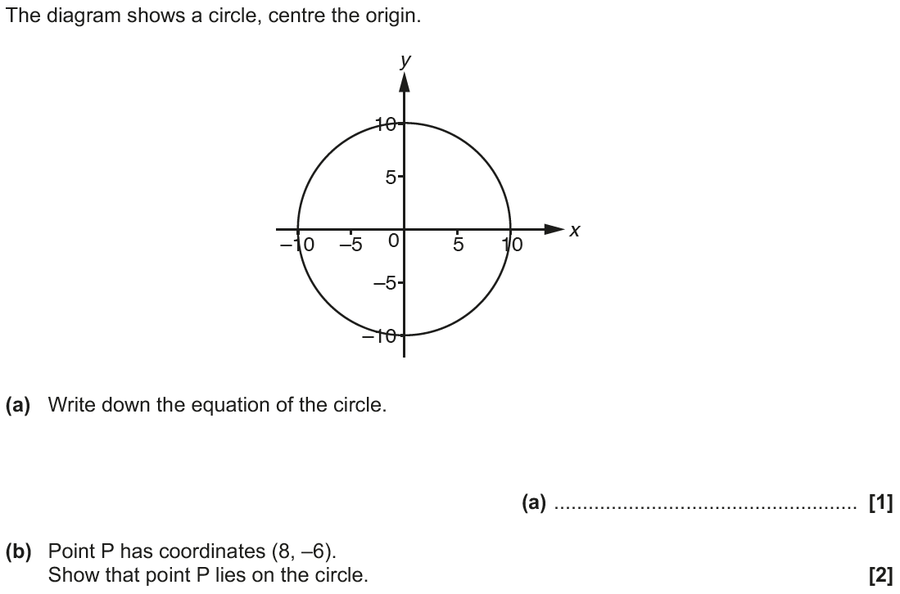
Drawing and Using Graphs
Nov 2017 3H Q17

Slide 17
Drawing and Using Graphs
Nov 2017 3H Q17
A
B
C

Slide 18
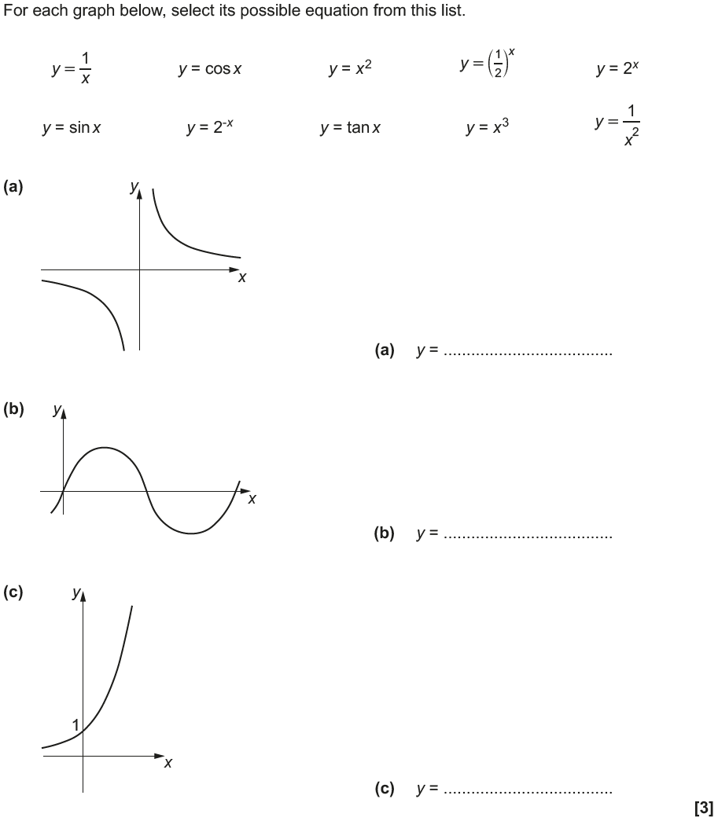
Drawing and Using Graphs
May 2018 1H Q17

Slide 19
Drawing and Using Graphs
May 2018 1H Q17
A
B
C

Slide 20
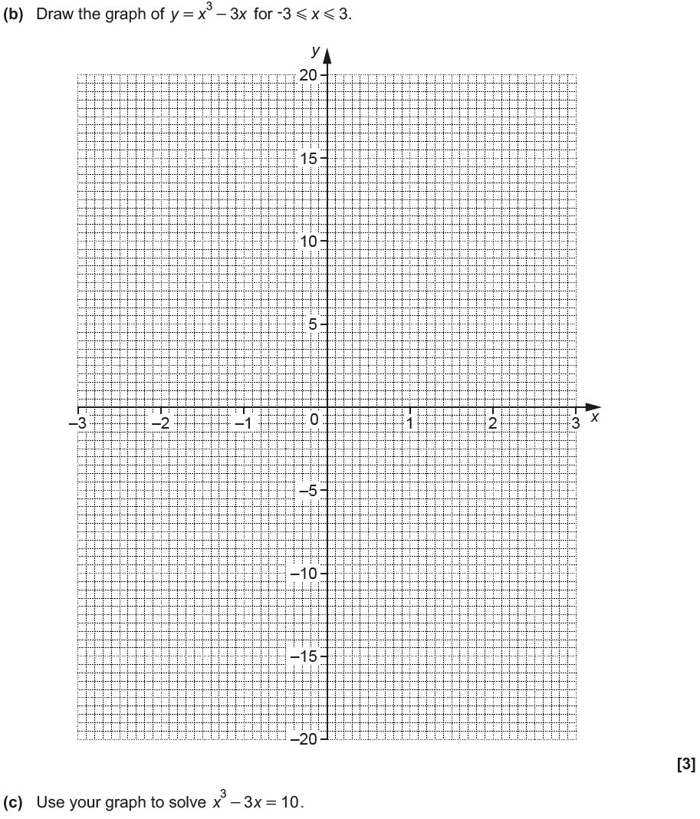
Drawing and Using Graphs
June 2018 2H Q9
Reveal graph

Slide 21
Drawing and Using Graphs
June 2018 2H Q9
A
B
C

Slide 22
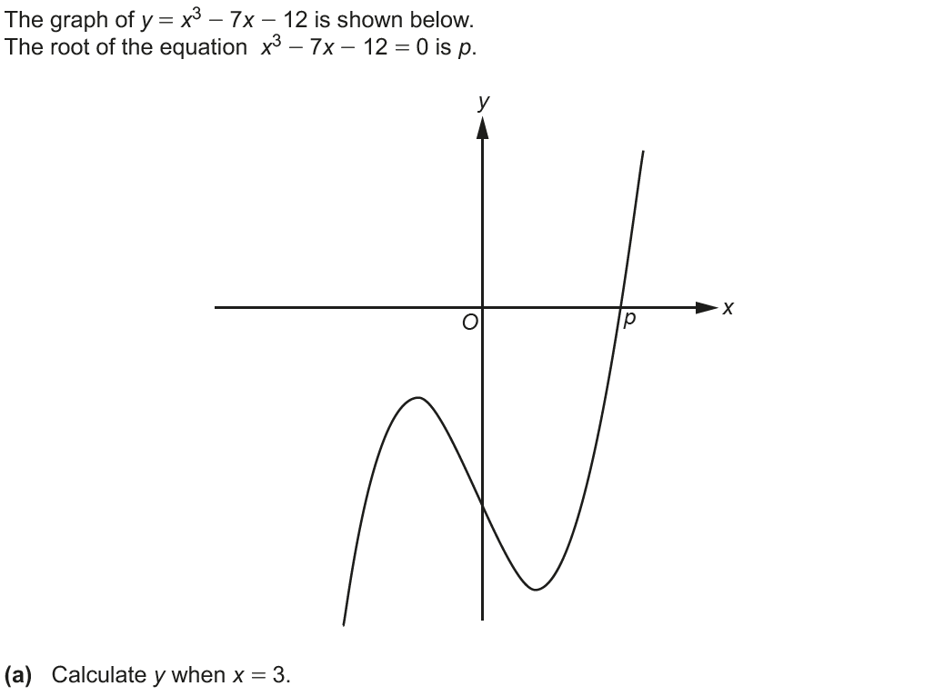
Drawing and Using Graphs
June 2018 3H Q9

Slide 23
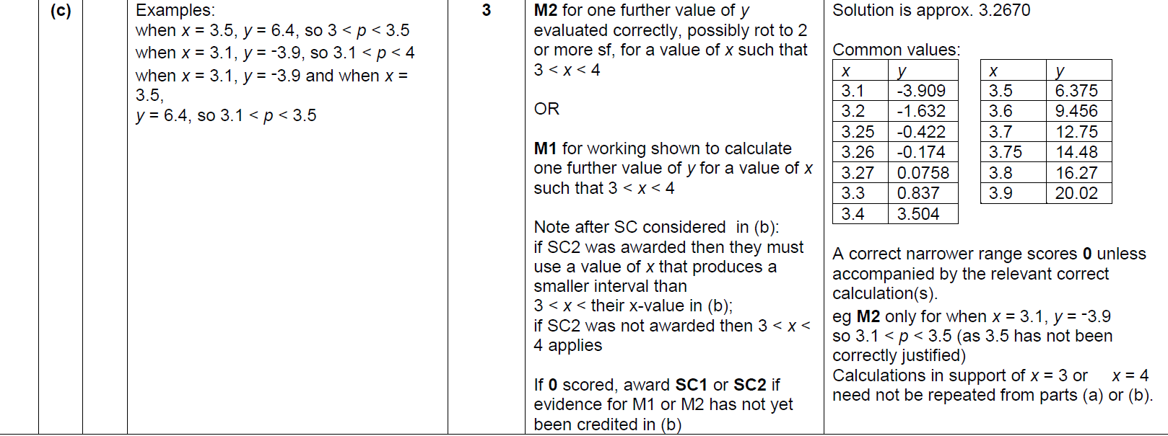
Drawing and Using Graphs
June 2018 3H Q9
A
B
C

Slide 24
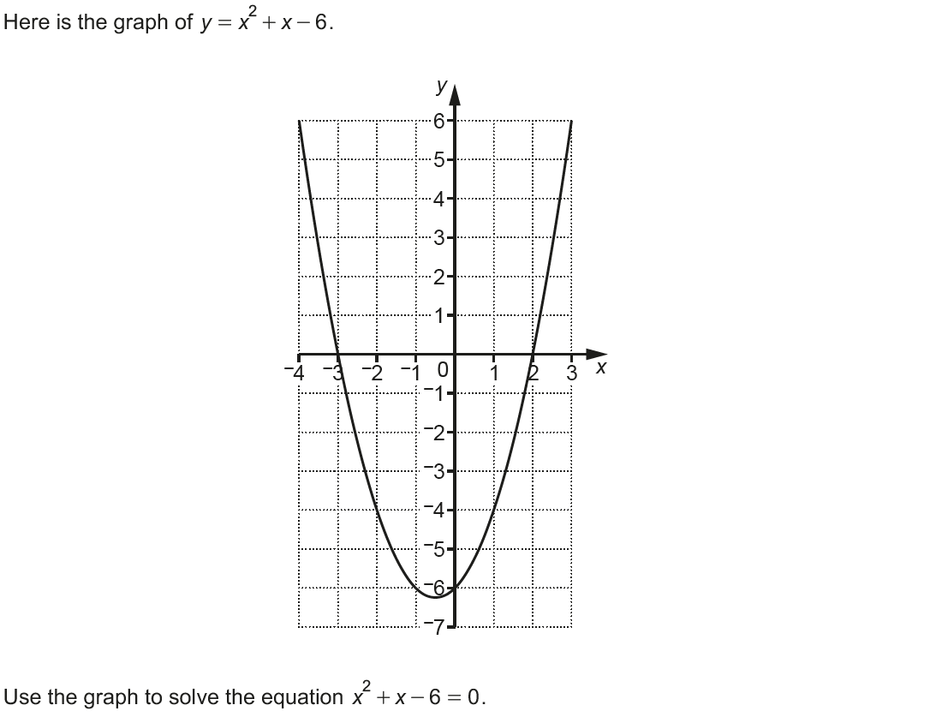
Drawing and Using Graphs
Nov 2018 1H Q10

Slide 25
Drawing and Using Graphs
Nov 2018 1H Q10
A

Slide 26
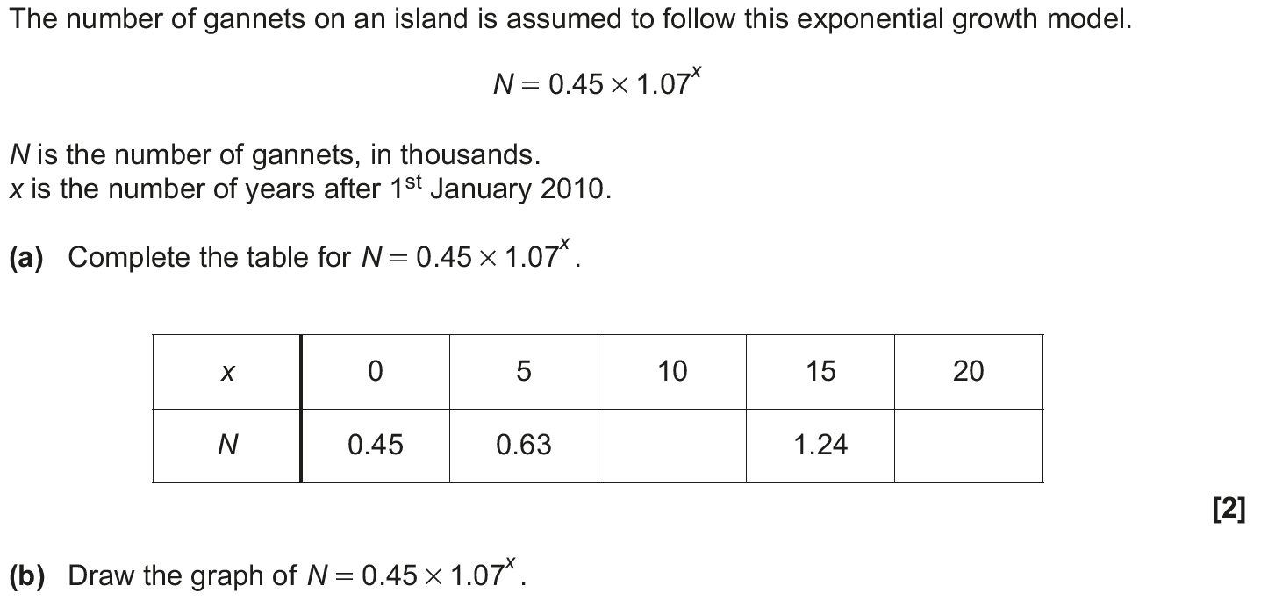
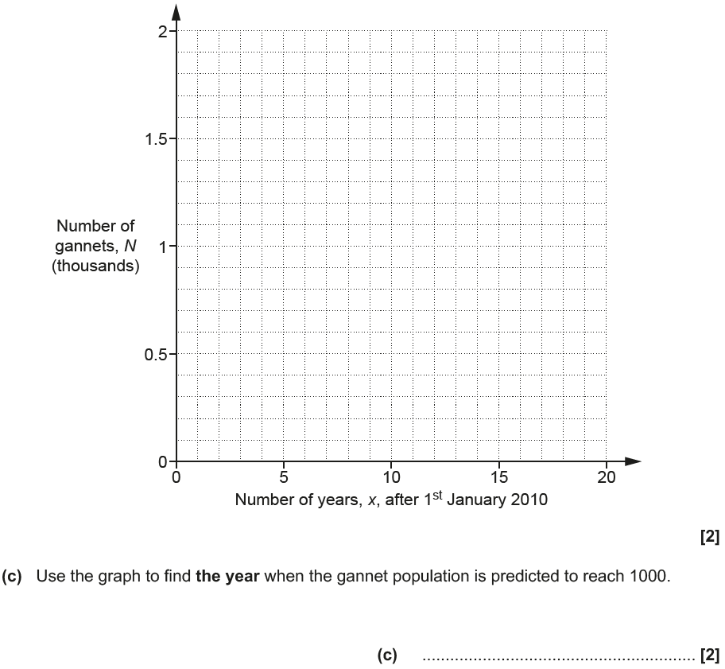
Drawing and Using Graphs
Nov 2018 1H Q21
Reveal graph

Slide 27
Drawing and Using Graphs
Nov 2018 1H Q21
A
B
C

Slide 28
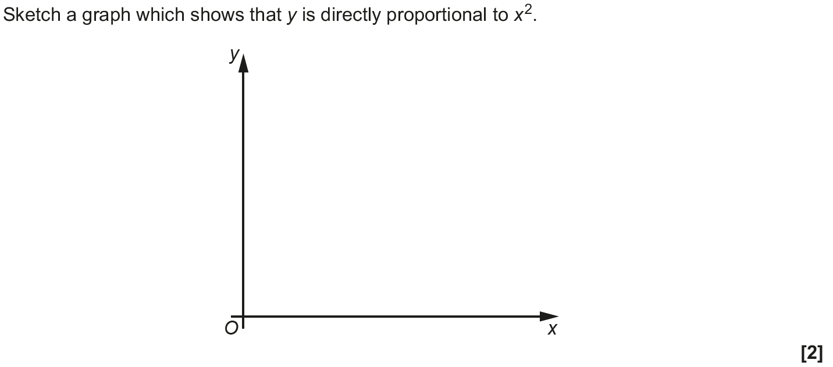
Drawing and Using Graphs
Nov 2018 3H Q10

Slide 29
Drawing and Using Graphs
Nov 2018 3H Q10
A

