Slide 1
Drawing and Using Graphs
Drawing and Using Graphs
June 2017 2H Q14
Nov 2018 1H Q17
June 2017 2H Q20
Nov 2018 2H Q14
June 2017 3H Q20
SAM
3H Q17
Nov 2018 2H Q15
Nov 2017 1H Q7
Spec 1
1H Q16
Nov 2018 3H Q3
June 2018 2H Q5
June 2019 3H Q17
June 2018 2H Q12
June 2019 3H Q21
June 2018 2H Q16
Intercepts and roots
Circles
Recognising shapes of graphs

Slide 2
Drawing and Using Graphs
SAM 3H Q17

Slide 3
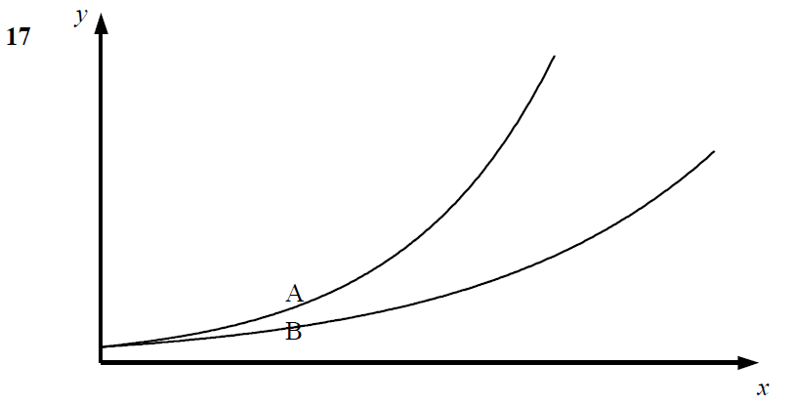
Drawing and Using Graphs
SAM 3H Q17
A
B
C

Slide 4
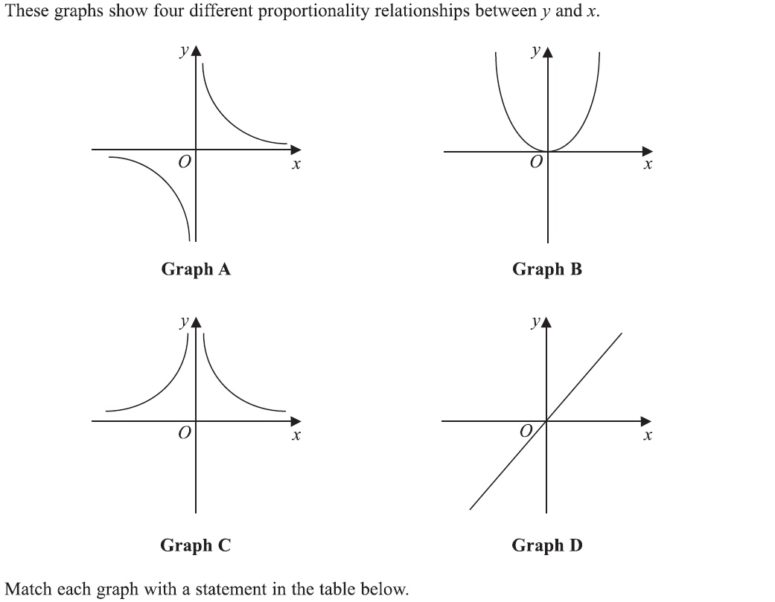
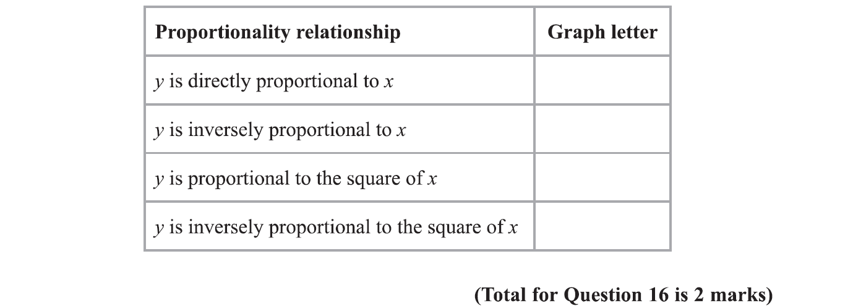
Drawing and Using Graphs
Specimen Set 1 1H Q16

Slide 5
Drawing and Using Graphs
Specimen Set 1 1H Q16
A

Slide 6
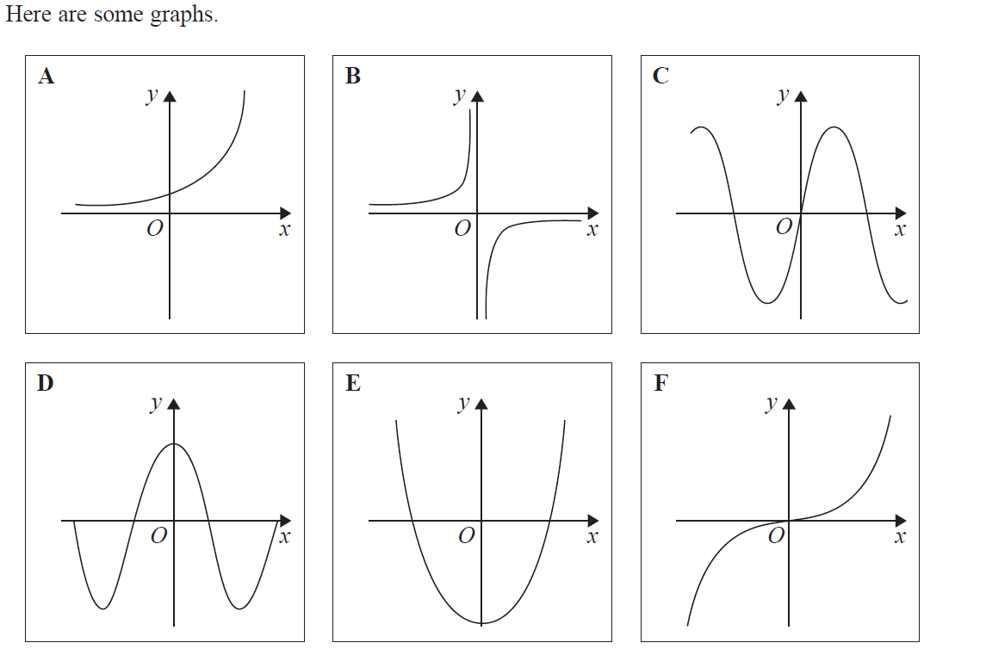
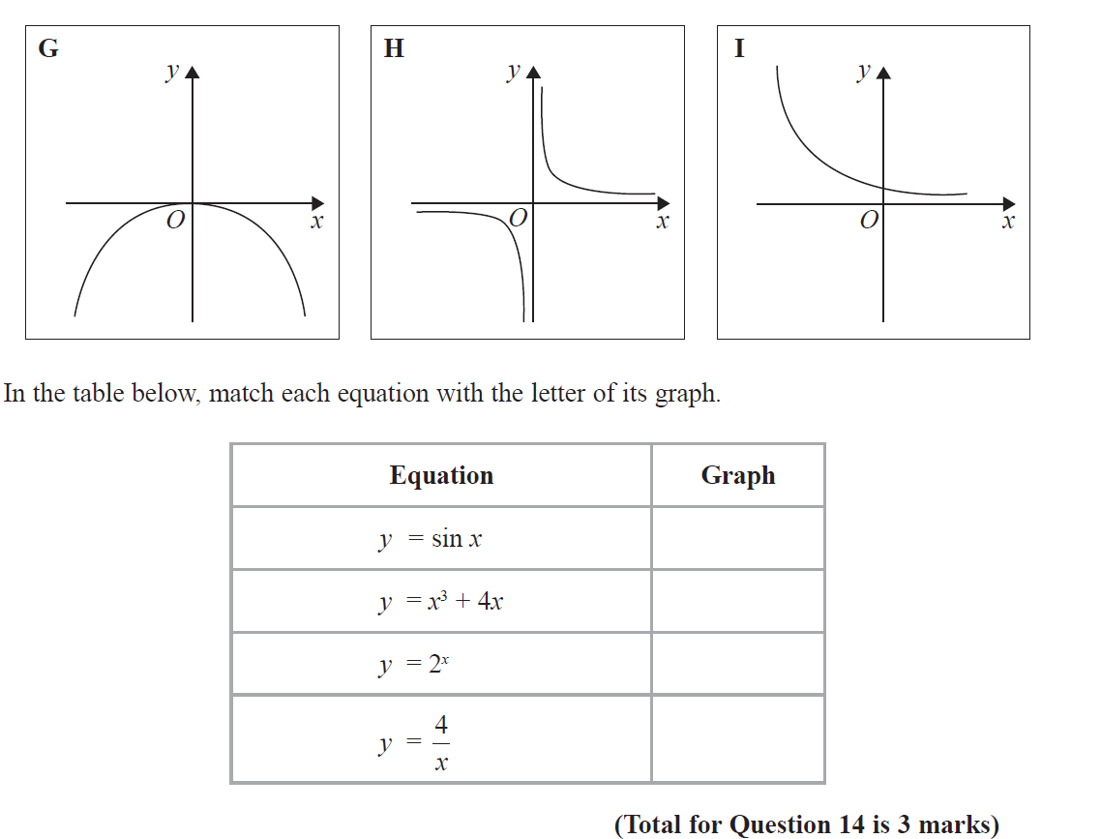
Drawing and Using Graphs
June 2017 2H Q14

Slide 7
Drawing and Using Graphs
June 2017 2H Q14
A

Slide 8
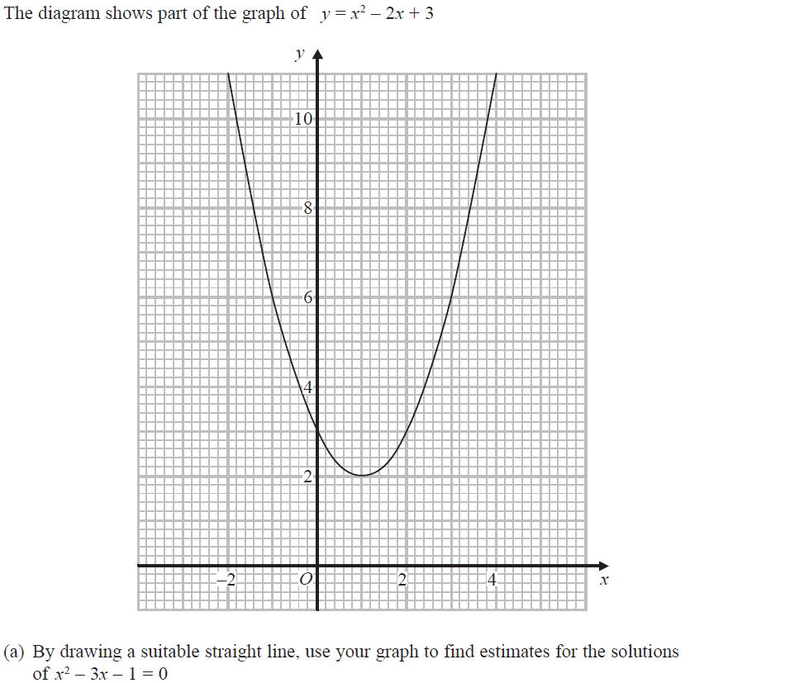
Drawing and Using Graphs
June 2017 2H Q20
Reveal Line for (a)

Slide 9
Drawing and Using Graphs
June 2017 2H Q20
A
B

Slide 10
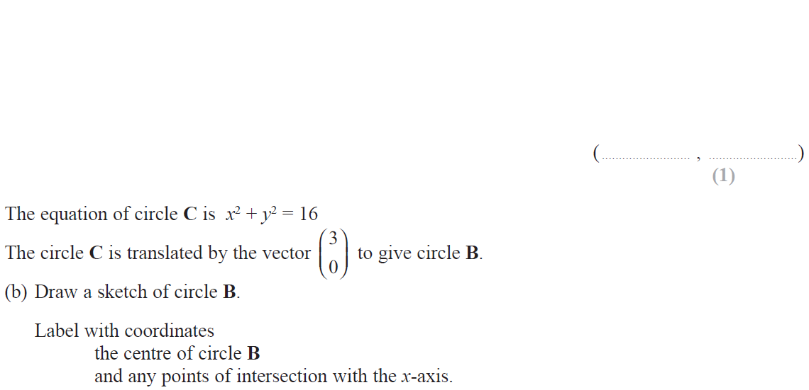
Drawing and Using Graphs
June 2017 3H Q20

Slide 11
Drawing and Using Graphs
June 2017 3H Q20
A
B

Slide 12
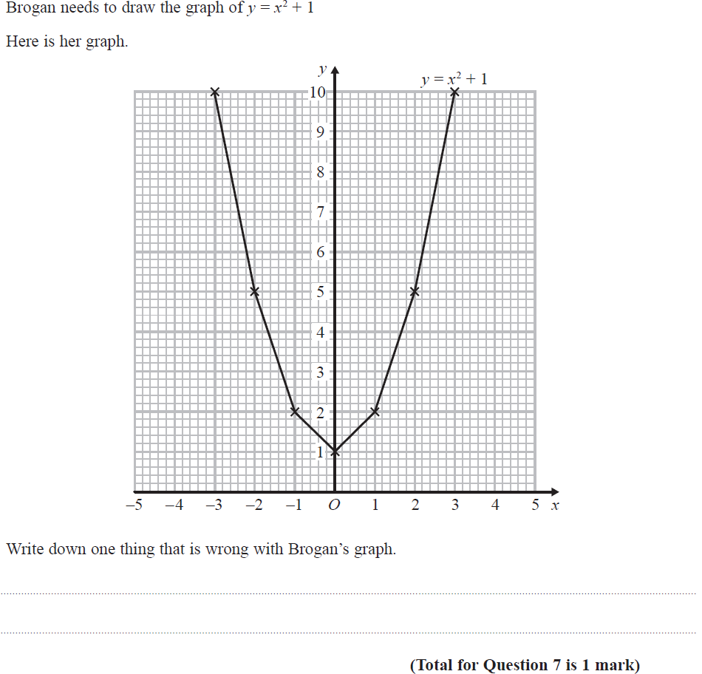
Drawing and Using Graphs
Nov 2017 1H Q7

Slide 13
Drawing and Using Graphs
Nov 2017 1H Q7
A

Slide 14
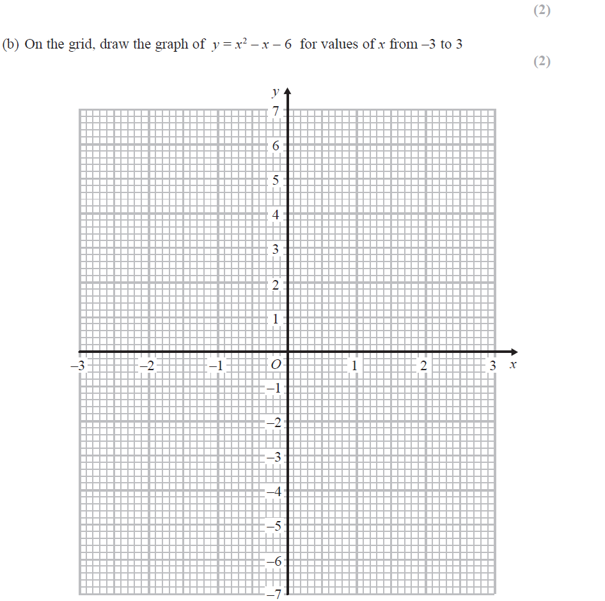
Drawing and Using Graphs
June 2018 2H Q5
Reveal Line for (b)

Slide 15
Drawing and Using Graphs
June 2018 2H Q5
A
B
C

Slide 16
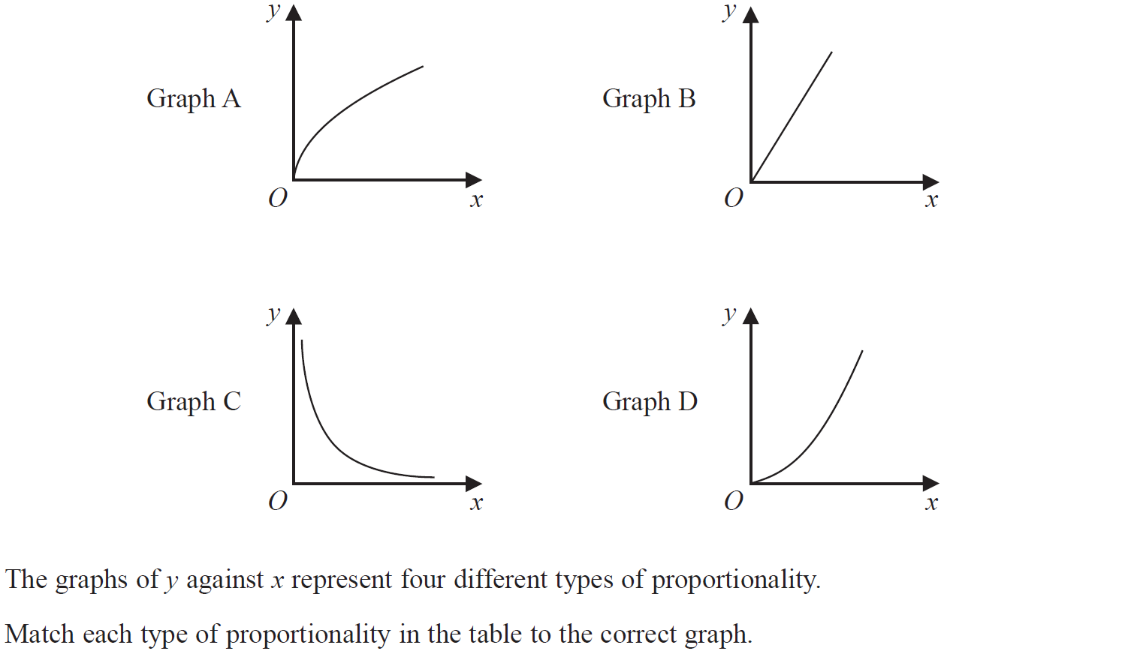
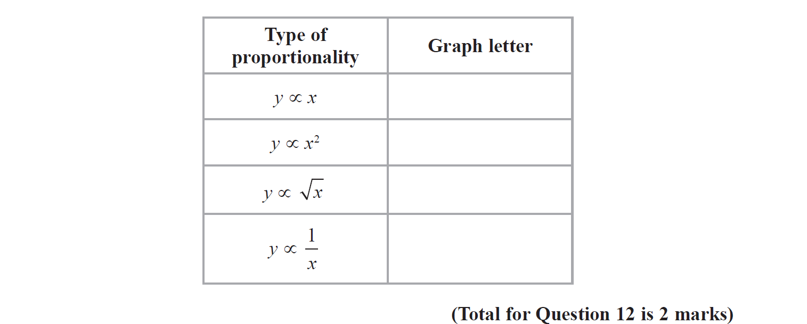
Drawing and Using Graphs
June 2018 2H Q12

Slide 17
Drawing and Using Graphs
June 2018 2H Q12
A

Slide 18
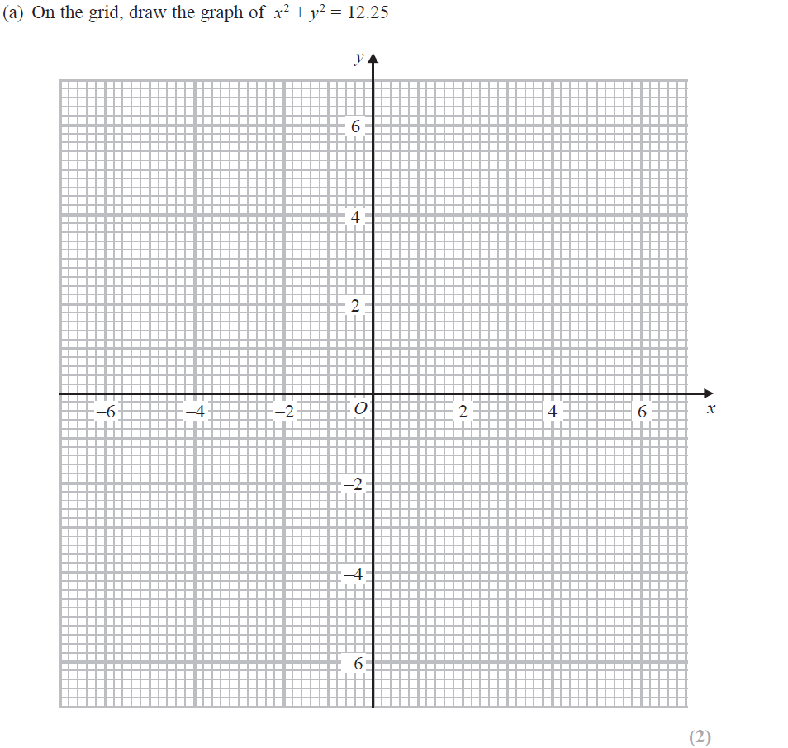
Drawing and Using Graphs
June 2018 2H Q16
Reveal Line (a)
Reveal Line 2x+y=1

Slide 19
Drawing and Using Graphs
June 2018 2H Q16
A
B

Slide 20
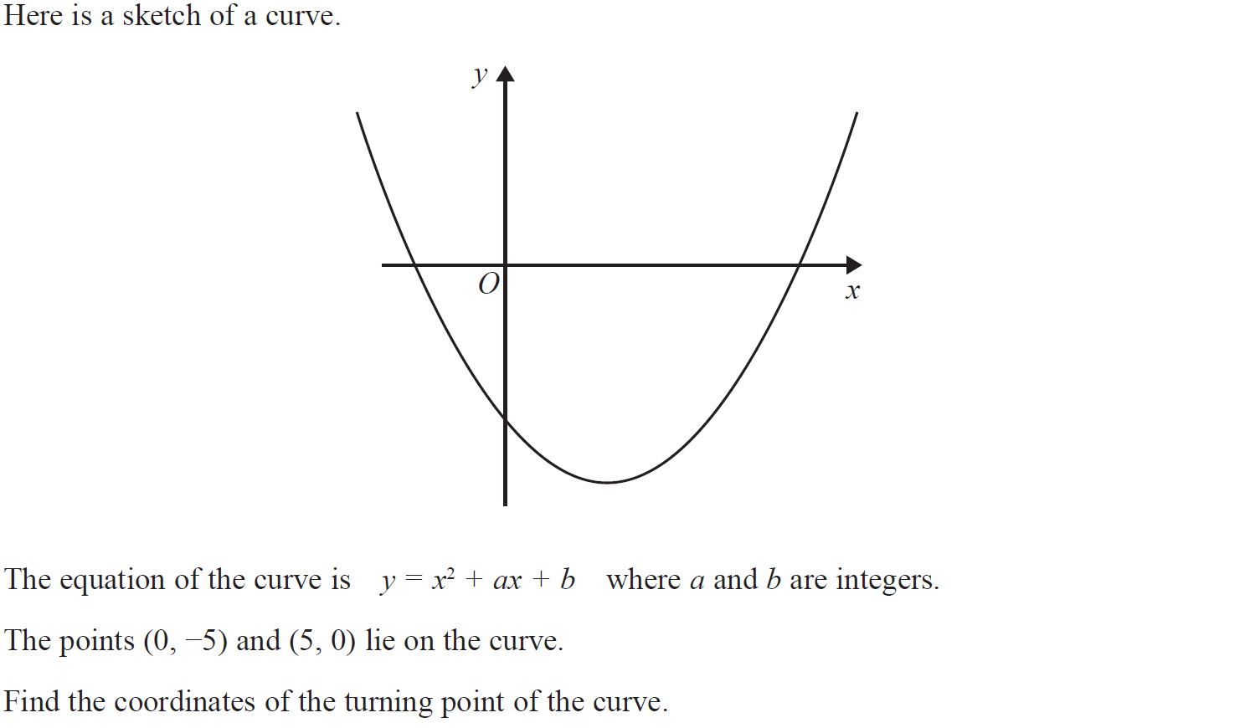
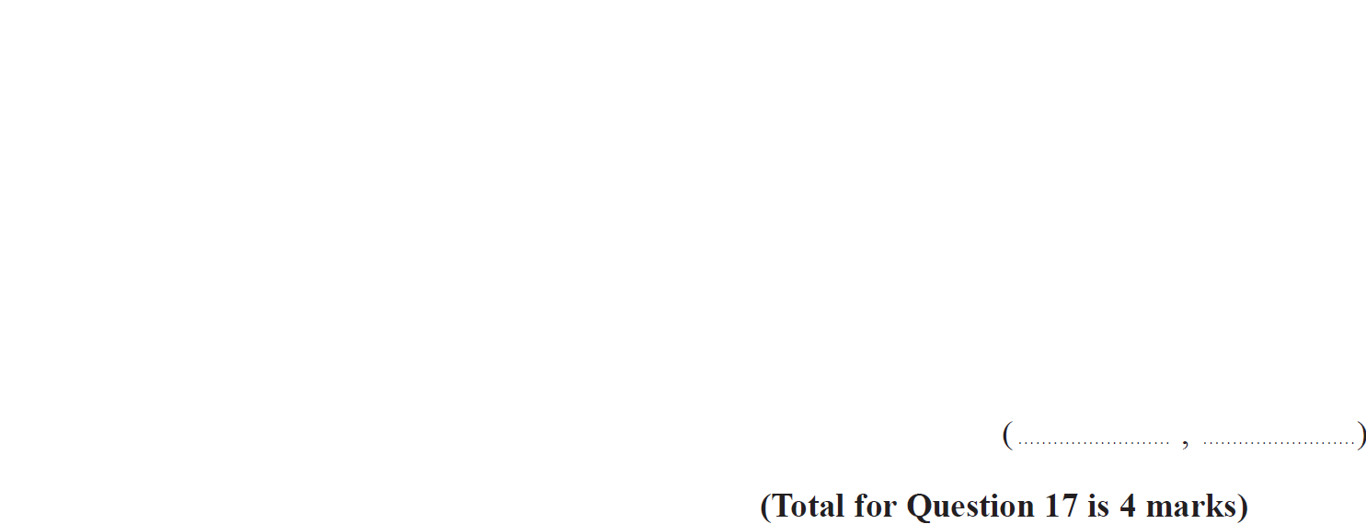
Drawing and Using Graphs
Nov 2018 1H Q17

Slide 21
Drawing and Using Graphs
Nov 2018 1H Q17
A

Slide 22
Drawing and Using Graphs
Nov 2018 2H Q14
Reveal Line

Slide 23
Drawing and Using Graphs
Nov 2018 2H Q14
A

Slide 24
Drawing and Using Graphs
Nov 2018 2H Q15

Slide 25
Drawing and Using Graphs
Nov 2018 2H Q15
A

Slide 26
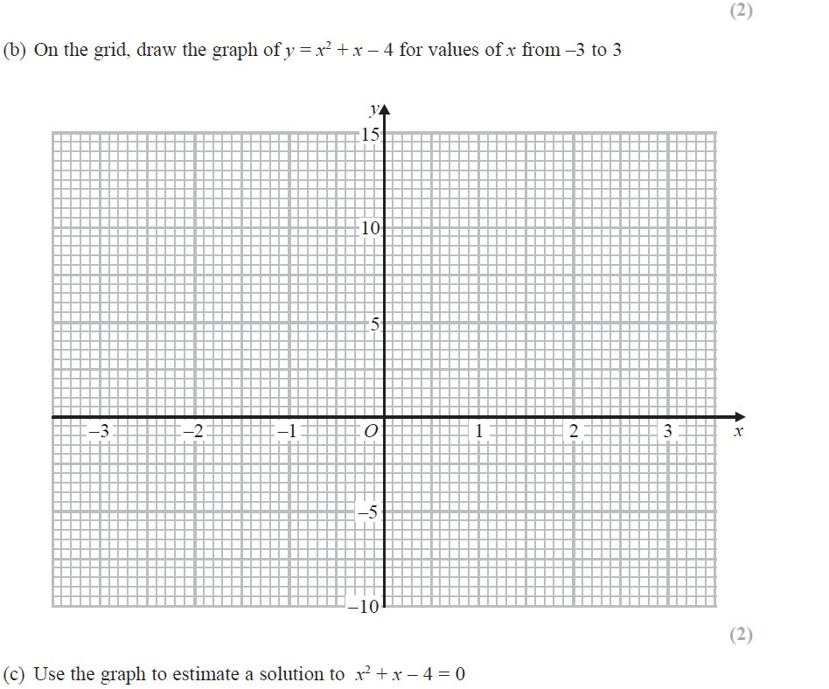
Drawing and Using Graphs
Nov 2018 3H Q3
Reveal Graph (b)

Slide 27
Drawing and Using Graphs
Nov 2018 3H Q3
A
B
C

Slide 28
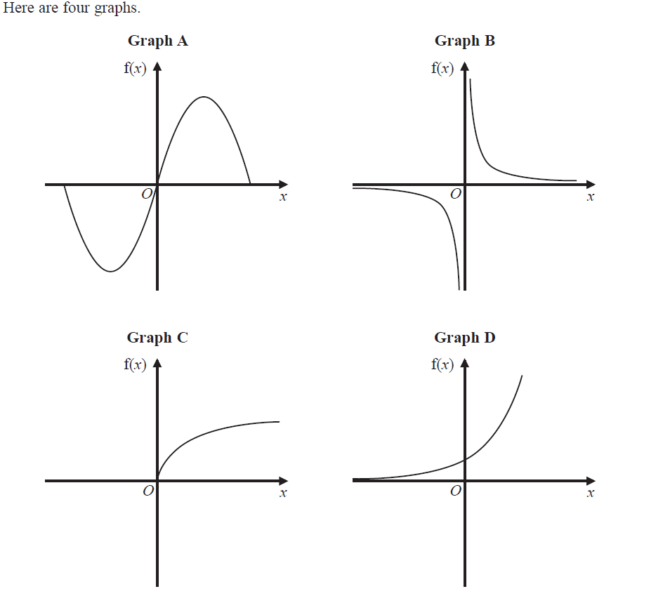
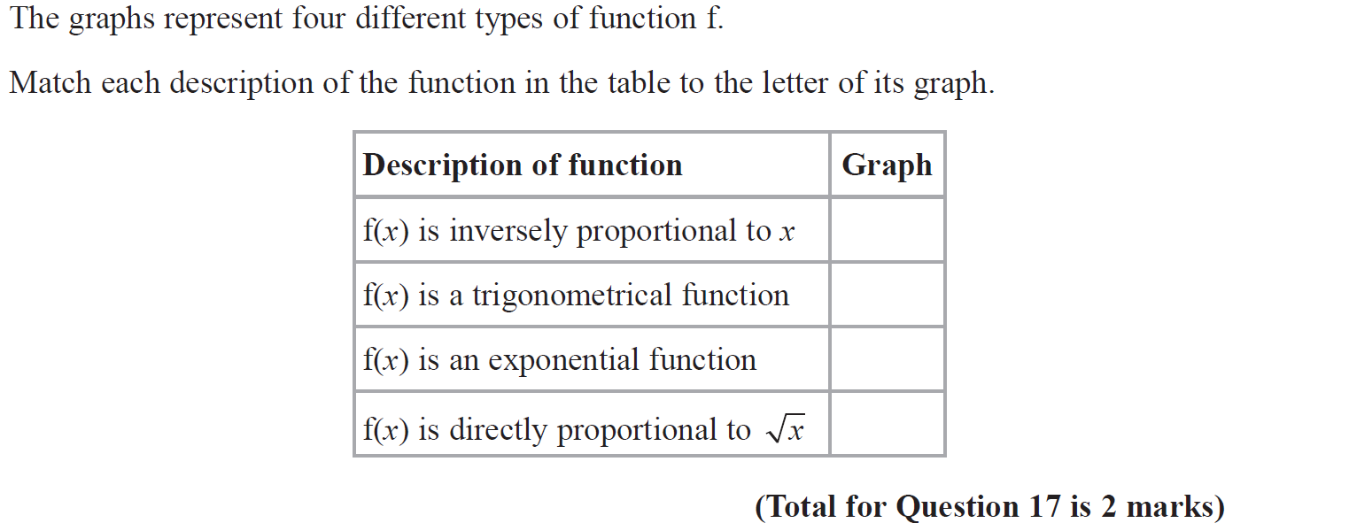
Drawing and Using Graphs
June 2019 3H Q17

Slide 29
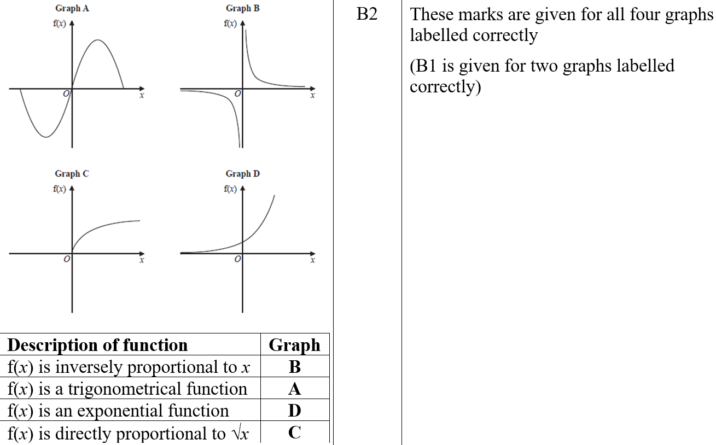
Drawing and Using Graphs
June 2019 3H Q17
A
A SF

Slide 30
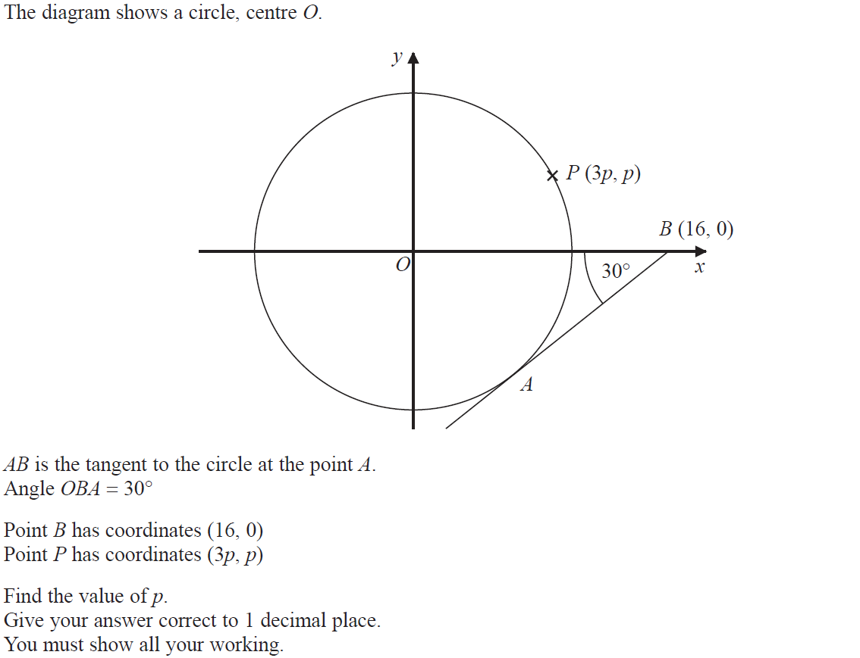
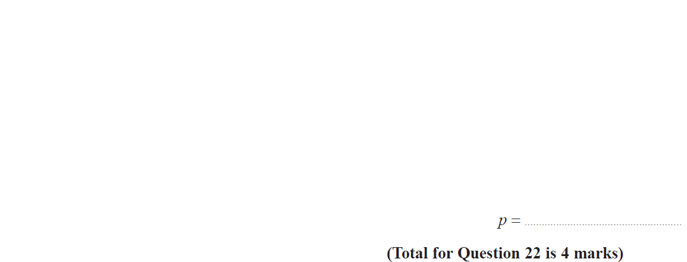
Drawing and Using Graphs
June 2019 3H Q22

Slide 31
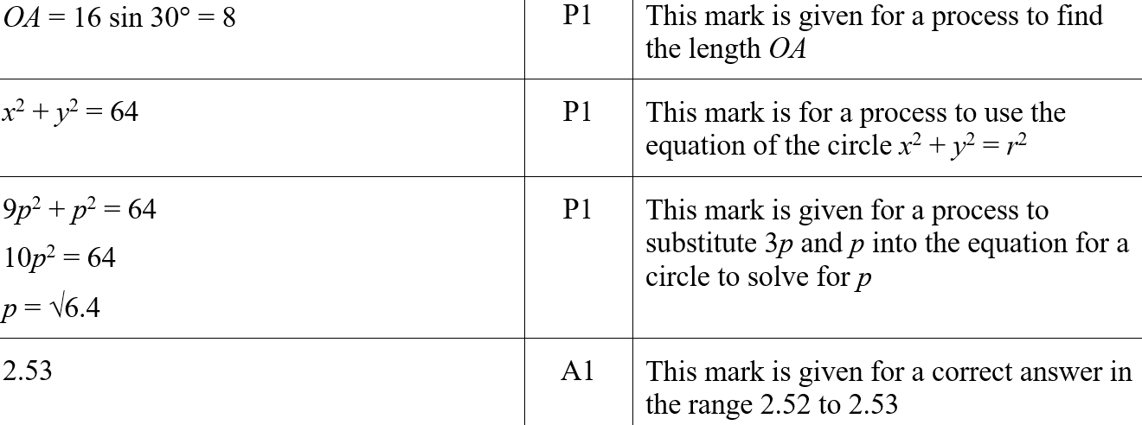
Drawing and Using Graphs
June 2019 3H Q22
A
A SF

