Slide 1
Drawing and Using Graphs
Drawing and Using Graphs
May 2017
1H Q20
Nov 2017
1H Q28
Nov 2018
1H Q25
June 2017
2H Q6
Nov 2017
2H Q3
Nov 2018
2H Q27
June 2017
2H Q27
Nov 2017
2H Q21
1 Marker
Nov 2018
3H Q12
June 2017
3H Q18
June 2018
2H Q22
Nov 2018
3H Q28
June 2017
3H Q23
June 2018
3H Q14
Intercepts and roots
Circles
Recognising shapes of graphs

Slide 2
Drawing and Using Graphs
May 2017 1H Q20

Slide 3
Drawing and Using Graphs
May 2017 1H Q20
A

Slide 4
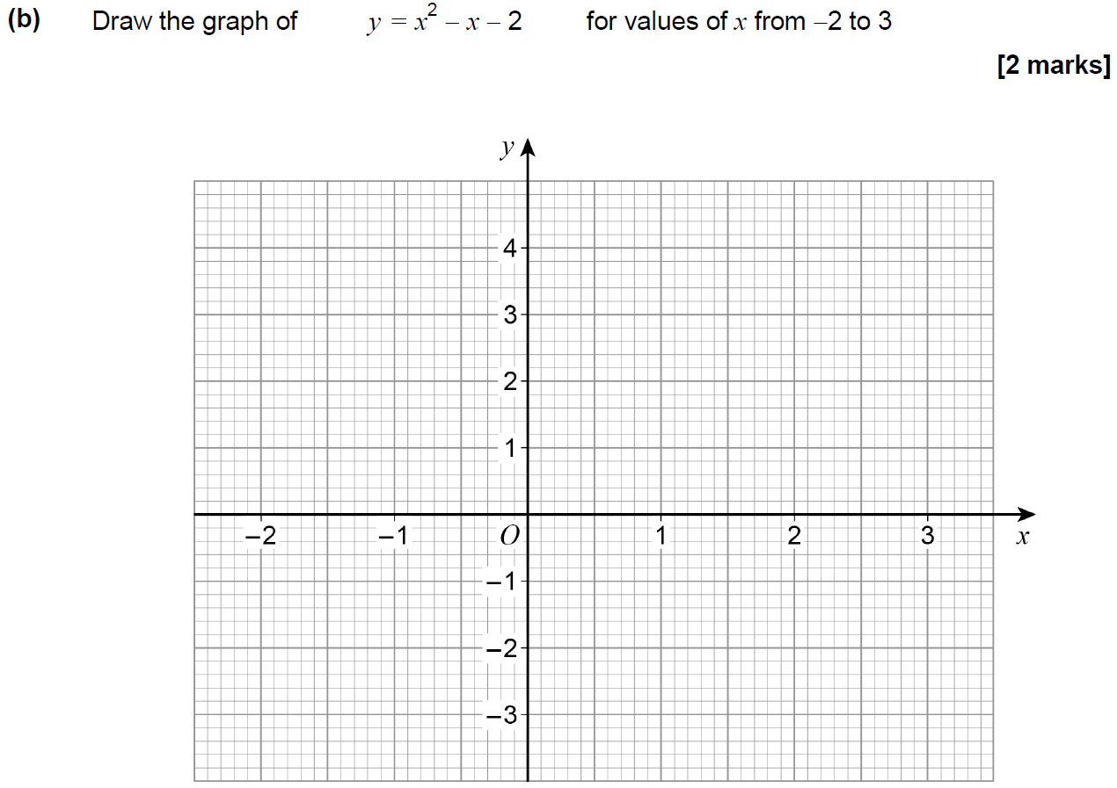
Drawing and Using Graphs
June 2017 2H Q6
Reveal Graph (b)

Slide 5
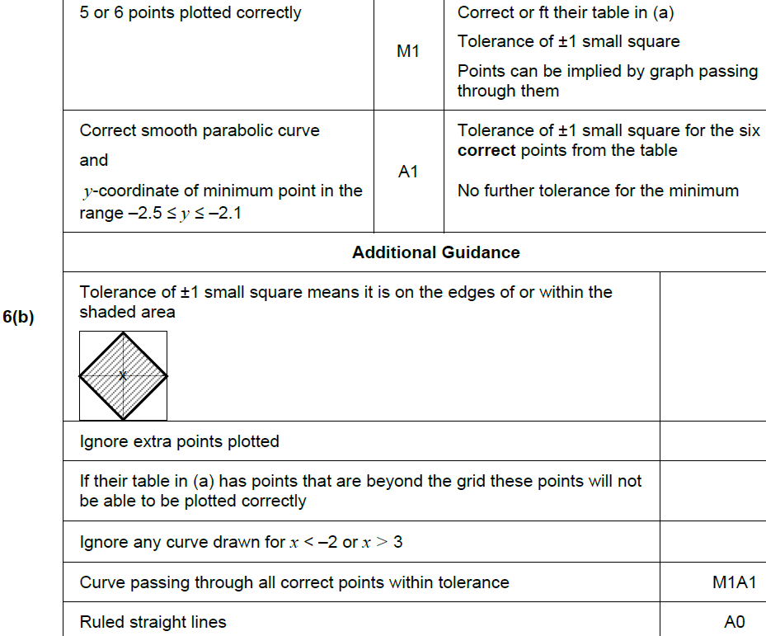
Drawing and Using Graphs
June 2017 2H Q6
A
B
C

Slide 6
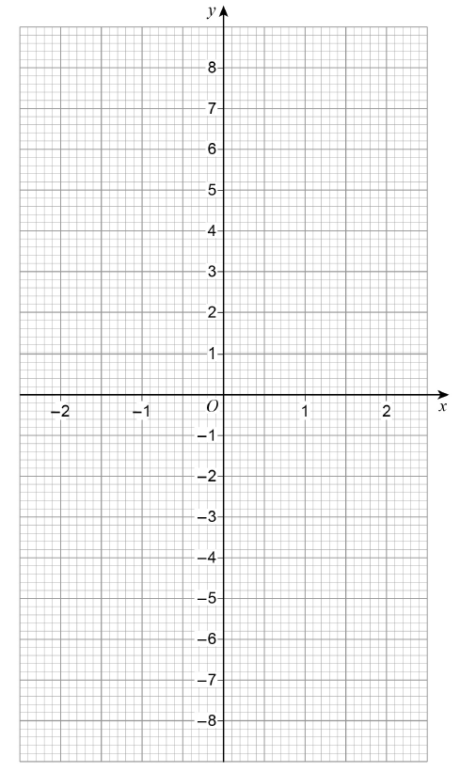
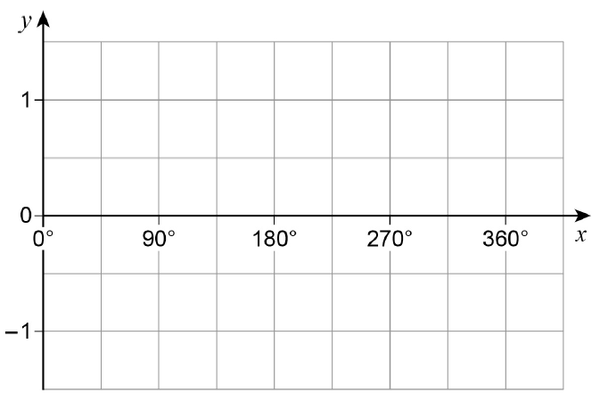
Drawing and Using Graphs
June 2017 2H Q27

Slide 7
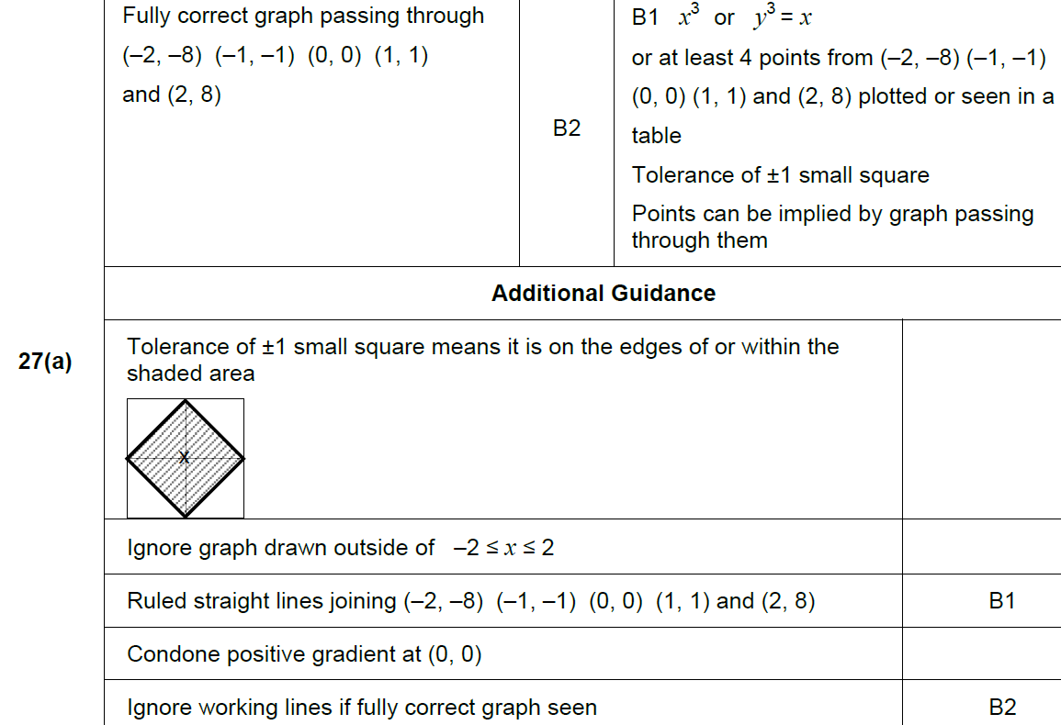
Drawing and Using Graphs
June 2017 2H Q27
A

Slide 8
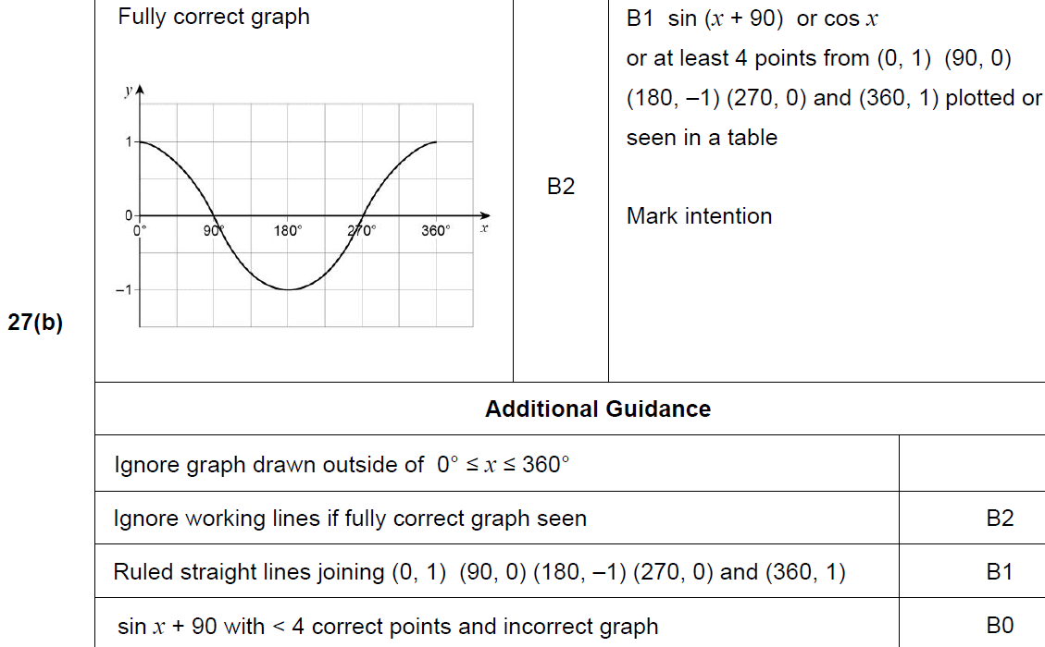
Drawing and Using Graphs
June 2017 2H Q27
B

Slide 9
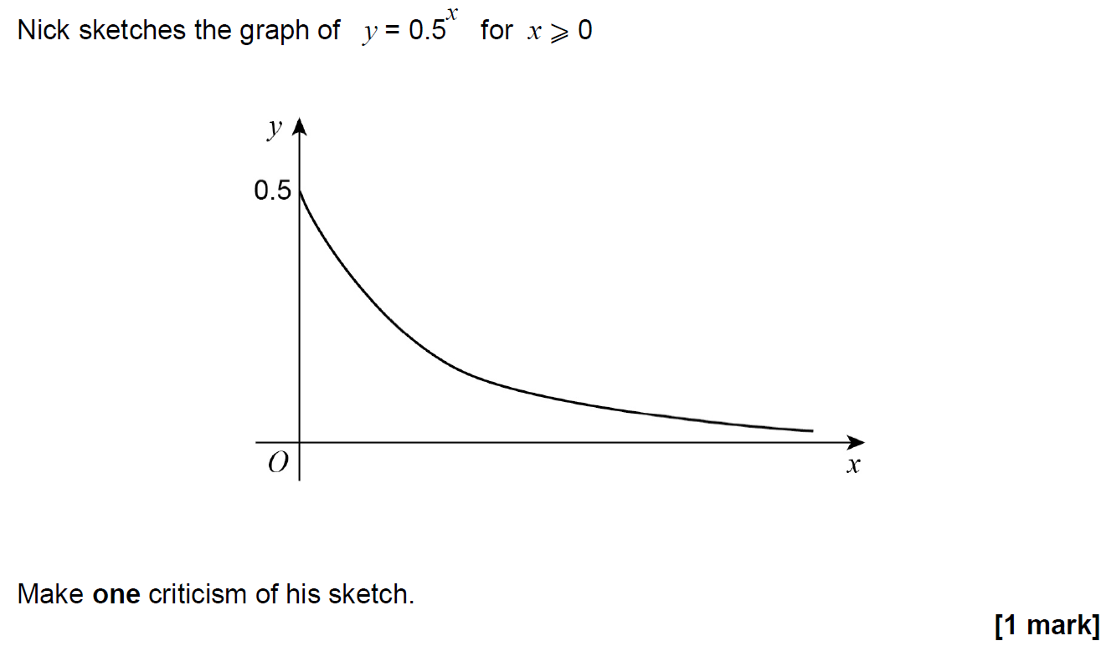
Drawing and Using Graphs
June 2017 3H Q18

Slide 10
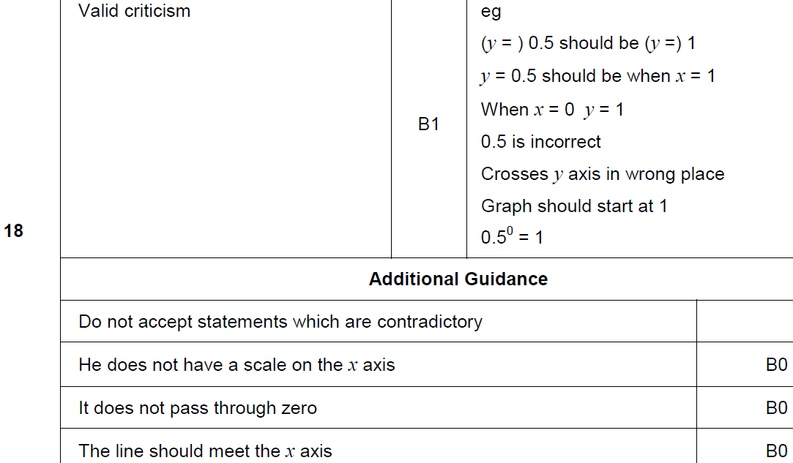
Drawing and Using Graphs
June 2017 2H Q27
A

Slide 11
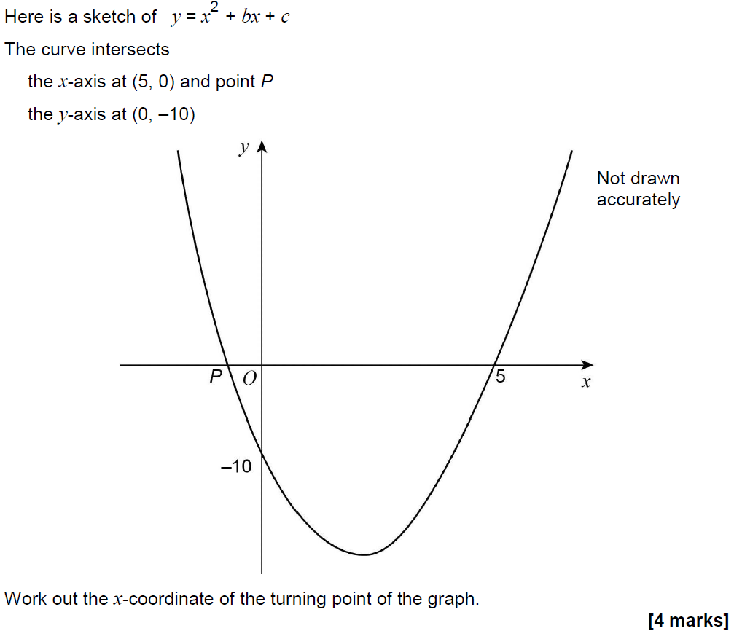
Drawing and Using Graphs
June 2017 3H Q23

Slide 12
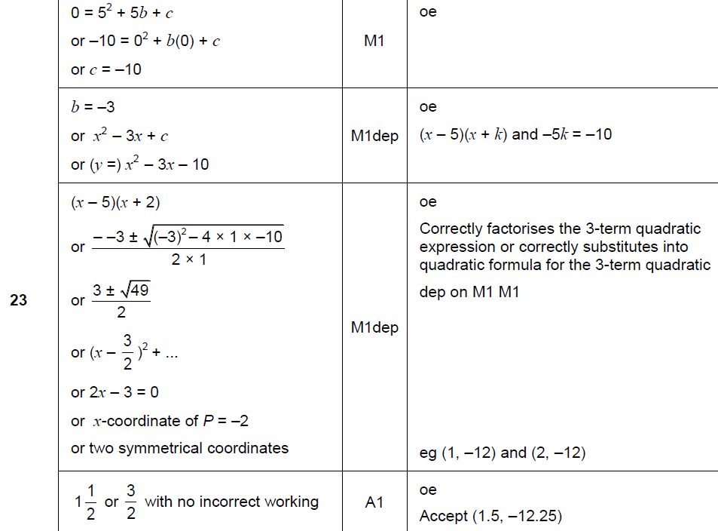
Drawing and Using Graphs
June 2017 3H Q23
A

Slide 13
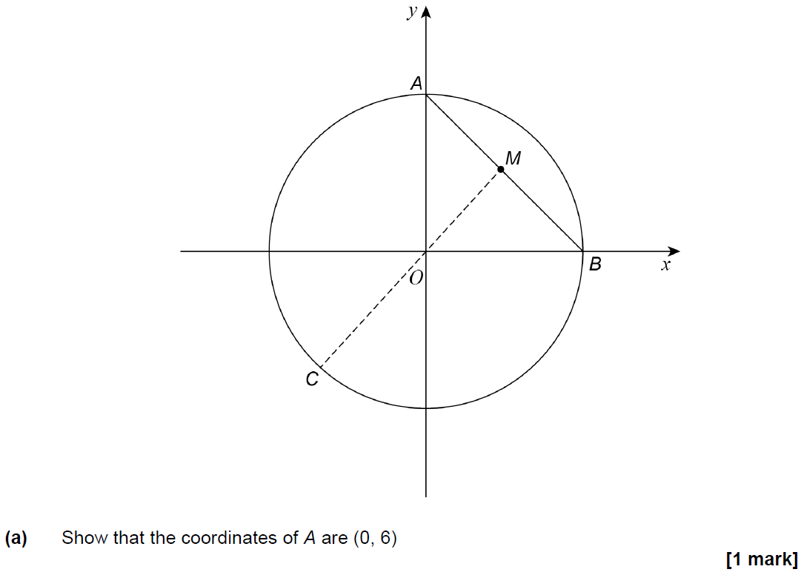
Drawing and Using Graphs
Nov 2017 1H Q28

Slide 14
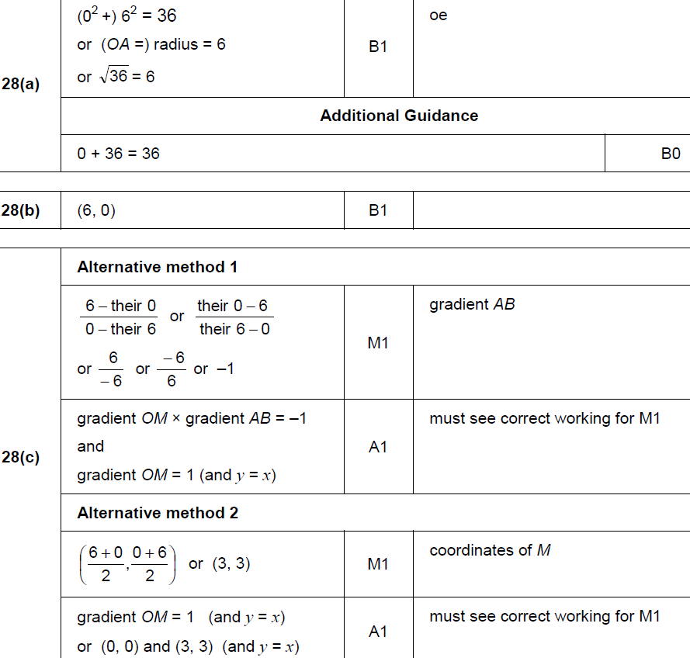
Drawing and Using Graphs
Nov 2017 1H Q28
A
B
C

Slide 15
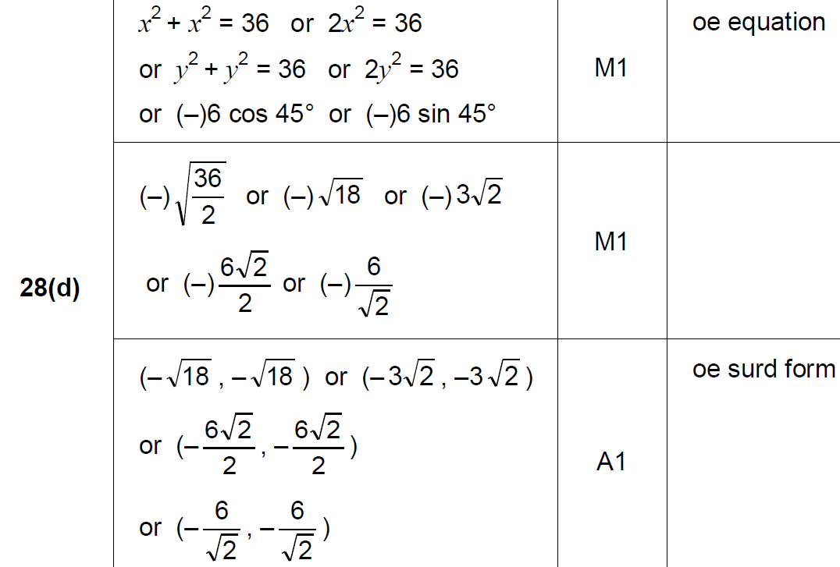
Drawing and Using Graphs
Nov 2017 1H Q28
D

Slide 16
Drawing and Using Graphs
Nov 2017 2H Q3

Slide 17
Drawing and Using Graphs
Nov 2017 2H Q3
A

Slide 18
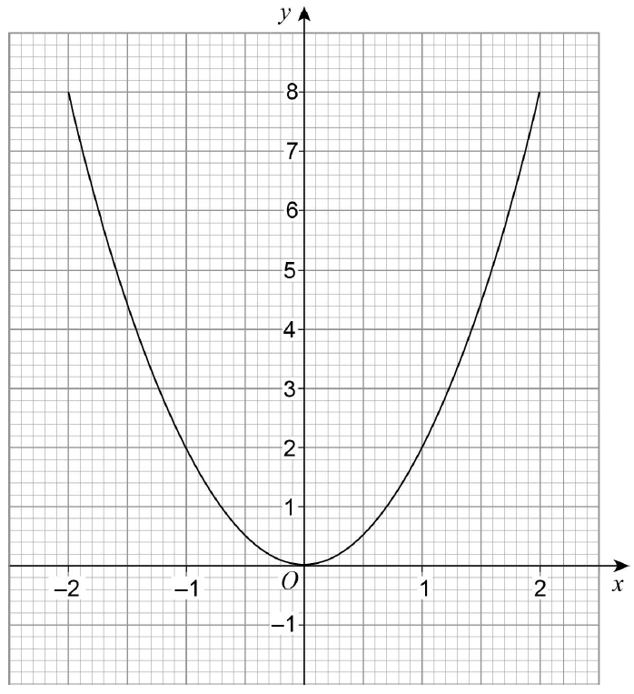
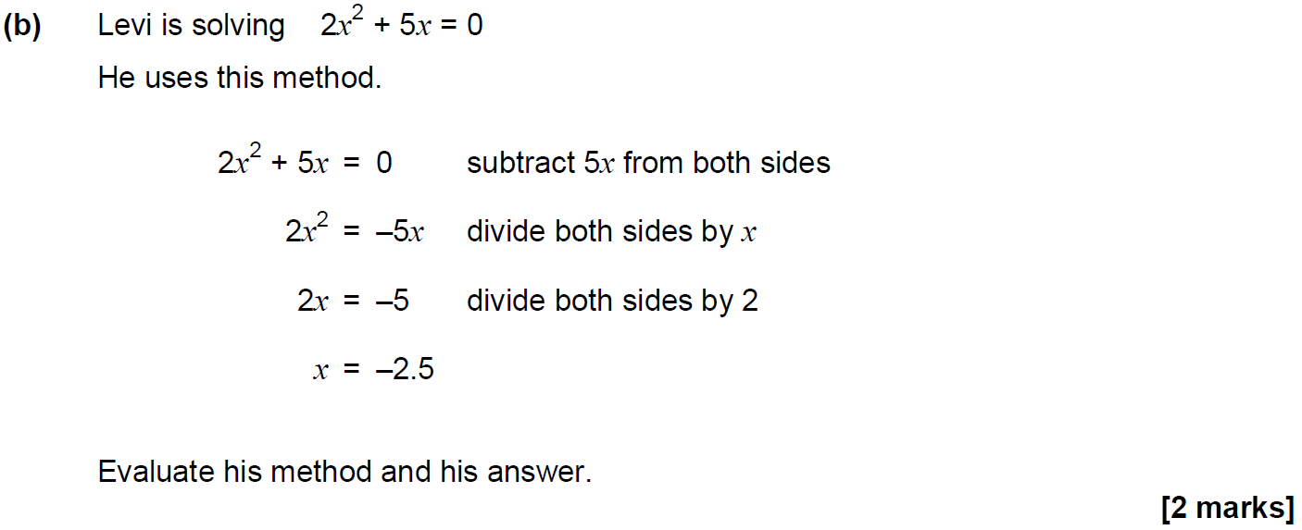
Drawing and Using Graphs
Nov 2017 2H Q21

Slide 19
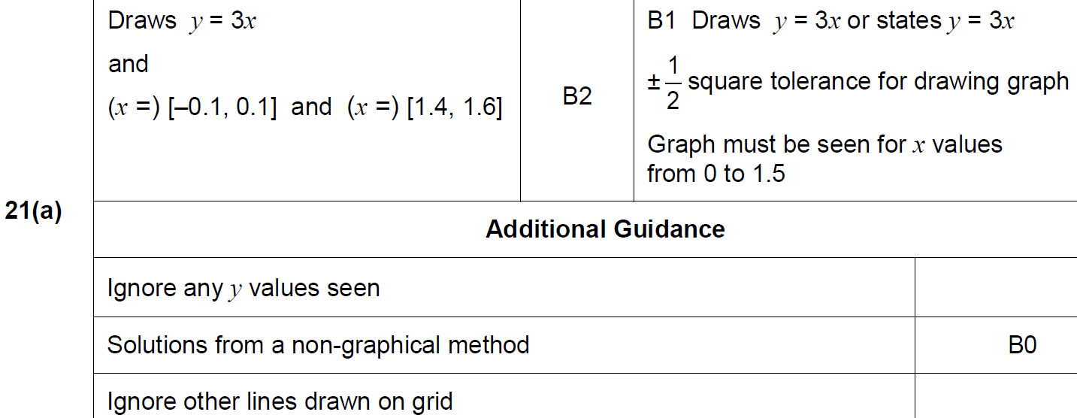
Drawing and Using Graphs
Nov 2017 2H Q21
A

Slide 20
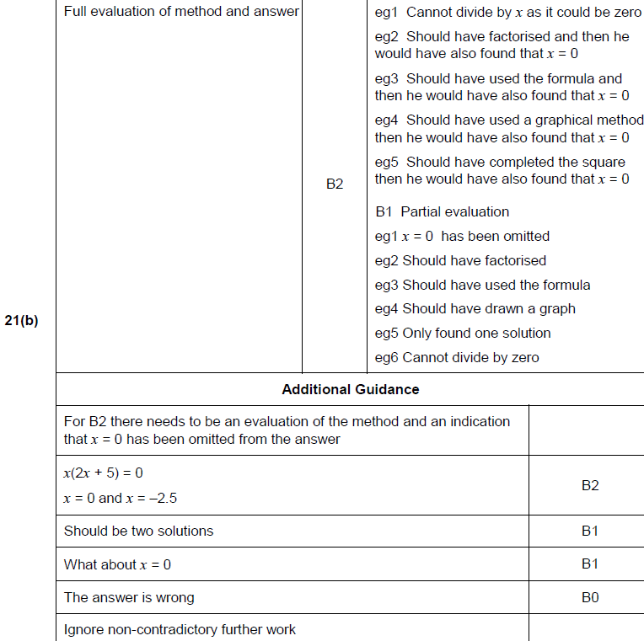
Drawing and Using Graphs
Nov 2017 2H Q21
B

Slide 21
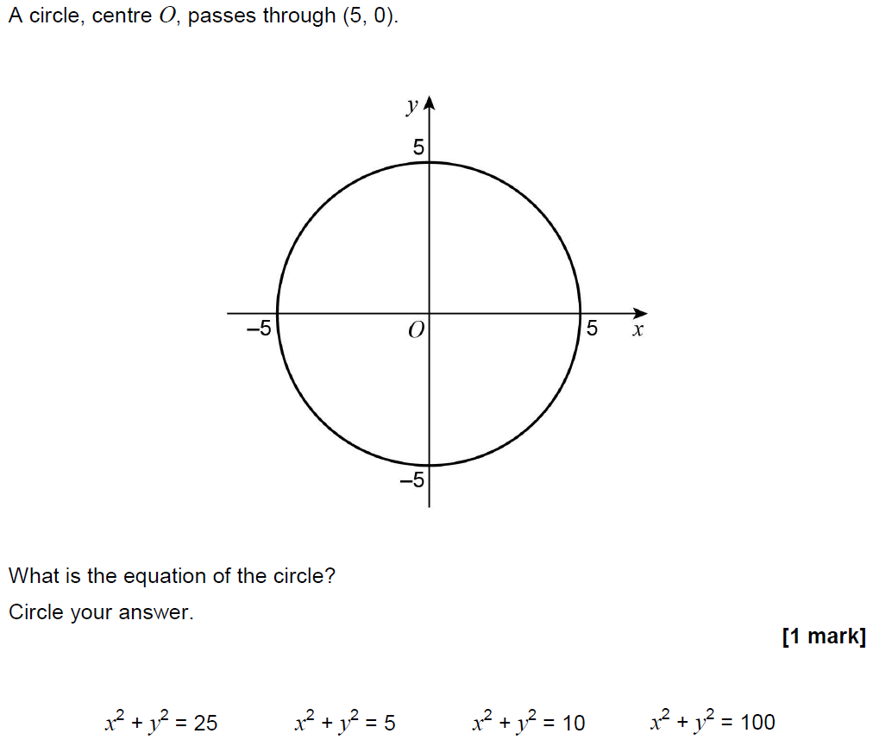
Drawing and Using Graphs
June 2018 2H Q22

Slide 22
Drawing and Using Graphs
June 2018 2H Q22
A

Slide 23
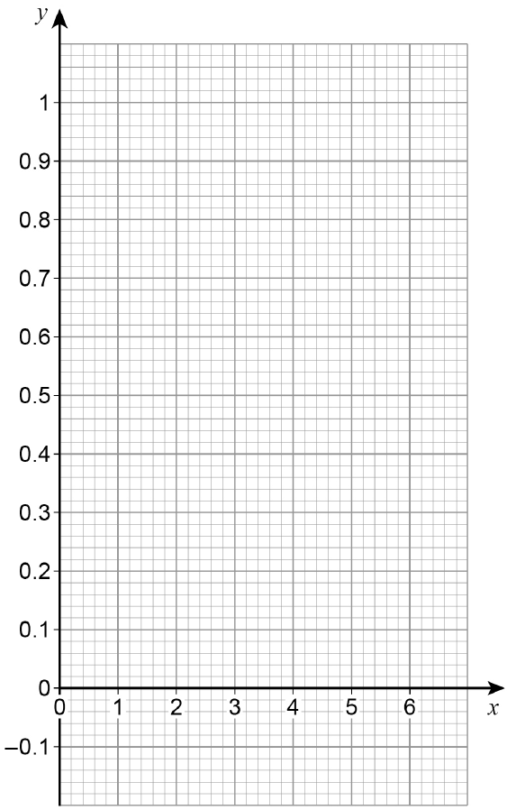
Drawing and Using Graphs
June 2018 3H Q14
Reveal Graph

Slide 24
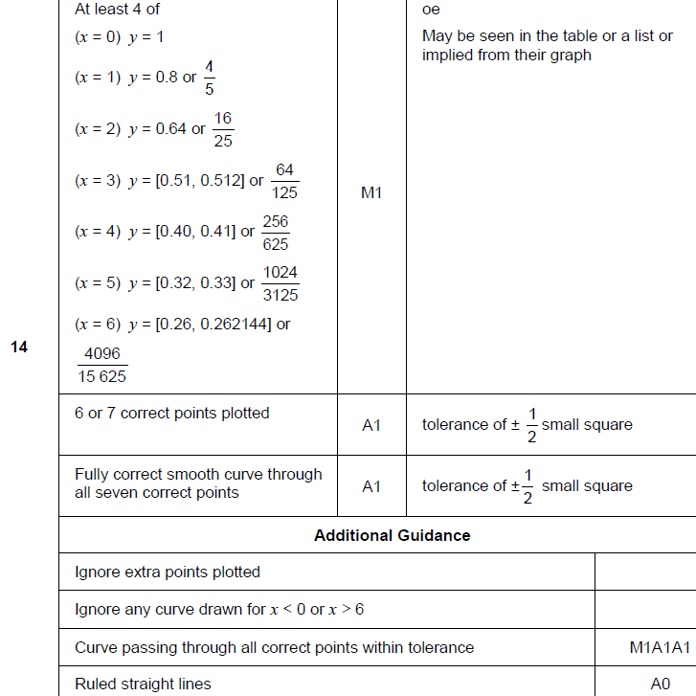
Drawing and Using Graphs
June 2018 3H Q14
A

Slide 25
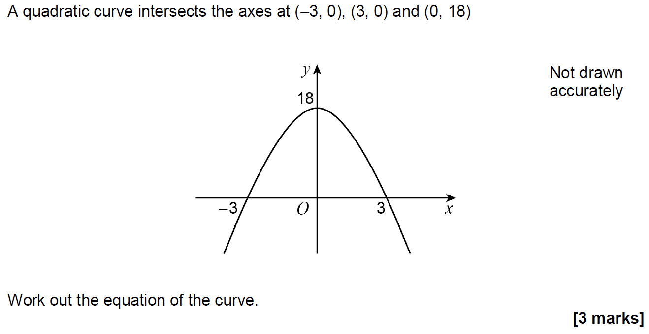
Drawing and Using Graphs
Nov 2018 1H Q25

Slide 26
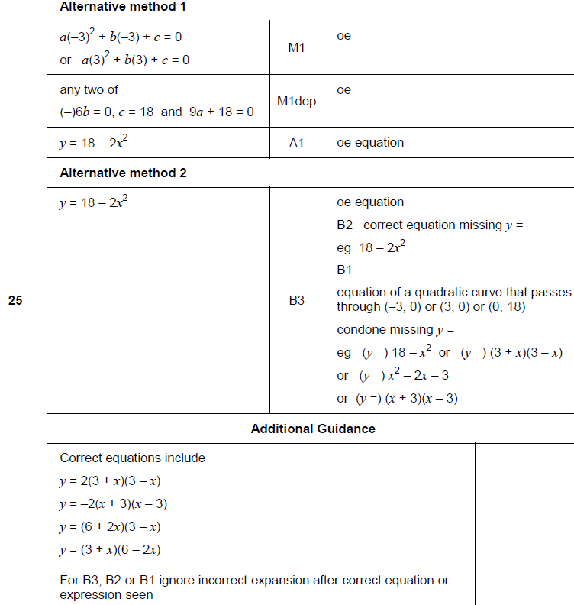
Drawing and Using Graphs
Nov 2018 1H Q25
A

Slide 27
Drawing and Using Graphs
Nov 2018 2H Q27

Slide 28
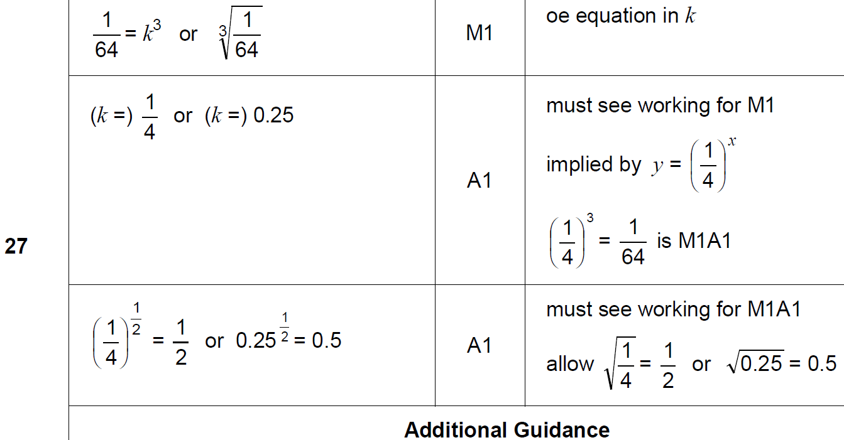
Drawing and Using Graphs
Nov 2018 2H Q27
A

Slide 29
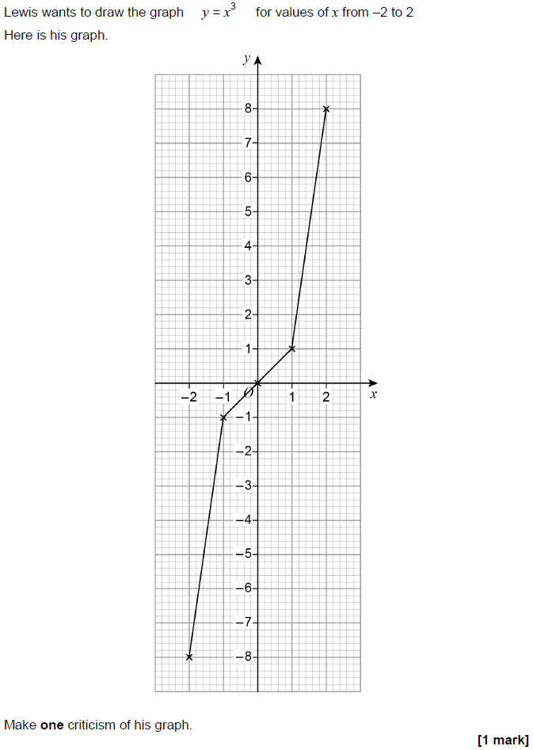
Drawing and Using Graphs
Nov 2018 3H Q12

Slide 30
Drawing and Using Graphs
Nov 2018 3H Q12
A

Slide 31
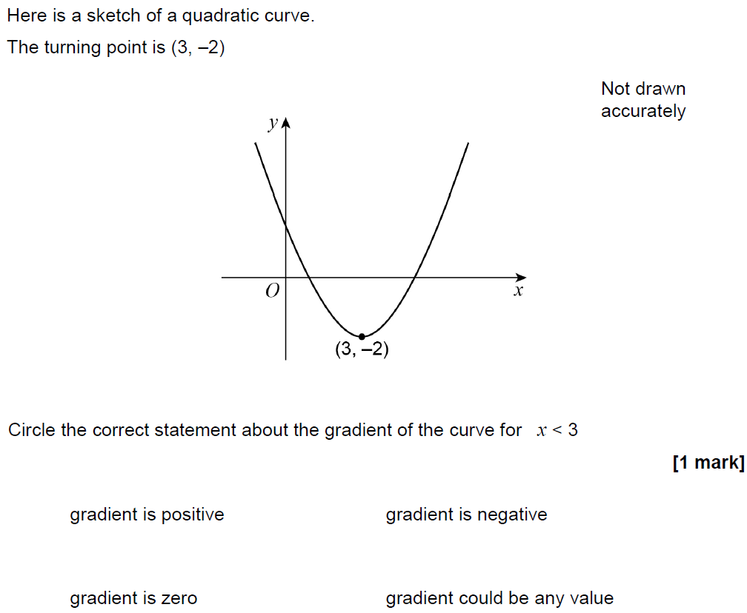
Drawing and Using Graphs
Nov 2018 3H Q28

Slide 32
Drawing and Using Graphs
Nov 2018 3H Q28
A

