Slide 1
Direct & Inverse Proportion
Direct & Inverse Proportion
June 2017
2H Q22
June 2018
3H Q21
June 2017
3H Q14
SAM
2H Q20
Nov 2018
2H Q9
1 Marker
Nov 2017
2H Q20
Nov 2018
2H Q21
May 2018
1H Q10

Slide 2
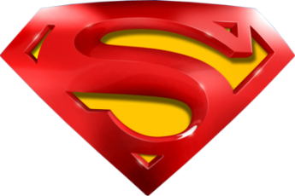
Direct & Inverse Proportion
SAM 2H Q20

Slide 3
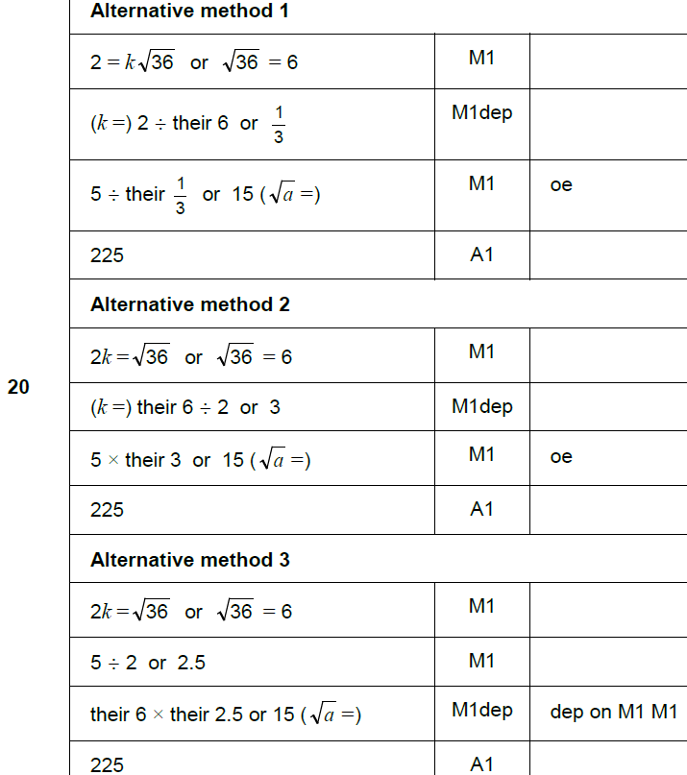
Direct & Inverse Proportion
SAM 2H Q20
A

Slide 4
Direct & Inverse Proportion
June 2017 2H Q22

Slide 5
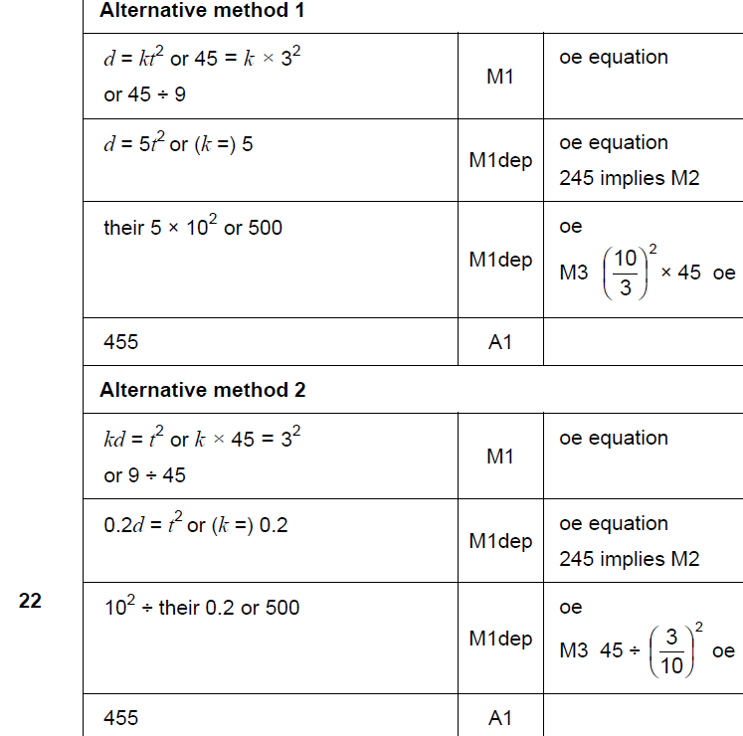
Direct & Inverse Proportion
June 2017 2H Q22
A

Slide 6
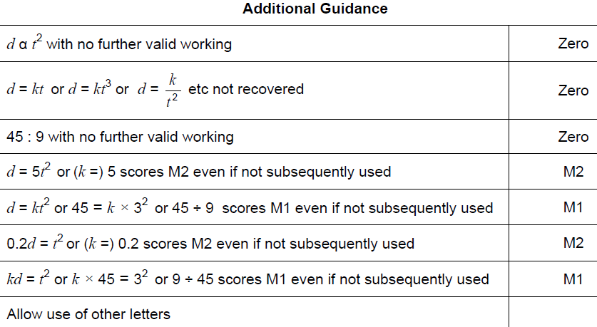
Direct & Inverse Proportion
June 2017 2H Q22
A notes

Slide 7
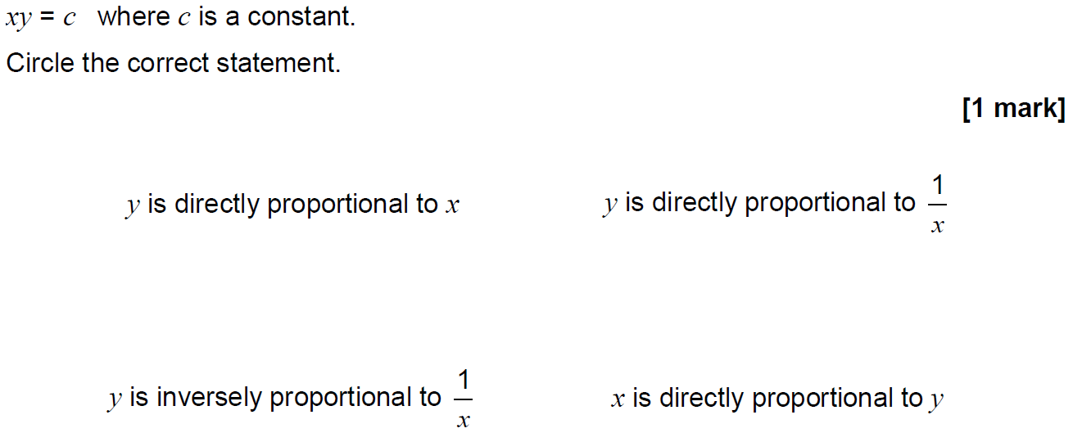
Direct & Inverse Proportion
June 2017 3H Q14

Slide 8
Direct & Inverse Proportion
June 2017 3H Q14
A

Slide 9
Direct & Inverse Proportion
Nov 2017 2H Q20

Slide 10
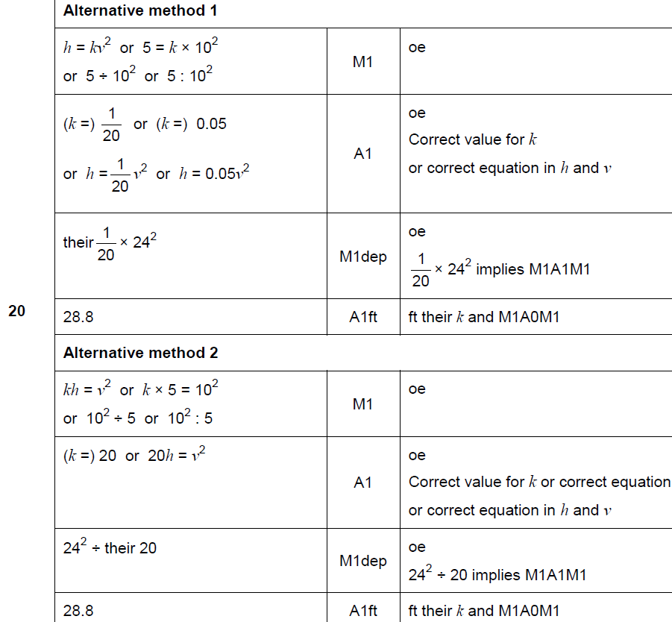
Direct & Inverse Proportion
Nov 2017 2H Q20
A

Slide 11
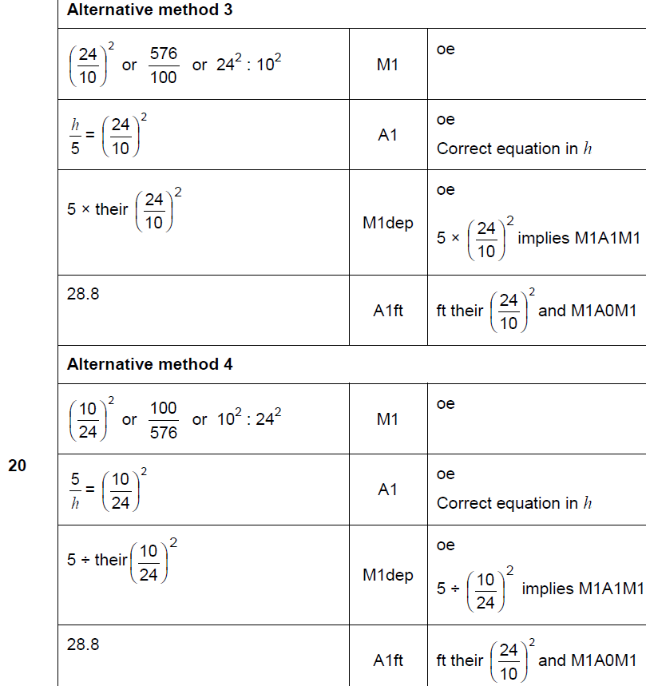
Direct & Inverse Proportion
Nov 2017 2H Q20
A

Slide 12
Direct & Inverse Proportion
Nov 2017 2H Q20
A notes

Slide 13
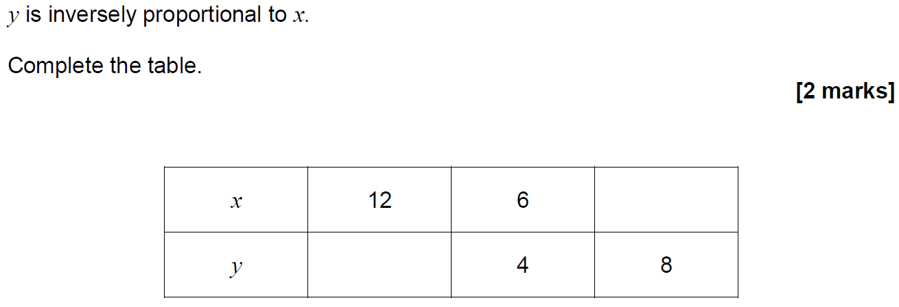
Direct & Inverse Proportion
May 2018 1H Q10

Slide 14
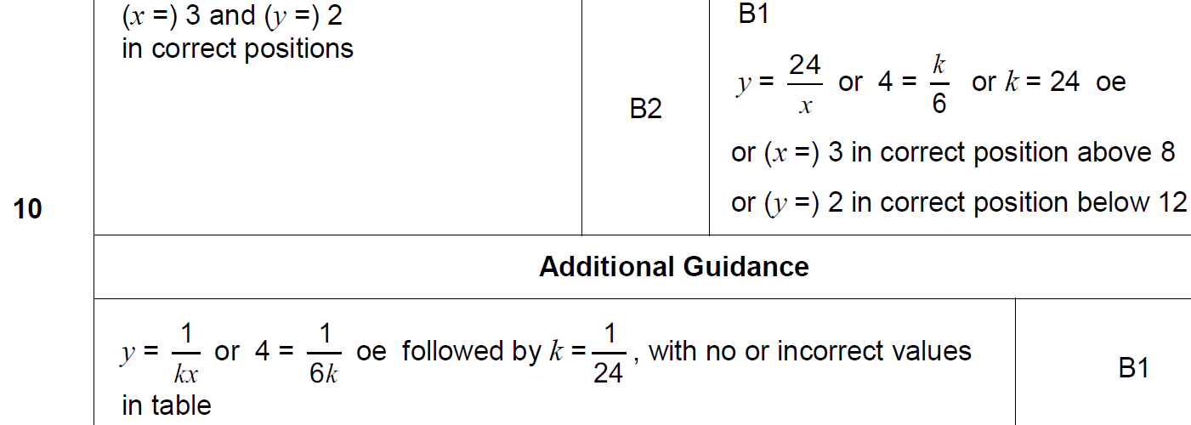
Direct & Inverse Proportion
May 2018 1H Q10
A

Slide 15
Direct & Inverse Proportion
June 2018 3H Q21
The mass of an ornament is m grams.
The height of the ornament is h centimetres.
m is directly proportional to the cube of h.
m = 1600 when h = 8
(a) Work out an equation connecting m and h.
[3 marks]
(b) Work out the mass of an ornament of height 12 centimetres.
[2 marks]

Slide 16
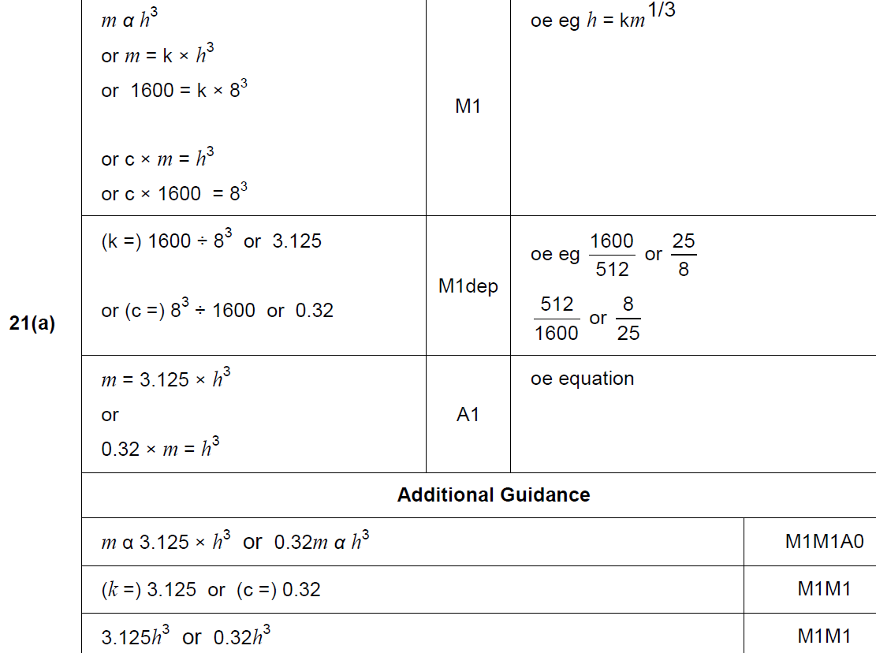
Direct & Inverse Proportion
June 2018 3H Q21
A

Slide 17
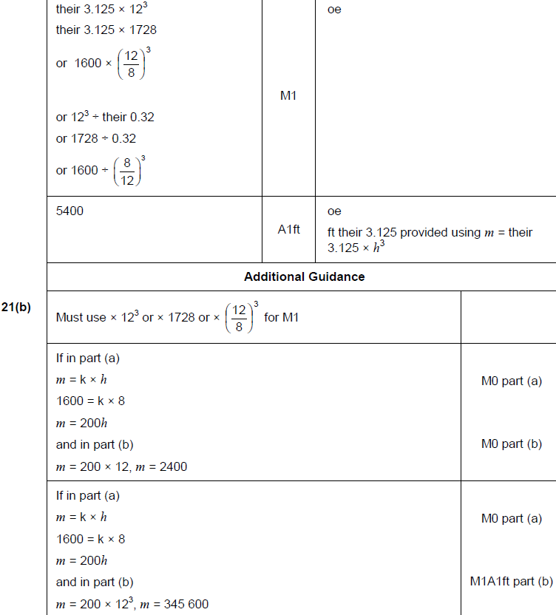
Direct & Inverse Proportion
June 2018 3H Q21
B

Slide 18
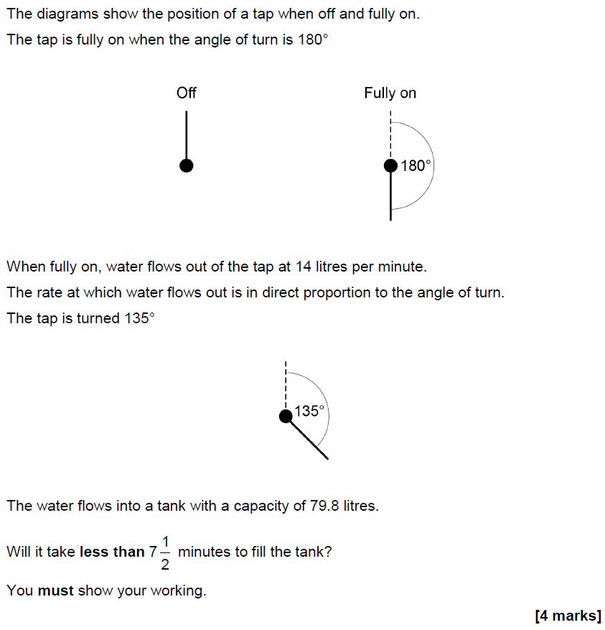
Direct & Inverse Proportion
Nov 2018 2H Q9

Slide 19
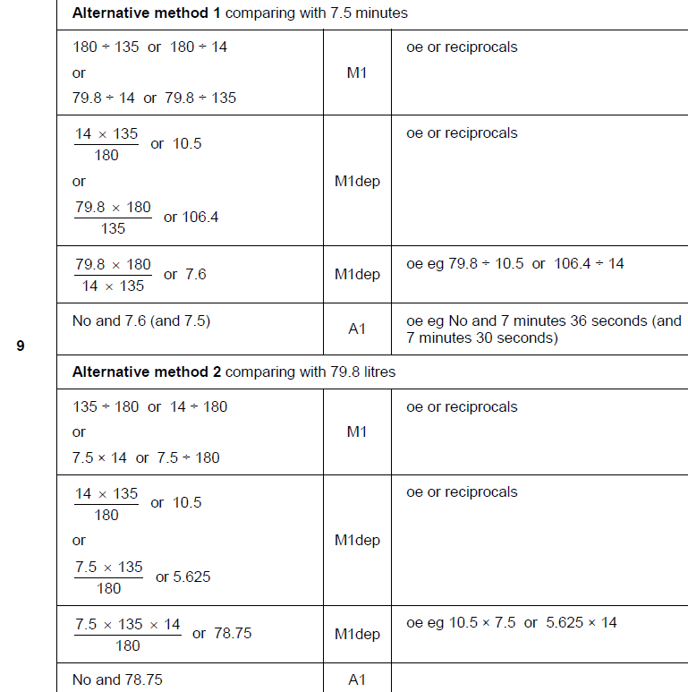
Direct & Inverse Proportion
Nov 2018 2H Q9
A

Slide 20
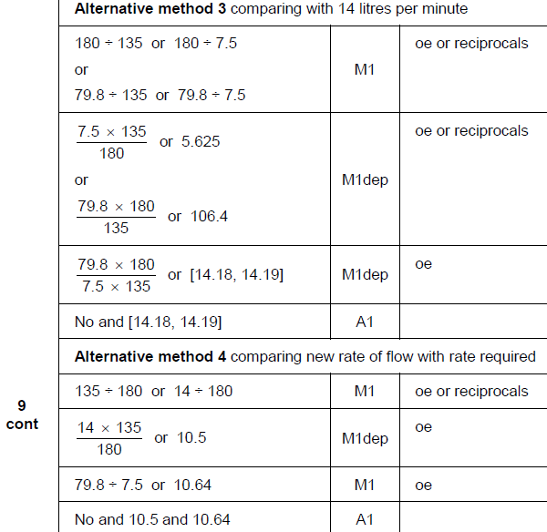
Direct & Inverse Proportion
Nov 2018 2H Q9
A Alternative 2 & 3

Slide 21
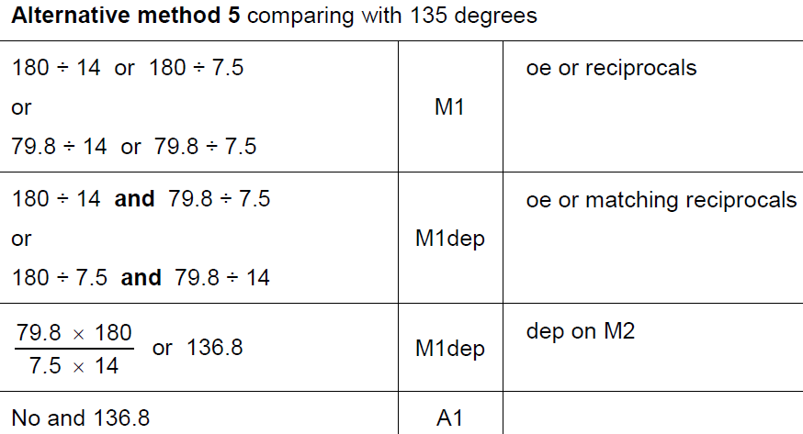
Direct & Inverse Proportion
Nov 2018 2H Q9
A Alternative 4 & notes

Slide 22
Direct & Inverse Proportion
Nov 2018 2H Q21

Slide 23
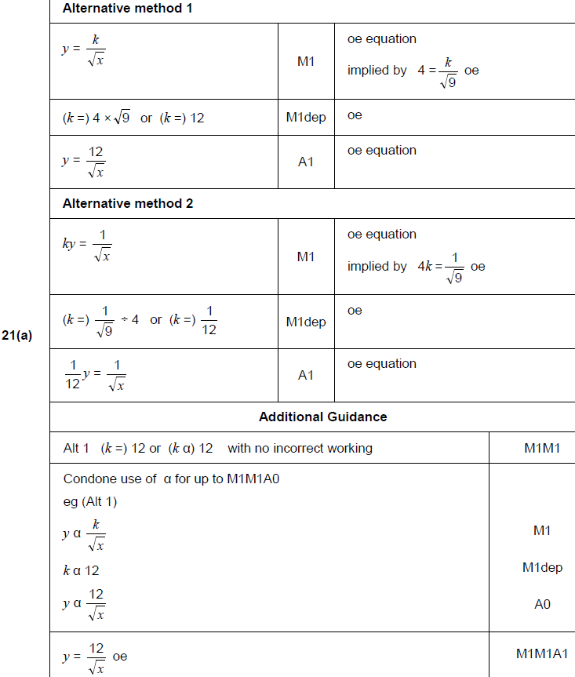
Direct & Inverse Proportion
Nov 2018 2H Q21
A

Slide 24
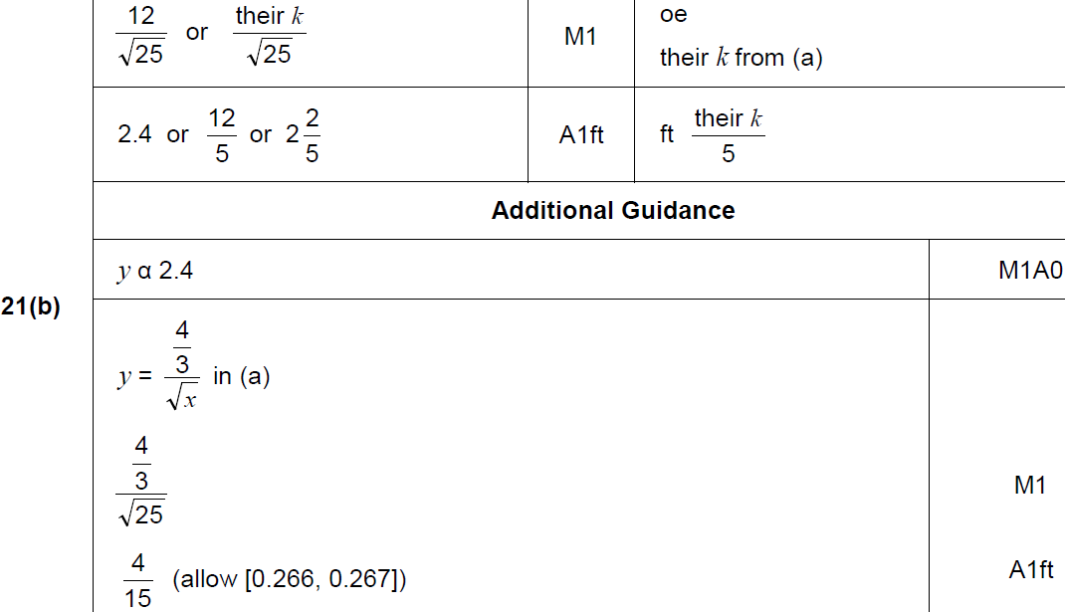
Direct & Inverse Proportion
Nov 2018 2H Q21
B

