Slide 1
Direct & Inverse Proportion
Direct & Inverse Proportion
SAM
2H Q13
May 2017
1H Q13
Edexcel
Spec 1
2H Q15
Nov 2017
1H Q16
AQA
Spec 2
1H Q10
May 2018
1H Q14
OCR
Spec 2
2H Q14
Nov 2018
3H Q14
Spec 2
3H Q6
May 2019
1H Q20

Slide 2
Direct & Inverse Proportion
Direct & Inverse Proportion
June 2017
2H Q22
Edexcel
June 2018
3H Q21
June 2017
3H Q14
AQA
SAM
2H Q20
Nov 2018
2H Q9
1 Marker
Nov 2017
2H Q20
OCR
Nov 2018
2H Q21
May 2018
1H Q10

Slide 3
Direct & Inverse Proportion
Direct & Inverse Proportion
Edexcel
May 2017
1H Q15
May 2018
1H Q11
SAM
1H Q15
AQA
June 2017
3H Q12
June 2018
3H Q6
Practice
1H Q13
OCR
Nov 2017
1H Q11
Nov 2018
1H Q14

Slide 4
Direct & Inverse Proportion
SAM 2H Q13

Slide 5
Direct & Inverse Proportion
SAM 2H Q13
A

Slide 6
Direct & Inverse Proportion
Specimen Set 1 2H Q15

Slide 7
Direct & Inverse Proportion
Specimen Set 1 2H Q15
A

Slide 8
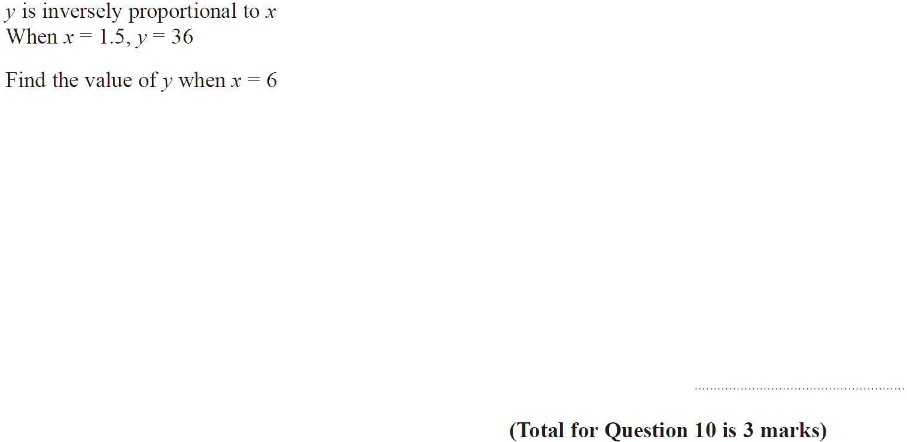
Direct & Inverse Proportion
Specimen Set 2 1H Q10

Slide 9
Direct & Inverse Proportion
Specimen Set 2 1H Q10
A

Slide 10
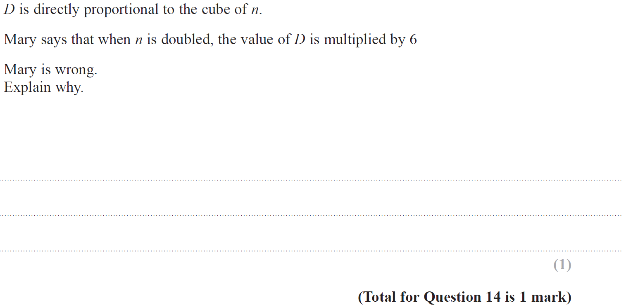
Direct & Inverse Proportion
Specimen Set 2 2H Q14

Slide 11
Direct & Inverse Proportion
Specimen Set 2 2H Q14
A

Slide 12
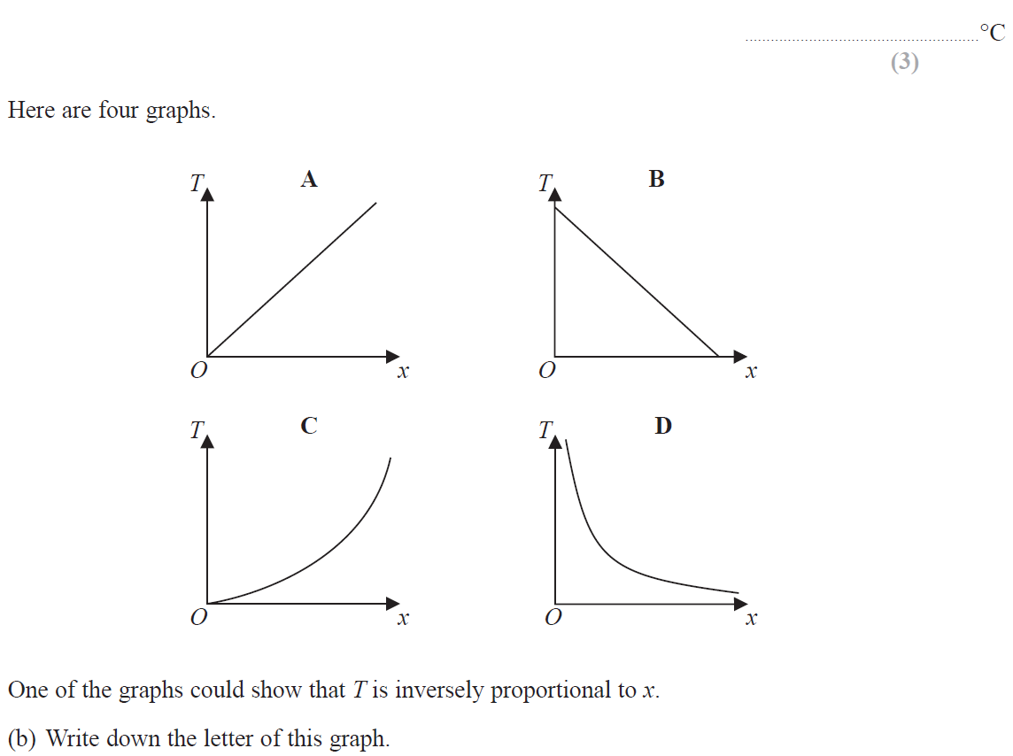
Direct & Inverse Proportion
Specimen Set 2 3H Q6

Slide 13
Direct & Inverse Proportion
Specimen Set 2 3H Q6
A
B

Slide 14
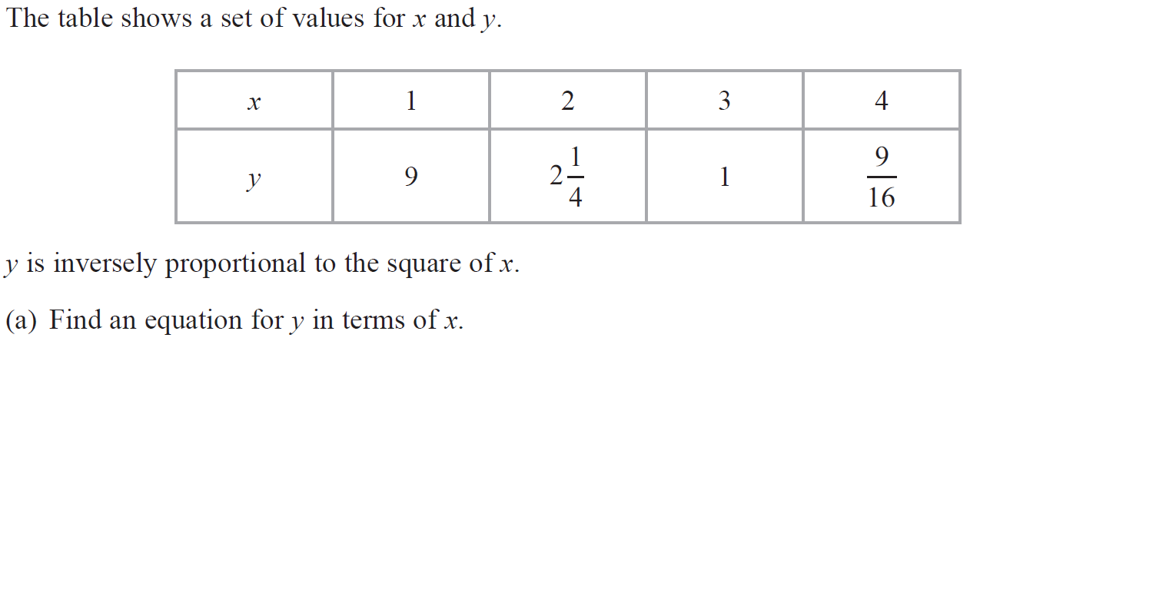
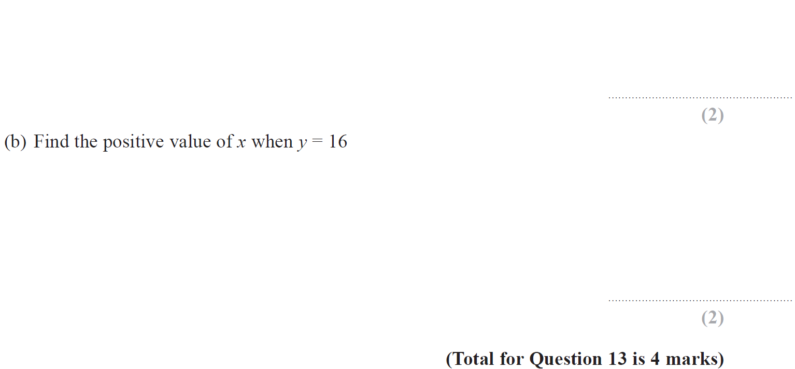
Direct & Inverse Proportion
May 2017 1H Q13

Slide 15
Direct & Inverse Proportion
May 2017 1H Q13
A
B

Slide 16
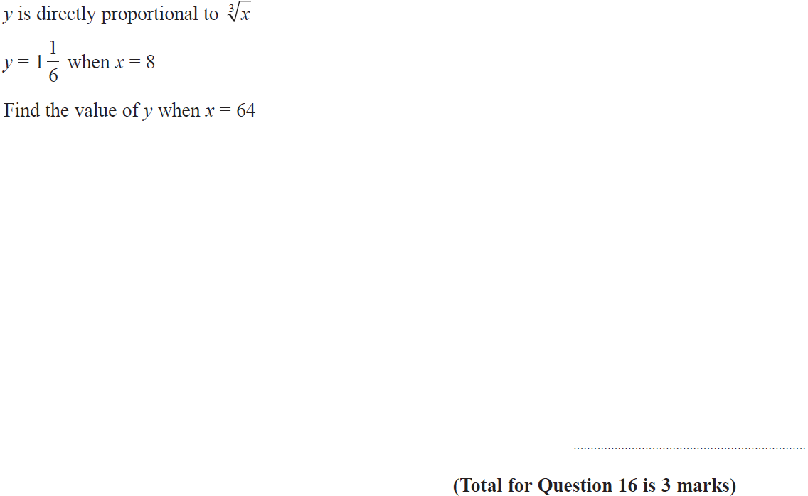
Direct & Inverse Proportion
Nov 2017 1H Q16

Slide 17
Direct & Inverse Proportion
Nov 2017 1H Q16
A

Slide 18
Direct & Inverse Proportion
May 2018 1H Q14

Slide 19
Direct & Inverse Proportion
May 2018 1H Q14
A

Slide 20
Direct & Inverse Proportion
Nov 2018 3H Q14

Slide 21
Direct & Inverse Proportion
Nov 2018 3H Q14
A

Slide 22
Direct & Inverse Proportion
May 2019 1H Q20

Slide 23
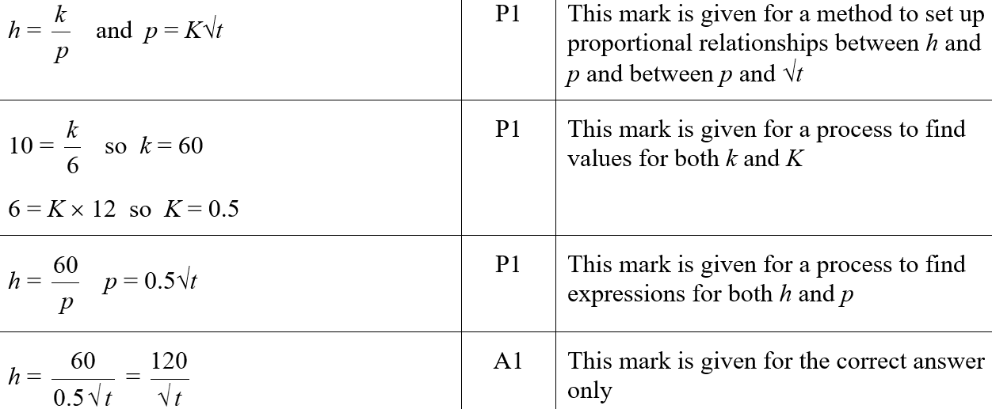
Direct & Inverse Proportion
May 2019 1H Q20
A
A SF

Slide 24
Direct & Inverse Proportion
SAM 2H Q20

Slide 25
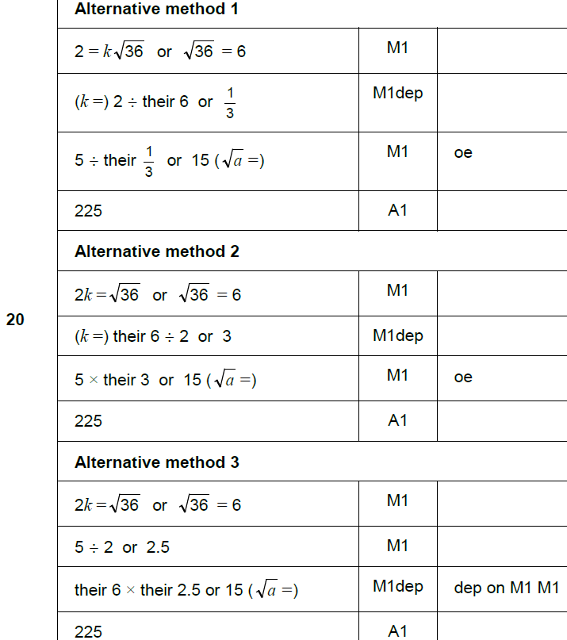
Direct & Inverse Proportion
SAM 2H Q20
A

Slide 26
Direct & Inverse Proportion
June 2017 2H Q22

Slide 27
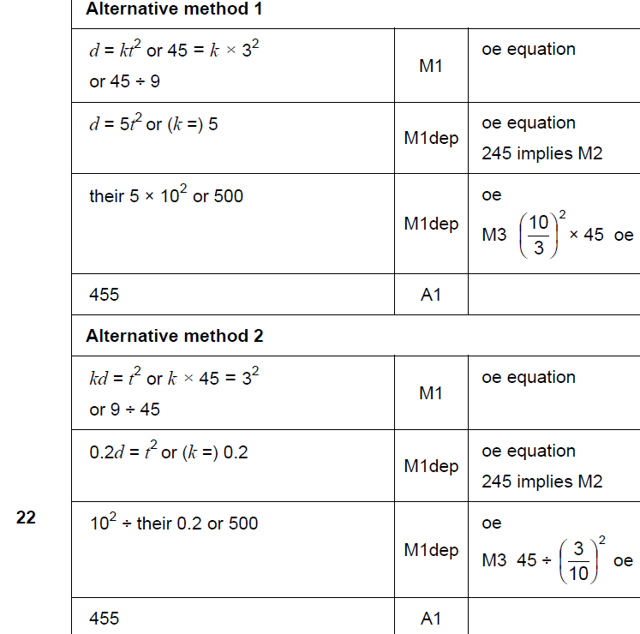
Direct & Inverse Proportion
June 2017 2H Q22
A

Slide 28
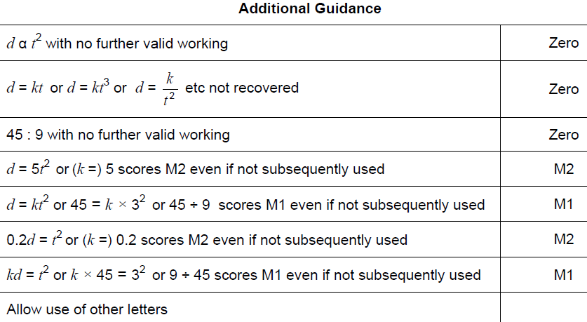
Direct & Inverse Proportion
June 2017 2H Q22
A notes

Slide 29
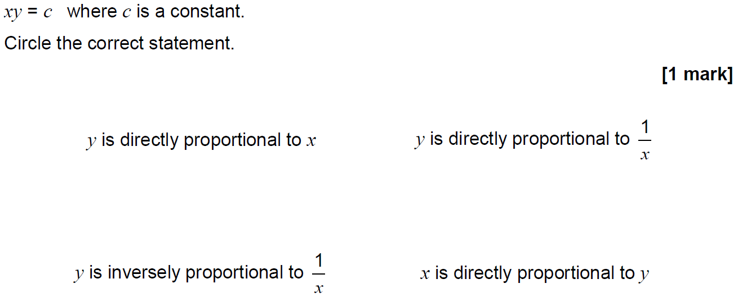
Direct & Inverse Proportion
June 2017 3H Q14

Slide 30
Direct & Inverse Proportion
June 2017 3H Q14
A

Slide 31
Direct & Inverse Proportion
Nov 2017 2H Q20

Slide 32
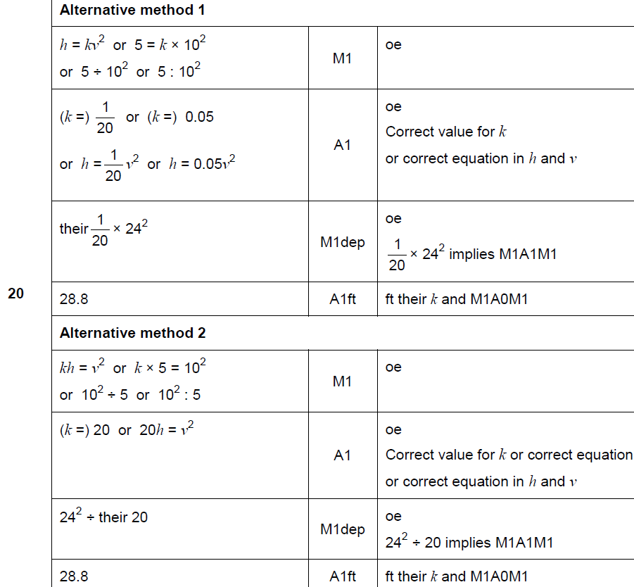
Direct & Inverse Proportion
Nov 2017 2H Q20
A

Slide 33
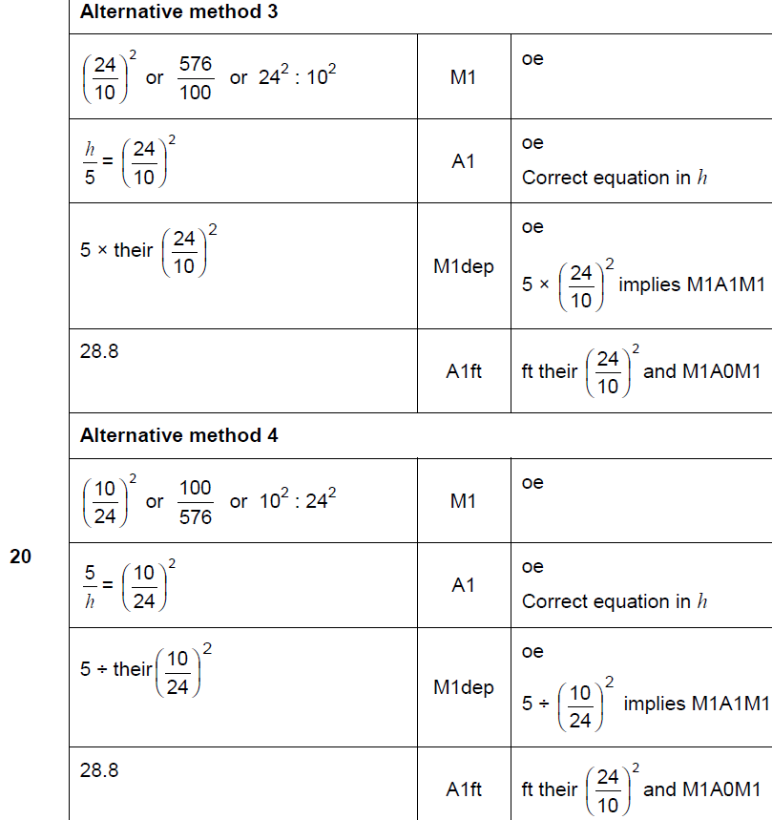
Direct & Inverse Proportion
Nov 2017 2H Q20
A

Slide 34
Direct & Inverse Proportion
Nov 2017 2H Q20
A notes

Slide 35
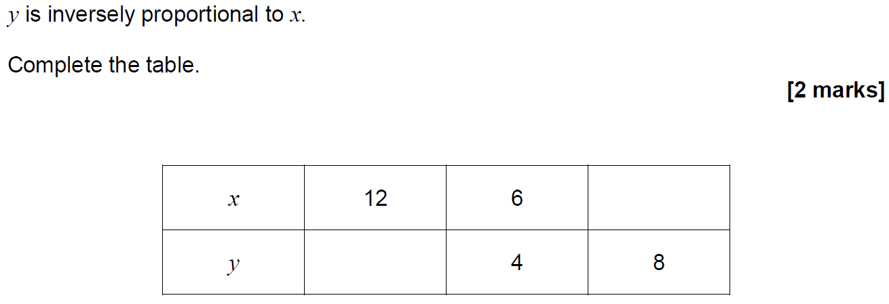
Direct & Inverse Proportion
May 2018 1H Q10

Slide 36
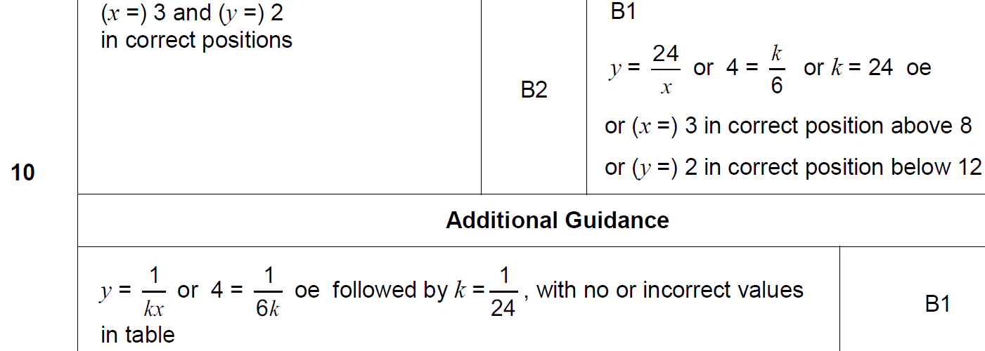
Direct & Inverse Proportion
May 2018 1H Q10
A

Slide 37
Direct & Inverse Proportion
June 2018 3H Q21
The mass of an ornament is m grams.
The height of the ornament is h centimetres.
m is directly proportional to the cube of h.
m = 1600 when h = 8
(a) Work out an equation connecting m and h.
[3 marks]
(b) Work out the mass of an ornament of height 12 centimetres.
[2 marks]

Slide 38
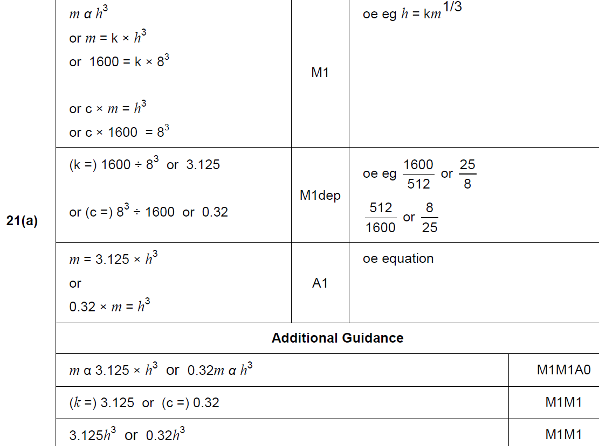
Direct & Inverse Proportion
June 2018 3H Q21
A

Slide 39
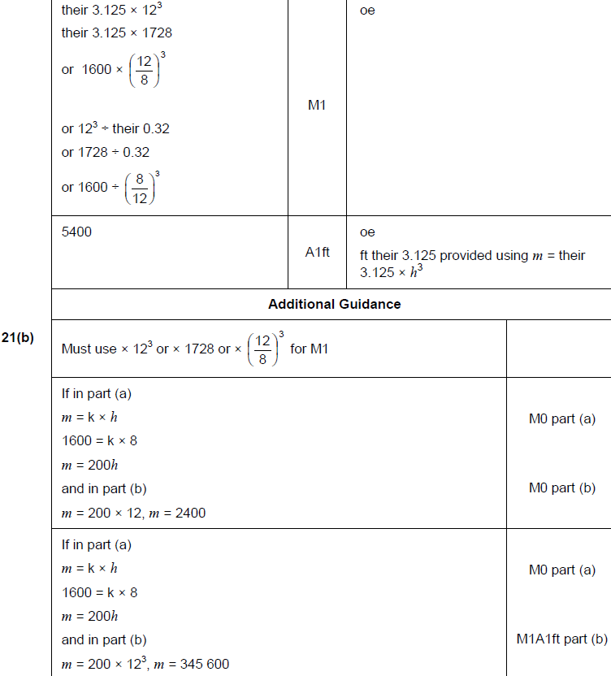
Direct & Inverse Proportion
June 2018 3H Q21
B

Slide 40
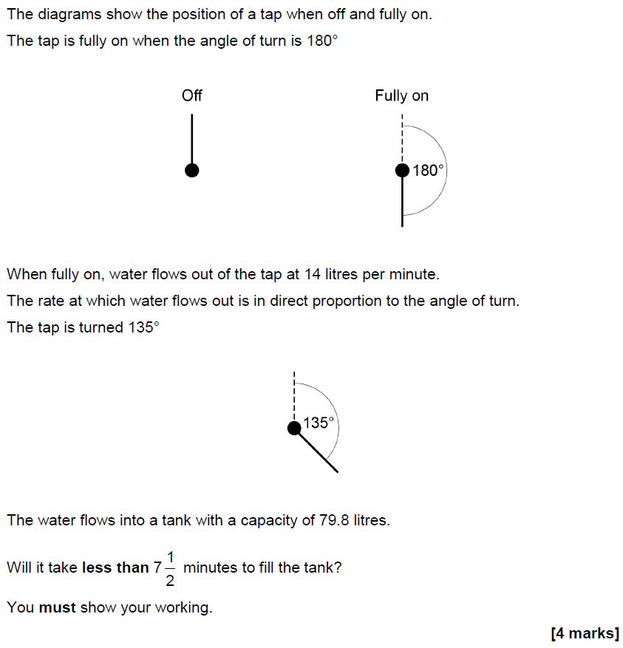
Direct & Inverse Proportion
Nov 2018 2H Q9

Slide 41
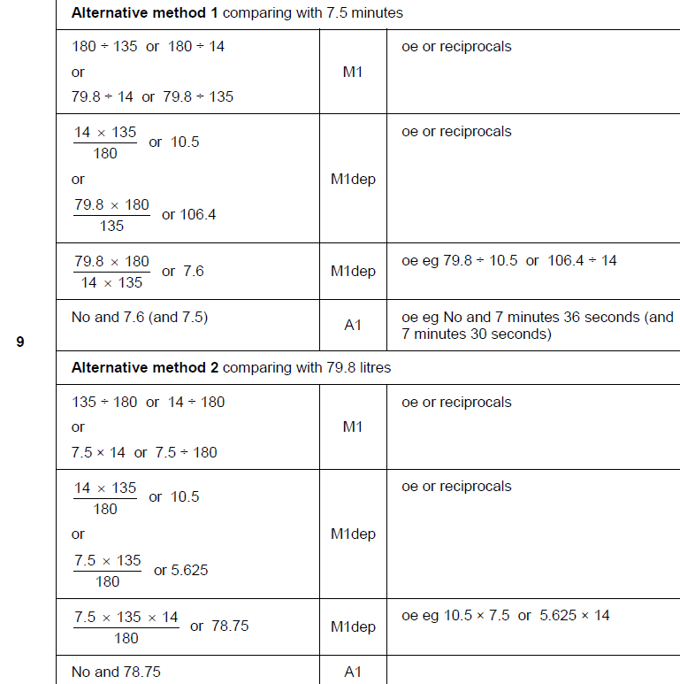
Direct & Inverse Proportion
Nov 2018 2H Q9
A

Slide 42
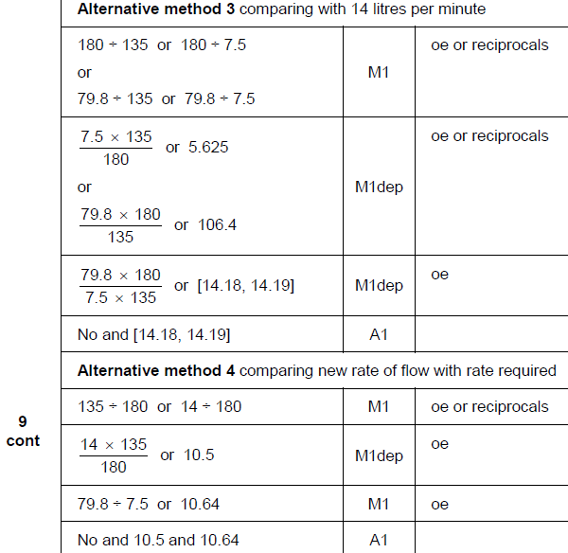
Direct & Inverse Proportion
Nov 2018 2H Q9
A Alternative 2 & 3

Slide 43
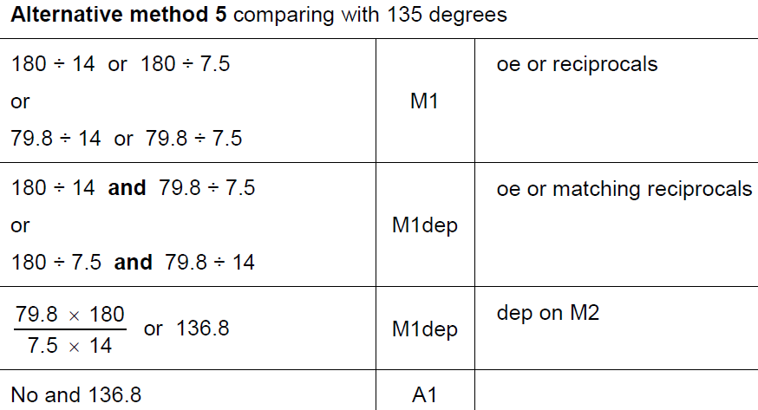
Direct & Inverse Proportion
Nov 2018 2H Q9
A Alternative 4 & notes

Slide 44
Direct & Inverse Proportion
Nov 2018 2H Q21

Slide 45
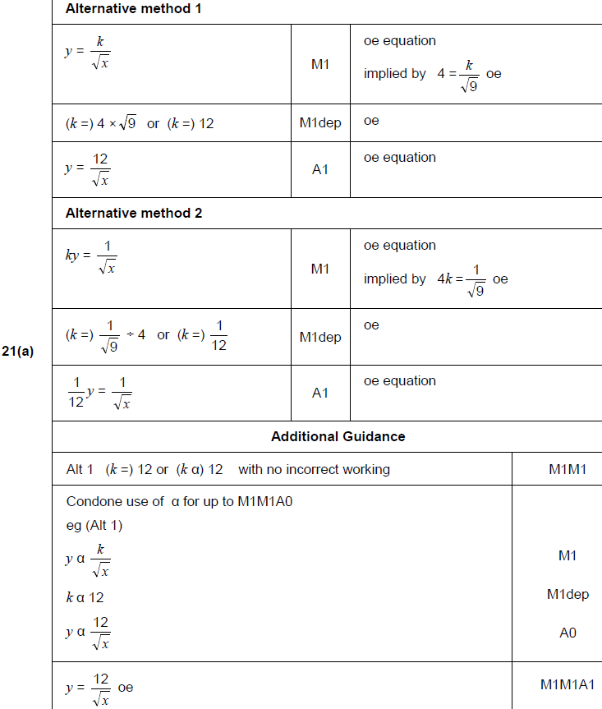
Direct & Inverse Proportion
Nov 2018 2H Q21
A

Slide 46
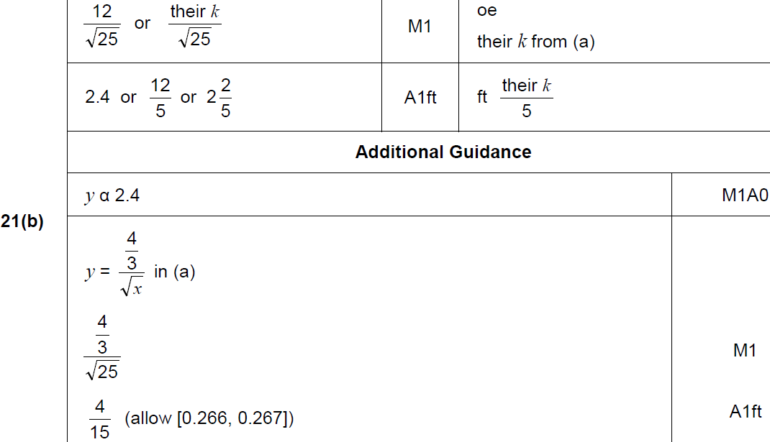
Direct & Inverse Proportion
Nov 2018 2H Q21
B

Slide 47
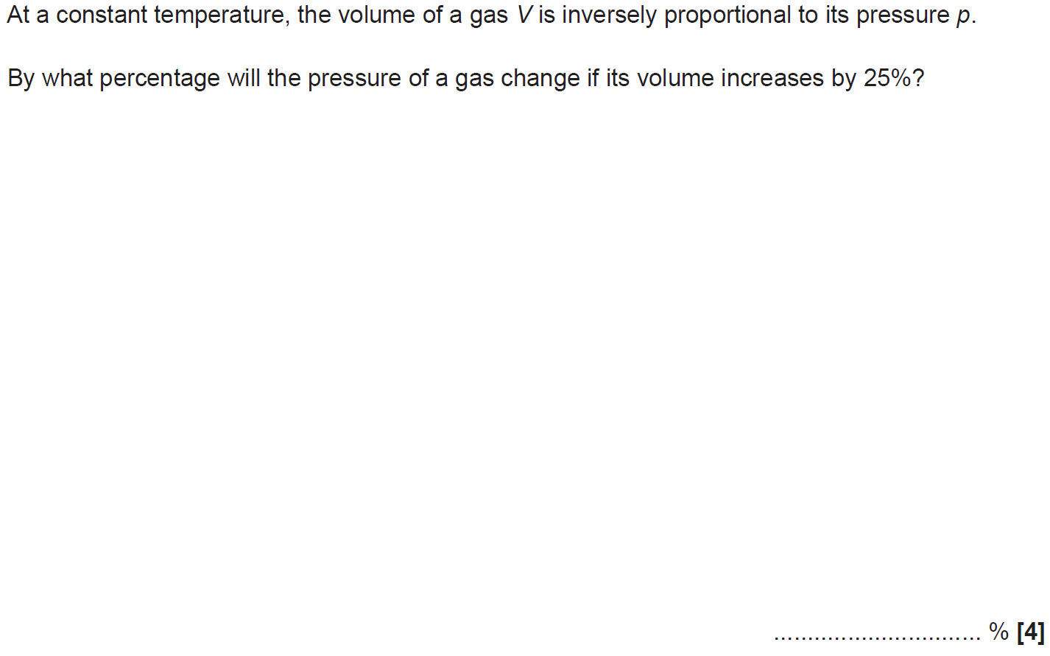
Direct & Inverse Proportion
SAM 1H Q15

Slide 48
Direct & Inverse Proportion
SAM 1H Q15
A

Slide 49
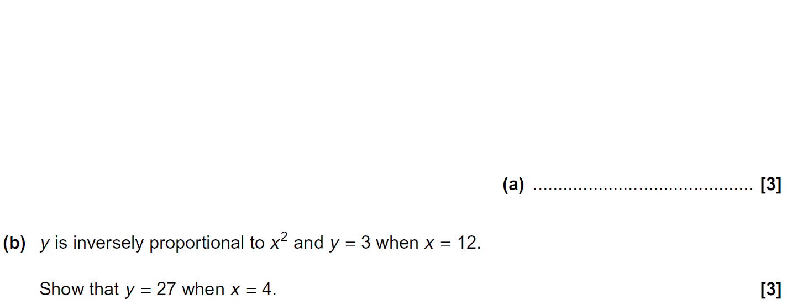
Direct & Inverse Proportion
Practice 1H Q13

Slide 50
Direct & Inverse Proportion
Practice 1H Q13
A
B

Slide 51
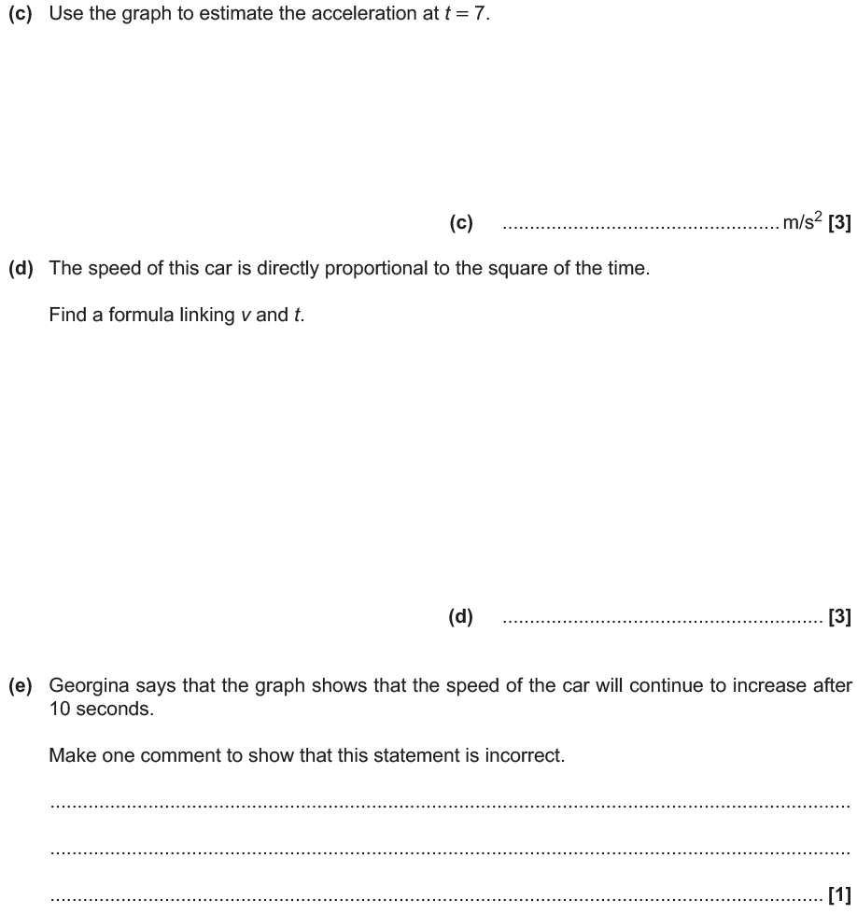
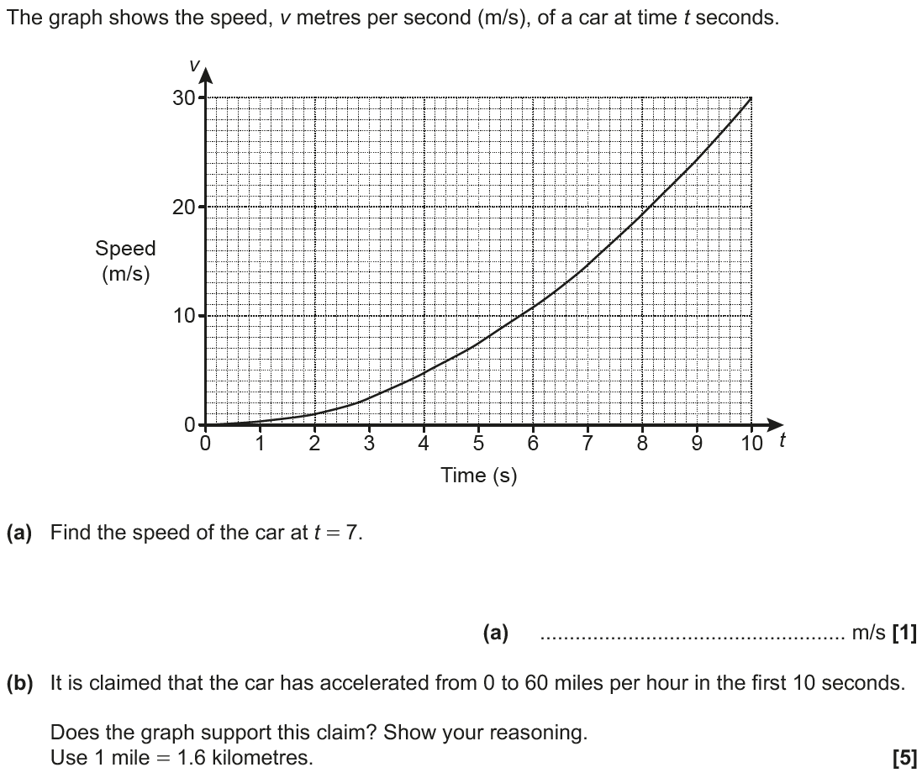
Direct & Inverse Proportion
May 2017 1H Q15

Slide 52
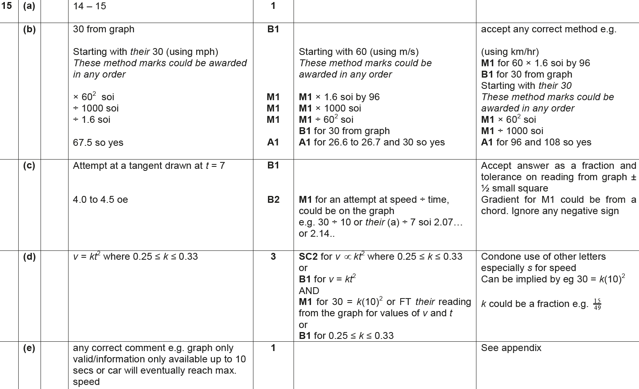
Direct & Inverse Proportion
May 2017 1H Q15
A
B
C
D
E

Slide 53
Direct & Inverse Proportion
June 2017 3H Q12

Slide 54
Direct & Inverse Proportion
June 2017 3H Q12
A

Slide 55
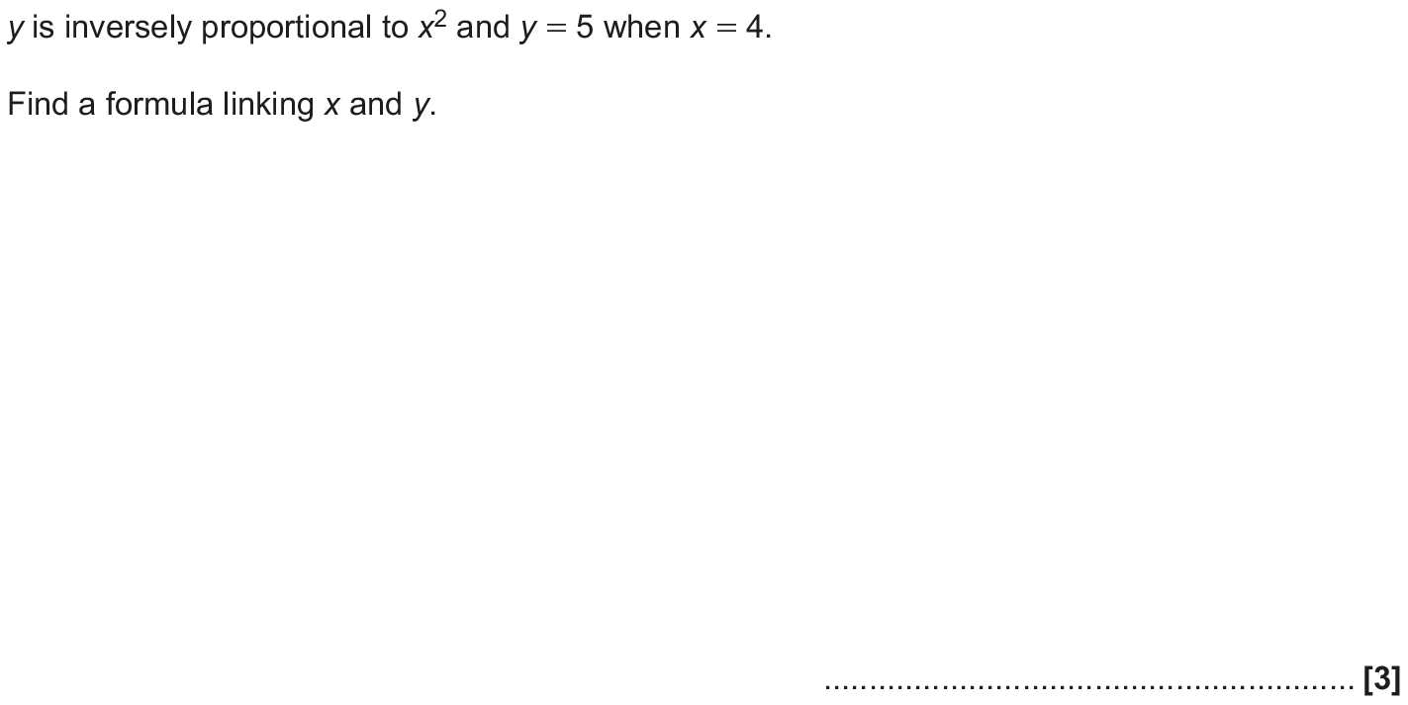
Direct & Inverse Proportion
Nov 2017 1H Q11

Slide 56
Direct & Inverse Proportion
Nov 2017 1H Q11
A

Slide 57
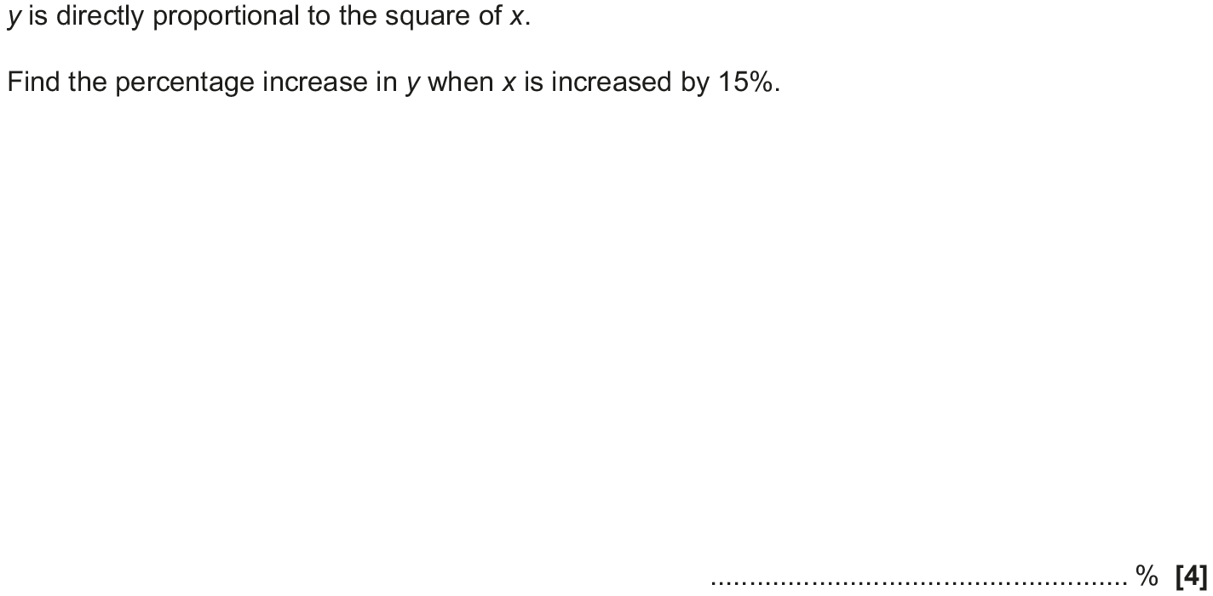
Direct & Inverse Proportion
May 2018 1H Q11

Slide 58
Direct & Inverse Proportion
May 2018 1H Q11
A

Slide 59
Direct & Inverse Proportion
June 2018 3H Q6

Slide 60
Direct & Inverse Proportion
June 2018 3H Q6
A

Slide 61
Direct & Inverse Proportion
Nov 2018 1H Q14

Slide 62
Direct & Inverse Proportion
Nov 2018 1H Q14
A

