Slide 1
Differentiation
Differentiation
Old Spec Q’s
SAM
1H Q21
May 2019
1H Q24
SAM
2H Q25
June 2019
2H Q18
June 2018
2H Q17
May 2018
1HR Q19
Jan 2019
1H Q12
Jan 2019
1HR Q13
Displacement, Velocity, Acceleration

Slide 2
Differentiation
SAM 1H Q21

Slide 3
Differentiation
SAM 1H Q21
A

Slide 4
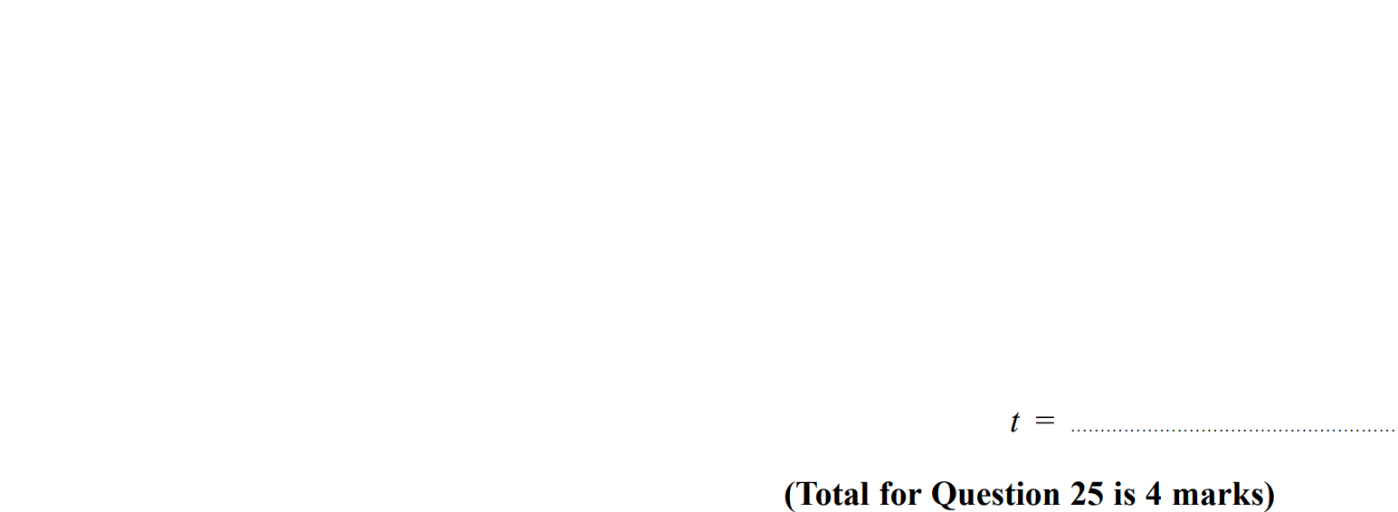
Differentiation
SAM 2H Q25

Slide 5
Differentiation
SAM 2H Q25
A

Slide 6
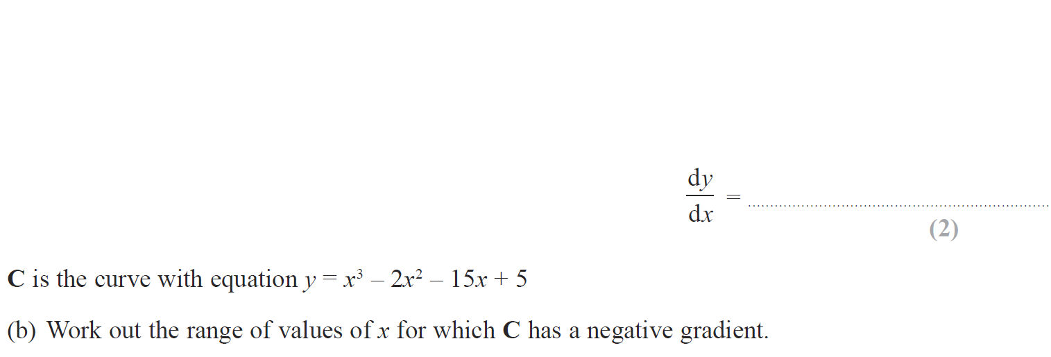
Differentiation
June 2018 2H Q17

Slide 7
Differentiation
June 2018 2H Q17
A
B

Slide 8
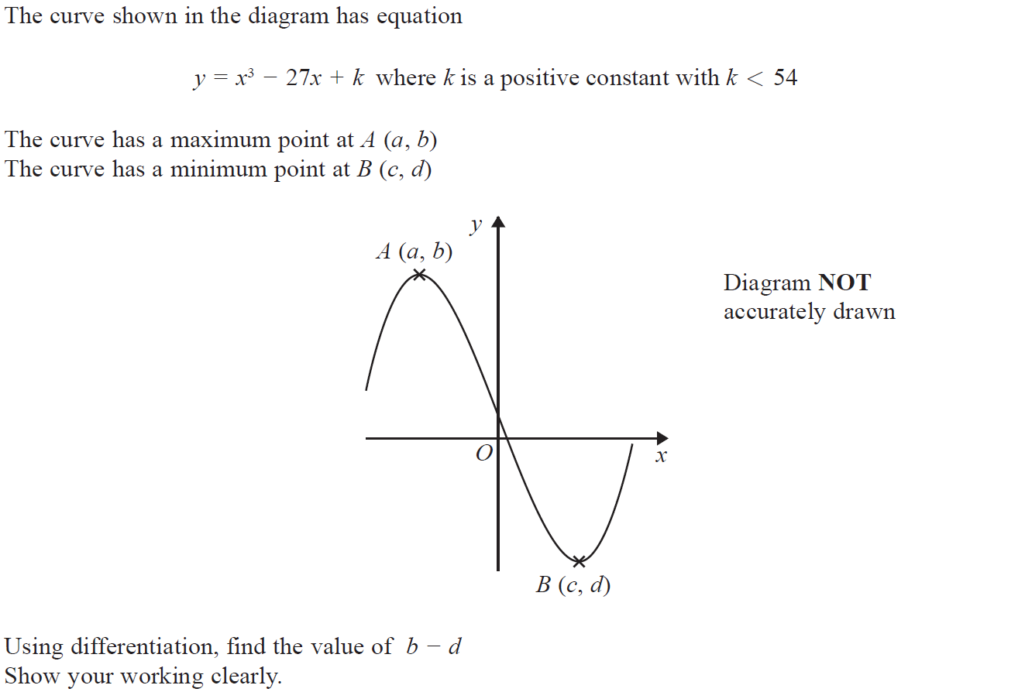
Differentiation
May 2018 1HR Q19

Slide 9
Differentiation
May 2018 1HR Q19
A

Slide 10
Differentiation
Jan 2019 1H Q12

Slide 11
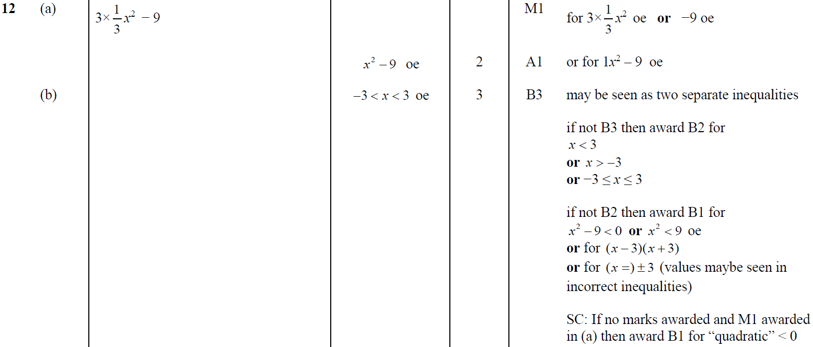
Differentiation
Jan 2019 1H Q12
A
B

Slide 12
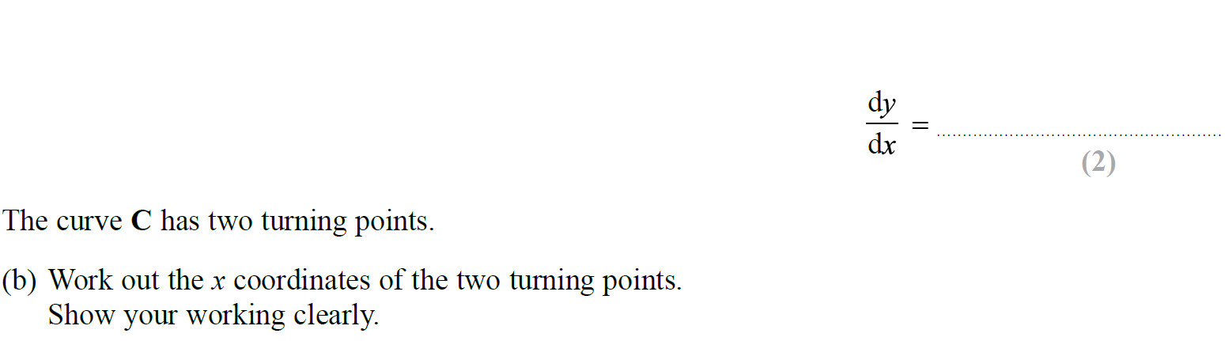
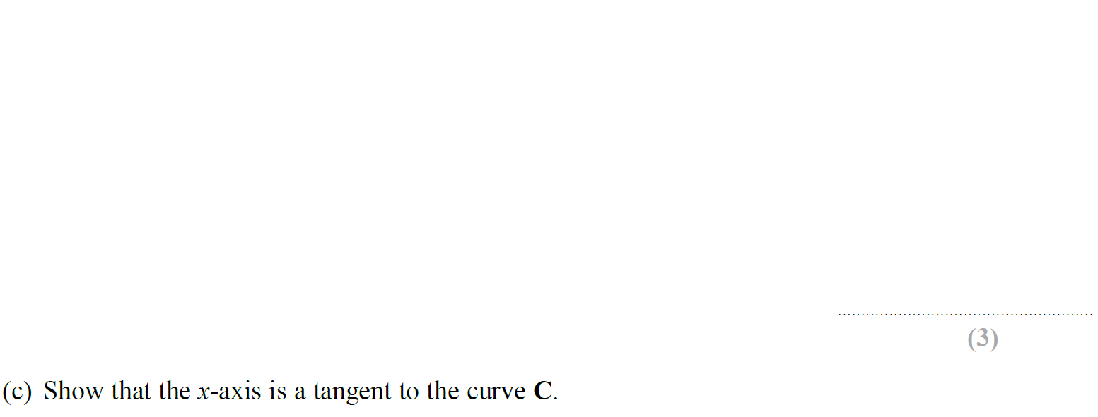
Differentiation
Jan 2019 1HR Q13

Slide 13
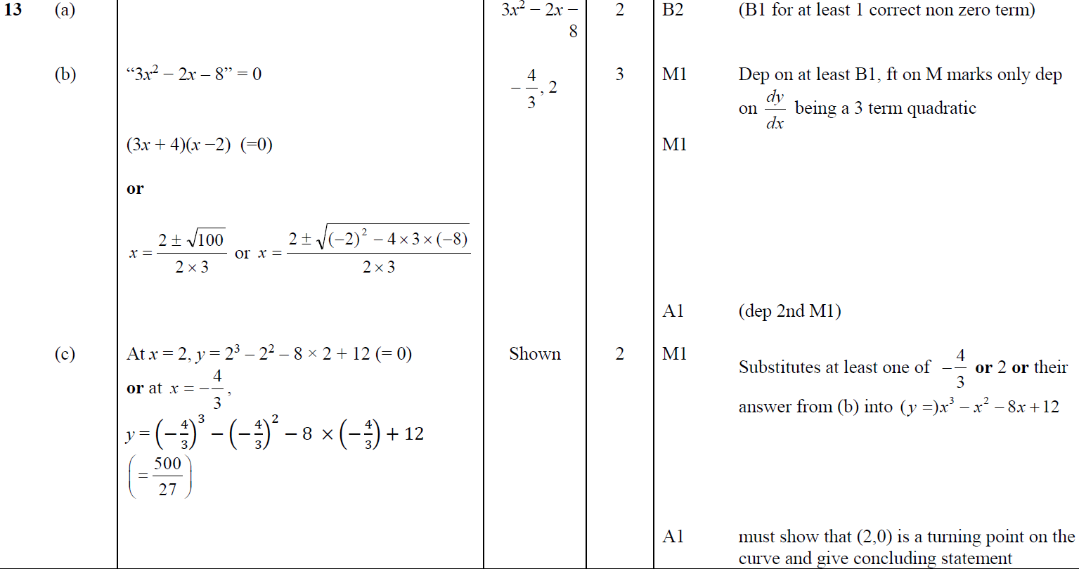
Differentiation
Jan 2019 1HR Q13
A
B
C

Slide 14
Differentiation
May 2019 1H Q24

Slide 15
Differentiation
May 2019 1H Q24
A

Slide 16
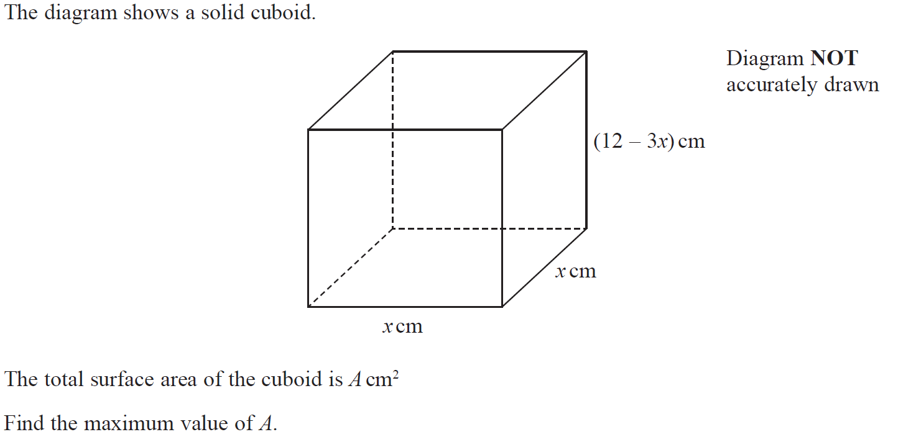
Differentiation
June 2019 2H Q18

Slide 17
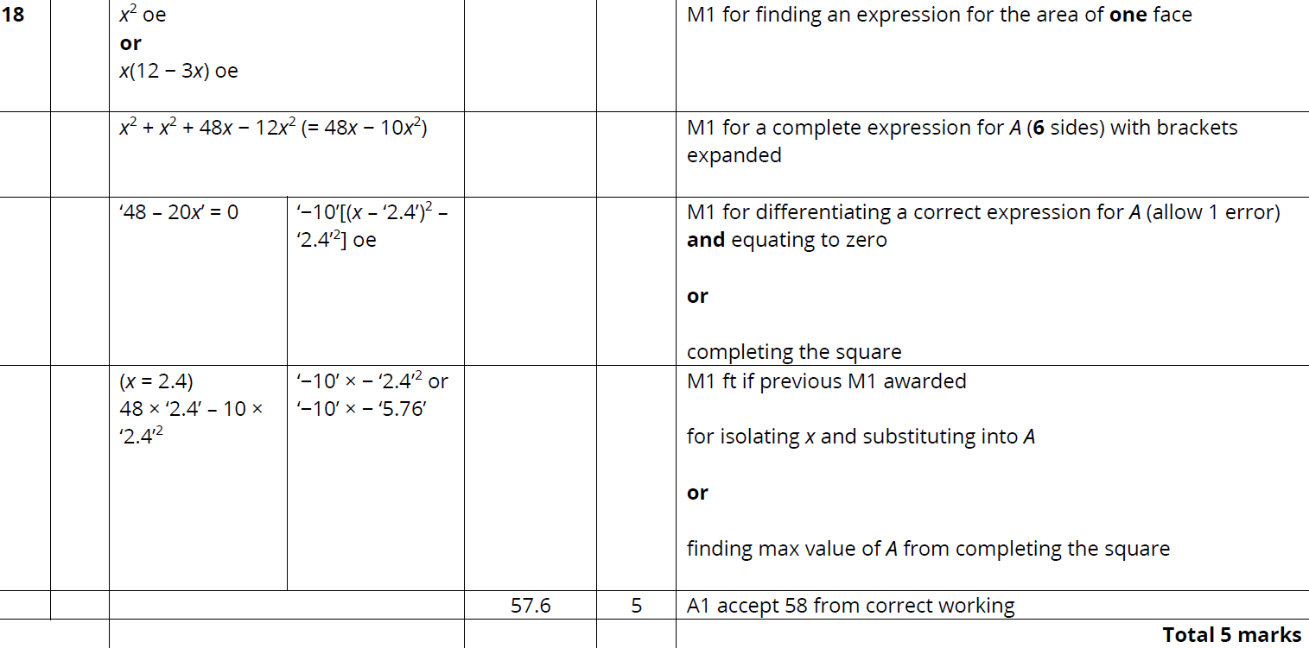
Differentiation
June 2019 2H Q18
A

Slide 18
Differentiation
Differentiation
New Spec Q’s
May 2004
3H Q13
Nov 2007
4H Q20
Jan 2012 3H Q14
May 2014 3H Q14
May 2016 3H Q14
Jan 2018 4HR Q16
Nov 2004
3H Q17
May 2008
4H Q19
May 2012 4H Q13
May 2014 3HR Q14
May 2016 3HR Q15
May 2018 3H Q18
May 2005
4H Q14
Nov 2008
4H Q20
Jan 2013 3H Q18
Jan 2015 3H Q18
Jan 2017 3H Q18
June 2018 4H Q14
Nov 2005
4H Q15
June 2009
4H Q17
May 2013 4H Q11
Jan 2015 3HR Q17
Jan 2017 4H Q17
May 2018 3HR Q17
May 2006
3H Q16
Nov 2009
4H Q19
May 2013 3HR Q19
June 2015 4H Q21
Jan 2017 3HR Q20
May 2006
4H Q18
June 2010
3H Q12
Jan 2014 4H Q15
June 2015 4HR Q21
June 2017 4H Q17
Nov 2006
3H Q14
Nov 2010
3H Q16
Jan 2014 3HR Q15
Jan 2016 4H Q16
May 2017 3HR Q15
May 2007
3H Q17
June 2011 3H Q21
Jan 2014 4HR Q15
Jan 2016 3HR Q15
Jan 2018 4H Q17
Displacement, Velocity, Acceleration

Slide 19
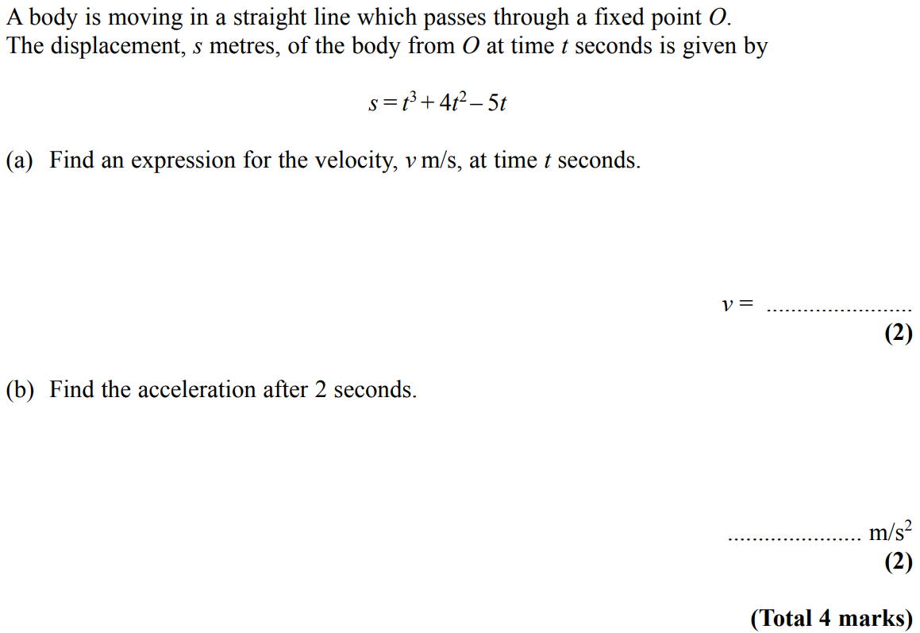
Differentiation
May 2004 3H Q13

Slide 20
Differentiation
May 2004 3H Q13
A
B

Slide 21
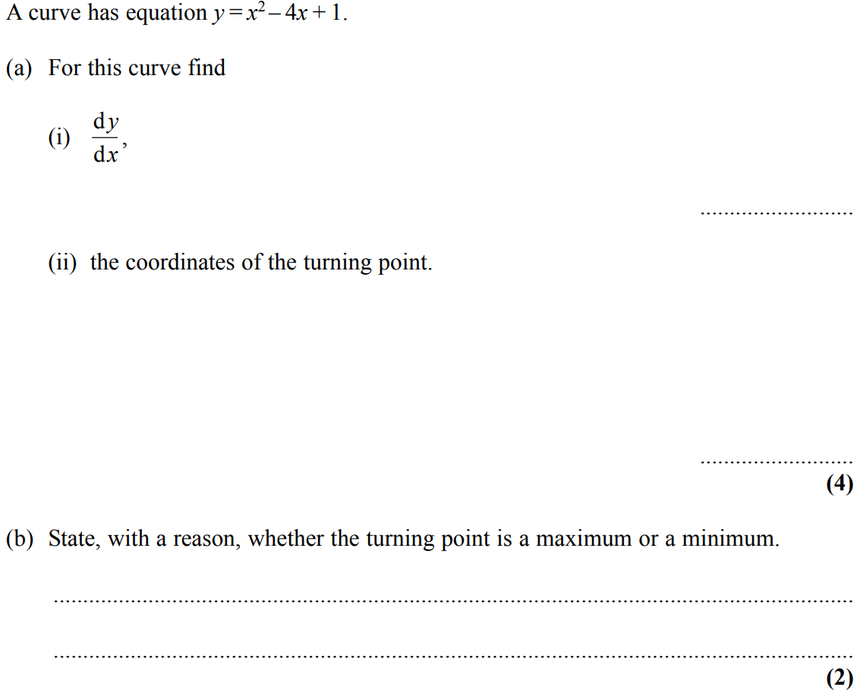
Differentiation
Nov 2004 3H Q17

Slide 22
Differentiation
Nov 2004 3H Q17
A (i)
A (ii)
B
C

Slide 23
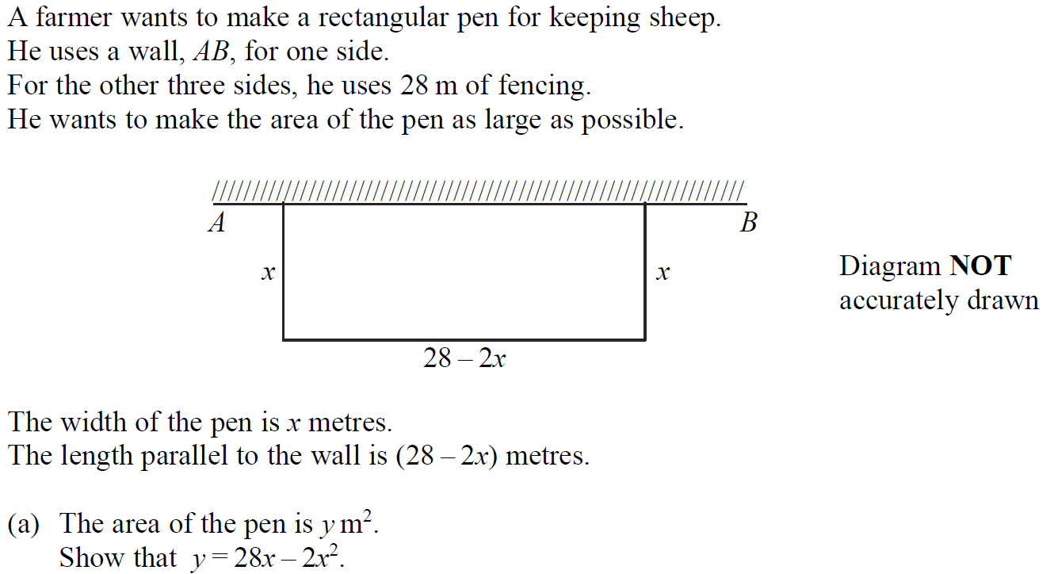
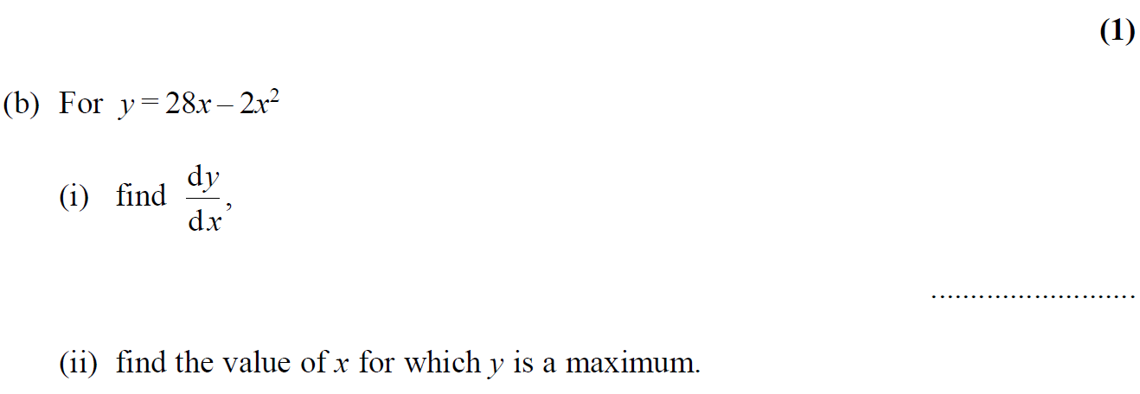
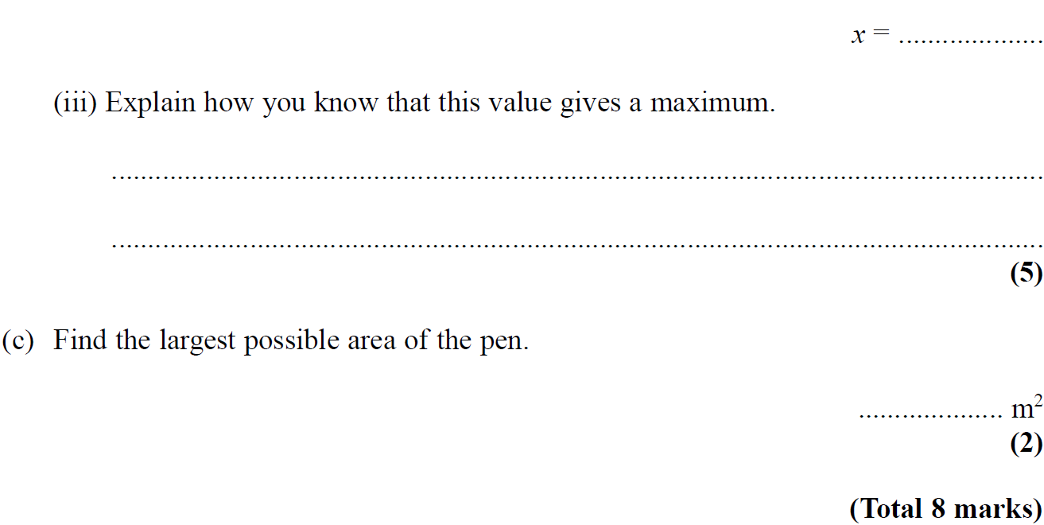
Differentiation
May 2005 4H Q14

Slide 24
Differentiation
May 2005 4H Q14
A
B (i)
B (ii)
B (iii)
C

Slide 25
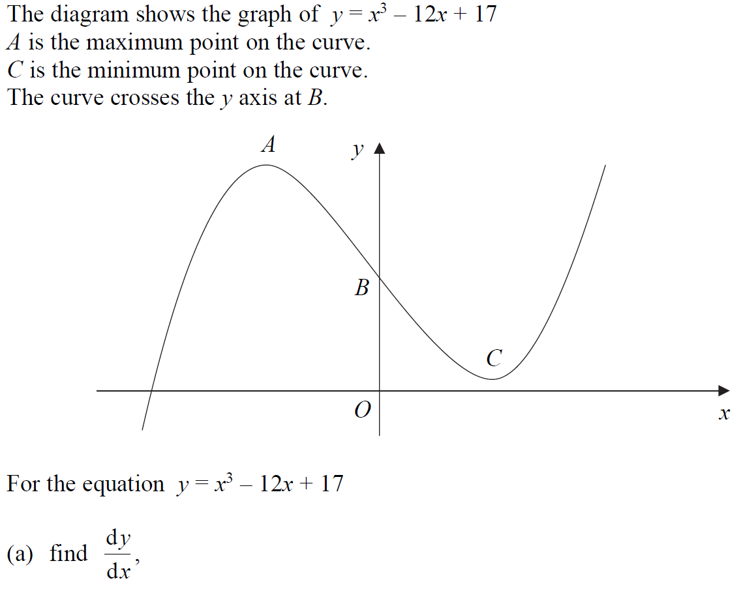
Differentiation
Nov 2005 4H Q15

Slide 26
Differentiation
Nov 2005 4H Q15
A
B
C

Slide 27
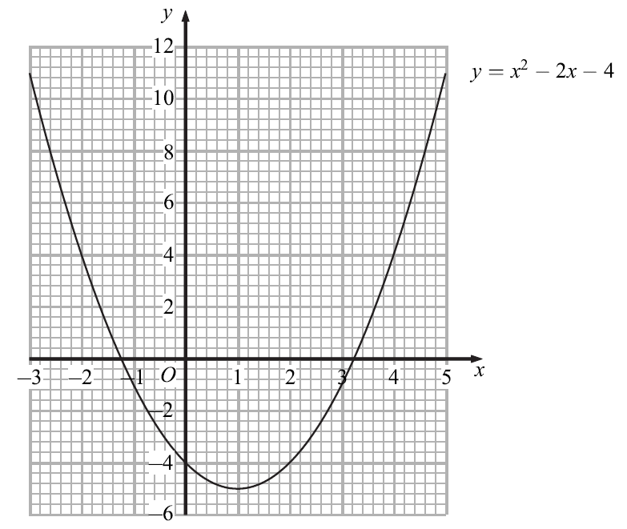
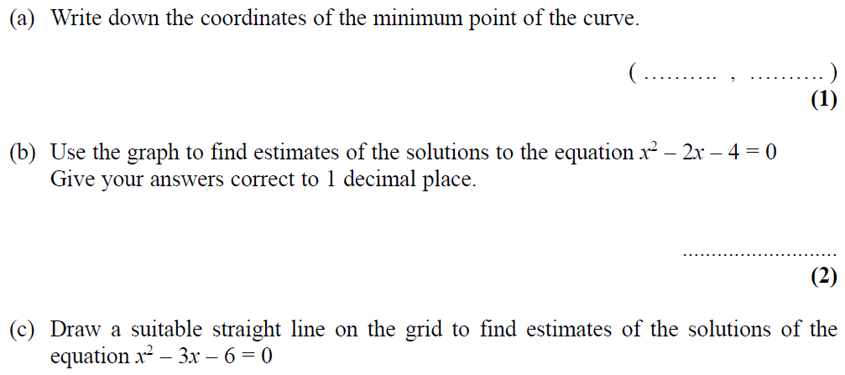
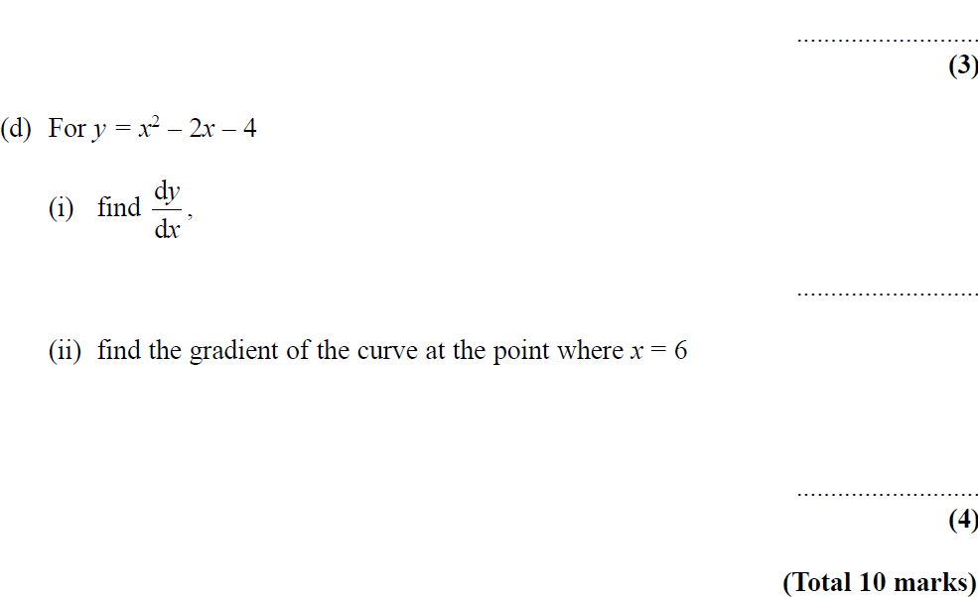
Differentiation
May 2006 3H Q16

Slide 28
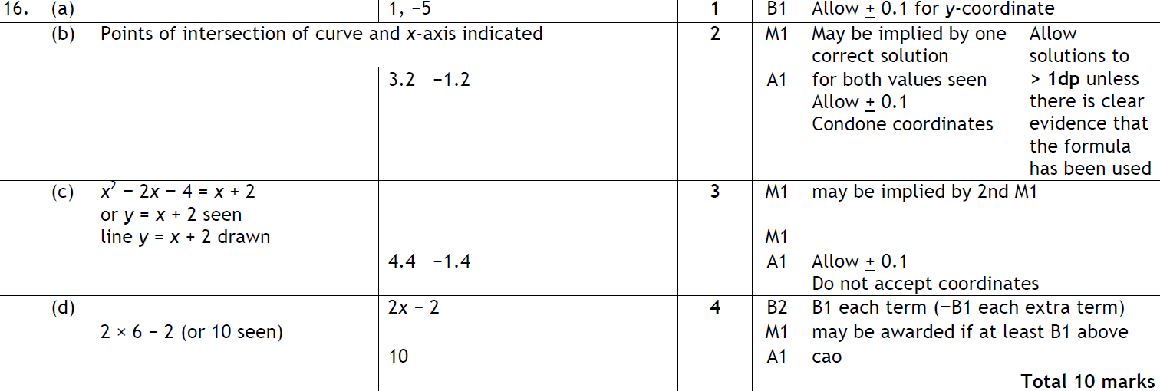
Differentiation
May 2006 3H Q16
A
B
C
D (i)
D (ii)

Slide 29
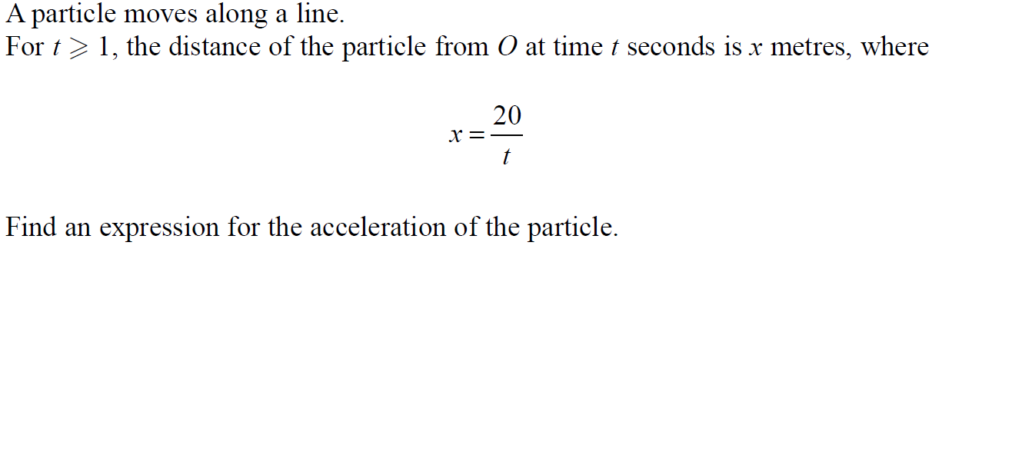
Differentiation
May 2006 4H Q18

Slide 30
Differentiation
May 2006 4H Q18
A

Slide 31
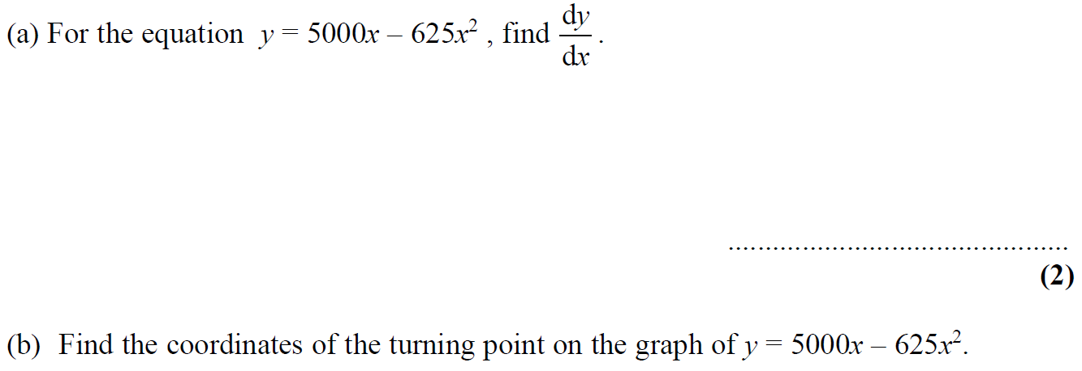
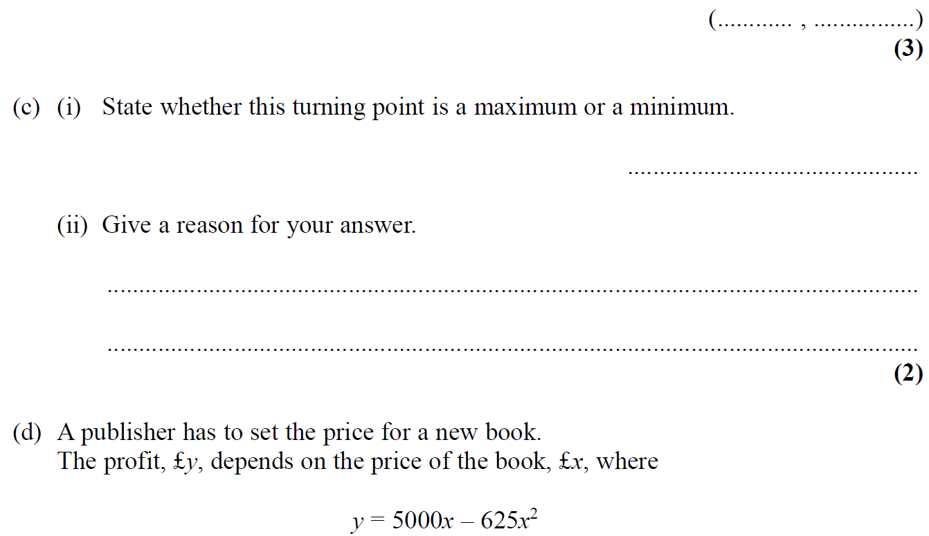
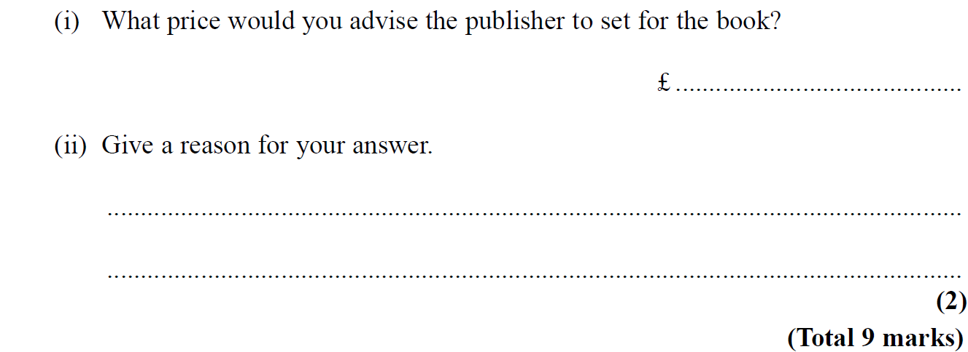
Differentiation
Nov 2006 3H Q14

Slide 32
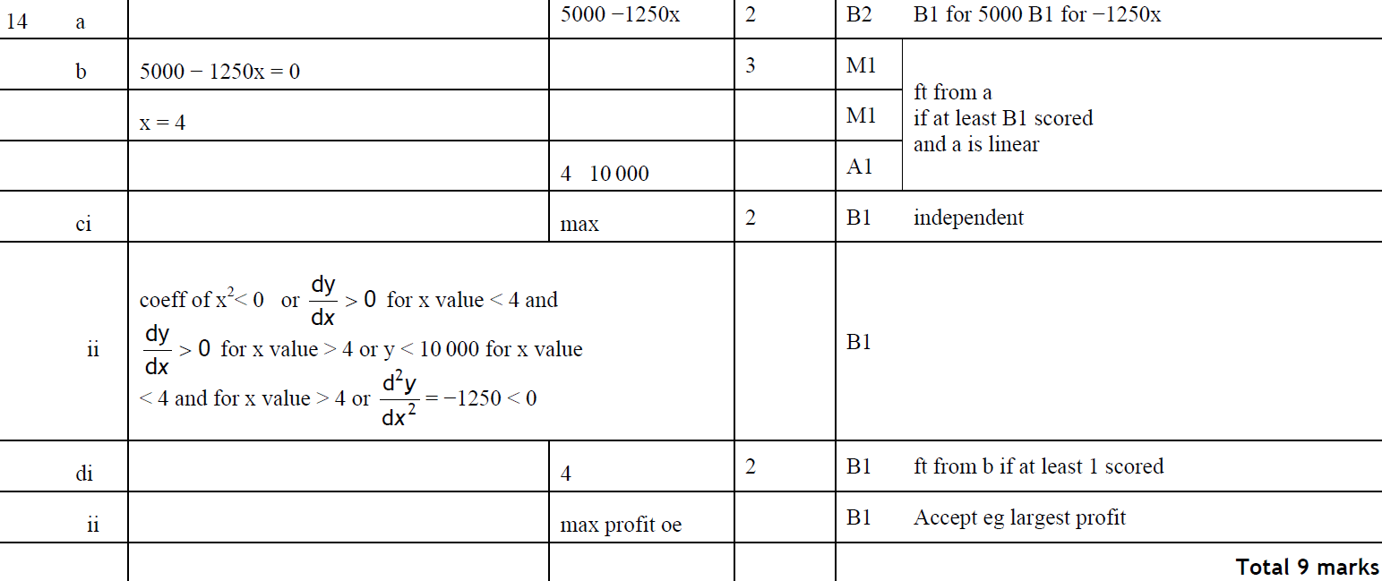
Differentiation
Nov 2006 3H Q14
A
B
C (i)
C (ii)
D (i)
D (ii)

Slide 33
Differentiation
May 2007 3H Q17

Slide 34
Differentiation
May 2007 3H Q17
A

Slide 35
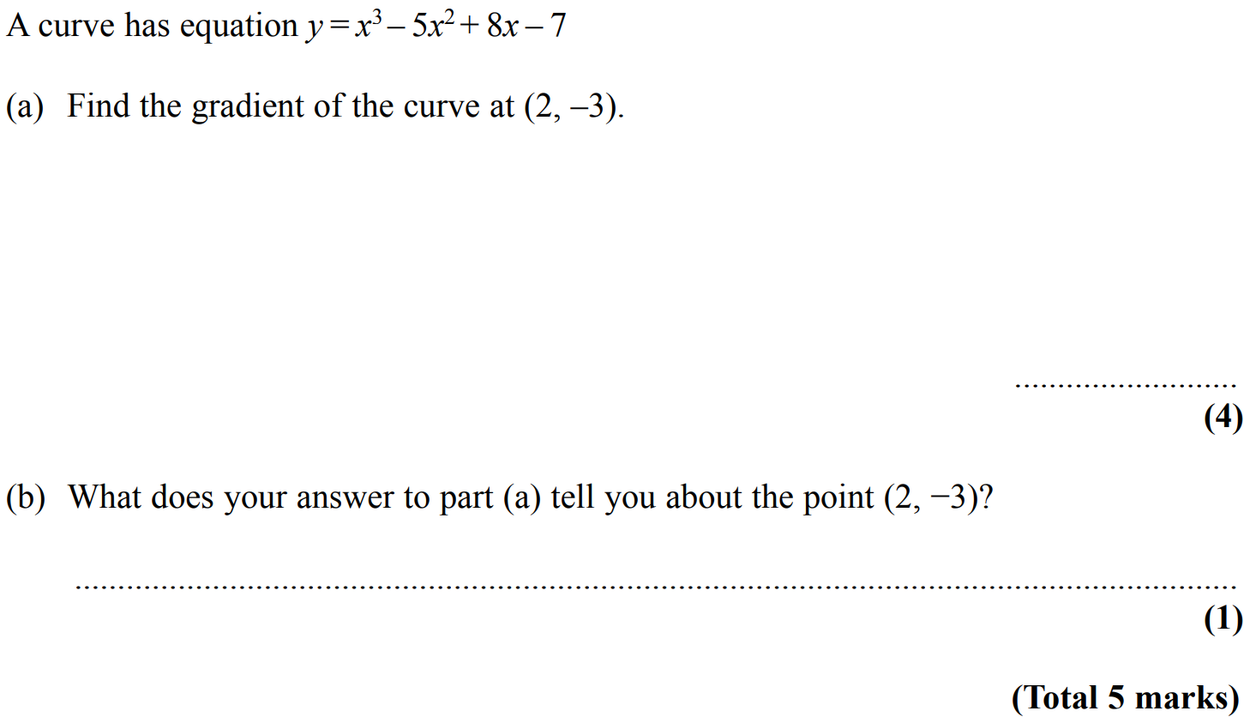
Differentiation
Nov 2007 4H Q20

Slide 36
Differentiation
Nov 2007 4H Q20
A
B

Slide 37
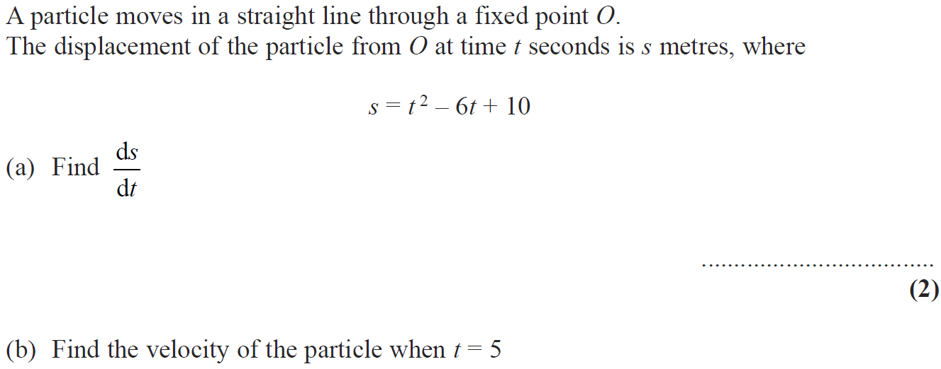
Differentiation
May 2008 4H Q19

Slide 38
Differentiation
May 2008 4H Q19
A
B
C

Slide 39
Differentiation
Nov 2008 4H Q20

Slide 40
Differentiation
Nov 2008 4H Q20
A (i)
A (ii)
B

Slide 41
Differentiation
June 2009 4H Q17

Slide 42
Differentiation
June 2009 4H Q17
A
B
C

Slide 43
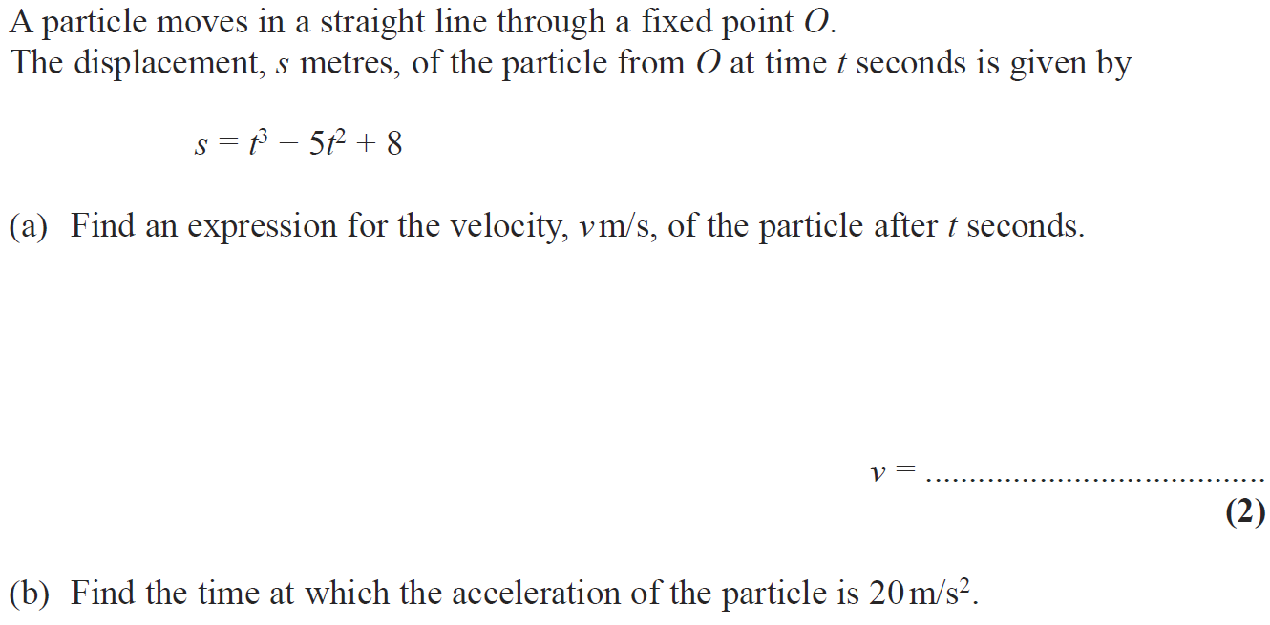
Differentiation
Nov 2009 4H Q19

Slide 44
Differentiation
Nov 2009 4H Q19
A
B

Slide 45
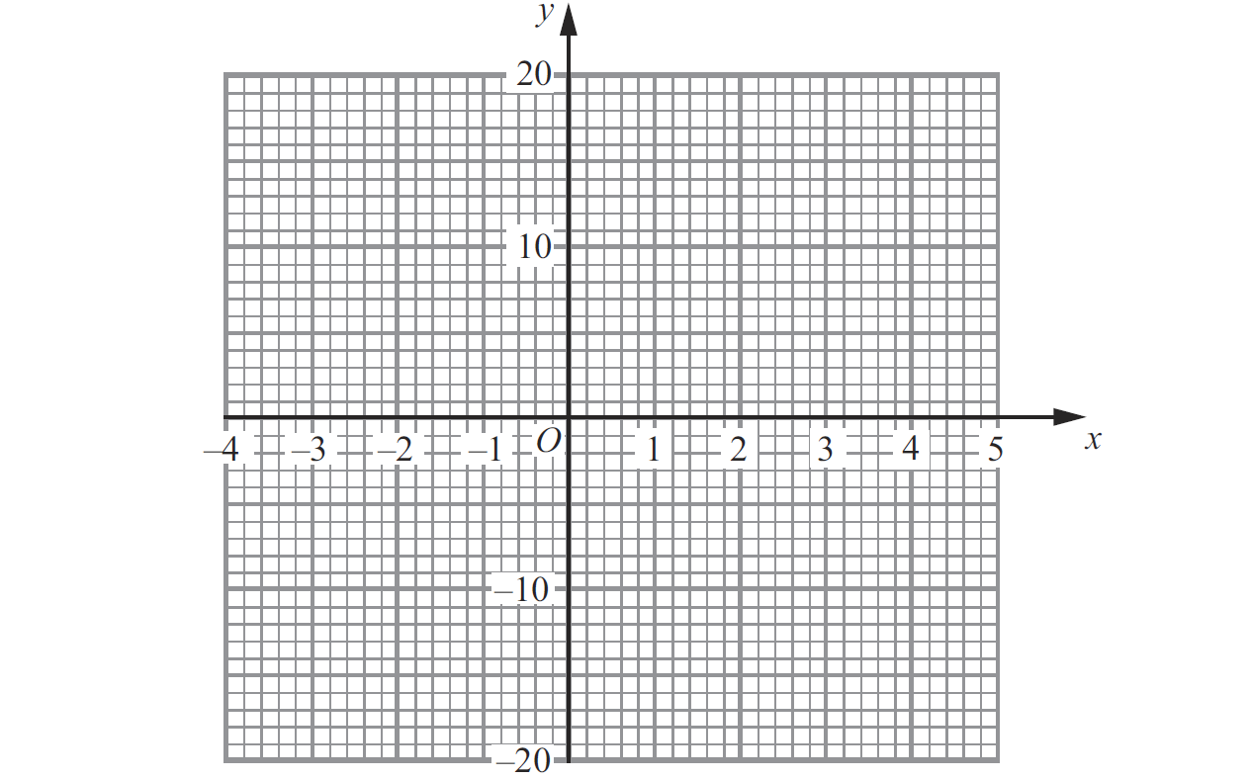
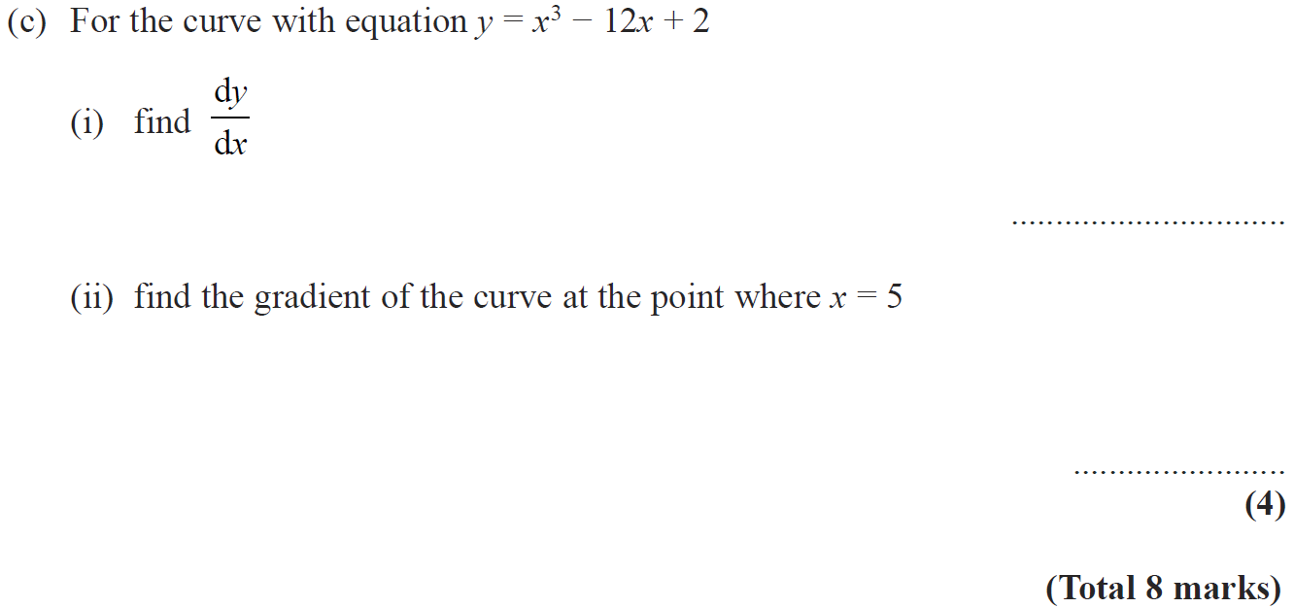
Differentiation
June 2010 3H Q12
Reveal graph

Slide 46
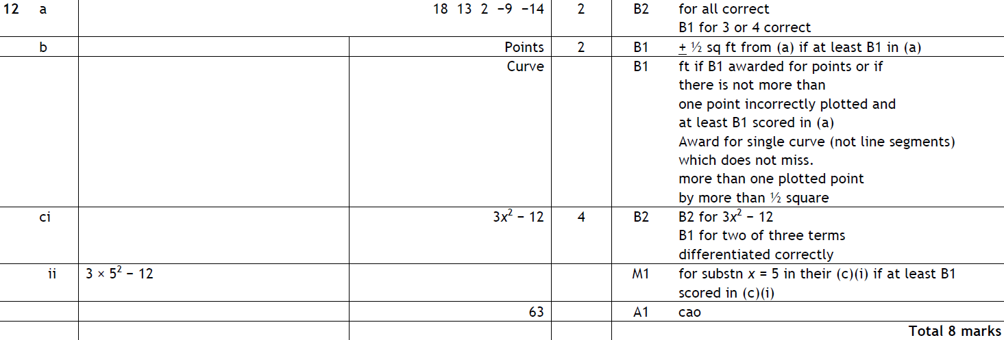
Differentiation
June 2010 3H Q12
A
B
C (i)
C (ii)

Slide 47
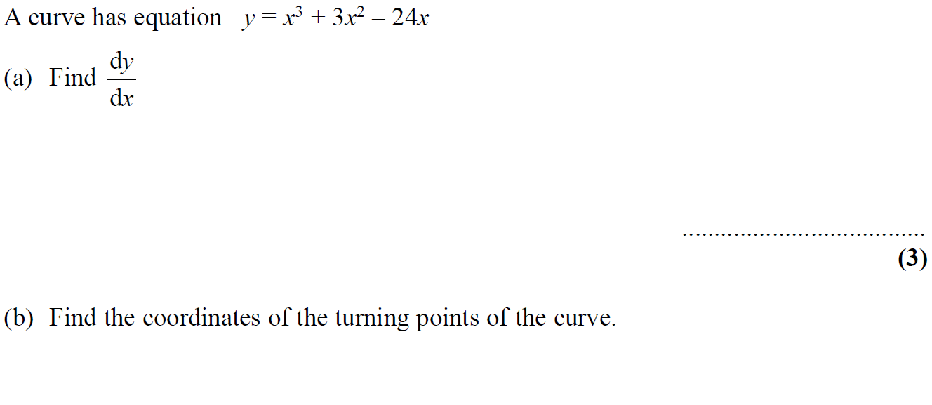
Differentiation
Nov 2010 3H Q16

Slide 48
Differentiation
Nov 2010 3H Q16
A
B

Slide 49
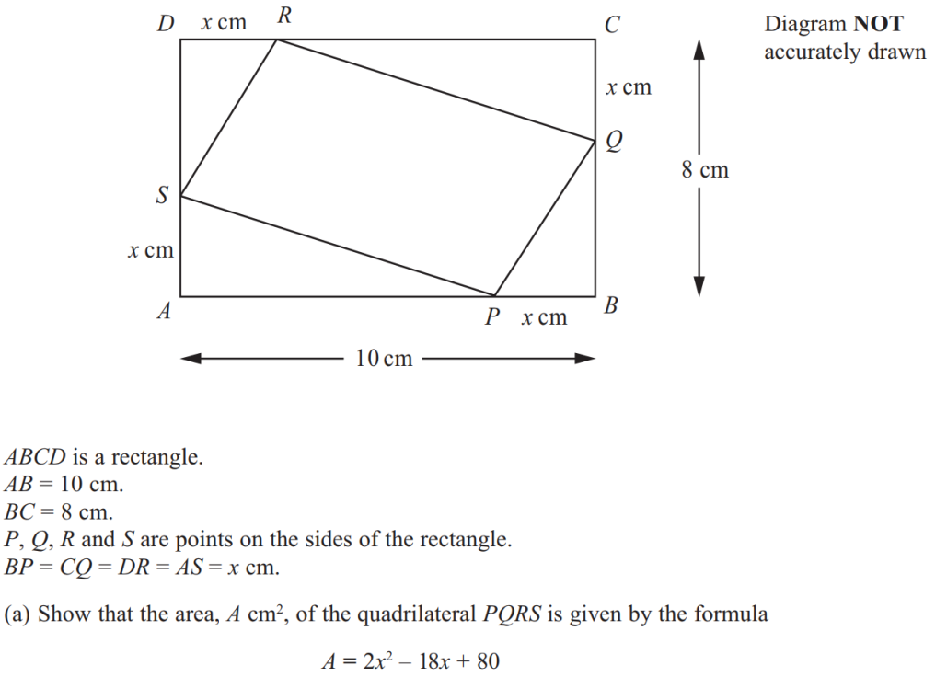
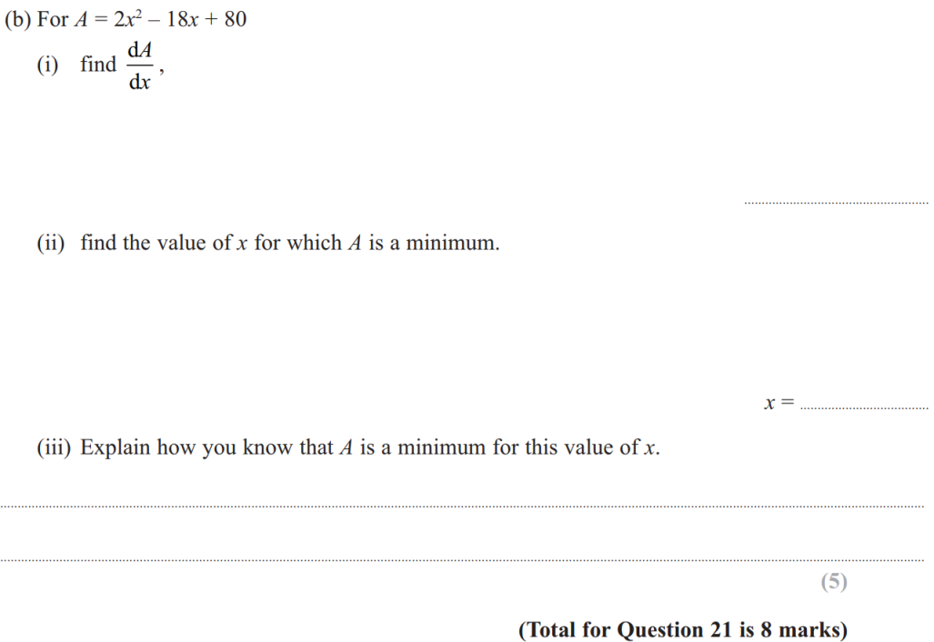
Differentiation
June 2011 3H Q21

Slide 50
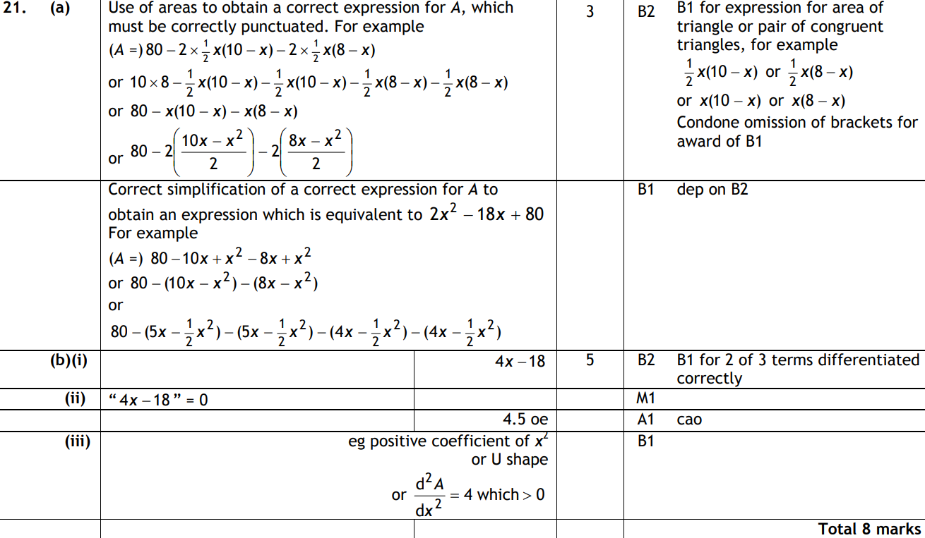
Differentiation
June 2011 3H Q21
A
B (i)
B (ii)
B (iii)

Slide 51
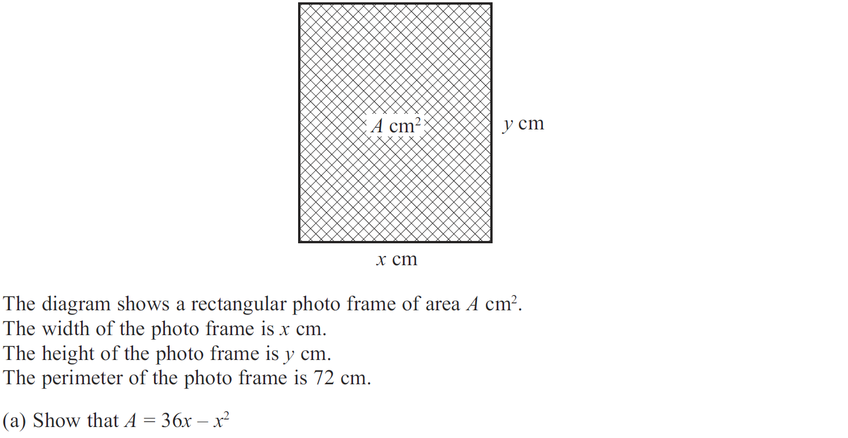
Differentiation
Jan 2012 3H Q14

Slide 52
Differentiation
Jan 2012 3H Q14
A
B
C

Slide 53
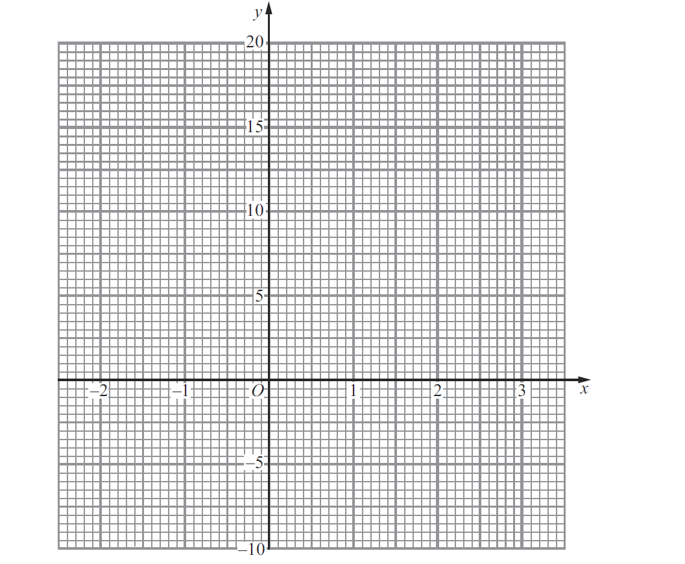
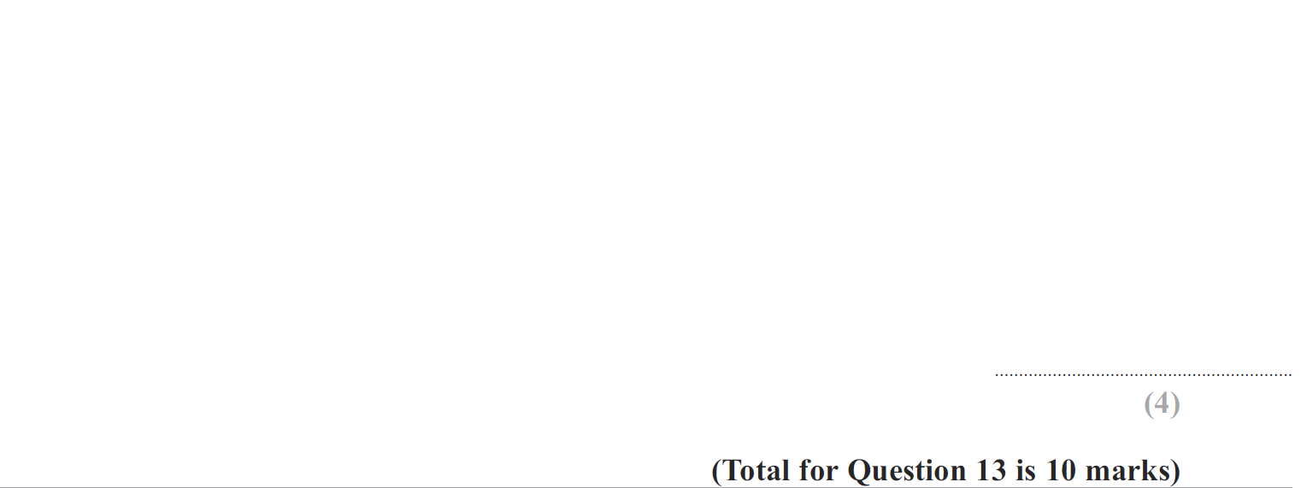
Differentiation
May 2012 4H Q13
Reveal graph

Slide 54
Differentiation
May 2012 4H Q13
A
B
C
D
E

Slide 55
Differentiation
Jan 2013 3H Q18

Slide 56
Differentiation
Jan 2013 3H Q18
A (i)
A (ii)
B

Slide 57
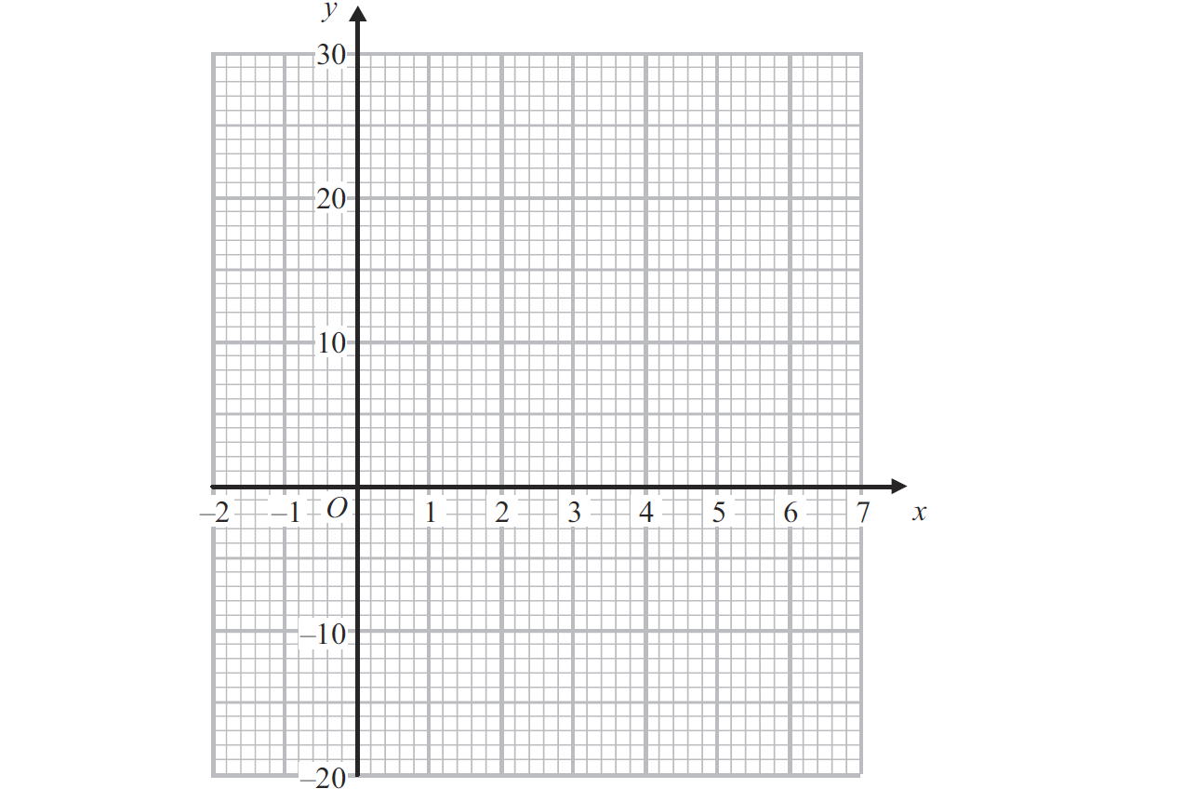
Differentiation
May 2013 4H Q11
Reveal graph

Slide 58
Differentiation
May 2013 4H Q11
A (i)
A (ii)
B
C (i)
C (ii)

Slide 59
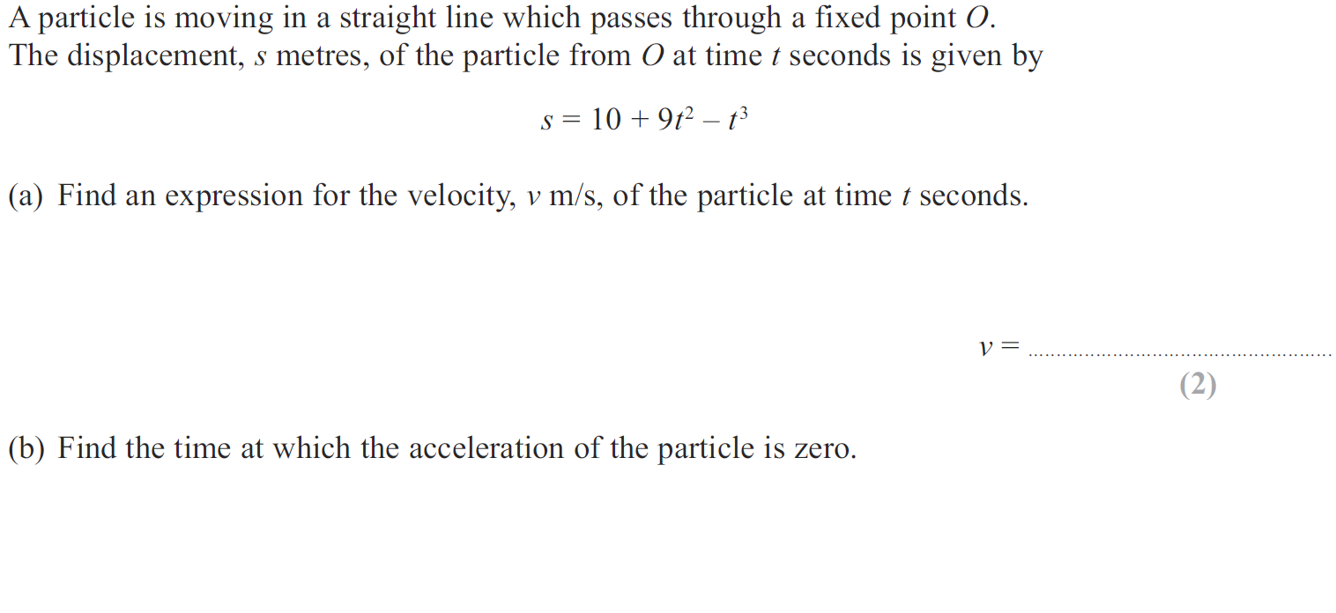
Differentiation
May 2013 3HR Q19

Slide 60
Differentiation
May 2013 3HR Q19
A
B

Slide 61
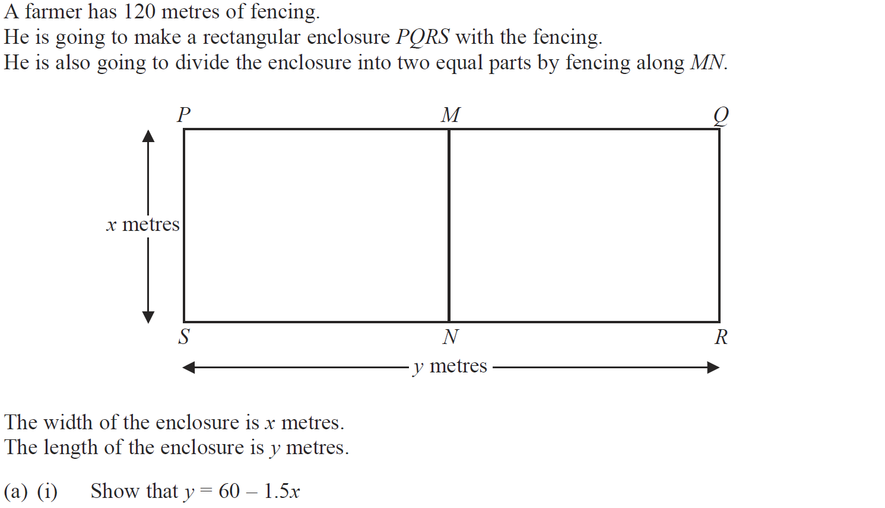
Differentiation
Jan 2014 4H Q15

Slide 62
Differentiation
Jan 2014 4H Q15
A (i)
A (ii)
B
C

Slide 63
Differentiation
Jan 2014 3HR Q15

Slide 64
Differentiation
Jan 2014 3HR Q15
A
B

Slide 65
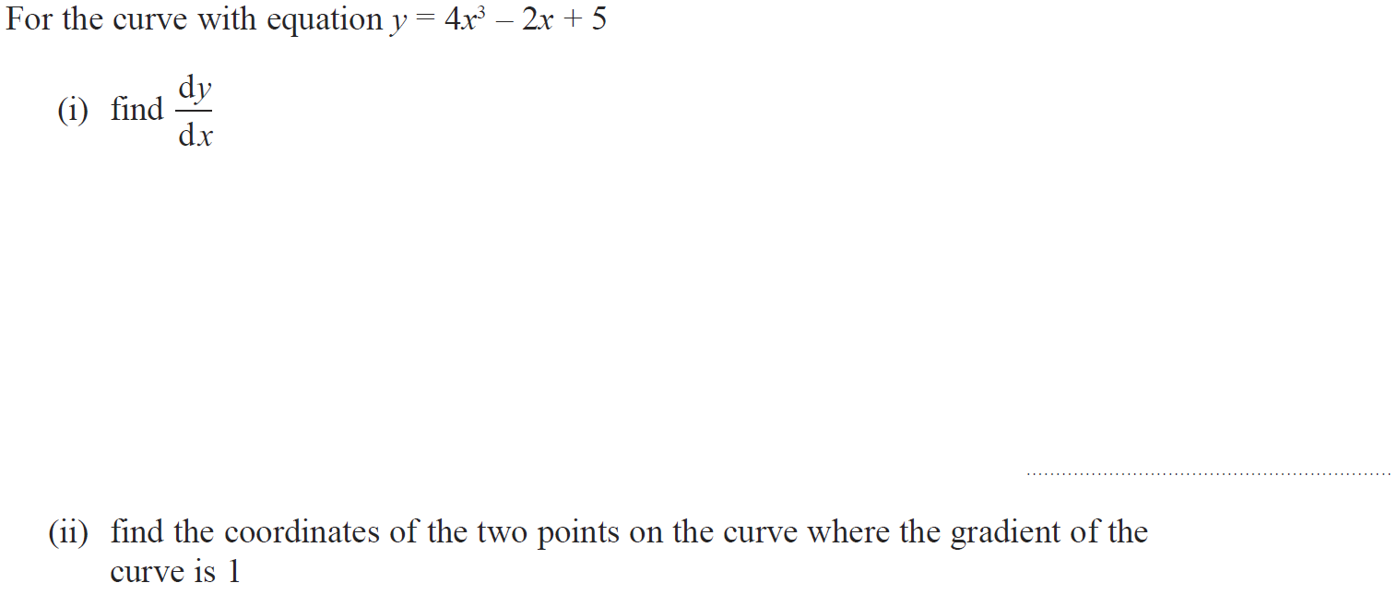
Differentiation
Jan 2014 4HR Q15

Slide 66
Differentiation
Jan 2014 4HR Q15
(i)
(ii)

Slide 67
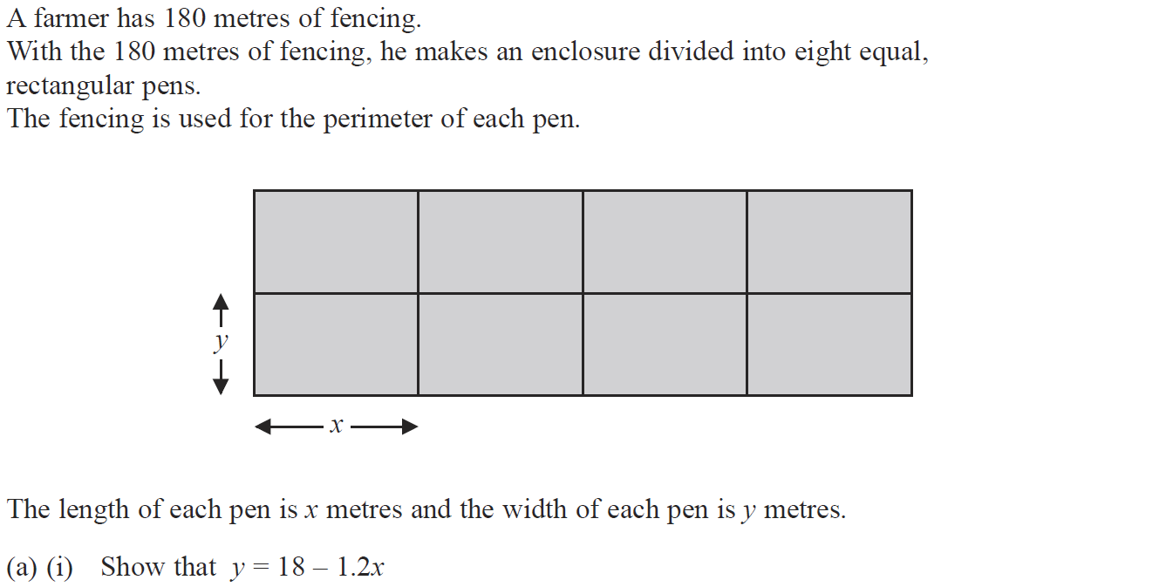
Differentiation
May 2014 3H Q14

Slide 68
Differentiation
May 2014 3H Q14
A (i)
A (ii)
B
C

Slide 69
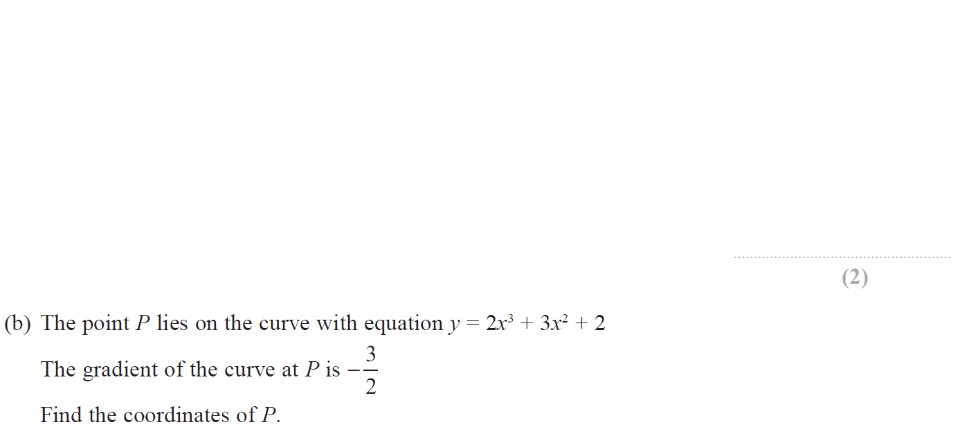
Differentiation
May 2014 3HR Q14

Slide 70
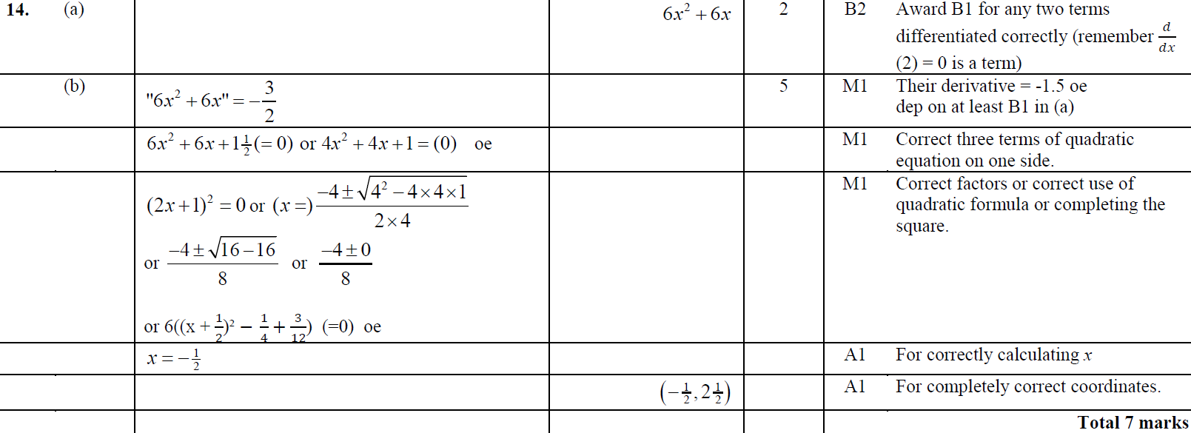
Differentiation
May 2014 3HR Q14
A
B

Slide 71
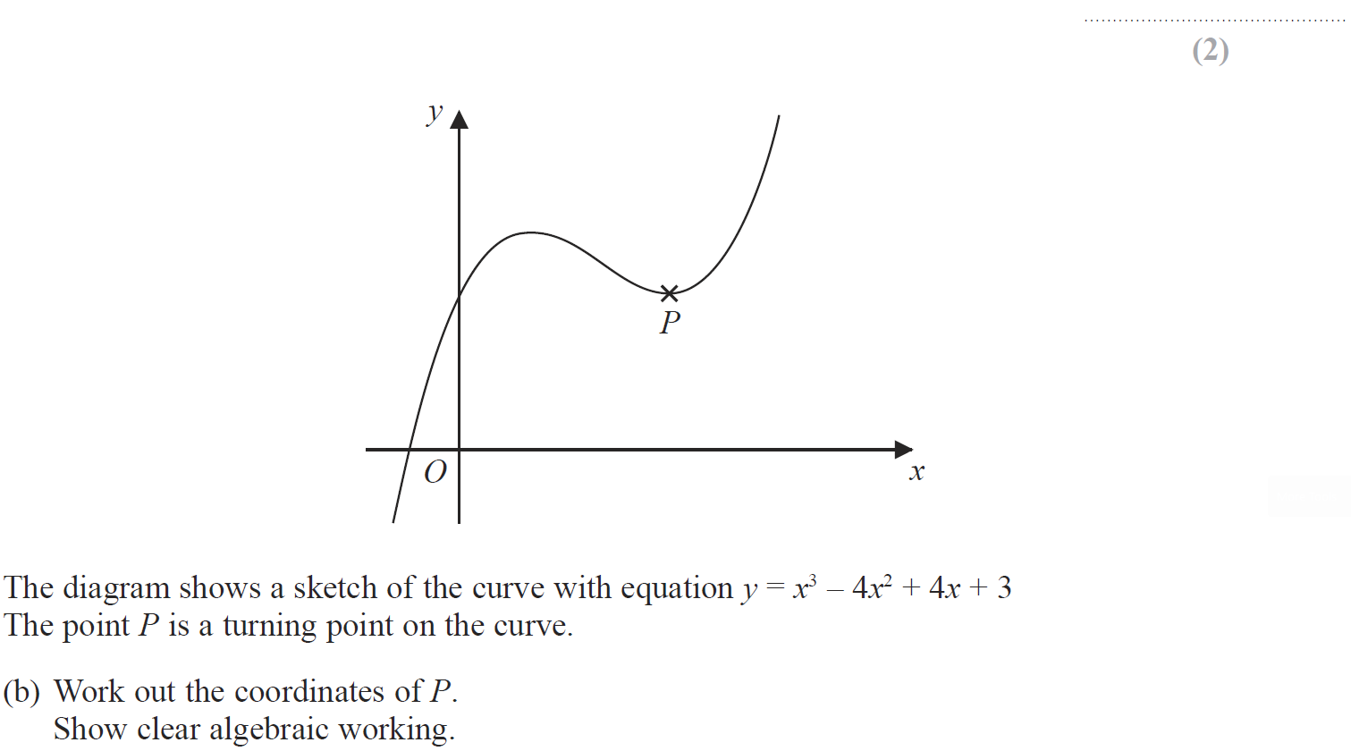
Differentiation
Jan 2015 3H Q18

Slide 72
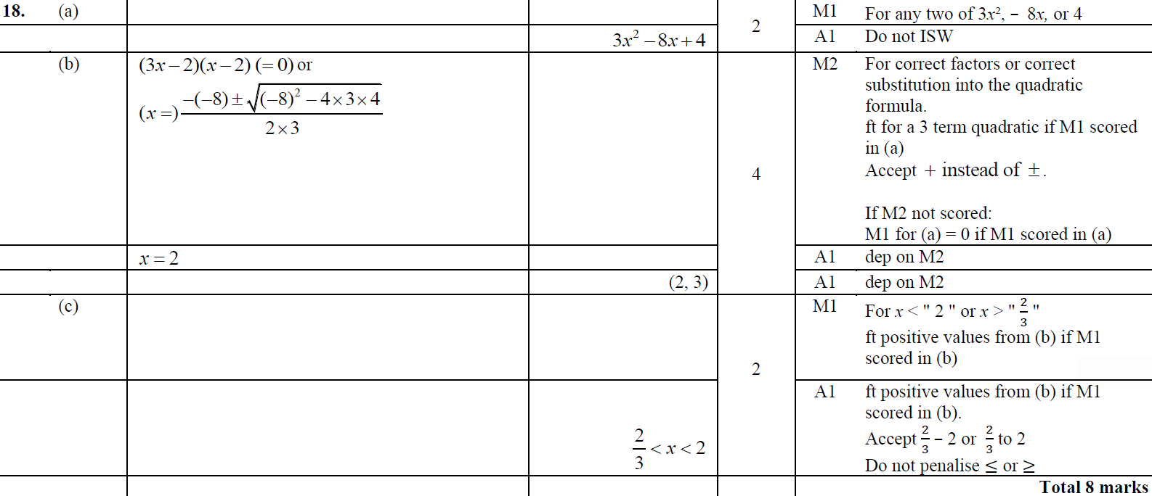
Differentiation
Jan 2015 3H Q18
A
B
C

Slide 73
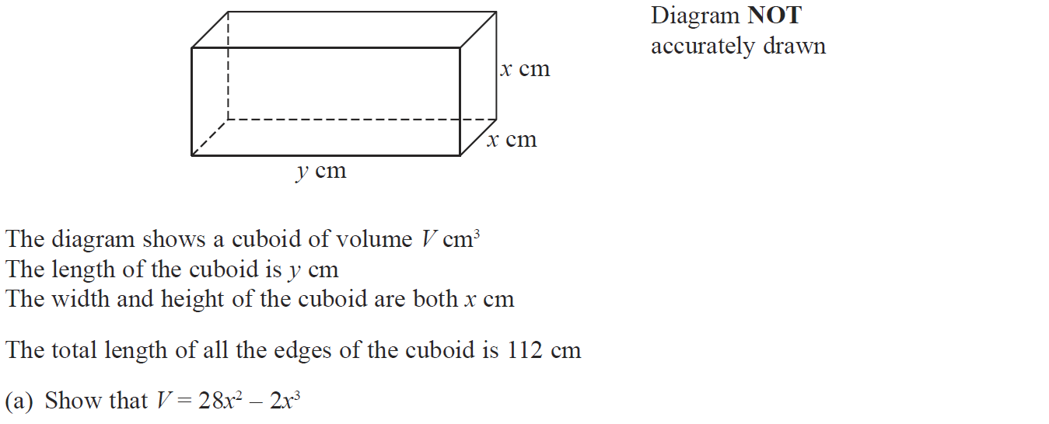
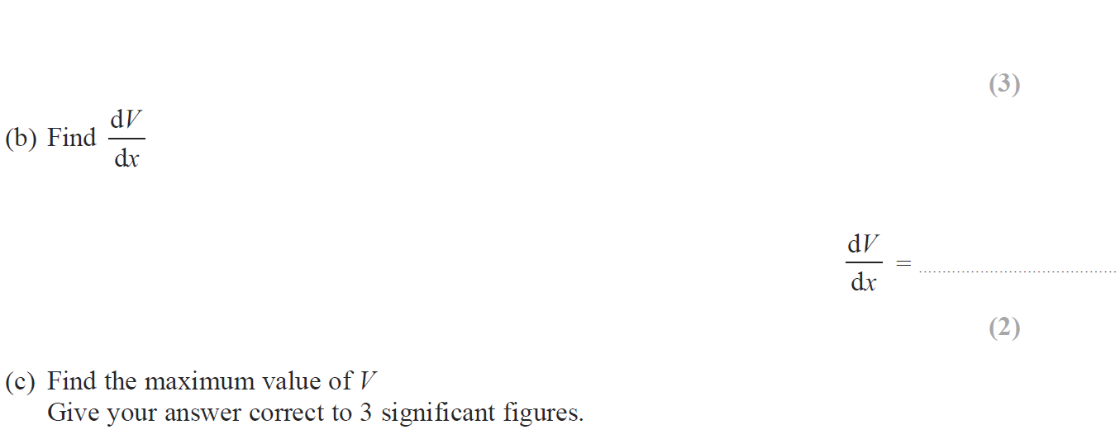
Differentiation
Jan 2015 3HR Q17

Slide 74
Differentiation
Jan 2015 3HR Q17
A
B
C

Slide 75
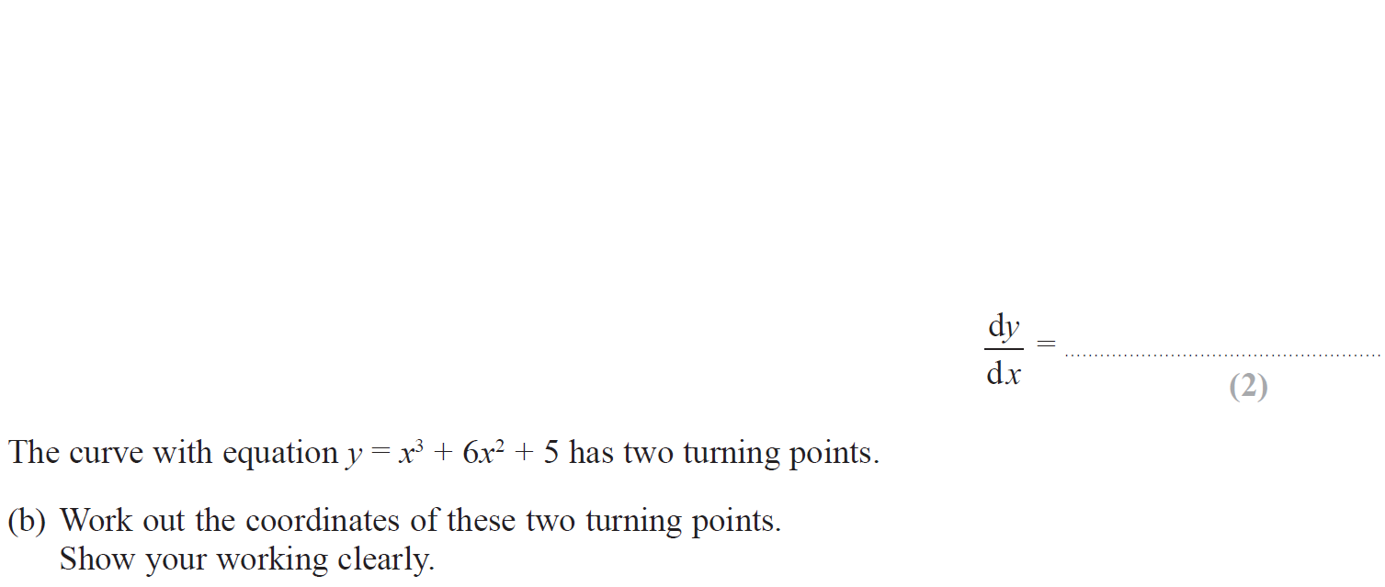
Differentiation
June 2015 4H Q21

Slide 76
Differentiation
June 2015 4H Q21
A
B

Slide 77
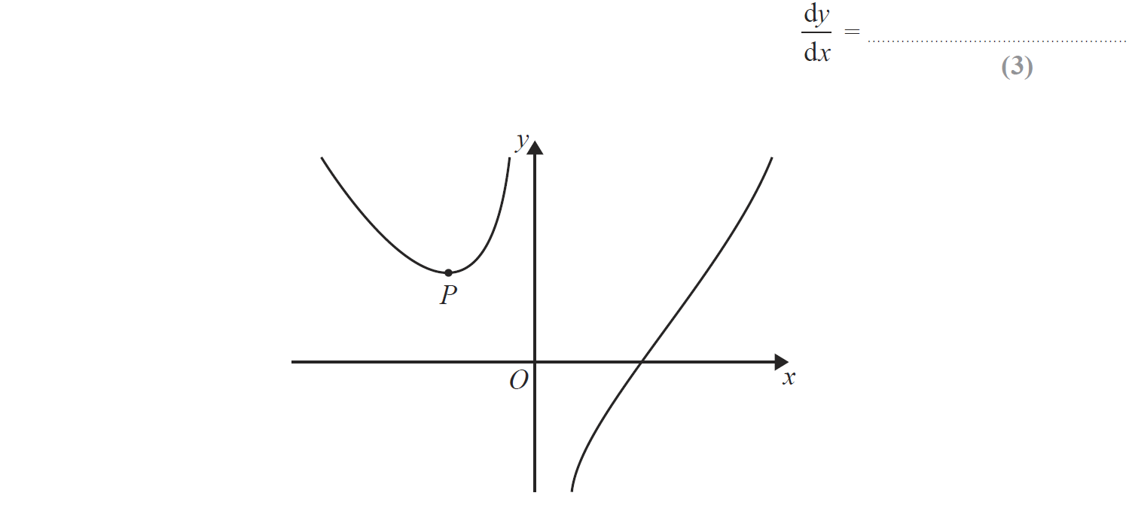
Differentiation
June 2015 4HR Q21

Slide 78
Differentiation
June 2015 4HR Q21
A
B

Slide 79
Differentiation
Jan 2016 4H Q16

Slide 80
Differentiation
Jan 2016 4H Q16
A
B

Slide 81
Differentiation
Jan 2016 3HR Q15

Slide 82
Differentiation
Jan 2016 3HR Q15
A
B
C

Slide 83
Differentiation
May 2016 3H Q14

Slide 84
Differentiation
May 2016 3H Q14
A
B

Slide 85
Differentiation
May 2016 3HR Q15

Slide 86
Differentiation
May 2016 3HR Q15
A
B

Slide 87
Differentiation
Jan 2017 3H Q18

Slide 88
Differentiation
Jan 2017 3H Q18
A

Slide 89
Differentiation
Jan 2017 4H Q17

Slide 90
Differentiation
Jan 2017 4H Q17
A

Slide 91
Differentiation
Jan 2017 3HR Q20

Slide 92
Differentiation
Jan 2017 3HR Q20
A
B

Slide 93
Differentiation
June 2017 4H Q17

Slide 94
Differentiation
June 2017 4H Q17
A
B

Slide 95
Differentiation
May 2017 3HR Q15

Slide 96
Differentiation
May 2017 3HR Q15
A
B
C

Slide 97
Differentiation
Jan 2018 4H Q17

Slide 98
Differentiation
Jan 2018 4H Q17
A
B

Slide 99
Differentiation
Jan 2018 4HR Q16

Slide 100
Differentiation
Jan 2018 4HR Q16
A
B

Slide 101
Differentiation
May 2018 3H Q18

Slide 102
Differentiation
May 2018 3H Q18
A
B

Slide 103
Differentiation
June 2018 4H Q14

Slide 104
Differentiation
June 2018 4H Q14
A
B
C

Slide 105
Differentiation
May 2018 3HR Q17

Slide 106
Differentiation
May 2018 3HR Q17
A
B
C

