Slide 1
Cumulative Frequency
Cumulative Frequency
May 2017
1H Q19
Nov 2017
1H Q22
SAM
3H Q13
1 Marker
May 2017
1H Q19
Nov 2017
2H Q16

Slide 2
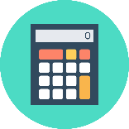
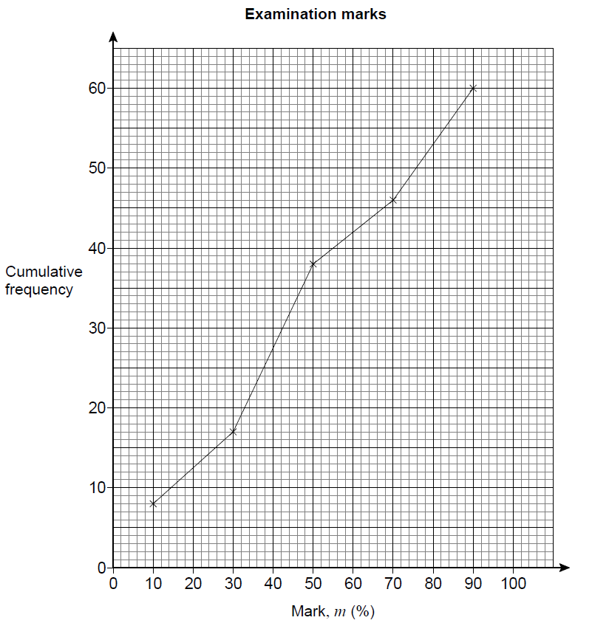
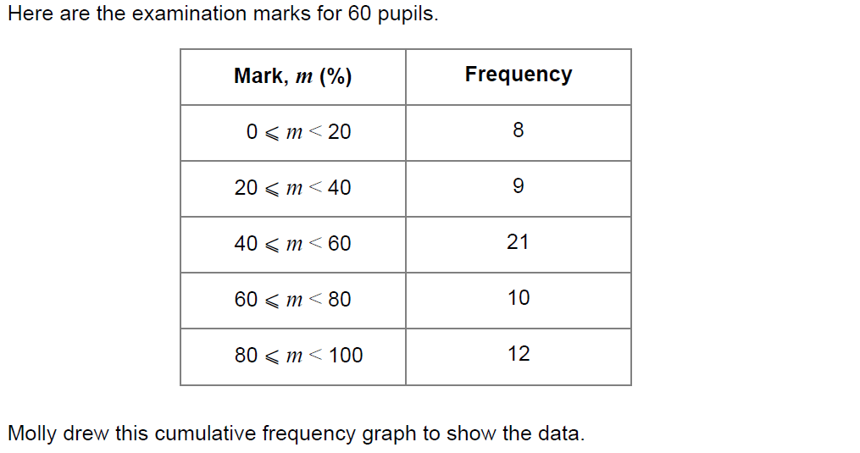
Cumulative Frequency
SAM 3H Q13

Slide 3
Cumulative Frequency
SAM 3H Q13
A

Slide 4
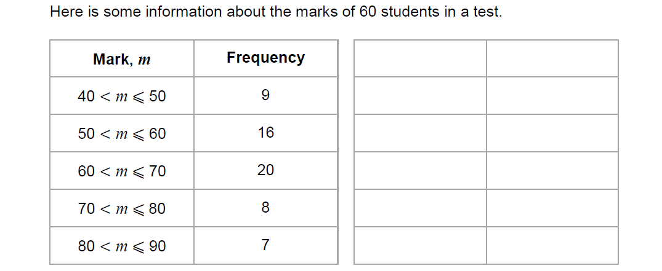
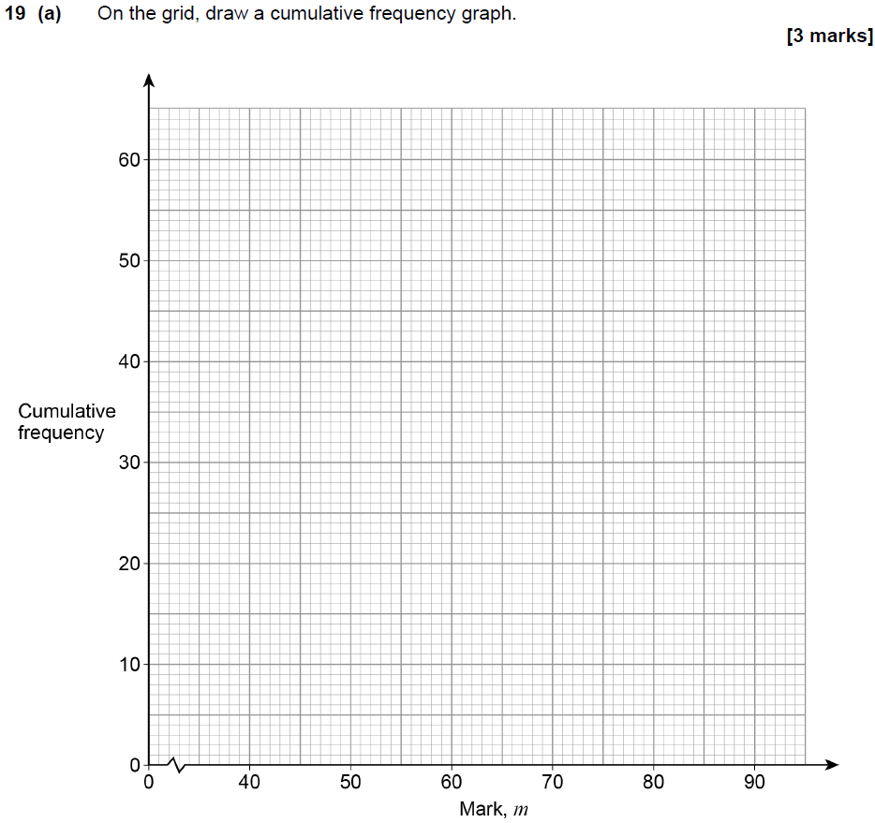
Cumulative Frequency
May 2017 1H Q19
Show Graph
Hide Graph

Slide 5
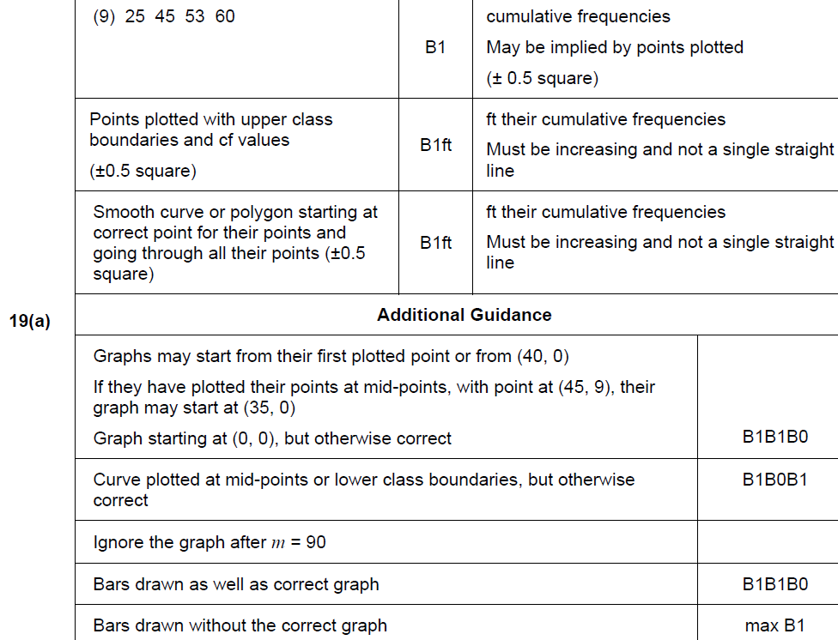
Cumulative Frequency
May 2017 1H Q19
A

Slide 6
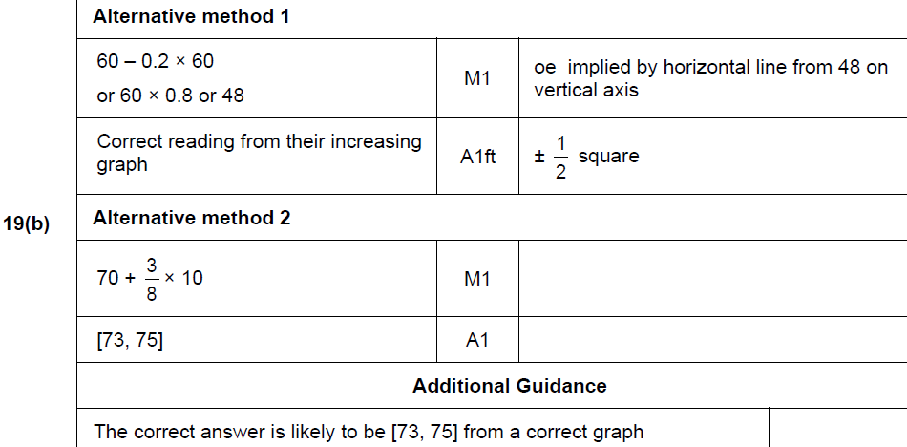
Cumulative Frequency
May 2017 1H Q19
B

Slide 7
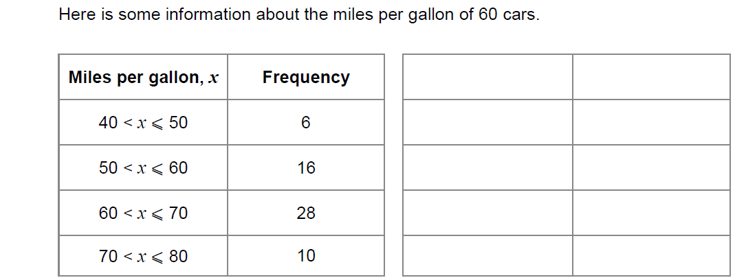
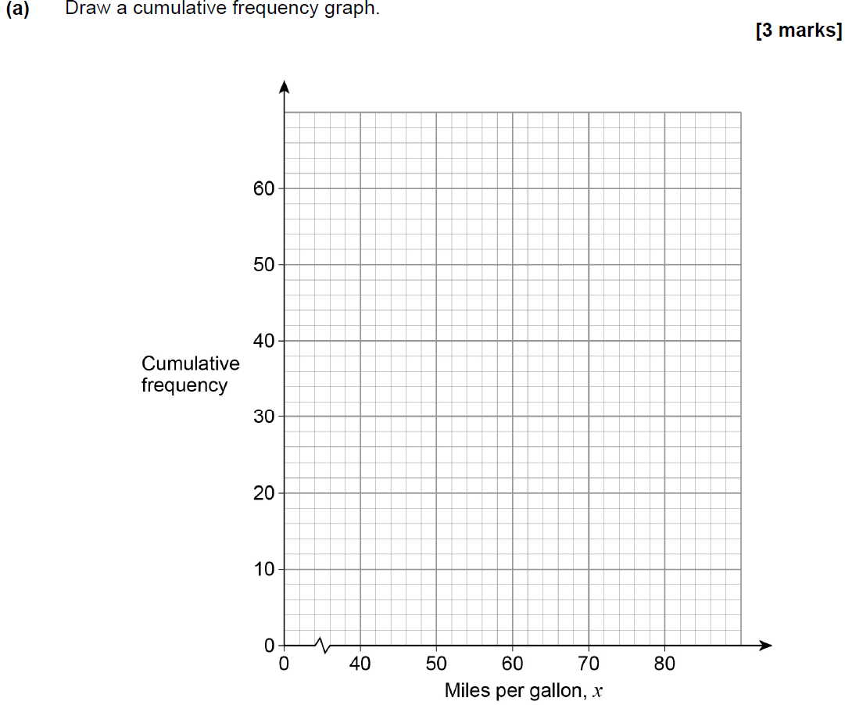
Cumulative Frequency
Nov 2017 1H Q22
Show Graph
Hide Graph

Slide 8
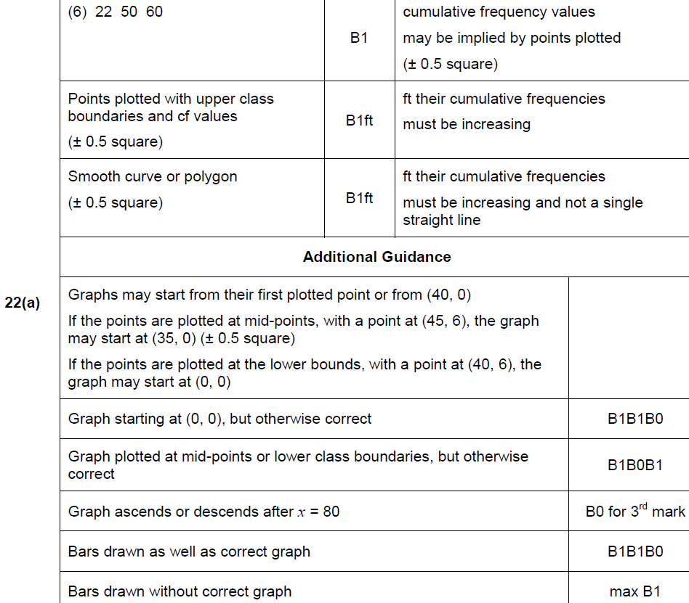
Cumulative Frequency
Nov 2017 1H Q22
A

Slide 9
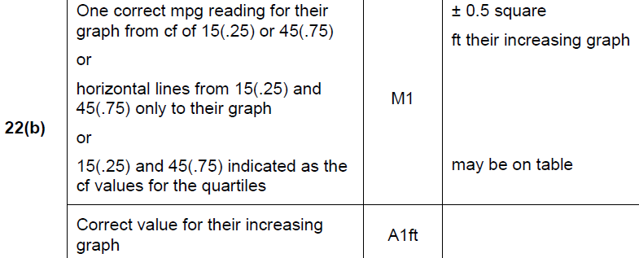
Cumulative Frequency
Nov 2017 1H Q22
B

Slide 10
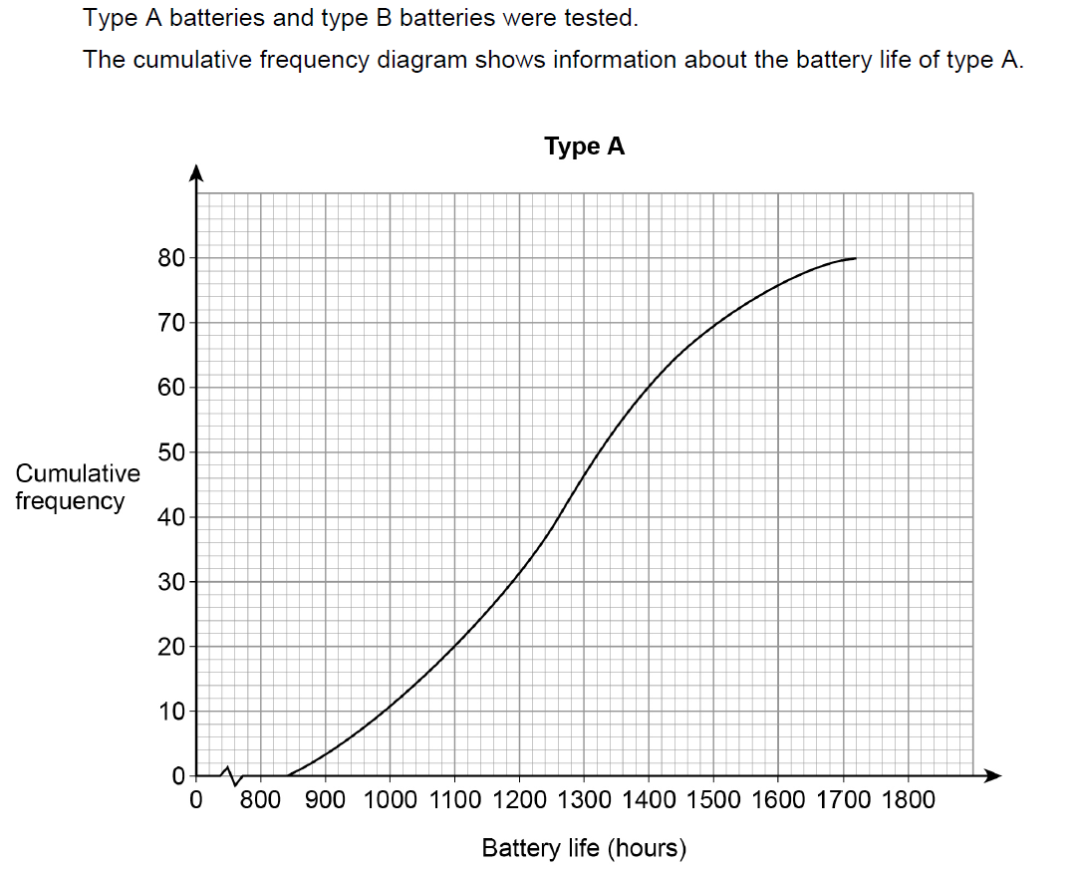
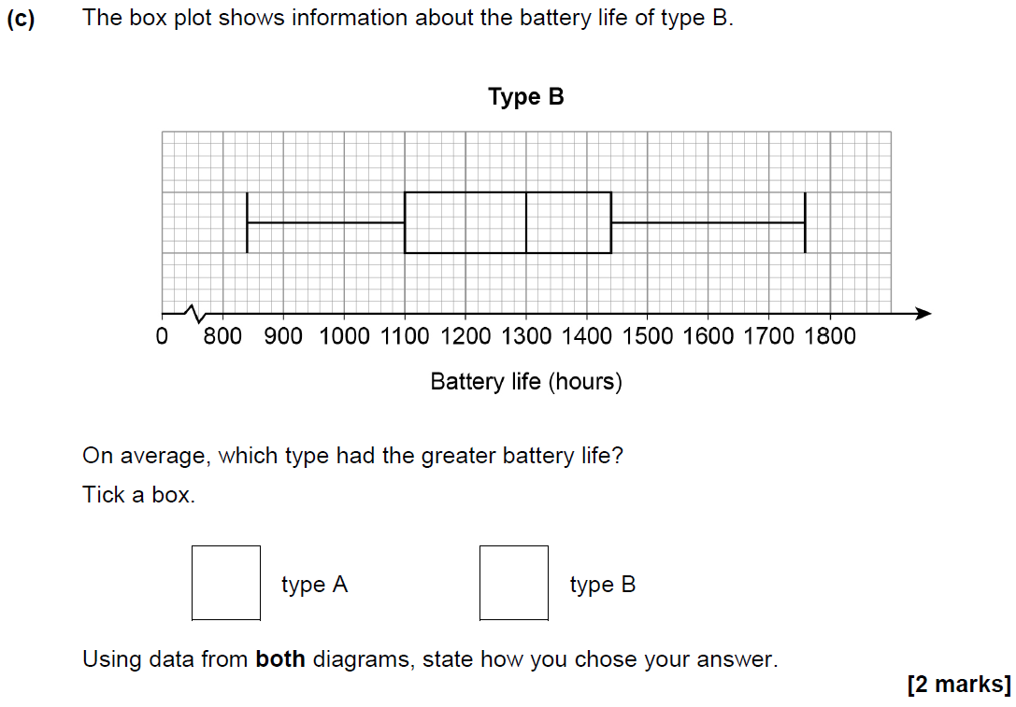
Cumulative Frequency
May 2018 1H Q19

Slide 11
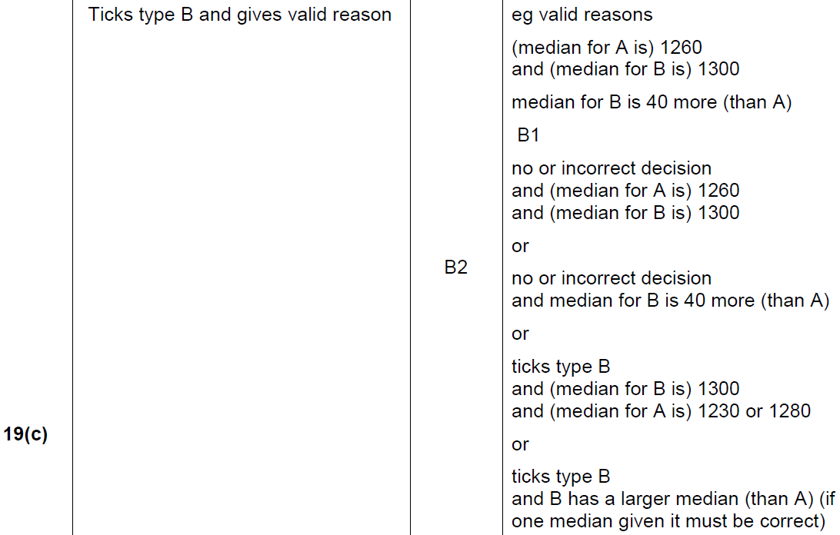
Cumulative Frequency
May 2018 1H Q19
A
B
C

Slide 12
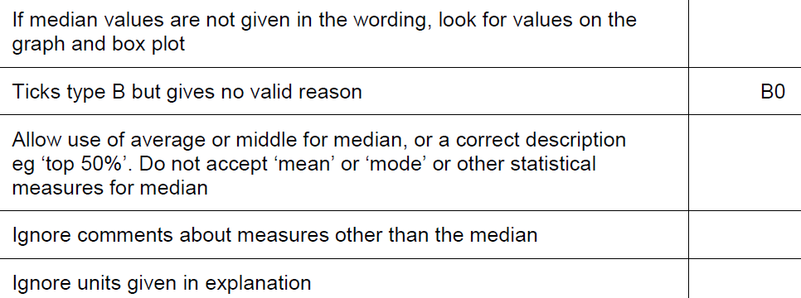
Cumulative Frequency
May 2018 1H Q19
C notes

Slide 13
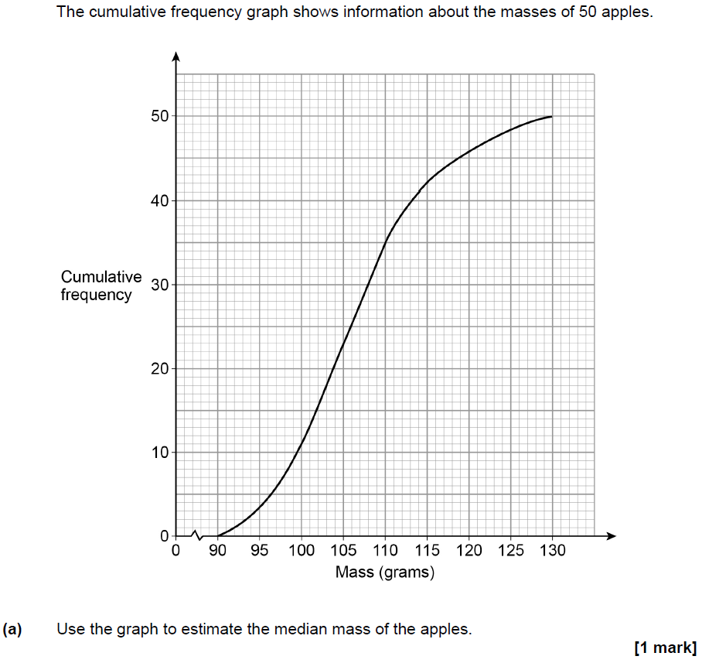
Cumulative Frequency
Nov 2018 2H Q16

Slide 14
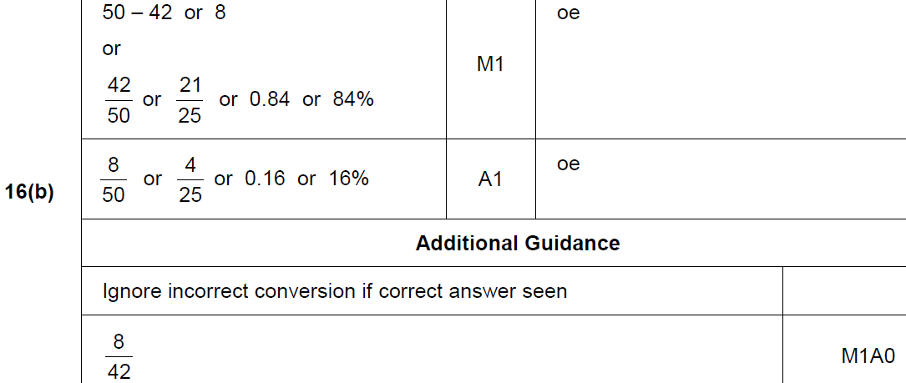
Cumulative Frequency
Nov 2018 2H Q16
A
B

