Slide 1
Cumulative Frequency
Cumulative Frequency
June 2017
2H Q8
Edexcel
SAM
3H Q7
Nov 2017
3H Q11
AQA
Spec 2
2H Q11
Nov 2018
1H Q9
OCR
June 2019
2H Q11

Slide 2
Cumulative Frequency
Cumulative Frequency
May 2017
1H Q19
Edexcel
Nov 2017
1H Q22
AQA
SAM
3H Q13
1 Marker
May 2017
1H Q19
OCR
Nov 2017
2H Q16

Slide 3
Cumulative Frequency
Cumulative Frequency
Edexcel
May 2017
1H Q12
SAM
1H Q14
AQA
Nov 2017
2H Q15
Practice
1H Q9
OCR
Nov 2018
2H Q15

Slide 4
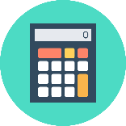
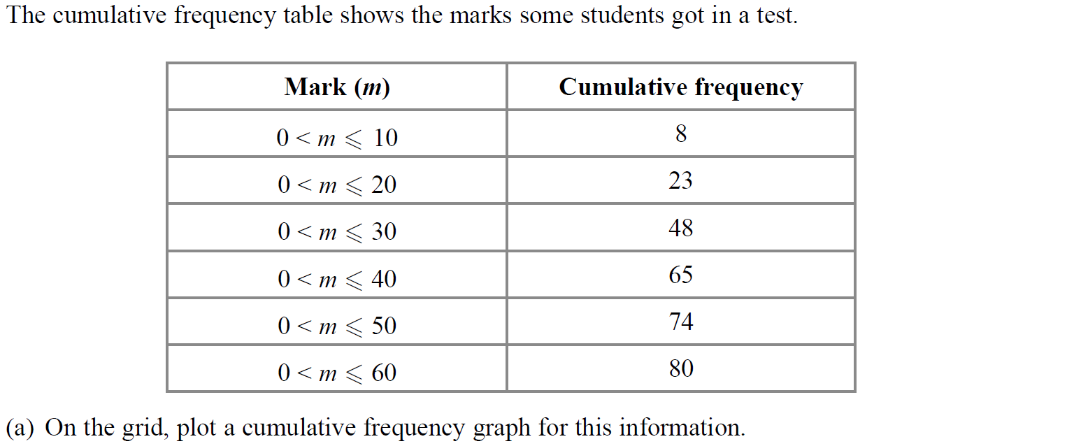
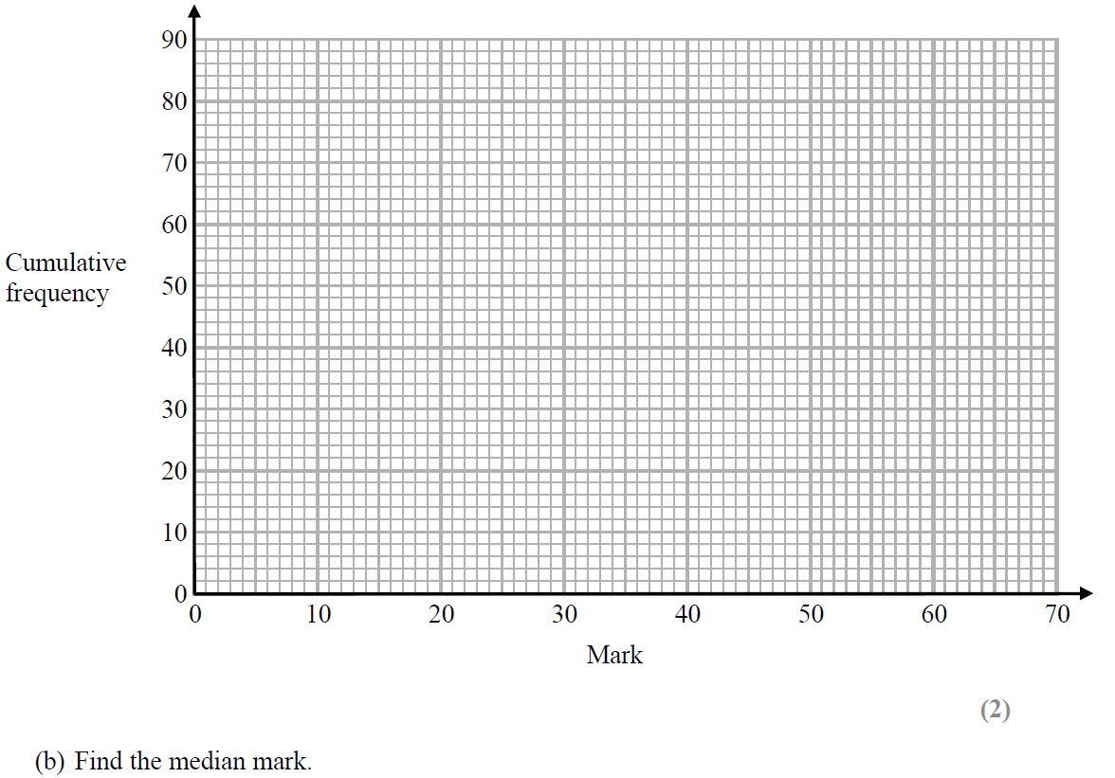
Cumulative Frequency
SAM 3H Q7
Show Graph
Hide Graph

Slide 5
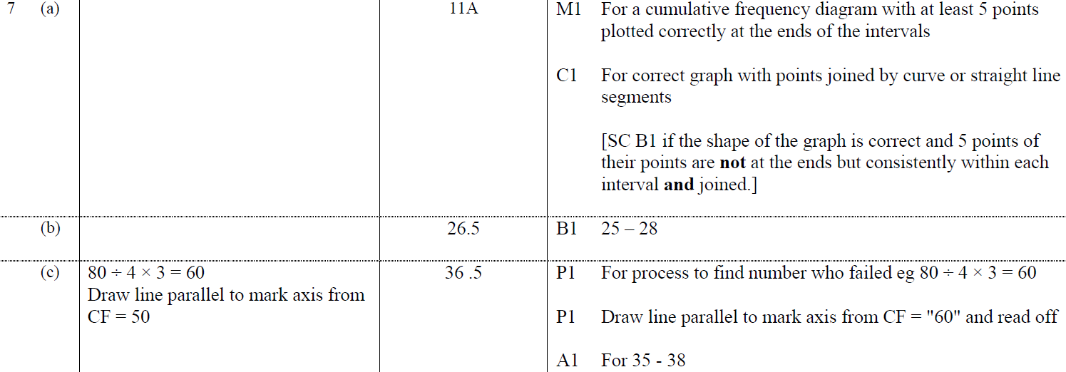
Cumulative Frequency
SAM 3H Q7
A
B
C

Slide 6
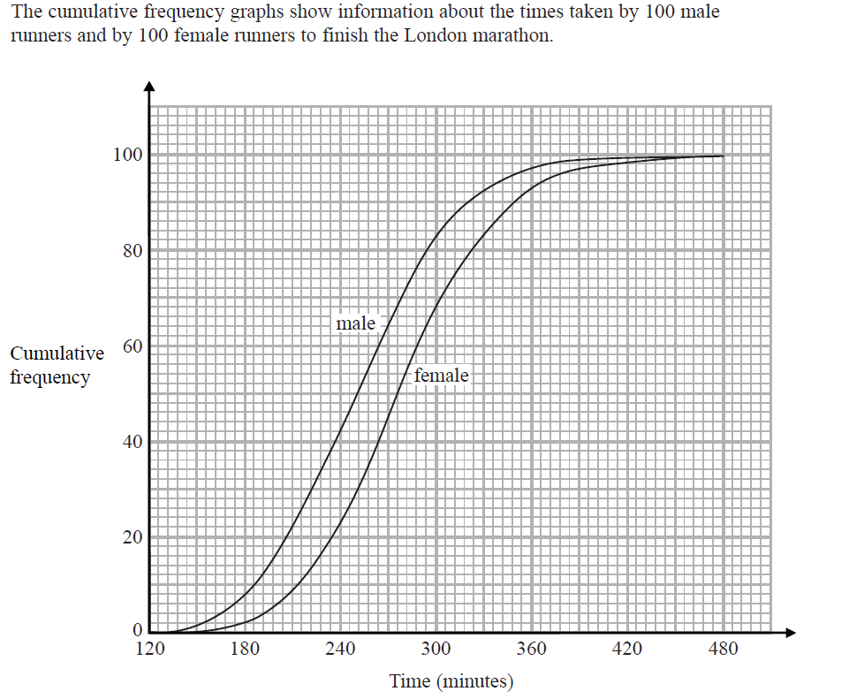
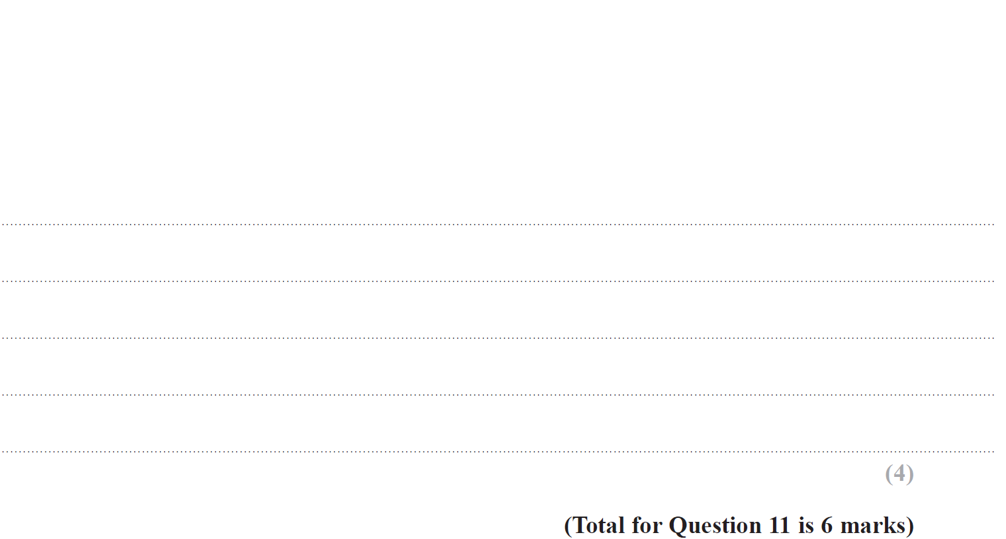
Cumulative Frequency
Specimen Set 2 2H Q11

Slide 7
Cumulative Frequency
Specimen Set 2 2H Q11
A
B

Slide 8
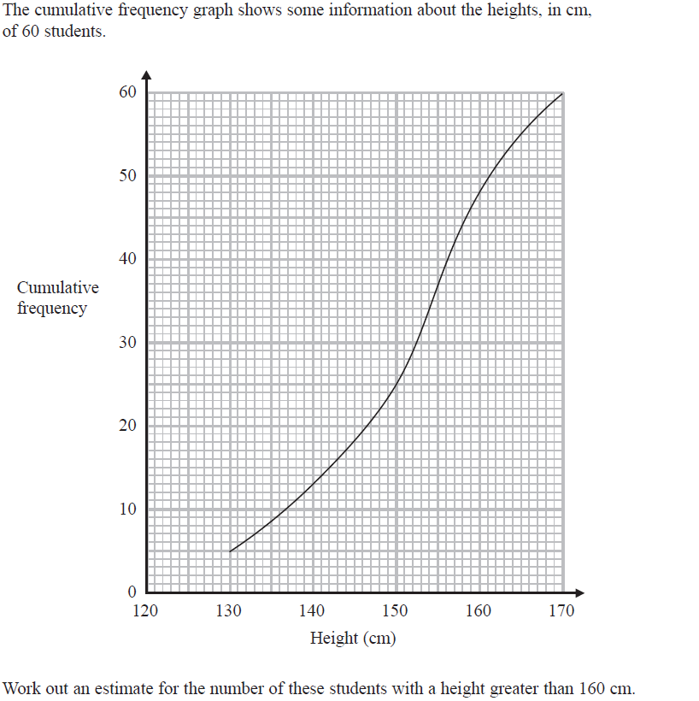
Cumulative Frequency
June 2017 2H Q8

Slide 9
Cumulative Frequency
June 2017 2H Q8
A

Slide 10
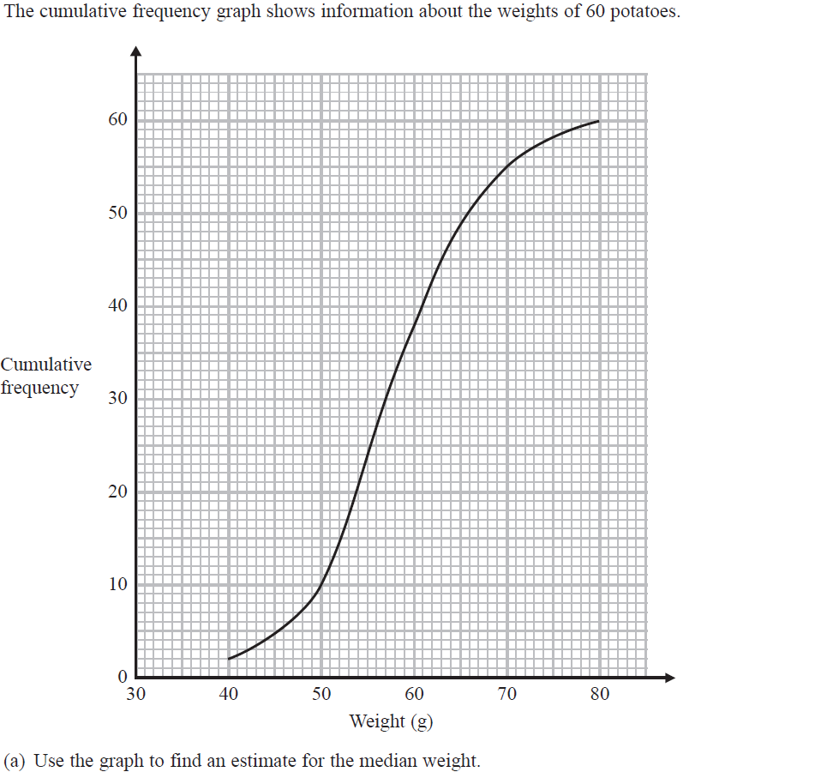
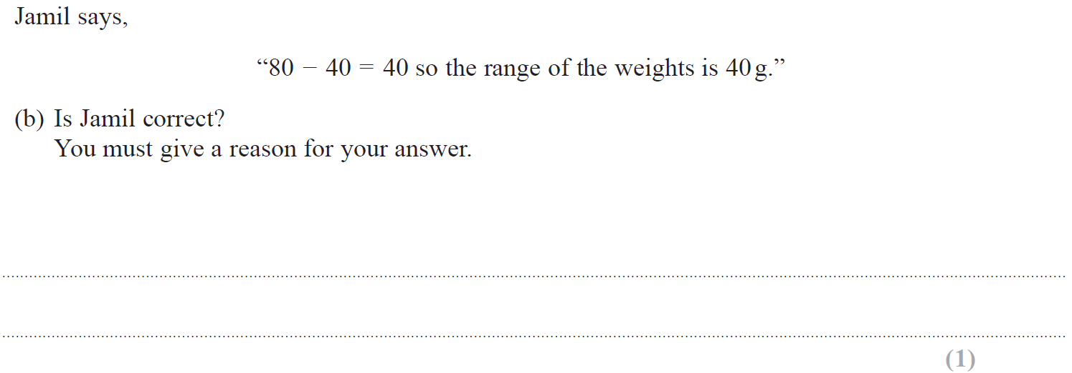
Cumulative Frequency
Nov 2017 3H Q11

Slide 11
Cumulative Frequency
Nov 2017 3H Q11
A
B
C

Slide 12
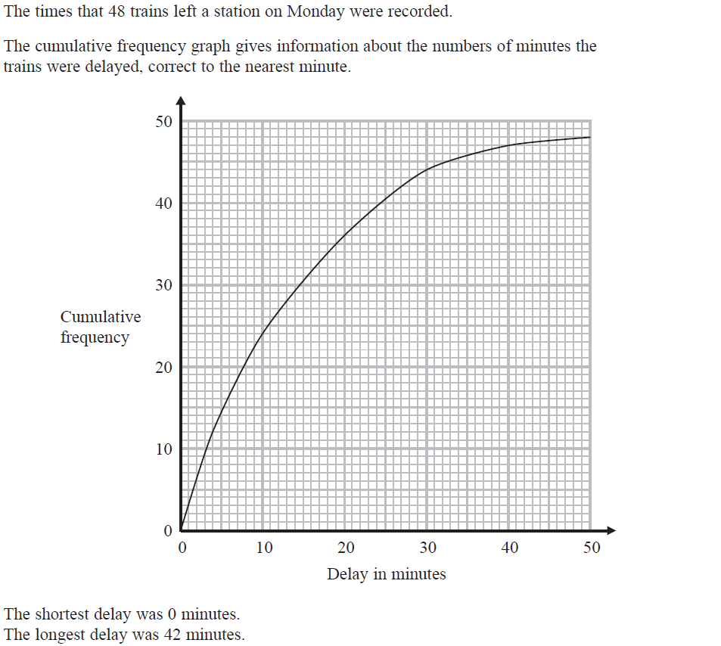
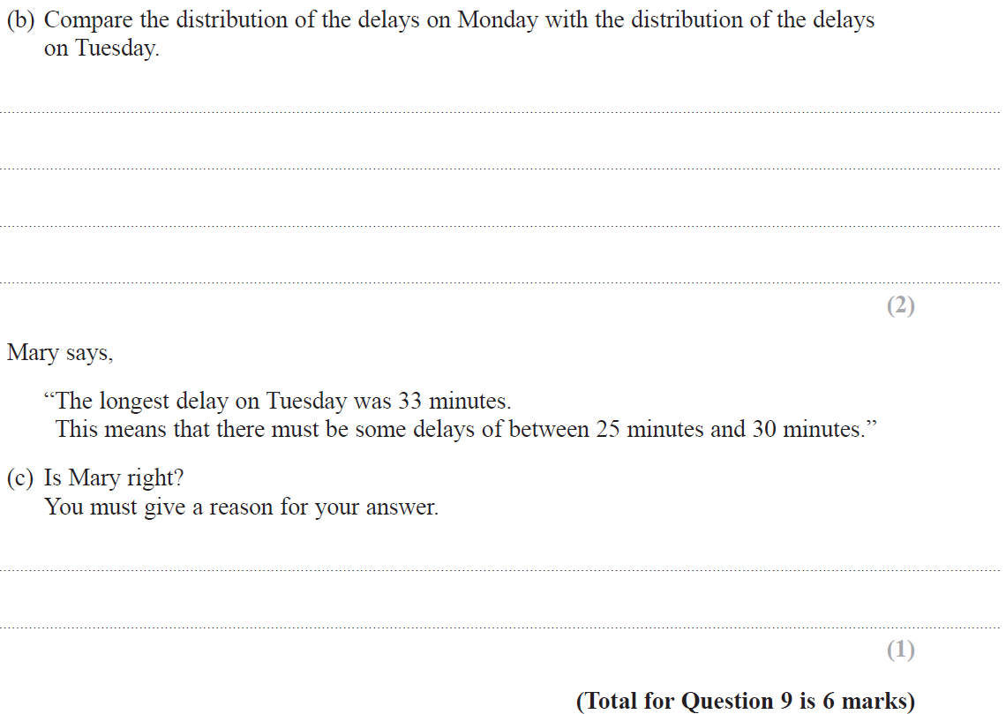
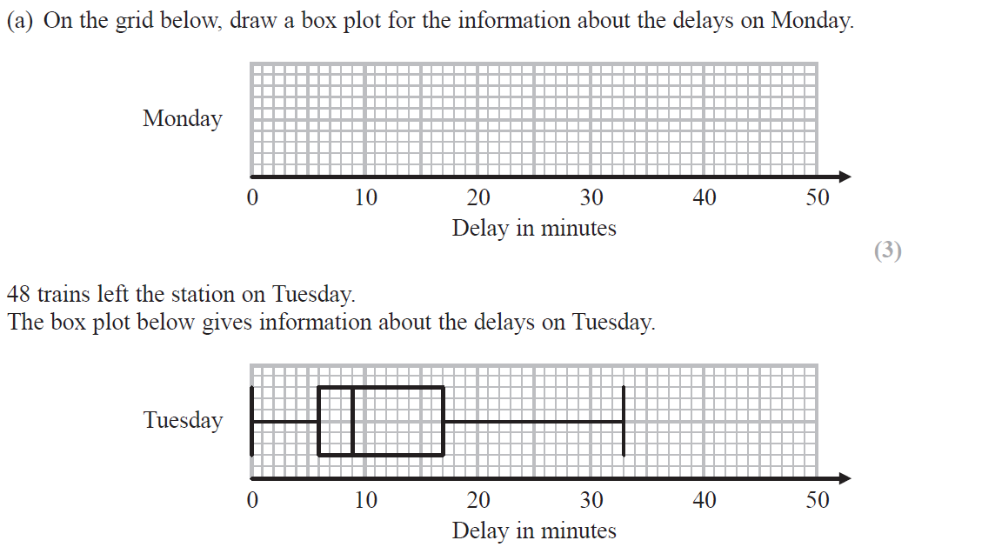
Cumulative Frequency
Nov 2018 1H Q9

Slide 13
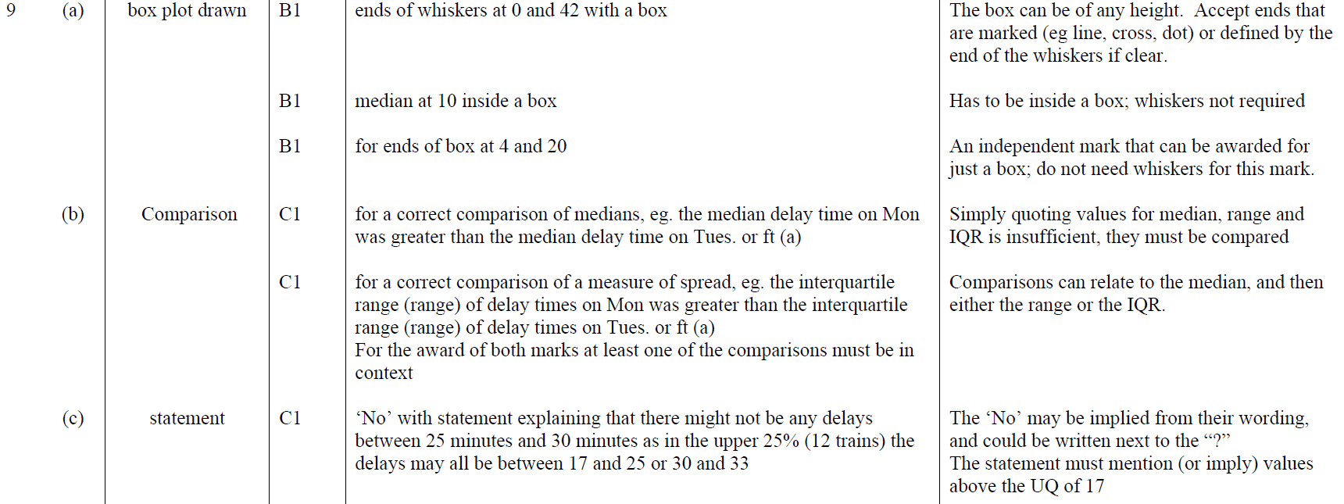
Cumulative Frequency
Nov 2018 1H Q9
A
B
C

Slide 14
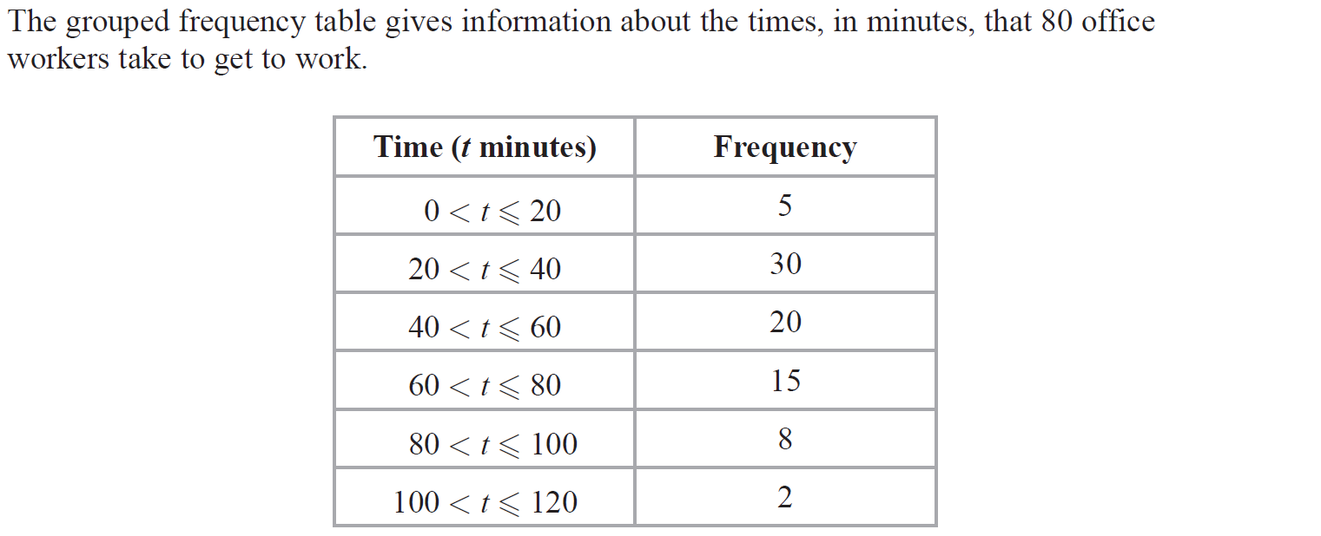
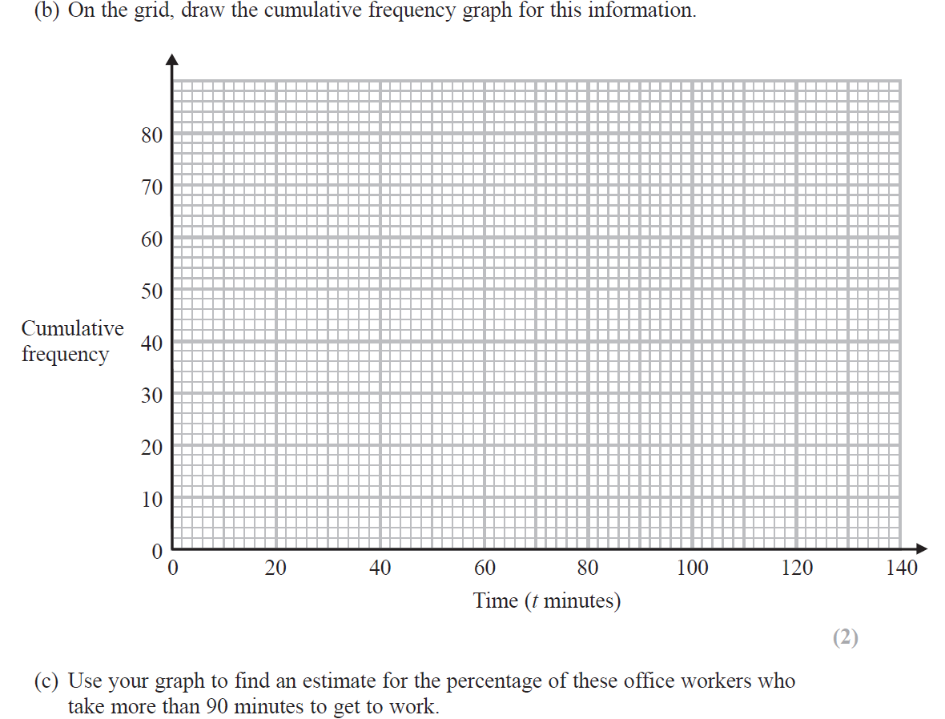
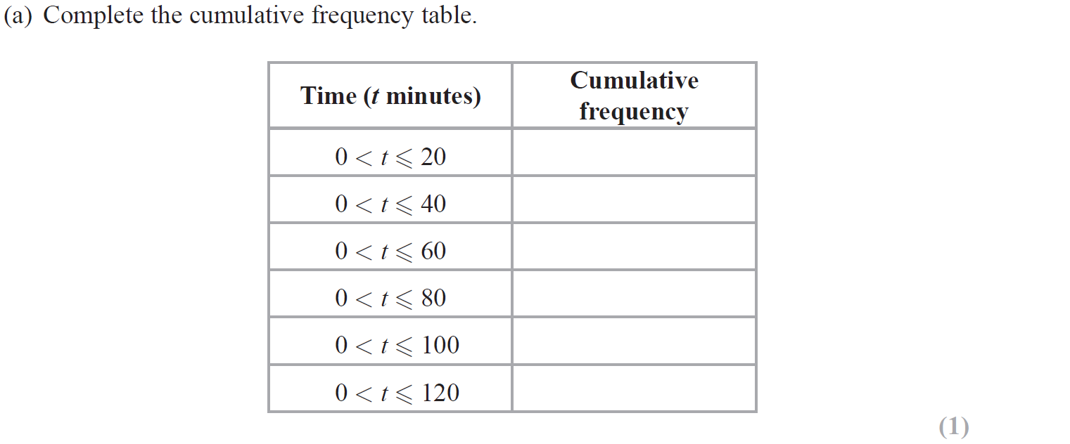
Cumulative Frequency
June 2019 2H Q11

Slide 15
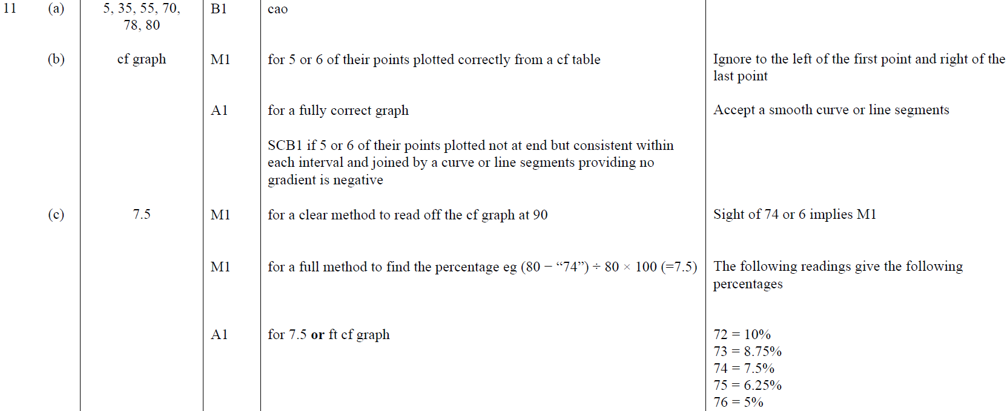
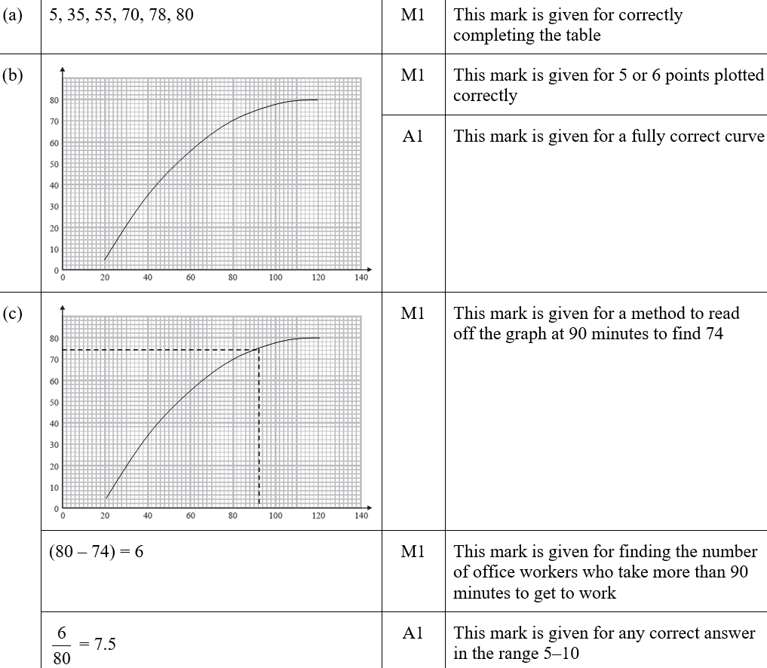
Cumulative Frequency
June 2019 2H Q11
A
B
C
A SF
B SF
C SF

Slide 16
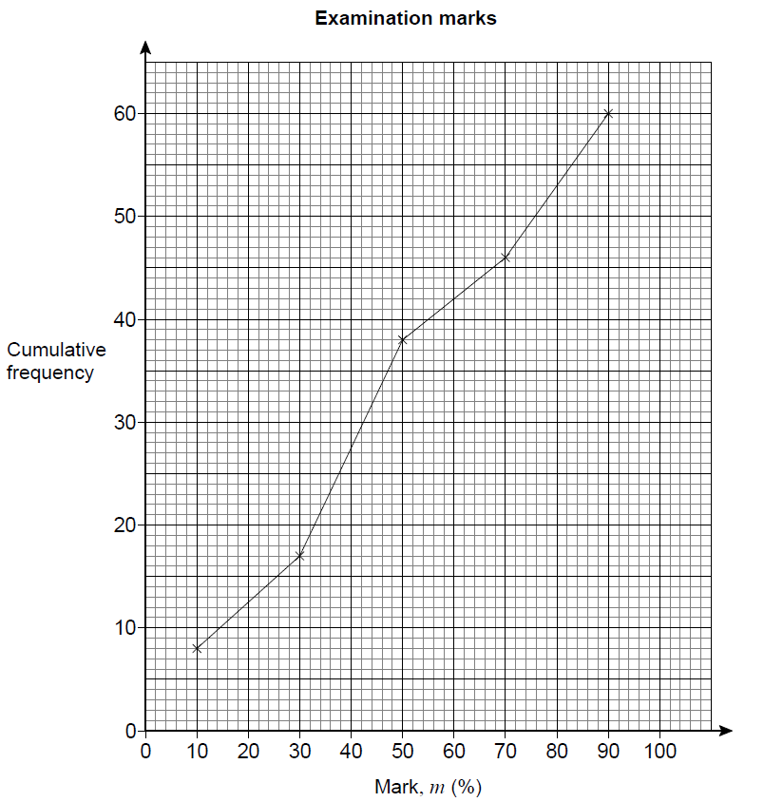
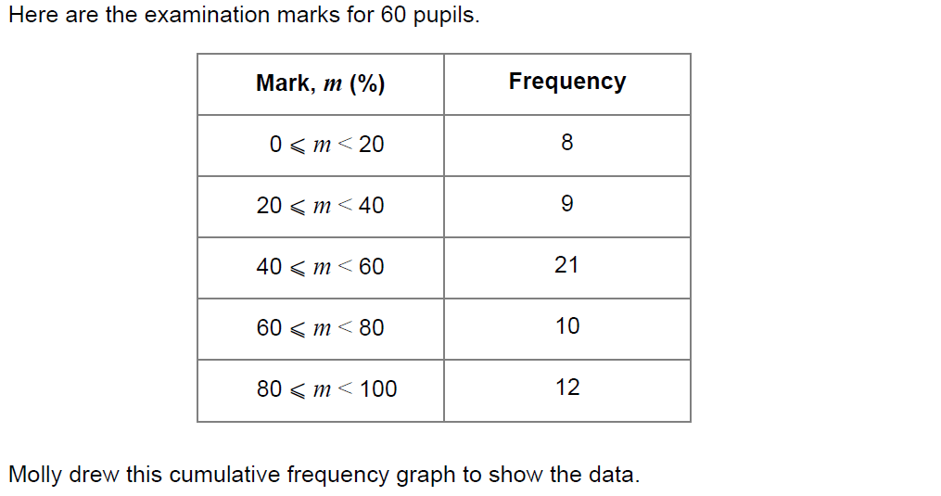
Cumulative Frequency
SAM 3H Q13

Slide 17
Cumulative Frequency
SAM 3H Q13
A

Slide 18
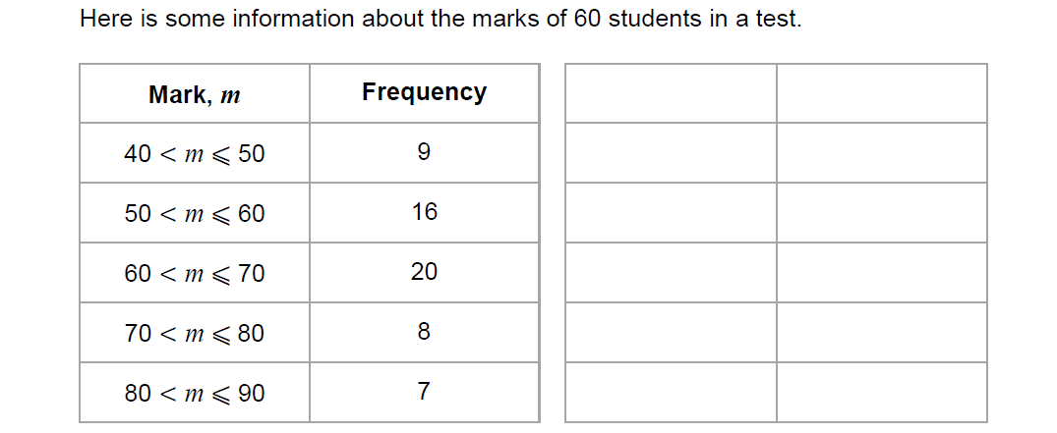
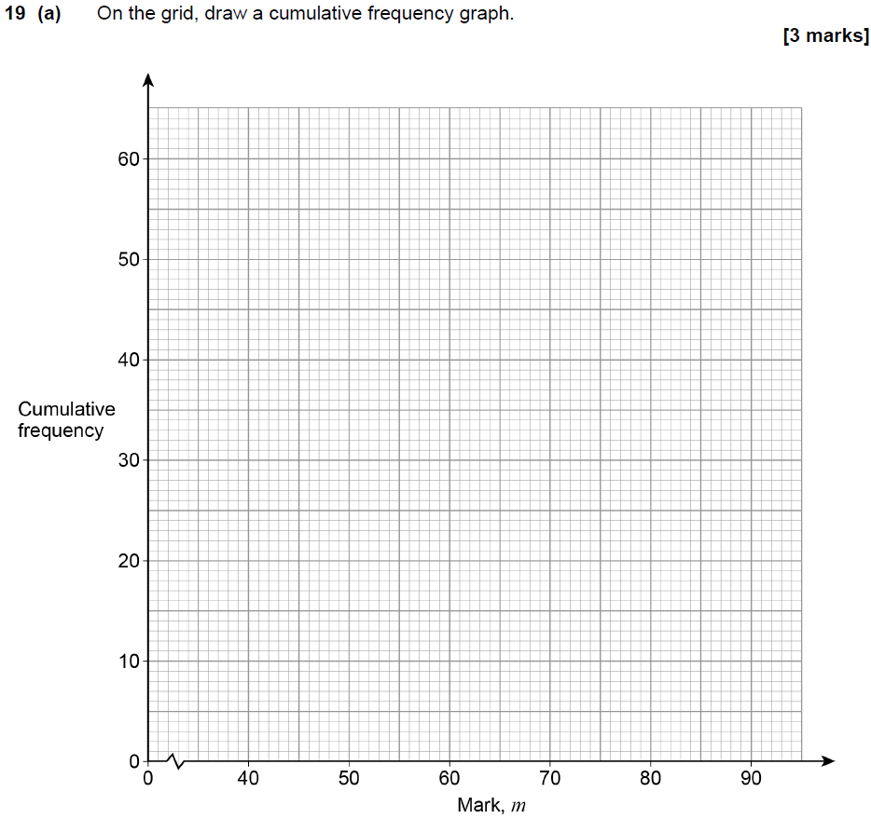
Cumulative Frequency
May 2017 1H Q19
Show Graph
Hide Graph

Slide 19
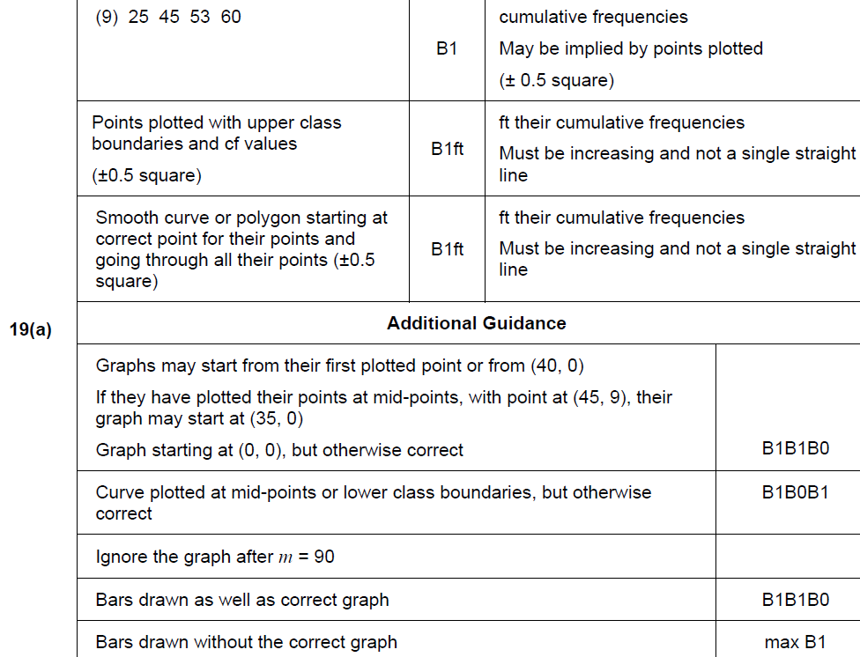
Cumulative Frequency
May 2017 1H Q19
A

Slide 20
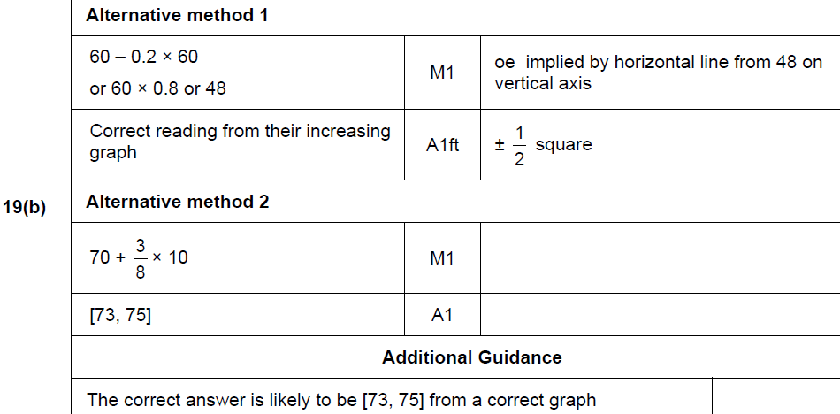
Cumulative Frequency
May 2017 1H Q19
B

Slide 21
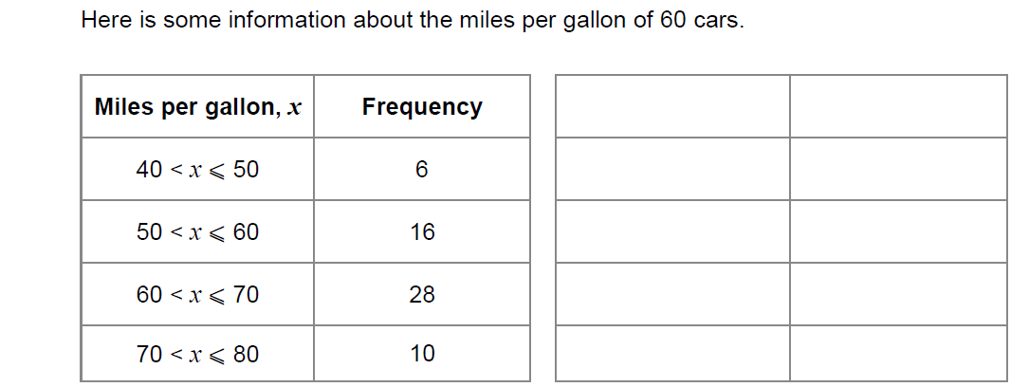
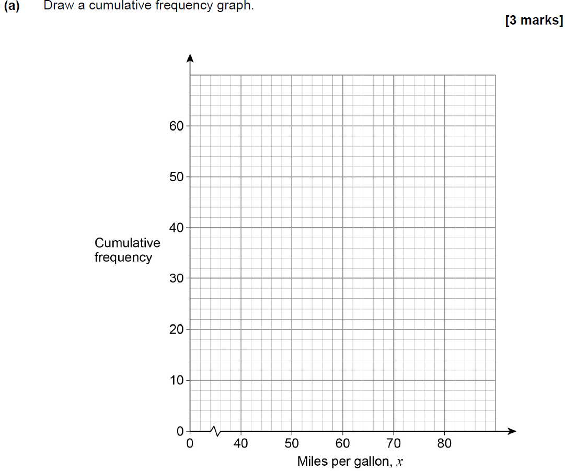
Cumulative Frequency
Nov 2017 1H Q22
Show Graph
Hide Graph

Slide 22
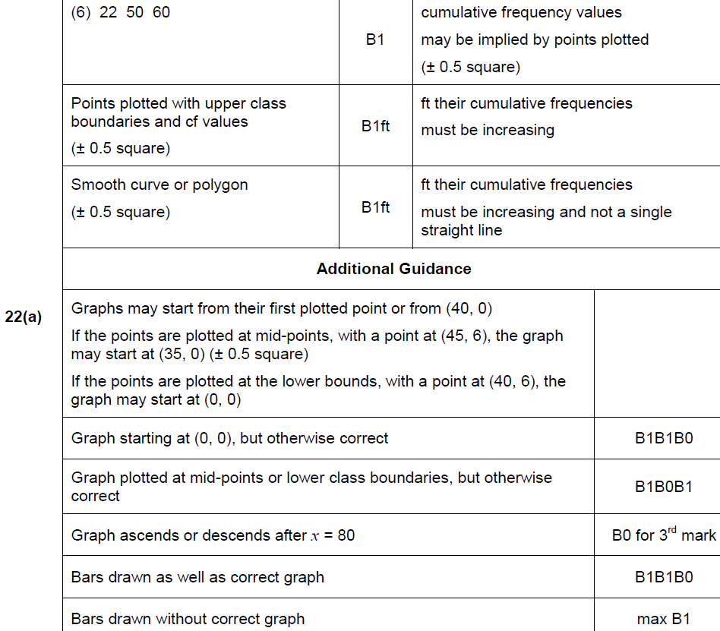
Cumulative Frequency
Nov 2017 1H Q22
A

Slide 23
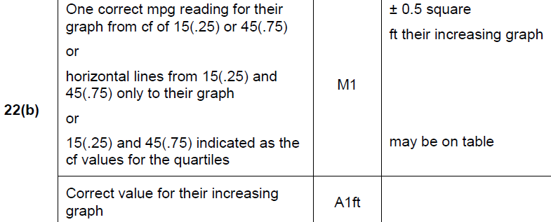
Cumulative Frequency
Nov 2017 1H Q22
B

Slide 24
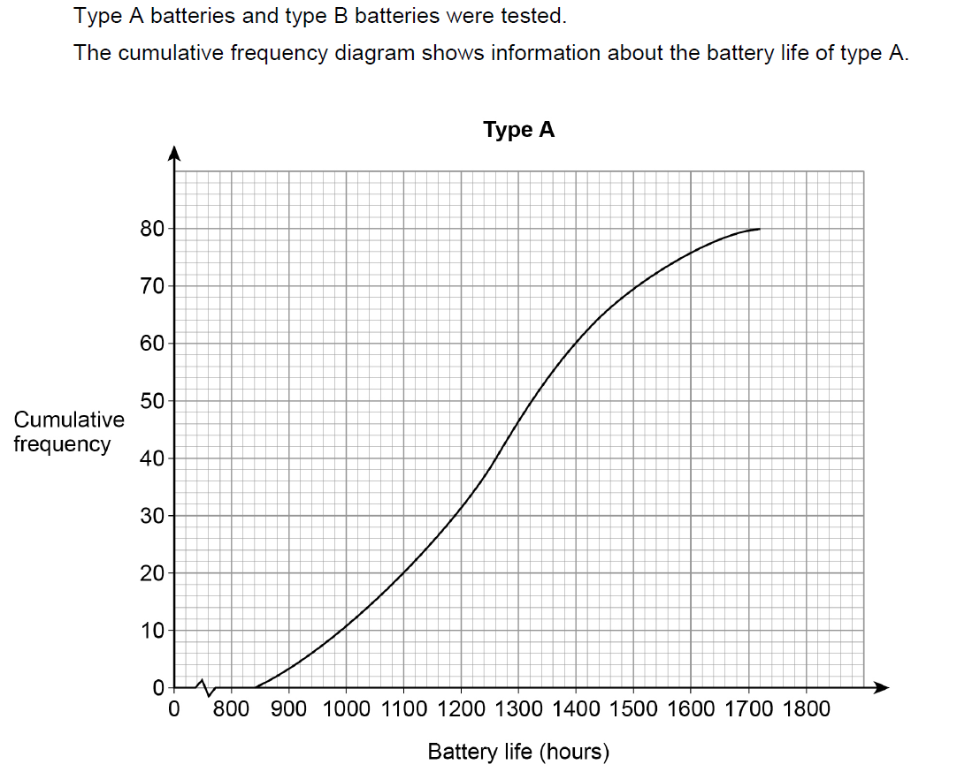
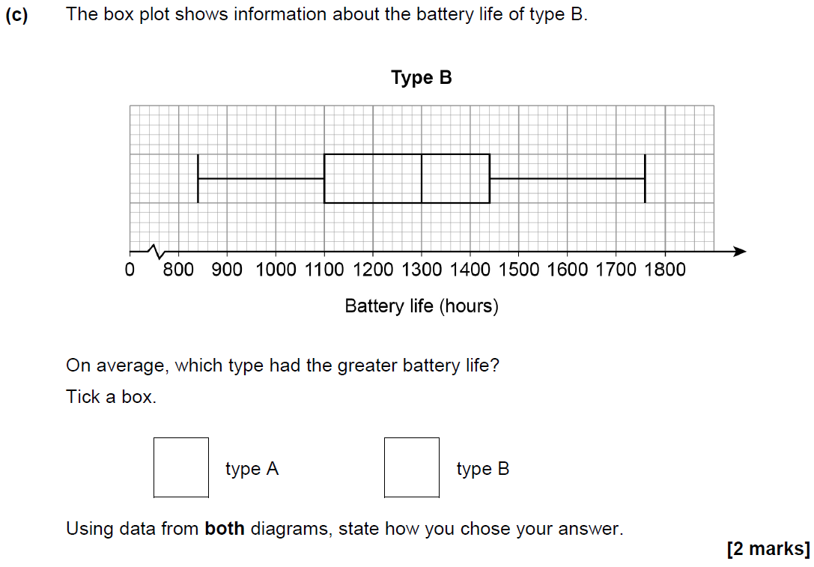
Cumulative Frequency
May 2018 1H Q19

Slide 25
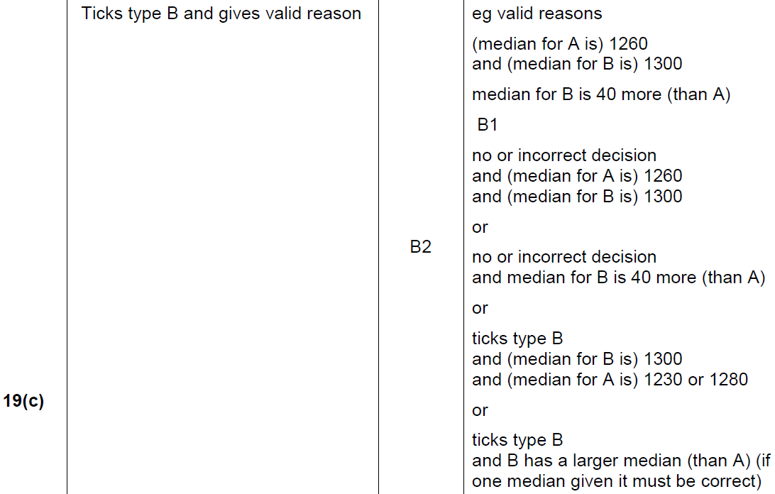
Cumulative Frequency
May 2018 1H Q19
A
B
C

Slide 26
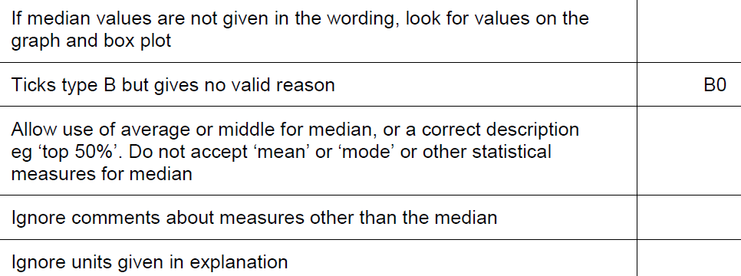
Cumulative Frequency
May 2018 1H Q19
C notes

Slide 27
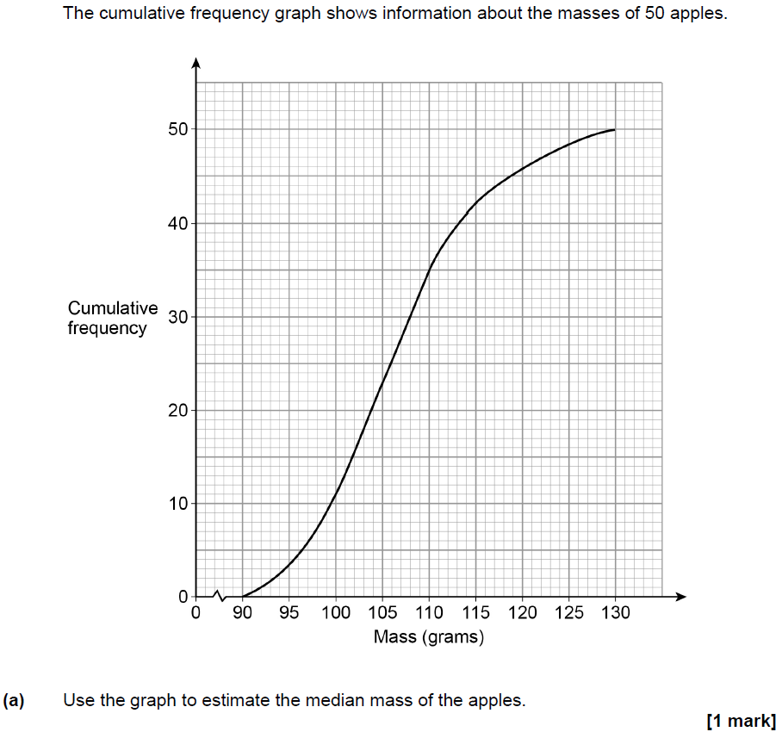
Cumulative Frequency
Nov 2018 2H Q16

Slide 28
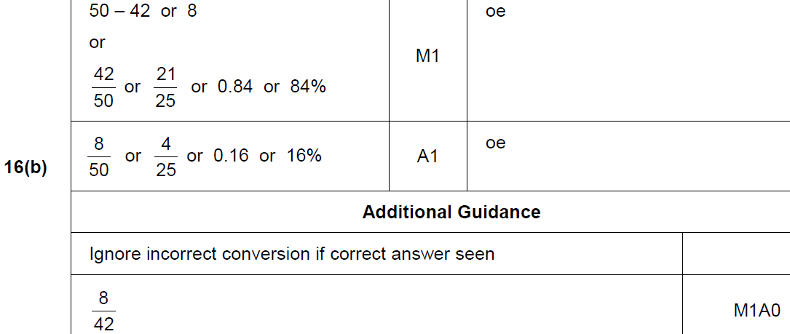
Cumulative Frequency
Nov 2018 2H Q16
A
B

Slide 29
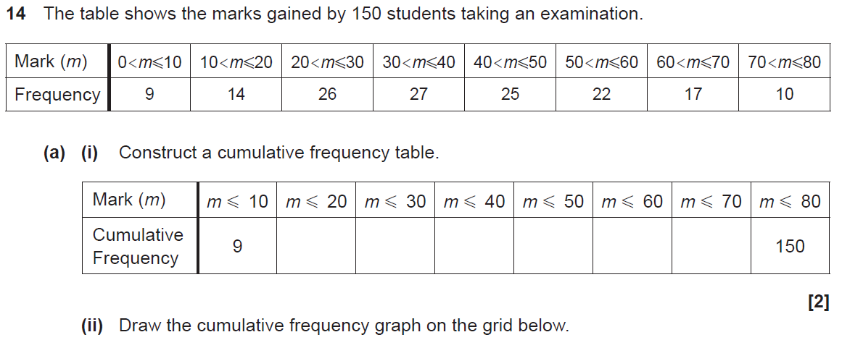
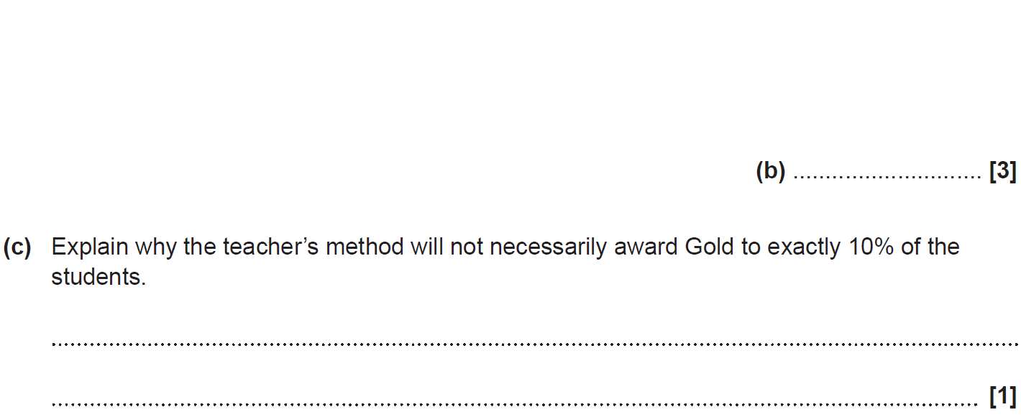
Cumulative Frequency
SAM 1H Q14

Slide 30
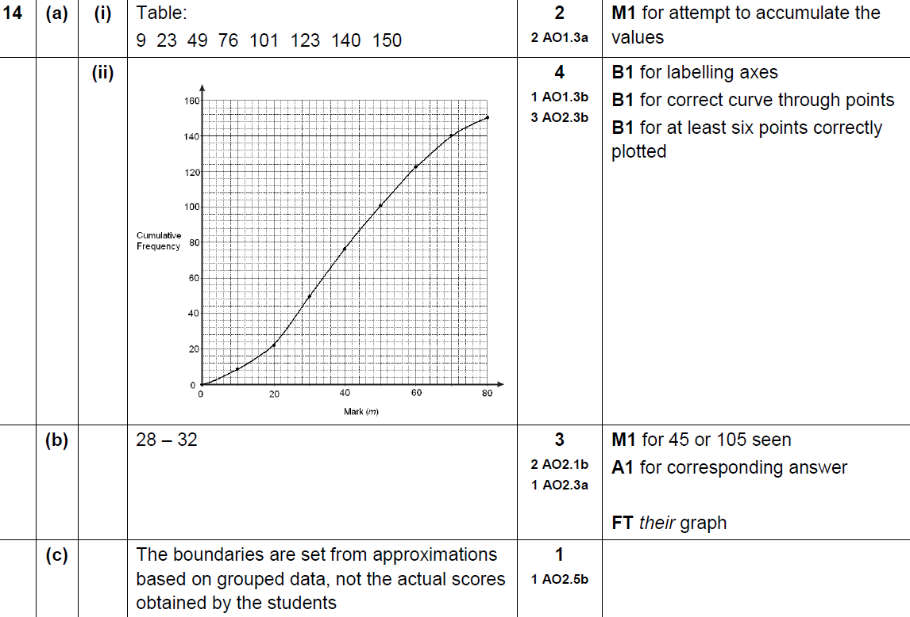
Cumulative Frequency
SAM 1H Q14
A (i)
A (ii)
B
C

Slide 31
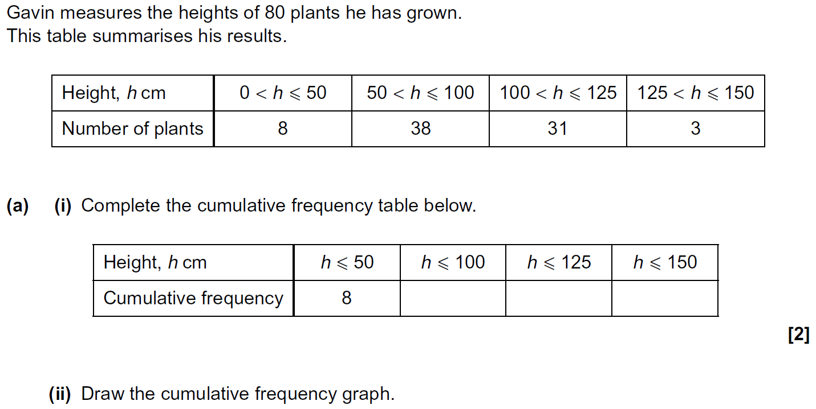
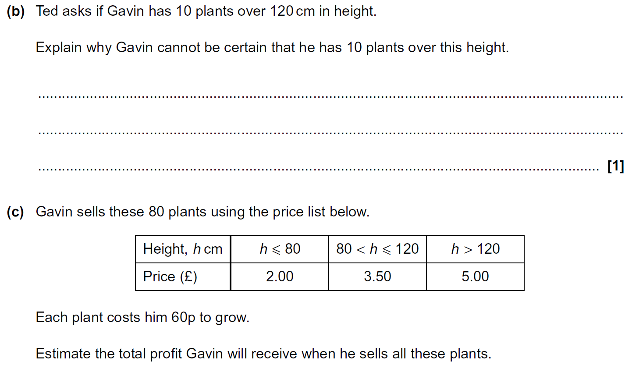
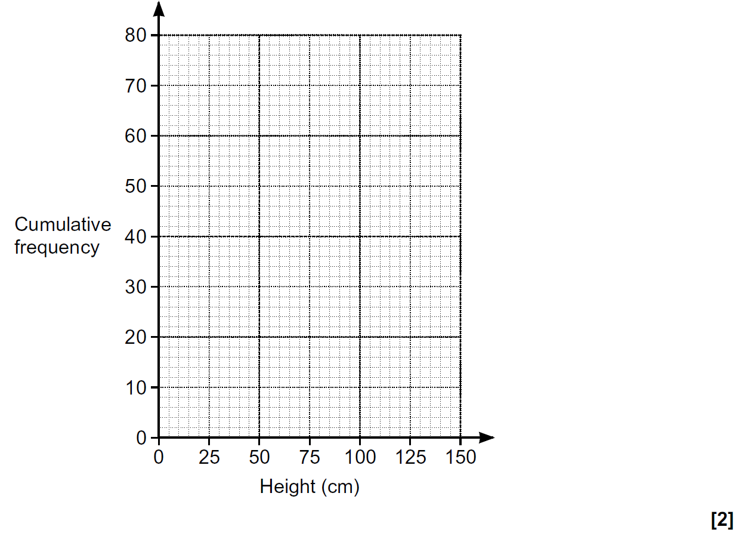
Cumulative Frequency
Practice 1H Q9

Slide 32
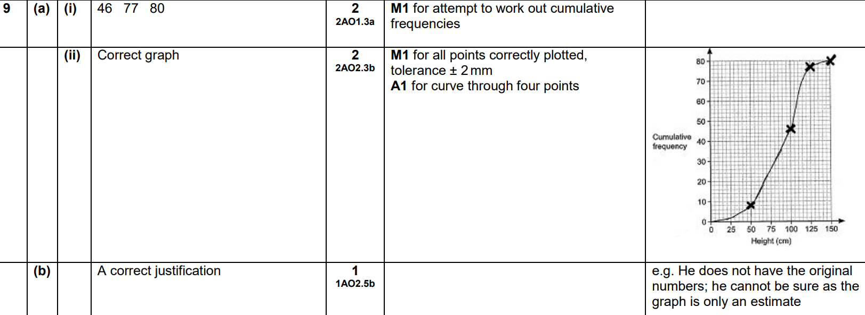
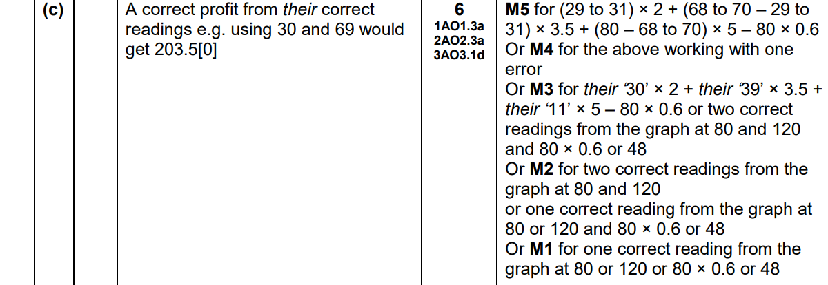
Cumulative Frequency
Practice 1H Q9
A (i)
A (ii)
B
C

Slide 33
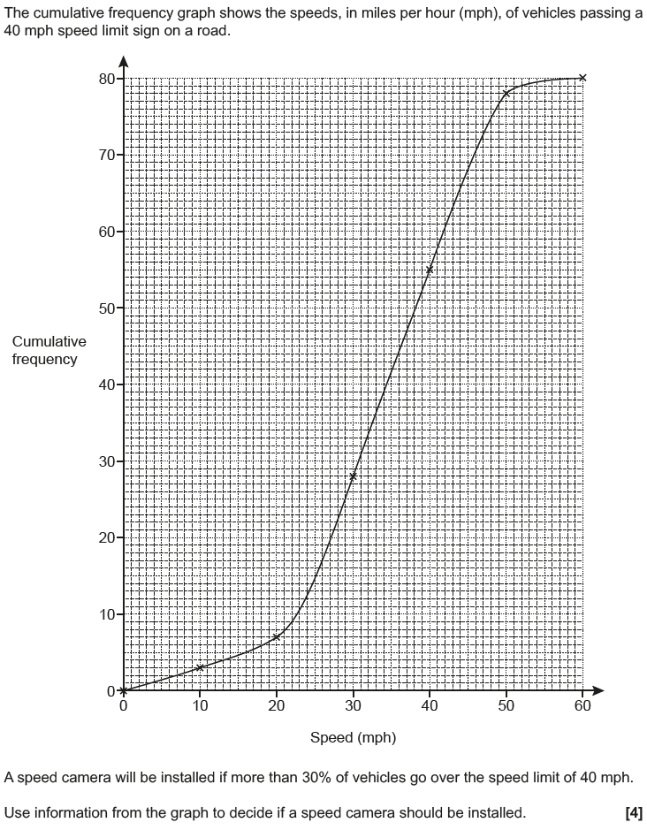
Cumulative Frequency
May 2017 1H Q12

Slide 34
Cumulative Frequency
May 2017 1H Q12
A

Slide 35
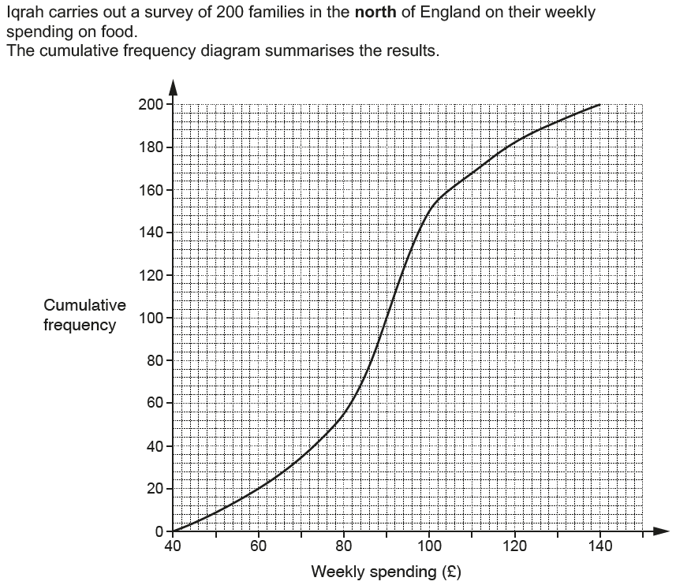
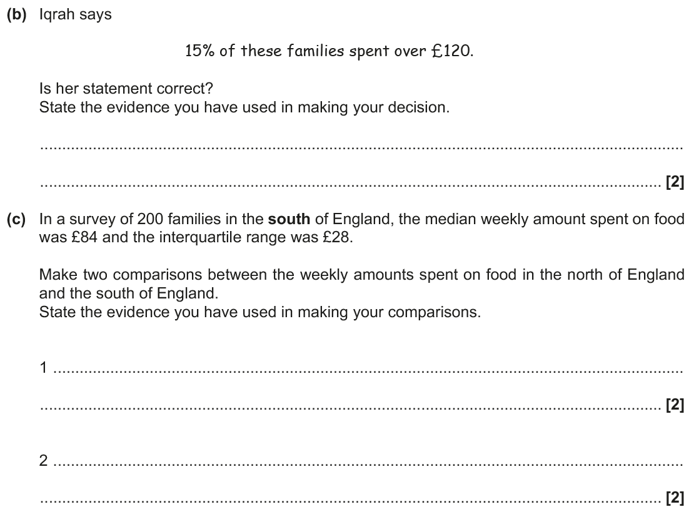
Cumulative Frequency
Nov 2017 2H Q15

Slide 36
Cumulative Frequency
Nov 2017 2H Q15
A (i)
A (ii)
B
C

Slide 37
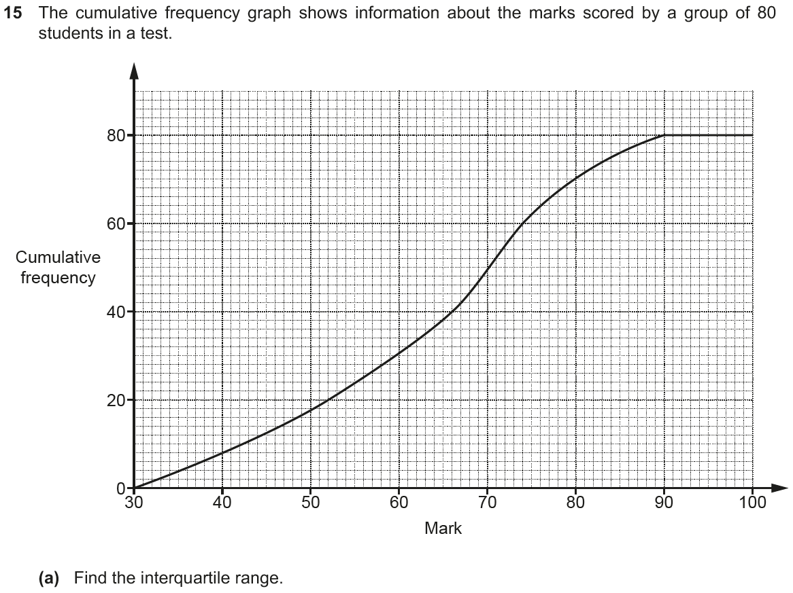
Cumulative Frequency
Nov 2018 2H Q15

Slide 38
Cumulative Frequency
Nov 2018 2H Q15
A
B

