Slide 1
Cumulative Frequency
Cumulative Frequency
June 2017
2H Q8
SAM
3H Q7
Nov 2017
3H Q11
Spec 2
2H Q11
Nov 2018
1H Q9
June 2019
2H Q11

Slide 2
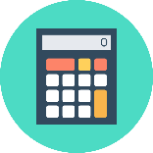
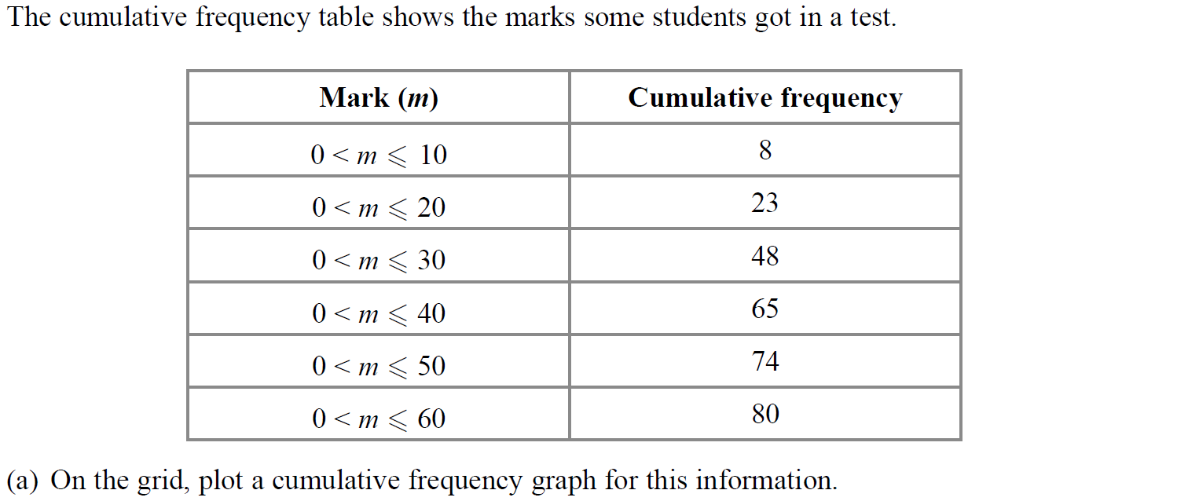
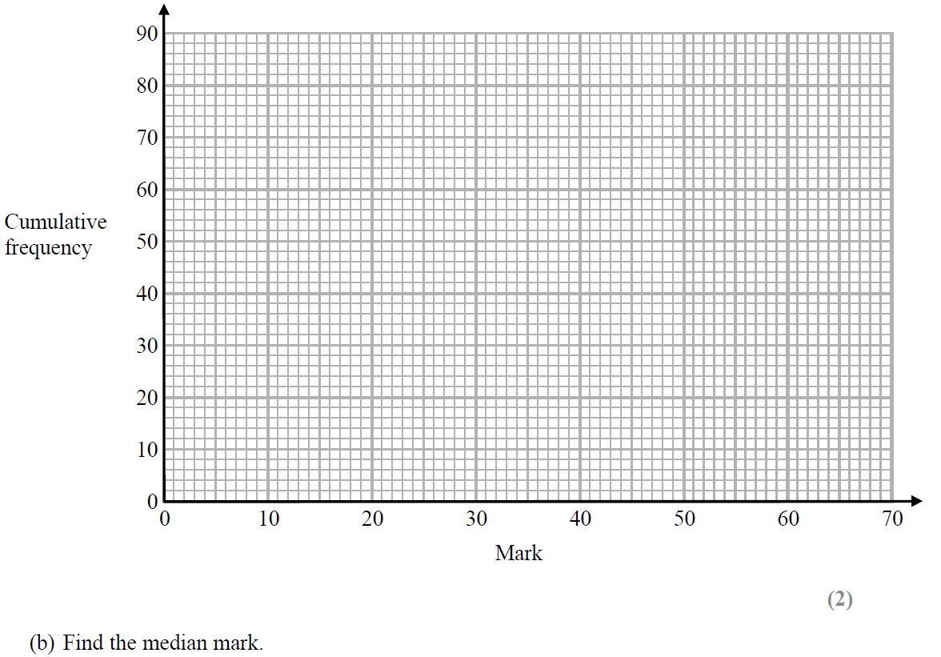
Cumulative Frequency
SAM 3H Q7
Show Graph
Hide Graph

Slide 3
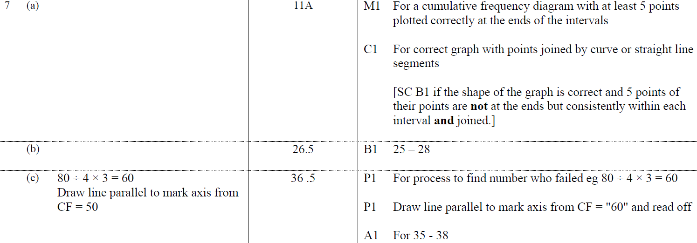
Cumulative Frequency
SAM 3H Q7
A
B
C

Slide 4
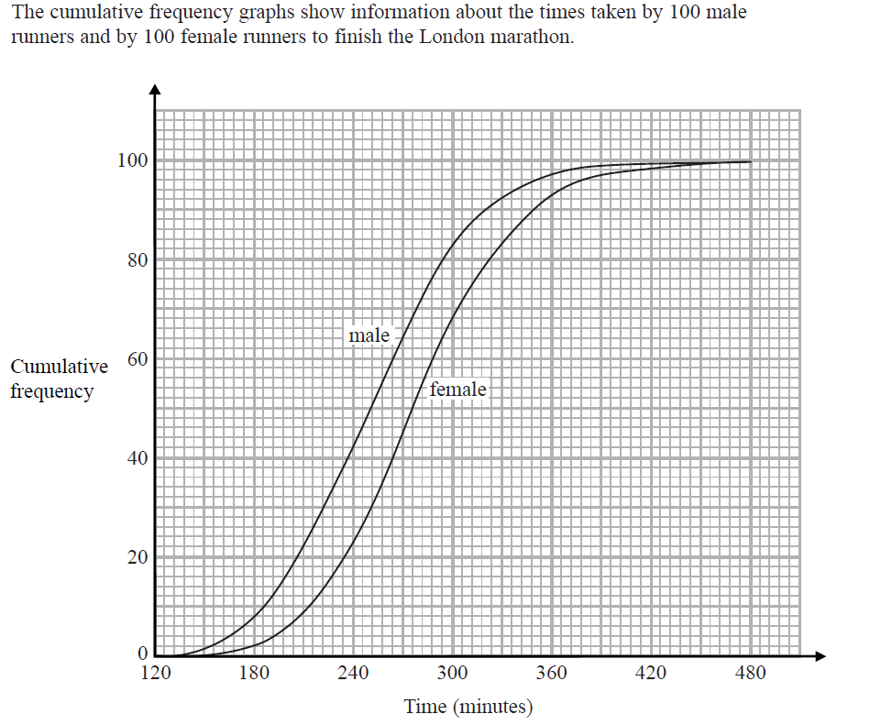
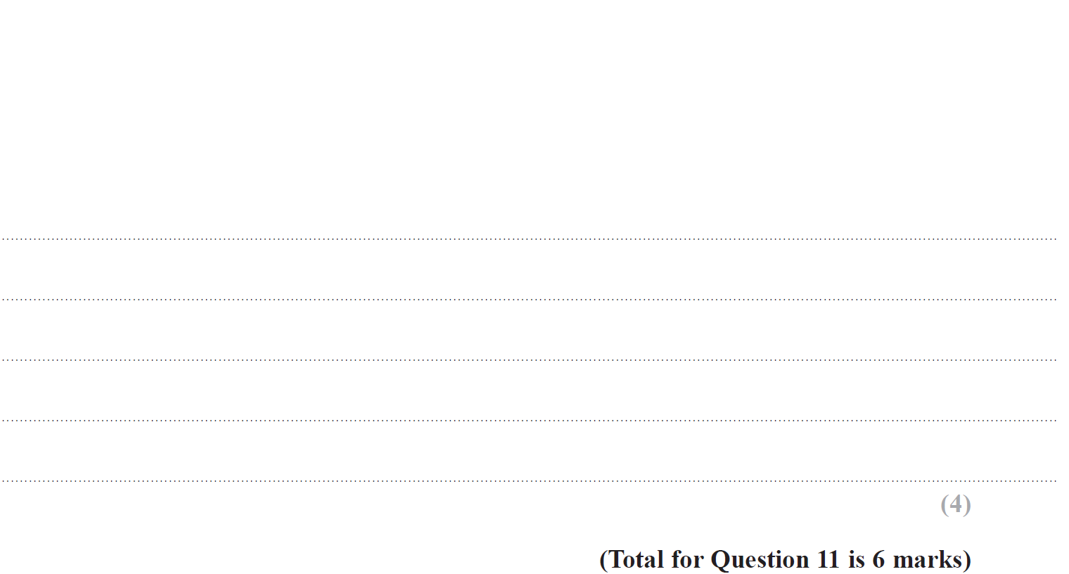
Cumulative Frequency
Specimen Set 2 2H Q11

Slide 5
Cumulative Frequency
Specimen Set 2 2H Q11
A
B

Slide 6
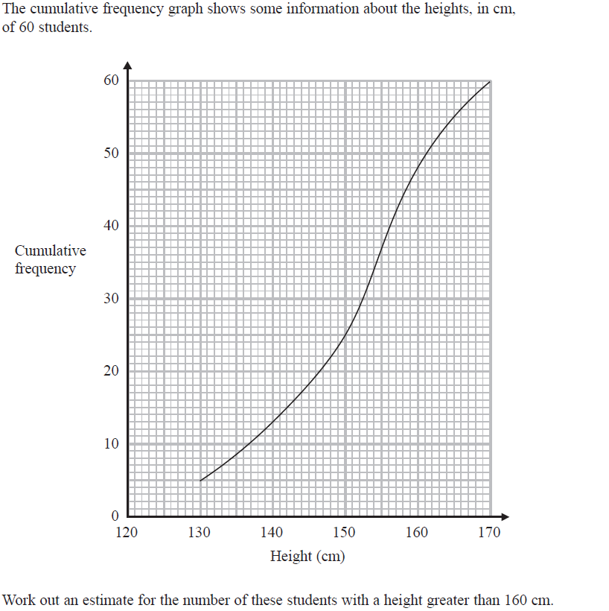
Cumulative Frequency
June 2017 2H Q8

Slide 7
Cumulative Frequency
June 2017 2H Q8
A

Slide 8
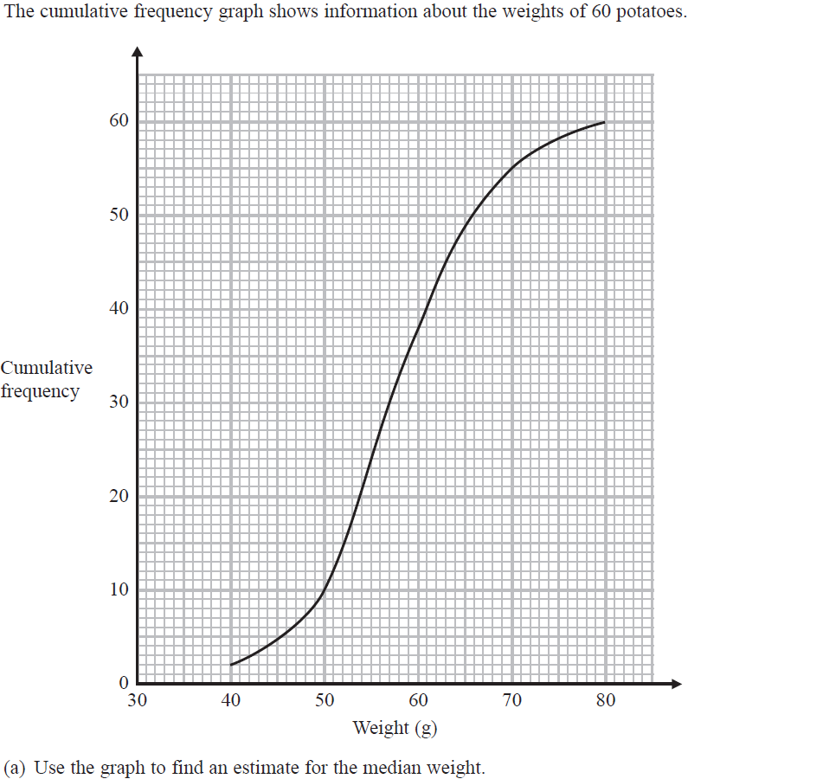
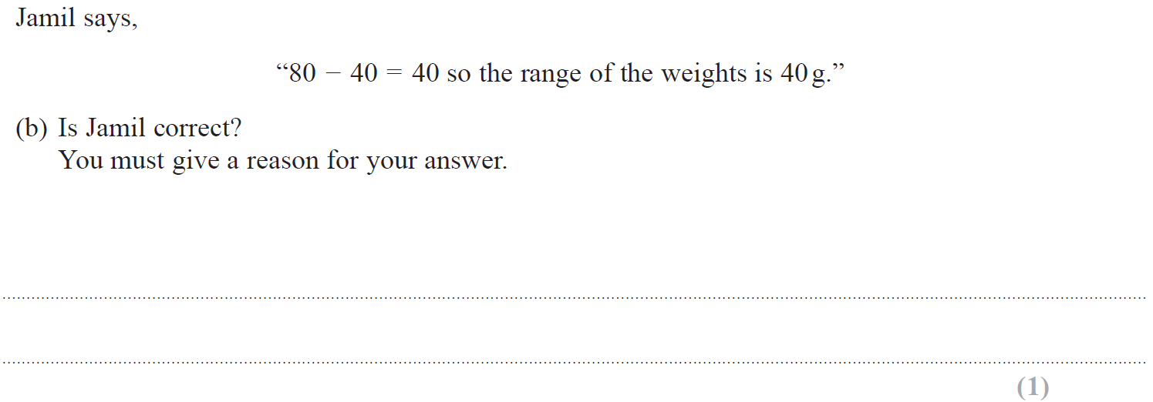
Cumulative Frequency
Nov 2017 3H Q11

Slide 9
Cumulative Frequency
Nov 2017 3H Q11
A
B
C

Slide 10
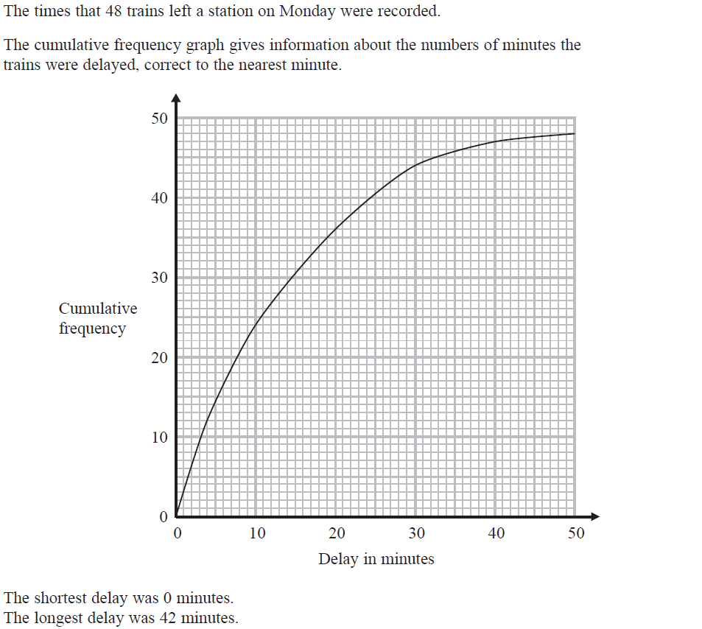
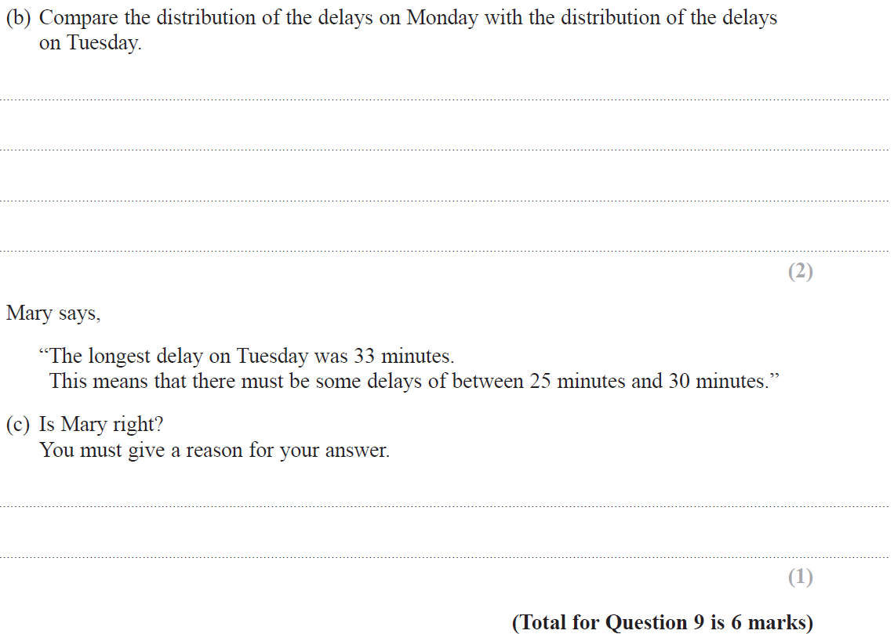
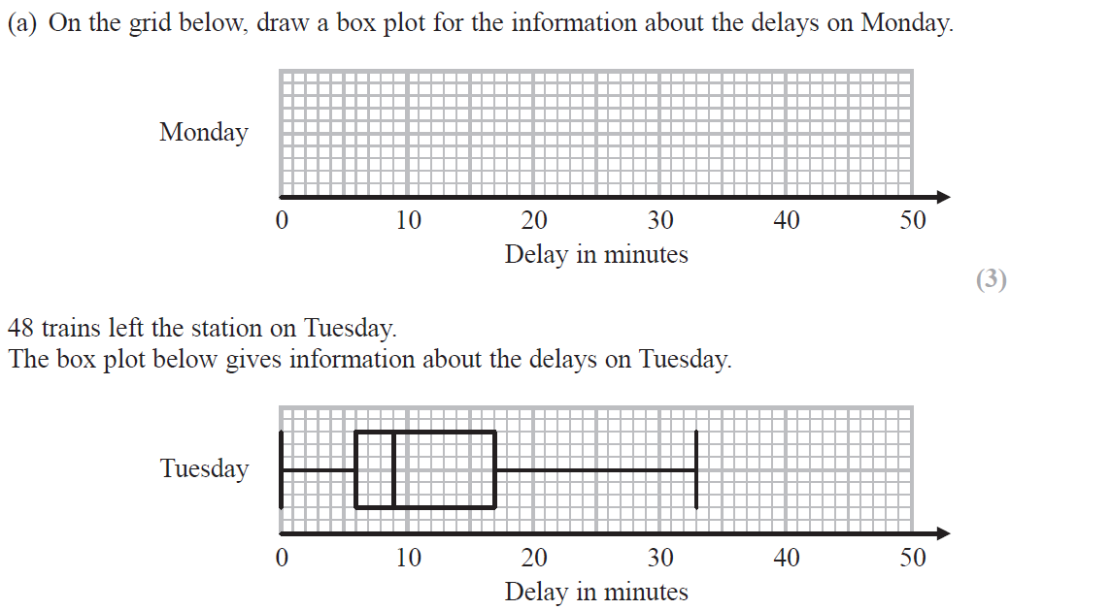
Cumulative Frequency
Nov 2018 1H Q9

Slide 11
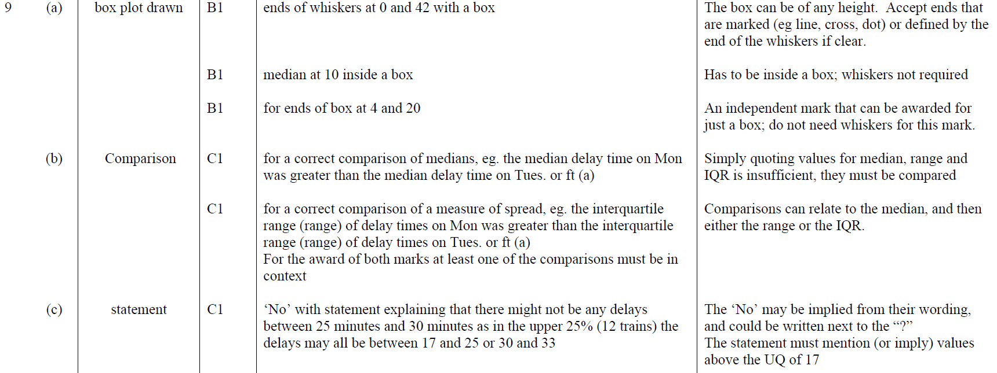
Cumulative Frequency
Nov 2018 1H Q9
A
B
C

Slide 12
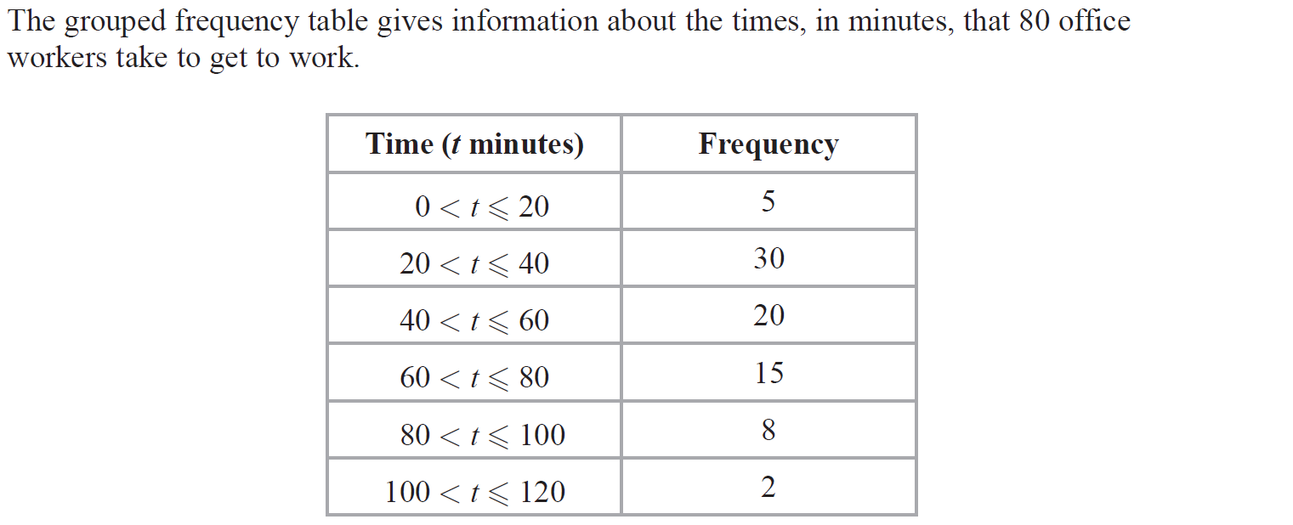
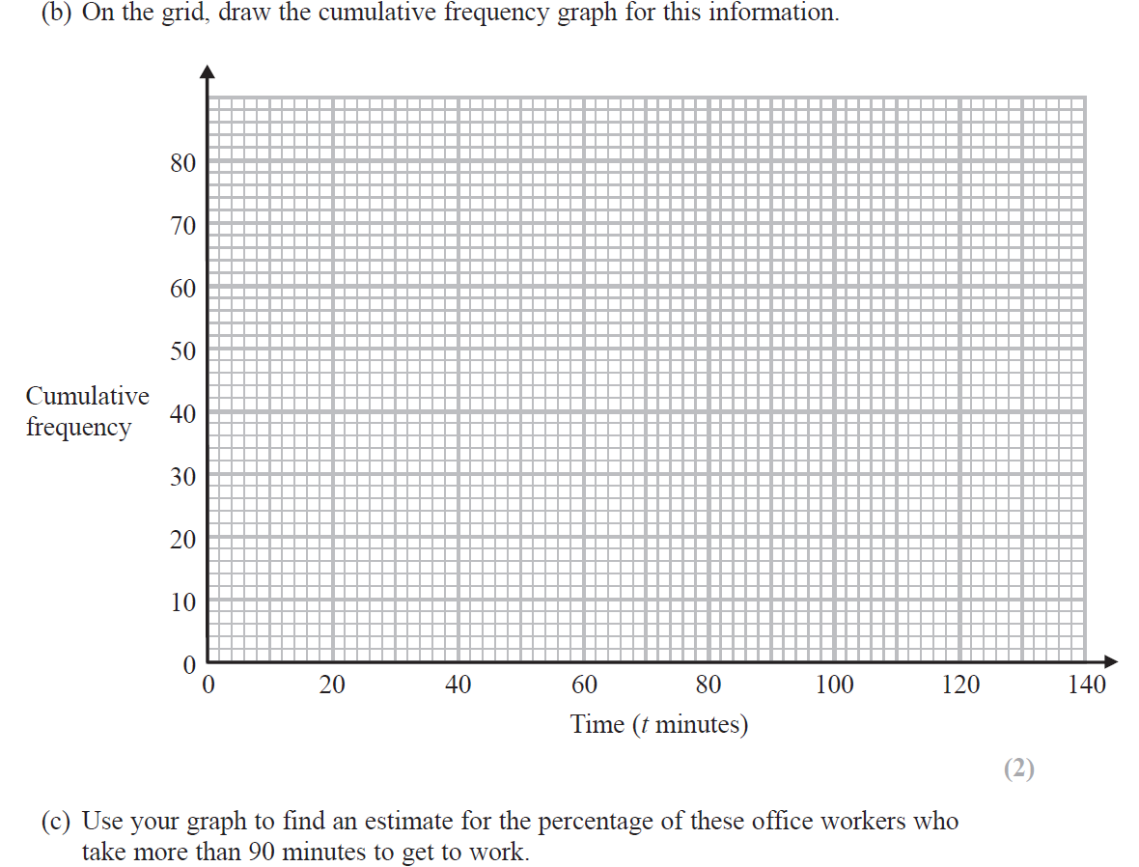
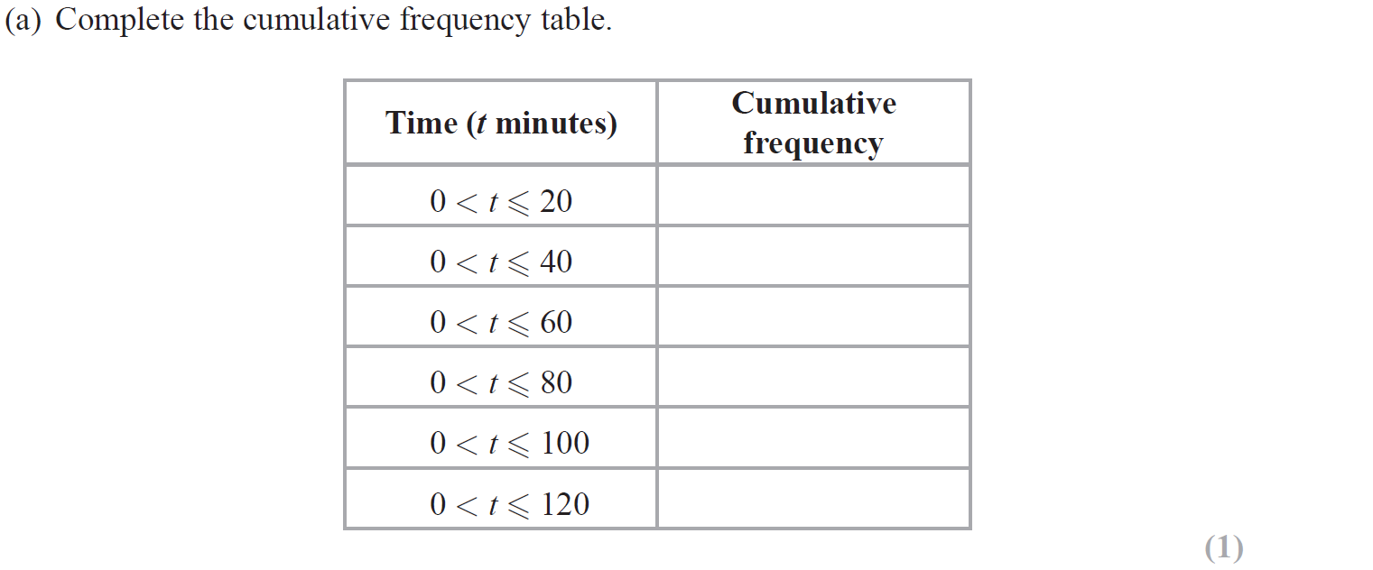
Cumulative Frequency
June 2019 2H Q11

Slide 13
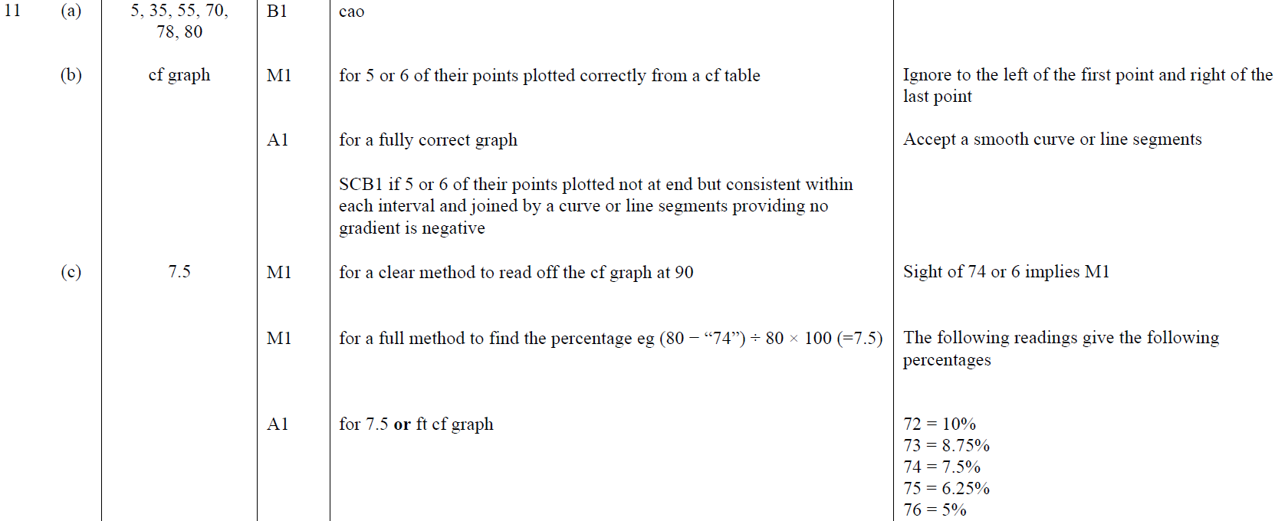
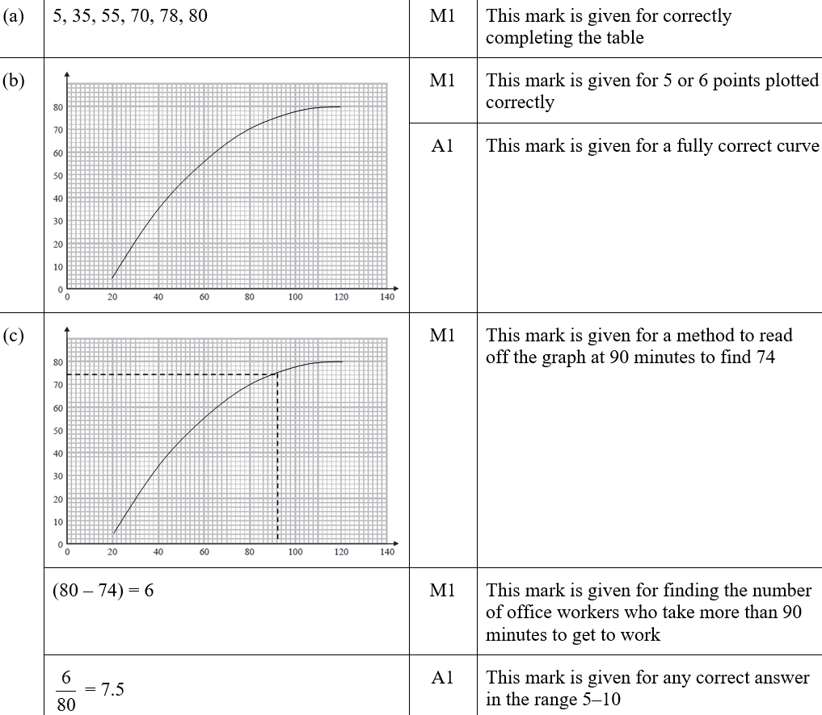
Cumulative Frequency
June 2019 2H Q11
A
B
C
A SF
B SF
C SF

