Slide 1
Scatter Diagrams & Correlation
Scatter Diagrams & Correlation
SAM
1H Q5
1 Marker

Slide 2
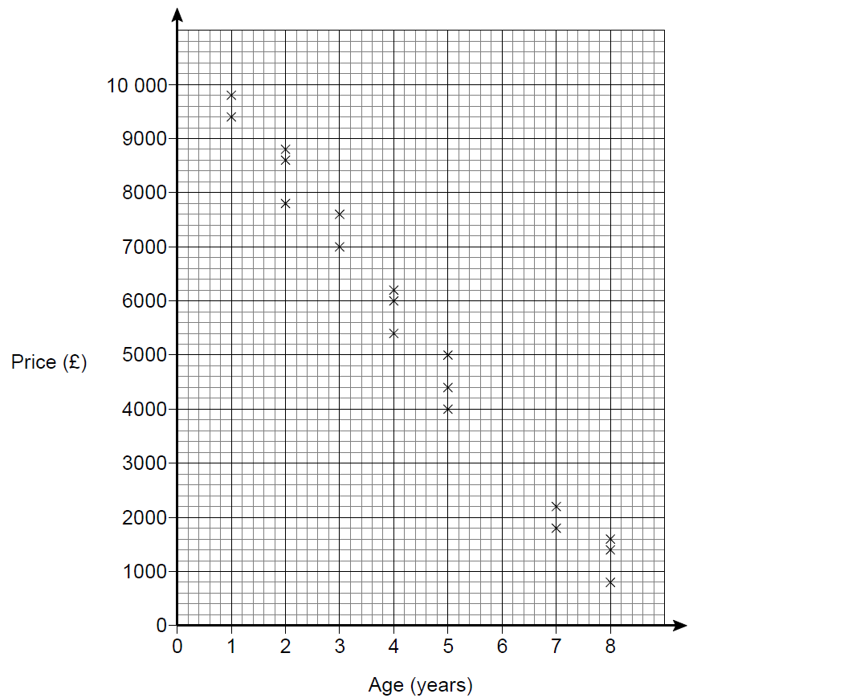
Scatter Diagrams & Correlation
SAM 1H Q5

Slide 3
Scatter Diagrams & Correlation
SAM 1H Q5
A

