Slide 1
Scatter Diagrams & Correlation
Scatter Diagrams & Correlation
June 2017
3H Q3
SAM
3H Q6
Nov 2017
1H Q4
Practice
2H Q7
May 2017
1H Q4
Nov 2017
3H Q1

Slide 2
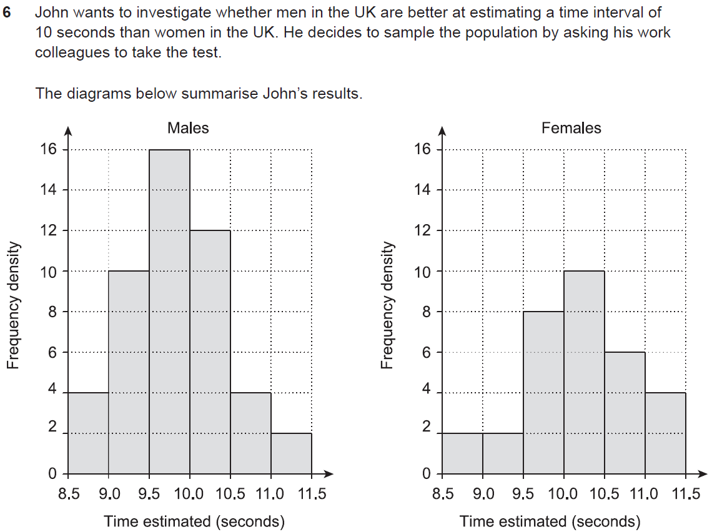
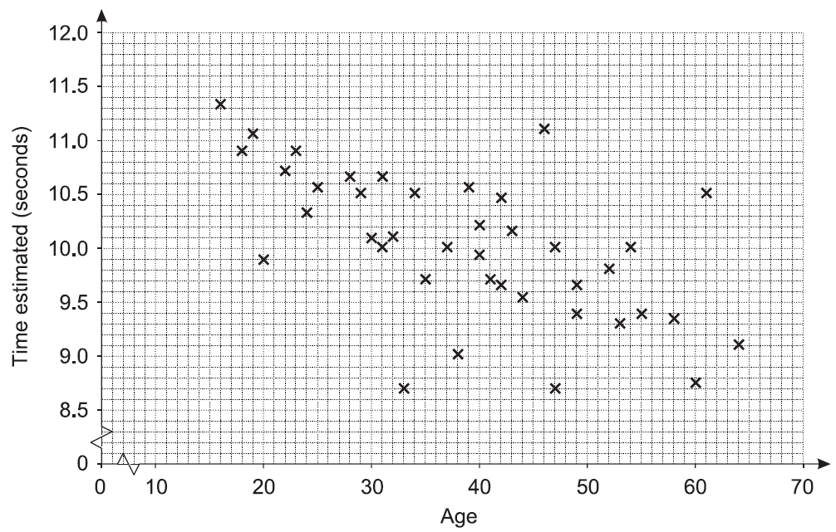
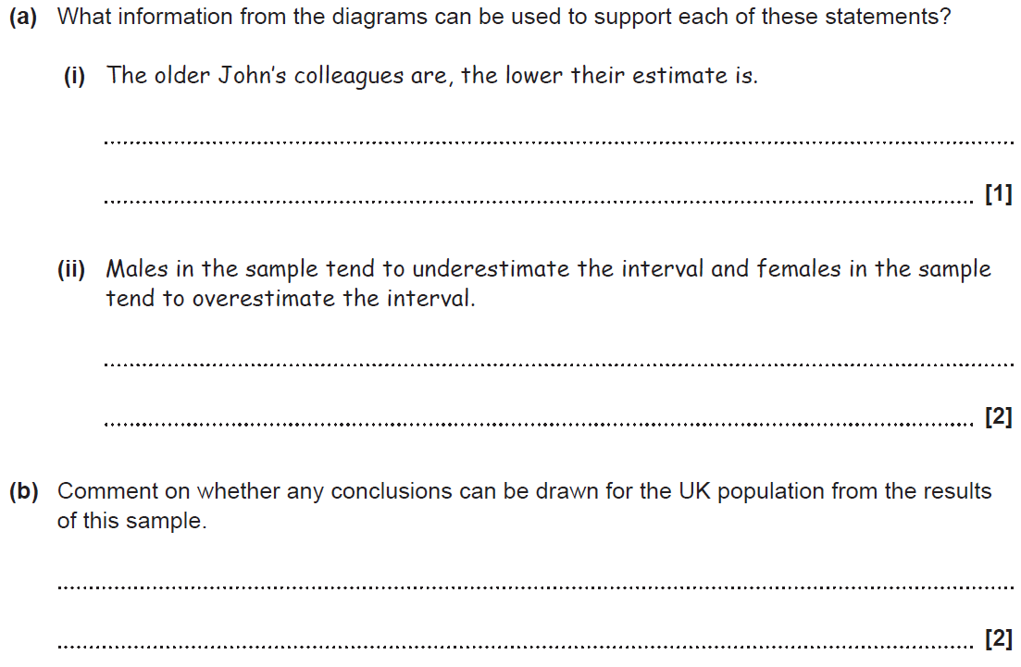
Scatter Diagrams & Correlation
SAM 3H Q6

Slide 3
Scatter Diagrams & Correlation
SAM 3H Q6
A (i)
A (ii)
B

Slide 4
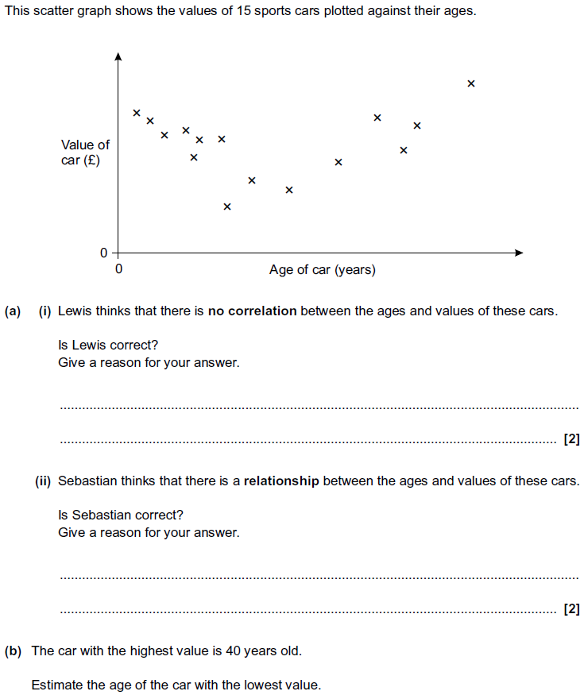
Scatter Diagrams & Correlation
Practice 2H Q7

Slide 5
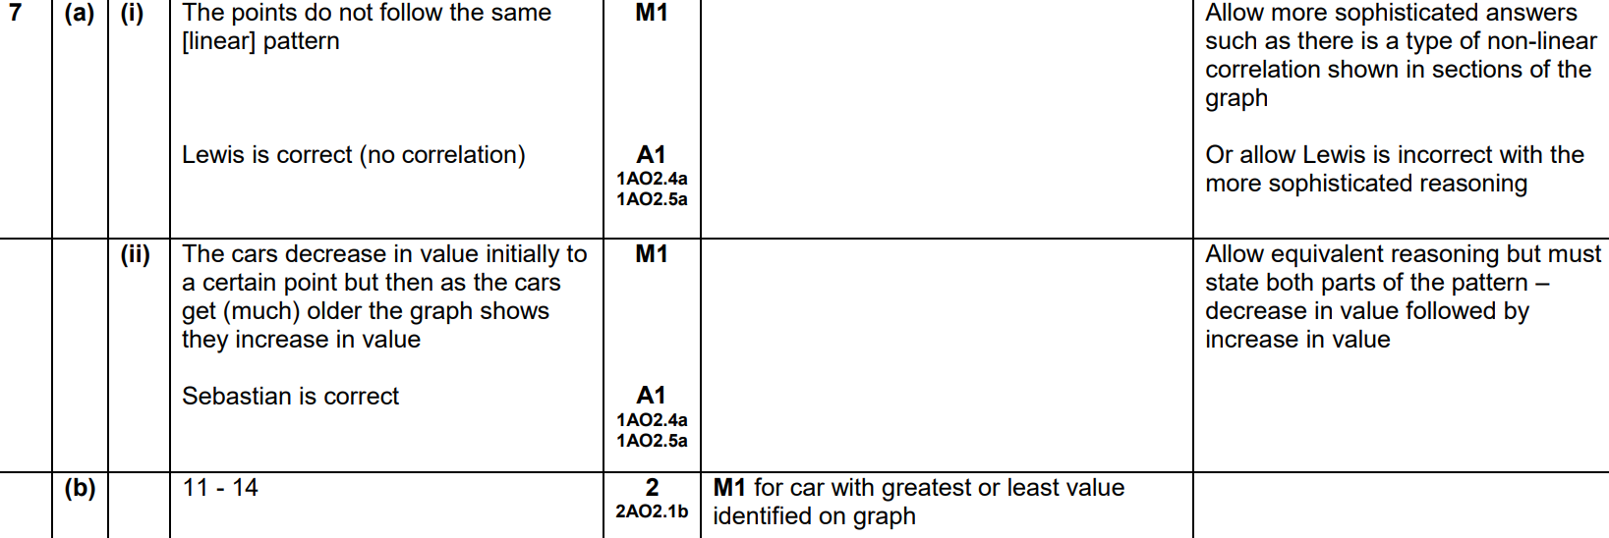
Scatter Diagrams & Correlation
Practice 2H Q7
A (i)
A (ii)
B

Slide 6
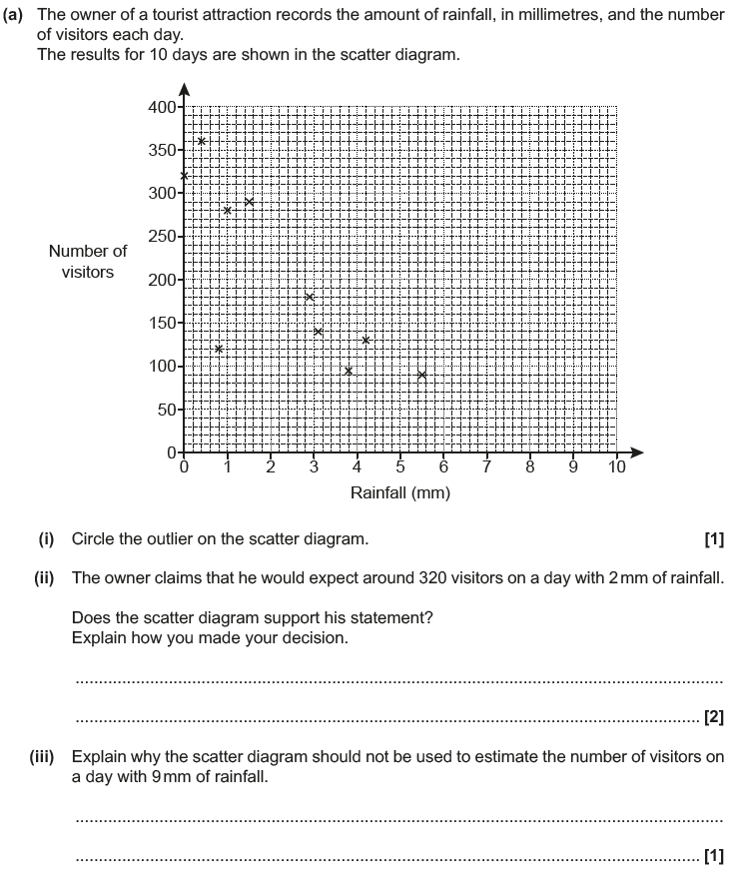
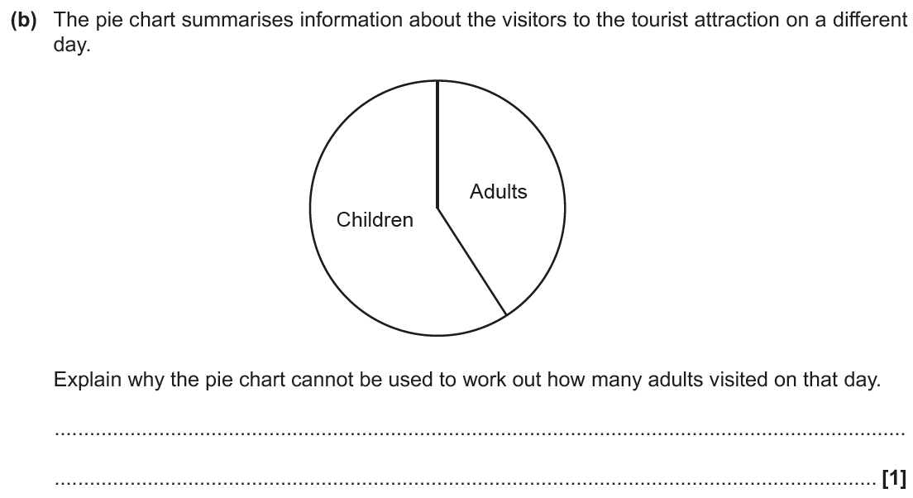
Scatter Diagrams & Correlation
June 2017 3H Q3

Slide 7
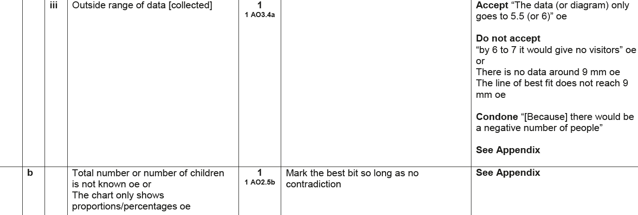
Scatter Diagrams & Correlation
June 2017 3H Q3
A (i)
A (ii)
A (iii)
B

Slide 8
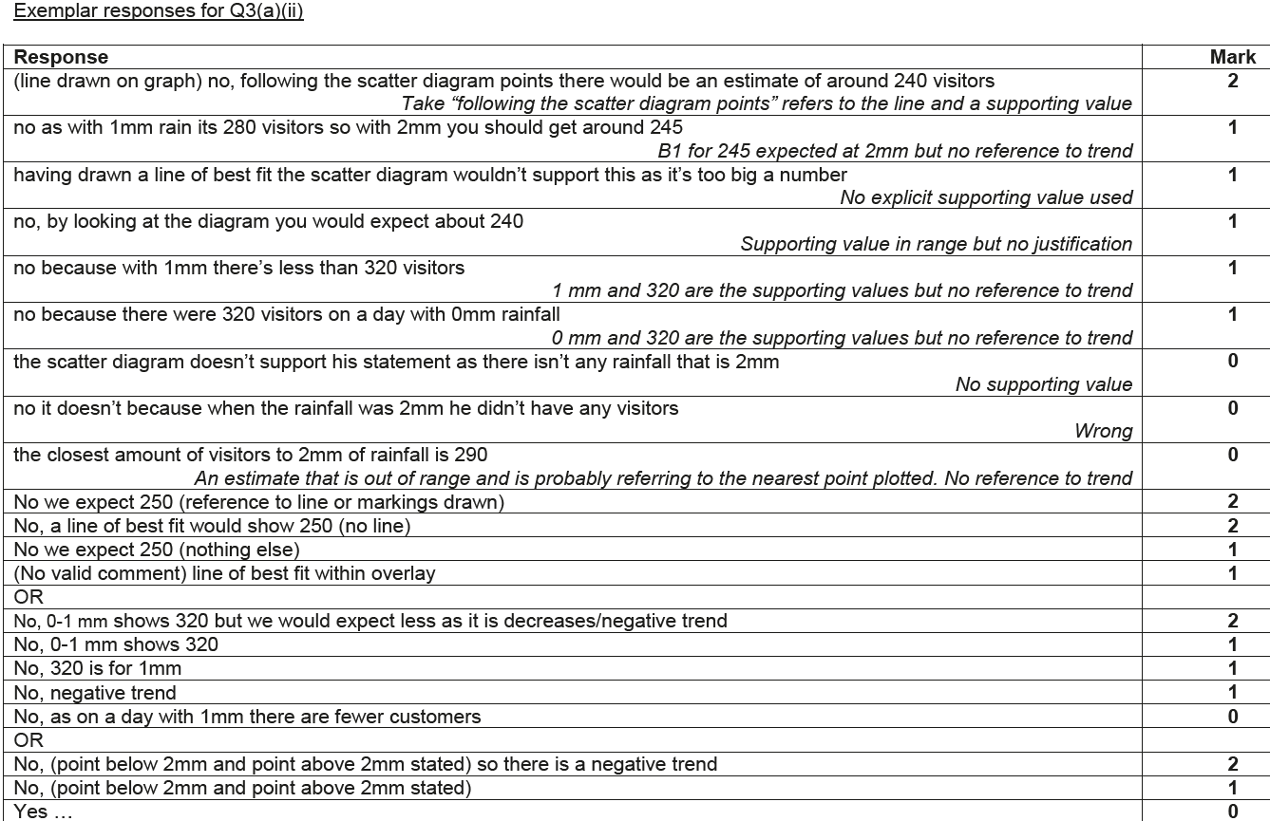
Scatter Diagrams & Correlation
June 2017 3H Q3
A (ii) Exemplar responses

Slide 9
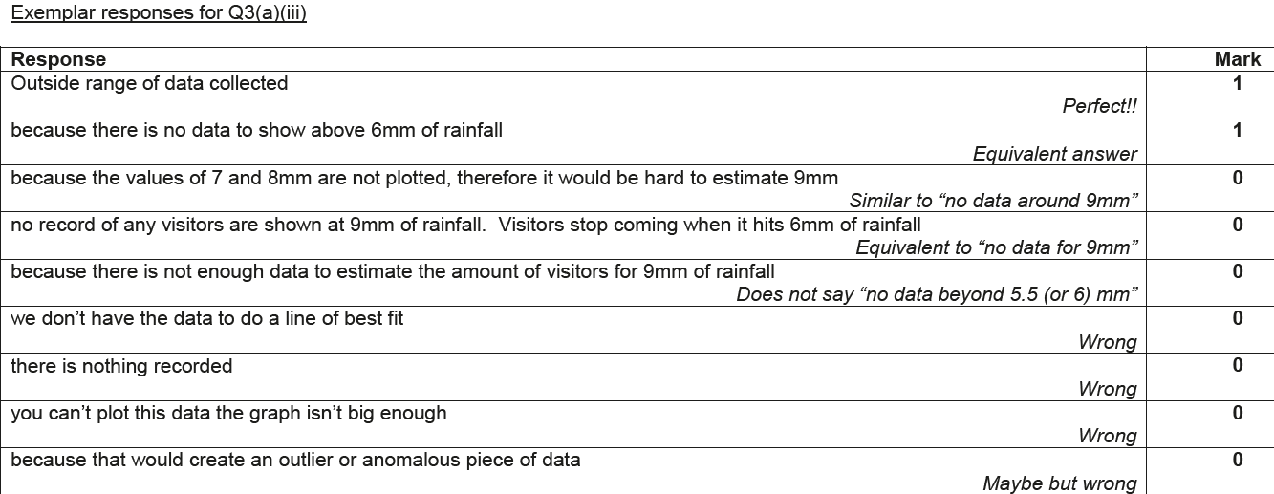
Scatter Diagrams & Correlation
June 2017 3H Q3
A (iii) Exemplar responses

Slide 10
Scatter Diagrams & Correlation
June 2017 3H Q3
B Exemplar responses

Slide 11
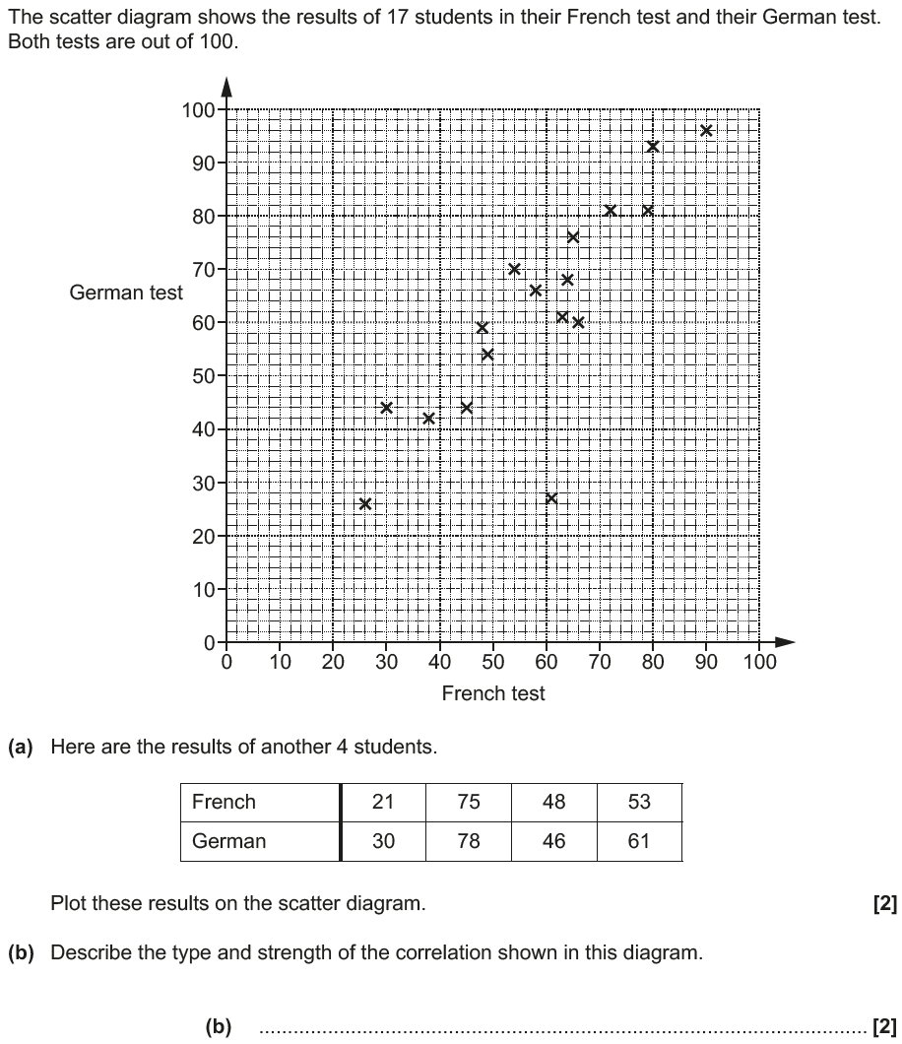
Scatter Diagrams & Correlation
Nov 2017 1H Q4

Slide 12
Scatter Diagrams & Correlation
Nov 2017 1H Q4
A
B
C

Slide 13
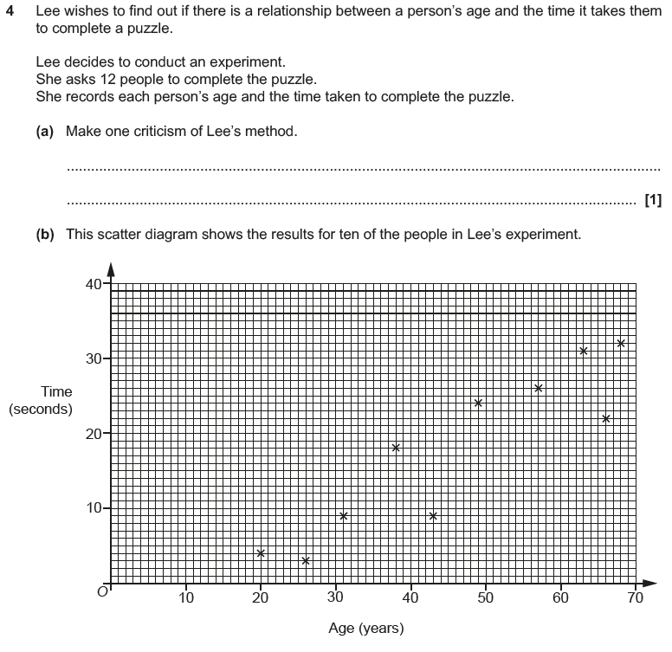
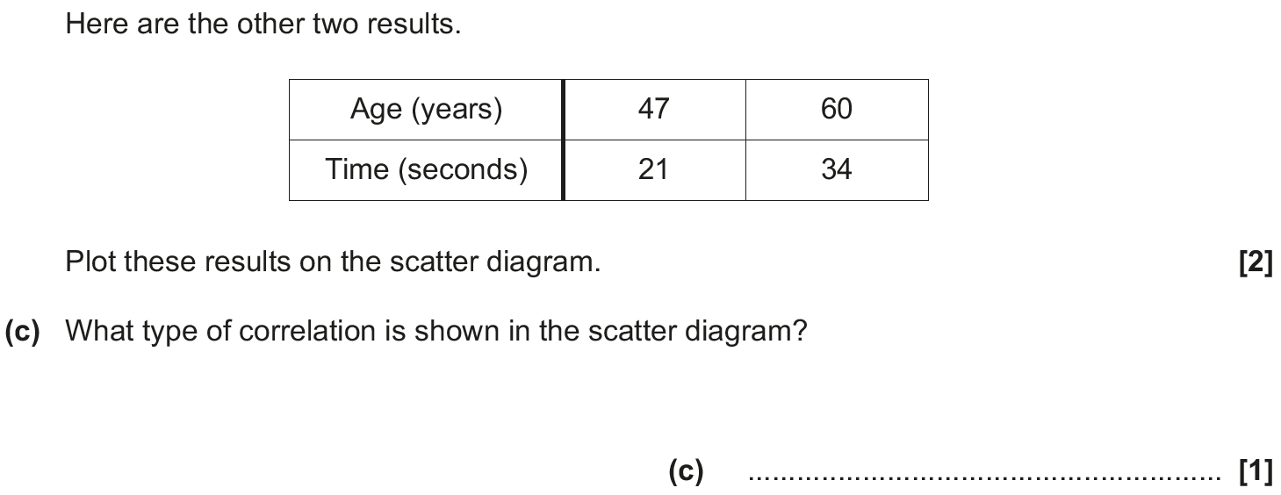
Scatter Diagrams & Correlation
May 2018 1H Q4

Slide 14
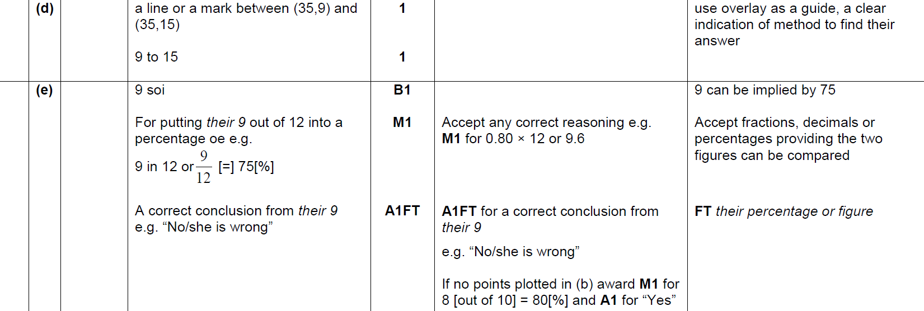
Scatter Diagrams & Correlation
May 2018 1H Q4
A
B
C
D
E

Slide 15
Scatter Diagrams & Correlation
May 2018 1H Q4
A Exemplar responses

Slide 16
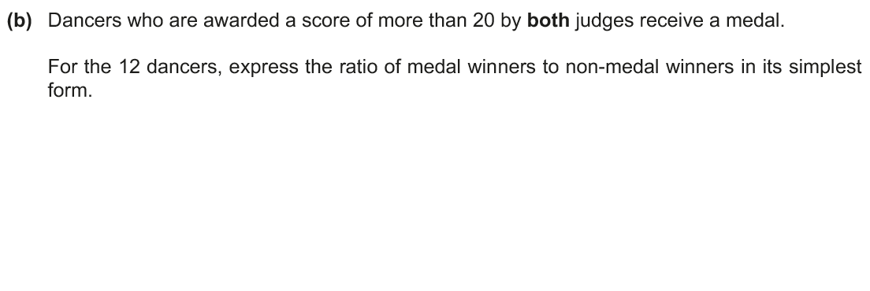
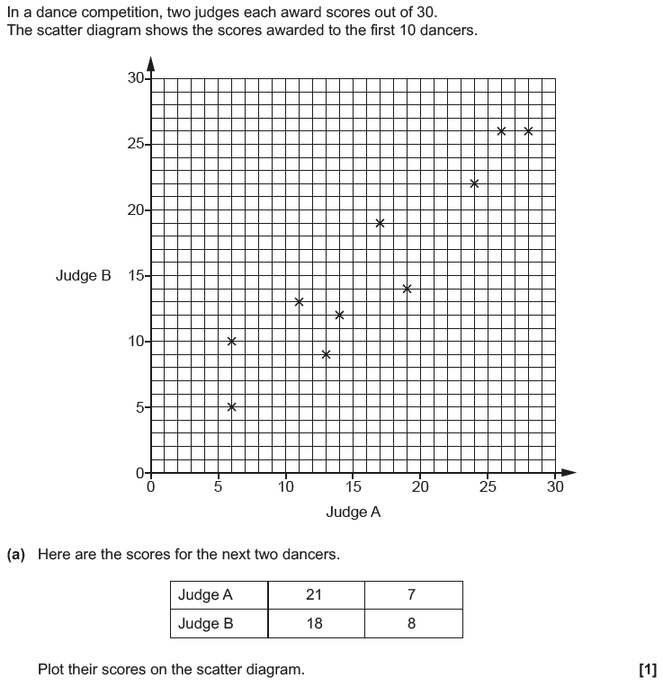
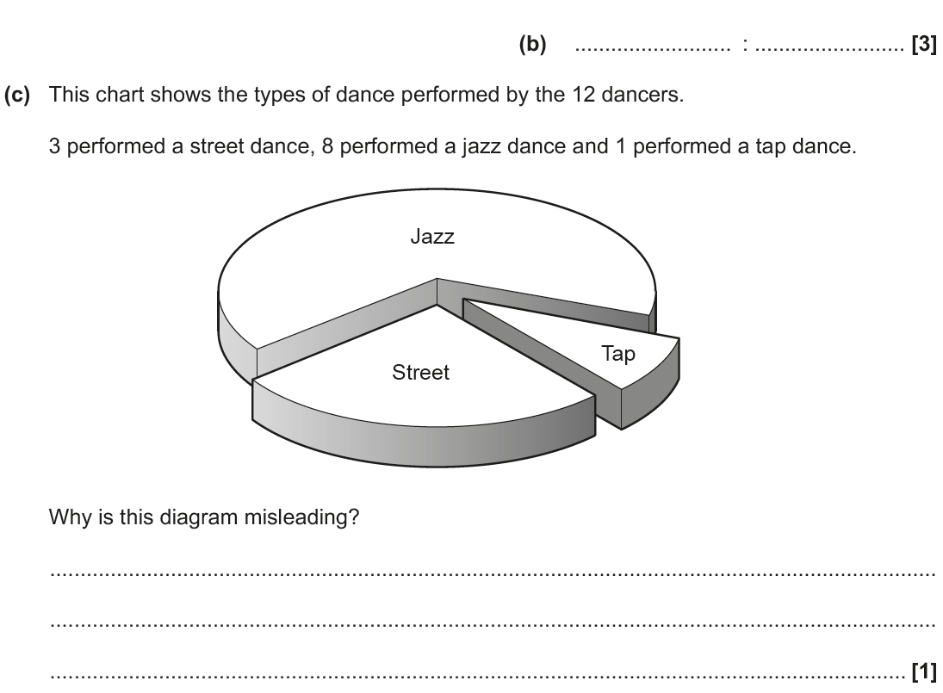
Scatter Diagrams & Correlation
Nov 2018 3H Q1

Slide 17
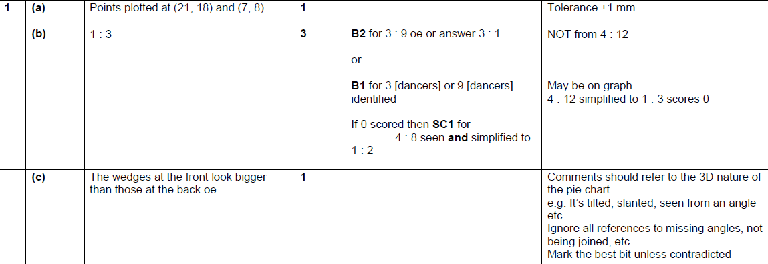
Scatter Diagrams & Correlation
Nov 2018 3H Q1
A
B
C

