Slide 1
Scatter Diagrams & Correlation
Scatter Diagrams & Correlation
SAM
3H Q4
May 2017 1H Q1
Spec 1
3H Q1
June 2018 3H Q1
Spec 2
3H Q5
Nov 2018 2H Q2

Slide 2
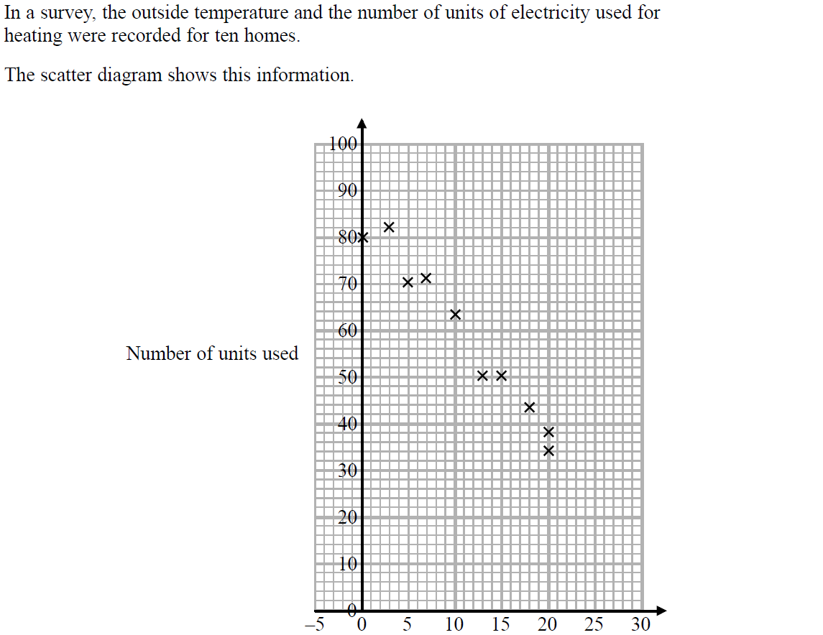
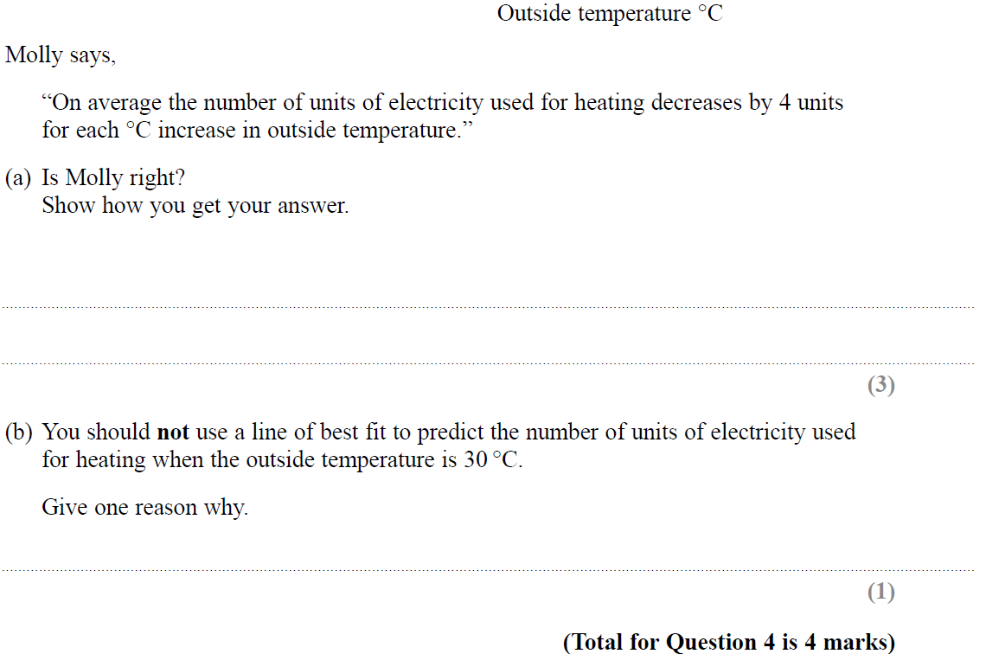
Scatter Diagrams & Correlation
SAM 3H Q4

Slide 3
Scatter Diagrams & Correlation
SAM 3H Q4
A
B

Slide 4
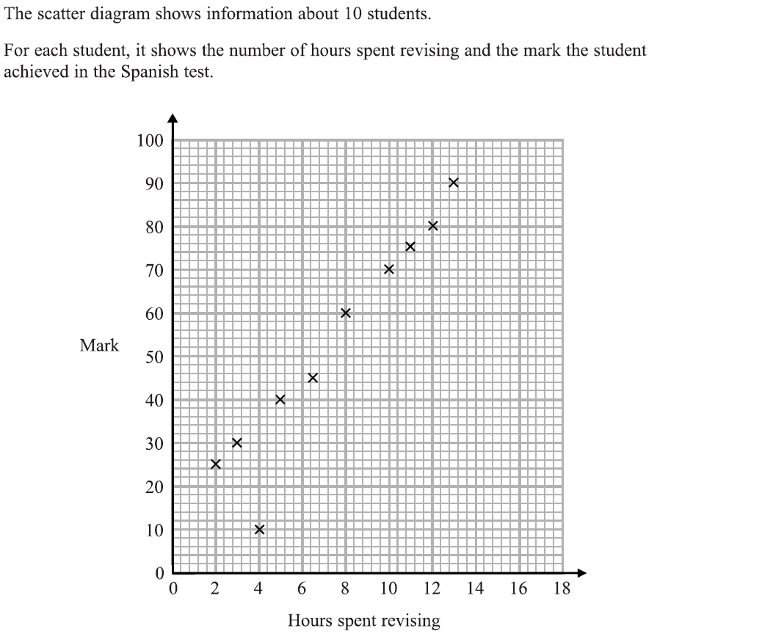
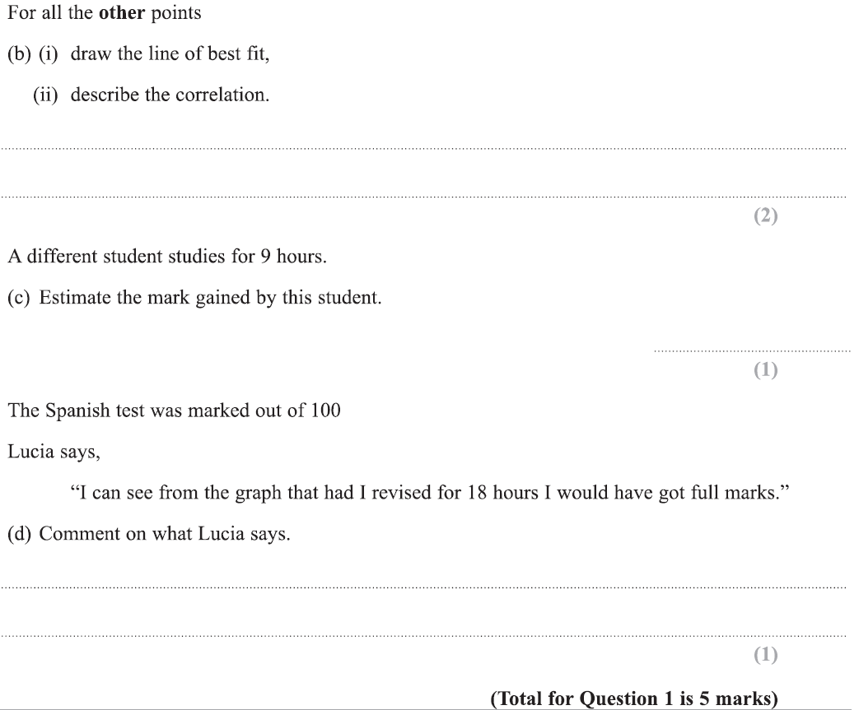
Scatter Diagrams & Correlation
Specimen Set 1 3H Q1

Slide 5
Scatter Diagrams & Correlation
Specimen Set 1 3H Q1
A
B (i)
B (ii)
C
D

Slide 6
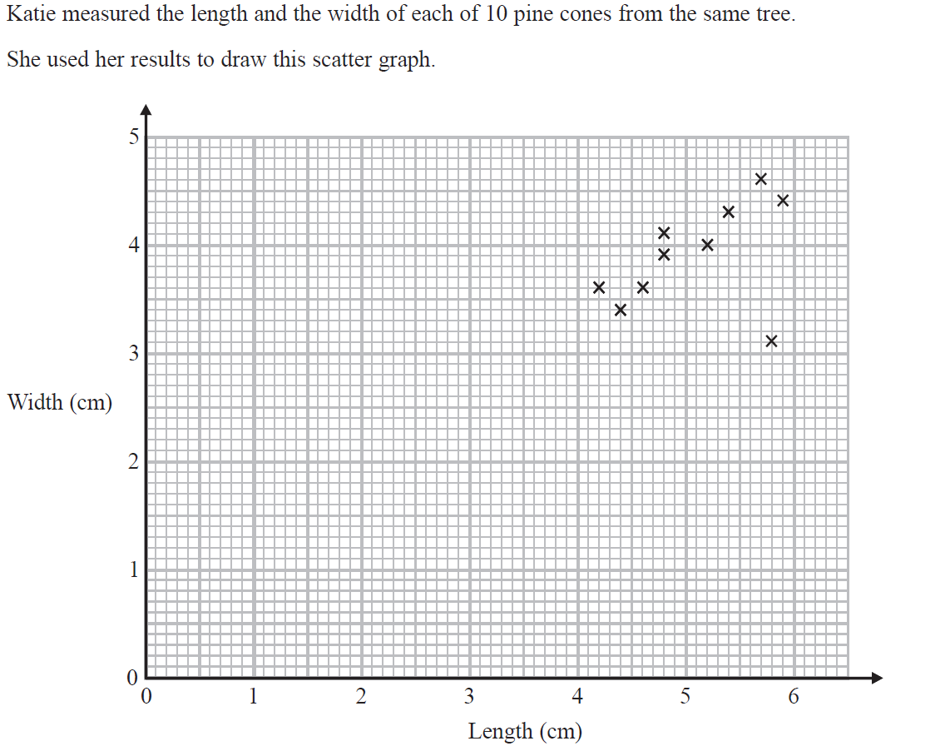
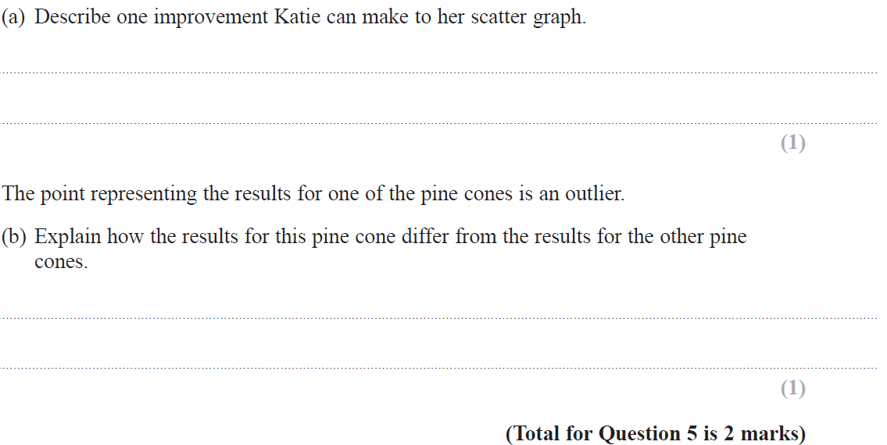
Scatter Diagrams & Correlation
Specimen Set 2 3H Q5

Slide 7
Scatter Diagrams & Correlation
Specimen Set 2 3H Q5
A
B

Slide 8
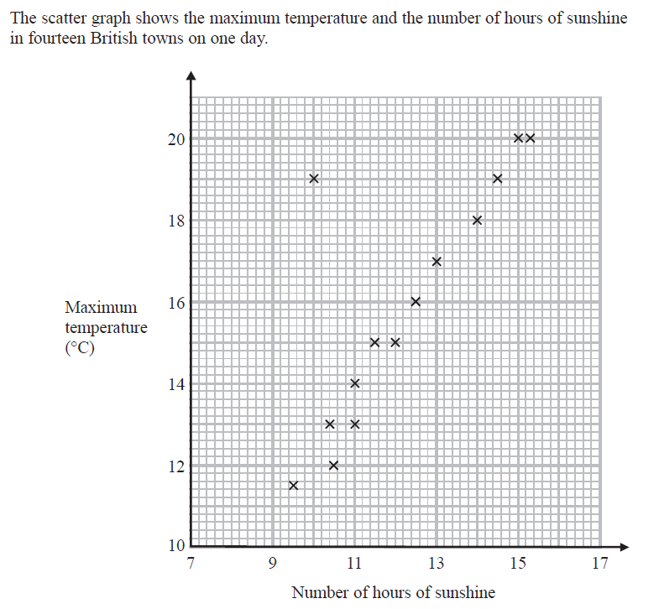
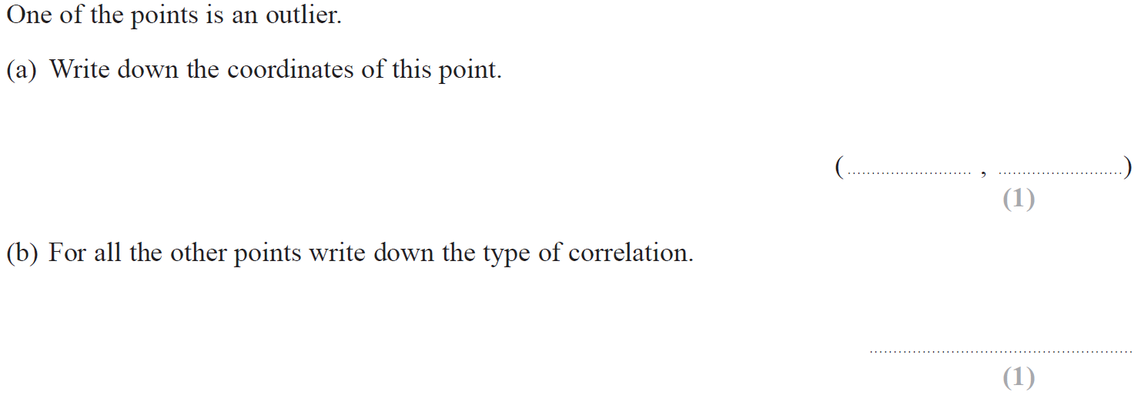
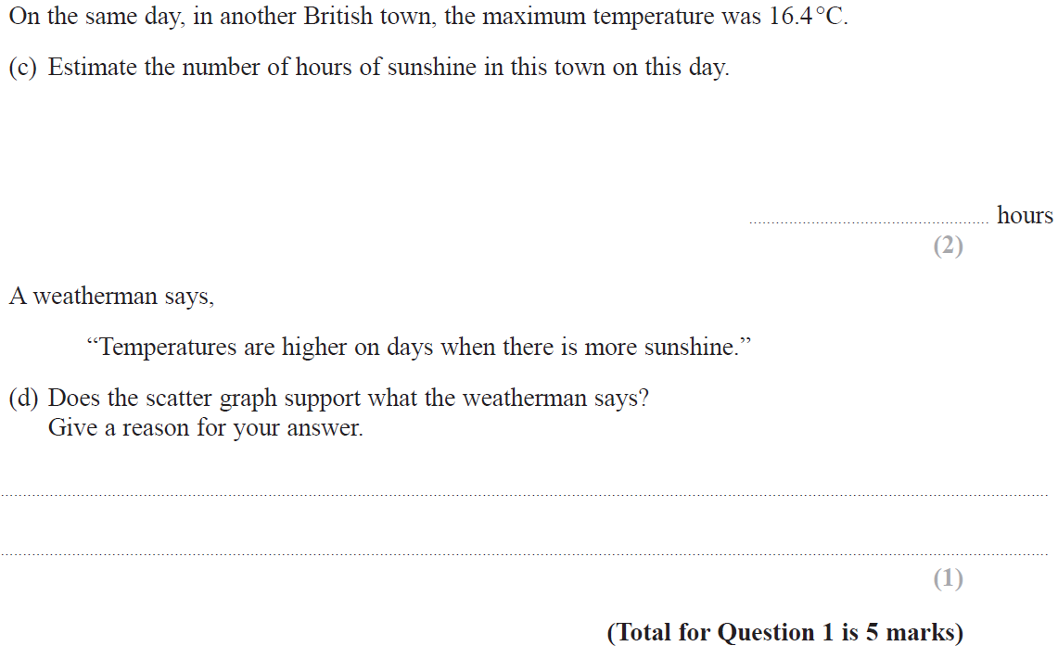
Scatter Diagrams & Correlation
May 2017 1H Q1

Slide 9
Scatter Diagrams & Correlation
May 2017 1H Q1
A
B
C
D

Slide 10
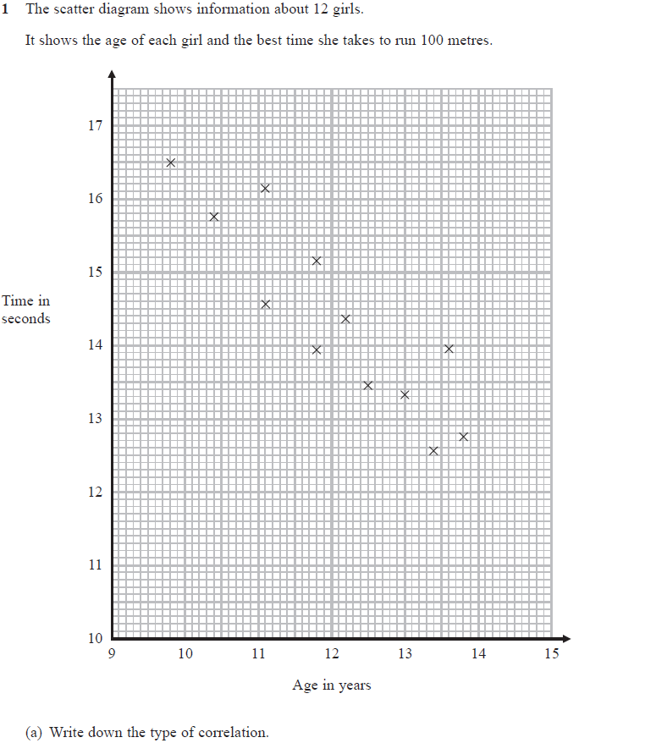
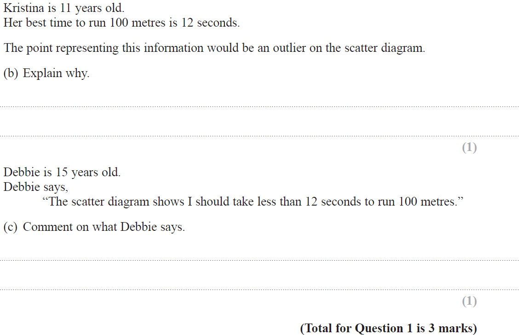
Scatter Diagrams & Correlation
June 2018 3H Q1

Slide 11
Scatter Diagrams & Correlation
June 2018 3H Q1
A
B
C

Slide 12
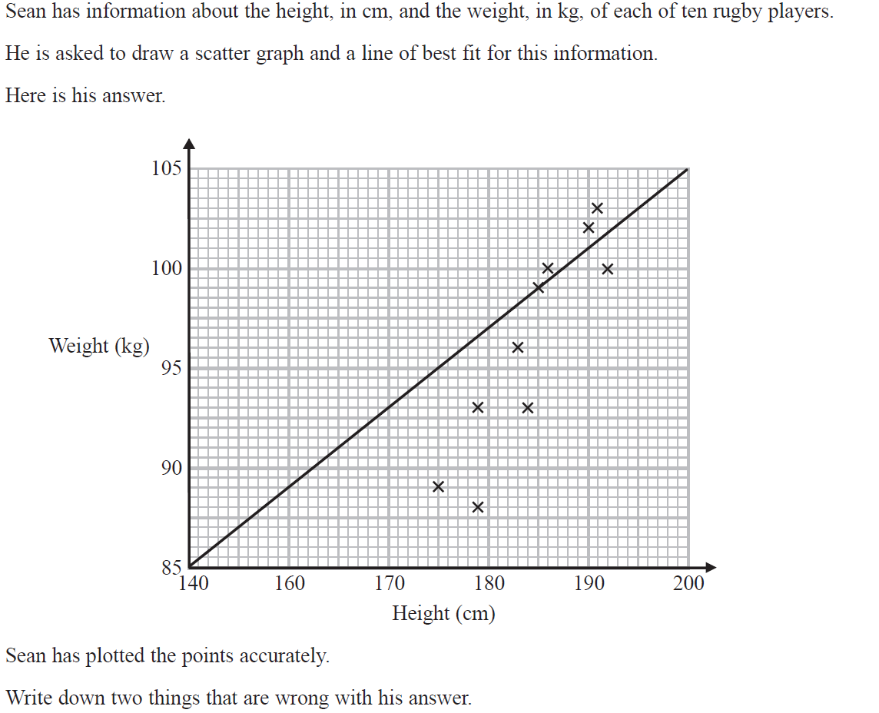
Scatter Diagrams & Correlation
Nov 2018 2H Q2

Slide 13
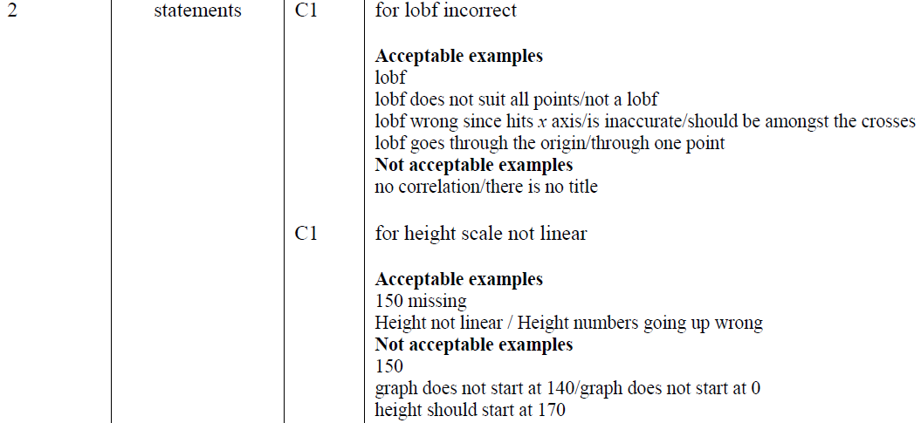
Scatter Diagrams & Correlation
Nov 2018 2H Q2
A

