Slide 1
Constructions
Constructions
Nov 2017
3H Q10
SAM
3H Q7
1 Marker
June 2018
2H Q14

Slide 2

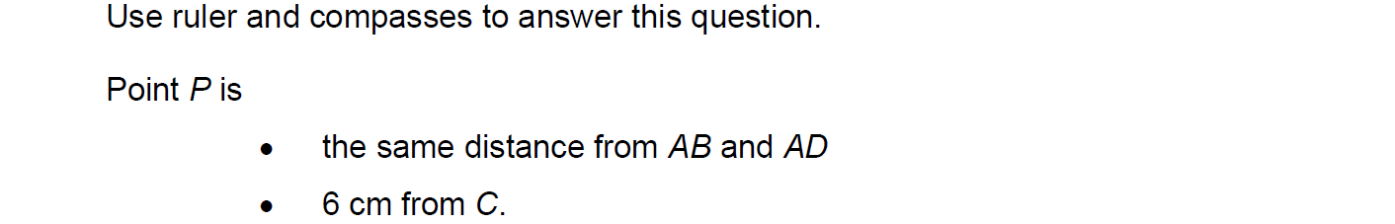
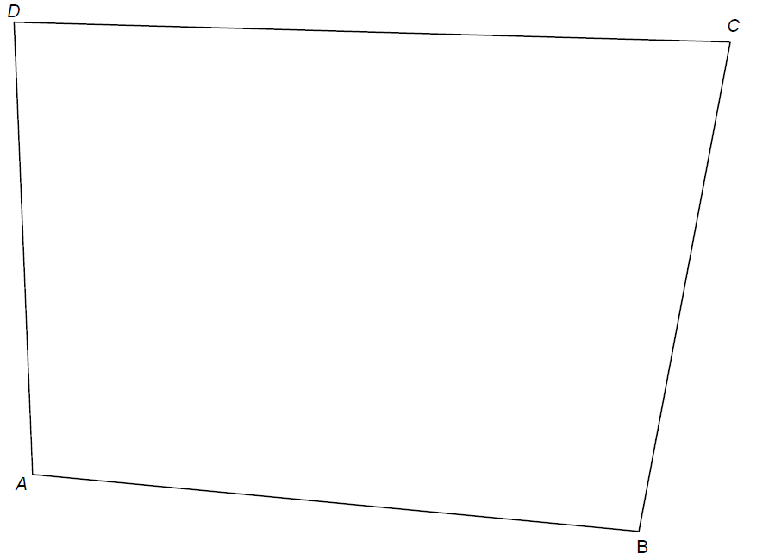

Constructions
SAM 3H Q7

Slide 3
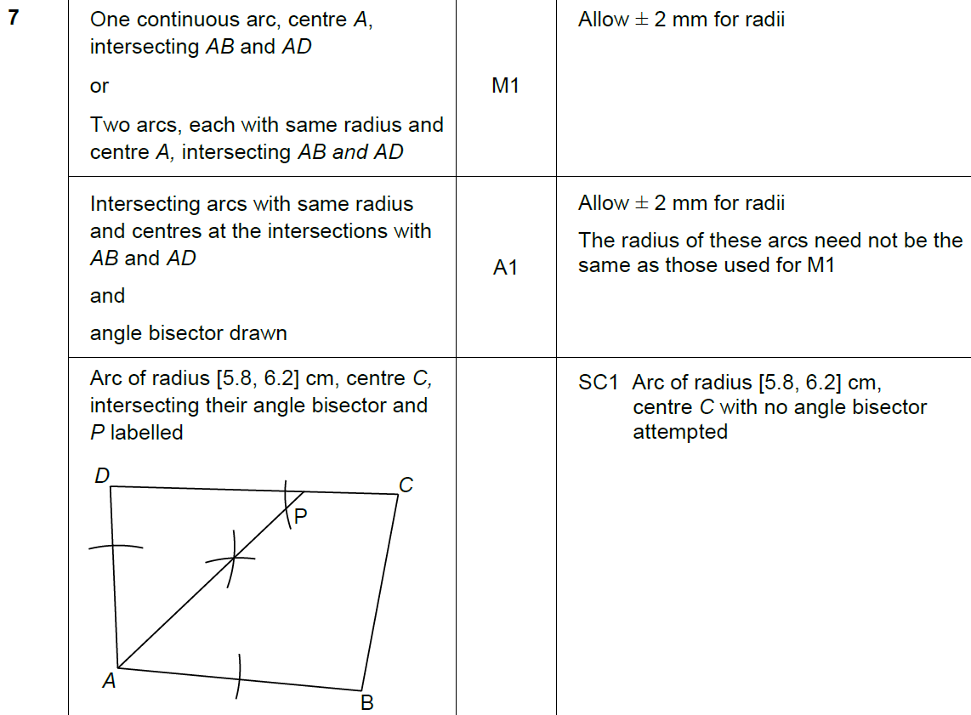

Constructions
SAM 3H Q7
A

Slide 4
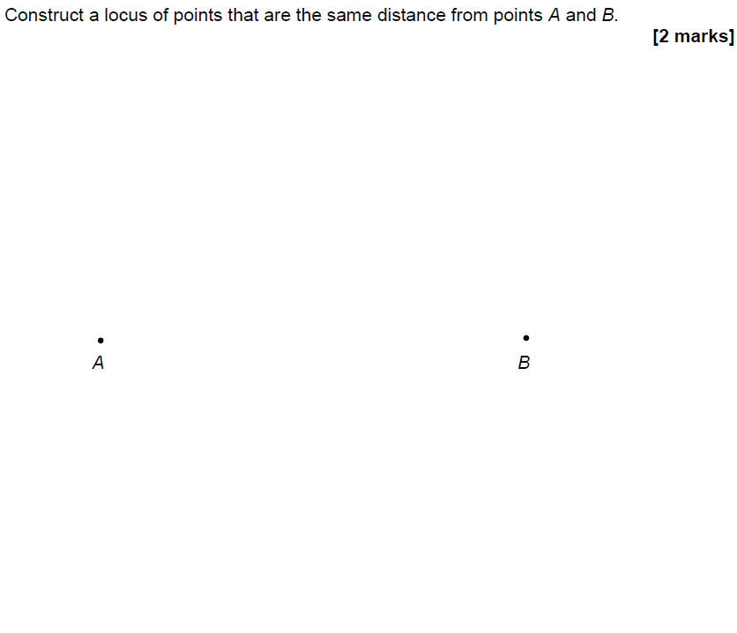
Constructions
Nov 2017 3H Q10
Construction line 1
Construction line 2
Construction line 3

Slide 5
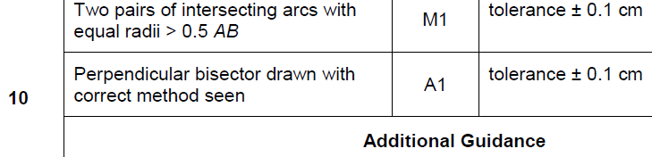
Constructions
Nov 2017 3H Q10
A

Slide 6
Constructions
June 2018 2H Q14
The scale drawing represents a garden.
Water from a sprinkler at P reaches up to 20 metres from P.
Water from a sprinkler at Q reaches up to 25 metres from Q.
Scale: 1 cm represents 5 m
Using a pair of compasses,
show the region that water from both sprinklers reaches.
[2 marks]

Slide 7
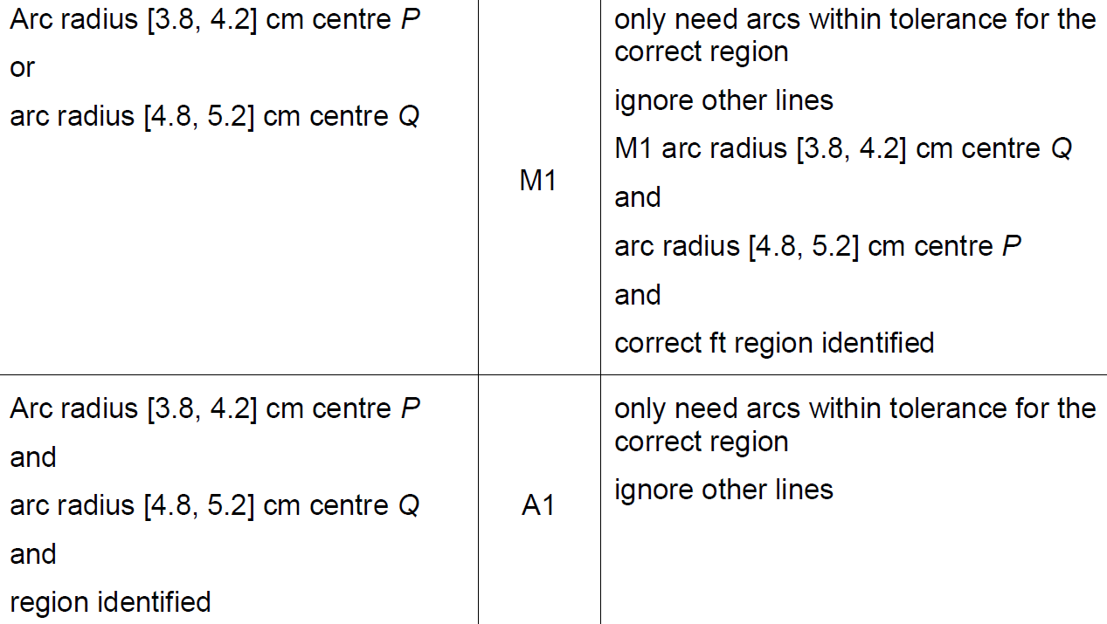
Constructions
June 2018 2H Q14
A

Slide 8
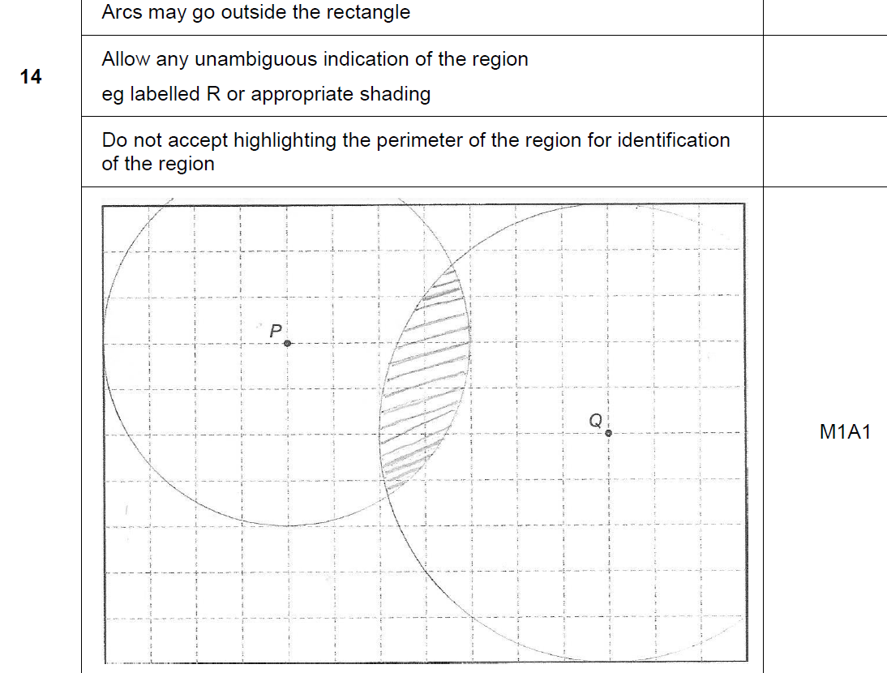
Constructions
June 2018 2H Q14
A notes

