Slide 1
Constructions & Bearings
Constructions
Old Spec Q’s
SAM
1H Q5
Jan 2019
2HR Q5
June 2019
2H Q2

Slide 2
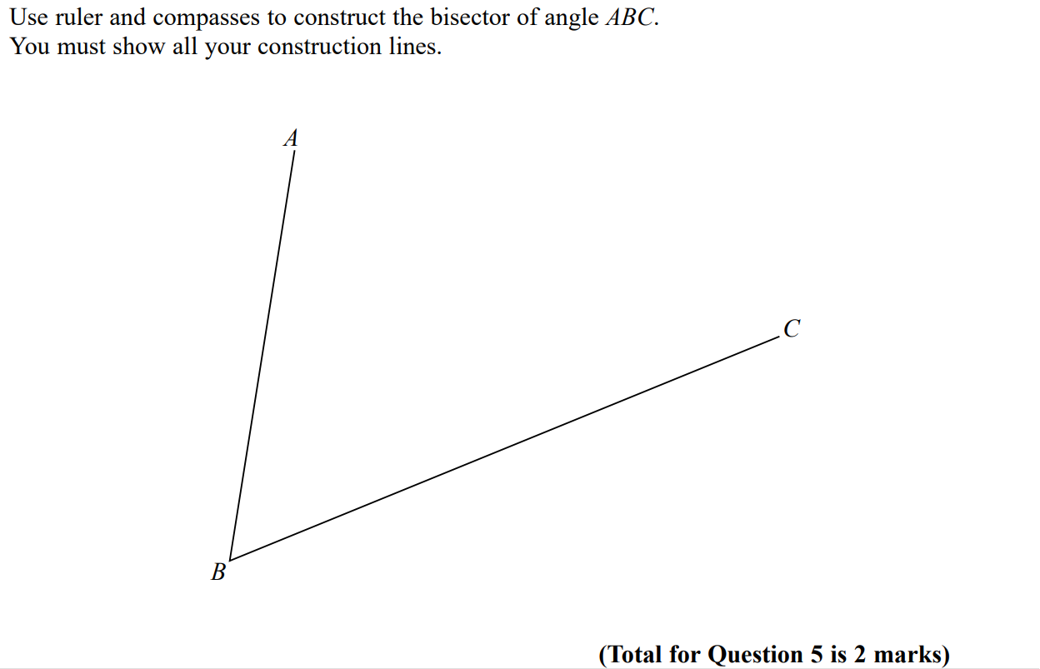
Constructions
SAM 1H Q5

Slide 3
Constructions
SAM 1H Q5
A

Slide 4
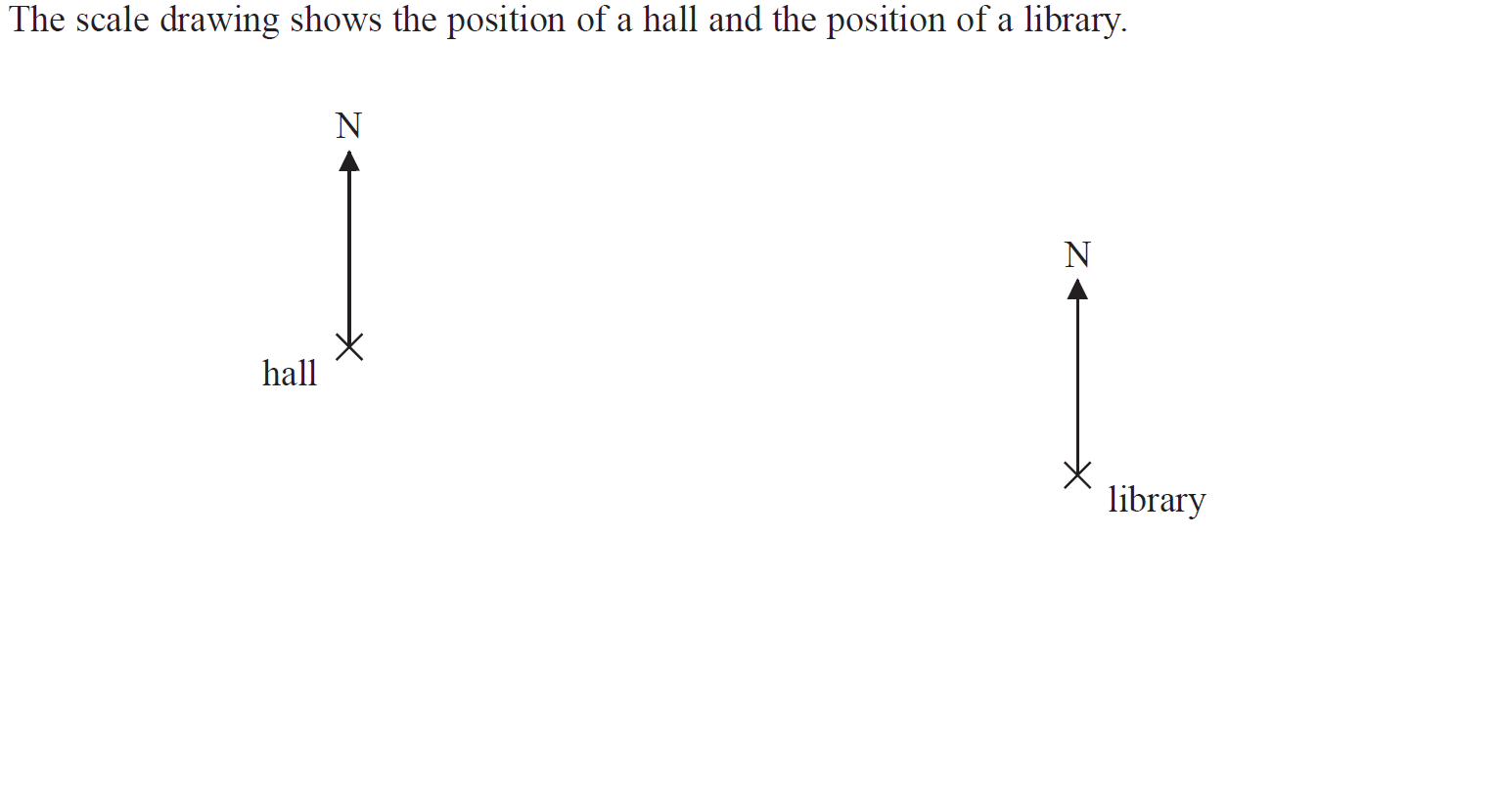
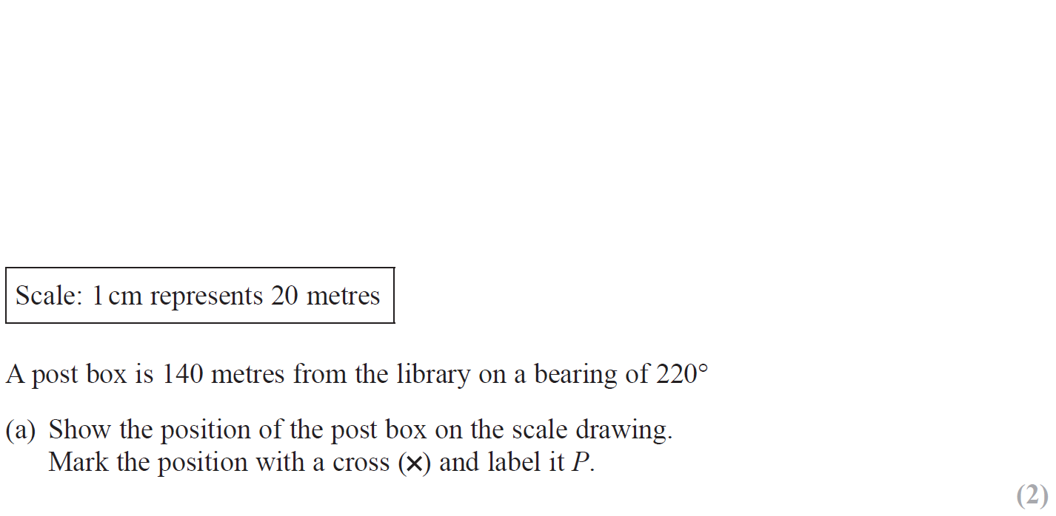
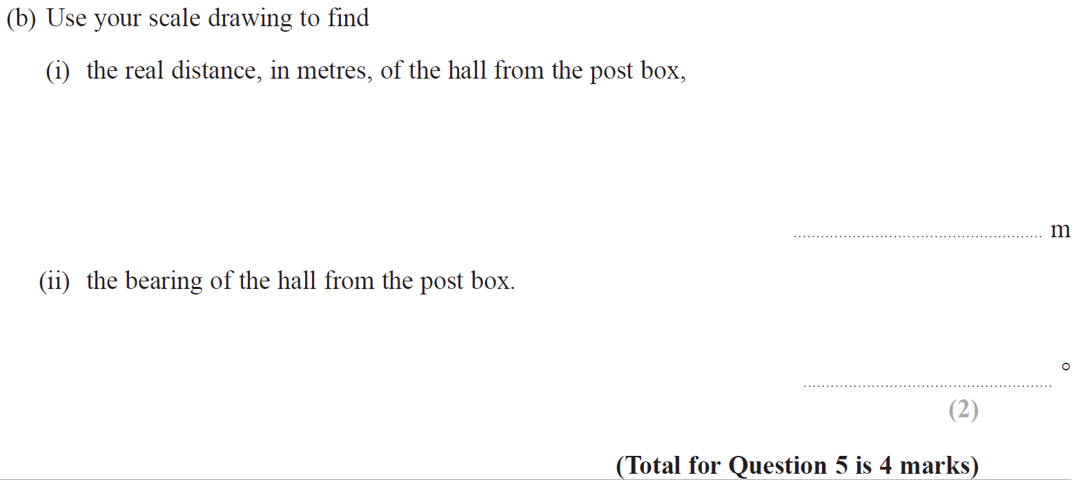
Constructions
Jan 2019 2HR Q5

Slide 5
Constructions
Jan 2019 2HR Q5
A (note that scale will be off if printing from this slide)

Slide 6
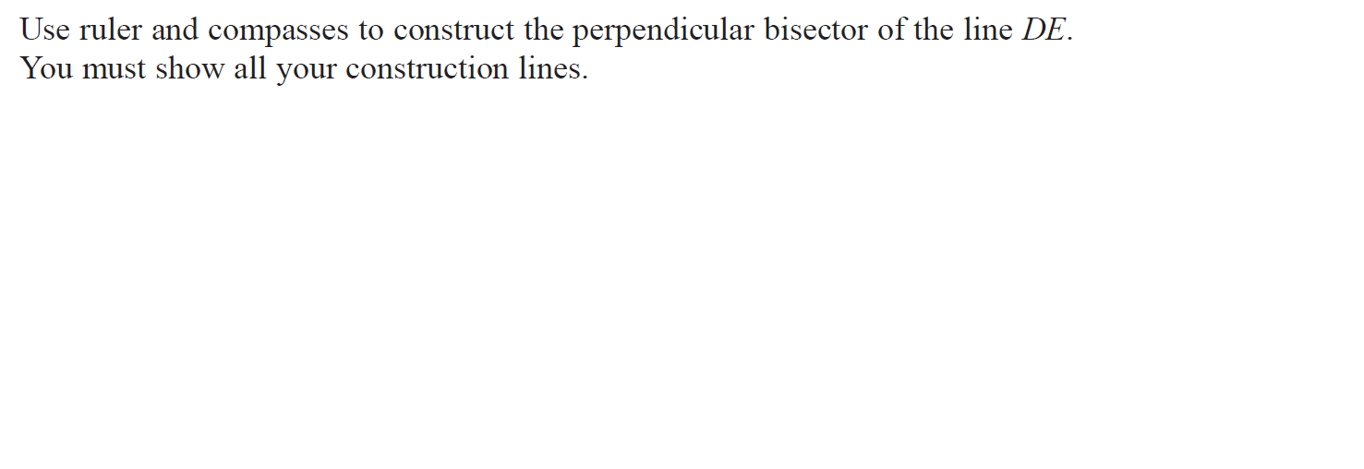
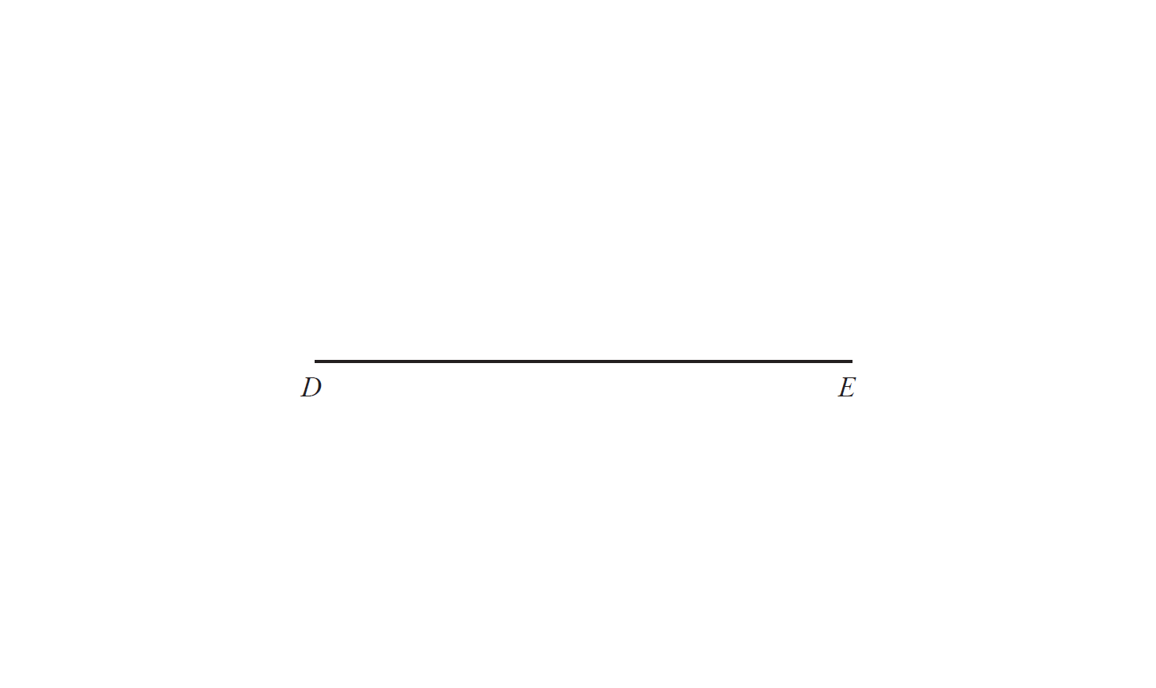
Constructions
June 2019 2H Q2

Slide 7
Constructions
June 2019 2H Q2
A

Slide 8
Constructions
Constructions
New Spec Q’s
Nov 2005 3H Q3
Jan 2014 4HR Q5
Nov 2005 4H Q5
May 2014 3H Q6
Nov 2007 4H Q9
May 2014 4H Q7
Nov 2009 4H Q8
Jan 2016 3H Q6
June 2011 4H Q8
May 2017 3H Q9
Jan 2012 3H Q4
Jan 2018 3H Q8
Jan 2013 4H Q12
Jan 2018 4H Q4
May 2013 4HR Q4

Slide 9
Constructions
Nov 2004 3H Q3

Slide 10
Constructions
Nov 2004 3H Q3
A

Slide 11
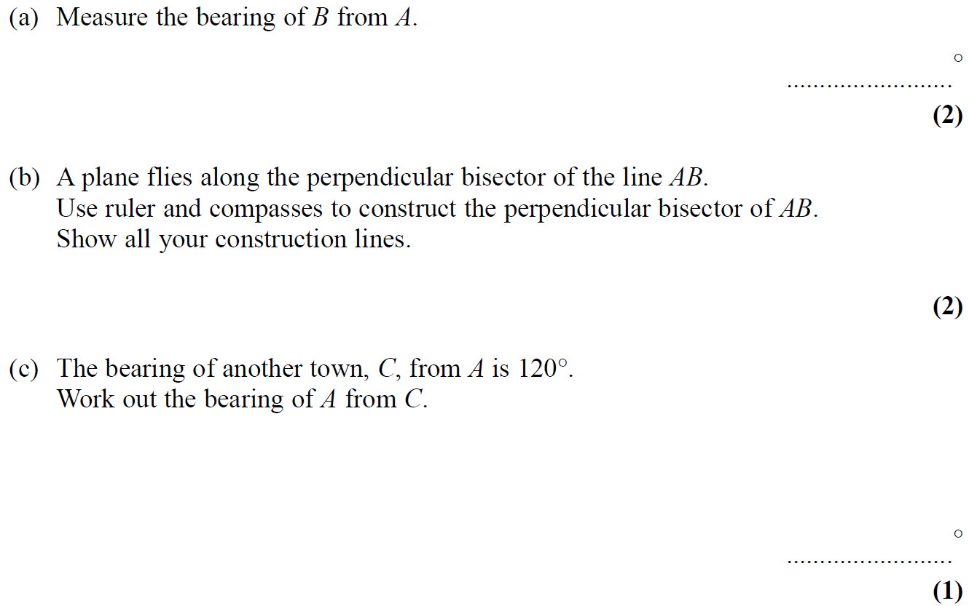
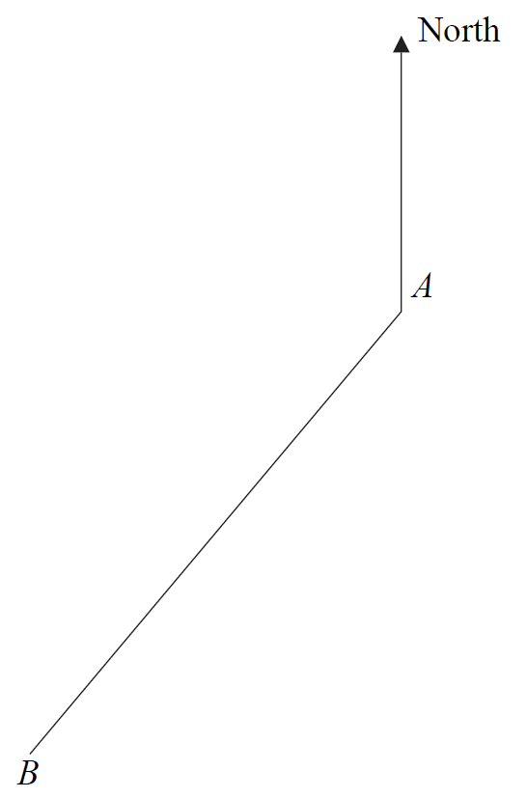
Constructions
Nov 2004 4H Q5

Slide 12
Constructions
Nov 2004 4H Q5
A
B
C

Slide 13
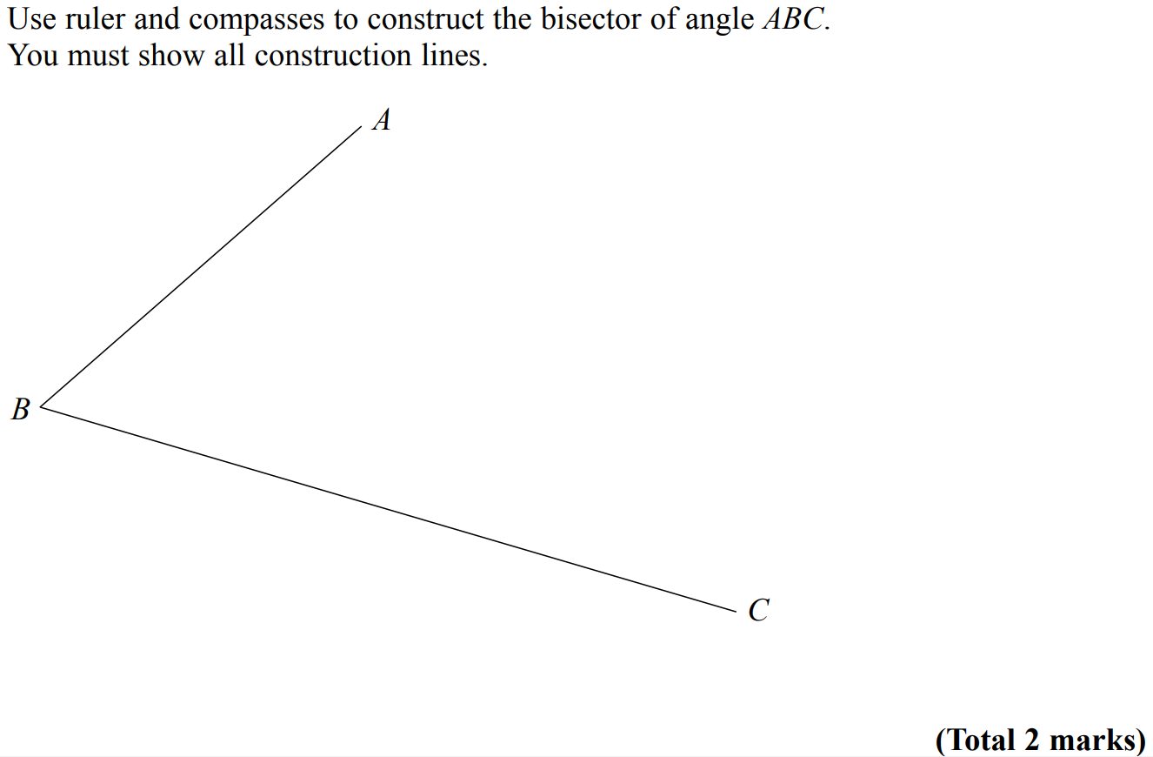
Constructions
Nov 2007 4H Q9

Slide 14
Constructions
Nov 2007 4H Q9
A

Slide 15
Constructions
Nov 2009 4H Q8

Slide 16
Constructions
Nov 2009 4H Q8
A

Slide 17
Constructions
June 2011 4H Q8

Slide 18
Constructions
June 2011 4H Q8
A

Slide 19
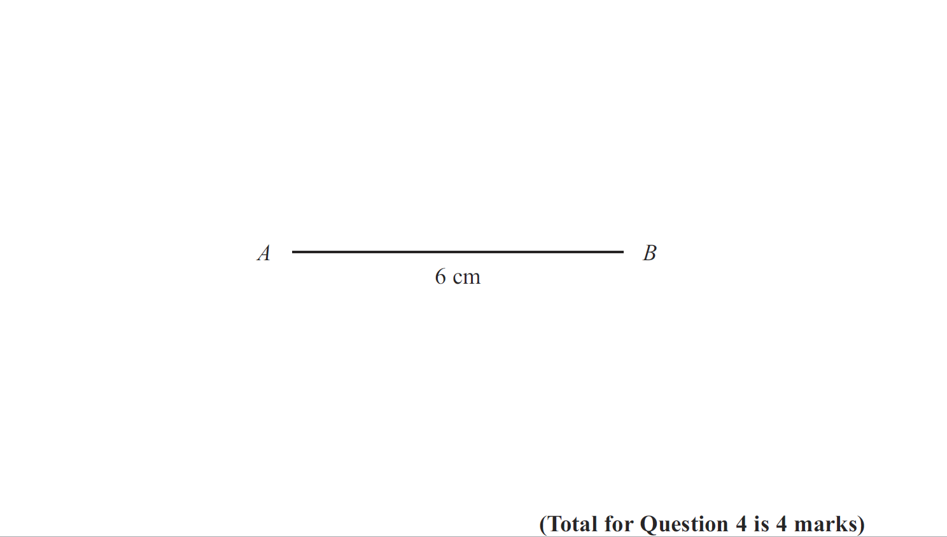
Constructions
Jan 2012 3H Q4

Slide 20
Constructions
Jan 2012 3H Q4
A

Slide 21
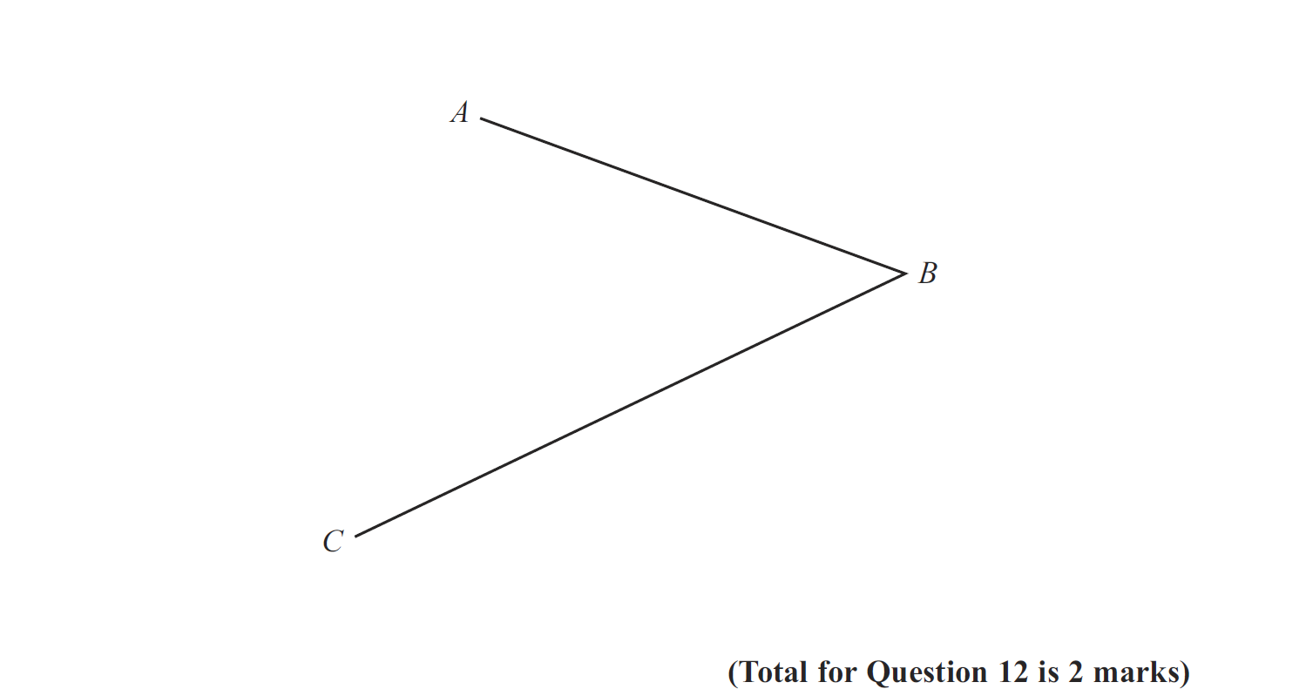
Constructions
Jan 2013 4H Q12

Slide 22
Constructions
Jan 2013 4H Q12
A

Slide 23
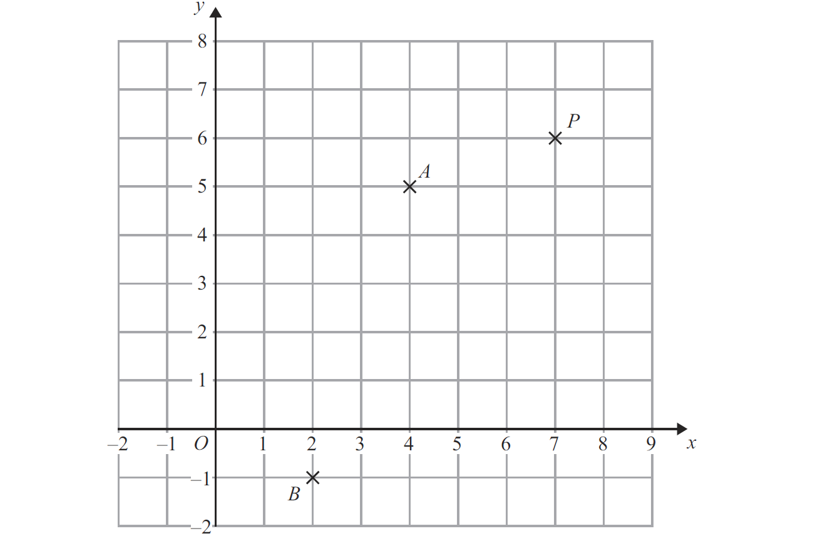
Constructions
May 2013 4HR Q4

Slide 24
Constructions
May 2013 4HR Q4
A
B

Slide 25
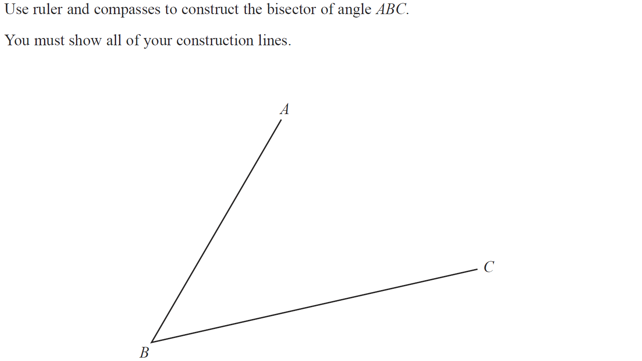
Constructions
Jan 2014 4HR Q5

Slide 26
Constructions
Jan 2014 4HR Q5
A

Slide 27
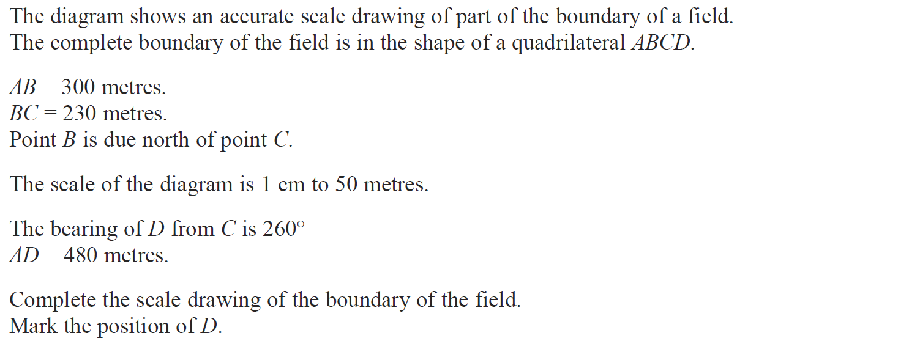
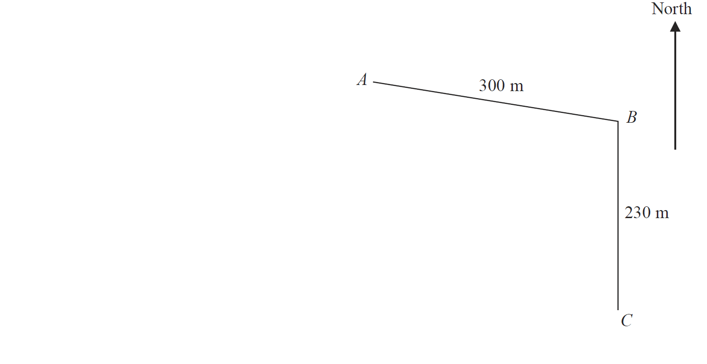
Constructions
May 2014 3H Q6

Slide 28
Constructions
May 2014 3H Q6
A

Slide 29
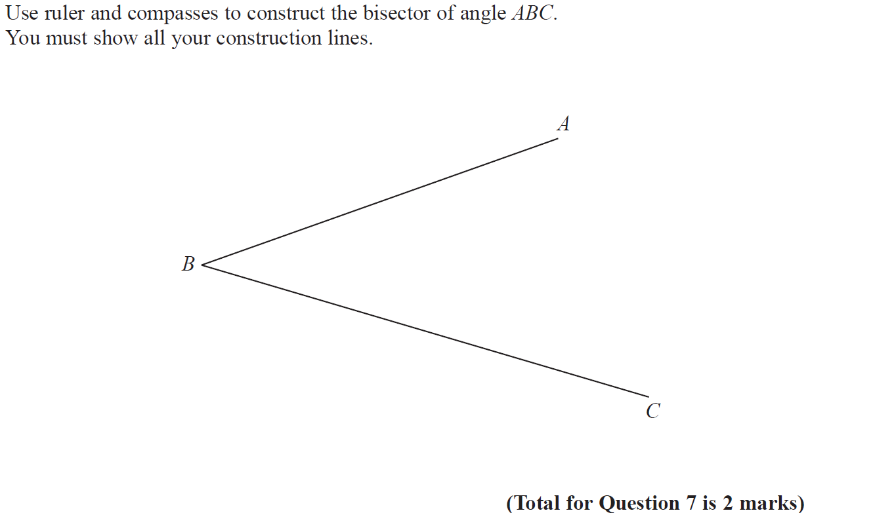
Constructions
May 2014 4H Q7

Slide 30
Constructions
May 2014 4H Q7
A

Slide 31
Constructions
Jan 2016 3H Q6

Slide 32
Constructions
Jan 2016 3H Q6
A

Slide 33
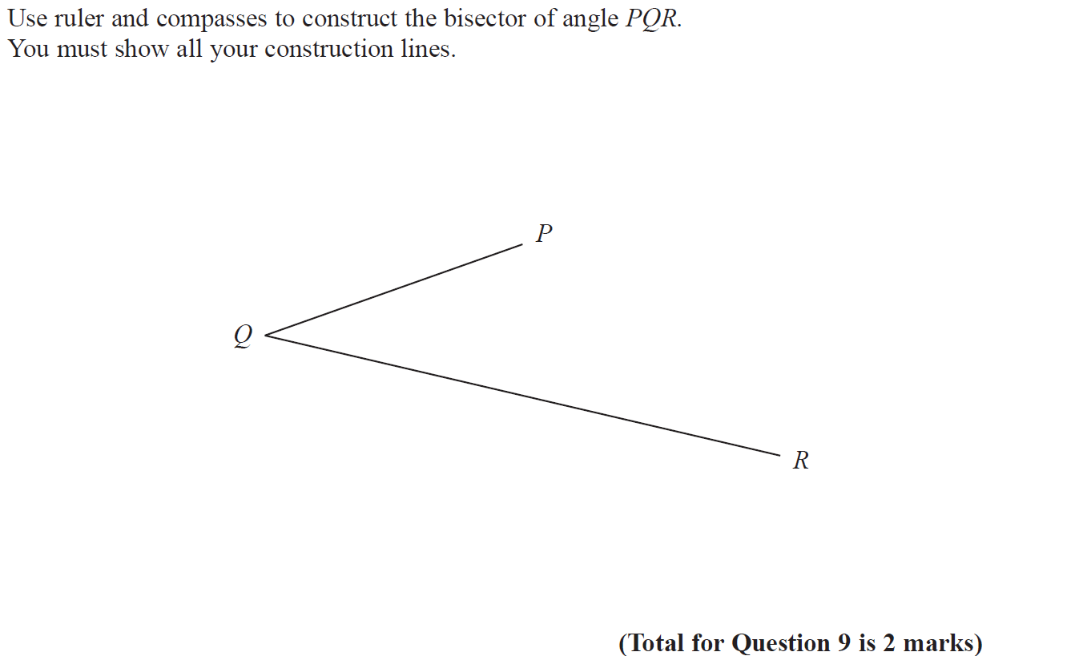
Constructions
May 2017 3H Q9

Slide 34
Constructions
May 2017 3H Q9
A

Slide 35
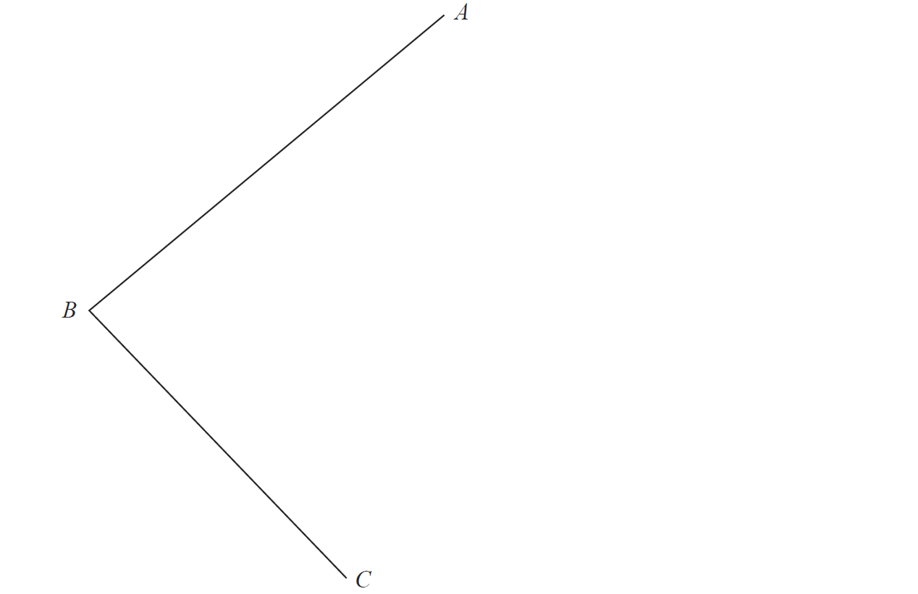
Constructions
Jan 2018 3H Q8

Slide 36
Constructions
Jan 2018 3H Q8
A

Slide 37
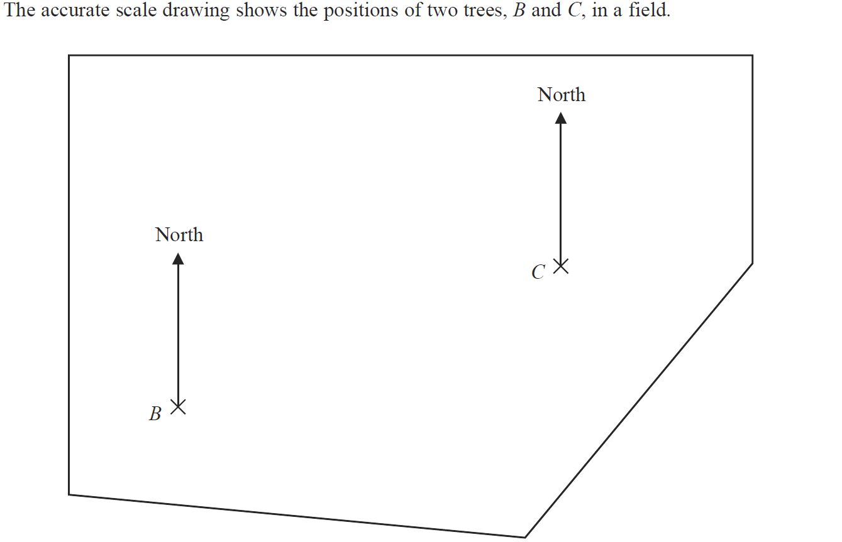
Constructions
Jan 2018 4H Q4

Slide 38
Constructions
Jan 2018 4H Q4
A

