Slide 1
Constructions
Constructions
Edexcel
AQA
No Questions to date
OCR

Slide 2
Constructions
Constructions
Edexcel
Nov 2017
3H Q10
AQA
SAM
3H Q7
1 Marker
June 2018
2H Q14
OCR

Slide 3
Constructions
Constructions
June 2017
3H Q2
Edexcel
Nov 2017
1H Q3
AQA
May 2018
1H Q7
OCR
Nov 2018
1H Q7

Slide 4

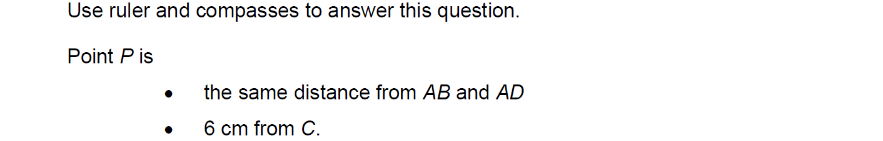
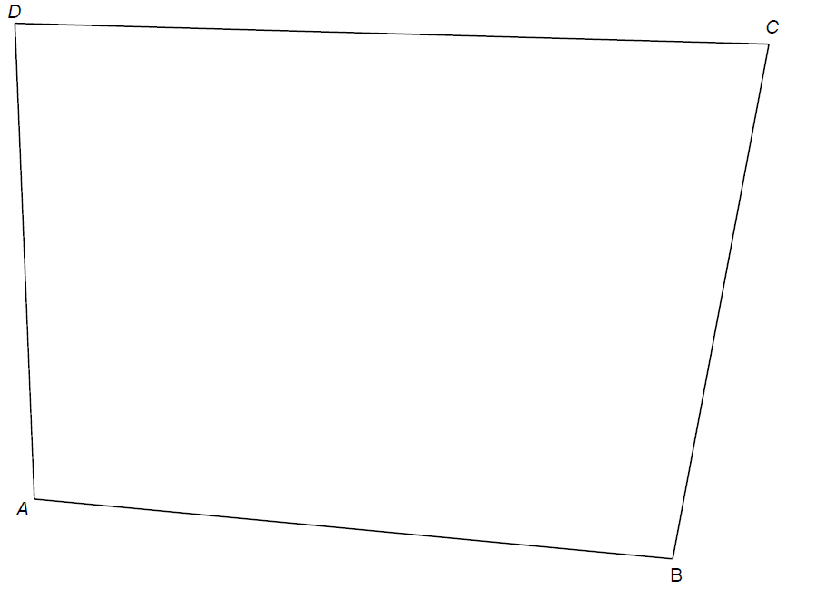

Constructions
SAM 3H Q7

Slide 5
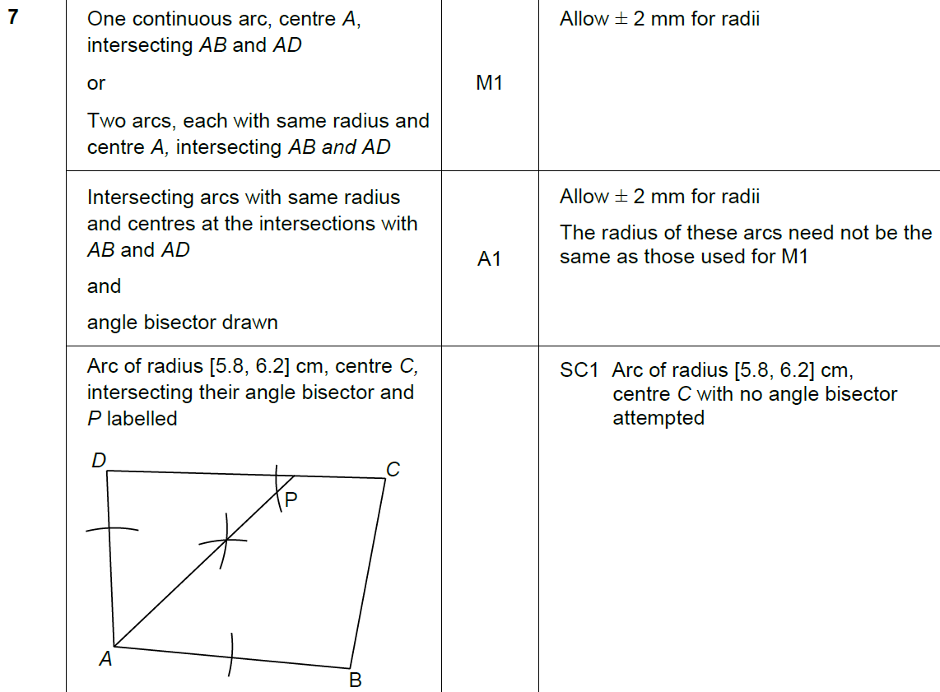

Constructions
SAM 3H Q7
A

Slide 6
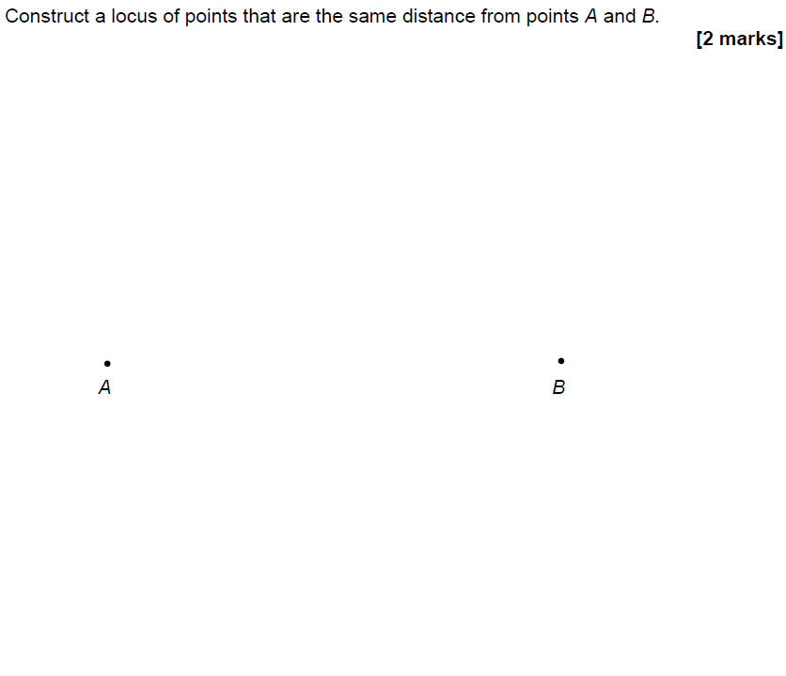
Constructions
Nov 2017 3H Q10
Construction line 1
Construction line 2
Construction line 3

Slide 7
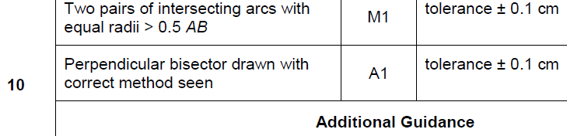
Constructions
Nov 2017 3H Q10
A

Slide 8
Constructions
June 2018 2H Q14
The scale drawing represents a garden.
Water from a sprinkler at P reaches up to 20 metres from P.
Water from a sprinkler at Q reaches up to 25 metres from Q.
Scale: 1 cm represents 5 m
Using a pair of compasses,
show the region that water from both sprinklers reaches.
[2 marks]

Slide 9
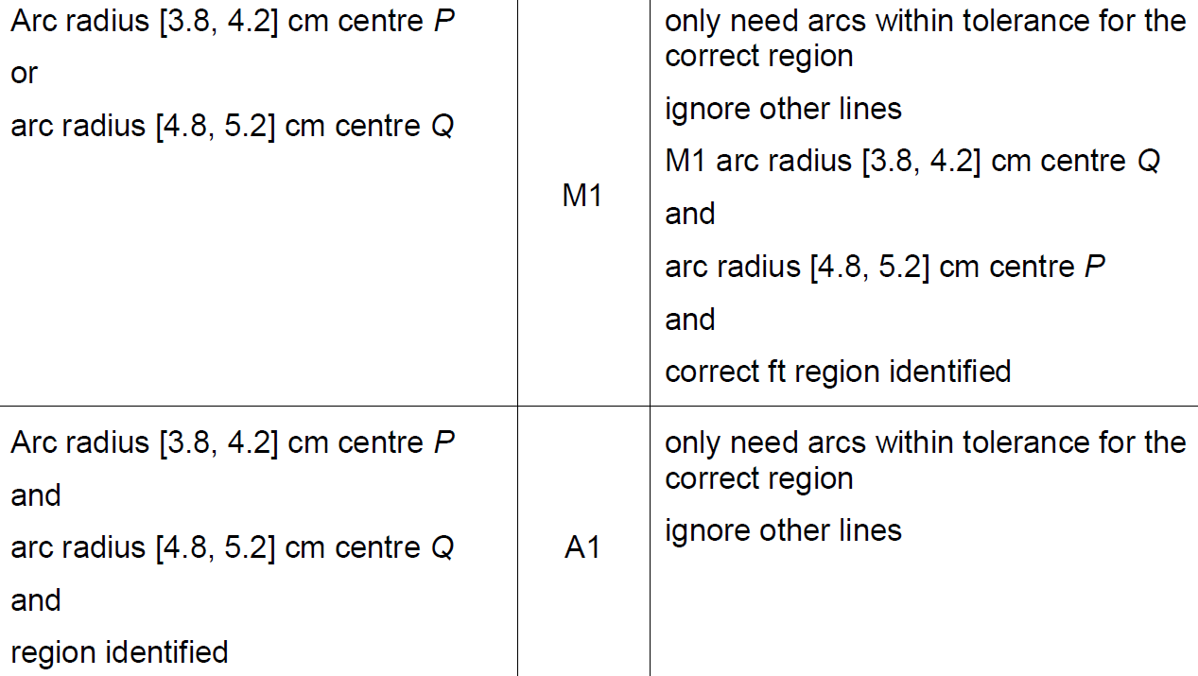
Constructions
June 2018 2H Q14
A

Slide 10
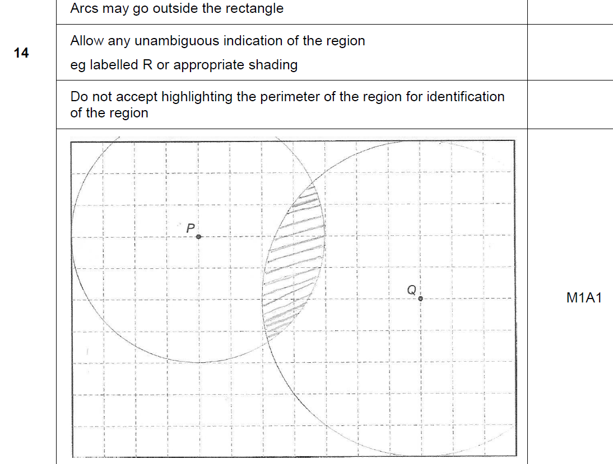
Constructions
June 2018 2H Q14
A notes

Slide 11
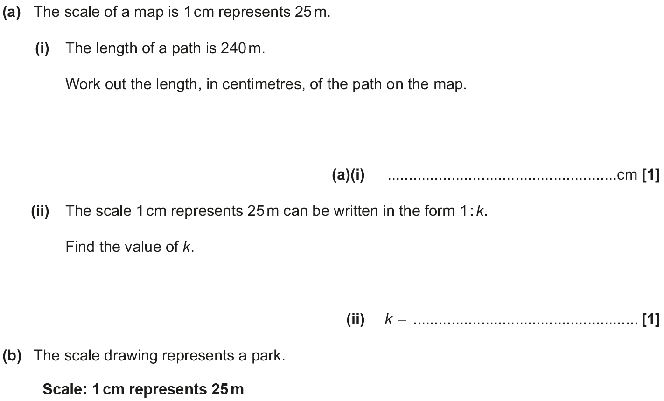
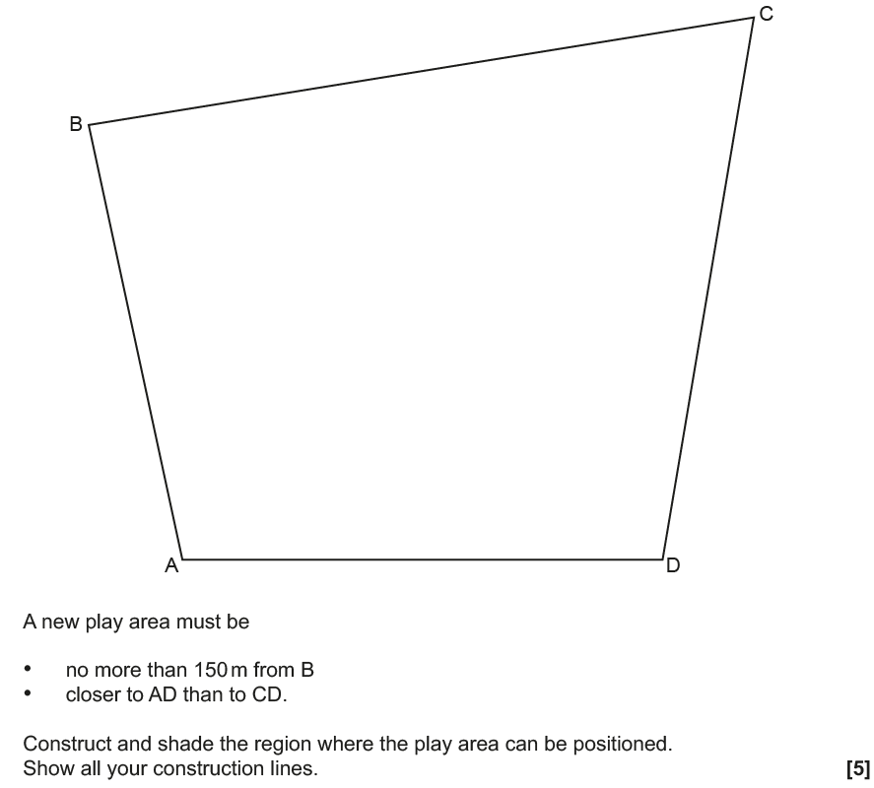
Constructions
June 2017 3H Q2
Construction line 1
Construction line 2
Construction line 3
note: AD = 12cm
Construction line 4
Construction line 5
Shaded region

Slide 12
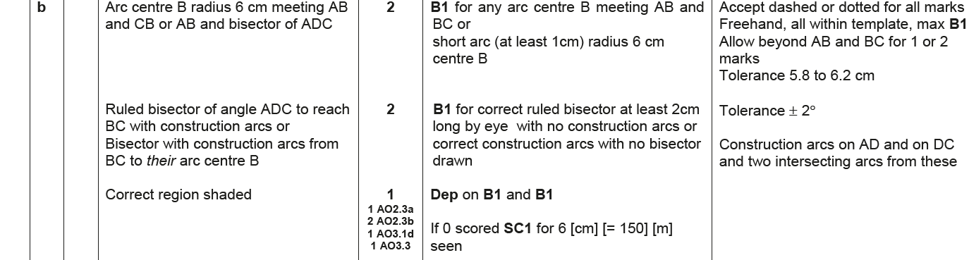
Constructions
June 2017 3H Q2
A (i)
A (ii)
B

Slide 13
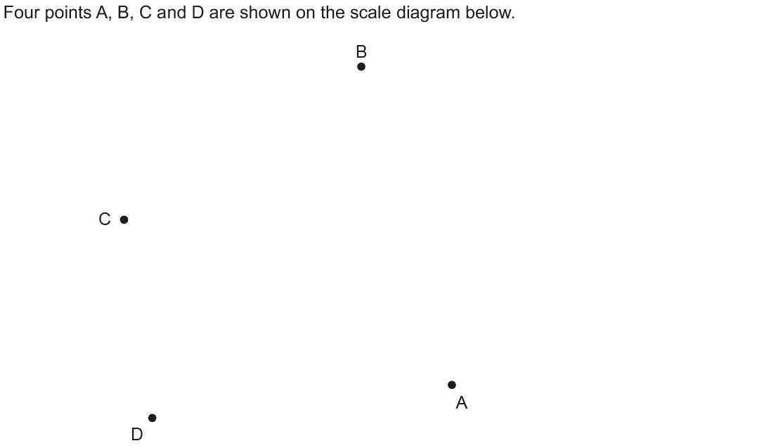
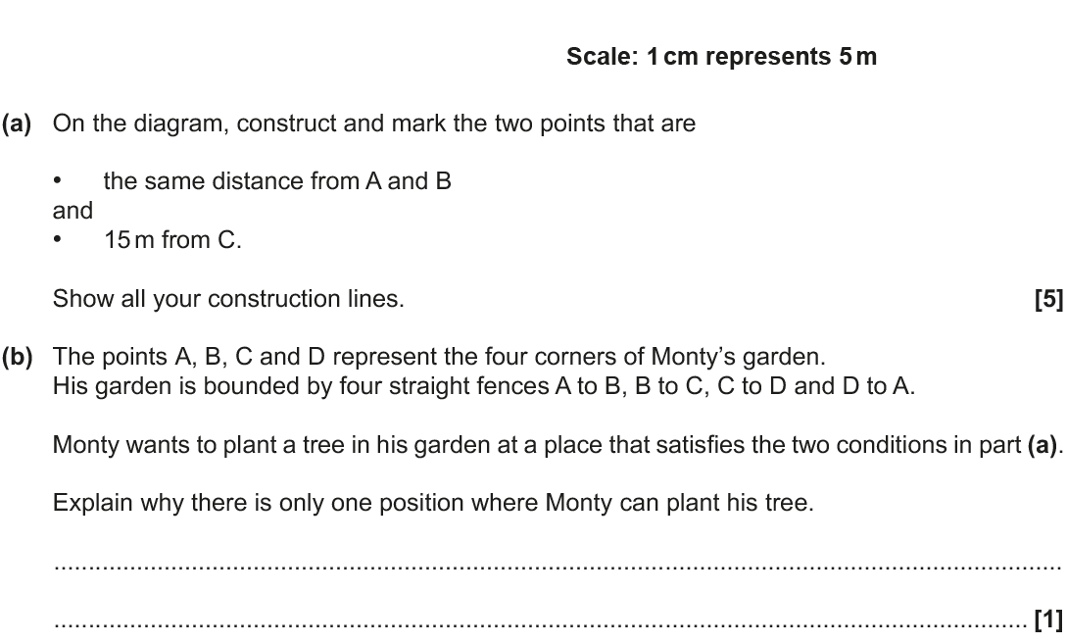
Constructions
Nov 2017 1H Q3
Construction line 1
Construction line 2
Construction line 3
Construction line 4
Reveal Points
note: BD = 12cm

Slide 14
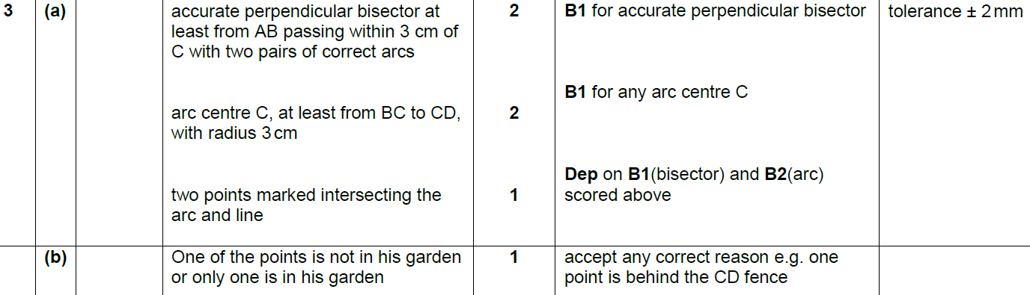
Constructions
Nov 2017 1H Q3
A
B

Slide 15
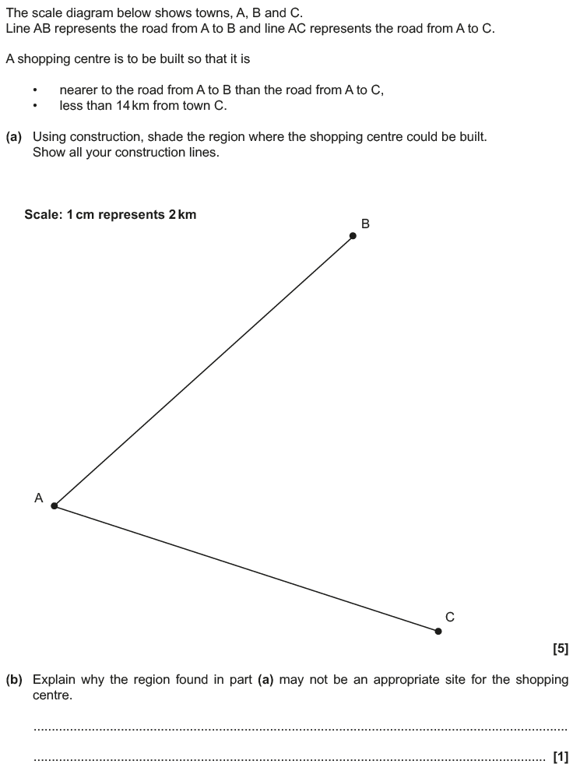
Constructions
May 2018 1H Q7
14 km line
Construction line 1
Construction line 2
Construction line 3
Reveal Region
note: AB = 12cm

Slide 16
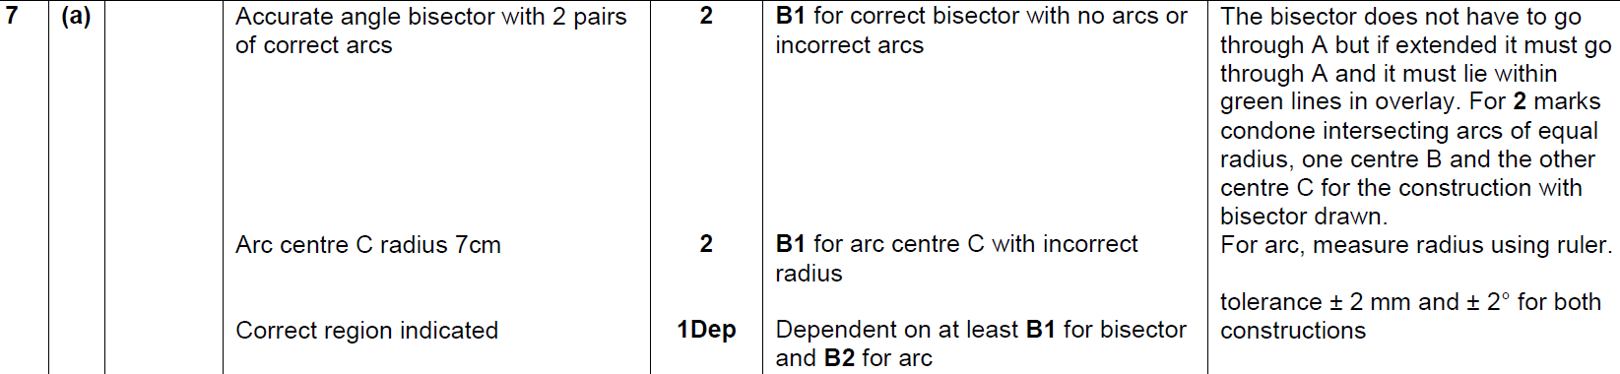
Constructions
May 2018 1H Q7
A
B

Slide 17
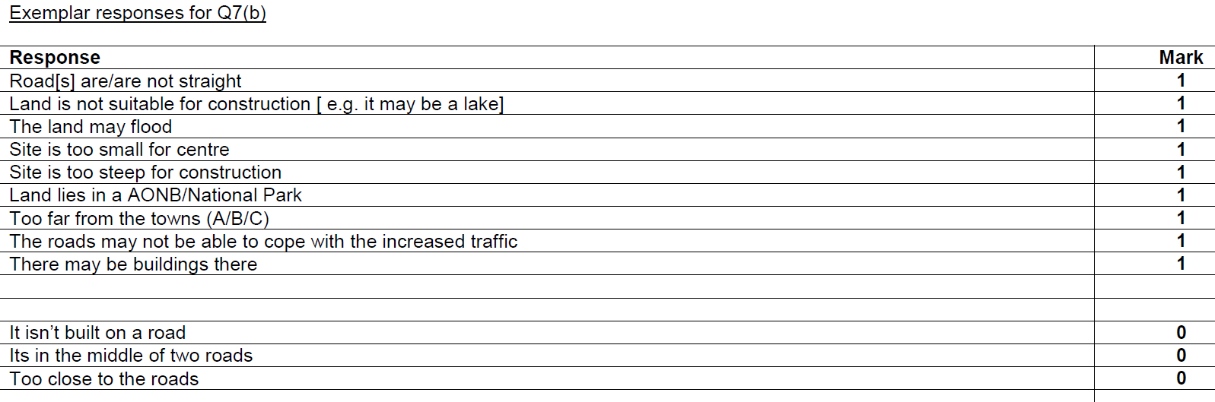
Constructions
May 2018 1H Q7
B Exemplar responses

Slide 18
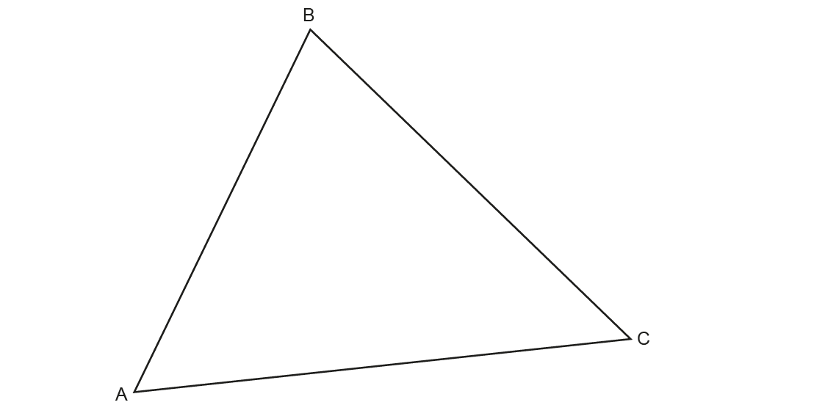
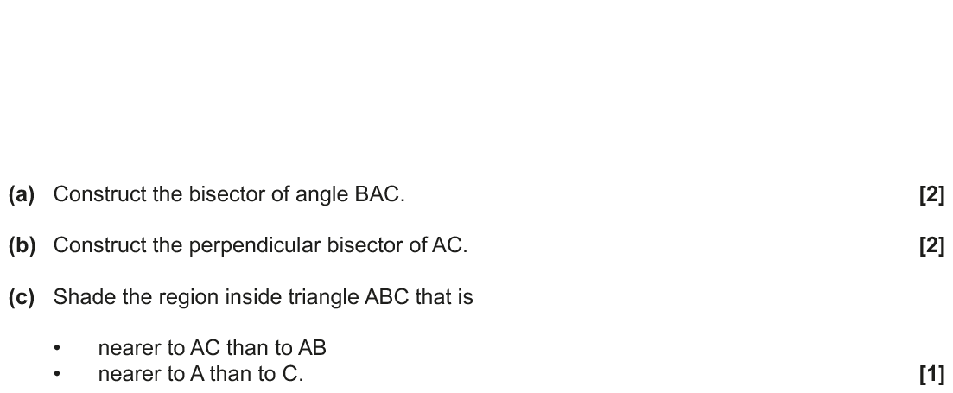
Constructions
Nov 2018 1H Q7
Construction line 1
Construction line 2
Construction line 3
Construction line 4
Construction line 5
Construction line 6
Construction line 7
Reveal Region

Slide 19
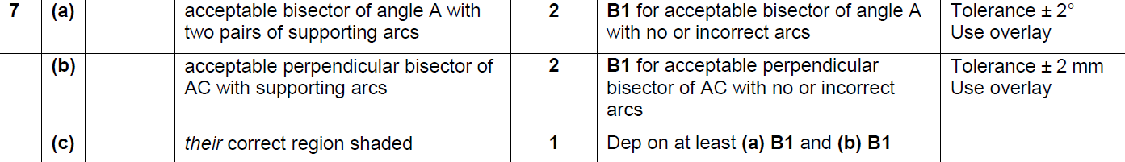
Constructions
Nov 2018 1H Q7
A
B
C

