Slide 1
Constructions
Constructions
June 2017
3H Q2
Nov 2017
1H Q3
May 2018
1H Q7
Nov 2018
1H Q7

Slide 2
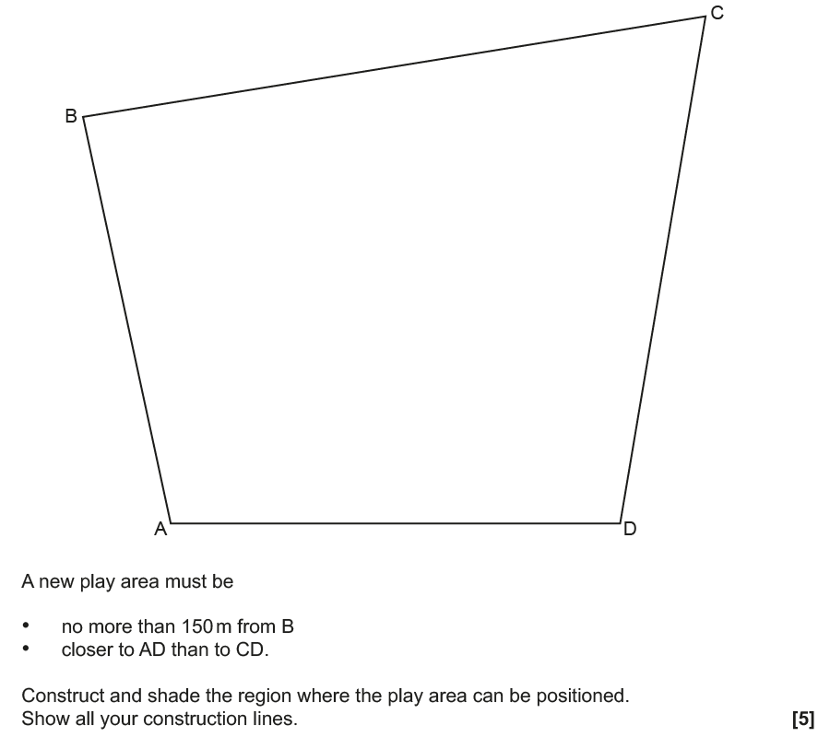
Constructions
June 2017 3H Q2
Construction line 1
Construction line 2
Construction line 3
note: AD = 12cm
Construction line 4
Construction line 5
Shaded region

Slide 3
Constructions
June 2017 3H Q2
A (i)
A (ii)
B

Slide 4
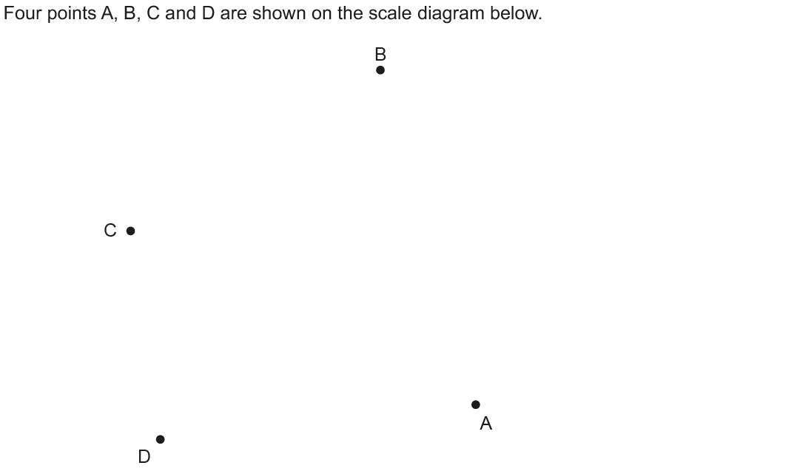
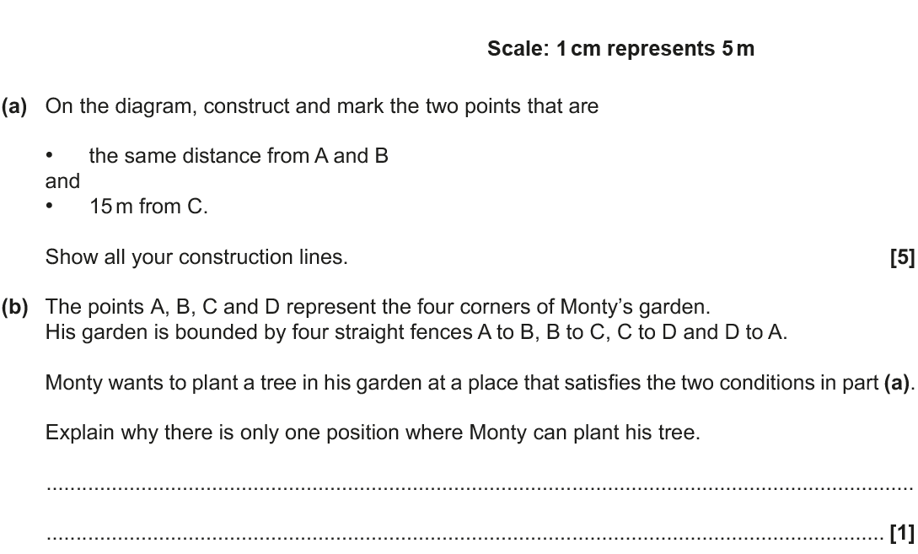
Constructions
Nov 2017 1H Q3
Construction line 1
Construction line 2
Construction line 3
Construction line 4
Reveal Points
note: BD = 12cm

Slide 5
Constructions
Nov 2017 1H Q3
A
B

Slide 6
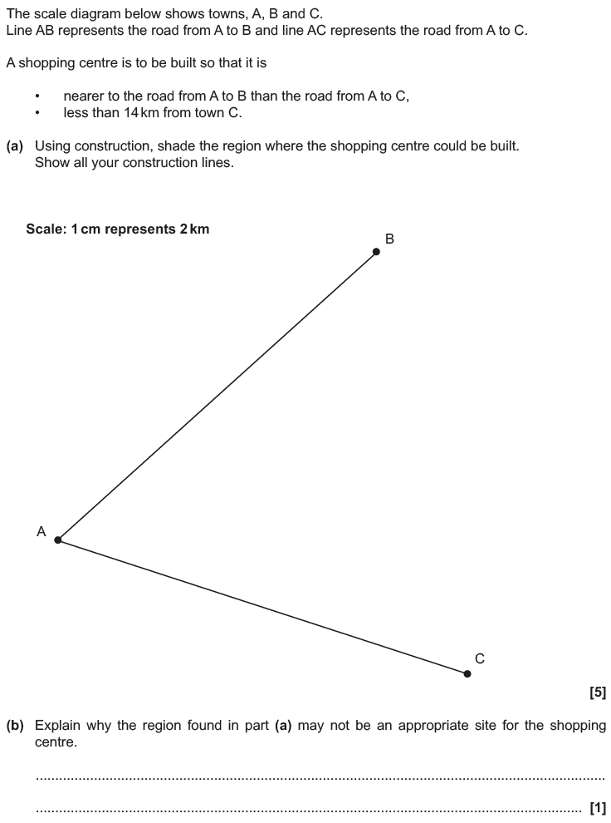
Constructions
May 2018 1H Q7
14 km line
Construction line 1
Construction line 2
Construction line 3
Reveal Region
note: AB = 12cm

Slide 7
Constructions
May 2018 1H Q7
A
B

Slide 8
Constructions
May 2018 1H Q7
B Exemplar responses

Slide 9
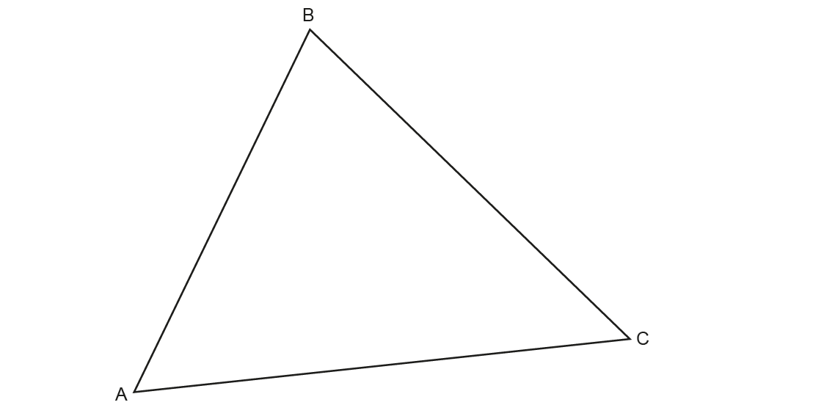
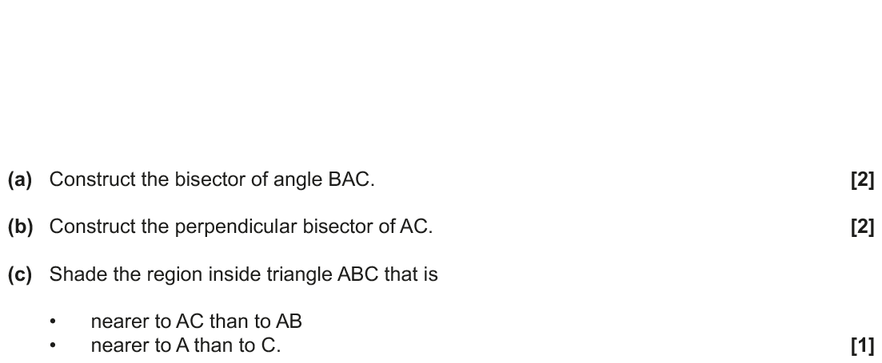
Constructions
Nov 2018 1H Q7
Construction line 1
Construction line 2
Construction line 3
Construction line 4
Construction line 5
Construction line 6
Construction line 7
Reveal Region

Slide 10
Constructions
Nov 2018 1H Q7
A
B
C

