Slide 1
Compound Measures
Compound Measures
May 2017
1H Q9
June 2018
2H Q10
June 2017
3H Q17
June 2018
2H Q16
Nov 2017
2H Q4
June 2018
3H Q12
SAM
2H Q17
Nov 2017
2H Q12
1 Marker
Nov 2018
2H Q9
Nov 2017
2H Q25
Nov 2018
2H Q15
Nov 2017
3H Q9
Nov 2018
3H Q21
Nov 2017
3H Q12

Slide 2
Compound Measures
SAM 2H Q17

Slide 3
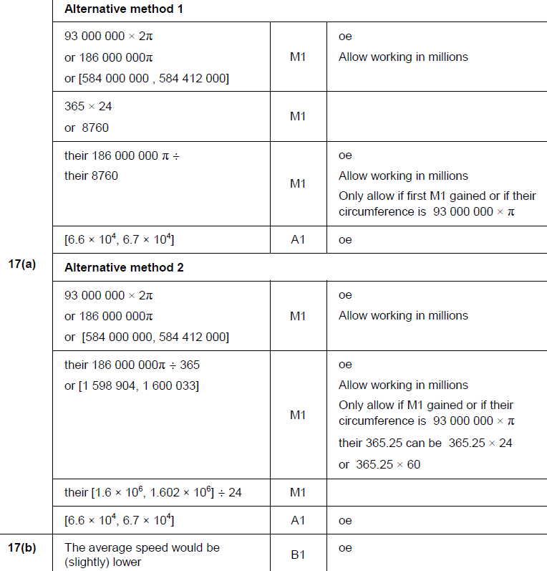
Compound Measures
SAM 2H Q17
A
B

Slide 4
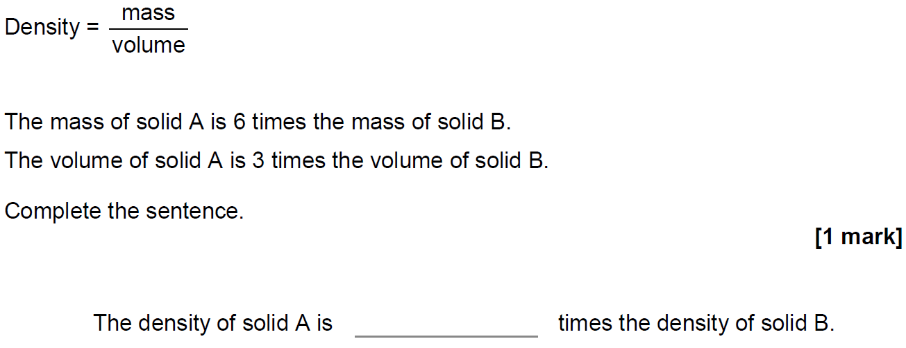
Compound Measures
May 2017 1H Q9

Slide 5
Compound Measures
May 2017 1H Q9
A
B

Slide 6
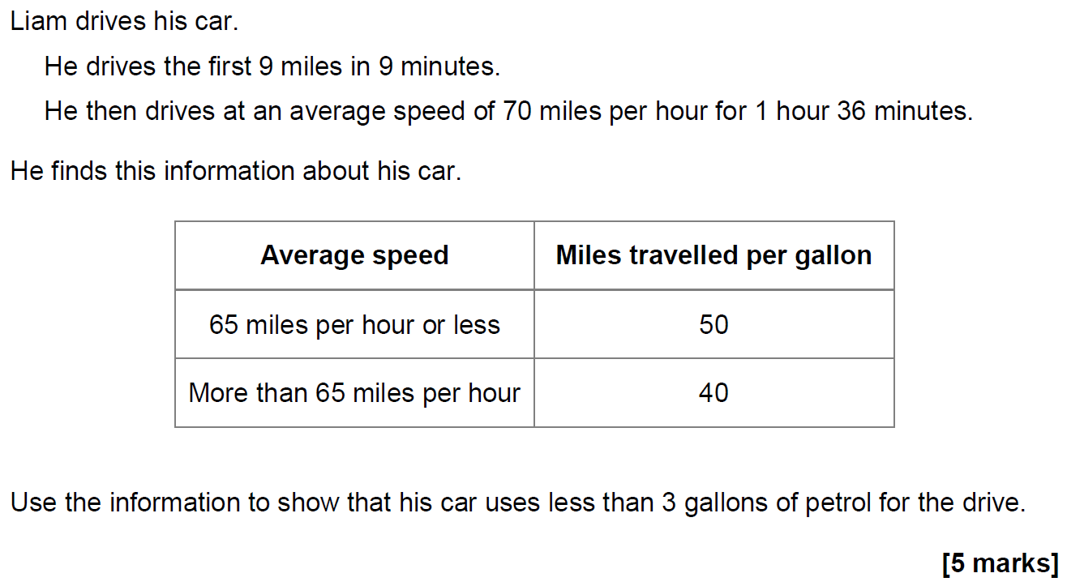
Compound Measures
June 2017 3H Q17

Slide 7
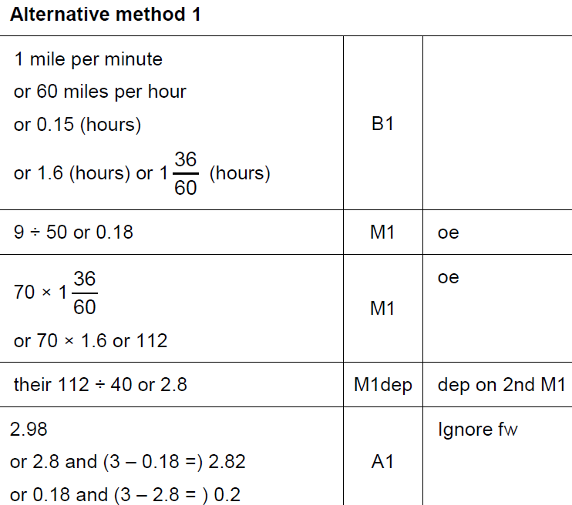
Compound Measures
June 2017 3H Q17
A

Slide 8
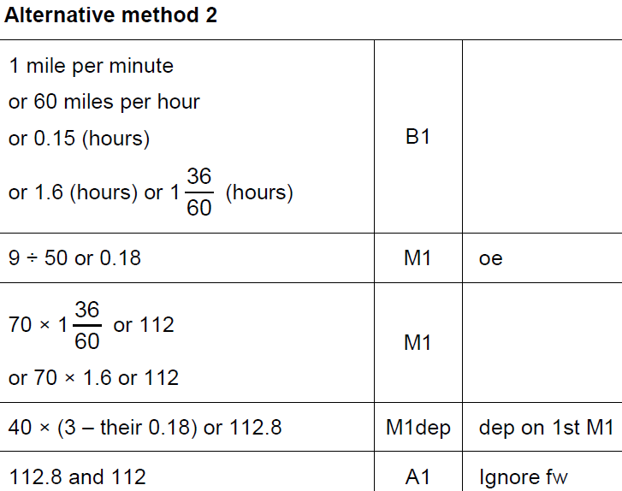
Compound Measures
June 2017 3H Q17
A Alternative 1

Slide 9
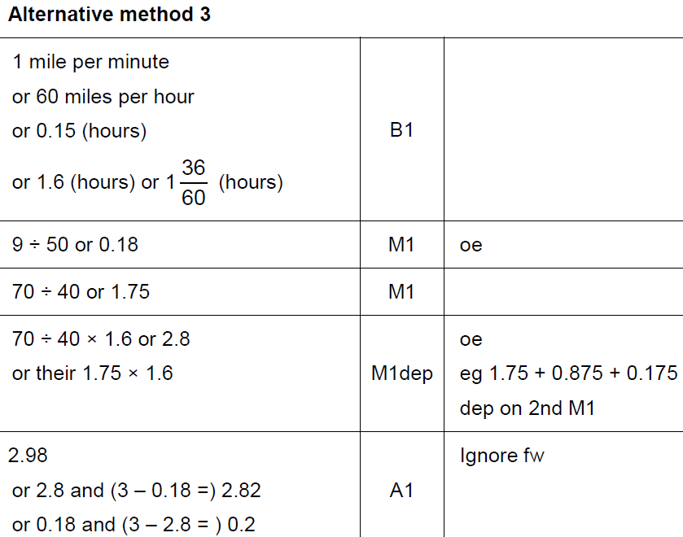
Compound Measures
June 2017 3H Q17
A Alternative 2

Slide 10
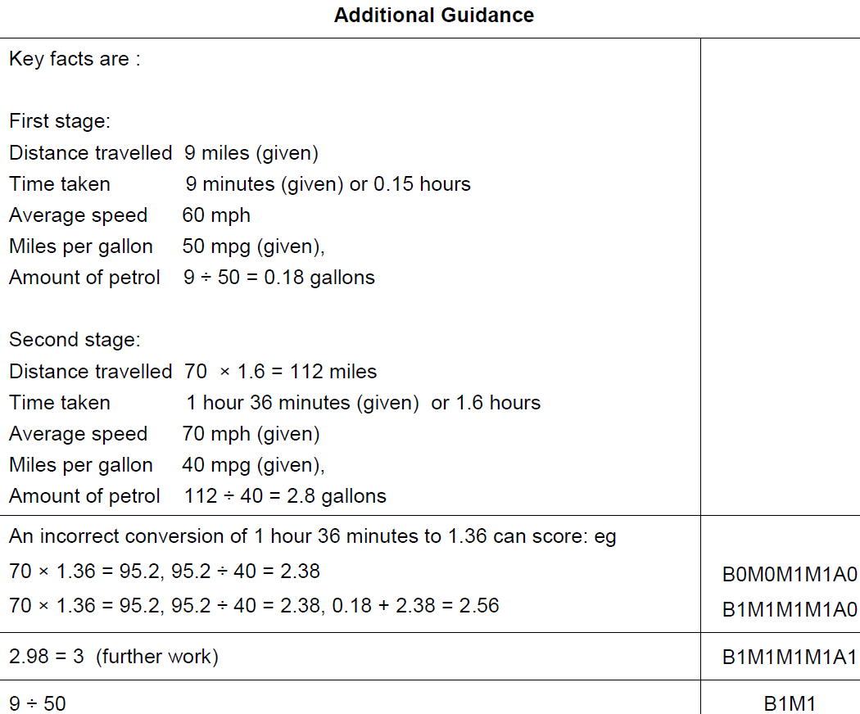
Compound Measures
June 2017 3H Q17
A notes

Slide 11
Compound Measures
Nov 2017 2H Q4

Slide 12
Compound Measures
Nov 2017 2H Q4
A

Slide 13
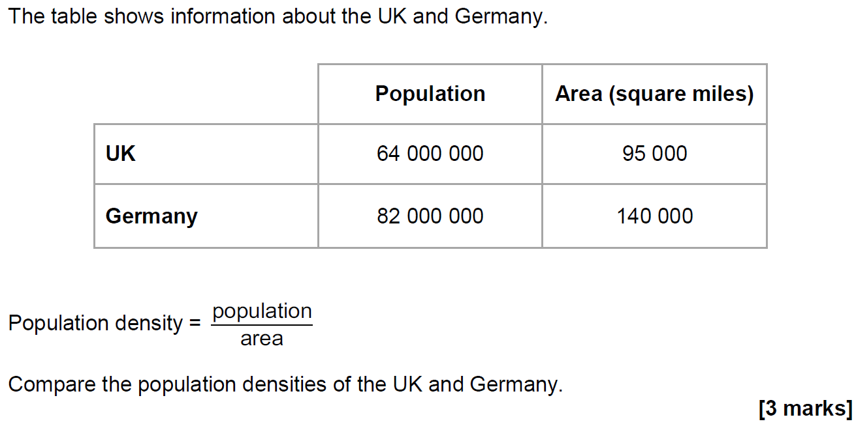
Compound Measures
Nov 2017 2H Q12

Slide 14
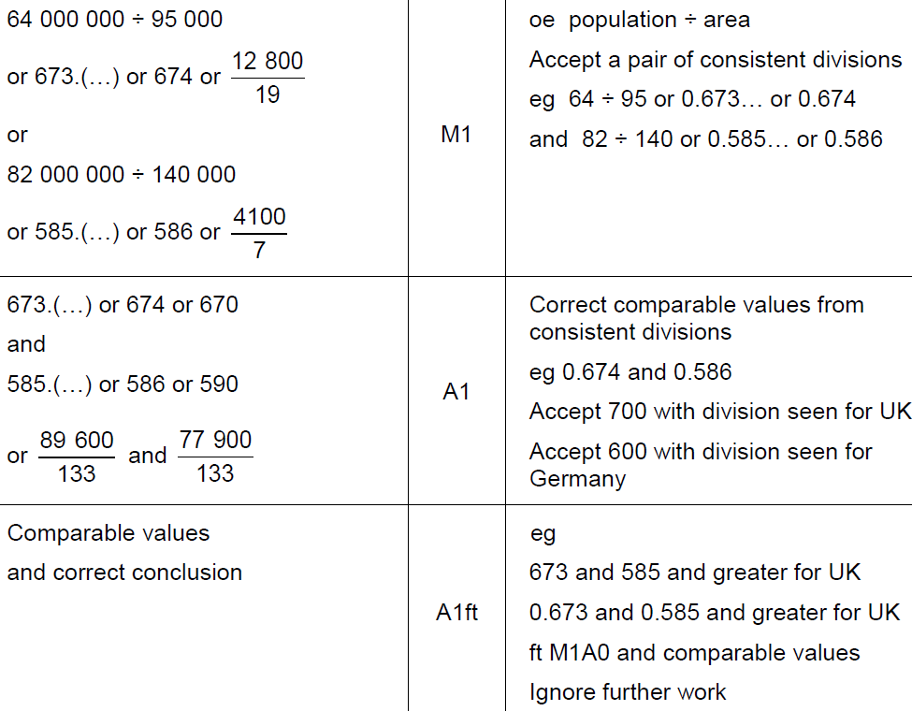
Compound Measures
Nov 2017 2H Q12
A

Slide 15
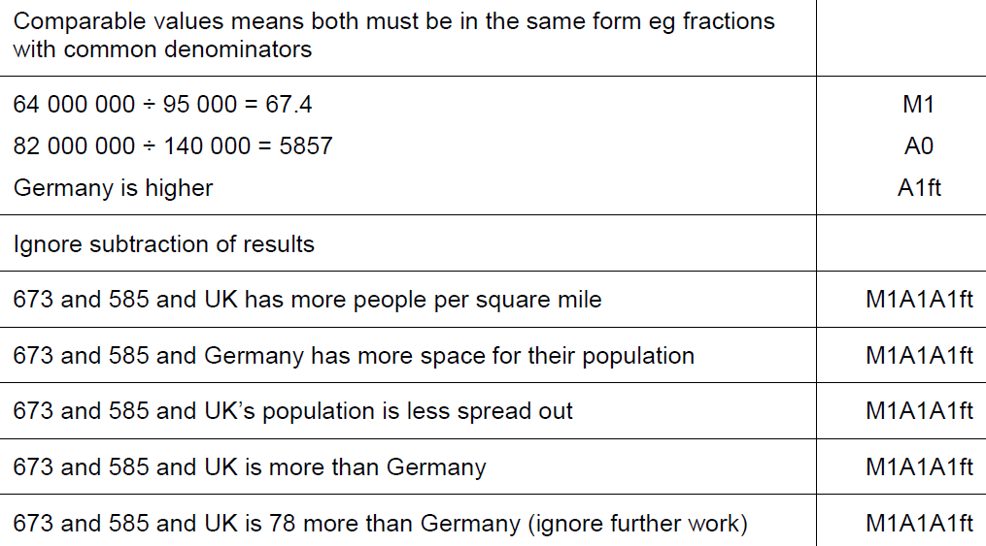
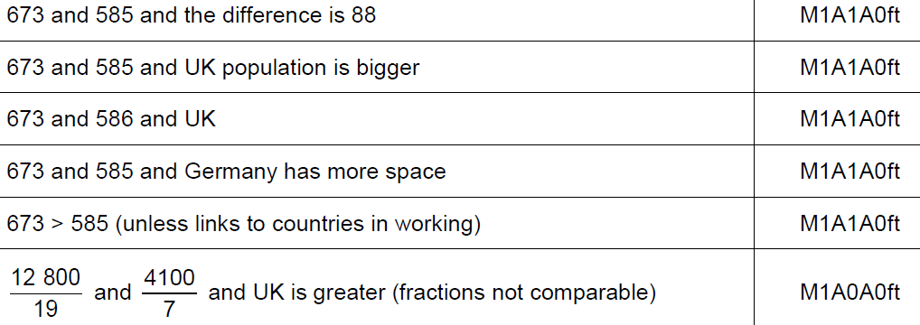
Compound Measures
Nov 2017 2H Q12
A notes

Slide 16
Compound Measures
Nov 2017 2H Q25

Slide 17
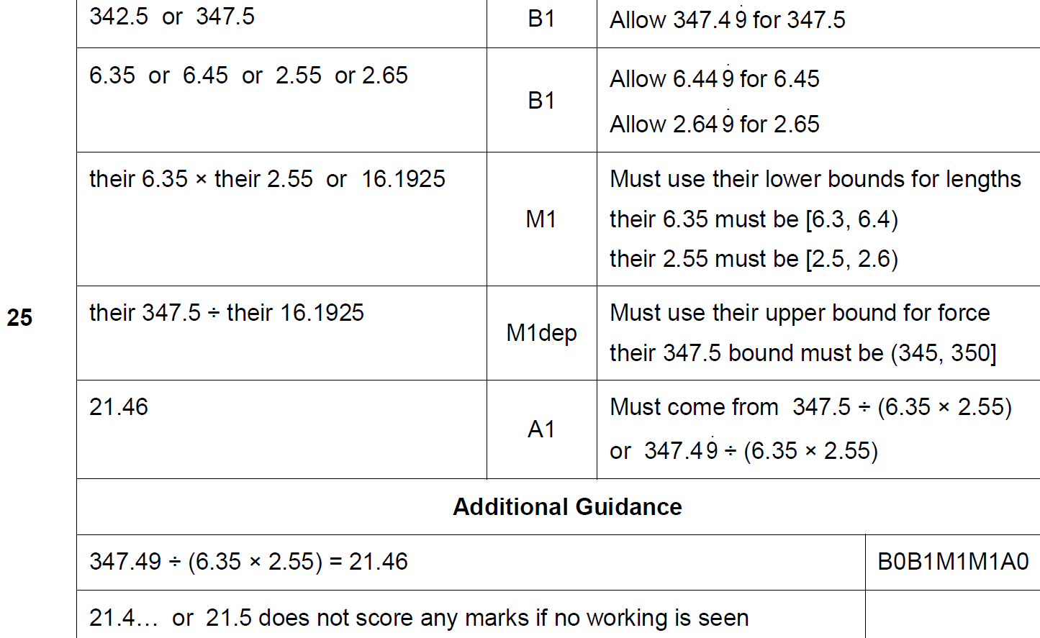
Compound Measures
Nov 2017 2H Q25
A

Slide 18
Compound Measures
Nov 2017 3H Q9

Slide 19
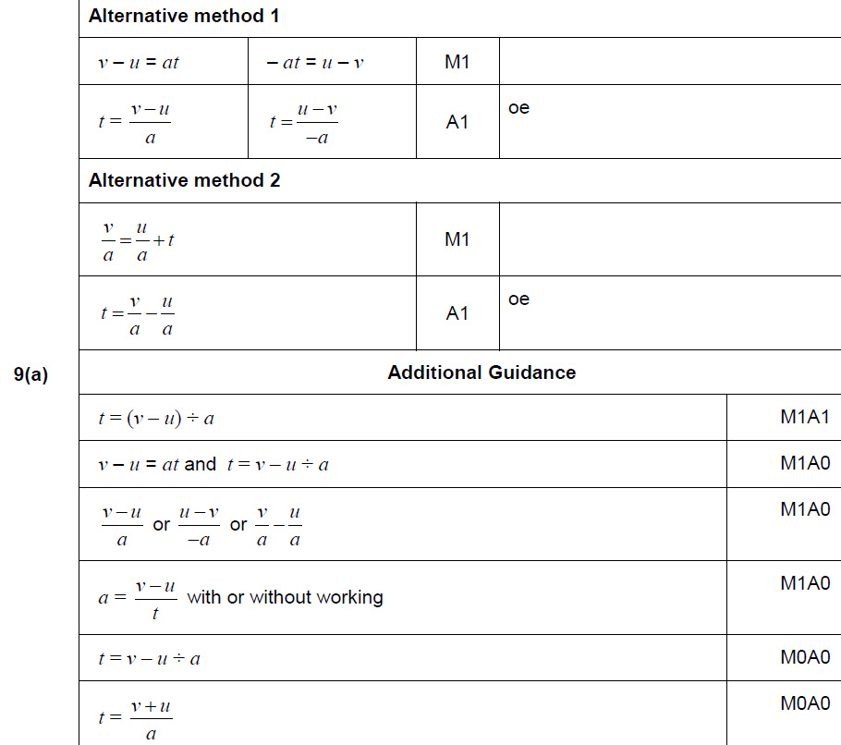
Compound Measures
Nov 2017 3H Q9
A

Slide 20
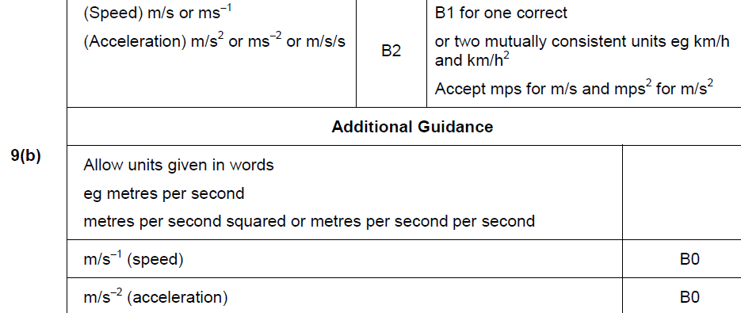
Compound Measures
Nov 2017 3H Q9
B

Slide 21
Compound Measures
Nov 2017 3H Q12
The distance by road from Newport to London is 140 miles.
Tom travels by coach from Newport to London.
The coach leaves Newport at 1.30 pm
(a) He assumes the coach will travel at an average speed of 50 mph
Use his assumption to work out the arrival time in London.
[3 marks]
(b) In fact, the coach has a lower average speed.
How does this affect the arrival time?
[1 mark]

Slide 22
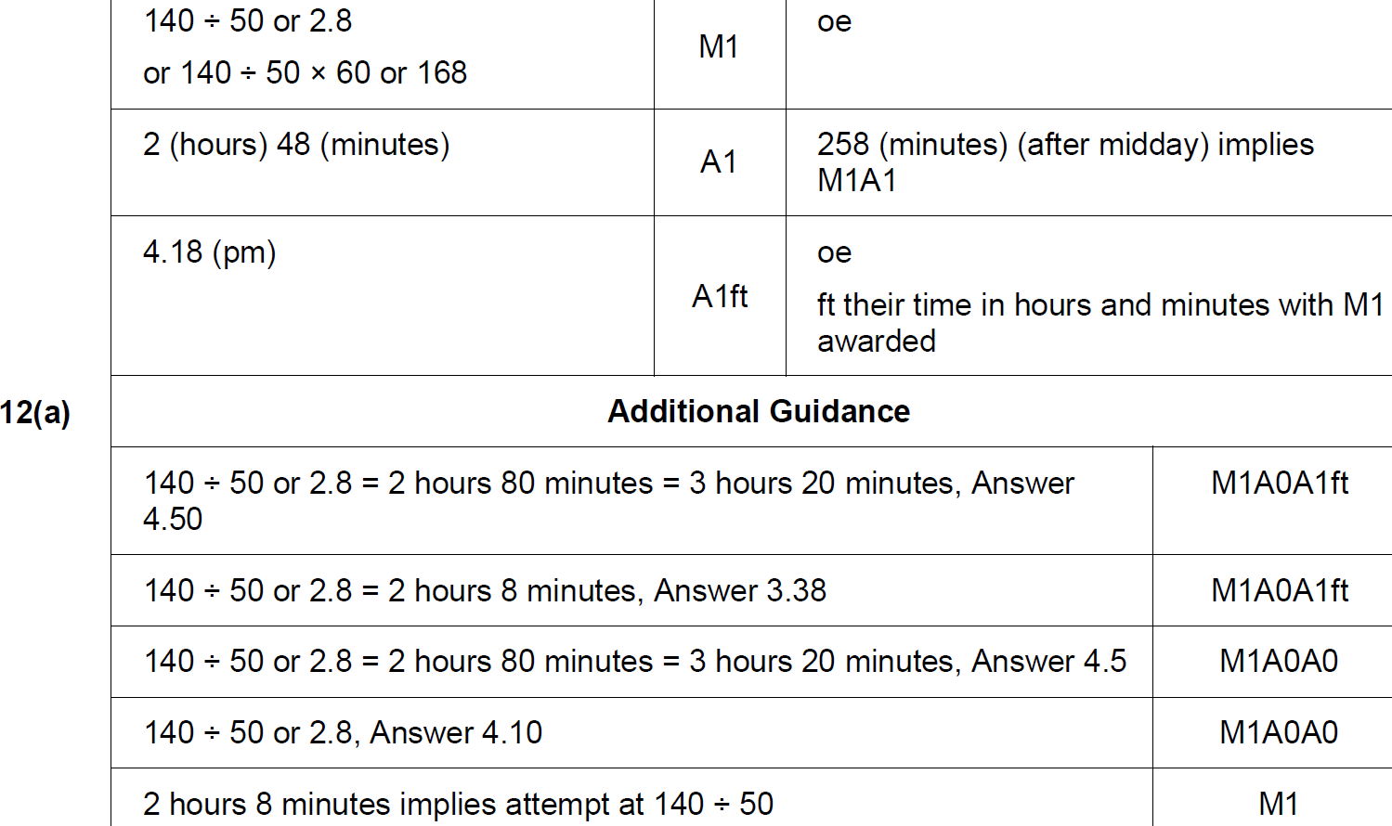
Compound Measures
Nov 2017 3H Q12
A

Slide 23
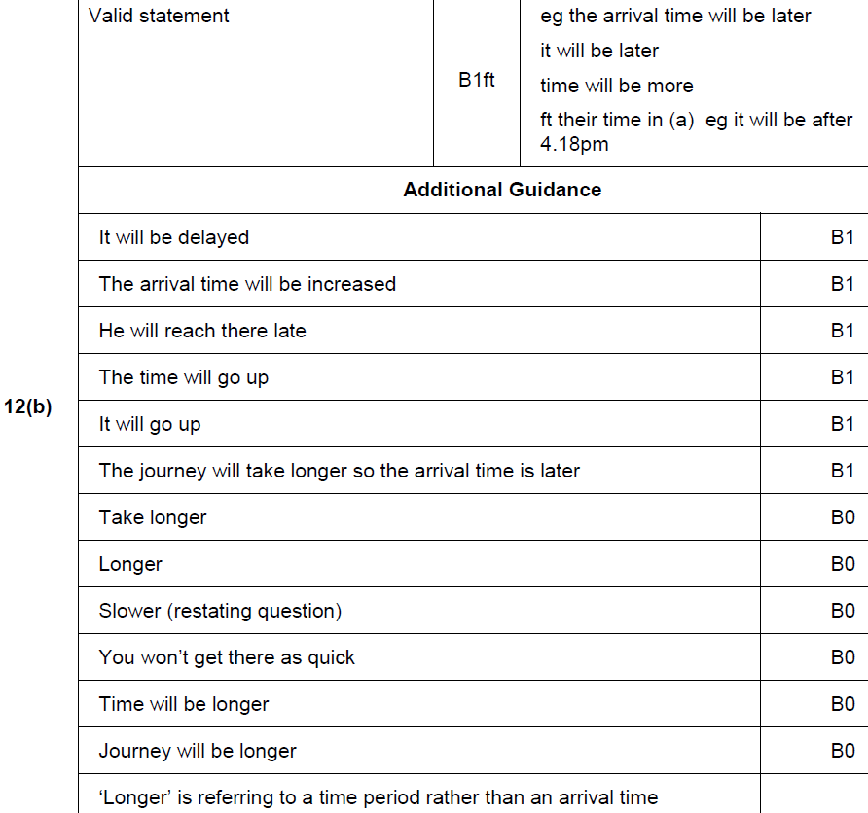
Compound Measures
Nov 2017 3H Q12
B

Slide 24
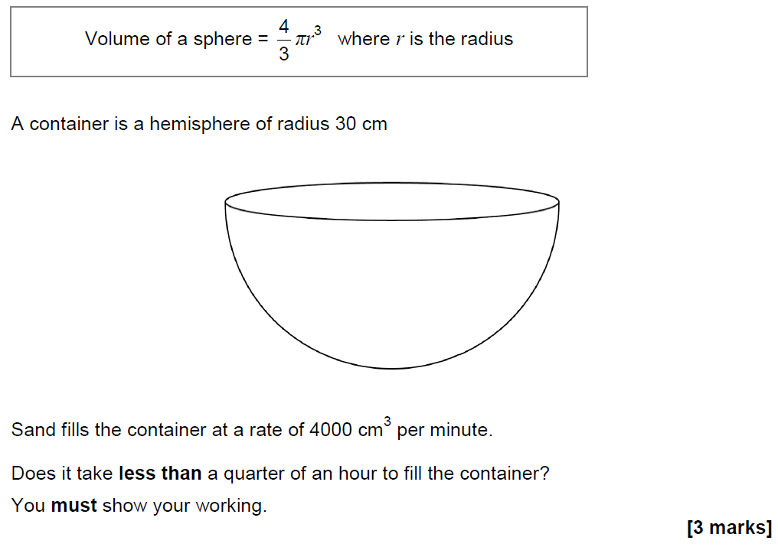
Compound Measures
June 2018 2H Q10

Slide 25
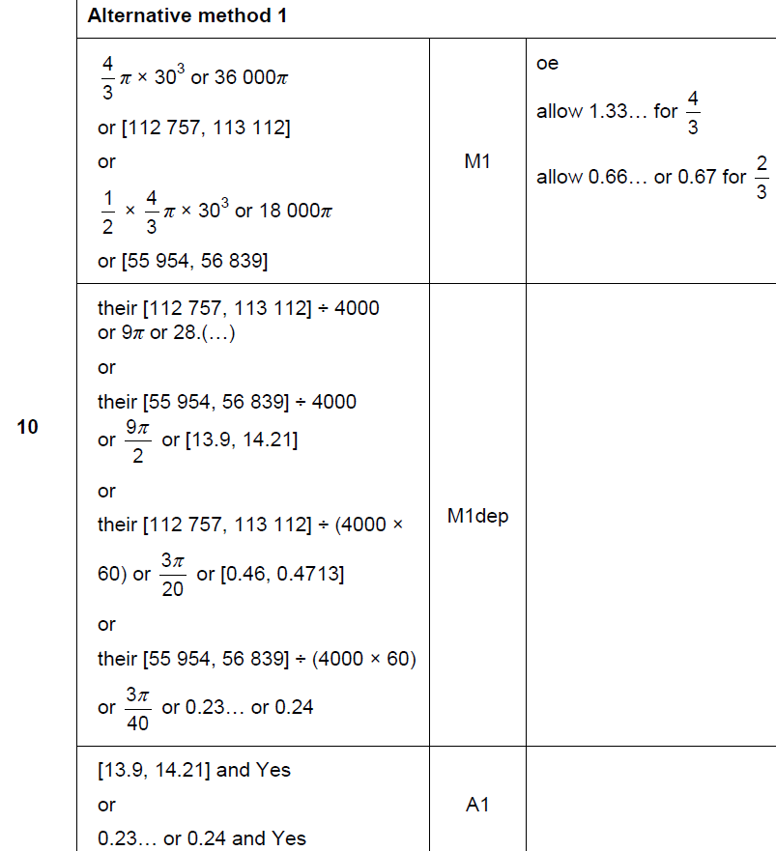
Compound Measures
June 2018 2H Q10
A

Slide 26
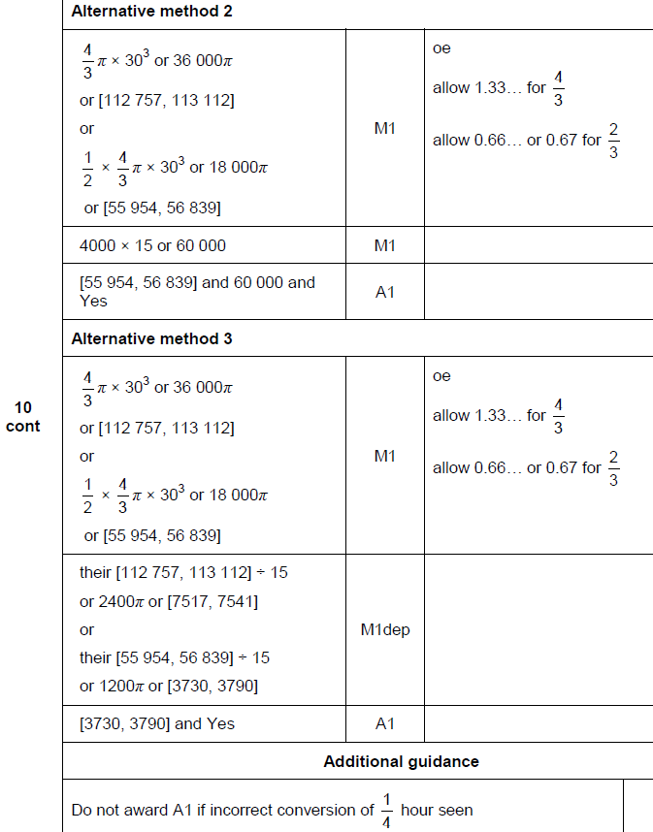
Compound Measures
June 2018 2H Q10
A Alternative & notes

Slide 27
Compound Measures
June 2018 2H Q16

Slide 28
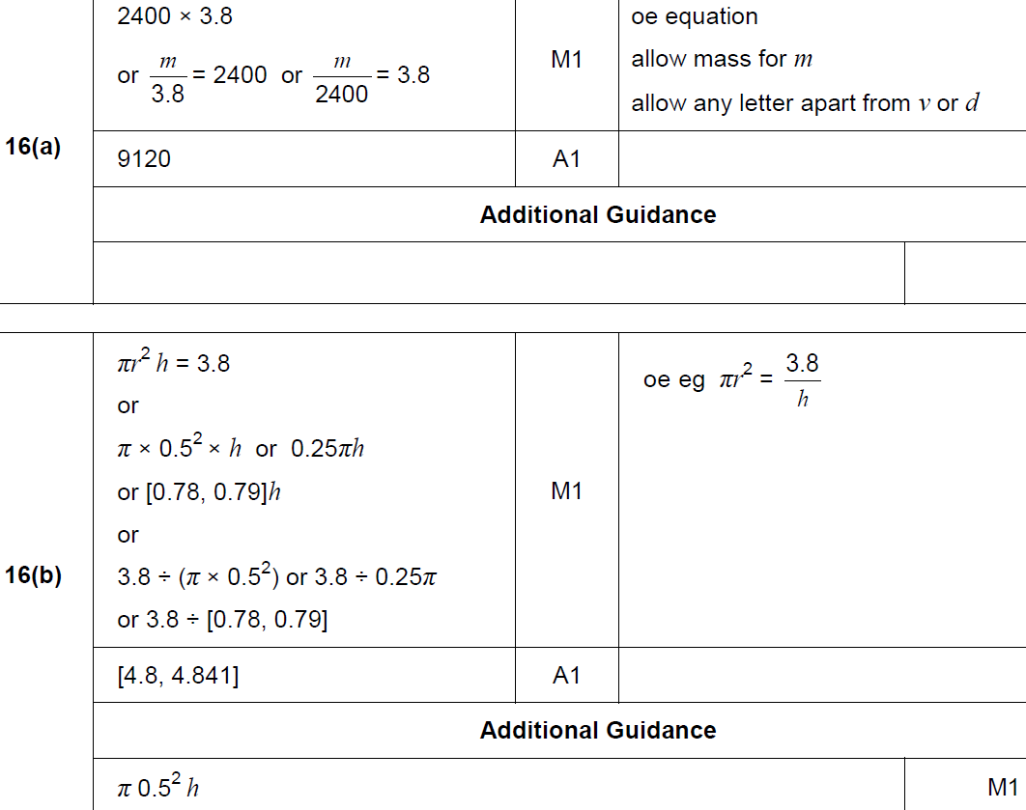
Compound Measures
June 2018 2H Q16
A
B

Slide 29
Compound Measures
June 2018 3H Q12

Slide 30
Compound Measures
June 2018 3H Q12
A

Slide 31
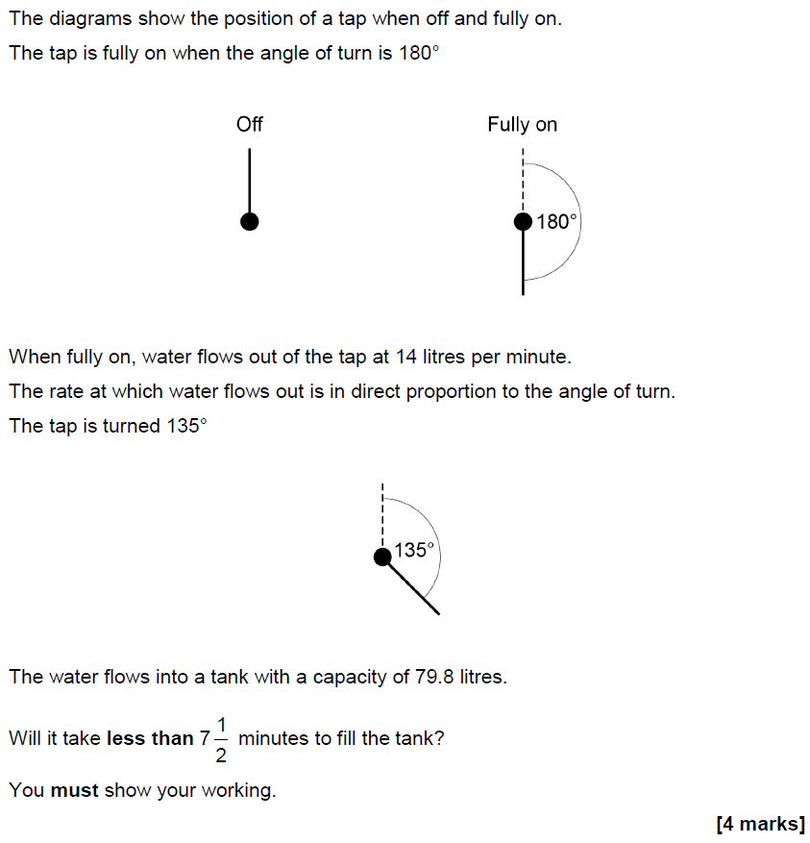
Compound Measures
Nov 2018 2H Q9

Slide 32
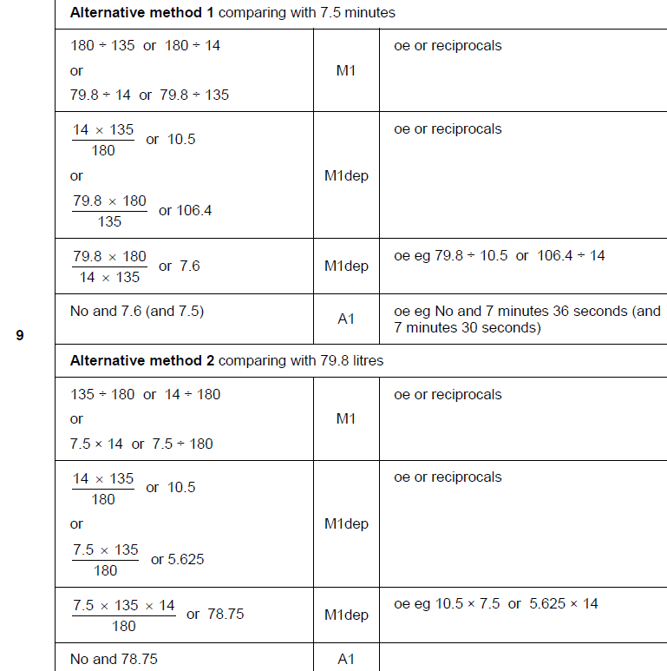
Compound Measures
Nov 2018 2H Q9
A

Slide 33
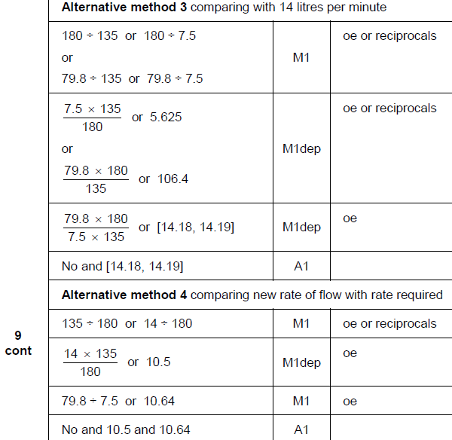
Compound Measures
Nov 2018 2H Q9
A Alternative 2 & 3

Slide 34
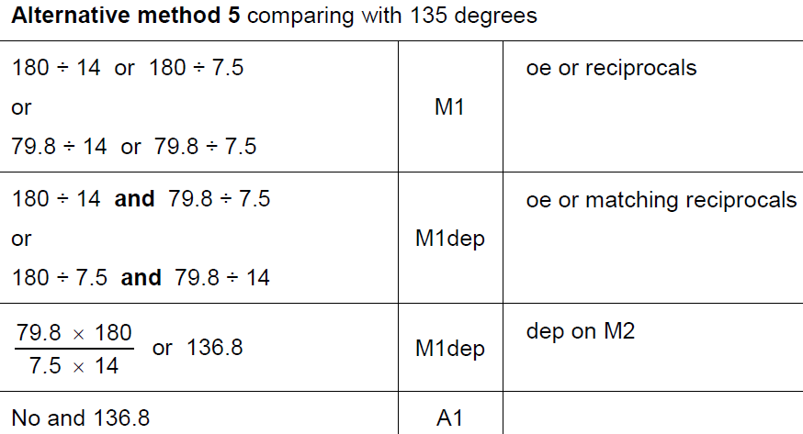
Compound Measures
Nov 2018 2H Q9
A Alternative 4 & notes

Slide 35
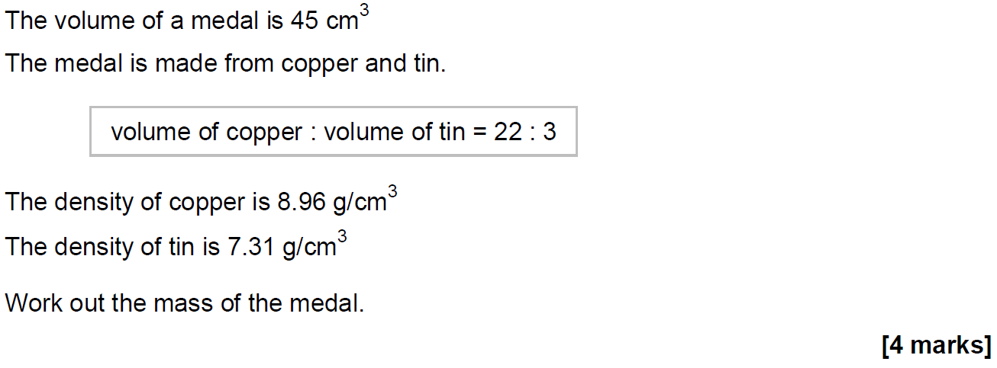
Compound Measures
Nov 2018 2H Q15

Slide 36
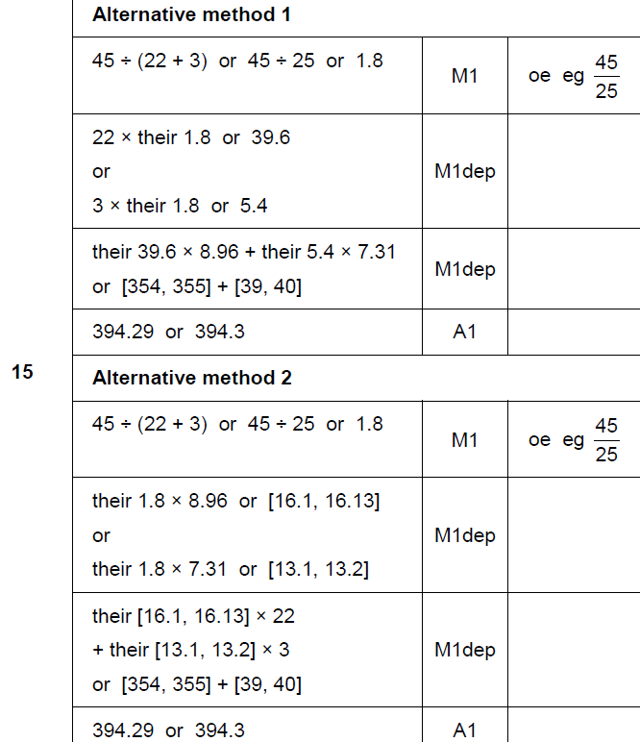
Compound Measures
Nov 2018 2H Q15
A

Slide 37
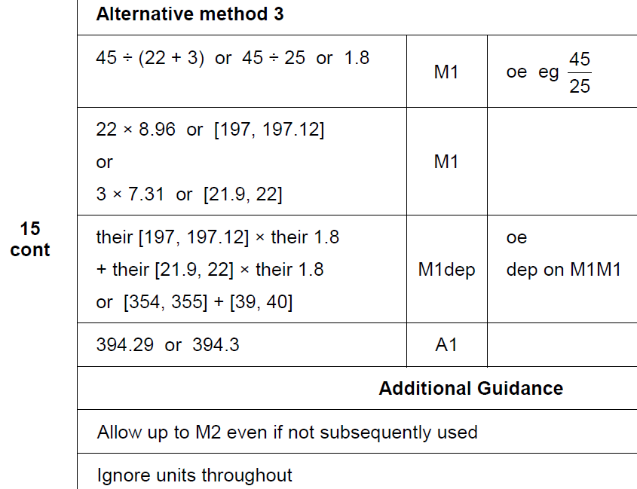
Compound Measures
Nov 2018 2H Q15
A Alternative 2 & notes

Slide 38
Compound Measures
Nov 2018 3H Q21
Priya and Joe travel the same 16.8 km route.
Priya starts at 9.00 am and walks at a constant speed of 6 km/h
Joe starts at 9.30 am and runs at a constant speed.
Joe overtakes Priya at 10.20 am
At what time does Joe finish the route?
[5 marks]

Slide 39
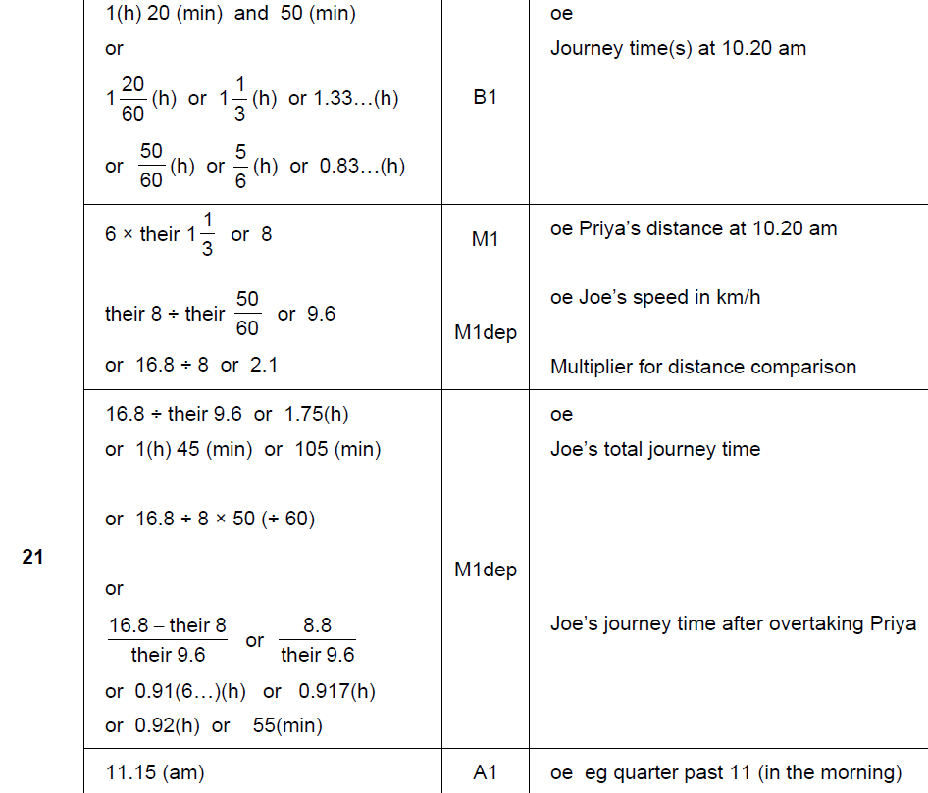
Compound Measures
Nov 2018 3H Q21
A

Slide 40
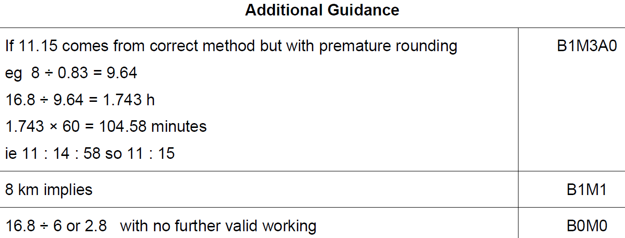
Compound Measures
Nov 2018 3H Q21
A notes

