Slide 1
Compound Measures
Compound Measures
June 2017
3H Q8
SAM
2H Q9
May 2018
1H Q5
SAM
3H Q1
Nov 2018
1H Q2
Practice
2H Q17
Nov 2018
2H Q4
Practice
3H Q4
Nov 2018
2H Q5

Slide 2
Compound Measures
SAM 2H Q9

Slide 3
Compound Measures
SAM 2H Q9
A

Slide 4
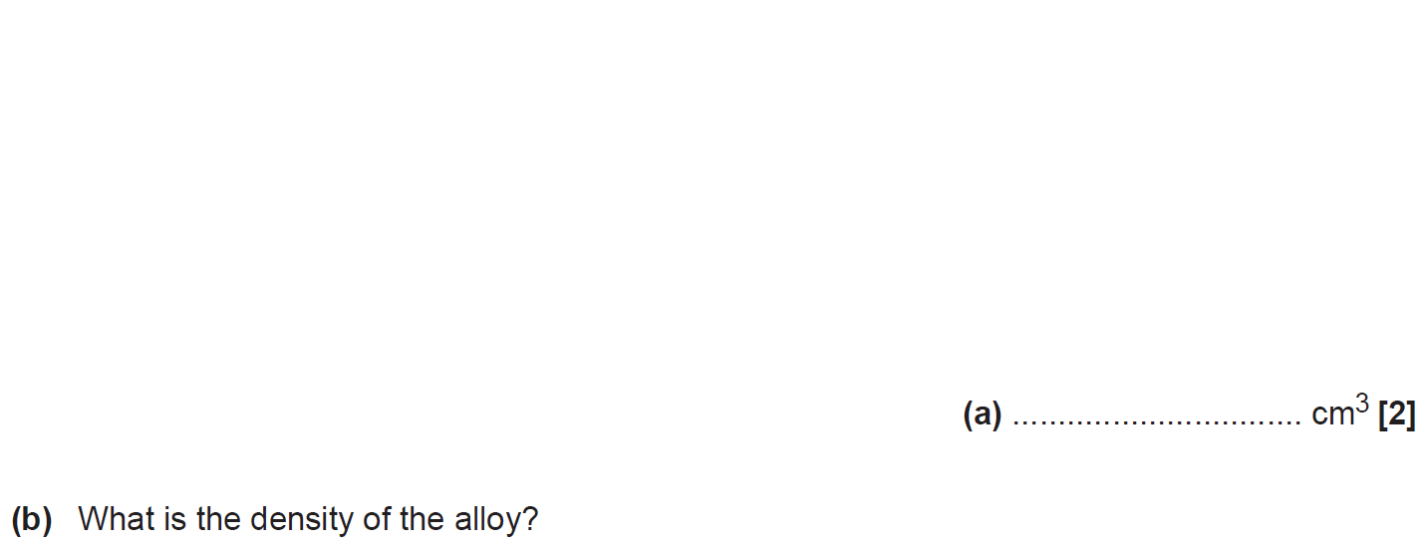
Compound Measures
SAM 3H Q1

Slide 5
Compound Measures
SAM 3H Q1
A
B

Slide 6
Compound Measures
Practice 2H Q17

Slide 7
Compound Measures
Practice 2H Q17
A

Slide 8
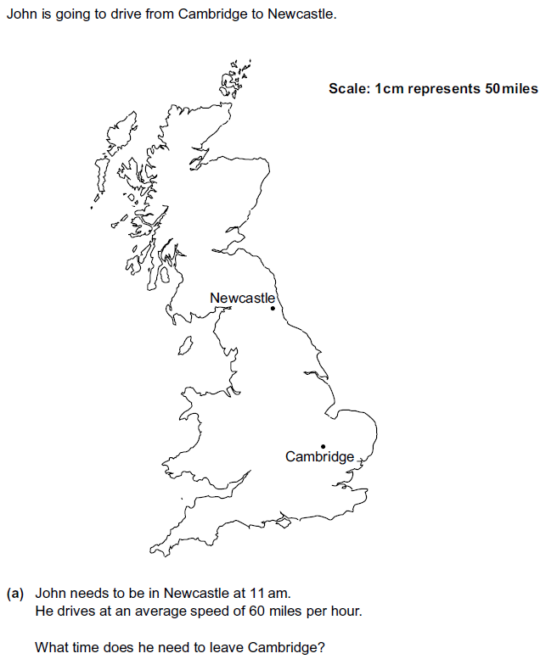
Compound Measures
Practice 3H Q4
*4cm in a straight line from Cambridge to Newcastle

Slide 9
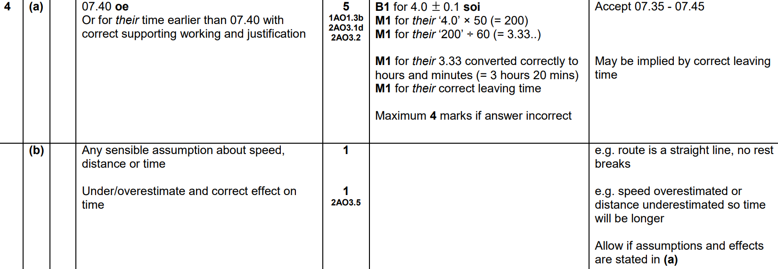
Compound Measures
Practice 3H Q4
A
B

Slide 10
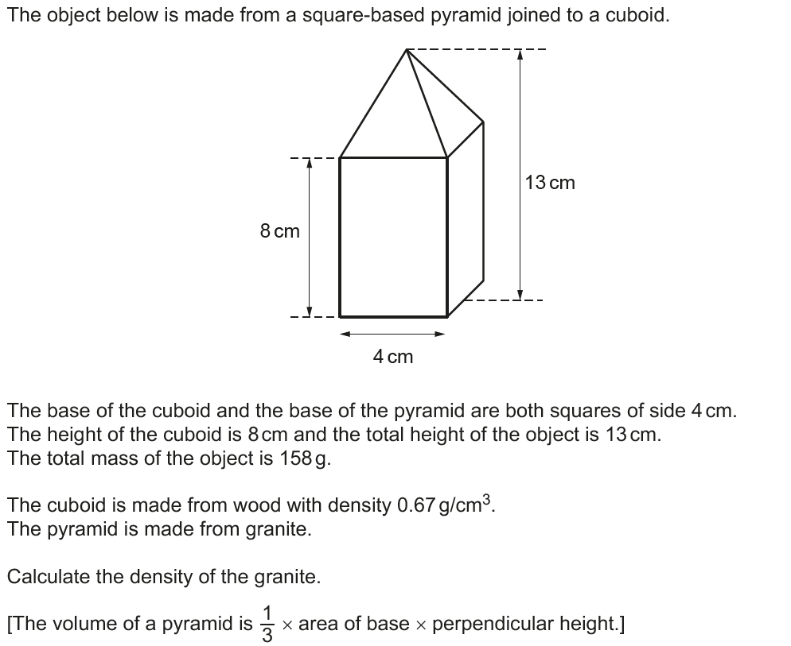
Compound Measures
June 2017 3H Q8

Slide 11
Compound Measures
June 2017 3H Q8
A

Slide 12
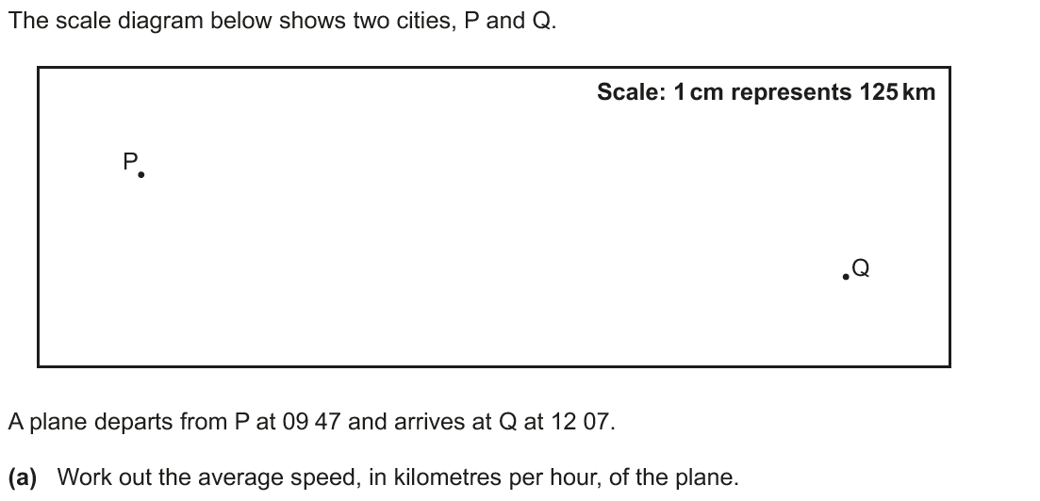
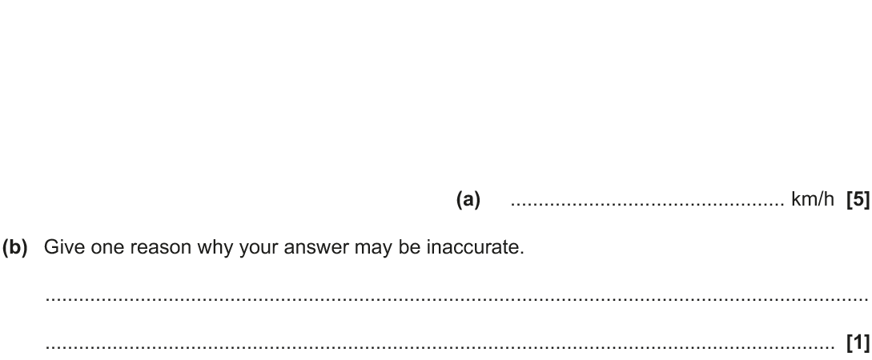
Compound Measures
May 2018 1H Q5
*11.6 cm in a straight line from P to Q

Slide 13
Compound Measures
May 2018 1H Q5
A
B

Slide 14
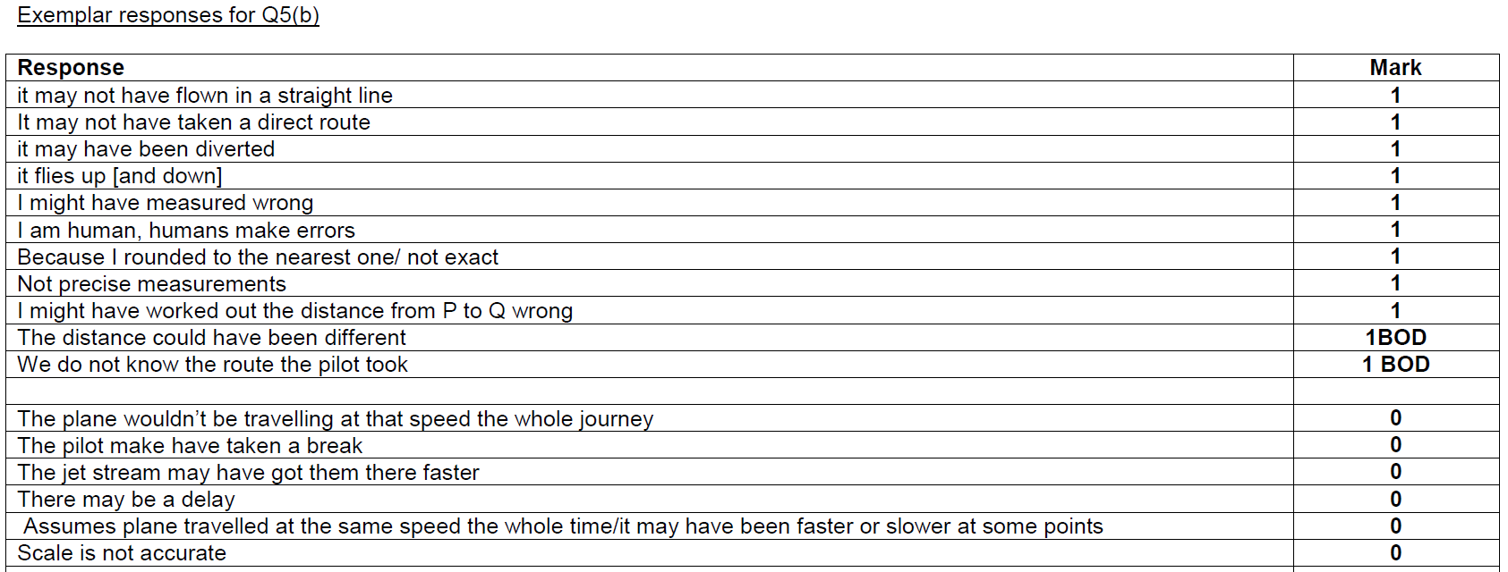
Compound Measures
May 2018 1H Q5
B Exemplar responses

Slide 15
Compound Measures
Nov 2018 1H Q2

Slide 16
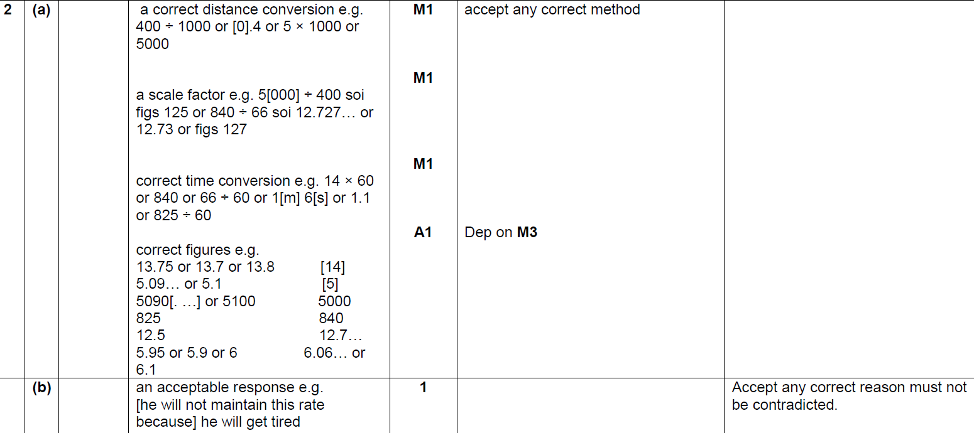
Compound Measures
Nov 2018 1H Q2
A
B

Slide 17
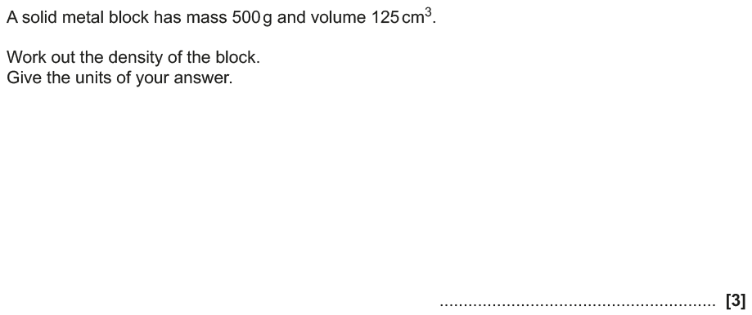
Compound Measures
Nov 2018 2H Q4

Slide 18
Compound Measures
Nov 2018 2H Q4
A

Slide 19
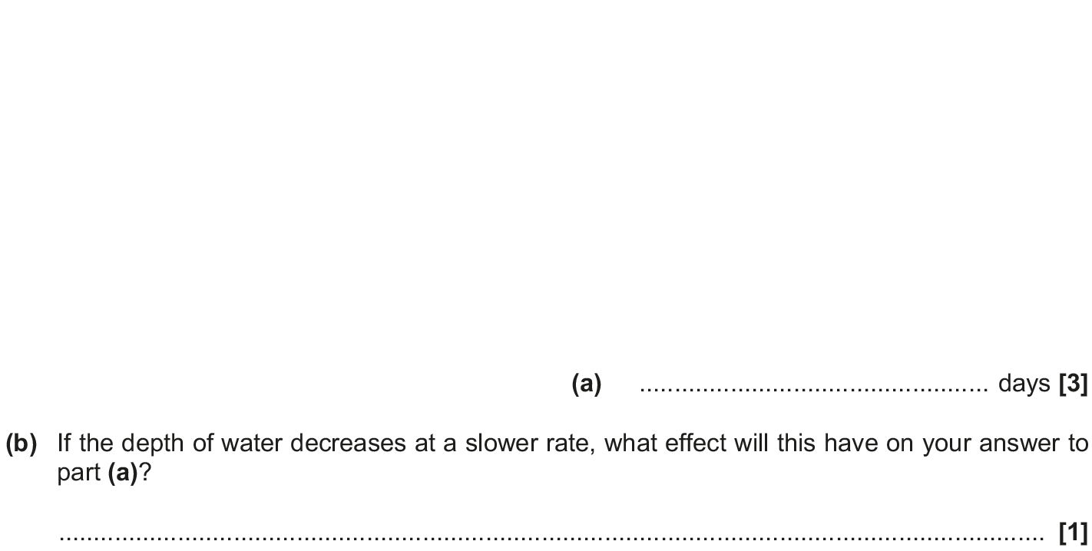
Compound Measures
Nov 2018 2H Q5

Slide 20
Compound Measures
Nov 2018 2H Q5
A
B

