Slide 1
Compound Measures
Compound Measures
SAM
1H Q4
June 2017
2H Q4
June 2018
2H Q21
SAM
1H Q12
June 2017
3H Q6
Nov 2018
1H Q5
SAM
2H Q4
June 2017
3H Q17
Nov 2018
2H Q20
SAM
2H Q22
Nov 2017
1H Q9
Nov 2018
3H Q5
Spec 1
1H Q2
Nov 2017
3H Q3
Nov 2018
3H Q18
Spec 1
1H Q12
May 2018
1H Q4
June 2019
3H Q13
Spec 2
3H Q12
June 2018
2H Q6

Slide 2
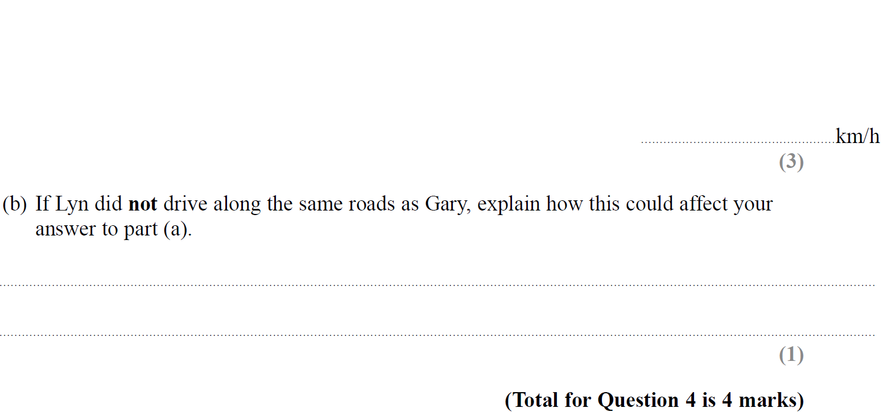
Compound Measures
SAM 1H Q4

Slide 3
Compound Measures
SAM 1H Q4
A
B

Slide 4
Compound Measures
SAM 1H Q12

Slide 5
Compound Measures
SAM 1H Q12
A

Slide 6
Compound Measures
SAM 2H Q4

Slide 7
Compound Measures
SAM 2H Q4
A

Slide 8
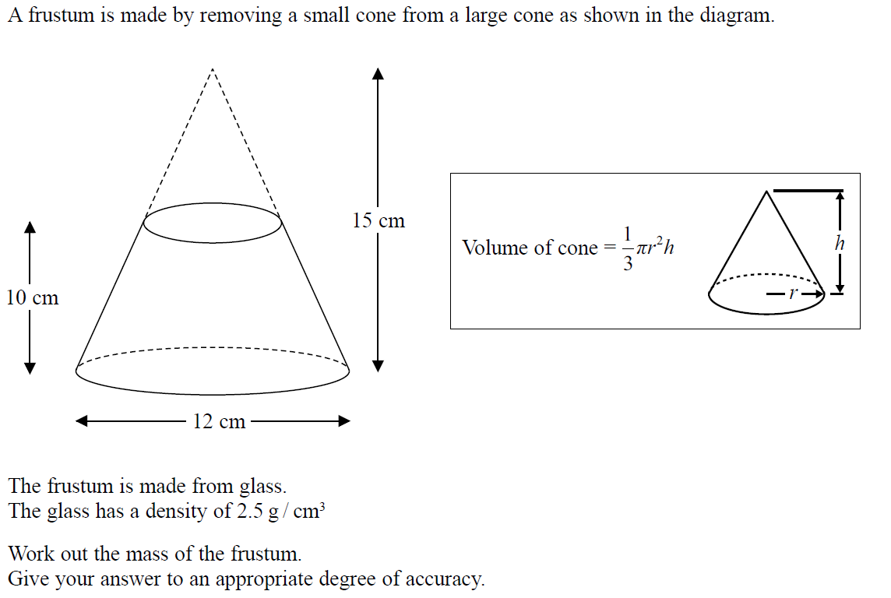
Compound Measures
SAM 2H Q22

Slide 9
Compound Measures
SAM 2H Q22
A

Slide 10
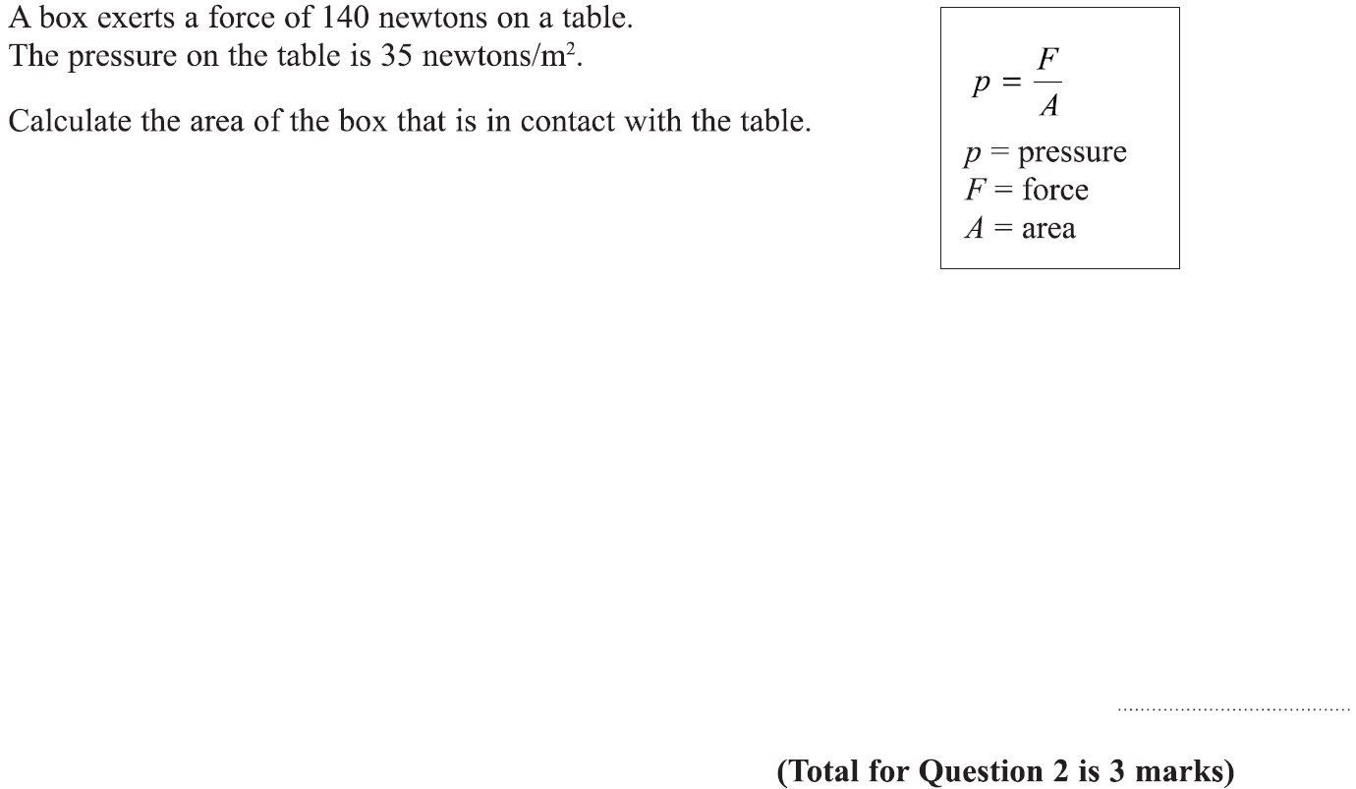
Compound Measures
Specimen Set 1 1H Q2

Slide 11
Compound Measures
Specimen Set 1 1H Q2
A

Slide 12
Compound Measures
Specimen Set 1 1H Q12

Slide 13
Compound Measures
Specimen Set 1 1H Q12
A

Slide 14
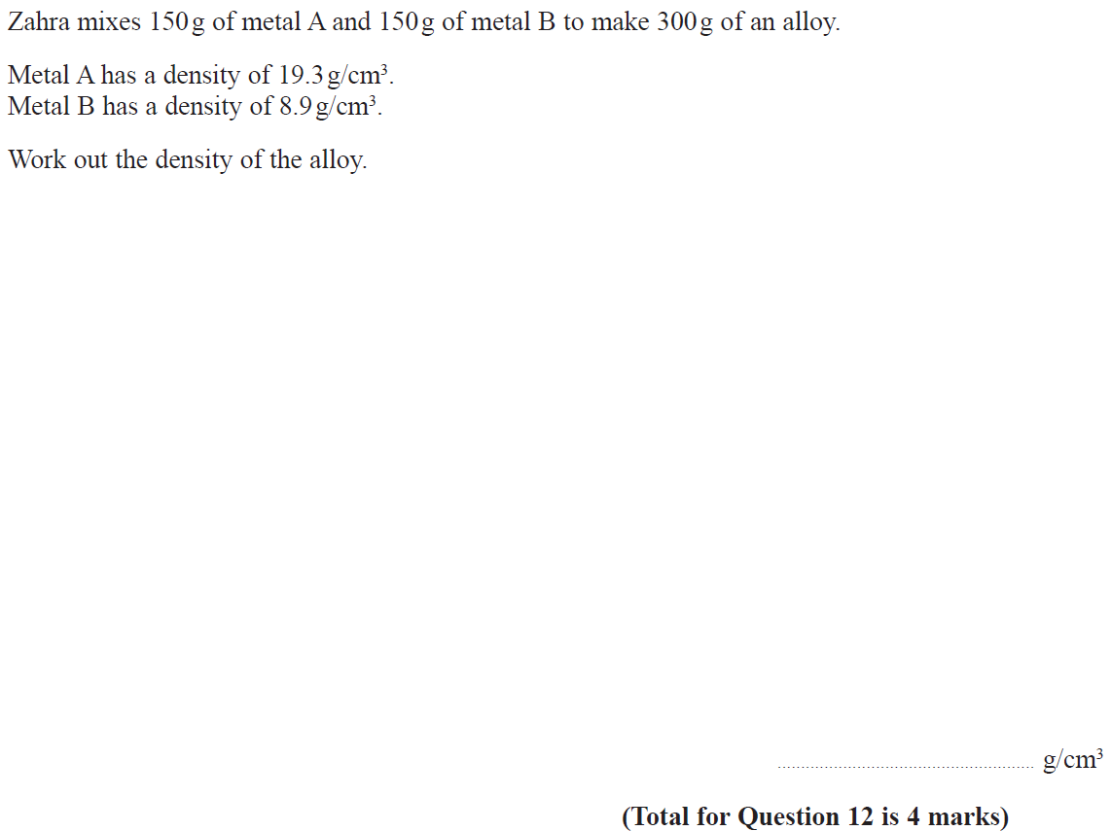
Compound Measures
Specimen Set 2 3H Q12

Slide 15
Compound Measures
Specimen Set 2 3H Q12
A

Slide 16
Compound Measures
June 2017 2H Q4

Slide 17
Compound Measures
June 2017 2H Q4
A
B

Slide 18
Compound Measures
June 2017 3H Q6

Slide 19
Compound Measures
June 2017 3H Q6
A

Slide 20
Compound Measures
June 2017 3H Q17

Slide 21
Compound Measures
June 2017 3H Q17
A
B

Slide 22
Compound Measures
Nov 2017 1H Q9

Slide 23
Compound Measures
Nov 2017 1H Q9
A

Slide 24
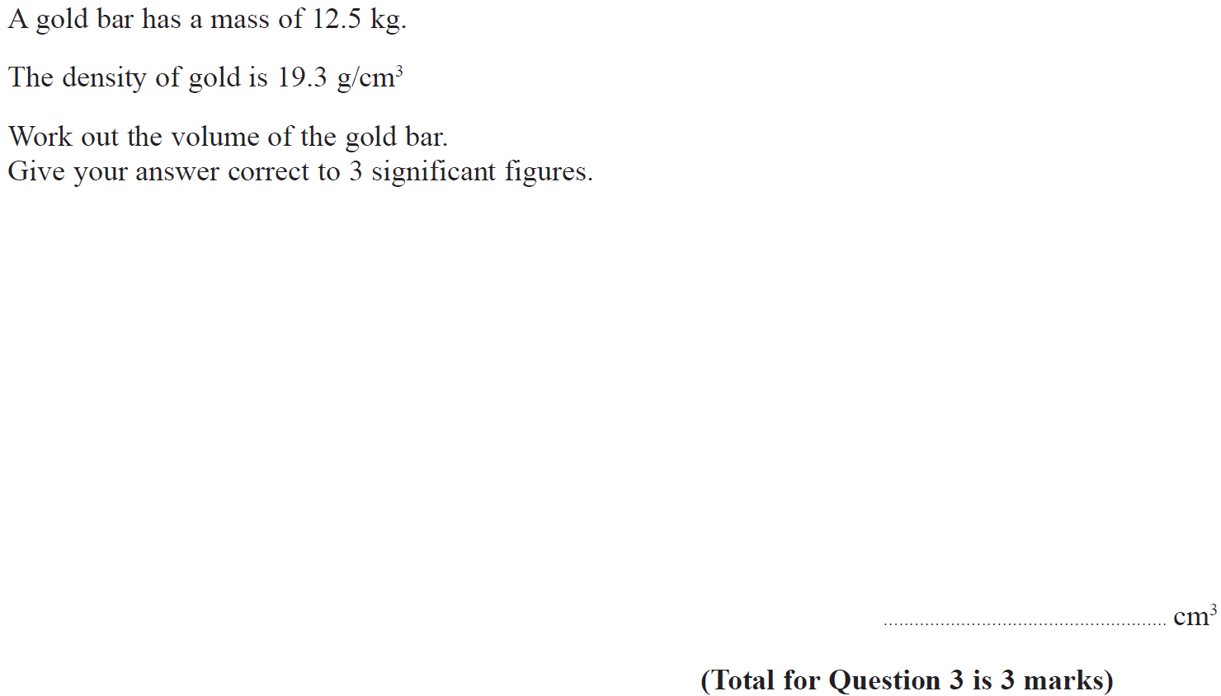
Compound Measures
Nov 2017 3H Q3

Slide 25
Compound Measures
Nov 2017 3H Q3
A

Slide 26
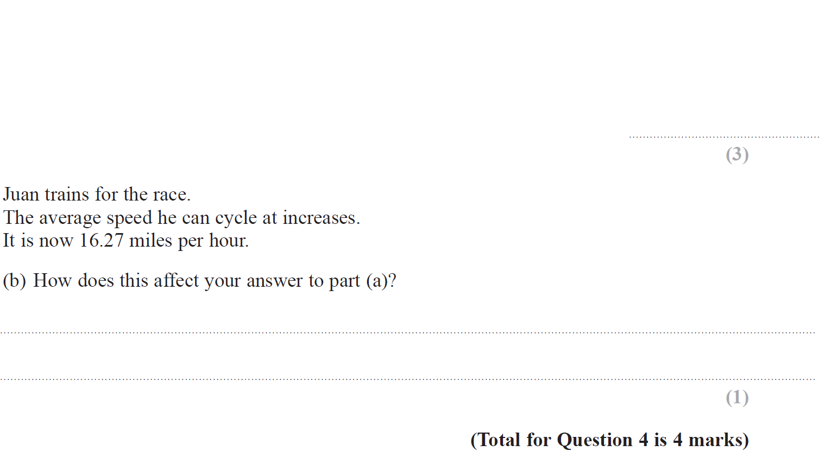
Compound Measures
May 2018 1H Q4

Slide 27
Compound Measures
May 2018 1H Q4
A
B

Slide 28
Compound Measures
June 2018 2H Q6

Slide 29
Compound Measures
June 2018 2H Q6
A

Slide 30
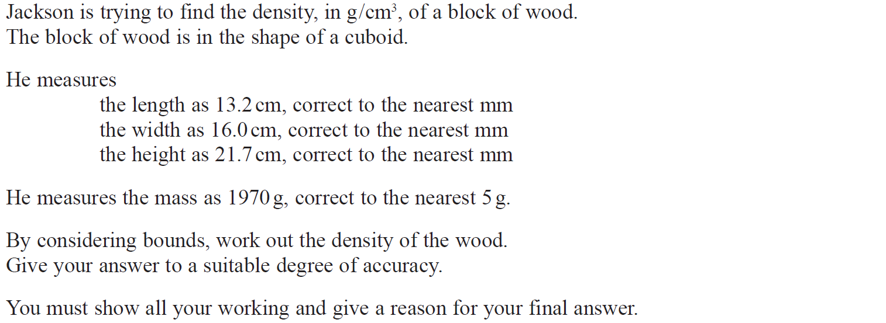
Compound Measures
June 2018 2H Q21

Slide 31
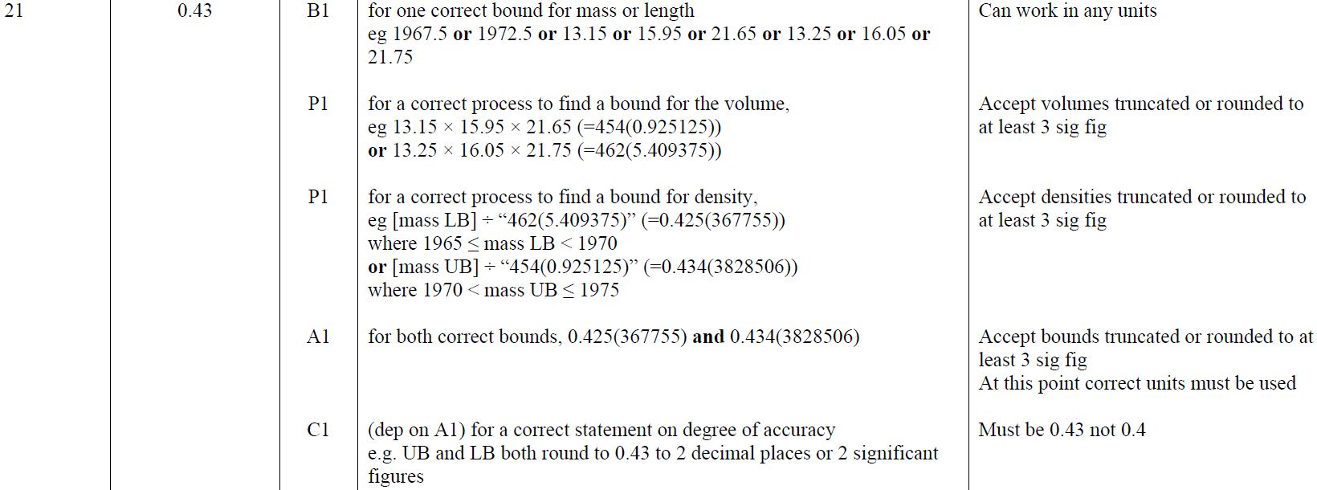
Compound Measures
June 2018 2H Q21
A

Slide 32
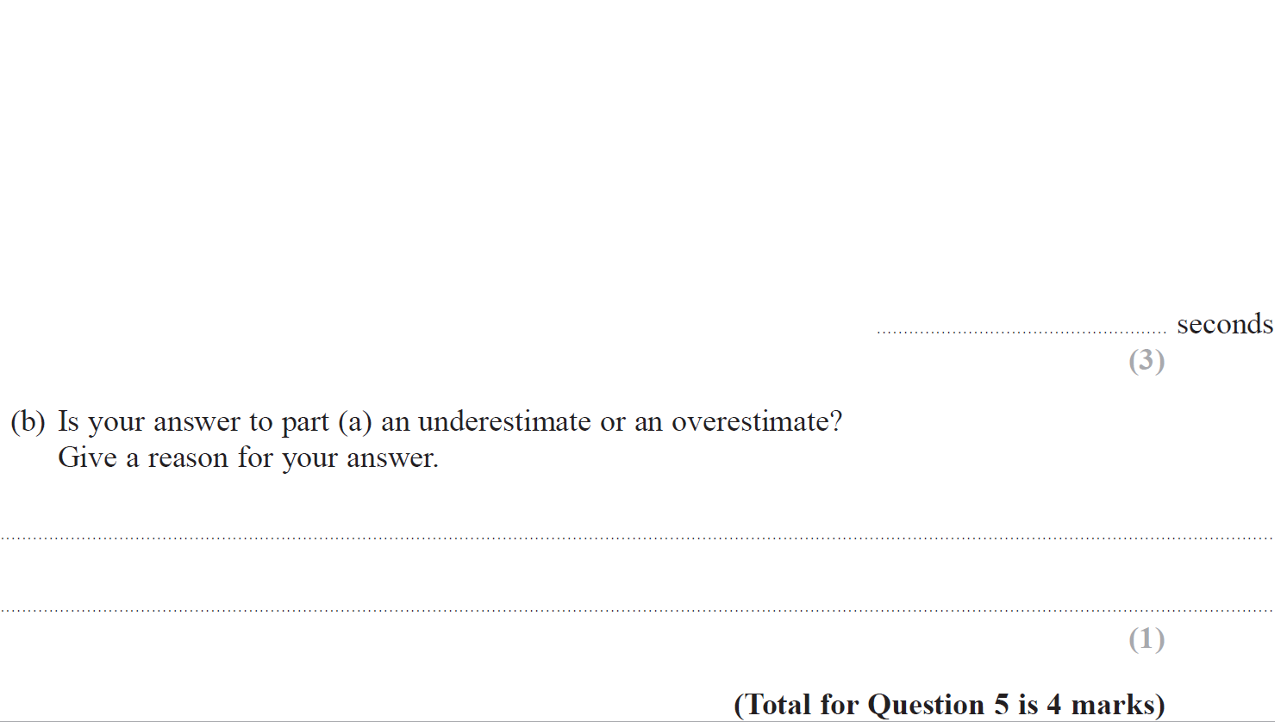
Compound Measures
Nov 2018 1H Q5

Slide 33
Compound Measures
Nov 2018 1H Q5
A
B

Slide 34
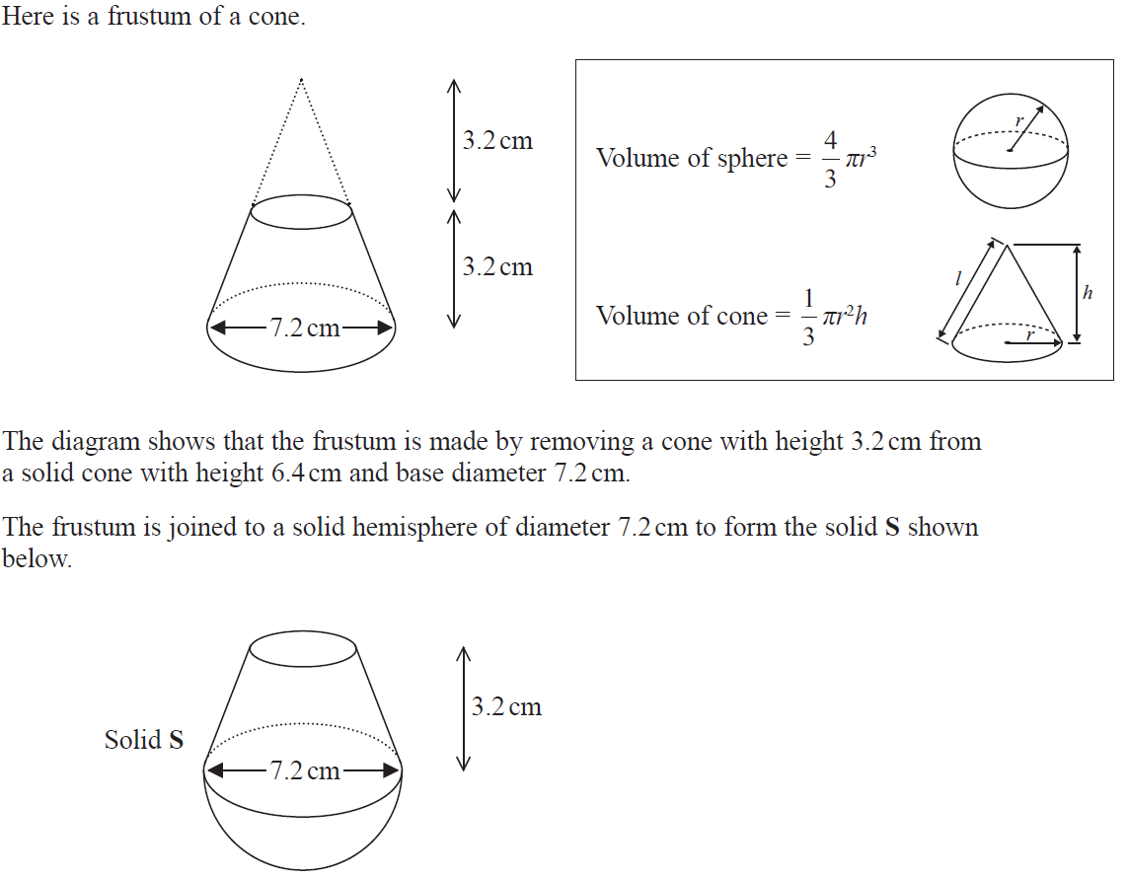
Compound Measures
Nov 2018 2H Q20

Slide 35
Compound Measures
Nov 2018 2H Q20
A

Slide 36
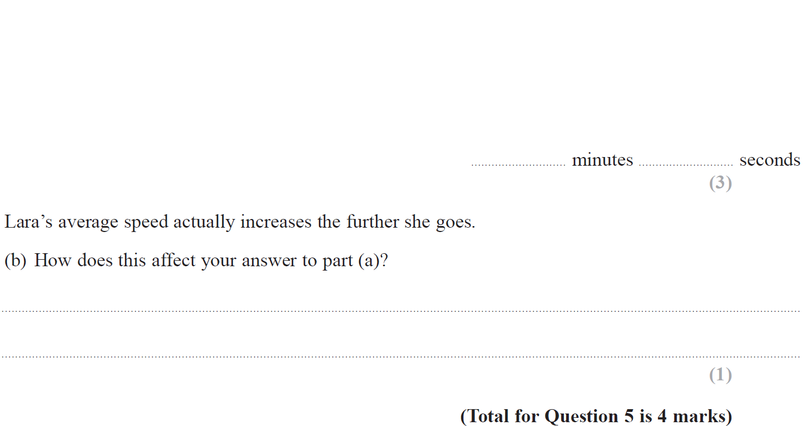
Compound Measures
Nov 2018 3H Q5

Slide 37
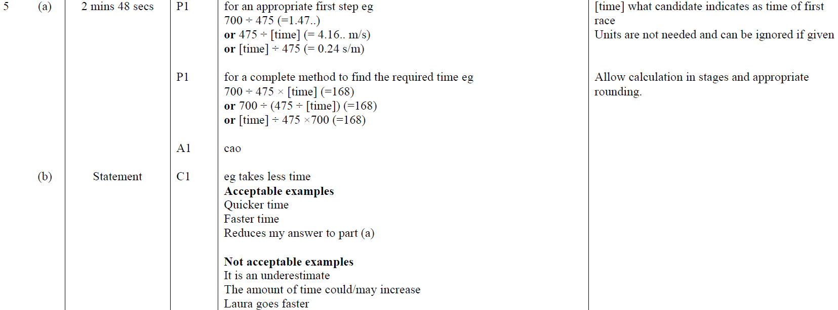
Compound Measures
Nov 2018 3H Q5
A
B

Slide 38
Compound Measures
Nov 2018 3H Q18

Slide 39
Compound Measures
Nov 2018 3H Q18
A

Slide 40
Compound Measures
June 2019 3H Q13

Slide 41
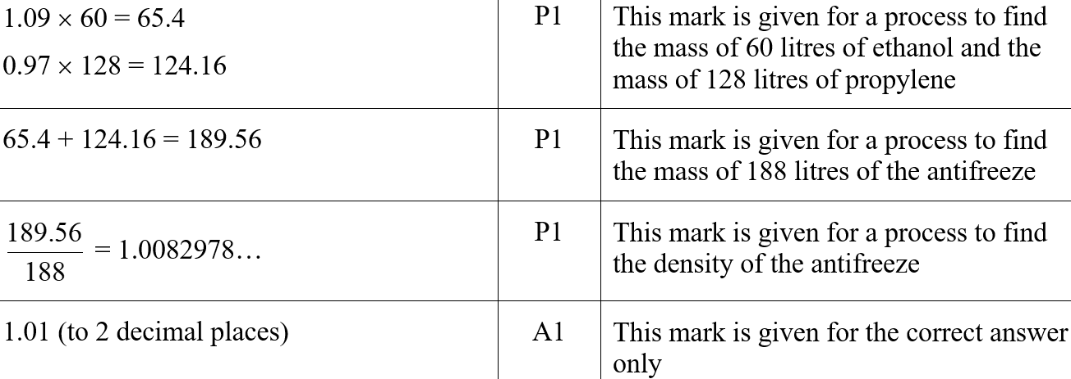
Compound Measures
June 2019 3H Q13
A
A SF

