Slide 1
Completing the Square
Completing the Square
NTSQ
Q1
Jan 2019
2HR Q20
NTSQ
Q2
May 2019
1H Q22
NTSQ
Q3
NTSQ
Q5
NTSQ
Q6
NTSQ
Q7
SAM
2H Q22
June 2018
2H Q21
June 2018
2HR Q24

Slide 2
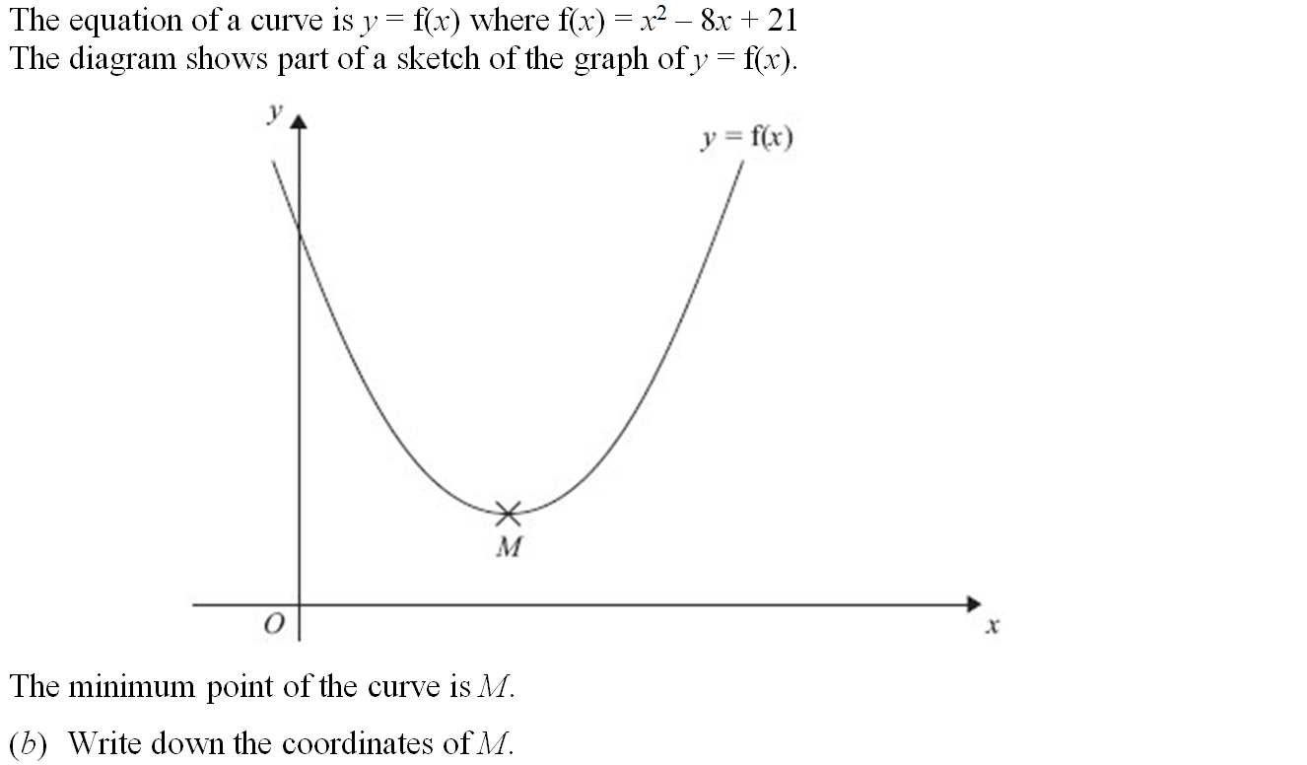
Completing the Square
NTSQ Q1

Slide 3
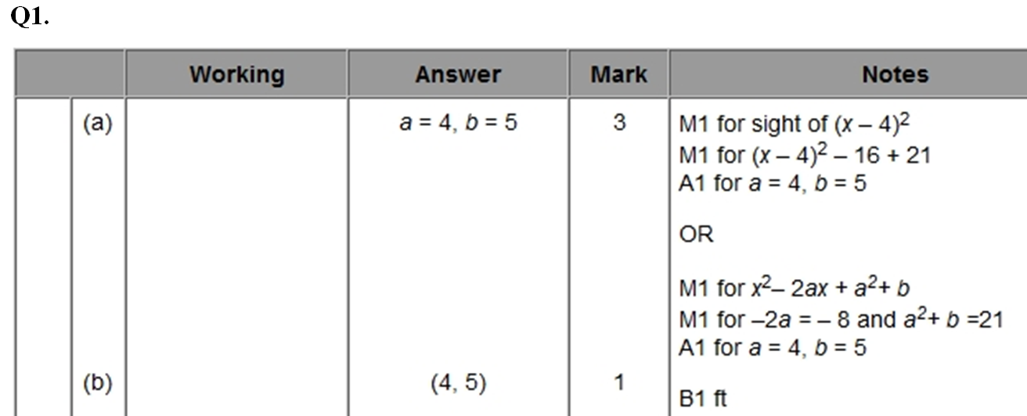
Completing the Square
NTSQ Q1
A
B

Slide 4
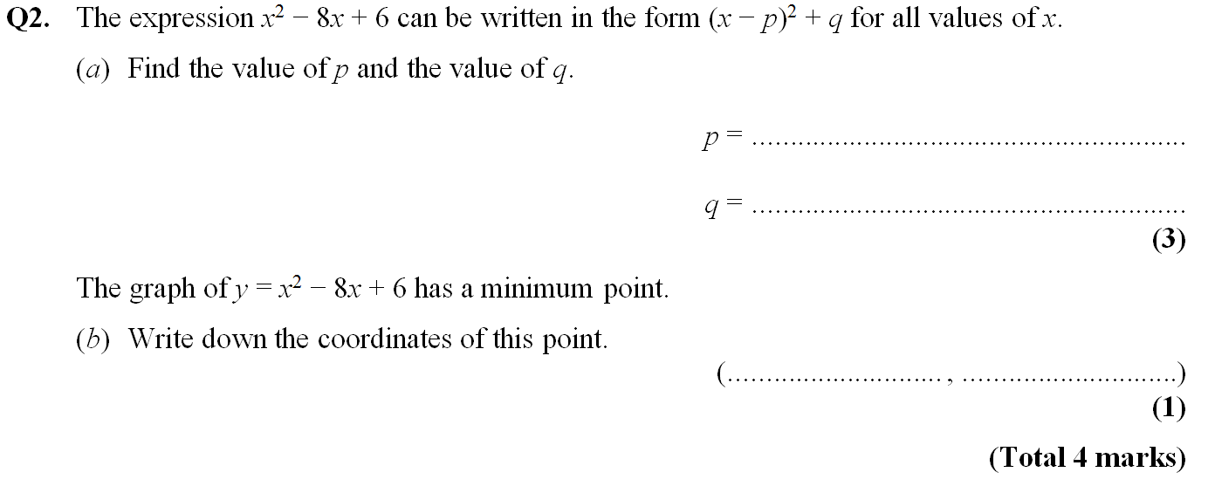
Completing the Square
NTSQ Q2

Slide 5
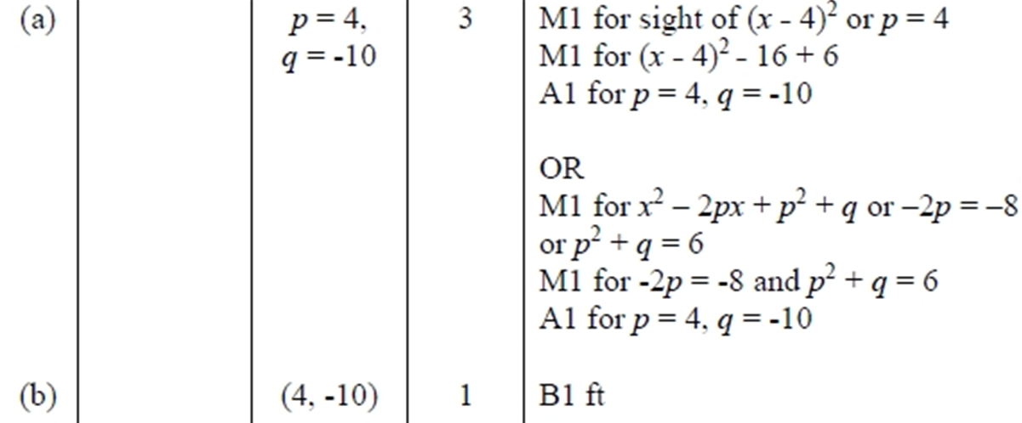
Completing the Square
NTSQ Q2
A
B

Slide 6
Completing the Square
NTSQ Q3

Slide 7
Completing the Square
NTSQ Q3
A

Slide 8
Completing the Square
NTSQ Q5

Slide 9
Completing the Square
NTSQ Q5
A
B

Slide 10
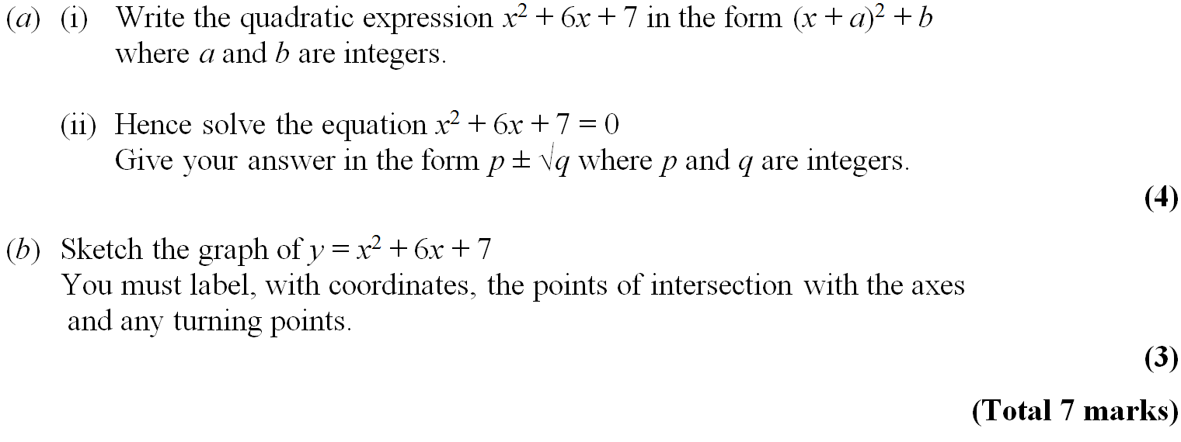
Completing the Square
NTSQ Q6

Slide 11
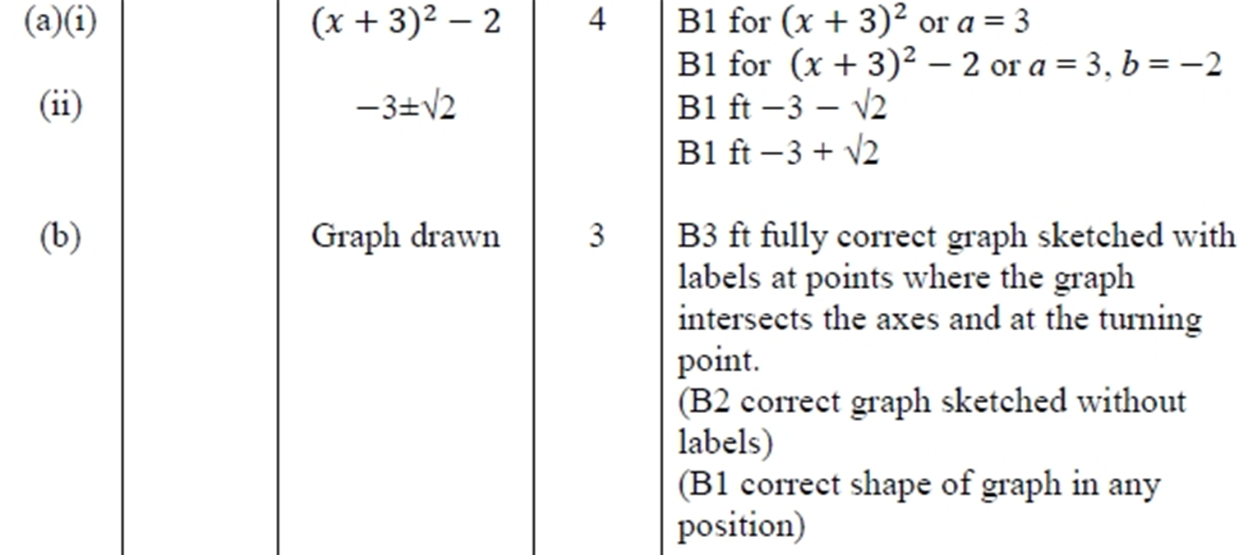
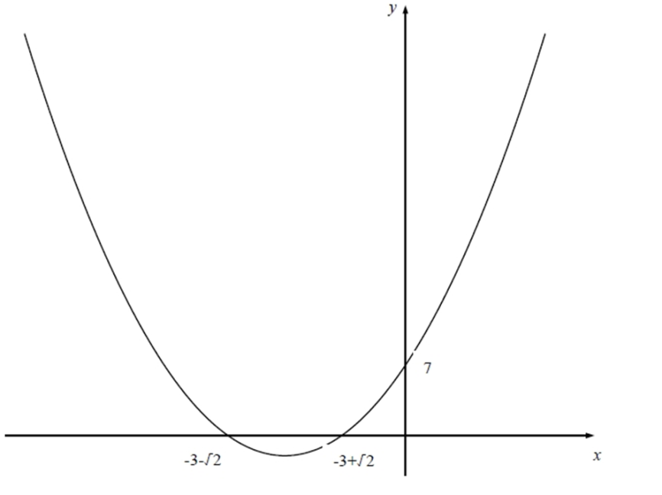
Completing the Square
NTSQ Q6
A (i)
A (ii)
B

Slide 12
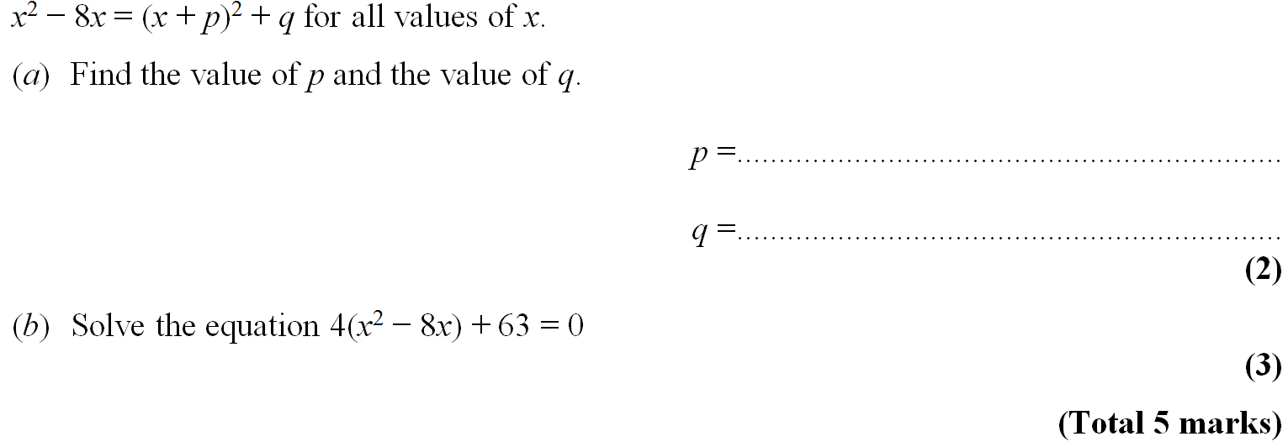
Completing the Square
NTSQ Q7

Slide 13
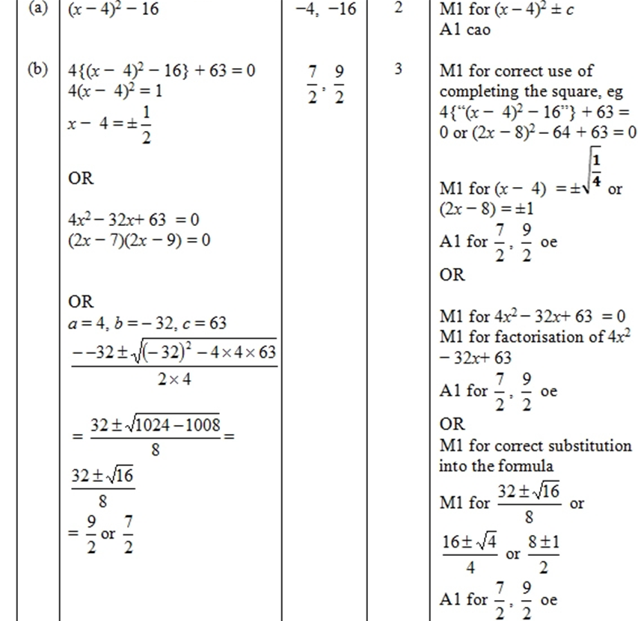
Completing the Square
NTSQ Q7
A
B

Slide 14
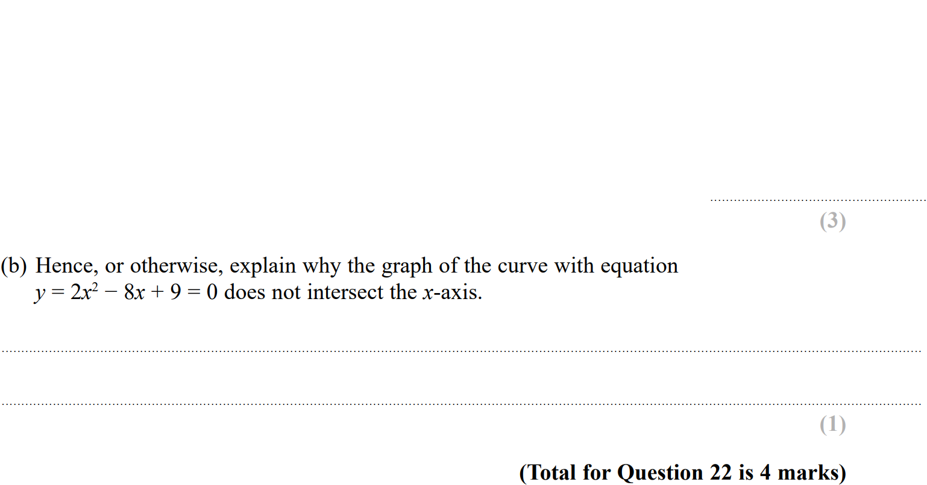
Completing the Square
SAM 2H Q22

Slide 15
Completing the Square
SAM 2H Q22
A
B

Slide 16
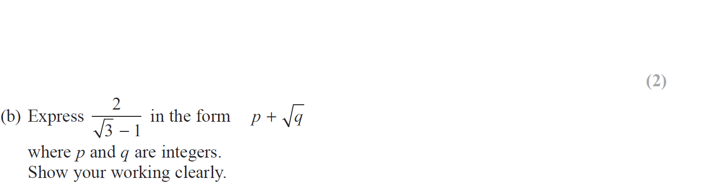
Completing the Square
June 2018 2H Q21

Slide 17
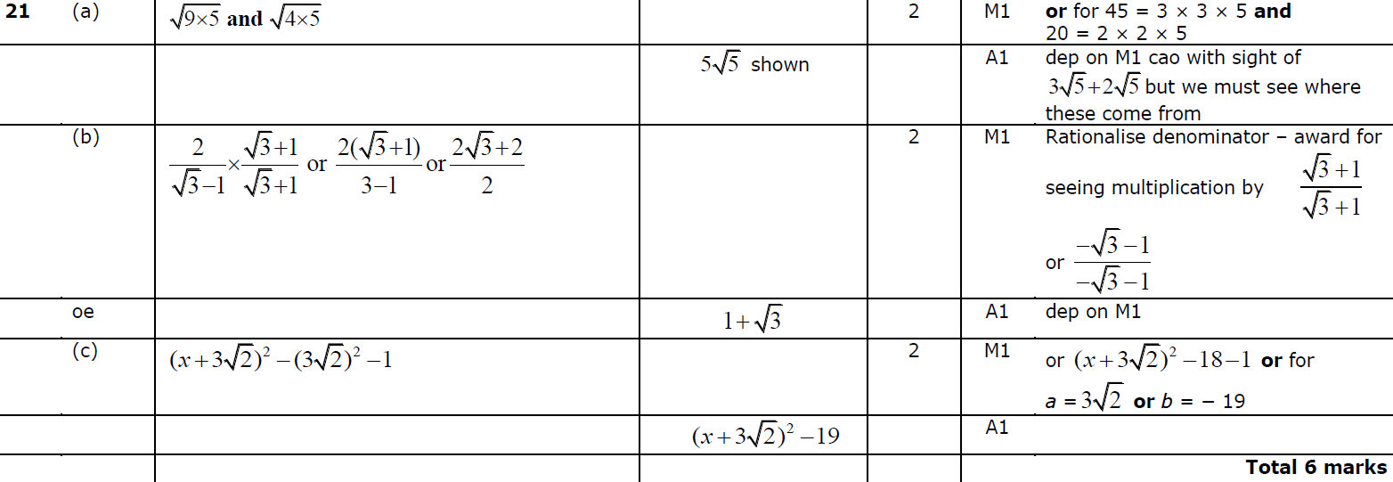
Completing the Square
June 2018 2H Q21
A
B
C

Slide 18
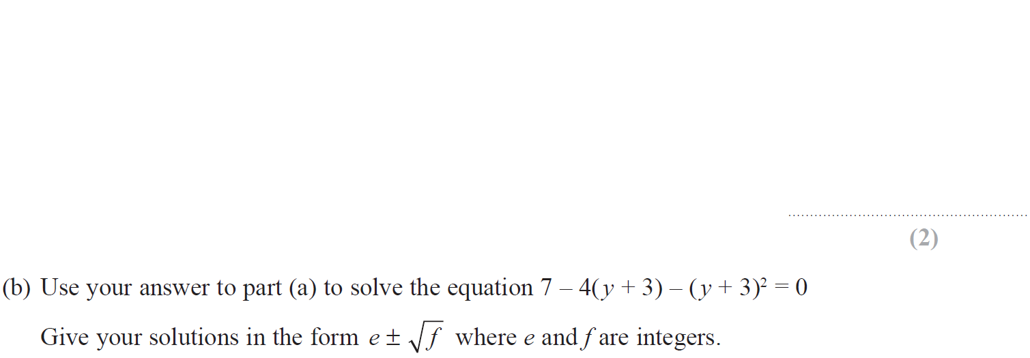
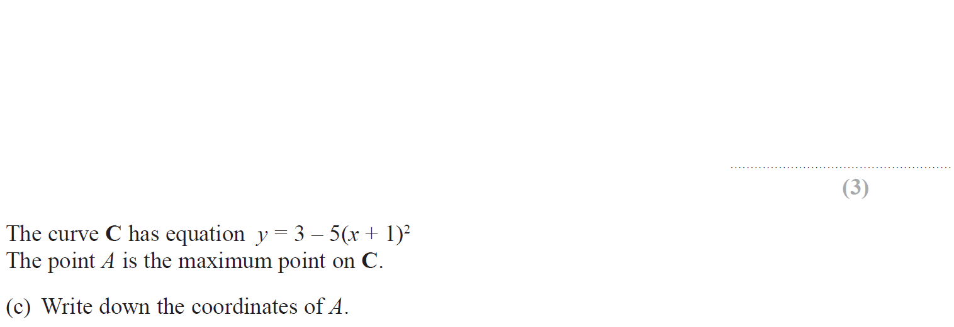
Completing the Square
June 2018 2HR Q24

Slide 19
Completing the Square
June 2018 2HR Q24
A
B
C

Slide 20
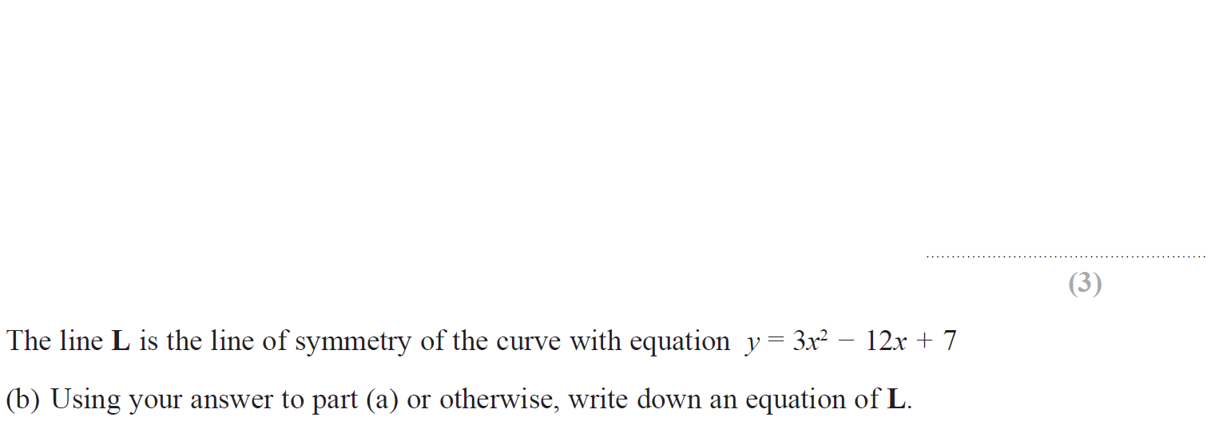
Completing the Square
Jan 2019 2HR Q20

Slide 21
Completing the Square
Jan 2019 2HR Q20
A
B

Slide 22
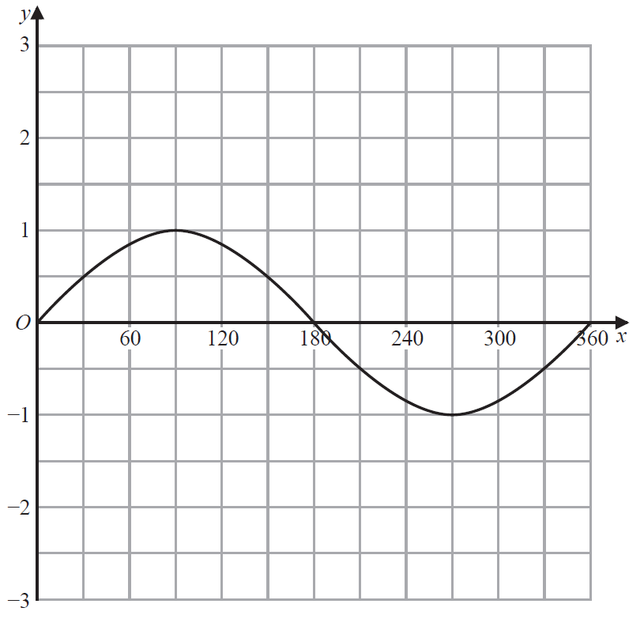
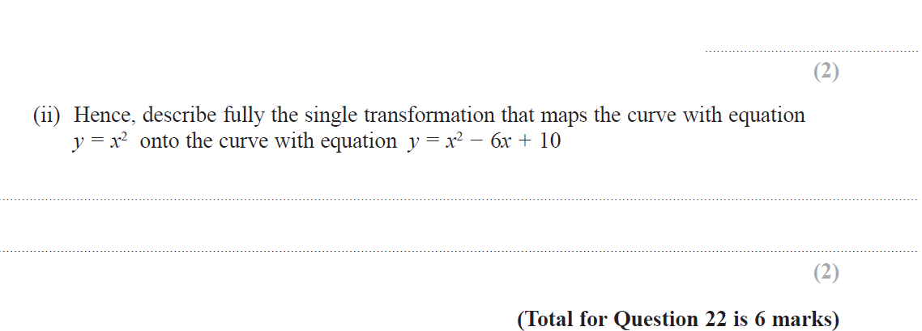
Completing the Square
May 2019 1H Q22
Reveal Graph (a)

Slide 23
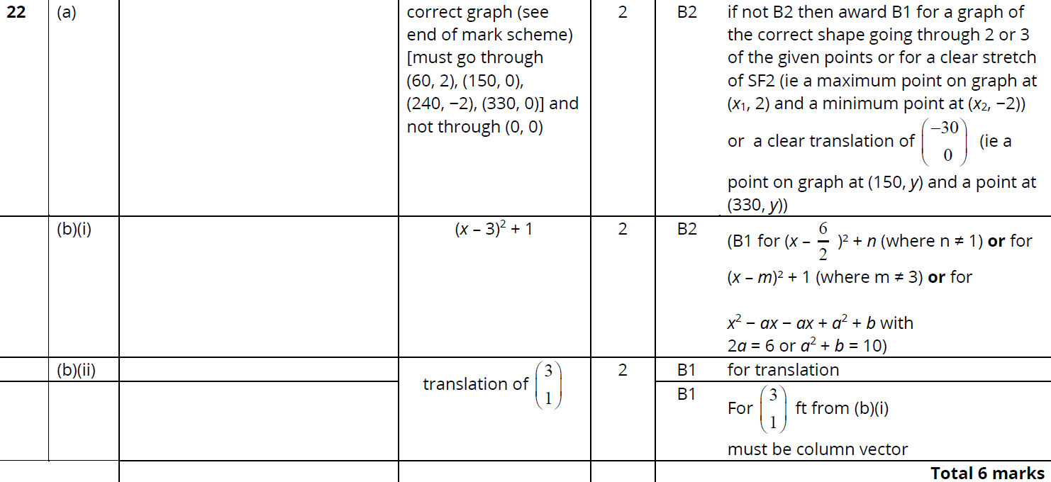
Completing the Square
May 2019 1H Q22
A
B (i)
B (ii)

