Slide 1
Completing the Square
Completing the Square
Edexcel
Spec 1
3H Q11
Nov 2017 3H Q13
AQA
Spec 2
3H Q22
May 2019 1H Q19
OCR
Transforming Quadratics

Slide 2
Completing the Square
Completing the Square
Edexcel
June 2017
3H Q27
AQA
SAM
2H Q25
Nov 2017
1H Q23
1 Marker
OCR
Nov 2018
3H Q20
Transforming Quadratics

Slide 3
Completing the Square
Completing the Square
May 2017
1H Q16
Edexcel
June 2017
2H Q19
SAM
2H Q20
AQA
Nov 2017
1H Q16
Practice
1H Q14
OCR
May 2018
1H Q15
Nov 2018
2H Q18
Transforming Quadratics

Slide 4
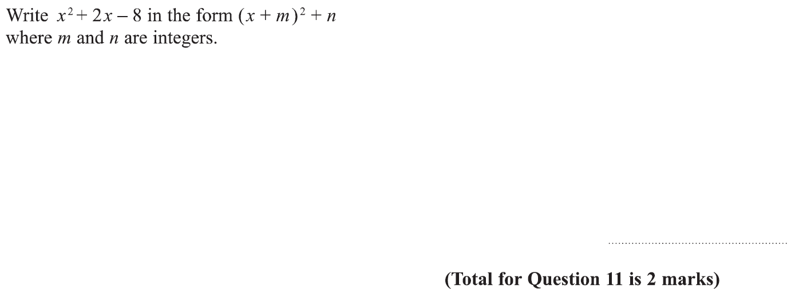
Completing the Square
Specimen Set 1 3H Q11

Slide 5
Completing the Square
Specimen Set 1 3H Q11
A

Slide 6
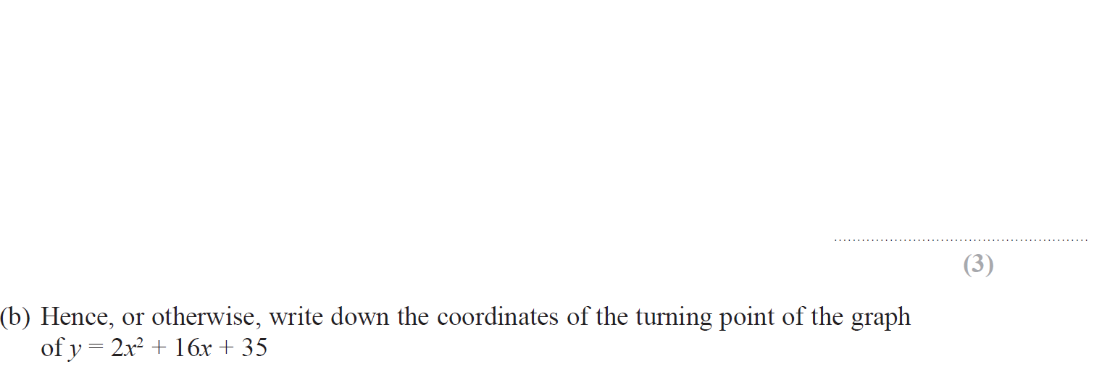
Completing the Square
Specimen Set 2 3H Q22

Slide 7
Completing the Square
Specimen Set 2 3H Q22
A
B

Slide 8
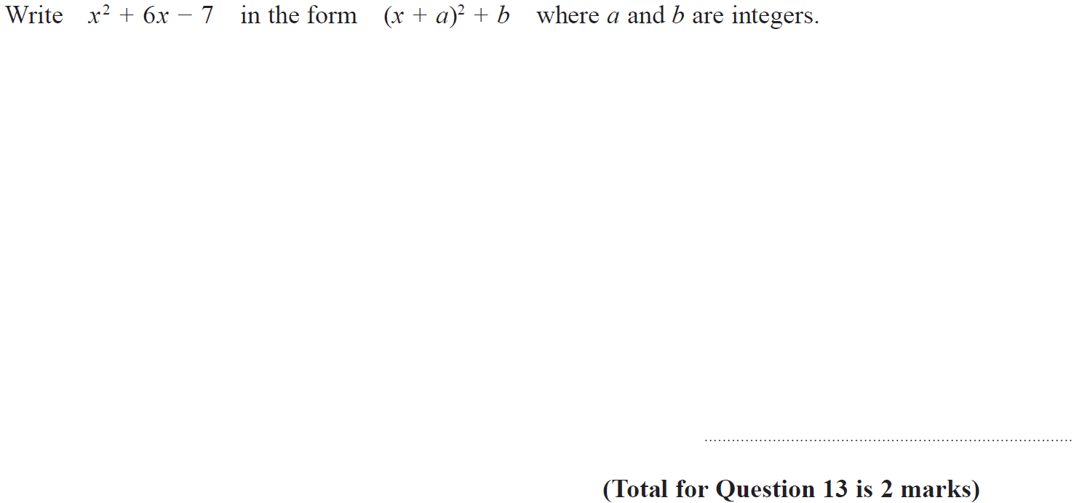
Completing the Square
Nov 2017 3H Q13

Slide 9
Completing the Square
Nov 2017 3H Q13
A

Slide 10
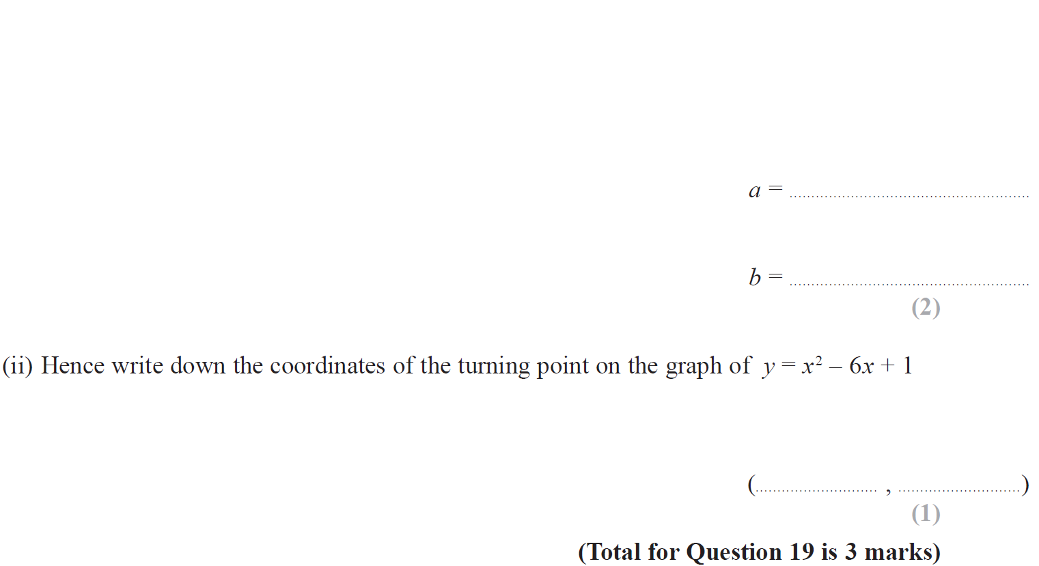
Completing the Square
May 2019 1H Q19

Slide 11
Completing the Square
May 2019 1H Q19
(i)
(ii)
(i) SF
(ii) SF

Slide 12
Completing the Square
SAM 2H Q25

Slide 13
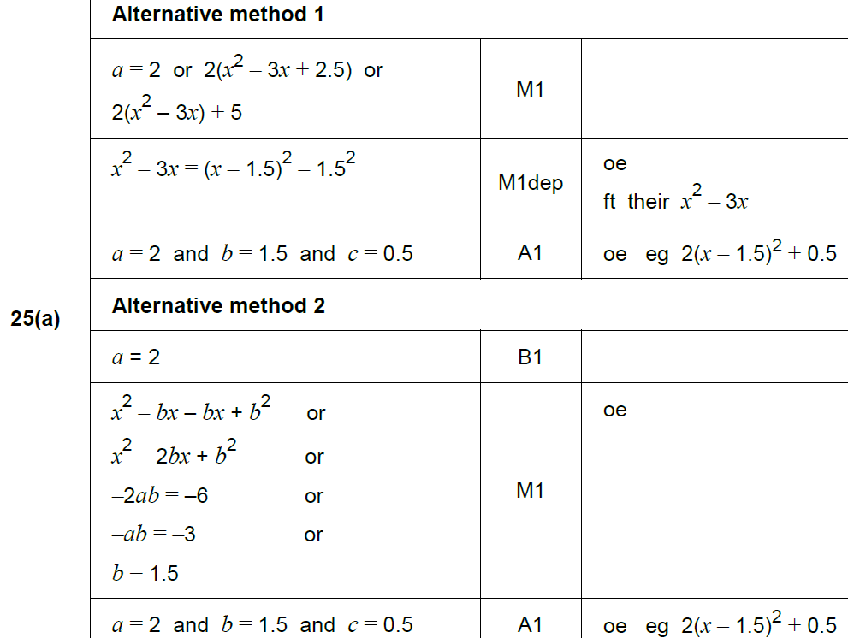
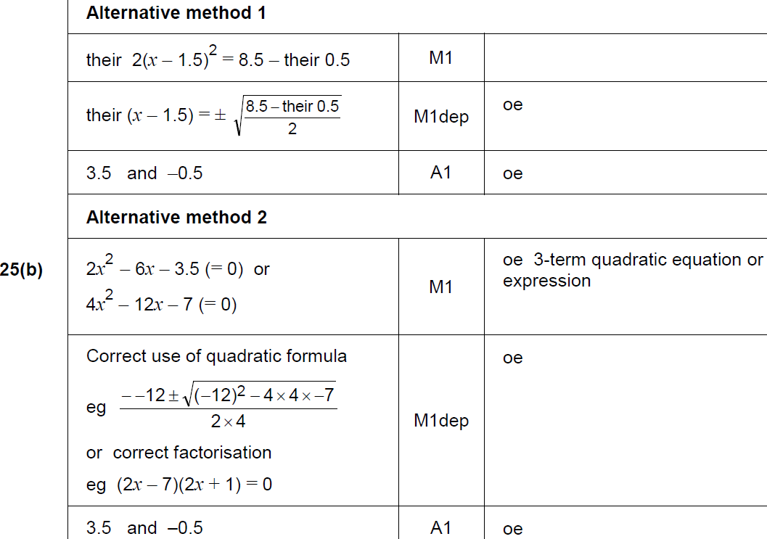
Completing the Square
SAM 2H Q25
A
B

Slide 14
Completing the Square
June 2017 3H Q27

Slide 15
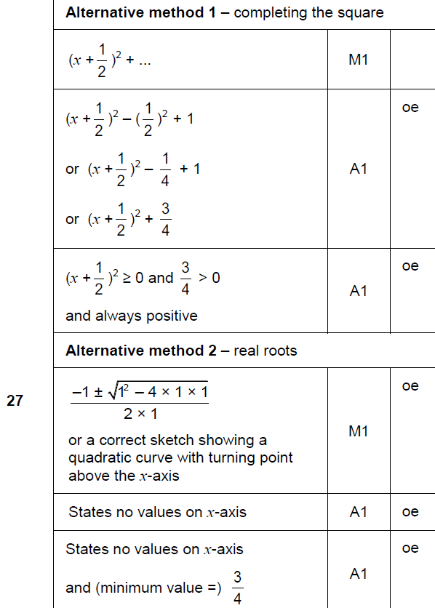
Completing the Square
June 2017 3H Q27
A

Slide 16
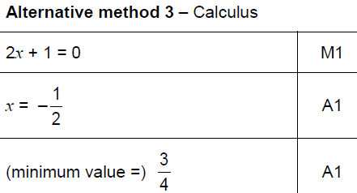
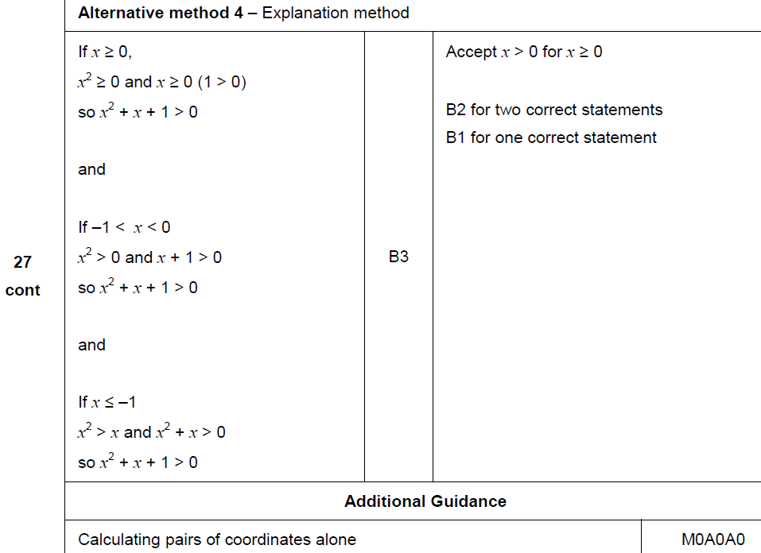
Completing the Square
June 2017 3H Q27
A Alternatives & notes

Slide 17
Completing the Square
Nov 2017 1H Q23

Slide 18
Completing the Square
Nov 2017 1H Q23
A

Slide 19
Completing the Square
Nov 2018 3H Q20

Slide 20
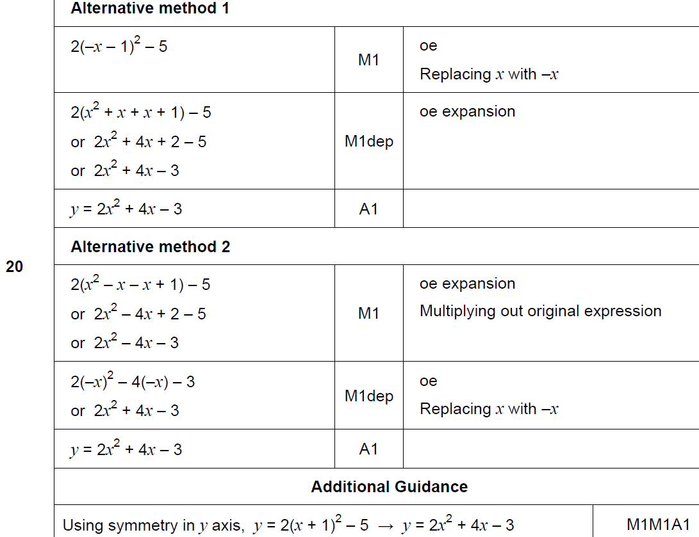
Completing the Square
Nov 2018 3H Q20
A

Slide 21
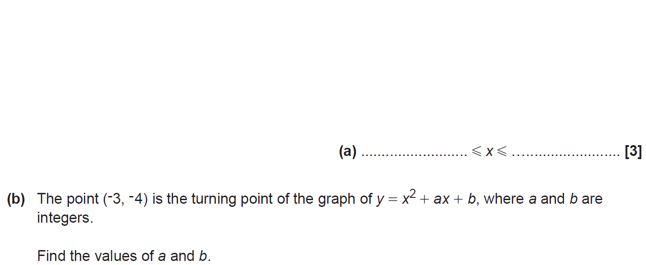
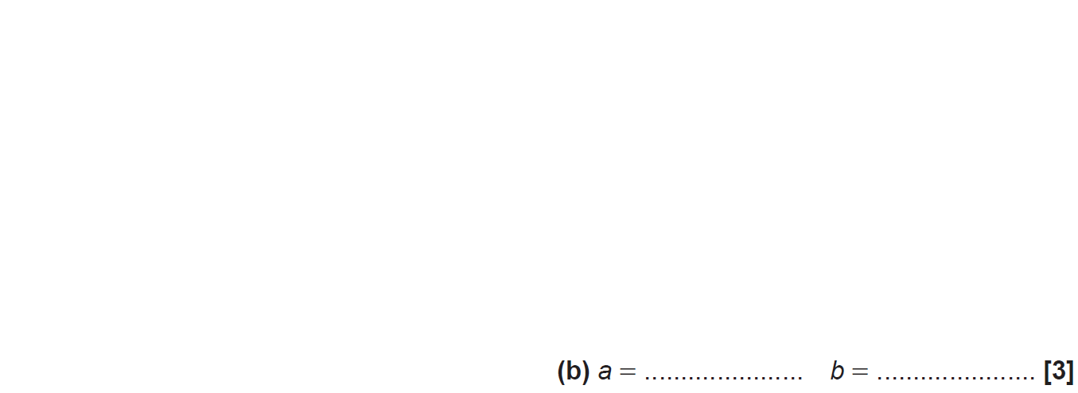
Completing the Square
SAM 2H Q20

Slide 22
Completing the Square
SAM 2H Q20
A
B

Slide 23
Completing the Square
Practice 1H Q14

Slide 24
Completing the Square
Practice 1H Q14
A
B

Slide 25
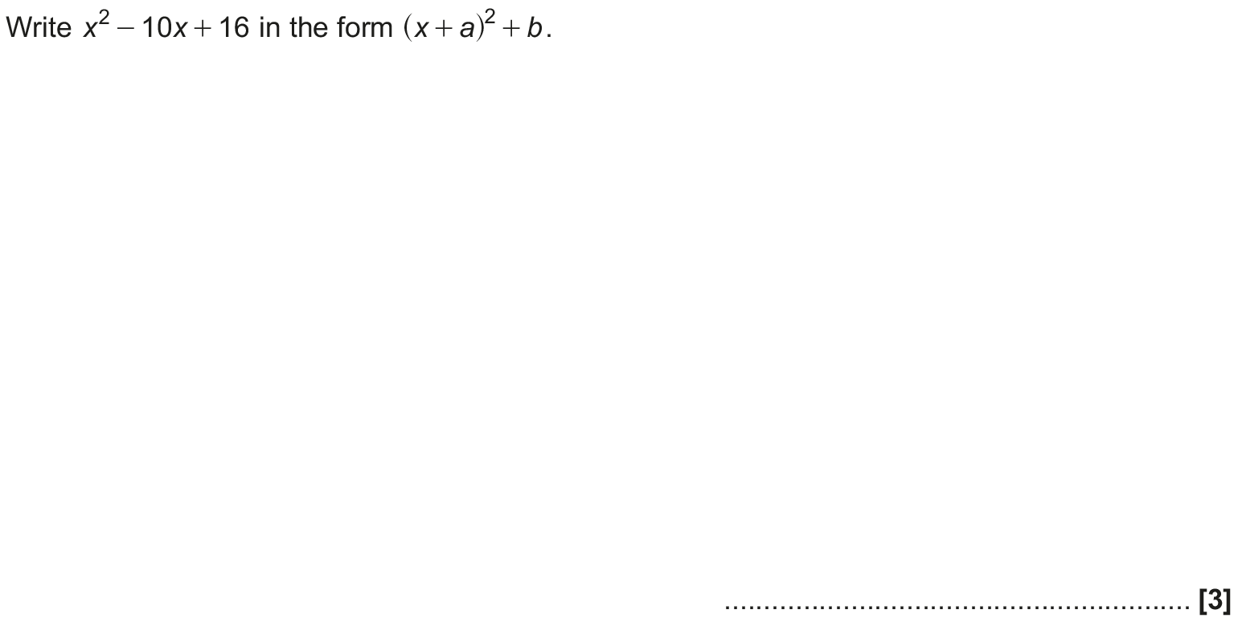
Completing the Square
May 2017 1H Q16

Slide 26
Completing the Square
May 2017 1H Q16
A

Slide 27
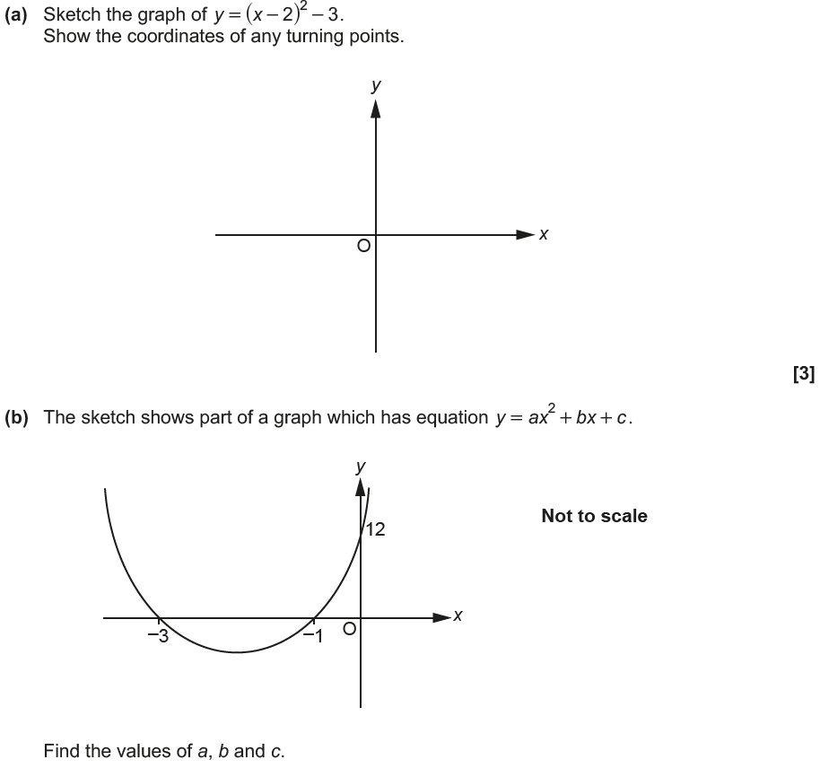
Completing the Square
June 2017 2H Q19

Slide 28
Completing the Square
June 2017 2H Q19
A
B

Slide 29
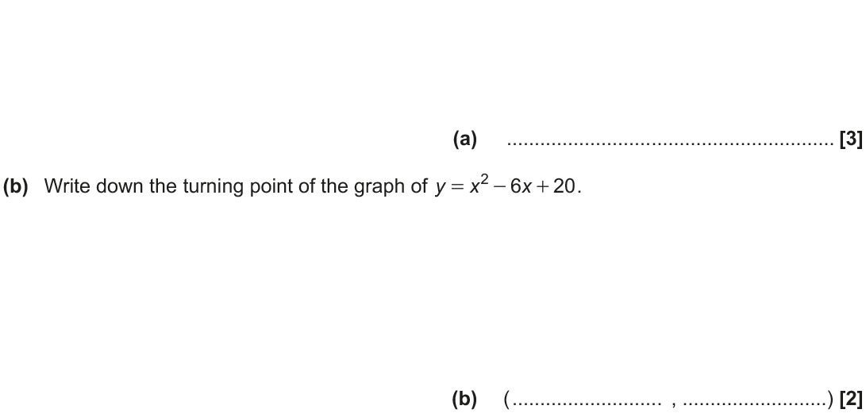
Completing the Square
Nov 2017 1H Q16

Slide 30
Completing the Square
Nov 2017 1H Q16
A
B

Slide 31
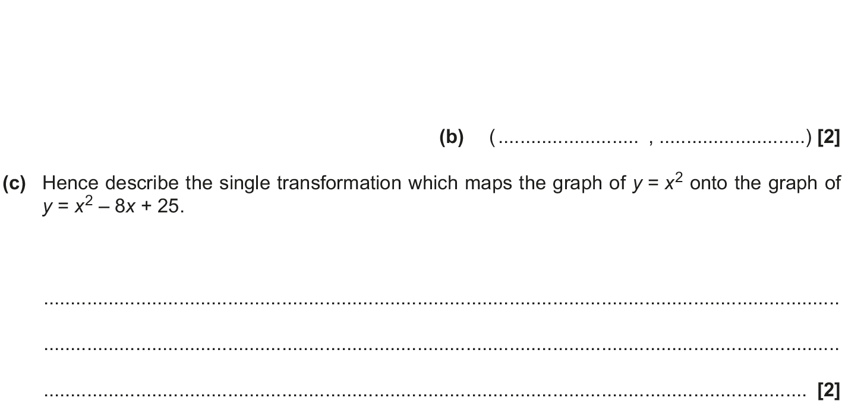
Completing the Square
May 2018 1H Q15

Slide 32
Completing the Square
May 2018 1H Q15
A
B
C

Slide 33
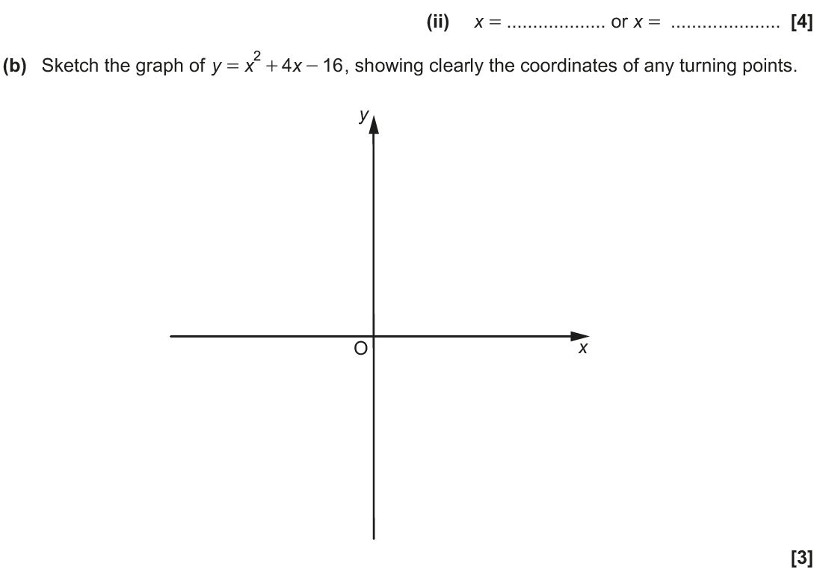
Completing the Square
Nov 2018 2H Q18

Slide 34
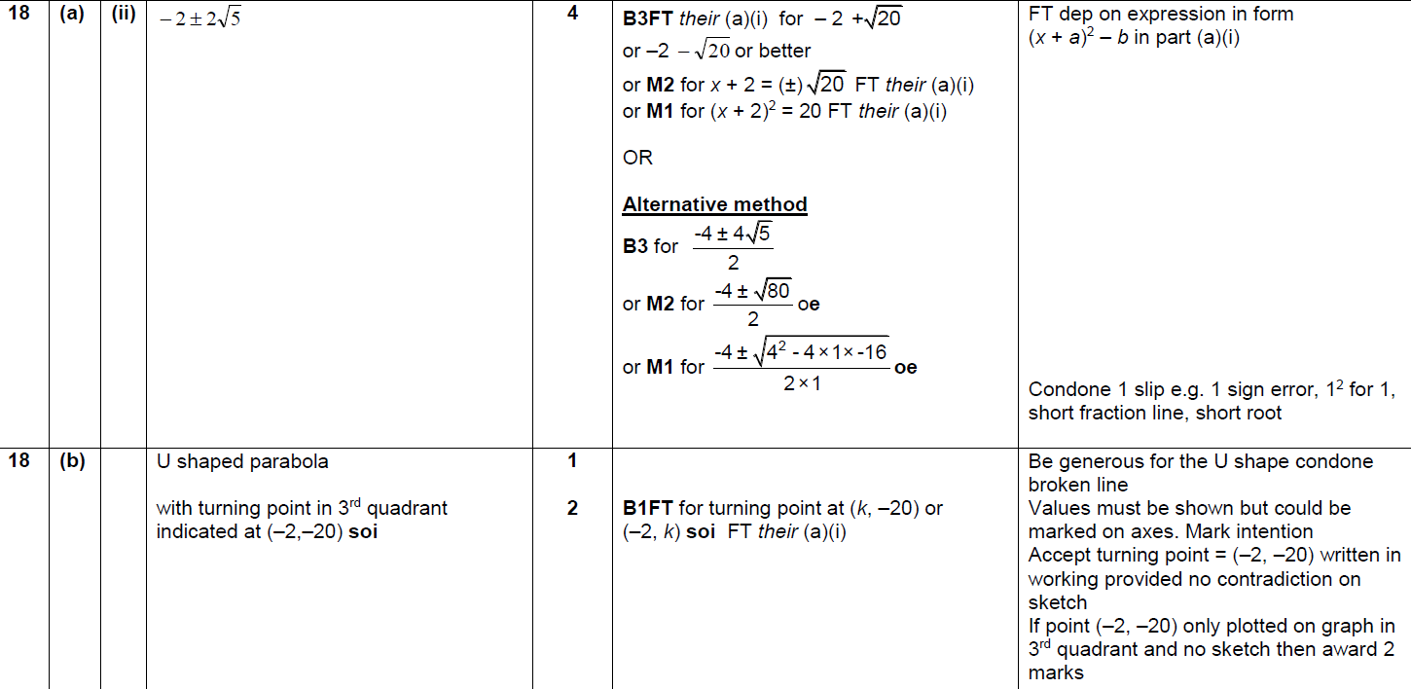
Completing the Square
Nov 2018 2H Q18
A (i)
A (i)
B

