Slide 1
Completing the Square
Completing the Square
May 2017
1H Q16
June 2017
2H Q19
SAM
2H Q20
Nov 2017
1H Q16
Practice
1H Q14
May 2018
1H Q15
Nov 2018
2H Q18
Transforming Quadratics

Slide 2
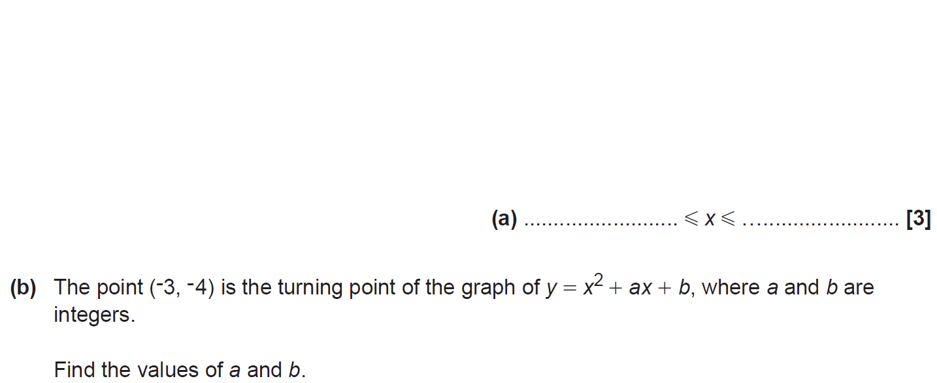
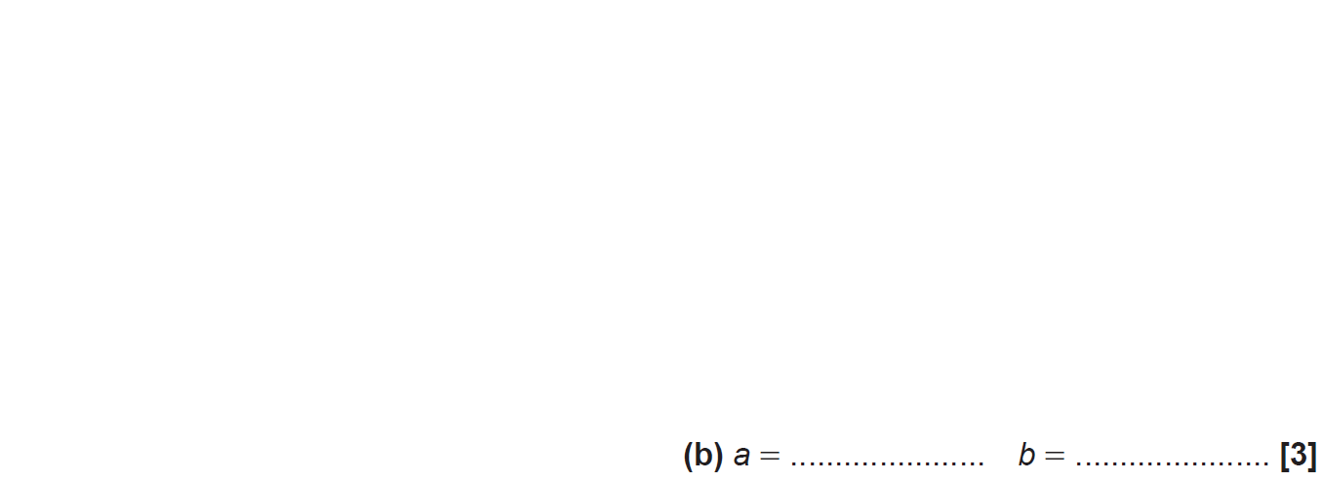
Completing the Square
SAM 2H Q20

Slide 3
Completing the Square
SAM 2H Q20
A
B

Slide 4
Completing the Square
Practice 1H Q14

Slide 5
Completing the Square
Practice 1H Q14
A
B

Slide 6
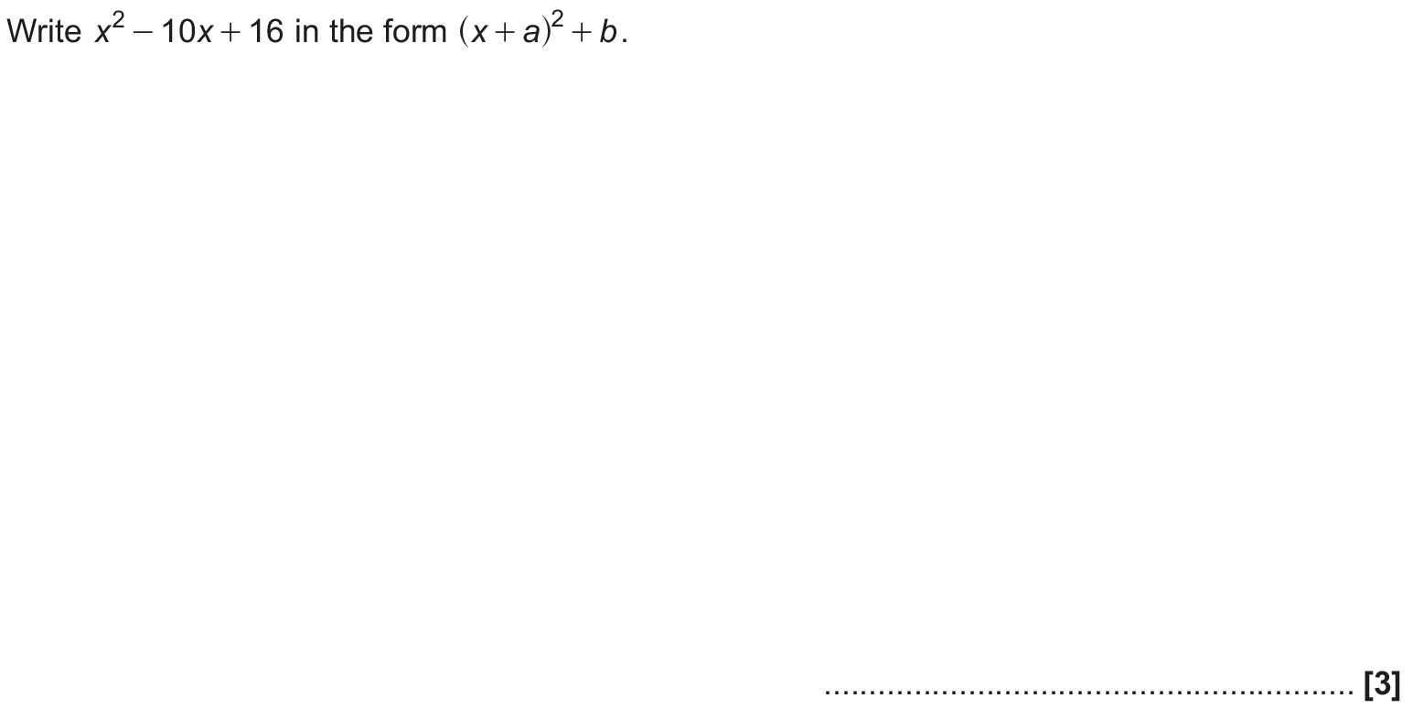
Completing the Square
May 2017 1H Q16

Slide 7
Completing the Square
May 2017 1H Q16
A

Slide 8
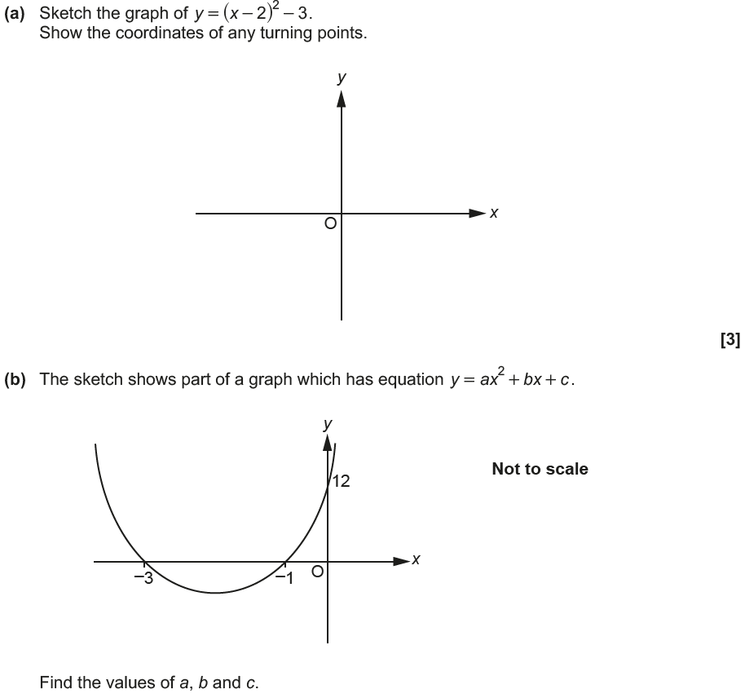
Completing the Square
June 2017 2H Q19

Slide 9
Completing the Square
June 2017 2H Q19
A
B

Slide 10
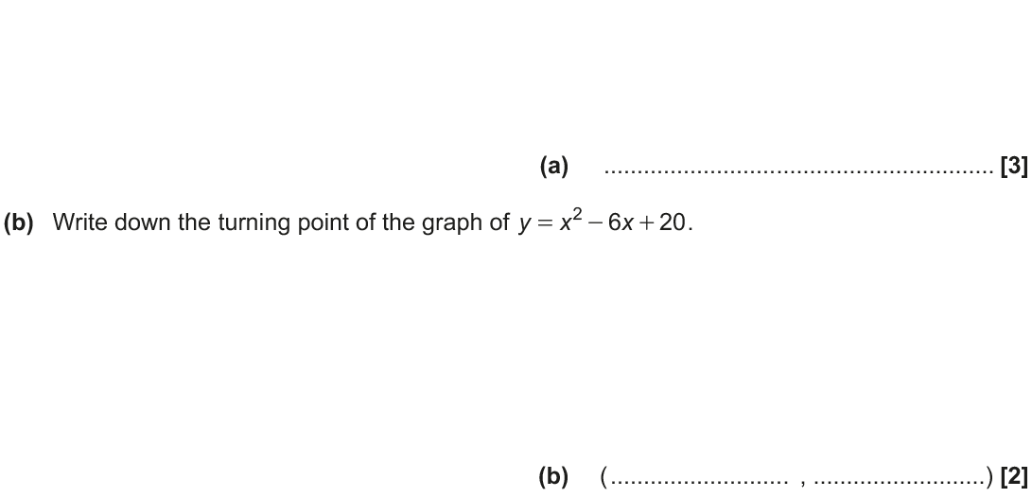
Completing the Square
Nov 2017 1H Q16

Slide 11
Completing the Square
Nov 2017 1H Q16
A
B

Slide 12
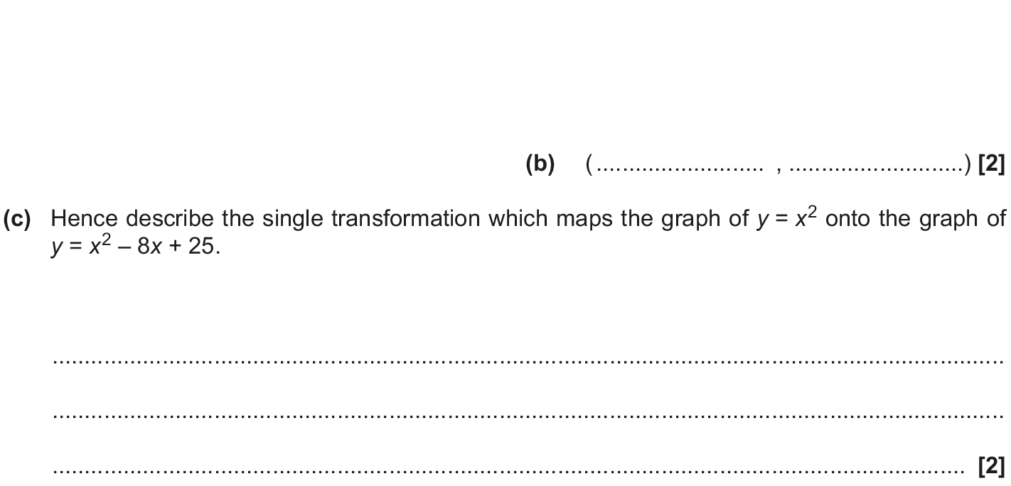
Completing the Square
May 2018 1H Q15

Slide 13
Completing the Square
May 2018 1H Q15
A
B
C

Slide 14
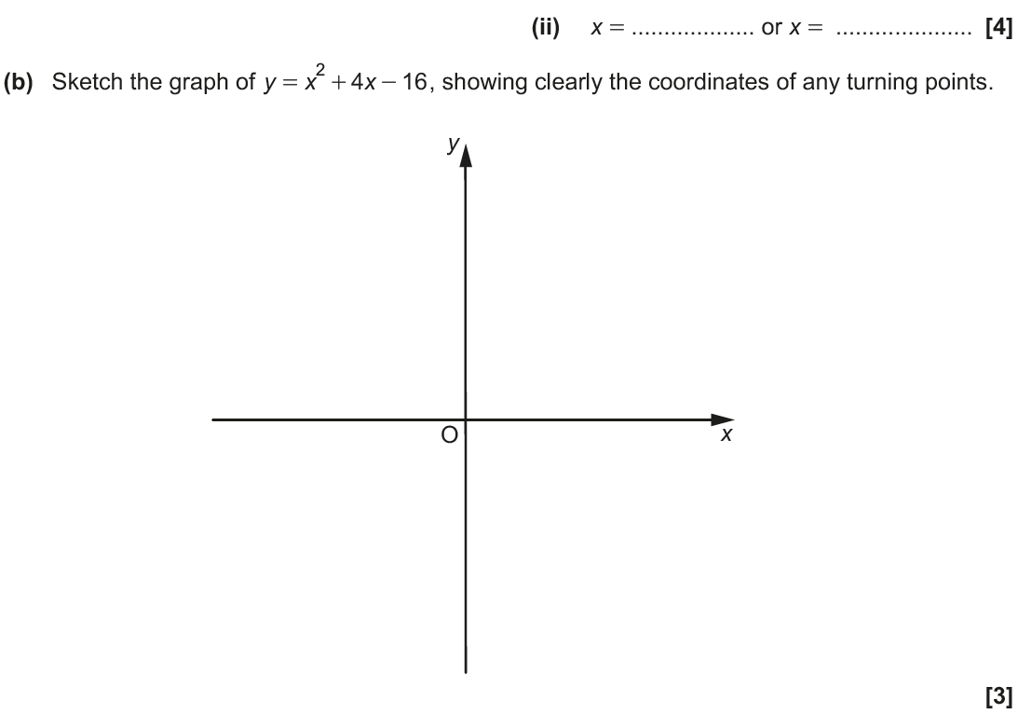
Completing the Square
Nov 2018 2H Q18

Slide 15
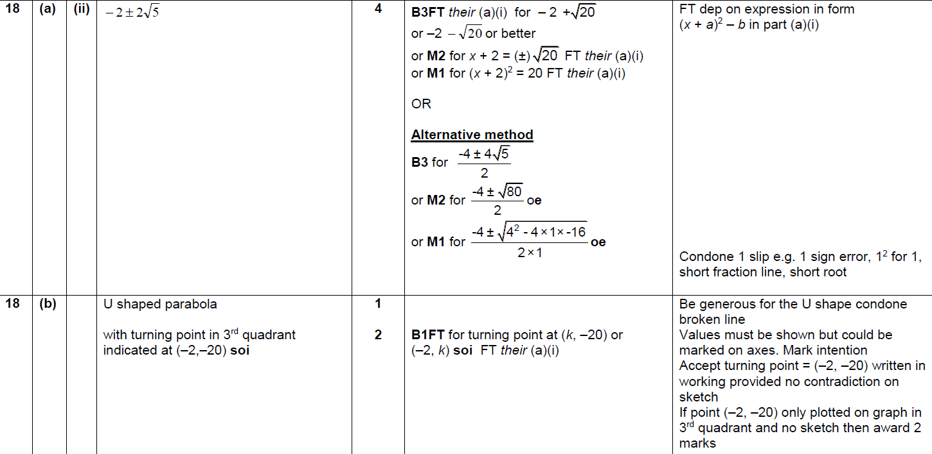
Completing the Square
Nov 2018 2H Q18
A (i)
A (i)
B

