Slide 1
Completing the Square
Completing the Square
Spec 1
3H Q11
Nov 2017 3H Q13
Spec 2
3H Q22
May 2019 1H Q19
Transforming Quadratics

Slide 2
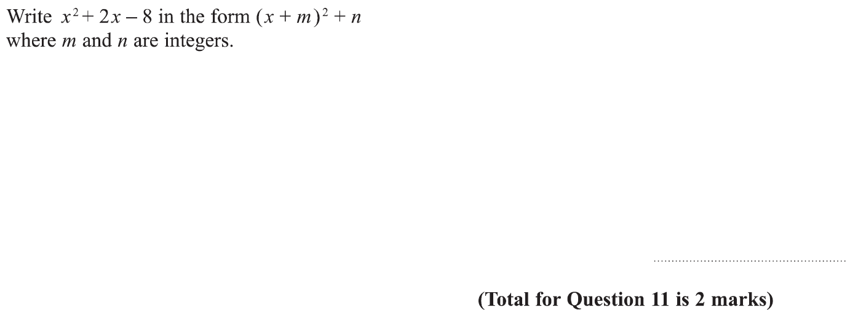
Completing the Square
Specimen Set 1 3H Q11

Slide 3
Completing the Square
Specimen Set 1 3H Q11
A

Slide 4
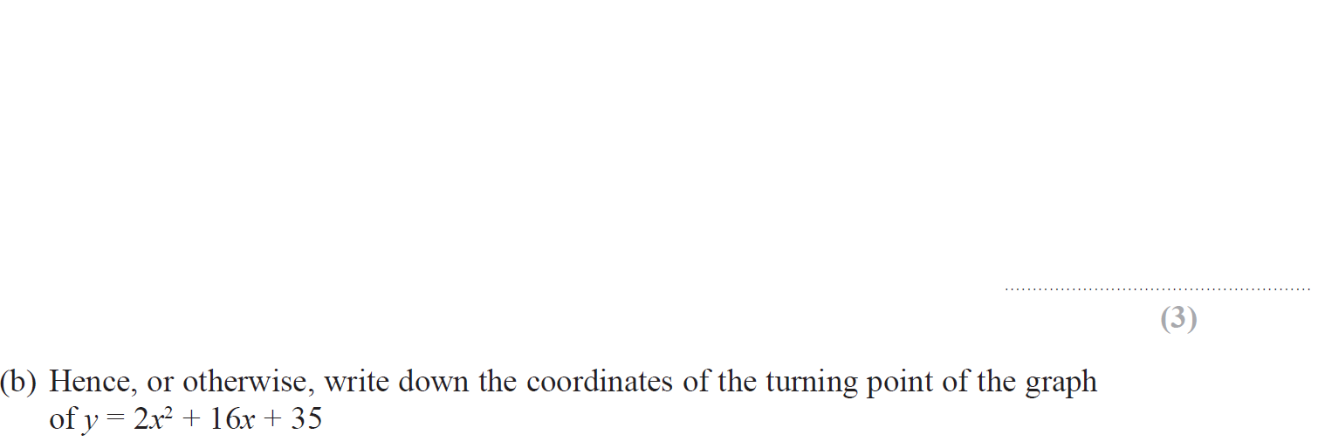
Completing the Square
Specimen Set 2 3H Q22

Slide 5
Completing the Square
Specimen Set 2 3H Q22
A
B

Slide 6
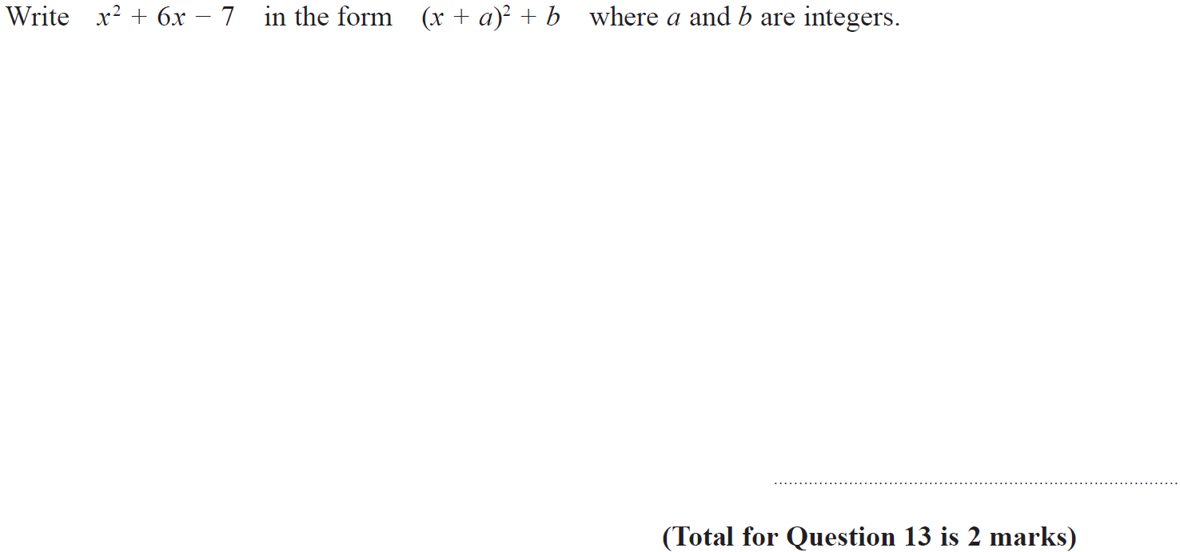
Completing the Square
Nov 2017 3H Q13

Slide 7
Completing the Square
Nov 2017 3H Q13
A

Slide 8
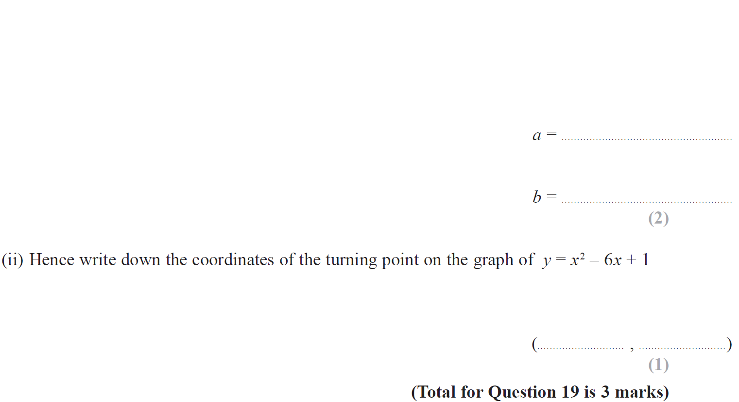
Completing the Square
May 2019 1H Q19

Slide 9
Completing the Square
May 2019 1H Q19
(i)
(ii)
(i) SF
(ii) SF

