Slide 1
Completing the Square
Completing the Square
June 2017
3H Q27
SAM
2H Q25
Nov 2017
1H Q23
1 Marker
Nov 2018
3H Q20
Transforming Quadratics

Slide 2
Completing the Square
SAM 2H Q25

Slide 3
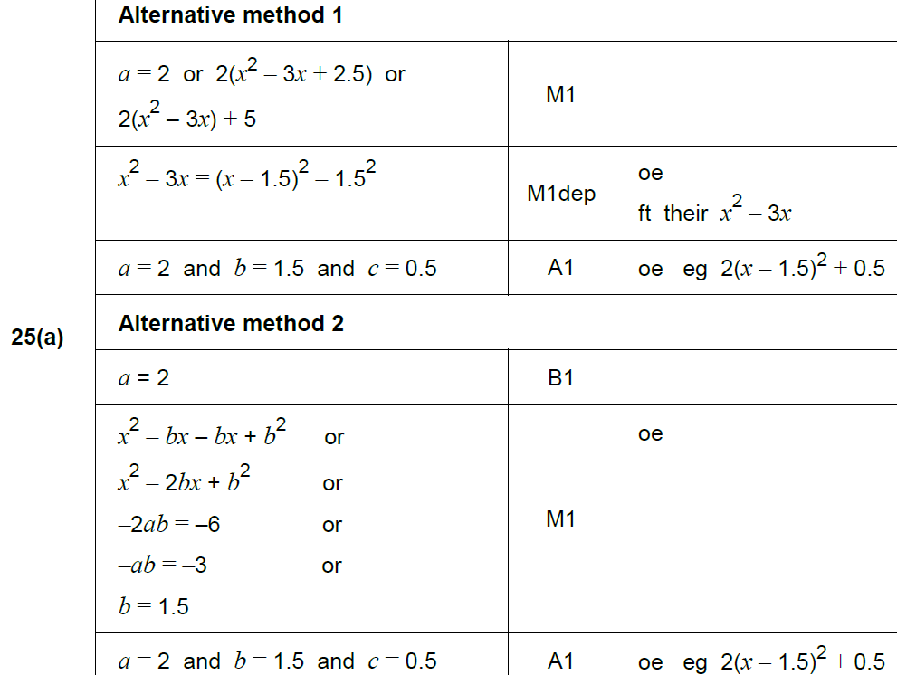
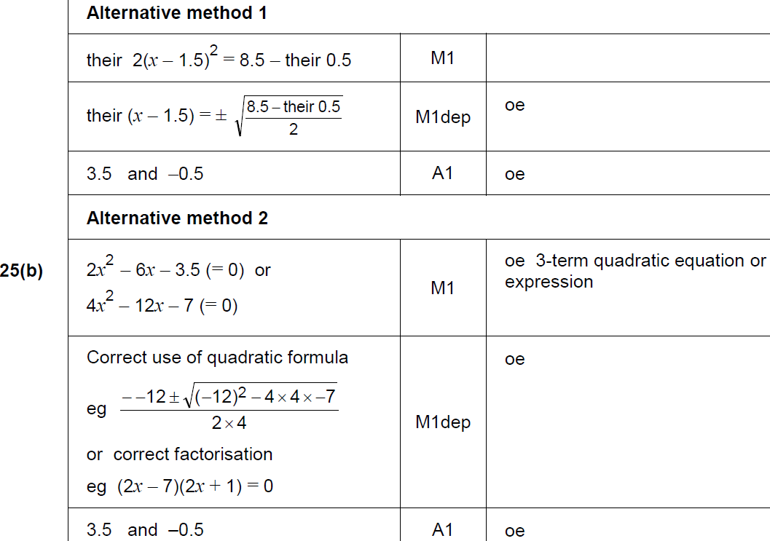
Completing the Square
SAM 2H Q25
A
B

Slide 4
Completing the Square
June 2017 3H Q27

Slide 5
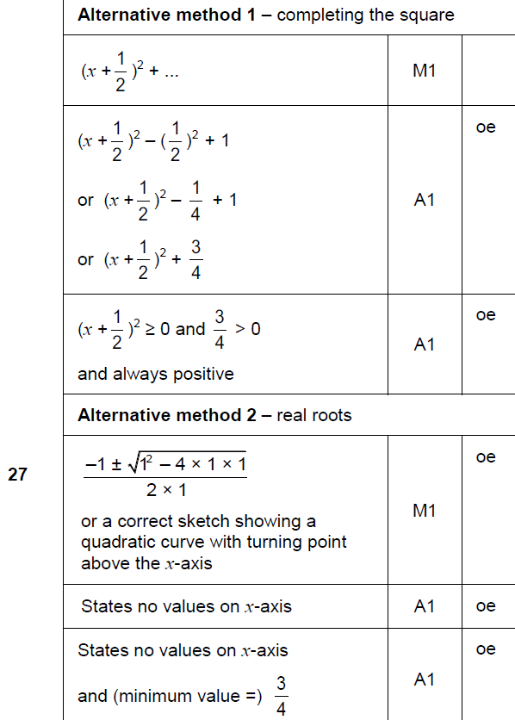
Completing the Square
June 2017 3H Q27
A

Slide 6
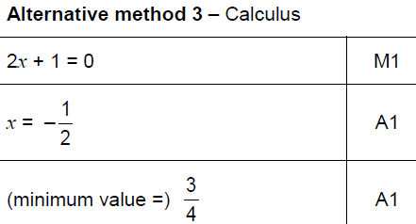
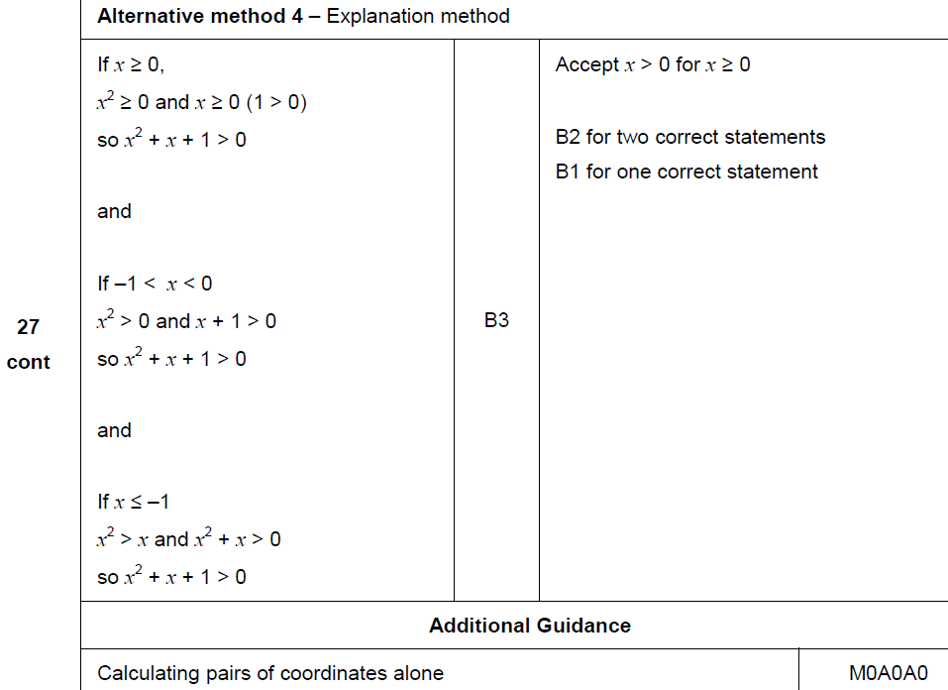
Completing the Square
June 2017 3H Q27
A Alternatives & notes

Slide 7
Completing the Square
Nov 2017 1H Q23

Slide 8
Completing the Square
Nov 2017 1H Q23
A

Slide 9
Completing the Square
Nov 2018 3H Q20

Slide 10
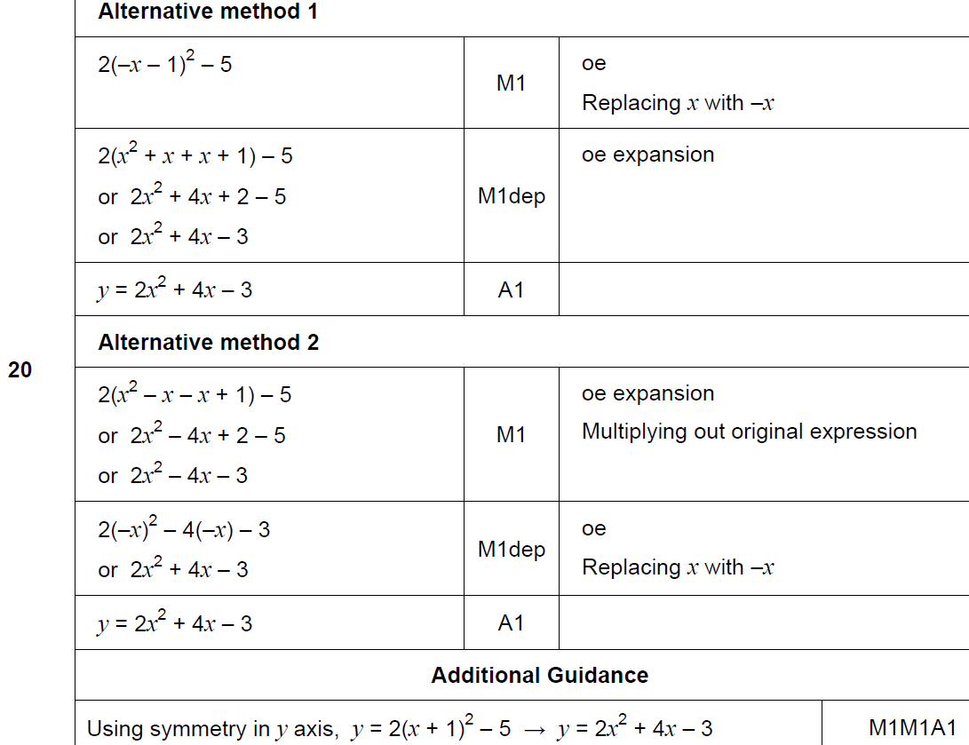
Completing the Square
Nov 2018 3H Q20
A

