Slide 1
Circles & Sectors
Circles & Sectors
May 2017
1H Q12
June 2018
2H Q1
June 2017
2H Q25
Nov 2018
2H Q5
1 Marker
Nov 2017
1H Q7
Nov 2018
2H Q8
Nov 2017
2H Q22
Nov 2018
3H Q9
Sectors

Slide 2
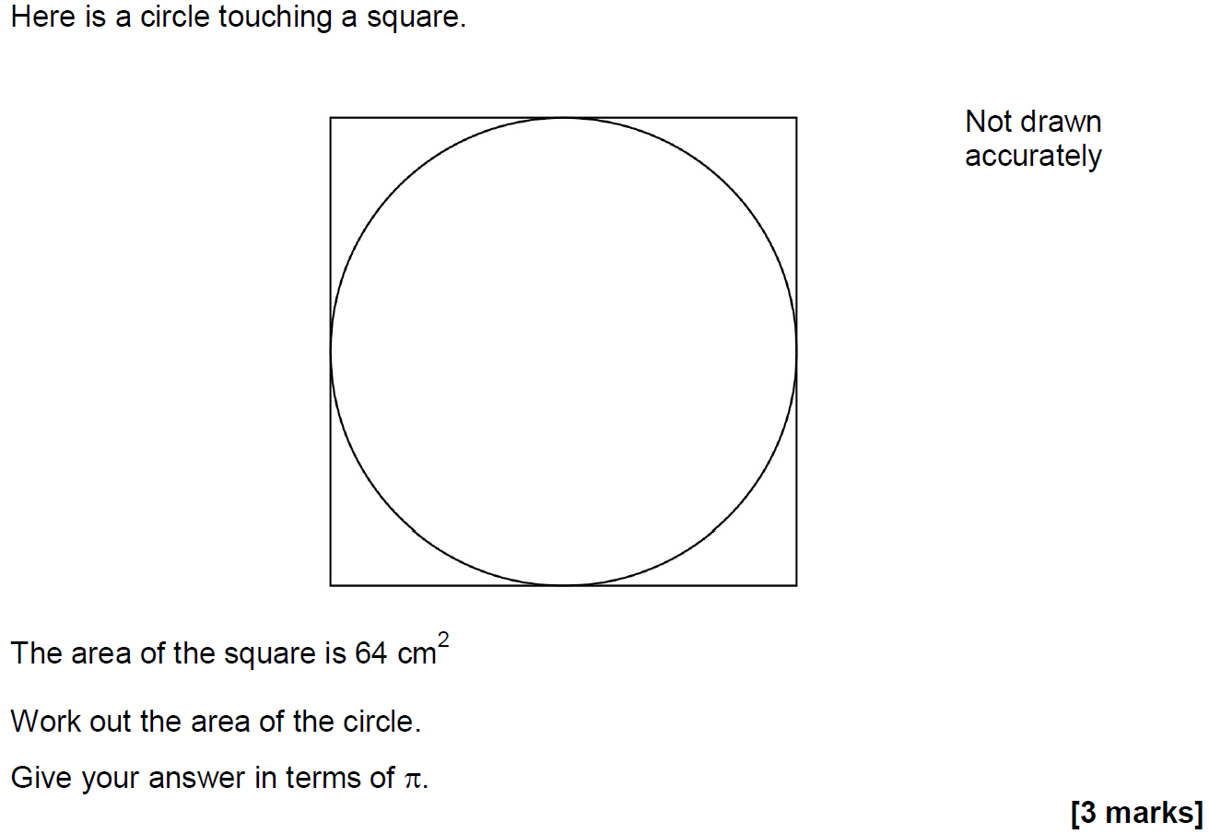
Circles & Sectors
May 2017 1H Q12

Slide 3
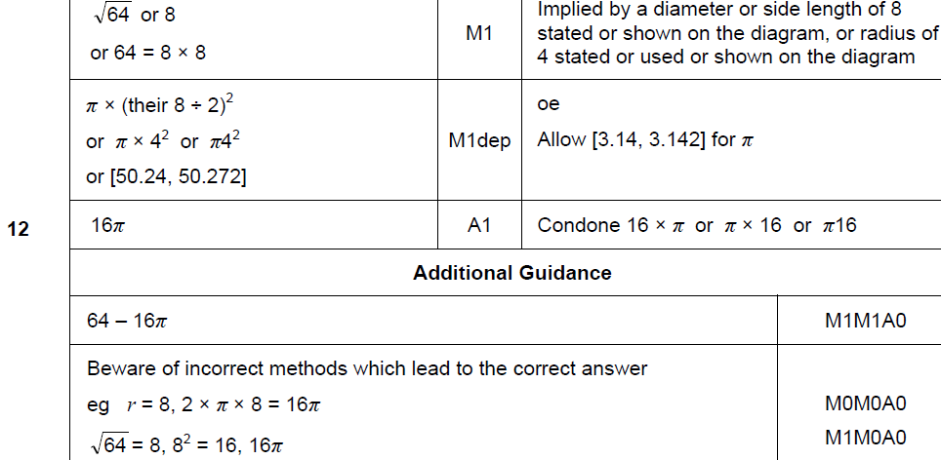
Circles & Sectors
May 2017 1H Q12
A

Slide 4
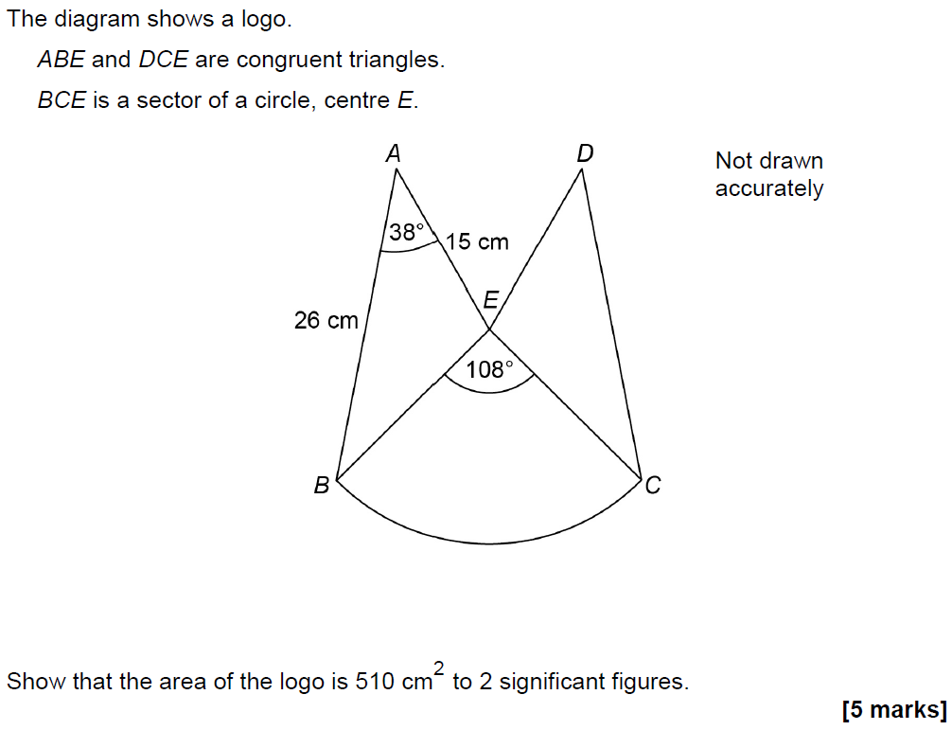
Circles & Sectors
June 2017 2H Q25

Slide 5
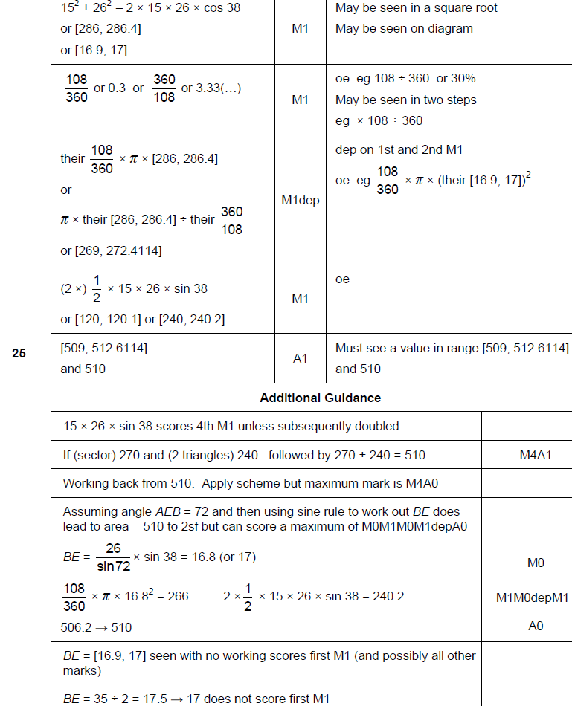
Circles & Sectors
June 2017 2H Q25
A

Slide 6
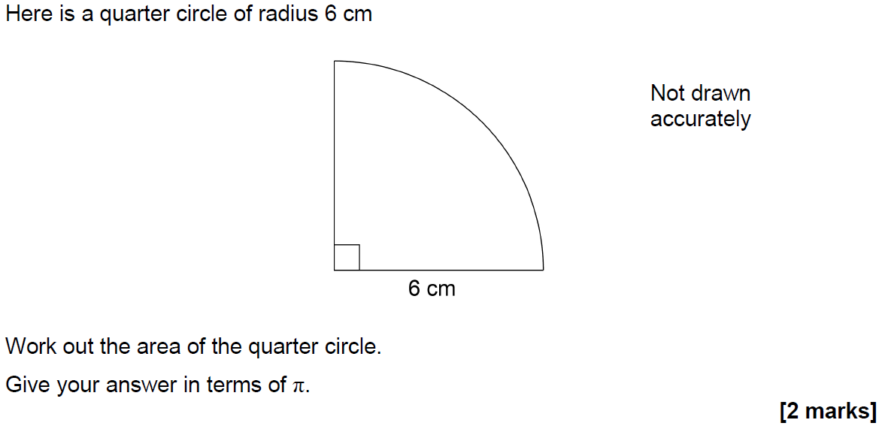
Circles & Sectors
Nov 2017 1H Q7

Slide 7
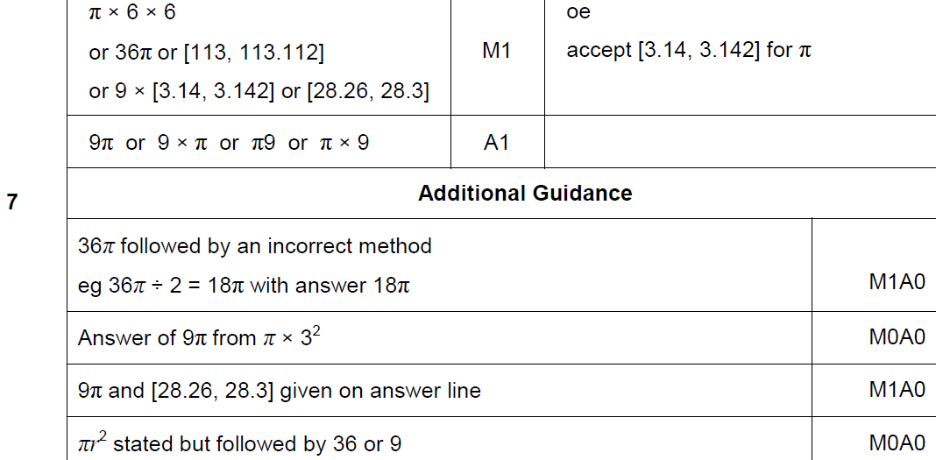
Circles & Sectors
Nov 2017 1H Q7
A

Slide 8
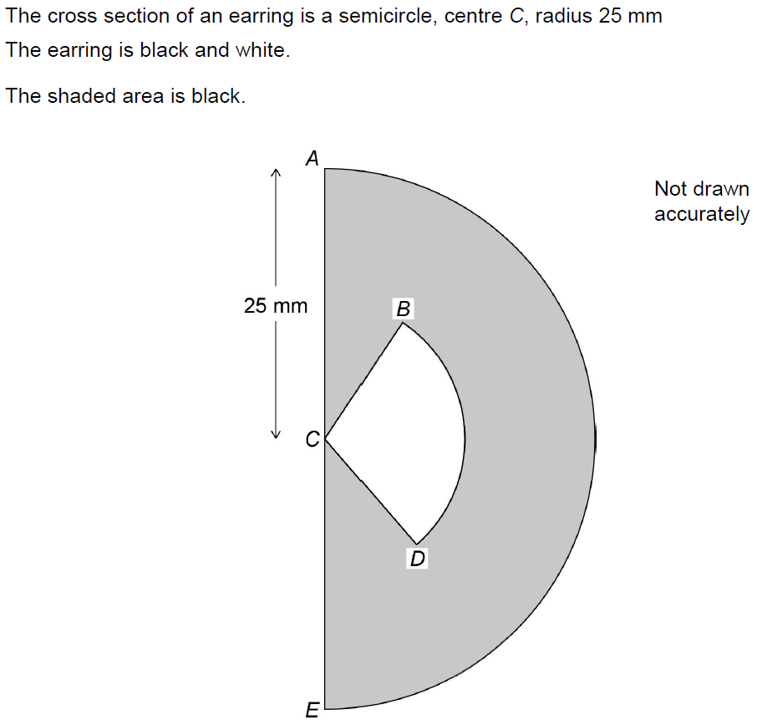
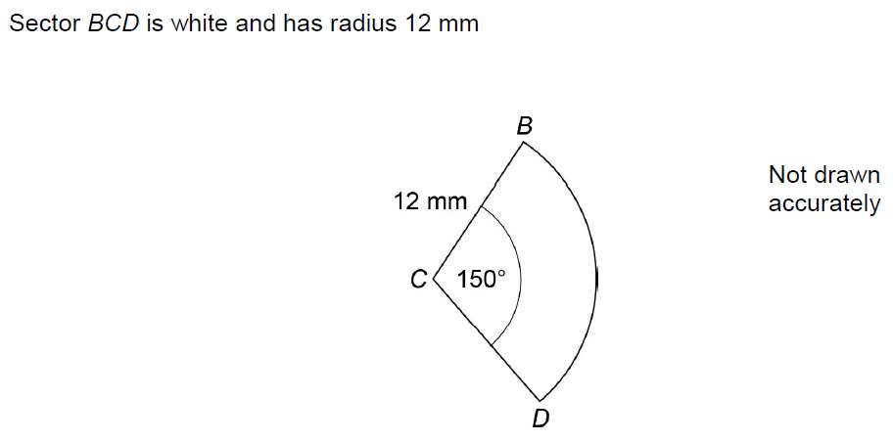
Circles & Sectors
Nov 2017 2H Q22

Slide 9
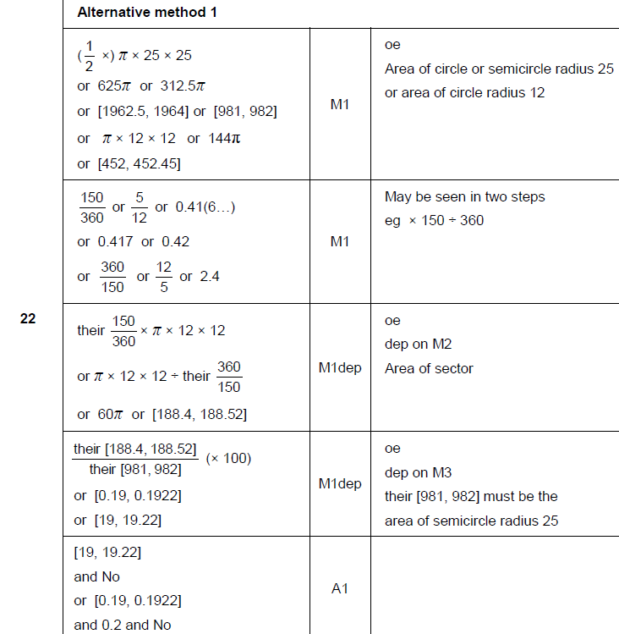
Circles & Sectors
Nov 2017 2H Q22
A

Slide 10
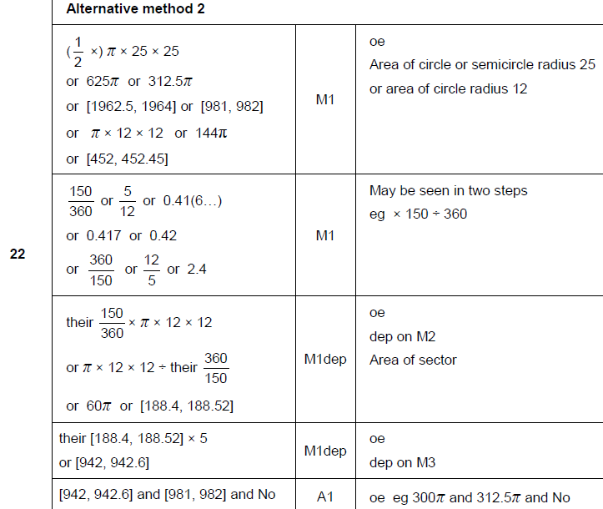
Circles & Sectors
Nov 2017 2H Q22
A Alternative 1

Slide 11
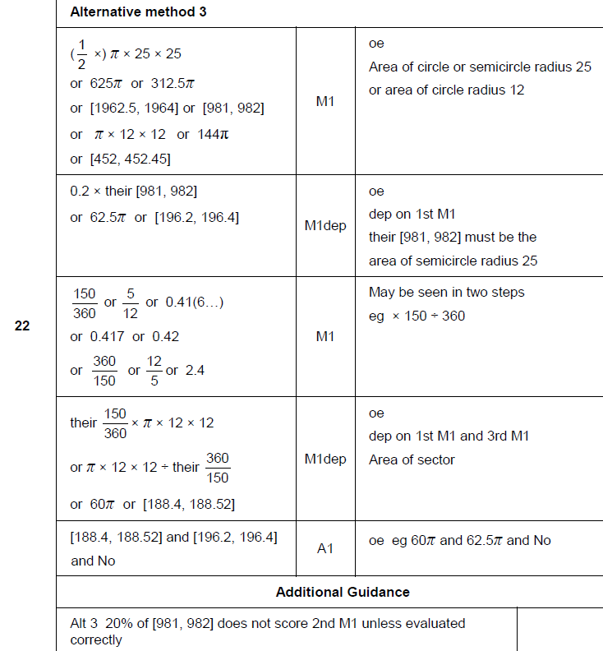
Circles & Sectors
Nov 2017 2H Q22
A Alternative 2 & notes

Slide 12
Circles & Sectors
June 2018 2H Q1

Slide 13
Circles & Sectors
June 2018 2H Q1
A

Slide 14
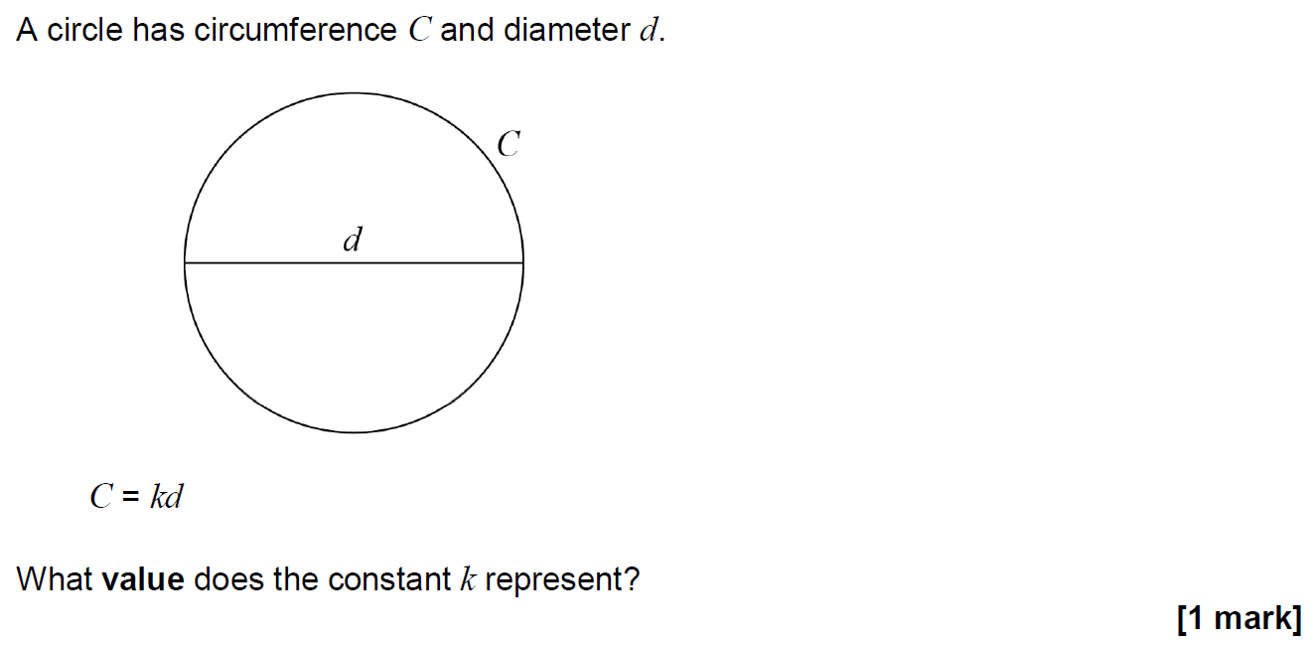
Circles & Sectors
Nov 2018 2H Q5

Slide 15
Circles & Sectors
Nov 2018 2H Q5
A

Slide 16
Circles & Sectors
Nov 2018 2H Q8

Slide 17
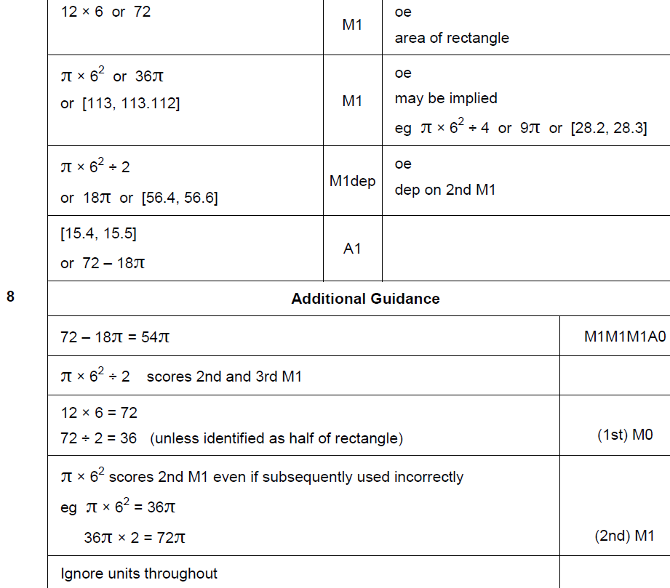
Circles & Sectors
Nov 2018 2H Q8
A

Slide 18
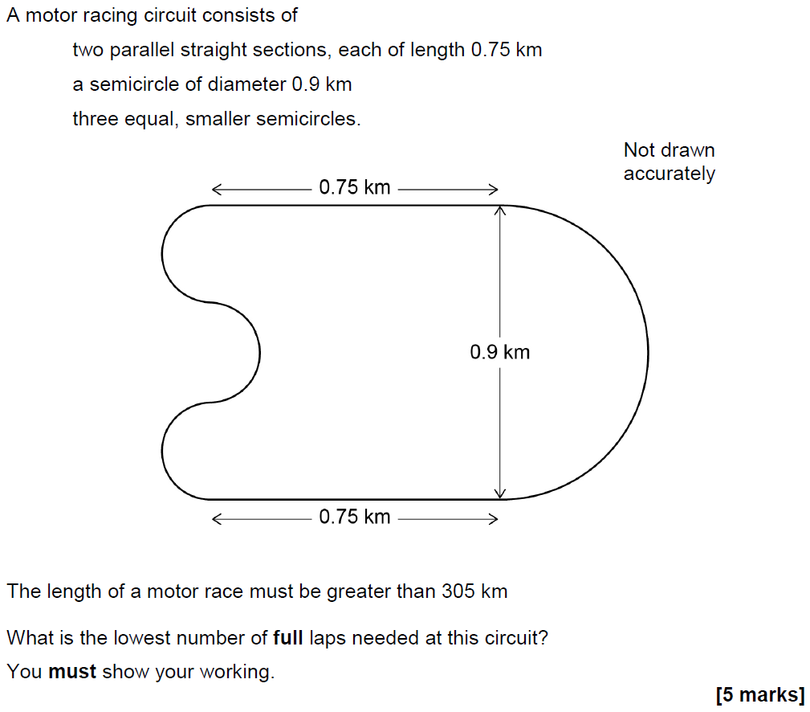
Circles & Sectors
Nov 2018 3H Q9

Slide 19
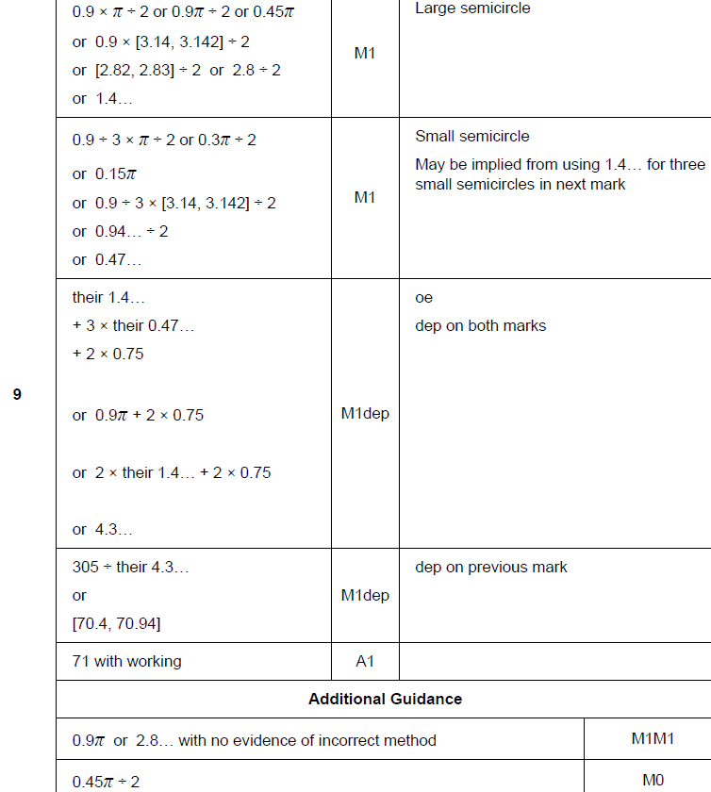
Circles & Sectors
Nov 2018 3H Q9
A

